Slide 1
RDF and XML: Towards a Unified Query Layer Nuno Lopes, Stefan Bischof, Orri Erling, Axel Polleres, Alexandre Passant, Diego Berrueta, Antonio Campos, Jérôme Euzenat, Kingsley Idehen, Stefan Decker, Stéphane Corlosquet, Jacek Kopecky, Janne Saarela, Thomas Krennwallner, Davide Palmisano, and Michal Zaremba (supporters of the W3C member submission)

Slide 2
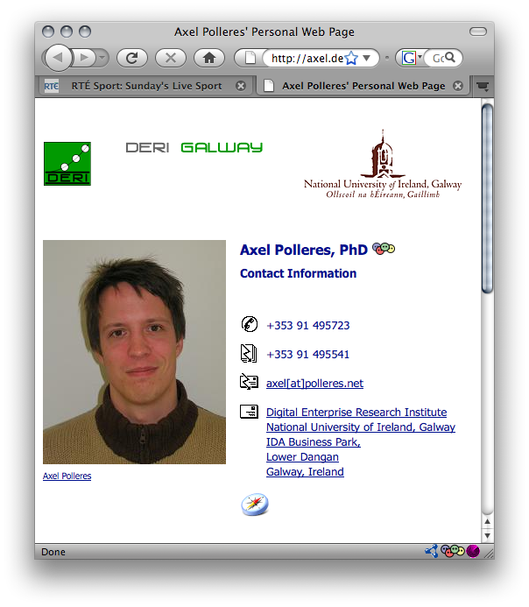
Semantic Data Access… … that would be the vision
RDF: common simple Data format underlying the Semantic Web
Queries (SPARQL1.1)
Ontologies (OWL2)
Rules (RIF)
<s1:messages>
<s1:msg id=“m1” format=“bin”>
<s1:sendername>3PO</s1:sendername>
<s1:receivername>R2D2<s1:receivername>
<s1:payload>0111010001</s1:payload>
</s1:msg>
<s1:msg id=“m2” format=“text”>
<s1:sendername>Obiwan</s1:sendername>
<s1:receivername>Luke<s1:receivername>
<s1:payload>Use the force</s1:payload>
</s1:msg>
<s1:messages>
id | FNAME | LNAME | AGE
1 | Bob | McBob | 42
2 | John | Johnson | 24
3 | Steve | Smith | 38
<www>
RDBMS
<XML>

Slide 3
Semantic Data Access… … that would be the vision
Queries
<emp:#1> a <emp:Employee>
<emp:#1> <name> “Bob McBob”.
…
<s1:3PO> a <s1:Agent>
<s1:3PO> <name> “3PO”.
<s1:3PO> <sent> <m1> . <m1> <format> <binary>.
<s1:Obiwan> a <s1:Agent>
<s1:Obiwan> <name> “Obiwan Kenobi”.
<s1:Obiwan> <sent> <m2> . <m2> <format> <text>.
…
<axel> a <Person>
<axel <name> “Axel Polleres”.
Ontologies
Rules
<s1:messages>
<s1:msg id=“m1” format=“bin”>
<s1:sendername>3PO</s1:sendername>
<s1:receivername>R2D2<s1:receivername>
<s1:payload>0111010001</s1:payload>
</s1:msg>
<s1:msg id=“m2” format=“text”>
<s1:sendername>Obiwan</s1:sendername>
<s1:receivername>Luke<s1:receivername>
<s1:payload>Use the force</s1:payload>
</s1:msg>
<s1:messages>
id | FNAME | LNAME | AGE
1 | Bob | McBob | 42
2 | John | Johnson | 24
3 | Steve | Smith | 38
<www>
RDBMS
<XML>

Slide 4
Semantic Data Access… … that would be the vision
Queries (SPARQL)
<emp:#1> a <emp:Employee>
<emp:#1> <name> “Bob McBob”.
<s1:3PO> a <s1:Agent>
<s1:3PO> <name> “3PO”.
<s1:3PO> <sent> <m1> . <m1> <format> <binary>.
<s1:Obiwan> a <s1:Agent>
<s1:Obiwan> <name> “Obiwan Kenobi”.
<s1:Obiwan> <sent> <m2> . <m2> <format> <text>.
<axel> a <Person>
<axel <name> “Axel Polleres”.
<emp:#1> a <Person>
Ontologies
(OWL2)
Rules
(RIF)
<s1:Obiwan> a <Person>
Query (SPARQL): “Give me all Persons”
SELECT ?X WHERE { ?X a <Person> }
Ontologies (OWL2, DL): “<emp:Employee> is a subclass of <Person>”
Rules (RIF, LP): “<s1:Agents> who never sent binary are Persons”

Slide 5
Bridging Gaps to the data “below”:
Queries
(SPARQL)
Can’t we just query “in one go”?
Rules
(RIF)
Ontologies
(OWL)
SQL (RDB2RDF)
XQuery/XSLT (GRDDL)
<www>
RDBMS
<XML>

Slide 6
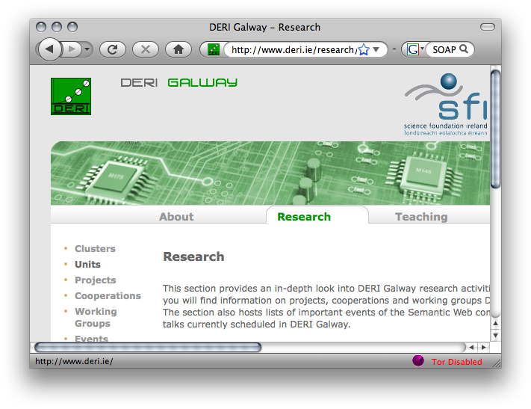
Our starting motivation (2008):
XSLT/XQuery
HTML
RSS
<XML/>
XSPARQL
SPARQL
SOAP/WSDL
6

Slide 7
Example:

Slide 8
So, why are XSLT, XQuery not enough?
Because RDF ≠ RDF/XML !!!
1) many different RDF/XML representations…
2) … and actually a lot of RDF data residing in RDF stores, accessible via SPARQL endpoints already, rather than in RDF/XML

Slide 9
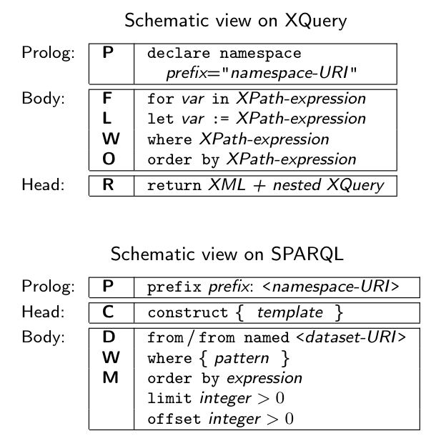
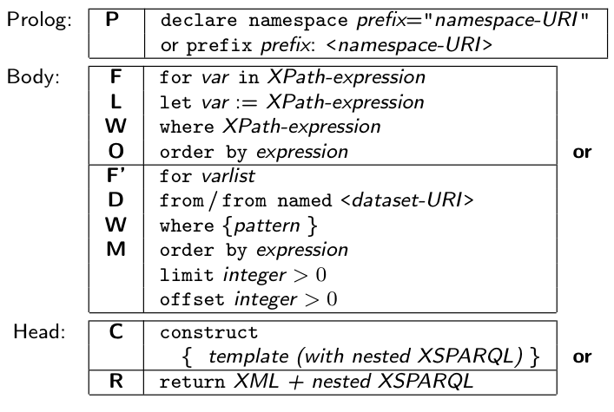
Our approach: XSPARQL (W3C submission)
New query language… but don’t reinvent!
XQuery + SPARQL = XSPARQL

Slide 10
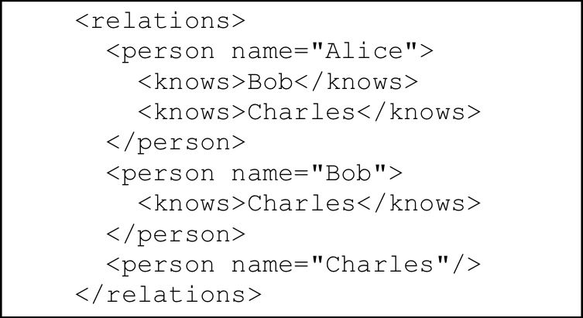
Example: Mapping from RDF to XML
<relations>
{ for $Person $Name
from <relations.rdf>
where { $Person foaf:name $Name }
order by $Name
return
<person name="{$Name}">
{for $FName
from <relations.rdf>
where {
$Person foaf:knows $Friend .
$Person foaf:name $Name .
$Friend foaf:name $Fname }
return <knows>{$FName}</knows>
} </person>
}</relations>

Slide 11
Example: Adding value generating functions to SPARQL
construct { :me foaf:knows _:b .
_:b foaf:name {fn:concat("""",?N," ",?F,"""”)} }
from <MyAddrBookVCard.rdf>
where {
?ADDR vc:Given ?N .
?ADDR vc:Family ?F .
}
…
:me foaf:knows _:b1. _:b1 foaf:name “Peter Patel-Schneider” .
:me foaf:knows _:b2. _:b2 foaf:name “Stefan Decker” .
:me foaf:knows _:b3. _:b3 foaf:name “Thomas Eiter” .
…

Slide 12
Implementation and semantics:
Formal Semantics (XSPARQL1.0):
Based on XQuery formal Semantics
Can be implemented based on rewriting to XQuery
Challenges/Limitations:
Nesting, scope of RDF dataset…
different “type systems” of RDF/XML (sequences)
adding ontological inference (to resolve heterogeneities)
We are working on this in XSPARQL1.1!

Slide 13
Formal Semantics:
Initial idea (and formalised in XSPARQL1.0):
extension of the XQuery semantics by plugging in SPARQL semantics in a modular way
Rewriting algorithm is defined for embedding XSPARQL into native XQuery plus interleaved calls to a SPARQL endpoint

Slide 14
Rewriting XSPARQL to XQuery…
construct { _:b foaf:name {fn:concat("""",$N," ",$F,"""")} } from <vcard.rdf>
where { $P vc:Given $N . $P vc:Family $F . }
let $aux_query := fn:concat("http://localhost:2020/sparql?query=", fn:encode-for-uri(
"select $P $N $F from <vcard.rdf>
where {$P vc:Given $N. $P vc:Family $F.}"))
for $aux_result at $aux_result_pos
in doc($aux_query)//sparql_result:result
let $P_Node := $aux_result/sparql_result:binding[@name="P"]
let $N_Node := $aux_result/sparql_result:binding[@name="N"]
let $F_Node := $aux_result/sparql_result:binding[@name="F"]
let $N := data($N_Node/*)let $N_NodeType := name($N_Node/*)
let $N_RDFTerm := local:rdf_term($N_NodeType,$N)
...
1. Encode SPARQL in HTTP call SELECT Query
2. Execute call, via fn:doc function
return ( fn:concat("_:b",$aux_result_pos," foaf:name "),
( fn:concat("""",$N_RDFTerm," ",$F_RDFTerm,"""") ), "." )
3. Collect results from SPARQL result format(XML)
4. construct becomes return that outputs triples.

Slide 15
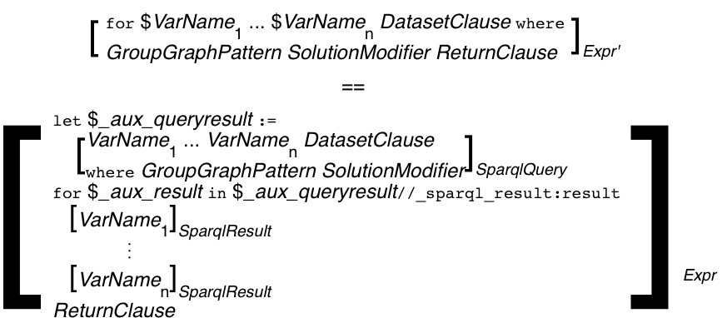
Formalisation
Current formalisation embeds rewriting in the functional semantics of XQuery:
http://xsparql.deri.org/spec/xsparql-semantics.html#id:flwor-expressions
mapping rules [·]_{Expr'} inherit from the definitions of XQuery's [·]_{Expr}

Slide 16
Ongoing work/Outlook:
Simple rewriting semantics has some limitations, which we are currently working on:
Adding RDFS/OWL entailment(and other SPARQL1.1 features)
Integrate RDB Querying (SQL), Json, etc.
Optimisations…
Nesting,scope of RDF dataset…
Different “type systems” of RDF/XML (sequences)…
Integrated engine(s)
SPARQL1.1
RDB
Json?

Slide 17
RDB Querying sketch
Use as an RDB2RDF exporter…
Extract foaf:knows relations from a RDB with two tables: containing persons and their knows relations
RDBForClause to specify input from RDB tables
prefix foaf: <http://xmlns.com/foaf/0.1/>
for p1.name as $x, p2.name as $y
from person as p1, person as p2, relation as r
where { p1.name = r.person and
p2.name = r.knows }
construct { $x foaf:knows $y }
SQL Where pattern
Output RDF (or XML)
Unified RDF/XML/RDB Query Layer =
XSPARQL + RDB2RDF ?

Slide 18
Optimisations – Example:
E.g. dependent Join… i.e.
<relations>
{ for $Person $Name
from <relations.rdf>
where { $Person foaf:name $Name }
order by $Name
return
<person name="{$Name}">
{for $Fname
where {
$Person foaf:knows $Friend .
$Friend foaf:name $Fname }
return <knows>{$FName}</knows>
} </person>
}</relations>
<relations>
{ let $aux := select $Person $Name $FName
from <relations.rdf>
where { $Person foaf:name $Name .
$Person foaf:knows $Friend .
$Friend foaf:name $Fname }
for $Name in $aux.Name
return
<person name="{$Name}">
{ for $FName in $aux.Fname
where $aux.Name = $Name
return <knows>{$FName}</knows>
} </person>
}</relations>
Only one SPARQL query

Slide 19
Summary:
Queries
Enable optimisation across layers
query each source format in native language instead of multistep transformation via
“narrow“ interfaces (e.g. SPARQL→ SPARQL-Resuly/XML→ Xquery/XSLT)
Enable declarative view (a la Relational Algebra for core fragment of the language)
Tighter integration of various source formats that populate the (Semantic) Web
This needs a cross-activity effort in W3C? Semantic Web + XML + others?
(SPARQL)
Ontologies
(OWL)
Rules
(RIF)
<www>
RDBMS
<XML>
One Unified RDF/XML/RDB Query Layer to combine
XQuery+SPARQL+GRDDL+SQL ?

Slide 20
Nesting,scope of RDF dataset…
Remember the query from before…. We were slightly cheating:
<relations>
{ for $Person $Name
from <relations.rdf>
where { $Person foaf:name $Name }
order by $Name
return
<person name="{$Name}">
{for $FName
from <relations.rdf>
where {
$Person foaf:knows $Friend .
$Person foaf:name $Name .
$Friend foaf:name $Fname }
return <knows>{$FName}</knows>
} </person>
}</relations>

Slide 21
Nesting,scope of RDF dataset…
Remember the query from before…. This is what one would rather expect
<relations>
{ for $Person $Name
from <relations.rdf>
where { $Person foaf:name $Name }
order by $Name
return
<person name="{$Name}">
{for $FName
where {
$Person foaf:knows $Friend .
$Friend foaf:name $Fname }
return <knows>{$FName}</knows>
} </person>
}</relations>
The nested query should be over the same Dataset as the outer query, bindings to bnodes should be preserved
Two separate, independent SPARQL calls don’t work anymore
Solution:
We need to add Dataset to the dynamic environment in the semantics.
We need a special SPARQL implementation that allows several calls to the same active graph.

Slide 22
Different “type systems” of RDF/XML (e.g. sequences)…
Social Graph queries a la [1]:
Give me all pairs of co-authors and their joint publications.
Assignment of graphs to variables needs new datatype RDFGraph
prefix foaf: <http://xmlns.com/foaf/0.1/>
prefix dc: <http://purl.org/dc/elements/1.1/>
let $ds := for *
from <http://dblp.l3s.de/d2r/resource/authors/Axel_Polleres>
where { $pub dc:creator [] }
construct {
{ for * from $pub where { $p dc:creator $o . }
construct {$p dc:creator <{$o}>} } }
let $allauthors :=
distinct-values(for $o from $ds where {$p dc:creator $o}
order by $o
return $o)
for $auth at $auth_pos in $allauthors
for $coauth in $allauthors[position() > $auth_pos]
let $commonPubs := count(
{ for $pub from $ds where { $pub dc:creator $auth, $coauth } return $pub }
)
where ($commonPubs > 0)
construct { [ :author1 $auth; :author2 $coauth; :commonPubs $commonPubs ] }
Nested CONSTRUCTs queries
Lists of RDFTerms need new datatype RDFTerm
1. Mauro San Martín, Claudio Gutierrez: Representing, Querying and Transforming Social Networks with RDF/SPARQL. ESWC 2009: 293-307

Slide 23
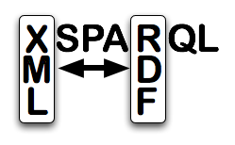
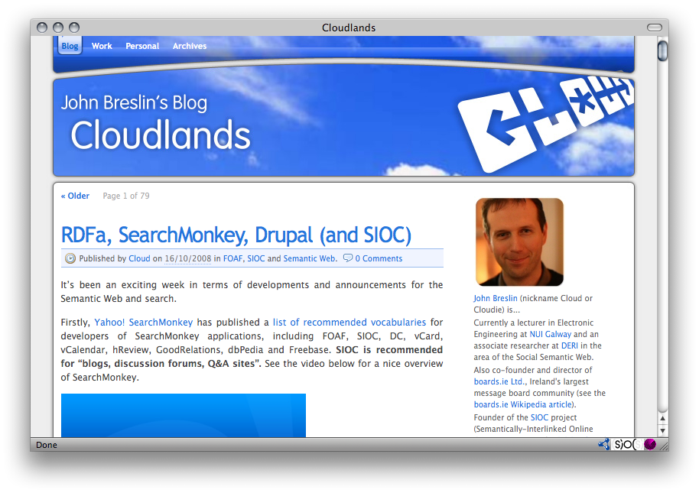
Use: SIOC-2-RSS
XSPARQL+SIOC enables customised RSS export:
<channel>
<title>
{for $name
from <http://www.johnbreslin.com/blog/index.php?sioc_type=site>
where { [a sioc:Forum] sioc:name $name }
return $name}
</title>
{for $seeAlso
from <http://www.johnbreslin.com/blog/index.php?sioc_type=site>
where { [a sioc:Forum] sioc:container_of [rdfs:seeAlso $seeAlso] } return <item>
{for $title $descr $date
from $seeAlso
where { [a sioc:Post] dc:title $title ;
sioc:content $descr;
dcterms:created $date }
return <title>$title</title>
<description>$descr</description>
<pubDate>$date</pubDate>}
</item>
RSS2.0
“Great stuff,... I have not seen any SIOC to RSS xslt examples or vice versa” (John Breslin, creator of SIOC)

Slide 24
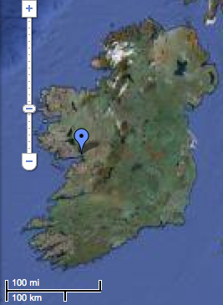
Use: Generate KML from FOAF+Geo:
XSPARQL+FOAF and GEO data enables KML map data:
<kml xmlns="http://www.opengis.net/kml/2.2">
{
for $person $name $long $lat
from <http://www.deri.ie/Stefan_Decker>
where { $person; foaf:name $name;
foaf:based_near [ geo:long $long; geo:lat $lat ] }
return <Placemark>
<name>{fn:concat("Location of ", $name)}</name>
<Point>
<coordinates>{fn:concat($long, ",", $lat, ",0")}</coordinates>
</Point>
</Placemark>
}
</kml>
http://www.deri.ie/Stefan_Decker#me
53.272900
foaf:name
foaf:locatedIn
geo:lat
“Stefan Decker”
http://dbpedia.org/resource/Galway
geo:lat
-9.041800
More:
http://xsparql.deri.org/spec/xsparql-use-cases.html

