Slide 1
SPARQL1.1: new features and friends (OWL2, RIF)
@AxelPolleres
Digital Enterprise Research Institute, National University of Ireland, Galway
These slides are provided under creative commons
Attribution-NonCommercial-ShareAlike 3.0 Unported License!

Slide 2



Disclaimer
Chair-hat off: While trying to convey best I can the current status of the
SPARQL Working Group, in this Tutorial I don’t claim to speak officially for the
group and will freely blend in my personal opinions… ;-)
2

Slide 3
What is SPARQL?
Query Language for RDF
  SQL “look-and-feel” for the Semantic Web
  Means to query the Web of Data
  Means to map between vocabularies
  Means to access RDF stores
SPARQL1.0 (standard since 2008):
  Query Language
  Protocol
  Result Format
SPARQL1.1 (in progress):
  SPARQL 1.1 query language (additional features: aggregate functions, subqueries, negation, project expressions, property paths, basic federated queries)
  SPARQL 1.1 Entailment regimes
  SPARQL 1.1 Update: A full data manipulation language
  SPARQL 1.1 Uniform HTTP Protocol for Managing RDF Graphs
  SPARQL 1.1 Service Descriptions
3

Slide 4
What you’ll hear
Run through SPARQL1.0
SPARQL 1.0 Formal Semantics, and theoretical results
New features in SPARQL 1.1 Query
SPARQL 1.1 Entailment Regimes
  Relation to OWL2
  Relation to RIF
Implementations, Status
4

Slide 5
RDF a plain data format for the Web
<http://dbpedia.org/resource/Brixen> <http://ontology.dumontierlab.com/isLocatedIn>
<http://dbpedia.org/resource/Italy> .
<http://dbpedia.org/resource/Brixen> <http://www.w3.org/2000/01/rdf-schema#label>
”Bressanone”@it .
_:x <http://www.w3.org/2000/01/rdf-schema#label> "Diego Calvanese" .
_:x <http://ontology.dumontierlab.com/isLocatedIn> <http://dbpedia.org/resource/Brixen> .
Italy
Subject Predicate Object
Subject U x B
Predicate U
Object U x B x L
isLocatedIn
Brixen
label
”Bressanone”@it
isLocatedIn
label
“Diego Calvanese”
Various syntaxes, RDF/XML, Turtle, N3, RDFa,…
URIs, e.g.
http://www.w3.org/2000/01/rdf-schema#label
http://ontology.dumontierlab.com/isLocatedIn
http://dbpedia.org/resource/Brixen
http://dbpedia.org/resource/Italy
Blanknodes:
“existential variables in the data” to express incomplete information, written as _:x or []
Literals, e.g.
"2010"^^xsd:gYear
"Brixen"@de
"Bressanone"@it
"Diego Calvanese"
5

Slide 6

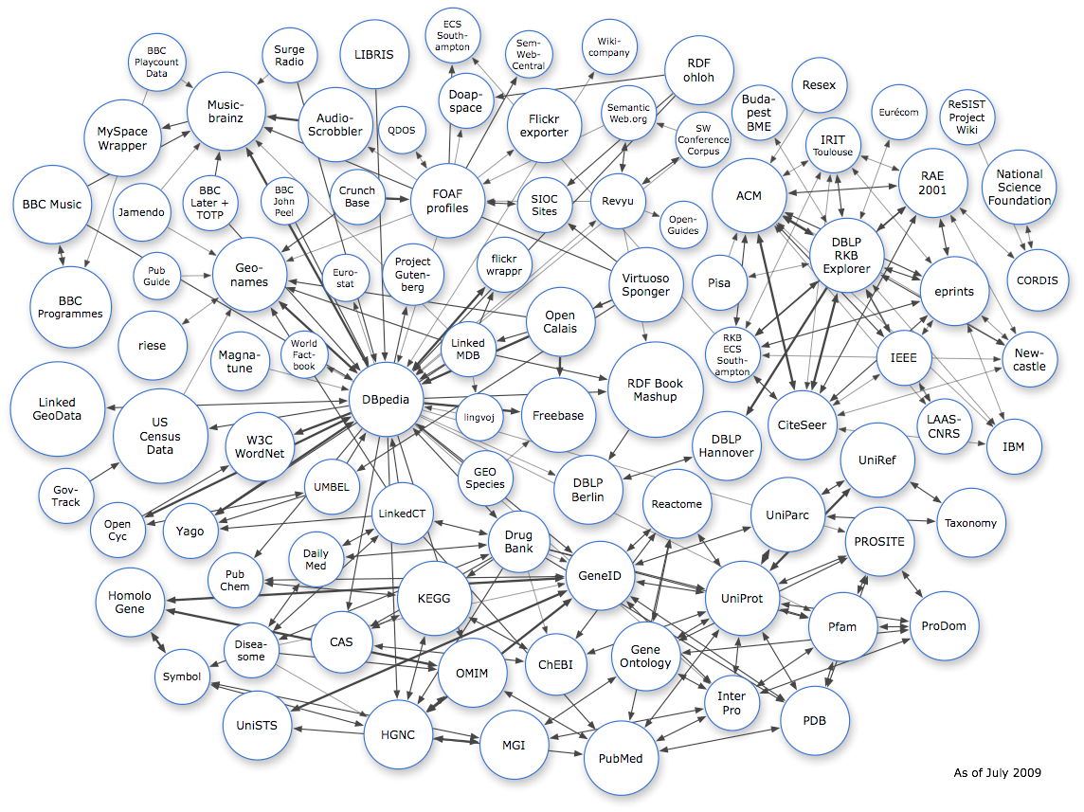

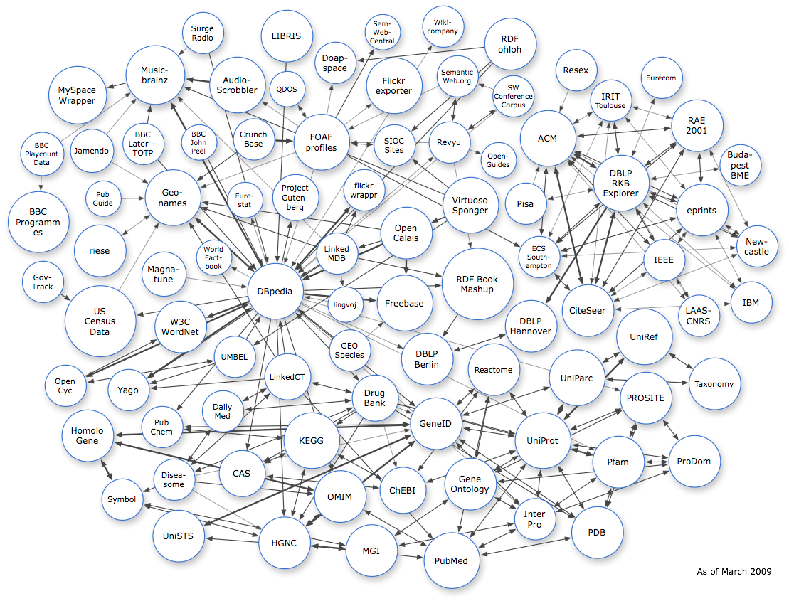
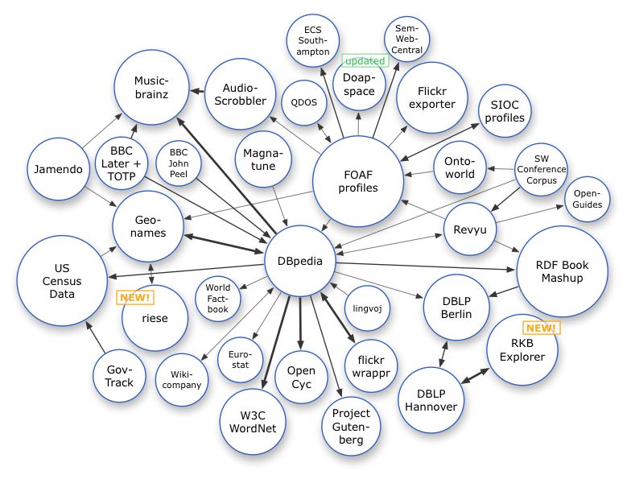



RDF Data on the Web: Linked Open Data
Excellent tutorial here: http://www4.wiwiss.fu- berlin.de/bizer/pub/LinkedDataTutorial/
…
March 2008
March 2009
July 2009
6

Slide 7
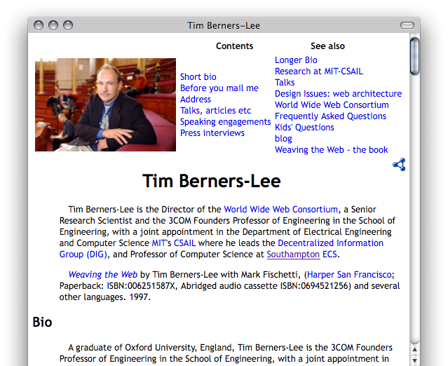
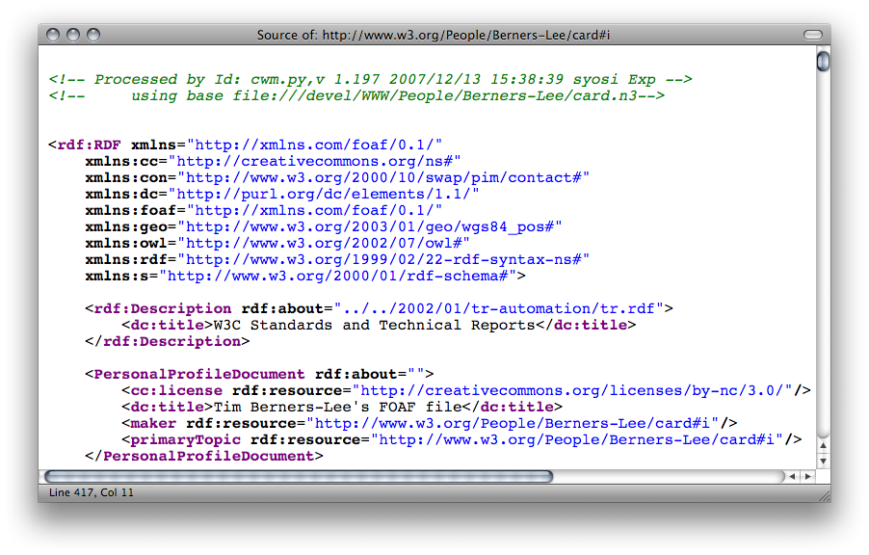
RDF Data online: Example 1/3
(i) directly by the publishers
(ii) by exporters
FOAF/RDF linked from a home page: personal data (foaf:name, foaf:phone, etc.), relationships foaf:knows, rdfs:seeAlso )
7

Slide 8
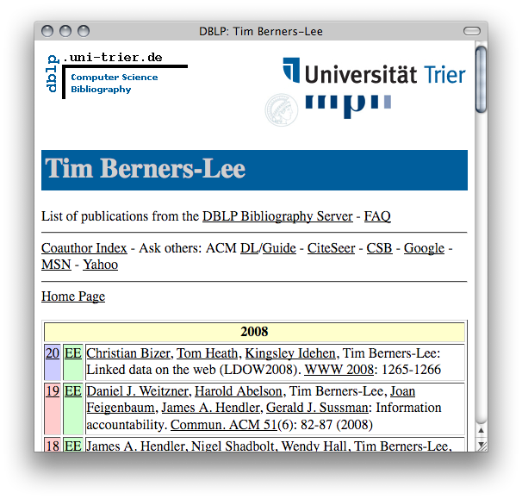
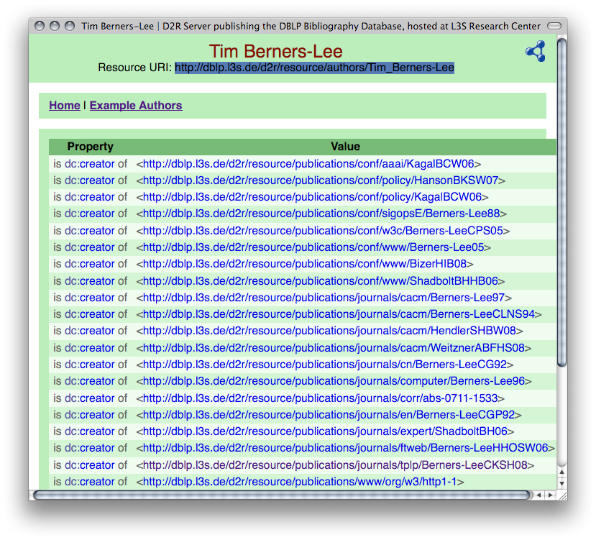
RDF Data online: Example 2/3
(i) directly by the publishers
(ii) by exporters, e.g. D2R and friends, RDFa exporters, etc.
e.g. L3S’ RDF export of the DBLP citation index, using FUB’s D2R (http://dblp.l3s.de/d2r/)
Gives unique URIs to authors, documents, etc. on DBLP! E.g.,
http://dblp.l3s.de/d2r/resource/authors/Tim_Berners-Lee,
http://dblp.l3s.de/d2r/resource/publications/journals/tplp/Berners-LeeCKSH08
Provides RDF version of all DBLP data and even a SPARQL query interface!
8

Slide 9
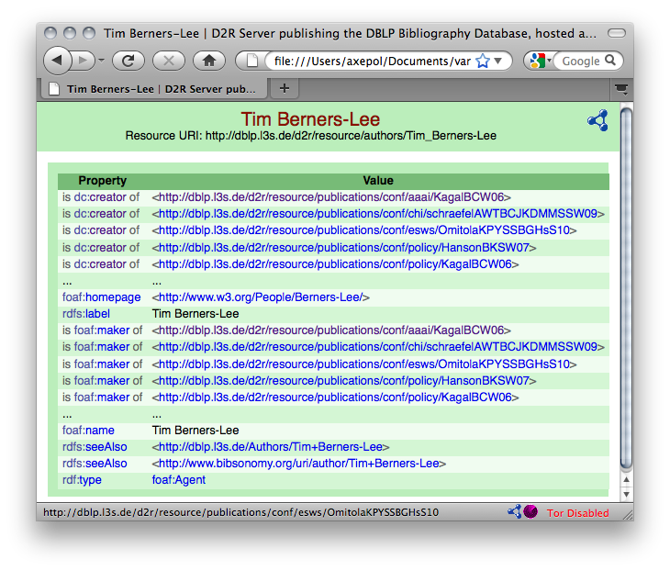
RDF Data online: Example 3/3
http://dblp.l3s.de/d2r/resource/authors/T
9

Slide 10
RDF Data online: Example – Turtle Syntax
  DBLP Data in RDF: Triples Turtle Syntax:
  @prefix rdf: <http://www.w3.org/1999/02/22-rdf-syntax-ns#>.
  @prefix dcterms: <http://purl.org/dc/terms/> .
  @prefix foaf: <http://xmlns.com/foaf/0.1/> .
  @prefix xsd: <http://www.w3.org/2001/XMLSchema#> .
  @prefix swrc: <http://swrc.ontoware.org/ontology#> .
  <http://dblp.l3s…/journals/tplp/Berners-LeeCKSH08> rdf:type swrc:Article.
  <http://dblp.l3s…/journals/tplp/Berners-LeeCKSH08> dcterms:issued "2008"^^xsd:gYear .
  <http://dblp.l3s…/journals/tplp/Berners-LeeCKSH08> foaf:maker <http://dblp.l3s…/Tim_Berners-Lee> .
  <http://dblp.l3s…/journals/tplp/Berners-LeeCKSH08> foaf:maker <http://dblp.l3s…/Dan_Connolly> .
  <http://dblp.l3s…/journals/tplp/Berners-LeeCKSH08> foaf:maker <http://dblp.l3s…/Jim_Hendler> .
  <http://dblp.l3s…/journals/tplp/Berners-LeeCKSH08> foaf:maker <http://dblp.l3s…/Lalana_Kagal> .
  <http://dblp.l3s…/journals/tplp/Berners-LeeCKSH08> foaf:maker <http://dblp.l3s…/Yosi_Scharf> .
  …
  <http://dblp.l3s…/conf/aaai/KagalBCW06> rdf:type swrc:inProceedings .
  <http://dblp.l3s…/conf/aaai/KagalBCW06> foaf:maker <http://dblp.l3s…/Tim_Berners-Lee> .
  …
  <http://dblp.l3s…/Tim_Berners-Lee> foaf:homepage <http://www.w3.org/People/Berners-Lee/> .
  <http://dblp.l3s…/Tim_Berners-Lee> foaf:name "Tim Berners-Lee" .
10

Slide 11
RDF Data online: Example – Turtle Syntax
  DBLP Data in RDF: Triples Turtle Syntax:
  @prefix rdf: <http://www.w3.org/1999/02/22-rdf-syntax-ns#>.
  @prefix dcterms: <http://purl.org/dc/terms/> .
  @prefix foaf: <http://xmlns.com/foaf/0.1/> .
  @prefix xsd: <http://www.w3.org/2001/XMLSchema#> .
  @prefix swrc: <http://swrc.ontoware.org/ontology#> .
  <http://dblp.l3s…/journals/tplp/Berners-LeeCKSH08> rdf:type swrc:Article ;
  dcterms:issued "2008"^^xsd:gYear ;
  foaf:maker <http://dblp.l3s…/Tim_Berners-Lee> ,
  <http://dblp.l3s…/Dan_Connolly> ,
  <http://dblp.l3s…/Jim_Hendler> ,
  <http://dblp.l3s…/Lalana_Kagal> ,
  <http://dblp.l3s…/Yosi_Scharf> .
  …
  <http://dblp.l3s…/conf/aaai/KagalBCW06> rdf:type swrc:inProceedings ;
  foaf:maker <http://dblp.l3s…/Tim_Berners-Lee> .
  …
  <http://dblp.l3s…/Tim_Berners-Lee> foaf:homepage <http://www.w3.org/People/Berners-Lee/> ;
  foaf:name "Tim Berners-Lee" .
11

Slide 12
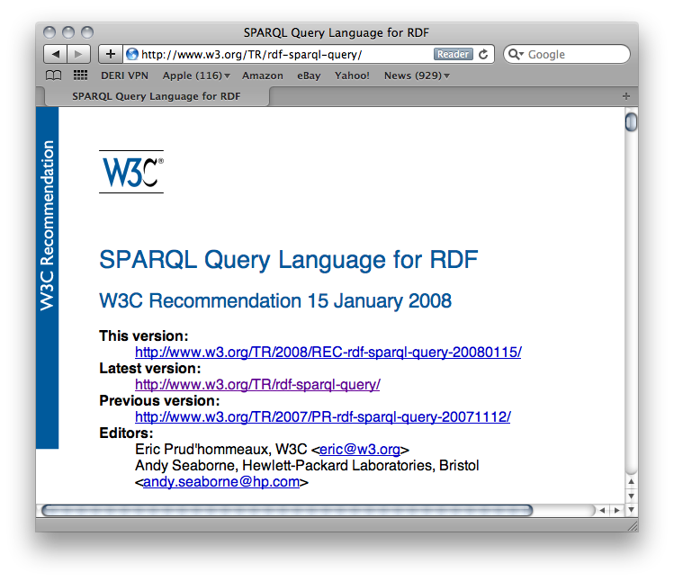
Linked Data: What’s the point?
Loads of structured data out there
You want to do structured queries on top of it …
SPARQL1.0 W3C Rec 15 January 2008… Now you can!
Without exaggeration, SPARQL is probably a not too small a part of the LOD success story! … at least an important building block
12

Slide 13
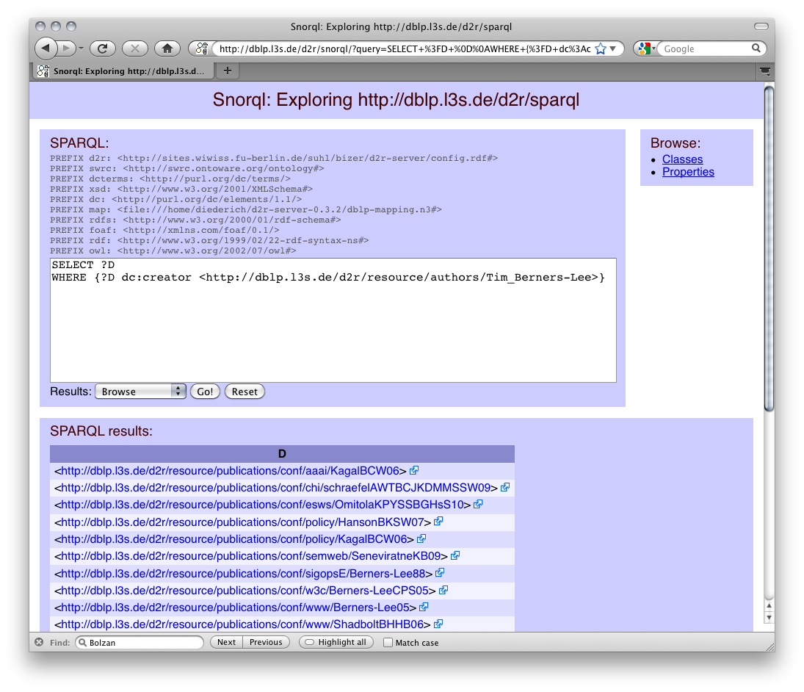
How can I query that data? SPARQL
Basic graph pattern matching ~ Conjunctive queries
Example:
“Give me all documents by Tim Berners-Lee”
Basic Graph Pattern (BGP) … set of RDF triples with variables in S,P,O , e.g.:
{?D foaf:maker <http://dblp.l3s.de/…/authors/Tim_Berners-Lee>}
PREFIX foaf: <http://xmlns.com/foaf/0.1/>
SELECT ?D
FROM <http://dblp.l3s.de/…/authors/Tim_Berners-Lee>
WHERE {?D foaf:maker <http://dblp.l3s.de/…/authors/Tim_Berners-Lee>}
FROM clause/Dataset can be implicit, e.g. when querying DBLP’s SPARQL endpoint
13

Slide 14
How can I query that data? SPARQL
Basic graph pattern matching ~ Conjunctive queries
Example:
“Give me all names of co-authors of Tim Berners-Lee”
PREFIX foaf: <http://xmlns.com/foaf/0.1/>
SELECT ?N
WHERE { ?D foaf:maker <http://dblp.l3s.de/…/authors/Tim_Berners-Lee>.
?D foaf:maker ?CoAuth .
?CoAuth foaf:name ?N }
PREFIX foaf: <http://xmlns.com/foaf/0.1/>
SELECT ?N
WHERE { _:D foaf:maker <http://dblp.l3s.de/…/authors/Tim_Berners-Lee>.
_:D foaf:maker _:C .
_:C foaf:name ?N }
Blank nodes in Queries play a similar role as (non-distinguished) variables.
PREFIX foaf: <http://xmlns.com/foaf/0.1/>
SELECT ?N
WHERE { [ foaf:maker <http://dblp.l3s.de/…/authors/Tim_Berners-Lee>,
[ foaf:name ?N ] ] . }
Blank nodes in Queries play a similar role as (non-distinguished) variables.
Turtle style shortcuts are allowed (a bit extreme here, admittedly)
Link
14

Slide 15
More complex patterns in SPARQL 1.0
UNION
OPTIONAL
FILTER
Querying named GRAPHs
Solution Modifiers (ordering, slicing/dicing results)
… plus some non-trivial combinations of these
15

Slide 16
UNIONs of conjunctive queries…
Unions of conjunctive queries
Example:
“Give me all names of co-authors or friends of Tim Berners-Lee”
Note: Duplicates possible,
bag/multiset semantics!
PREFIX foaf: <http://xmlns.com/foaf/0.1/>
SELECT ?N
WHERE {
{ [ foaf:maker <http://dblp.l3s.de/…/authors/Tim_Berners-Lee>,
[ foaf:name ?N ] ] . }
UNION
{ <http://www.w3.org/People/Berners-Lee/card#i> foaf:knows ?F .
?F foaf:name ?N }
}
?N
"Lalana Kagal"
"Tim Berners-Lee"
"Dan Connolly”
"Jim Hendler”
…
"Michael Hausenblas”
"Jim Hendler”
"Charles McCathieNevile”
…
?N
"Lalana Kagal"
"Tim Berners-Lee"
"Dan Connolly”
"Jim Hendler”
…
?N
"Michael Hausenblas”
"Jim Hendler”
"Charles McCathieNevile”
…
U
=
16

Slide 17
UNIONs of conjunctive queries…
Avoid Duplicates: keyword DISTINCT
Example:
“Give me all names of co-authors or friends of Tim Berners-Lee”
PREFIX foaf: <http://xmlns.com/foaf/0.1/>
SELECT DISTINCT ?N
WHERE {
{ [ foaf:maker <http://dblp.l3s.de/…/authors/Tim_Berners-Lee>,
[ foaf:name ?N ] ] . }
UNION
{ <http://www.w3.org/People/Berners-Lee/card#i> foaf:knows ?F .
?F foaf:name ?N }
}
?N
"Lalana Kagal"
"Tim Berners-Lee"
"Dan Connolly”
"Jim Hendler”
…
"Michael Hausenblas”
"Charles McCathieNevile”
…
?N
"Lalana Kagal"
"Tim Berners-Lee"
"Dan Connolly”
"Jim Hendler”
…
?N
"Michael Hausenblas”
"Jim Hendler”
"Charles McCathieNevile”
…
U
=
17

Slide 18
UNIONs of conjunctive queries…
Unions of conjunctive queries
Example:
“Give me all names of co-authors or friends of Tim Berners-Lee”
Note: variables can be
unbound in a result!
PREFIX foaf: <http://xmlns.com/foaf/0.1/>
SELECT ?CoAuthN ?FrN
WHERE {
{ [ foaf:maker <http://dblp.l3s.de/…/authors/Tim_Berners-Lee>,
[ foaf:name ?CoAuthN ] ] . }
UNION
{ <http://www.w3.org/People/Berners-Lee/card#i> foaf:knows ?F .
?F foaf:name ?FrN }
}
?CoAuthN | ?FrN
"Lalana Kagal"
"Tim Berners-Lee"
"Dan Connolly”
"Jim Hendler”
…
 | "Michael Hausenblas”
 | "Jim Hendler”
 | "Charles McCathieNevile”
 | …
18

Slide 19
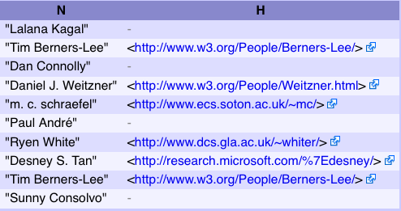
OPTIONAL query parts
Optional parts in queries (Left Outer Join)
Example:
“Give me all names of co-authors of Tim Berners-Lee
and optionally their homepage”
Another example where
variables can be
unbound in results!
PREFIX foaf: <http://xmlns.com/foaf/0.1/>
SELECT ?N ?H
WHERE {
?D foaf:maker <http://dblp.l3s.de/…/authors/Tim_Berners-Lee>.
?D foaf:maker ?CoAuth .
?CoAuth foaf:name ?N .
OPTIONAL { ?CoAuth foaf:homepage ?H }
}
19

Slide 20
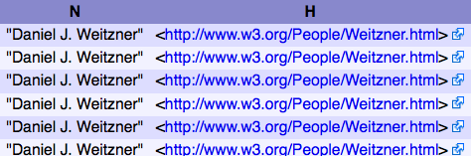
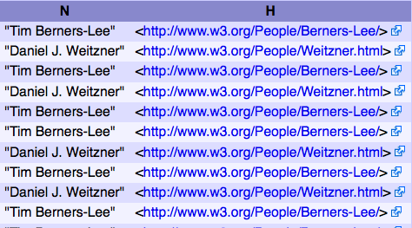
FILTERING out query results
FILTERs allow to specify FILTER conditions on patterns
Example:
“Give me all names of co-authors of Tim Berners-Lee
and whose homepage starts with http://www.w3…”
different from Tim B.-L. himself”
PREFIX foaf: <http://xmlns.com/foaf/0.1/>
SELECT ?N ?H
WHERE {
?D foaf:maker <http://dblp.l3s.de/…/authors/Tim_Berners-Lee>.
?D foaf:maker ?CoAuth .
?CoAuth foaf:name ?N .
?CoAuth foaf:homepage ?H .
FILTER( regex( str(?H) , "^http://www.w3" ) )
}
PREFIX foaf: <http://xmlns.com/foaf/0.1/>
SELECT ?N ?H
WHERE {
?D foaf:maker <http://dblp.l3s.de/…/authors/Tim_Berners-Lee>.
?D foaf:maker ?CoAuth .
?CoAuth foaf:name ?N .
?CoAuth foaf:homepage ?H .
FILTER( regex( str(?H) , "^http://www.w3" ) &&
?CoAuth != <http://dblp.l3s.de/…/authors/Tim_Berners-Lee> )
}
20

Slide 21
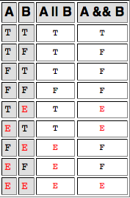
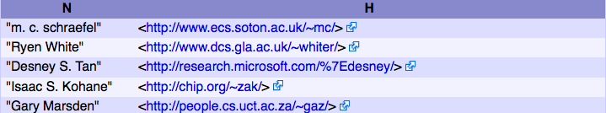
FILTERING out query results
FILTERs allow to specify FILTER conditions on pattern
Can use an extensible library of built-in functions
  checking: bound(), isIRI(), isBlank(), regex() …
  Conversion/extraction: str(), datatype(), lang() …
Can be complex: && , ||, !
ATTENTION: Evaluated in a 3-valued logic: true, false, error
Example:
Will result in E for unbound ?H
Whole FILTER expr
always E for unbound ?H
PREFIX foaf: <http://xmlns.com/foaf/0.1/>
SELECT ?N ?H
WHERE {
?D foaf:maker <http://dblp.l3s.de/…/authors/Tim_Berners-Lee>.
?D foaf:maker ?CoAuth . ?CoAuth foaf:name ?N .
OPTIONAL { ?CoAuth foaf:homepage ?H . }
FILTER( ! regex( str(?H) , "^http://www.w3" ) &&
?CoAuth != <http://dblp.l3s.de/…/authors/Tim_Berners-Lee> )
}
A | !A
T | F
F | T
E | E
21

Slide 22
FILTERING out query results
ATTENTION: FILTERs can NOT assign/create new values…
PREFIX ex: <http://example.org/>
SELECT ?Item ?NewP
WHERE { ?Item ex:price ?Pr FILTER (?NewP = ?Pr + 10 ) }
Non-safe variable in
FILTERs are considered
unbound. The Filter will
just always result in E
➔ Result always empty
Obviously, common query languages like SQL can do this…
SELECT Item, Price+10 AS NewPrice FROM Table
… FILTER in SPARQL is like WHERE in SQL, but SPARQL1.0 doesn’t have AS
22

Slide 23
Querying named GRAPHs
Find me people who have been involved with at least three ISWC or ESWC conference events.
(from SPARQL endpoint at data.semanticweb.org)
SELECT ?person WHERE {
GRAPH ?g1 { ?person a foaf:Person }
GRAPH ?g2 { ?person a foaf:Person }
GRAPH ?g3 { ?person a foaf:Person }
FILTER(?g1 != ?g2 && ?g1 != ?g3 && ?g2 != ?g3) . }
The GRAPH ?g construct allows a pattern to match against one of the named graphs in the RDF dataset. The URI of the matching graph is bound to ?g (or whatever variable was actually used).
The FILTER assures that we're finding a person who occurs in three distinct graphs.
23

Slide 24
Slicing and Dicing results
Solution Modifiers
  DISTINCT/REDUCED
  ORDER BY
  LIMIT/OFFSET
Example:
SELECT DISTINCT ?person WHERE {
GRAPH ?g1 { ?person a foaf:Person }
GRAPH ?g2 { ?person a foaf:Person }
GRAPH ?g3 { ?person a foaf:Person }
FILTER(?g1 != ?g2 && ?g1 != ?g3 && ?g2 != ?g3) . }
ORDER BY ?person
LIMIT 10
Link

Slide 25
ASC, DESC, ORDER BY Expressions
25

Slide 26
More complex query examples 1/2
“IF-THEN-ELSE”
  “Give me the names of persons, if it exists, otherwise the nicknames, if it exists, otherwise the labels”
      SELECT ?X ?N
      WHERE{ ?X rdf:type foaf:Person
      OPTIONAL { ?X foaf:name ?N }
      OPTIONAL { ?X foaf:nickname ?N }
      OPTIONAL { ?X rdfs:label ?N } }
“Conditional OPTIONAL”
  “Give me the names and - only of those whose name starts with ‘D’ - the homepage”
      SELECT ?N ?H
      WHERE{ ?X foaf:name ?N
      OPTIONAL { ?X foaf:homepage ?H
      FILTER ( regex( str(?N), "^D" ) ) }
      }
OPTIONAL is
order-dependent!
OPTIONAL is
order-dependent!
OPTIONAL is NOT
modular/compositional!
(?N is not considered
unsafe in this FILTER)*
Non-compositionality raised some eyebrows… [Angles&Gutierrez, 2008] showed that compositional semantics can be
achieved by rewriting.
26

Slide 27
More complex query examples 2/2
Negation
  “Give me all Persons without a homepage”
  Option 1: by combination of OPTIONAL and FILTER(!bound(…) )
      SELECT ?X
      WHERE{ ?X rdf:type foaf:Person
      OPTIONAL { ?X foaf:homepage ?H }
      FILTER( !bound( ?H ) ) }
  Option 2: by even weirder combination of OPTIONAL with GRAPH queries…
      SELECT ?X
      WHERE{ ?X rdf:type foaf:Person
      OPTIONAL { ?X foaf:homepage ?H }
      GRAPH boundcheck.ttl {?H :is :unbound } }
  where the aux. graph boundcheck.ttl contains the single triple [] :is :unboud.
27

Slide 28
Constructing Graphs
Construct new graphs:
“everybody knows their co-authors”
CONSTRUCT { ?X foaf:knows ?Y }
WHERE{ ?D foaf:maker ?X, ?Y .
  FILTER( ?X != ?Y ) }
28

Slide 29


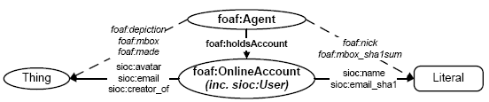
Constructing Graphs
Map between ontologies:
E.g. for expressing complex ontology mappings between and
“an sioc:name of a sioc:User is a foaf:nick”
CONSTRUCT { ?X foaf:nick ?Y }
WHERE{ ?X foaf:holdsAccount [sioc:name ?Y ]. }
    Actually, expressible in new OWL2 ( but not in OWL1):
    foaf:nick owl:propertyChainAxiom (foaf:holdsAccount sioc:name)
29

Slide 30
Constructing Graphs
Limitations
  Again, no assignment, creation of values
    How to concatenate first name and last name?
  No aggregation (e.g. COUNT, SUM, …):
    How to create a graph that has publication count per person for DBLP?
    No RDFS/OWL inference (so combining mappings in RDFS/OWL with queries in SPARQL not possible)
30

Slide 31
SPARQL1.0 Formal Semantics
Graph patterns:
    BGPs
    P1 P2
    P FILTER R
    P1 UNION P2
    P1 OPTIONAL P2
Semantics
  eval(D(G), graph pattern) … D is a dataset,
  G is the “active graph”
  recursively defined for all graph patterns in Section 12.5 of
  http://www.w3.org/TR/rdf-sparql-query/
  Spec. semantics is a bit hard to read …
31

Slide 32
Formal Semantics á la [Perez et al. 2006]
ISWC 2006
Easier to explain… let’s steal from that here and explain the diffs:
Example Graph:
:tim foaf:knows :jim .
:jim foaf:knows :tim .
:tim foaf:knows :lalana .
Example Pattern:
P = { ?X foaf:knows ?Y }.
eval(P,G) = { μ1 = { ?x → :tim , ?y → :jim } , μ2 = { ?x → :jim , ?y → :tim } ,
μ3 = { ?x → :tim , ?y → :lalana }
Definition 1:
The evaluation of the BGP P over a graph G, denoted by eval(P,G), is the set of all mappings μ such that:
dom(μ) is exactly the set of variables occurring in P
μ(P)⊆G
32

Slide 33
Algebra á la [Perez et al. 2006]
Definition 2:
mappings μ1, μ2 are compatible iff they agree in their shared variables.
Let M1, M2 be sets of mappings
Definition 3:
Join:
M1 M2 = { μ1∪μ2 | μ1∈ M1, μ2∈M2, and μ1, μ2 are compatible}
Union:
M1 ∪ M2 = { μ | μ ∈ M1 or μ ∈ M2}
Minus:
M1 \ M2 = {μ∈M1 | forall μ′ ∈M2, μ and μ′ are not compatible }
LeftJoin:
M1 M2 = (M1 M2) ∪ ( M1 \ M2 )
Filter:
M|_{R} = { μ | μ ∈ M and μ(R) = true}
P1 P2
P1 UNION P2
P1 OPTIONAL P2
P FILTER R
33

Slide 34
Semantics full as per [Perez et al.2006]
eval(BGP,G) … see Definition 1
eval(P1 P2,G) = eval(P1, G) eval(P2, G)
eval(P1 UNION P2,G) = eval(P1, G) ∪ eval(P2, G)
eval(P1 OPTIONAL P2, G) = eval(P1, G) eval(P2, G)
eval(P FILTER R,G) = eval(P, G) |_{R}
34

Slide 35
ISSUE 1) Recall from before:
SPARQL allows duplicates !
Unions of conjunctive queries
Example:
“Give me all names of co-authors or friends of Tim Berners-Lee”
Note: Duplicates possible,
bag/multiset semantics!
PREFIX foaf: <http://xmlns.com/foaf/0.1/>
SELECT ?N
WHERE {
{ [ foaf:maker <http://dblp.l3s.de/…/authors/Tim_Berners-Lee>,
[ foaf:name ?N ] ] . }
UNION
{ <http://www.w3.org/People/Berners-Lee/card#i> foaf:knows ?F .
?F foaf:name ?N }
}
?N
"Lalana Kagal"
"Tim Berners-Lee"
"Dan Connolly”
"Jim Hendler”
…
"Michael Hausenblas”
"Jim Hendler”
"Charles McCathieNevile”
…
35

Slide 36
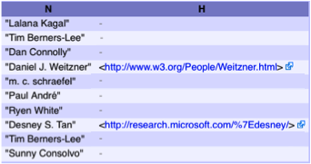
ISSUE 2) Recall from before:
FILTERS can make OPTIONAL non-compositional!
“Conditional OPTIONAL”
  “Give me the names and only of those whose name starts with ‘D’ the homepage”
      SELECT ?N ?H
      WHERE{ ?X foaf:name ?N
      OPTIONAL { ?X foaf:homepage ?H
      FILTER ( regex( str(?N), "^D" ) ) }
      }
OPTIONAL is NOT
modular/compositional!
(?N is not considered
unsafe in this FILTER)*
36

Slide 37
Adapting [Perez et al. 2006]
Definition 1:
The evaluation of the BGP P over a graph G, denoted by eval(P,G), is the set of all mappings μ such that:
dom(μ) is exactly the set of variables occurring in P
μ(P)⊆G
Definition 1:
The evaluation of the BGP P over a graph G, denoted by eval(P,G), is the set of all mappings μ such that:
dom(μ) is exactly the set of variables occurring in P
μ(P) |= G
Remark: This behavior can likewise be achieved if you replace all bnodes in queries simply with variables …
  Definition in Section 12.3.1 of SPARQL spec counts cardinality of mappings exactly by number of instance mappings
  i.e. behavior exactly the same as replacing query bnodes with variables
  in fact, Perez et al. (for that reason) don’t consider Bnodes in triple patterns
37

Slide 38
Adapting [Perez et al. 2006]
ISSUE1: Algebra operations need to be adapted to multiset/bag semantics:
Definition 3:
Join:
M1 M2 = { μ1∪μ2 | μ1∈ M1, μ2∈M2, and μ1, μ2 are compatible}
Union:
M1 ∪ M2 = { μ | μ ∈ M1 or μ ∈ M2}
Minus:
M1 \ M2 = {μ∈M1 | forall μ′ ∈M2, μ and μ′ are not compatible }
LeftJoin:
M1 M2 = (M1 M2) ∪ ( M1 \ M2 )
Filter:
M|_{R} = { μ | μ ∈ M and μ(R) = true}
Definition 3:
Join:
M1 M2 = μ1∪μ2 | μ1∈ M1, μ2∈M2, and μ1, μ2 are compatible
Union:
M1 ∪ M2 = μ | μ ∈ M1 or μ ∈ M2
Minus:
M1 \ M2 = μ∈M1 | forall μ′ ∈M2, μ and μ′ are not compatible
LeftJoin:
M1 M2 = (M1 M2) ∪ ( M1 \ M2 )
Filter:
M|_{R} = { μ | μ ∈ M and μ(R) = true}
{
{
{
{
ISSUE2: non-compositionality of FILTERs in OPTIONAL
{
{
{
{
{
{
{
{
38

Slide 39
Semantics as per SPARQL1.0 spec:
eval(BGP,G) … see Definition 1
eval(P1 P2,G) = eval(P1, G) eval(P2, G)
eval(P1 UNION P2,G) = eval(P1, G) ∪ eval(P2, G)
eval(P FILTER R,G) = eval(P, G) |_{R}
eval(P1 OPTIONAL {P2 FILTER R} , G) consists of all μ such that:
μ = μ1 ∪ μ2, such that
μ1 ∈ eval(P1,G) and μ2 ∈ eval(P2,G) are compatible and μ(R) = true, or
μ ∈ eval(P1,G) and
there is no compatible μ2 ∈ eval(P2,G) for μ, or
μ ∈ eval(P1,G) and
for any compatible μ2 ∈ eval(P2,G), μ ∪ μ2 does not satisfy R.
39

Slide 40
Academic works around SPARQL
SPARQL semantics
  [Perez et al. 2006] (pre-dates the spec) [Perez et al. 2009]
SPARQL equivalences
  also in [Perez et al. 2006],[Perez et al. 2009]
  More in [Schmidt et al. 2010]
SPARQL expressivity
  Reducible to datalog with negation [Polleres 2007]
  Other way around also works [Angles &Gutierrez 2008]
Proposed Extensions
  Aggregates [Polleres et al. 2007]
  Property Paths [Alkhateeb et al. 2009], [Perez et al. 2008]
40

Slide 41

SPARQL1.1
WG might still change some of the syntax/semantics definitions presented here based on community input
41

Slide 42
This is where SPARQL1.1 starts
Missing common feature requirements in existing implementations or requested urgently by the community:
  Assignment/Project Expressions
  Aggregate functions (SUM, AVG, MIN, MAX, COUNT, …)
  Subqueries
  Property paths
    complaint: SPARQL1.0 isn’t quite a “graph” query language
Ease of use:
  Why is Negation “hidden” in SPARQL1.0?
Interplay with other SW standards:
  SPARQL1.0 only defined for simple RDF entailment
  Other Entailment regimes missing:
    RDF(S), OWL
    OWL2
    RIF

Slide 43
Goals of SPARQL1.1
Per charter (http://www.w3.org/2009/05/sparql-phase-II-charter.html)
  “The scope of this charter is to extend SPARQL technology to include some of the features that the community has identified as both desirable and important for interoperability based on experience with the initial version of the standard.”
No inclusion of new features that still require research
Upwards compatible with SPARQL1.0
The name SPARQL1.1 shall indicate an incremental change rather than any fundamental changes.
43

Slide 44
Goals of SPARQL1.1
List of agreed features:
Additions to the Query Language:
  Project Expressions
  Aggregate functions
  Subqueries
  Negation
  Property Paths (time permitting)
  Extend the function library (time permitting)
  Basic federated Queries (time permitting)
Entailment (time permitting)
SPARQL Update
  Full Update language
  plus simple RESTful update methods for RDF graphs (HTTP methods)
Service Description
  Method for discovering a SPARQL endpoint’s capabilities
  Summary of its data
We will focus on these in today’s Tutorial
44

Slide 45
Part 1: new query features
Project Expressions
  Aggregate functions
  Subqueries
  Negation
  Property Paths
45

Slide 46
Project Expressions
Assignments, Creating new values…
PREFIX ex: <http://example.org/>
SELECT ?Item ?NewP
WHERE { ?Item ex:price ?Pr FILTER (?NewP = ?Pr * 1.1) }
PREFIX ex: <http://example.org/>
SELECT ?Item (?Pr * 1.1 AS ?NewP )
WHERE { ?Item ex:price ?Pr }
Data:
Results:
Leave unbound!
@prefix ex: <http://example.org/> .
ex:lemonade1 ex:price 3 .
ex:beer1 ex:price 3.
ex:wine1 ex:price 3.50 .
?Item | ?NewP
lemonade1 | 3.3
beer1 | 3.3
wine1 | 3.85
?Item | ?NewP
lemonade1 | 3.3
beer1 | 3.3
wine1 | 3.85
liqueur1
ex:liqueur1 ex:price "n/a".
Ignore entire row in result?
46

Slide 47
Project expressions - Semantics
Assignments, Creating new values…
Semantics:
PREFIX ex: <http://example.org/>
SELECT ?Item (?Pr * 1.1 AS ?NewP )
WHERE { ?Item ex:price ?Pr }
PREFIX ex: <http://example.org/>
SELECT ?Item (?Pr * 1.1 AS ?Pr )
WHERE { ?Item ex:price ?Pr }
extend(μ, var, expr) = μ if var not in dom(μ) and eval(expr) is an error
extend(μ, var, expr) = μ ∪ { var → value | var not in dom(μ) and value = eval(expr) is defined}
extend(μ, var, expr) undefined if var in dom(μ)
For sets of solutions:
extend(M , var, term) = { extend(μ, var, term) | μ in M }
extend(μ, var, expr) undefined if var in dom(μ)
47

Slide 48
Project Expressions
Assignments, boolean values…
In general: result type as of Section 16.3 Operator Mapping in SPARQL1.1 Query spec.
PREFIX ex: <http://example.org/>
SELECT ?Item ( IsNumeric(?Pr) AS ?NewP )
WHERE { ?Item ex:price ?Pr }
Data:
Results:
@prefix ex: <http://example.org/> .
ex:lemonade1 ex:price 3 .
ex:beer1 ex:price 3.
ex:wine1 ex:price 3.50 .
?Item | ?NewP
lemonade1 | “1”^^xsd:boolean
beer1 | “1”^^xsd:boolean
wine1 | “1”^^xsd:boolean
liqueur1 | “0”^^xsd:boolean
ex:liqueur1 ex:price "n/a".
48

Slide 49
Aggregates
49

Slide 50
Aggregates
“Count items”
PREFIX ex: <http://example.org/>
SELECT (Count(?Item) AS ?C)
WHERE { ?Item ex:price ?Pr }
Data:
Results:
@prefix ex: <http://example.org/> .
ex:lemonade1 ex:price 3 ;
rdf:type ex:Softdrink.
ex:beer1 ex:price 3;
rdf:type ex:Beer.
ex:wine1 ex:price 3.50 ;
rdf:type ex:Wine.
ex:wine2 ex:price 4 .
rdf:type ex:Wine.
ex:wine3 ex:price "n/a”;
rdf:type ex:Wine.
?C
5
50

Slide 51
Aggregates
“Count categories”
PREFIX ex: <http://example.org/>
SELECT (Count(?T AS ?C)
WHERE { ?Item rdf:type ?T }
PREFIX ex: <http://example.org/>
SELECT (Count(DISTINCT ?T) AS ?C)
WHERE { ?Item rdf:type ?T }
Data:
Results:
@prefix ex: <http://example.org/> .
ex:lemonade1 ex:price 3 ;
rdf:type ex:Softdrink.
ex:beer1 ex:price 3;
rdf:type ex:Beer.
ex:wine1 ex:price 3.50 ;
rdf:type ex:Wine.
ex:wine2 ex:price 4 .
rdf:type ex:Wine.
ex:wine3 ex:price "n/a”;
rdf:type ex:Wine.
?C
5
?C
3
51

Slide 52
Aggregates - Grouping
“Count items per categories”
PREFIX ex: <http://example.org/>
SELECT ?T (Count(?Item) AS ?C)
WHERE { ?Item rdf:type ?T }
GROUP BY ?T
Data:
Results:
@prefix ex: <http://example.org/> .
ex:lemonade1 ex:price 3 ;
rdf:type ex:Softdrink.
ex:beer1 ex:price 3;
rdf:type ex:Beer.
ex:wine1 ex:price 3.50 ;
rdf:type ex:Wine.
ex:wine2 ex:price 4 .
rdf:type ex:Wine.
ex:wine3 ex:price "n/a”;
rdf:type ex:Wine.
?T | ?C
Softdrink | 1
Beer | 1
Wine | 3

Slide 53
Aggregates – Filtering Groups
“Count items per categories, for those categories having more than one item”
PREFIX ex: <http://example.org/>
SELECT ?T (Count(?Item) AS ?C)
WHERE { ?Item rdf:type ?T }
GROUP BY ?T
HAVING Count(?Item) > 1
Data:
Results:
@prefix ex: <http://example.org/> .
ex:lemonade1 ex:price 3 ;
rdf:type ex:Softdrink.
ex:beer1 ex:price 3;
rdf:type ex:Beer.
ex:wine1 ex:price 3.50 ;
rdf:type ex:Wine.
ex:wine2 ex:price 4 .
rdf:type ex:Wine.
ex:wine3 ex:price "n/a”;
rdf:type ex:Wine.
?T | ?C
Wine | 3
53

Slide 54
Other Aggregates
SUM … as usual
AVG … as usual
MIN … as usual
MAX … as usual
SAMPLE … “pick” one non-deterministically
GROUP_CONCAT … concatenate values with a designated separator string
…this list is extensible … new built-ins will need to define
error-behaviour, extra-parameters
(like SEPARATOR in GROUP_CONCAT)
54

Slide 55
Example SUM
Under discussion:
WG might decide to simply ignore non-numerics in Sum/Avg, but at the moment just delecates to “+”
“Sum Prices per categories”
PREFIX ex: <http://example.org/>
SELECT ?T (Sum(?Pr) AS ?P)
WHERE { ?Item rdf:type ?T; ex:price ?Pr }
GROUP BY ?T
PREFIX ex: <http://example.org/>
SELECT ?T (Sum(?Pr) AS ?P)
WHERE { ?Item rdf:type ?T; ex:price ?Pr
FILTER( isNumeric(?Pr) ) }
GROUP BY ?T
PREFIX ex: <http://example.org/>
SELECT ?T (Sum(COALESCE(xs:decimal(?Pr),0) AS ?P)
WHERE { ?Item rdf:type ?T; ex:price ?Pr }
GROUP BY ?T
PREFIX ex: <http://example.org/>
SELECT ?T (Sum(IF(isNumeric(?Pr),?Pr,0) AS ?P)
WHERE { ?Item rdf:type ?T; ex:price ?Pr }
GROUP BY ?T
PREFIX ex: <http://example.org/>
SELECT (Count(?T AS ?C)
WHERE { ?Item rdf:type ?T }
Data:
Results:
@prefix ex: <http://example.org/> .
ex:lemonade1 ex:price 3 ;
rdf:type ex:Softdrink.
ex:beer1 ex:price 3;
rdf:type ex:Beer.
ex:wine1 ex:price 3.50 ;
rdf:type ex:Wine.
ex:wine2 ex:price 4 .
rdf:type ex:Wine.
ex:wine3 ex:price "n/a";
rdf:type ex:Wine.
?T | ?C
Softdrink | 3
Beer | 3
Wine
?T | ?C
Softdrink | 3
Beer | 3
Wine | 7.5
55

Slide 56

Example GROUP_CONCAT, SAMPLE
“pick one sample name per person, plus a concatenated list of nicknames ”
PREFIX foaf: <http://xmlns.com/foaf/0.1/>
SELECT ( SAMPLE(?N) as ?Name)
( GROUP_CONCAT(?M; SEPARATOR = ", ") AS ?Nicknames )
WHERE { ?P a foaf:Person ;
foaf:name ?N ;
foaf:nick ?M . }
GROUP BY ?P
@prefix ex: <http://example.org/> .
@prefix foaf: <http://xmlns.com/foaf/0.1/> .
ex:alice a foaf:Person; foaf:name "Alice Wonderland";
foaf:nick "Alice", "The real Alice".
ex:bob a foaf:Person;
foaf:name "Robert Doe", "Robert Charles Doe",
"Robert C. Doe";
foaf:nick "Bob","Bobby","RobC","BobDoe".
ex:charles a foaf:Person;
foaf:name "Charles Charles";
foaf:nick "Charlie" .
56

Slide 57
Aggregates - Semantics
Evaluate a list of (GROUP BY) expressions:
Use these to partition a solution sequence:
ListEval(ExprList, μ) returns a list E, where E[i] = μ( ExprList[i] )
Group((), Ω) = { 1 → Ω }
Group(ExprList, Ω) = { ListEval(ExprList, μ) →
{ μ' | μ' in Ω, ListEval(ExprList, μ) = ListEval(ExprList, μ') } | μ in Ω }
produces a grouped solution sequence
SELECT Sum(?y) AS ?Sy
WHERE { :s :p ?x; :q ?y }
GROUP BY ?x
Assume solution sequence S = ( {?x→2, ?y→3}, {?x→2, ?y→5}, {?x→6, ?y→7} ),
Group((?x), S) = { (2) → ( {?x→2, ?y→3}, {?x→2, ?y→5} ),
(6) → ( {?x→6, ?y→7} ) } }
57

Slide 58
Aggregates - Semantics
Definition: Aggregation (simplified)
Aggregation applies set function “func” (e.g. sum, min, max, …) to a multiset of lists of expressions and a grouped solution sequence, G as produced by the Group function. It produces a single value for each key and partition for that key (key, X).
Aggregation(ExprList, func, G) = { dom(g) → F | g in G }
where M = ListEvalE(ExprList, range(g))
F = func(M), for non-DISTINCT
F = func(Distinct(M)), for DISTINCT
multiset
G = { (2) → ( {?x→2, ?y→3}, {?x→2, ?y→5} ),
(6) → ( {?x→6, ?y→7} ) } }
Aggregation( ?y, Sum, G ) = { (2) → Sum( (3), (5) ) , (6) → Sum( (7) ) }
= { (2) → 8 , (6) → 7 }
G = { (2) → ( {?x→2, ?y→3}, {?x→2, ?y→3} ),
(6) → ( {?x→6, ?y→7} ) } }
Aggregation( ?y, Sum, G ) = { (2) → Sum( (3), (3) ) , (6) → Sum( (7) ) }
= { (2) → 6 , (6) → 7 }
58

Slide 59
Aggregates - Semantics
Ommitted details on
error handling and scalar
Parameters like “SEPERATOR”
in GROUP_CPONCAT
Definition: Aggregation (simplified)
Aggregation applies set function “func” (e.g. sum, min, max, …) to a multiset of lists of expressions and a grouped solution sequence, G as produced by the Group function. It produces a single value for each key and partition for that key (key, X).
Aggregation(ExprList, func, G) = { dom(g) → F | g in G }
where M = ListEvalE(ExprList, range(g))
F = func(M), for non-DISTINCT
F = func(Distinct(M)), for DISTINCT
G = { (2) → ( {?x→2, ?y→3}, {?x→2, ?y→5} ),
(6) → ( {?x→6, ?y→7} ) } }
Aggregation( ?y, Sum, G ) = { (2) → Sum( (3), (5) ) , (6) → Sum( (7) ) }
= { (2) → 8 , (6) → 7 }
Aggregations subsequently mapped back via Extend(…) to solution multisets
SELECT Sum(?y) AS ?Sy
WHERE { :s :p ?x; :q ?y }
GROUP BY ?x
{ { ?x → 2 ?Sy → 8 }, {?x→6, ?Sy→7} }
59

Slide 60
Aggregates - Semantics
Ommitted details on
error handling and scalar
Parameters like “SEPERATOR”
in GROUP_CPONCAT
Definition: Aggregation (simplified)
Aggregation applies set function “func” (e.g. sum, min, max, …) to a multiset of lists of expressions and a grouped solution sequence, G as produced by the Group function. It produces a single value for each key and partition for that key (key, X).
Aggregation(ExprList, func, G) = { dom(g) → F | g in G }
where M = ListEvalE(ExprList, range(g))
F = func(M), for non-DISTINCT
F = func(Distinct(M)), for DISTINCT
G = { (2) → ( {?x→2, ?y→3}, {?x→2, ?y→5} ),
(6) → ( {?x→6, ?y→7} ) } }
Aggregation( ?y, Sum, G ) = { (2) → Sum( (3), (5) ) , (6) → Sum( (7) ) }
= { (2) → 8 , (6) → 7 }
Aggregations subsequently mapped back via Extend(…) to solution multisets
SELECT Sum(?y) AS ?Sy
WHERE { :s :p ?x; :q ?y }
GROUP BY ?x
{ { ?x → 2 ?Sy → 8 }, {?x→6, ?Sy→7} }
60

Slide 61
Subqueries
61

Slide 62
Subqueries to realise complex mappings
    How to concatenate first name and last name?
    Now possible without problems per subqueries!
PREFIX foaf: <http://xmlns.com/foaf/0.1/>
PREFIX fn: <http://www.w3.org/2005/xpath-functions#>
CONSTRUCT{ ?P foaf:name ?FullName }
WHERE {
SELECT ?P ( fn:concat(?F, " ", ?L) AS ?FullName )
WHERE { ?P foaf:firstName ?F ; foaf:lastName ?L. }
}
62

Slide 63
Subqueries “Limit per resource”
Give me all titles of papers of 10 persons who co-authored with Tim Berners-Lee
  Returns titles for 10 persons, instead of just 10 rows
SELECT ?T
WHERE {
?D foaf:maker ?P ; rdfs:label ?T .
{
SELECT DISTINCT ?P
WHERE { ?D foaf:maker <http://dblp.l3s.de/…/authors/Tim_Berners-Lee>, ?P .
FILTER ( ?P != <http://dblp.l3s.de/…/authors/Tim_Berners-Lee> )
}
LIMIT 10
}
}
SELECT ?T
WHERE {
?D foaf:maker ?P ; rdfs:label ?T .
{
SELECT DISTINCT ?P
WHERE { ?D foaf:maker <http://dblp.l3s.de/…/authors/Tim_Berners-Lee>, ?P .
FILTER ( ?P != <http://dblp.l3s.de/…/authors/Tim_Berners-Lee> )
}
LIMIT 10
}
}
63

Slide 64
Subqueries - Semantics
Note: Before Solution Modifiers are applied, SPARQL semantics converts solution multisets to solution sequences
Subqueries require one additional algebra operator, toMultiset, which takes Sequences and returns Multisets
SELECT ?T
WHERE {
?D foaf:maker ?P ; rdfs:label ?T .
{
}
}
SELECT DISTINCT ?P
WHERE { ?D foaf:maker <http://dblp…/Tim_Berners-Lee>, ?P .
FILTER ( ?P != <http://dblp…/Tim_Berners-Lee> )
}
ORDER BY ?P
LIMIT 10
eval(P,G)
ToList(M)
OrderBy(Ω,cond)
Slice(Ω,start,length)
ToMultiSet(Ω)
64

Slide 65
Subqueries – Known Limitations
Attention: Subqueries are compositional, but that limits some use cases, one might think of… e.g.
an alternative “limit per resource” query:
… does NOT return 3 titles per author!
Different ?P/ different scope than the ?P outside of the subquery… i.e. no correlation
SELECT ?P ?T
WHERE { ?P rdf:type Person .
{ SELECT ?T
WHERE { ?D foaf:maker ?P ; dc:title ?T }
LIMIT 3 }
}
?P | ?T
:jim | “Doc1”
:jim | “Doc2”
:jim | “Doc3”
:tim | “Doc1”
:tim | “Doc2”
:tim | “Doc3”
:jim a foaf:Person .
:tim a foaf:Person .
:d1 foaf:maker :tim, :jim; dc:title “Doc1” .
:d2 foaf:maker :tim, :jim; dc:title “Doc2” .
:d3 foaf:maker :jim; dc:title “Doc3” .
:d4 foaf:maker :tim; dc:title “Doc4” .
65

Slide 66
Subqueries – Known Limitations
Attention: Subqueries are compositional, but that limits some use cases, one might think of… e.g.
an alternative “limit per resource” query:
… does NOT return 3 titles per author!
Doesn’t work either… this is “only” a normal join, doesn’t inject binding inside the query
SELECT ?P ?T
WHERE { ?P rdf:type Person .
{ SELECT ?T ?P
WHERE { ?D foaf:maker ?P ; dc:title ?T }
LIMIT 3 }
}
?P | ?T
:jim | “Doc1”
:tim | “Doc1”
:tim | “Doc2”
:jim a foaf:Person .
:tim a foaf:Person .
:d1 foaf:maker :tim, :jim; dc:title “Doc1” .
:d2 foaf:maker :tim, :jim; dc:title “Doc2” .
:d3 foaf:maker :jim; dc:title “Doc3” .
:d4 foaf:maker :tim; dc:title “Doc4” .
66

Slide 67
FROM in Subqueries? NO!
Note: At this point, no Dataset Clauses in Subselects, i.e.:
PREFIX foaf: <http://xmlns.com/foaf/0.1/>
SELECT ?N
WHERE {
{ SELECT ?N
FROM <http://www.w3.org/People/Berners-Lee/card>
<http://www.w3.org/People/Berners-Lee/card#i> foaf:knows ?F .
?F foaf:name ?N }
UNION
{ SELECT ?N
FROM <http://dblp.l3s.de/…/authors/Tim_Berners-Lee>
{ [ foaf:maker <http://dblp.l3s.de/…/authors/Tim_Berners-Lee>,
[ foaf:name ?N ] ] . } }
}
67

Slide 68
(NOT) EXISTS: Another form of Subqueries
Note Subqueries in EXIST are evaluated AFTER substitution!
      Graph:
      :a a foaf:Person ;
      foaf:homepage <http://a1> ;
      foaf:homepage <http://a2> .
      :b a foaf:Person .
      Query:
      SELECT ?X
      WHERE{ ?X rdf:type foaf:Person
      EXISTS { ?X foaf:homepage ?H } ) }
?X
:a
Recall, Filter semantics:
Substitute R and then check
whether ASK query
evaluates to true
Filter:
M|_{R} = { μ | μ ∈ M and μ(R) = true}
68

Slide 69
(NOT) EXISTS: Another form of Subqueries
Note Subqueries in EXIST are evaluated AFTER substitution!
      Graph:
      :a a foaf:Person ;
      foaf:homepage <http://a1> ;
      foaf:homepage <http://a2> .
      :b a foaf:Person .
      Query:
      SELECT ?X
      WHERE{ ?X rdf:type foaf:Person
      ?X foaf:homepage ?H }
?X
:a
:a
As opposed to EXISTS,
joinss can create dublicates
69

Slide 70
MINUS and NOT EXISTS
70

Slide 71
MINUS and NOT EXISTS
Negation as failure in SPARQL1.0 is “ugly”:
      SELECT ?X
      WHERE{ ?X rdf:type foaf:Person
      OPTIONAL { ?X foaf:homepage ?H }
      FILTER( !bound( ?H ) ) }
SPARQL1.1 has two alternatives to do the same
  NOT EXISTS in FILTERs
    detect non-existence
  (P1 MINUS P2 ) as a new binary operator
    “Remove rows with matching bindings”
    only effective when P1 and P2 share variables
Semantics
      SELECT ?X
      WHERE{ ?X rdf:type foaf:Person
      FILTER ( NOT EXISTS { ?X foaf:homepage ?H } ) }
      SELECT ?X
      WHERE{ ?X rdf:type foaf:Person
      MINUS { ?X foaf:homepage ?H } ) }
71

Slide 72
MINUS and NOT EXISTS
May have different results, e.g.:
      PREFIX ex: <http://example.org/>
      SELECT ?X
      WHERE{ ?S ?P ?O
      FILTER( NOT EXISTS { ex:a ex:b ex:c } ) }
      PREFIX ex: <http://example.org/>
      SELECT *
      WHERE{ ?S ?P ?O
      MINUS { ex:a ex:b ex:c } }
@prefix ex: <http://example.org/> .
ex:a ex:b ex:c
?S | ?P | ?O
?S | ?P | ?O
a | b | c
72

Slide 73
Current Semantics of MINUS
Definition 3:
Join:
M1 M2 = μ1∪μ2 | μ1∈ M1, μ2∈M2, and μ1, μ2 are compatible
Union:
M1 ∪ M2 = μ | μ ∈ M1 or μ ∈ M2
Minus:
M1 \ M2 = μ∈M1 | forall μ′ ∈M2, μ and μ′ are not compatible
LeftJoin:
M1 M2 = (M1 M2) ∪ ( M1 \ M2 )
Filter:
M|_{R} = { μ | μ ∈ M and μ(R) = true}
Definition 3:
Join:
M1 M2 = μ1∪μ2 | μ1∈ M1, μ2∈M2, and μ1, μ2 are compatible
Union:
M1 ∪ M2 = μ | μ ∈ M1 or μ ∈ M2
Minus:
M1 \ M2 = μ∈M1 | forall μ′ ∈M2, μ and μ′ are not compatible
or dom(μ) and dom(μ') are disjoint
LeftJoin:
M1 M2 = (M1 M2) ∪ ( M1 \ M2 )
Filter:
M|_{R} = { μ | μ ∈ M and μ(R) = true}
{
{
{
{
{
{
{
{
{
{
{
{
{
{
{
{
{
{
{
{
{
{
{
{
73

Slide 74
Property Path Expressions

Slide 75
Property Path expressions
Concatenate property paths, Arbitrary Length paths, etc.
E.g. names of people Tim Berners-Lee transitively co-authored papers with…
SELECT DISTINCT ?N
WHERE {<http://dblp…/Tim_Berners-Lee>,
(^foaf:maker/foaf:maker)+/foaf:name ?N
}
75

Slide 76
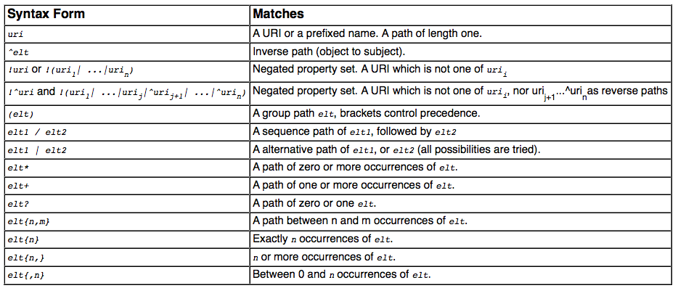
Path expressions full list of operators
elt … Path Element
Semantics: by translation to native SPARQL with two core property paths Operators:
  ArbitraryPath(X, path, Y)
  ZeroLengthPath(X, path, Y)
76

Slide 77
Path expressions
Can be used for some ontological inference (well known since [Perez et al. 2008]
E.g. Find all Beers in the Beer ontology
PREFIX beer: <http://www.purl.org/net/ontology/beer#>
PREFIX rdf: <http://www.w3.org/1999/02/22-rdf-syntax-ns#>
PREFIX rdfs: <http://www.w3.org/2000/01/rdf-schema#>
SELECT ?beer
FROM <http://www.purl.org/net/ontology/beer>
WHERE {
?beer rdf:type/rdfs:subClassOf* beer:Beer .
}
PREFIX beer: <http://www.purl.org/net/ontology/beer#>
PREFIX rdf: <http://www.w3.org/1999/02/22-rdf-syntax-ns#>
PREFIX rdfs: <http://www.w3.org/2000/01/rdf-schema#>
SELECT ?beer
FROM <http://www.purl.org/net/ontology/beer>
WHERE {
?beer rdf:type beer:Beer .
}
No results under simple entailment…
Link
77

Slide 78
Implementations of SPARQL 1.1 Query:
Some current (partial) SPARQL1.1 implementations:
ARQ
  http://sourceforge.net/projects/jena/
  http://sparql.org/sparql.html
OpenAnzo
  http://www.openanzo.org/
Perl RDF
  http://github.com/kasei/perlrdf/
Corese
  http://www-sop.inria.fr/teams/edelweiss/wiki/wakka.php?wiki=CoreseDownloads
etc.
Others probably forthcoming…
Loads of SPARQL1.0 endpoints around
  Dbpedia: http://dbpedia.org/snorql/
  DBLP: http://dblp.l3s.de/d2r/snorql/
  Etc.
78

Slide 79
Part 2: Entailment Regimes
SPARQL 1.1 querying over OWL2 ontologies and RIF rulesets?
79

Slide 80
SPARQL1.1 Entailment Regimes
SPARQL1.1 will define SPARQL query answering over OWL2 ontologies and RIF rule sets:
  http://www.w3.org/TR/sparql11-entailment/
  RDF Entailment Regime
  RDFS Entailment Regime
  D-Entailment Regime
  OWL 2 RDF-Based Semantics Entailment Regime
  OWL 2 Direct Semantics Entailment Regime
  RIF Core Entailment
    Won’t go into details of those, but sketch the main ideas!
80

Slide 81
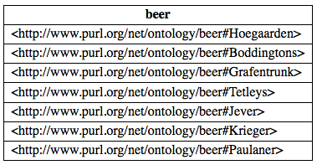
RDFS/OWL2 and SPARQL1.1
General Idea: Answer Queries with implicit answers
E.g. example from before:
PREFIX beer: <http://www.purl.org/net/ontology/beer#>
PREFIX rdf: <http://www.w3.org/1999/02/22-rdf-syntax-ns#>
PREFIX rdfs: <http://www.w3.org/2000/01/rdf-schema#>
SELECT ?beer
FROM <http://www.purl.org/net/ontology/beer>
WHERE {
?beer rdf:type beer:Beer .
}

Slide 82
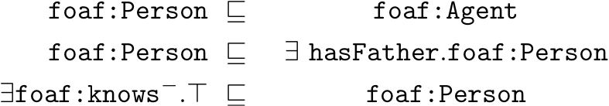
OWL2 and SPARQL1.1
General Idea: Answer Queries with implicit answers
E.g. Graph/Ontology:
T-Box:
A-Box:
SELECT ?X { ?X a foaf:Person }
Pure SPARQL 1.0 returns only :Jeff,
should also return :aidan
foaf:Person rdfs:subClassOf foaf:Agent .
foaf:Person rdfs:subclassOf
[ a owl:Restriction ;
owl:onProperty :hasFather ;
owl:someValuesFrom foaf:Person ] .
foaf:knows rdfs:range foaf:Person.
:jeff a Person .
:jeff foaf:knows :aidan .
:jeff a Person .
:jeff foaf:knows :aidan .
82

Slide 83
SPARQL1.1+RDFS/OWL: Challenges+Pitfalls
Challenges+Pitfalls:
  Possibly Infinite answers (by RDFS ContainerMembership properties, OWL datatype reasoning, etc.)
  Conjunctive Queries: non-distinguished variables
  SPARQL 1.1 features: Aggregates
83

Slide 84
SPARQL1.1+RDFS/OWL: Challenges+Pitfalls
Current Solution:
  Possibly Infinite answers (by RDFS ContainerMembership properties, OWL datatype reasoning, etc.)
    Restrict answers to rdf:/rdfs:/owl:vocabulary minus rdf:_1 … rdf:_n plus terms occurring in the data graph
  Non-distinguished variables
    No non-distinguished variables, answers must result from BGP matching, projection a post-processing step not part of SPARQL entailment regimes.
  SPARQL 1.1 other features: e.g. Aggregates, etc.
    Again not affected, answers must result from BGP matching, projection a post-processing step not part of entailment.
  Simple, BUT: maybe not always entirelty intuitive, so
    Good to know ;-)
84

Slide 85
Possibly Infinite answers RDF(S): Container Membership
Graph:
  :rr2010Proceedings :hasEditors [ a rdf:Seq;
  rdf:_1 :pascal_hitzler;
  rdf:_2 :thomas_lukasiewicz
  ] .
  Query with RDFS Entailment in mind:
  SELECT ?CM { ?CM a rdfs:ContainerMembershipProperty}
  Entailed by RDFS (axiomatic Triples):
  rdfs:_1 a rdfs:ContainerMembershipProperty .
  rdfs:_2 a rdfs:ContainerMembershipProperty .
  rdfs:_3 a rdfs:ContainerMembershipProperty .
  rdfs:_4 a rdfs:ContainerMembershipProperty .
  …
85

Slide 86
Possibly Infinite answers RDF(S): Container Membership
Graph:
  :rr2010Proceedings :hasEditors [ a rdf:Seq;
  rdf:_1 :pascal_hitzler;
  rdf:_2 :thomas_lukasiewicz
  ] .
  Query with RDFS Entailment in mind:
  SELECT ?CM { ?CM a rdfs:ContainerMembershipProperty}
  SPARQL 1.1 restricts answers to rdf:/rdfs:/owl:vocabulary minus rdf:_1 … rdf:_n plus terms occurring in the data graph
  So, the only answers in SPARQL1.1 are:
  { ?CM/rdfs:_1, ?CM/rdfs:_2, }
86

Slide 87
More on SPARQL 1.1 + RDFS
SPARQL 1.1 restricts answers to rdf:/rdfs:/owl:vocabulary minus rdf:_1 … rdf:_n plus terms occurring in the data graph
ATTENTION: this also means no “surrogate blank nodes”!
Graph
Note: the informative RDFS inference rules at
  http://www.w3.org/TR/rdf-mt/#rules
contains the following rules:
BUT: the following query
SELECT ?L WHERE { ?L rdf:type rdfs:Literal }
has no answers by above restriction!
  :alice :name "Alice" .
rdfs1: {_:L rdf:type rdfs:Literal } :- {?S ?P ?L .} ∧ literal(?L)
where _:L is a blank node allocated to the literal bound to ?L
87

Slide 88
Possibly Infinite answers OWL: datatype reasoning
Stupid way to say Peter is 50:
ex:Peter a [ a owl:Restriction ;
owl:onProperty ex:age ;
owl:allValuesFrom [ rdf:type rdfs:Datatype ;
owl:oneOf ("50"^^xsd:integer) ] ] .
Stupid query asking What is NOT Peters age:
SELECT ?x WHERE {
ex:Peter a [ a owl:Restriction ; owl:onProperty ex:age ; owl:allValuesFrom [ a rdfs:Datatype ; owl:datatypeComplementOf [ a rdfs:Datatype ; owl:oneOf (?x) ] ] ] }
Theoretical answer: all literal different from 50
  No danger in SPARQL 1.1 restricts answers to rdf:/rdfs:/owl:vocabulary minus rdf:_1 … rdf:_n plus terms occurring in the data graph
88

Slide 89
Non-distinguished variables:
E.g. Graph
foaf:Person rdfs:subClassOf foaf:Agent .
foaf:Person rdfs:subclassOf
[ a owl:Restriction ;
owl:onProperty :hasFather ;
owl:someValuesFrom foaf:Person ] .
foaf:knows rdfs:range foaf:Person.
:jeff a Person .
:jeff foaf:knows :aidan .
SELECT ?X ?Y { ?X :hasFather ?Y }
No answer, because no known value for ?Y in the data graph.
89

Slide 90
Non-distinguished variables:
E.g. Graph
foaf:Person rdfs:subClassOf foaf:Agent .
foaf:Person rdfs:subclassOf
[ a owl:Restriction ;
owl:onProperty :hasFather ;
owl:someValuesFrom foaf:Person ] .
foaf:knows rdfs:range foaf:Person.
:jeff a Person .
:jeff foaf:knows :aidan .
SELECT ?X { ?X :hasFather ?Y }
But what about this one? ?Y looks like a “non-distinguished” variable
Solution: In SPARQL 1.1 answers must result from BGP matching, projection a post-processing step not part of entailment ➔ so, still no answer.
90

Slide 91
Non-distinguished variables:
Simple Solution may seem not always intuitive, but:
  OWL Entailment in SPARQL based on BGP matching, i.e.
    always only returns results with named individuals
    Doesn’t affect SELECT: takes place before projection
    That is: non-distinguished variables can’t occur “by design”
  In fact, conjunctive queries with non-distinguished variable still an open research problem for OWL:
    Decidable for SHIQ, [B. Glimm et al. 2008]
    Decidable for OWL1 DL without transitive properties OWL1 Lite without nominals [B. Glimm, KR-10]
    Decidability for SHOIN, SROIQ though still unknown…
91

Slide 92
SPARQL1.1 Entailment & complex graph patterns
Once again: SPARQL entailment defined only at the level of BGP matching
SPARQL1.1 Algebra is layered “on top”, no interaction
No result!
  :person1 rdf:type [ owl:unionOf (:male :female) ] .
SELECT ?X { {?X rdf:type :male }
UNION
{?X rdf:type :female }
}
92

Slide 93
SPARQL 1.1 other features: Aggregates
Similar as before… aggregates are evaluated within algebra after BGP matching, so, no effect:
foaf:Person rdfs:subClassOf foaf:Agent .
foaf:Person rdfs:subclassOf
[ a owl:Restriction ;
owl:onProperty :hasFather ;
owl:someValuesFrom foaf:Person ] .
:jeff a Person .
:jeff foaf:knows :aidan .
foaf:knows rdfs:range foaf:Person.
SELECT ?X { ?X a foaf:Person }
Under RDFS/OWL entailment returns : {?X/jeff, ?X/aidan}
93

Slide 94
SPARQL 1.1 other features: Aggregates
Similar as before… aggregates are evaluated as post-processing after BGP matching, so, no effect:
foaf:Person rdfs:subClassOf foaf:Agent .
foaf:Person rdfs:subclassOf
[ a owl:Restriction ;
owl:onProperty :hasFather ;
owl:someValuesFrom foaf:Person ] .
:jeff a Person .
:jeff foaf:knows :aidan .
foaf:knows rdfs:range foaf:Person.
SELECT (Count(?X) AS ?Y) { ?X a foaf:Person }
Attention! owl:sameAs inference does NOT affect counting!!!
Attention! owl:sameAs inference does NOT affect counting!!! …
But bnodes do!
:jeff :hasFather [a Person].
:jeff owl:sameAs :aidan.
Under RDFS/OWL entailment returns : {?Y/2}
{?Y/2}
{?Y/3}
94

Slide 95
SPARQL1.1 + RIF
RIF … Rule Interchange format, Rec. since 2010
  RIF: Rule Interchange Format (rather than Rule language)
    Framework for Rule Languages
    Support RDF import: interesting for rule languages on top of RDF
    Built-Ins support (close to XPath/XQuery functions and operators)
    RIF Dialects:
      RIF BLD: basic logic dialect = Horn rules with Built-ins, Equality
      RIF Core: Datalog fragment (no logical function symbols, no head-equality)
      RIF PRD: Production rules dialect
    Normative XML syntax
  Commonalities with OWL:
    RIF can model OWL2 RL
    Share same Datatypes (XSD Datatypes, most OWL2 Datatypes)
    Combinations of RIF with RDF, RDFS, and OWL defined in:
    http://www.w3.org/TR/rif-rdf-owl/
95

Slide 96
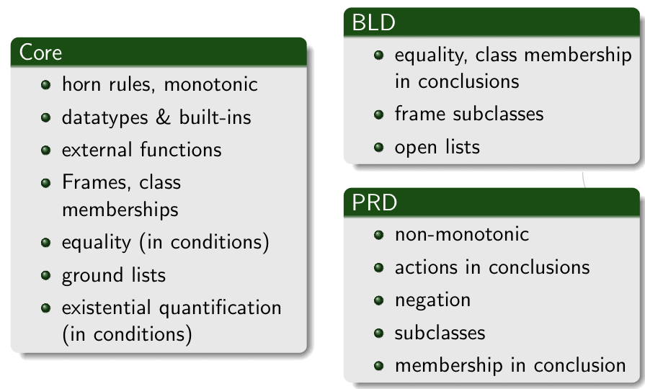
RIF Dialects
SPARQL1.1 so far only defines
Entailment for RIF Core… room for improvement (cf. e.g. Demo Obermeier et al. RR2010)
96

Slide 97
SPARQL1.1 + RIF Core + RDFS/OWL
RIF Core allows to encode RDFS, e.g.:
RIF Core allows to encode OWL2 RL, e.g. :
Plus more (custom rules, including Built-ins):
rdfs1: { ?S rdf:type ?C } :- { ?S ?P ?O . ?P rdfs:domain ?C . }
rdfs2: { ?O rdf:type ?C } :- { ?S ?P ?O . ?P rdfs:range ?C . }
rdfs3: { ?S rdf:type ?C2 } :- {?S rdf:type ?C1 . ?C1 rdfs:subclassOf ?C2 . }
owl1: { ?S1 owl:SameAs ?S2 } :-
{ ?S1 ?P ?O . ?S2 ?P ?O . ?P rdf:type owl:InverseFunctionalProperty}
owl2: { ?Y ?P ?O } :- { ?X owl:SameAs ?Y . ?X ?P ?O }
owl3: { ?S ?Y ?O } :- { ?X owl:SameAs ?Y . ?S ?X ?O }
owl4: { ?S ?P ?Y } :- { ?X owl:SameAs ?Y . ?S ?P ?X }
{?X foaf:name ?FullN } :- { ?X foaf:firstName ?F. ?X foaf:lastName ?L }
AND ?FullN = fn:concat(?F, " ", ?L)
<http://ruleset1.rif>
97

Slide 98
How to reference to a RIF Ruleset from SPARQL?
In OWL Entailment Regime, OWL is assumed to be part of the RDF Graph (OWL/RDF)
RIF’s so far only a normative syntax is RIF/XML
  RIF encoding in RDF (RIF/RDF) underway:
  http://www.w3.org/2005/rules/wiki/RIF_In_RDF
  Will also provide a new RDF property rif:usedWithProfile to import RIF rulesets (in RIF/XML or RIF/RDF). e.g.
In current draft called rif:imports
  <http://ruleset1.rif> rif:usedWithProfile
  <http://www.w3.org/ns/entailment/Simple> .
  <http://dblp.l3s…/Tim_Berners-Lee>
  foaf:homepage <http://www.w3.org/People/Berners-Lee/> ;
  foaf:name "Tim Berners-Lee" .
  <http://www.w3.org/People/Berners-Lee/card#i>
  foaf:homepage <http://www.w3.org/People/Berners-Lee/> ;
  foaf:firstName "Timothy”;
  foaf:lastName "Berners-Lee" .
?P | ?N
<dblp/Tim> | Tim Berners-Lee
?P | ?N
<dblp/Tim> | Tim Berners-Lee
<w3/B-Lee/card#i> | Tim Berners-Lee
<dblp/Tim> | Timothy Berners-Lee
<w3/B-Lee/card#i> | Timothy Berners-Lee
  SELECT ?P ?N { ?P foaf:name ?N }
w/o RIF Entailment…
98

Slide 99
SPARQL1.1 + RIF Core Challenges
Semantics:
  Relatively Straightforward: BGPs matching defined as being RIF-RDF-entailed by RDF data graph in combination with the referenced ruleset.
Infinite answers possible
  (even though RIF Core has no function symbols):
So far (as opposed to SPARQL/OWL SPARQL/RDFS) no restrictions on finiteness in SPARQL1.1/RIF
  Finite answers up to the user, or
  Restrict to strongly safe RIF Core (inspired by [Eiter et al. 2006] or
  System streams out answers (e.g. a la Prolog)
  :a :b 1 .
  {?S ?P (?O + 1) } :- {?S ?P ?O } .
  SELECT ?O { :a :b ?O .}
99

Slide 100
Wrapping up
SPARQL 1.0
  UNIONs of Conjunctive Queries, FILTERs, GRAPH queries, OPTIONAL, (hidden) negation
  contributed largely to the current Linked Data boom
  Inspired interesting academic work
SPARQL 1.1
  A reasonable next step
    Incorporating highly demanded features
    Closing the gaps to neighbour standards (OWL2, RIF)
  Not all of it is trivial → SPARQL1.1 takes a very pragmatic path
Hopefully inspiring for more research, more data, and more applications!
100

Slide 101
What I didn’t talk about…
List of agreed features:
Additions to the Query Language:
  Project Expressions
  Aggregate functions
  Subqueries
  Negation
  Property Paths (time permitting)
  Extend the function library (time permitting)
  Basic federated Queries (time permitting)
Entailment (time permitting)
SPARQL Update
  Full Update language
  plus simple RESTful update methods for RDF graphs (HTTP methods)
Service Description
  Method for discovering a SPARQL endpoint’s capabilities
  Summary of its data
101

Slide 102
Extended Function Library
Functions Library in SPARQL1.0 is insufficient:
  Bound( . )
  isLiteral( . )
  isBlank( . )
  isIRI( . )
  Str( . )
  Regex( . , .)
  +,-,*, <, >, =
New functions to be included in standard library:
  COALESCE, IF
  Functions from the Xpath/Xquery function library
    String manipulation, more math, etc. … e.g. fn:concat
Essentially: rubber-stamp common functions present in current implementations
102

Slide 103
  Basic federated Queries (time permitting)
http://www.w3.org/TR/sparql11-federated-query/
  Will be integrated in Query spec
Essentially new pattern SERVICE
  Similar to GRAPH
  allows delegate query parts to a specific (remote) endpoint
Recall: We were cheating in this query before!!
PREFIX foaf: <http://xmlns.com/foaf/0.1/>
SELECT ?N
WHERE {
{ <http://www.w3.org/People/Berners-Lee/card#i> foaf:knows ?F .
?F foaf:name ?N }
UNION
{ [ foaf:maker <http://dblp.l3s.de/…/authors/Tim_Berners-Lee>,
[ foaf:name ?N ] ] . }
}
Tim’s FOAF
file
DBLP SPARQL endpoint
103

Slide 104
  Basic federated Queries (time permitting)
http://www.w3.org/TR/sparql11-federated-query/
  Will be integrated in Query spec
Essentially new pattern SERVICE
  Similar to GRAPH
  allows delegate query parts to a specific (remote) endpoint
PREFIX foaf: <http://xmlns.com/foaf/0.1/>
SELECT ?N
FROM <http://www.w3.org/People/Berners-Lee/card>
WHERE {
{ <http://www.w3.org/People/Berners-Lee/card#i> foaf:knows ?F .
?F foaf:name ?N }
UNION
{ SERVICE <http://dblp.l3s.de/d2r/sparql>
{ [ foaf:maker <http://dblp.l3s.de/…/authors/Tim_Berners-Lee>,
[ foaf:name ?N ] ] . } }
}

Slide 105
  Basic federated Queries (time permitting)
ISSUES:
  treatment of variables in SERVICE
SERVICE ?v { P }
  Alternatives for semantics:
    “FILTER-Style”: evaluate SERVICE patterns last within a group, but probably needs to forbid interactions between several SERVICE PATTERNS within the same group:
    E.g. { SERVICE ?X { :S :P ?Y } SERVICE ?Y { :S :P ?X } }
    OPTIONAL Style: evaluate bindings in place (non-compositional)
    GRAPH style: i.e. define an extension of RDF dataset including a “service set”

Slide 106
Basic Federated Queries - BINDINGS
Sometimes you want to “inject” or “fix” some bindings into the query to be sent to an external endpoint.
Goal: reduce data to be transferred:
Example:
… WHERE { ?s :p2 ?v2 } BINDINGS ?s ?v1 { ( <s1> 7 ) ( <s2> UNBOUND ) }
Join( [ { ?s⇒<s1> ?v1⇒7 }
{ ?s⇒<s2> } ],
BGP (?s :p2 ?v2) )
Note: does NOT really allow to inject variable bindings, only constants! → remains compositional

Slide 107
Basic Federated Queries - BINDINGS
Sometimes you want to “inject” or “fix” some bindings into the query to be sent to an external endpoint.
Goal: reduce data to be transferred:
Example:
… WHERE { ?s :p2 ?v2 } BINDINGS ?s ?v2 { ( <s1> 7 ) ( <s2> UNBOUND ) }
… WHERE { { ?s :p2 ?v2 }
{ {SELECT ( <s1> AS ?s ) ( 7 AS ?v2 ) WHERE {} }
UNION
{SELECT ( <s2> AS ?s ) WHERE {} }
➔ doesn’t add expressivity…

Slide 108
SPARQL1.1 Update
Like SQL … SPARQL/RDF Stores need a standard Data Manipulation Languagehttp://www.w3.org/TR/sparql11-update/
SPARQL 1.1 Update Language
  Graph Update
    INSERT DATA
    DELETE DATA
    DELETE/INSERT
    DELETE
    INSERT
    DELETE WHERE
    LOAD
    CLEAR
  Graph Management
    CREATE
    DROP
Issue: Graph-aware stores vs. Quad Stores
108

Slide 109
Service Description
Base vocabulary to describe
features of SPARQL endpoints
datasets (via vocabularies external to the Spec,e.g. VOID)
http://www.w3.org/TR/sparql11-service-description/
3.2 Classes
3.2.1 sd:Service
3.2.2 sd:Language
3.2.3 sd:Function
3.2.4 sd:Aggregate
3.2.5 sd:EntailmentRegime
3.2.6 sd:EntailmentProfile
3.2.7 sd:GraphCollection
3.2.8 sd:Dataset
3.2.9 sd:Graph
3.2.10 sd:NamedGraph
3.3 Instances
3.3.1 sd:SPARQL10Query
3.3.2 sd:SPARQL11Query
3.3.3 sd:SPARQL11Update
3.3.4 sd:DereferencesURIs
3.3.5 sd:UnionDefaultGraph
3.3.6 sd:RequiresDataset
3.3.7 sd:EmptyGraphs
3.4 Properties
3.4.1 sd:url
3.4.2 sd:feature
3.4.3 sd:defaultEntailmentRegime
3.4.4 sd:supportedEntailmentProfile
3.4.5 sd:entailmentRegime
3.4.6 sd:extensionFunction
3.4.7 sd:extensionAggregate
3.4.8 sd:languageExtension
3.4.9 sd:supportedLanguage
3.4.10 sd:propertyFeature
3.4.11 sd:defaultDatasetDescription
3.4.12 sd:availableGraphDescriptions
3.4.13 sd:resultFormat
3.4.14 sd:defaultGraph
3.4.15 sd:namedGraph
3.4.16 sd:name
3.4.17 sd:graph

Slide 110

Please comment!!!
Chair-hat on: Pleeeeeease
Read the specs!
Send us comments public-rdf-dawg-comments@w3.org
110

Slide 111
References
[Alkhateeb et al. 2009] Faisal Alkhateeb, Jean-Francois Baget, and Jerome Euzenat. Extending SPARQL with regular expression patterns (for querying RDF). JWS, 7(2), 2009.
[Angles & Gutierrez, 2008] Renzo Angles and Claudio Gutierrez. The expressive power of SPARQL, ISWC 2008.
[Eiter et al. 2006] Thomas Eiter, Giovambattista Ianni, Roman Schindlauer and Hans Tompits. Effective Integration of Declarative Rules with External Evaluations for Semantic-Web Reasoning, ESWC 2006.
[Perez et al. 2006] Jorge Perez, Marcelo Arenas, Claudio Gutierrez. Semantics and complexity of SPARQL. ISWC 2006.
[Perez et al. 2009] Jorge Perez, Marcelo Arenas, Claudio Gutierrez. Semantics and complexity of SPARQL. ACM ToDS 34(3), 2009.
[Perez et al. 2008] Jorge Perez, Marcelo Arenas, and Claudio Gutierrez. nSPARQL: A navigational language for RDF. In 7th International Semantic Web Conference, ISWC 2008.
[Polleres 2007] Axel Polleres From SPARQL to Rules (and back). WWW 2007
[Polleres et al. 2007] Axel Polleres,Francois Scharffe,and Roman Schindlauer. SPARQL++ for mapping between RDF vocabularies. ODBASE 2007.
[Schmidt et al. 2010] Michael Schmidt, Michael Meier, and Georg Lausen. Foundations of sparql query optimization. ICDT2010

Slide 112
Relevant W3C Specs
SPARQL Query Language for RDF http://www.w3.org/TR/rdf-sparql-query/
SPARQL1.1 Query Language for RDF (working draft) http://www.w3.org/TR/sparql11-query/
SPARQL1.1 Entailment Regimes (working draft) http://www.w3.org/TR/sparql11-entailment/
RDF(S) Entailment/D-Entailment:
RDF Semantics http://www.w3.org/TR/rdf-mt/
OWL Entailment:
OWL2 Web Ontology Language Primer http://www.w3.org/TR/owl2-primer/
OWL2 Web Ontology Language Profiles http://www.w3.org/TR/owl2-profiles/
RIF Entailment:
RIF Core Dialect http://www.w3.org/TR/rif-core/
RIF Basic Logic Dialect http://www.w3.org/TR/rif-bld/
RIF RDF and OWL compatibility http://www.w3.org/TR/rif-rdf-owl/
112

Slide 113
Acknowledgements
The members of the W3C SPARQL WG, particularly Lee Feigenbaum, who I stole some examples from
The members of the W3C RIF WG
The RR2010 chairs for inviting me ☺
113

Slide 114
(backup-slides) Some own work…
GiaBATA
Implementing SPARQL, OWL2RL, RIF on top of DLV
114

Slide 115
GiaBATA
A system which implements dynamic SPARQL querying, under different entailment regimes and how it can be implemented.
Based on LP engine DLV
  Datalog with built-ins (covers roughly RIF Core),
  persistent Database backend (DLV-DB)
  Optimisations (rewriting to push join processing into SQL as far as possible, magic sets,…)
  plus a lot more features (nonmonotonicity, aggregates, …)
Overall idea for SPARQL+RDFS/OWL2RL over RDF graphs:
  Translate OWL2RL to Datalog rules a la RIF, see above.
  Translate SPARQL query to Datalog [Polleres, 2007]
  Feed resulting program into a rules engine (DLV-DB) that runs over a Rel DB storing RDF graphs.
Check Details at [Ianni et al. 2009]:http://axel.deri.ie/~axepol/presentations/20091029iann-etal-ISWC2009_GiaBATA.pptx
115

Slide 116
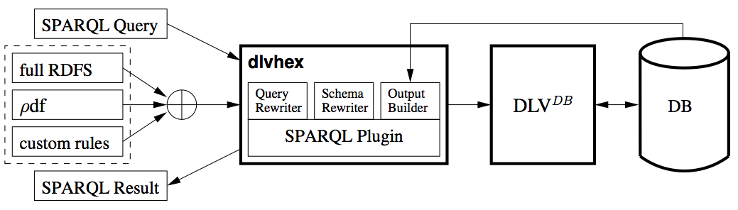
How to implement this?
GiaBATA system [Ianni et al., 2009]:
  SPARQL → dlvhex (logic program)‏
  Ruleset → dlvhex (logic program)
Deductive Database techniques:
  Datalog engine (dlvhex)‏
  Postgres SQL Database underneath (dlv-db)‏
  RDF storable in different schemas in RDB
  Magic sets, storage
→ SQL
116

Slide 117
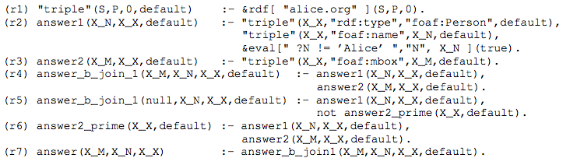
SPARQL → dlvhex (logic program)‏
Based on [Polleres 2007]
Non-recursive Datalog with negation and built-ins:
117

Slide 118
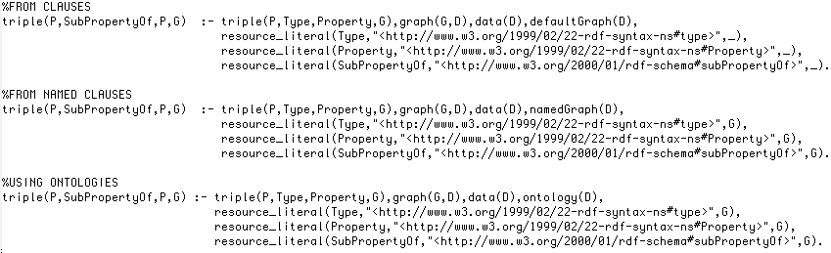
OWL2RL Static Ruleset → dlvhex (logic program)‏
Straighforward, just translates rules in a way “compatible” with the SPARQL translation:
{?s ?q ?o } <= {?s ?p ?o . ?p rdfs:subPropertyOf ?q}
118

Slide 119
SPARQL+Rules → SQL
Done by dlv-DB, cf. [Terracina, et al.,2008]
  All non-recursive parts are pushed to the Database
  All recursive parts handled by semi-naïve evaluation
  (more efficient than WITH RECURSIVE views in SQL, where necessary, intermediate results temporarily materialized into the DB)‏
Some necessary optimisations to make this reasonably performant:
  FILTER expression evaluation is pushed to SQL (3-valued semantics of SPARQL Filters is handled natively in SQL)‏
  No miracles… but magic: Magic set optimisations for focused fwd-chaining evaluation.
  Join-reordering based on statistics/selectivity e.g. a la [Vidal et al. 2009], not yet implemented, but we did some manual reordering to optimize the query plan in the experiments.

Slide 120
Extending GiaBATA to SPARQL1.1 – Future Work
OWL2RL and RIF Entailment, done, but doesn’t yet consume RIF directly:
  Integration with RIF-plugin [Obermeier et al. RR2010] planned
SPARQL1.1 features:
Subqueries , doable (however: modulo solution modifiers)
NOT EXISTS, MINUS, doable
Property Path Expressions, doable
Aggregates, probably doable, cf. [Polleres et al. 2007], [Faber et al. 2004]
120

Slide 121
Additional References
[Ianni et al., 2009] G. Ianni, T. Krennwallner, A. Martello, A. Polleres. Dynamic querying of mass-storage RDF data with rule-based entailment regimes. ISWC2009
[Obermeier et al. 2010] Philipp Obermeier, Marco Marano and Axel Polleres - Processing RIF and OWL2RL within DLVHEX. RR2010 – System Demo.
[Terracina, et al.,2008] Terracina, G., Leone, N., Lio, V., Panetta, C.: Experimenting with recursive queries in database and logic programming systems. Theory Pract. Log. Program. 8(2) (2008) 129–165.
[Vidal et al. 2010] M.-E. Vidal, E. Ruckhaus, T. Lampo, A. Marínez, J. Sierra, A. Polleres. On the efficiency of joining group patterns in SPARQL queries. ESWC2010
Additional Acknowledgements:
Giovambattista Ianni, Alessandra Martello, Thomas Krennwallner, Philipp Obermeier

