Slide 1
OWL: Yet to Arrive on the Web of Data? Birte Glimm, Aidan Hogan, Markus Krötzsch, Axel Polleres

Slide 2
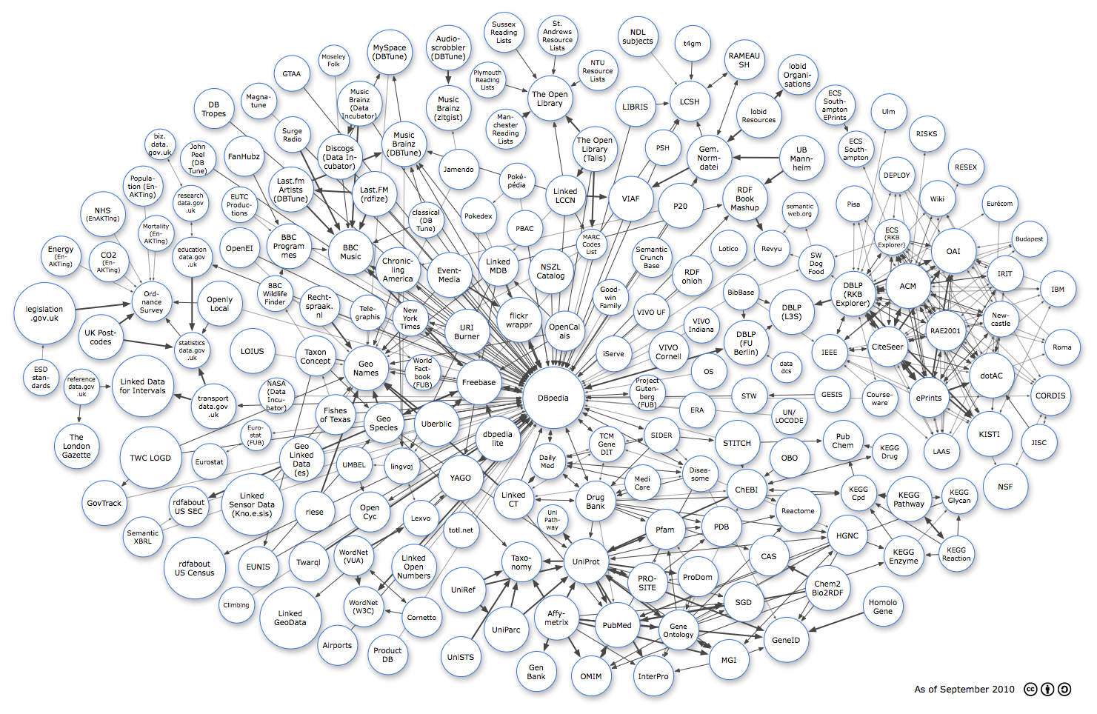
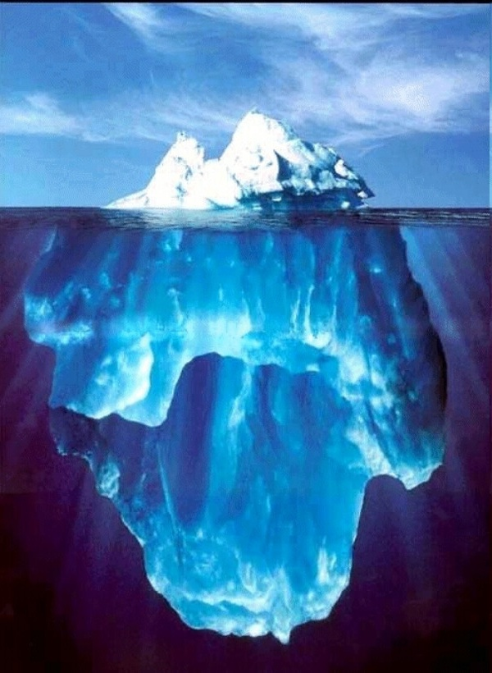
A Web beyond Data?
+ OWL
explicit data
implicit data

Slide 3
WHY LINKED DATA NEEDS OWL…
(…now …or at least something like OWL.)

Slide 4
How to answer a simple little question…
foaf:page
Gimme webpages
relating to
Tim Berners-Lee
timbl:i
timbl:i foaf:page ?pages .

Slide 5
Hetereogenity in schema…
webpage: properties
= rdfs:subPropertyOf
mo:musicBrainz
= owl:inverseOf
doap:homepage
mo:myspace
…
foaf:homepage
foaf:weblog
foaf:primaryTopic
foaf:isPrimaryTopicOf
foaf:topic
foaf:page

Slide 6
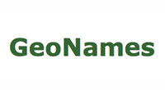
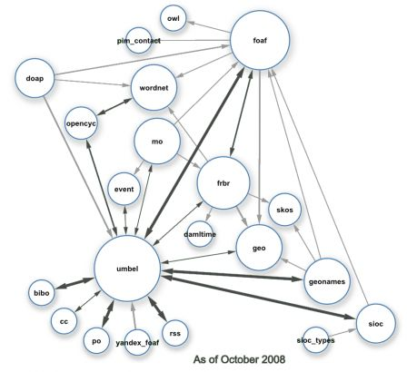
Linked Data, RDFS and OWL: Linked Vocabularies
…
SKOS
…
Image from http://blog.dbtune.org/public/.081005_lod_constellation_m.jpg:; Giasson, Bergman

Slide 7
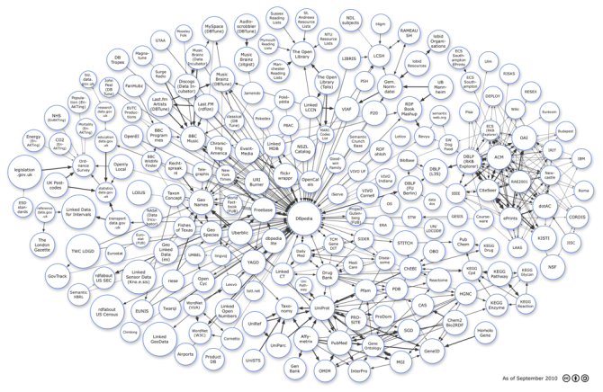
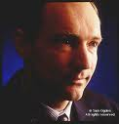
Naming in Linked Data: Linked Resources
Tim Berners-Lee: URIs
dblp:100007
timbl:i
db:Tim-Berners_Lee
identica:45563
= owl:sameAs
…
fb:en.tim_berners-lee
adv:timbl

Slide 8
Need (some) OWL reasoning…
SKOS
mo:myspace
foaf:primaryTopic
foaf:page
foaf:topic
doap:homepage
foaf:homepage
Gimme webpages
relating to
Tim Berners-Lee
foaf:isPrimaryTopicOf
identica:45563
adv:timbl
db:Tim-Berners_Lee
dblp:100007
fb:en.tim_berners-lee
timbl:i
timbl:i foaf:page ?pages .
... 7 x 6 = 42 possible patterns

Slide 9
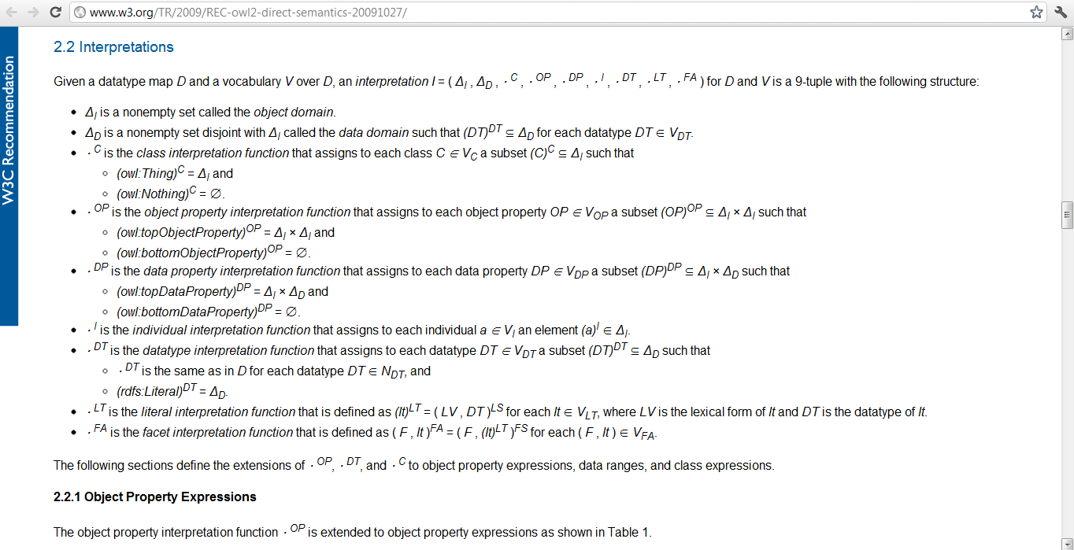
…BUT OWL iS HARD
(…to learn, to understand, to implement, to compute, to teach, to represent in RDF, to publish, to parse, to use appropriately...)

Slide 10
MAYBE LINKED DATA only NEEDS a LITTLE OWL…
(…for now)

Slide 11
So what OWL is used out there?
Looked at Billion Triple Challenge 2011 Dataset
2.1 billion quadruples, crawled from…
7.4 million RDF/XML documents, covering…
791 (pay-level) domains
Count OWL features used in the dataset:
Per use
Per document
Per domain
Can be skewed by data
Ranked OWL features using PageRank:
Rank documents based on dereferenceable links
For each OWL feature, sum the rank of documents using it
Intuition: Approximates probability of encountering an OWL feature during a random walk of the data

Slide 12
Results of ranking (see paper for all details)
1 rdf:Property 5.74E-1
2 rdfs:range 4.67E-1
3 rdfs:domain 4.62E-1
4 rdfs:subClassOf 4.60E-1
5 rdfs:Class 4.45E-1
6 rdfs:subPropertyOf 2.35E-1
7 owl:Class 1.74E-1
8 owl:ObjectProperty 1.68E-1
9 rdfs:Datatype 1.68E-1
10 owl:DatatypeProperty 1.65E-1
11 owl:AnnotationProperty 1.60E-1
12 owl:FunctionalProperty 9.18E-2
13 owl:equivalentProperty 8.54E-2
14 owl:inverseOf 7.91E-2
15 owl:disjointWith 7.65E-2

Slide 13
Results of ranking (see paper for all details)
…
16 owl:sameAs 7.29E-2
17 owl:equivalentClass 5.24E-2
18 owl:InverseFunctionalProperty 4.79E-2
19 owl:unionOf 3.15E-2
20 owl:SymmetricProperty 3.13E-2
21 owl:TransitiveProperty 2.98E-2
22 owl:someValuesFrom 2.13E-2
23 rdf:_* 1.42E-2
24 owl:allValuesFrom 2.98E-3
25 owl:minCardinality 2.43E-3
26 owl:maxCardinality 2.14E-3
27 owl:cardinality 1.75E-3
28 owl:oneOf 4.13E-4
29 owl:hasValue 3.91E-4
owl:intersectionOf 3.37E-4
31 owl:NamedIndividual 3.37E-4

Slide 14
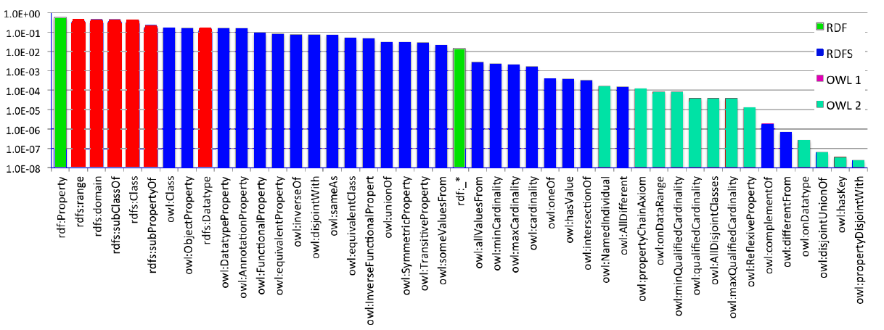
Observations?
RDFS features amongst the most prominently used
OWL 2 features not yet used prominently
RDF | RDFS | OWL | OWL 2
x-axis is log-scale!

Slide 15
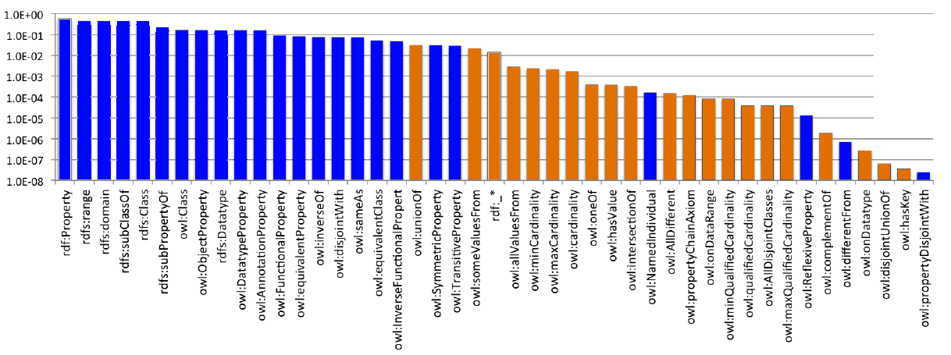
Observations?
(OWL) Features expressed with a single RDF triple are most prominent
Roughly speaking, features not requiring blank nodes
e.g., sub-class/-property, inverse-of, equivalent property/class, sameas, domain/range, disjoint with, etc.
Not those requiring lists or n-ary predicate in RDF mapping
e.g., union, intersection, cardinalities, all-disjoint, some/all/has-value restrictions, hasKey, pCAs, etc.
Single Triple (No BNodes) | Multi-Triple (Needs BNodes)
x-axis is log-scale!

Slide 16
Datatype Analysis?
dateTime, boolean, integer, string, date, long, anyURI, int, float, gYear in top ten (resp.)
Various OWL2 datatypes not used at all
Some sites use custom (but undefined) datatypes
See paper for details!

Slide 17
WHAT ABOUT TOOL SUPPORT?

Slide 18
Tool support?
OWL Libraries for parsing, etc., not much choice:
OWL API, Protegé, Jena … (all heavyweight Java libs)
Has to do with multi-triple axioms!
Query engines with reasoning support
Many support non-standard profiles or partially support a profile
Most use rule-based engines
Datatype support rarely complete (mostly by canonicalization)

Slide 19
SO WHAT ABOUT THAT LITTLE OWL?
…that’s sufficient for current Linked Data trends.

Slide 20
Introducing OWL LD (Linked Data)
Define a new sub-profile of OWL RL that includes only those features expressible as a single triple:
Easy to parse / process tuple-at-a-time ✔
Easy to publish ✔
Easy to query ✔✔
Easy to validate / check well-formedness ✔✔
Covers most prominently used features! ✔✔✔
Miss some features, e.g., owl:unionOf₍₁₈₎ ✘(✘✘?)
OWL LD similar to other profiles (motivated from other perspectives)
RDFS-Plus(/RDFS 3.0): Allemang & Hendler. Semantic Web for the Working Ontologist.
L2: Fischer, Ünel, Bishop, Fensel. Towards a scalable, pragmatic knowledge representation language for the web. In Ershov Memorial Conf., pages 124–134, 2009.

Slide 21
Introducing OWL LD (Linked Data)
Define a subset of OWL 2 RL/RDF rules that apply for these features and that can be applied for any RDF graph
(see paper for full rule-list; includes 47 rules)
http://semanticweb.org/OWLLD/
Define a subset of OWL 2 RL grammar such that a conformant ontology/vocabulary can optionally be interpreted under Direct Semantics (and thus tools like PelletDB, QuOnTo, DLEJena, Protegé, HermiT, Racer, etc.)
http://semanticweb.org/OWLLD/

Slide 22
CONCLUSIONs?

Slide 23
Has OWL arrived on the Web of Data?
Partially…
RDFS features still most prominent
Many OWL features are prominently used
OWL 2 features currently not well adopted
Practical tool support emerging, but for different profiles of OWL
OWL LD:
Single-triple expressible features only
Prominently used; easier to support
Rules defined as a subset of OWL 2 RL/RDF
Grammar defined (if needed for OWL Direct Semantics)
Similar to RDFS-Plus, RDFS 3.0 and L2
(but motivated here based on an empirical survey)
How about a new OWL profile for Linked Data?

