Slide 1
SPARQL Update under RDFS Entailment in Fully Materialized and Redundancy-Free Triple Stores
Axel Polleres and Albin Ahmeti (TU Wien)
Contact: @AxelPolleres

Slide 2
Outline
Motivation – SPARQL1.1 Update & Entailment
State of the art – What do current triple stores do?
Our main contribution:
  Discuss possible Update&Entailment semantics
  Draw from query rewriting algorithm
Conclusions
Future work

Slide 3
Motivation (1/2)
Recent standardization of SPARQL 1.1 Update, and alongside the triple stores implementing it
Query rewriting techniques already explored in the context of DL-Lite and OBDA
Emerge the need for a more systematic approach of dealing with SPARQL 1.1 Update over TBox-es
Nothing endures but change. - Heraclitus

Slide 4
Motivation (2/2)
SPARQL1.1: DELETE{ … }
INSERT { … }
WHERE { …}
The need for Postulates:
  What does it mean if an implied triple is explicitly
    (re-)inserted, or
    deleted?
  Which (if any) additional triples should be
    inserted, or
    deleted
  upon updates?

Slide 5
State of the art
What do implementations do?
  Entailment typically only handled at (bulk) loading but not in the context of Updates.
  No “standard” behaviour for deletions: left out explicitly in the SPARQL 1.1 spec
Current approaches in the literature limited either to DELETE or INSERT operations…
…but no combined treatment of DELETE + INSERT + BGP matching in the WHERE clause as in SPARQL1.1 Update
Orthogonal to our approach
  Gutierrez et al. in the context of RDFS
  Calvanese et al. in the context of DL-Lite
Related to our approach
  Pichler et al., Complexity results of redundancy elimination under different (rule-based) entailment regimes
  Various works in classical AI and philosophy

Slide 6
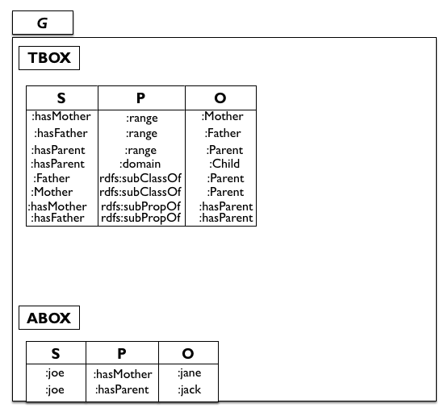

Slide 7
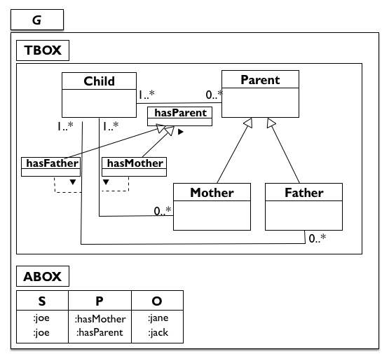
We consider the schema fixed

Slide 9
What should a triple store do in such a situation?
How to preserve a materialized/reduced store?

Slide 10
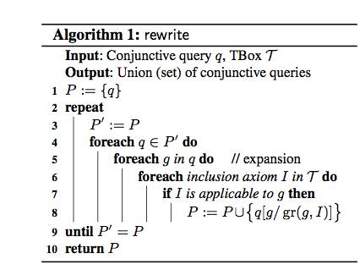
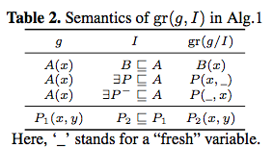
Query rewriting algorithms
Can we use/modify these for updates?
SELECT ?X WHERE
{ :joe :hasParent ?Y }
UNION
{ :joe :hasFather ?Y }
UNION
{:joe :hasMother ?Y }
SELECT ?X WHERE
{:joe :hasParent ?Y }
rewrite(q,T)

Slide 11
Observation:

Slide 12
Contribution:
Discuss possible update semantics in this context
Consider both Materialized and Redundancy-free stores
Even in our restricted setting this turns out to be challening:
Our setting:
  We allow ABox updates only, Tbox fixed
  Use pure RDFS as TBox language (without axiomatic triples, blank nodes)
  Restrict on BGPs to only allow Abox Insert/Deletes
INSERT {:joe :hasFather ?Y }
WHERE
{:joe :hasParent ?Y }
INSERT {:joe ?Y :foo}
WHERE
{:joe rdf:type ?Y }

Slide 13
Overall Proposed update semantics
Materialized-preserving semantics
  (baseline semantics)
Redundancy-free preserving semantics
  (baseline semantics)

Slide 14
Baseline semantics
  Naïve Update followed by re-materialization
  Naïve update followed by re-reduce

Slide 17
Alternative Materialized-pres. semantics
  Delete the instantiations of 𝑃_{𝑑} plus all their causes;
  Insert the instantiations of 𝑃_{𝑖} plus all their effects.

Slide 20
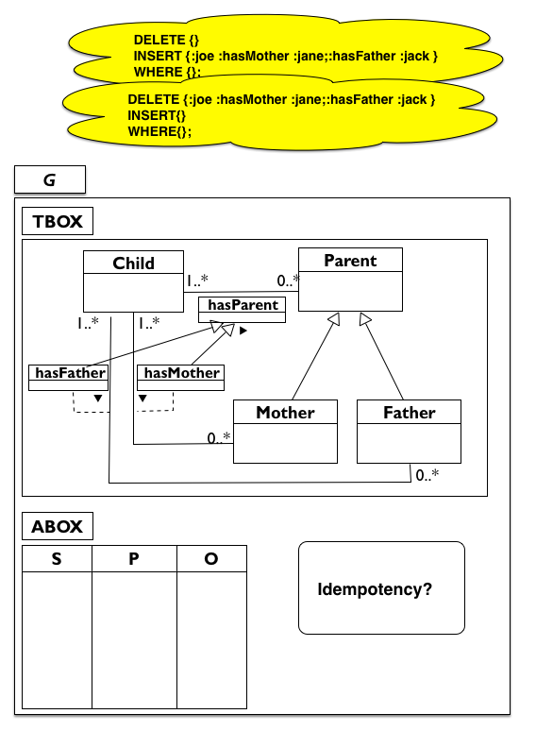

Slide 22
Alternative Materialized-pres. semantics
  Extends
  Additionally (recursively) delete “dangling” effects for instantiations of 𝑃_{𝑑}
    i.e. triples that would not be implied any longer by any non-deleted triples after deletion
    No formalization given yet, but let’s check the intuition…

Slide 24
To be detailed...
DELETE {joe a :Child. :joe :hasMother :jane.
:joe :hasParent :jane, :jack. …
:jane a Mother . :jane a :Parent .}
INSERT { :jane a :Mother . :jane a Parent . }
Recall: the intuition was to additionally delete triples that would not be implied any longer by any non-deleted triples after deletion.
?

Slide 25
Alternative reduced-pres. semantics
  Extends
  Delete the instantiations of 𝑃_{𝑑} plus all their causes;

Slide 27
Conclusions
This preliminary research is the first step to close the gap leaked by the current standards (SPARQL1.1 Update vs. SPARQL1.1 Entailment Regimes)
We looked into various materialized and reduce preserving semantics
  Seemingly no “one-size fits all” semantics
  Non-intuitive corner cases in each semantics
  → depends on use case?
SPARQL 1.1 Update, i.e. pairing DELETE and INSERT templates with a common WHERE clause (BGP matching) imposes a non-trivial challenge!

Slide 28
Future work
Extend with OWL QL/RL features for expressing TBox
  Benefit from a more expressive query language
  Query rewriting algorithms are widely explored
  Imposes new challenges such as dealing with inconsistencies
  Discuss complexity
Less restricted BGPs
  Any Tbox updates we could allow?
Implementation of proposed update semantics against the triple stores

