Slide 1
How (well) do Datalog, SPARQL and RIF interplay?
Axel Polleres (twitter: @AxelPolleres)
12/12/2013 Informatik-Kolloqium, Innsbruck

Slide 2
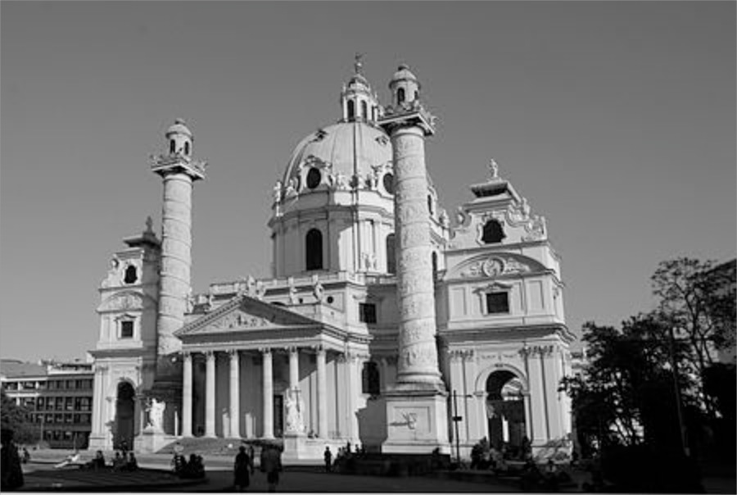
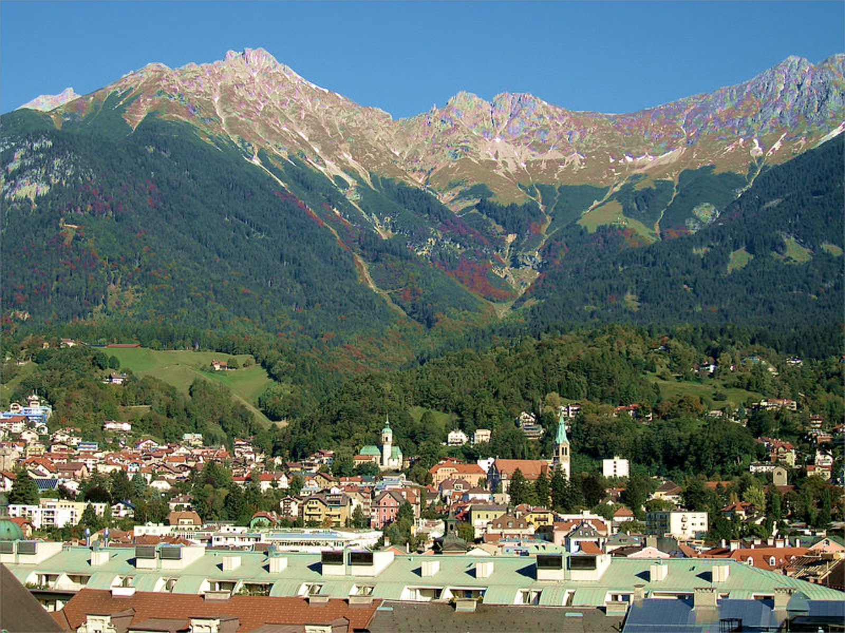
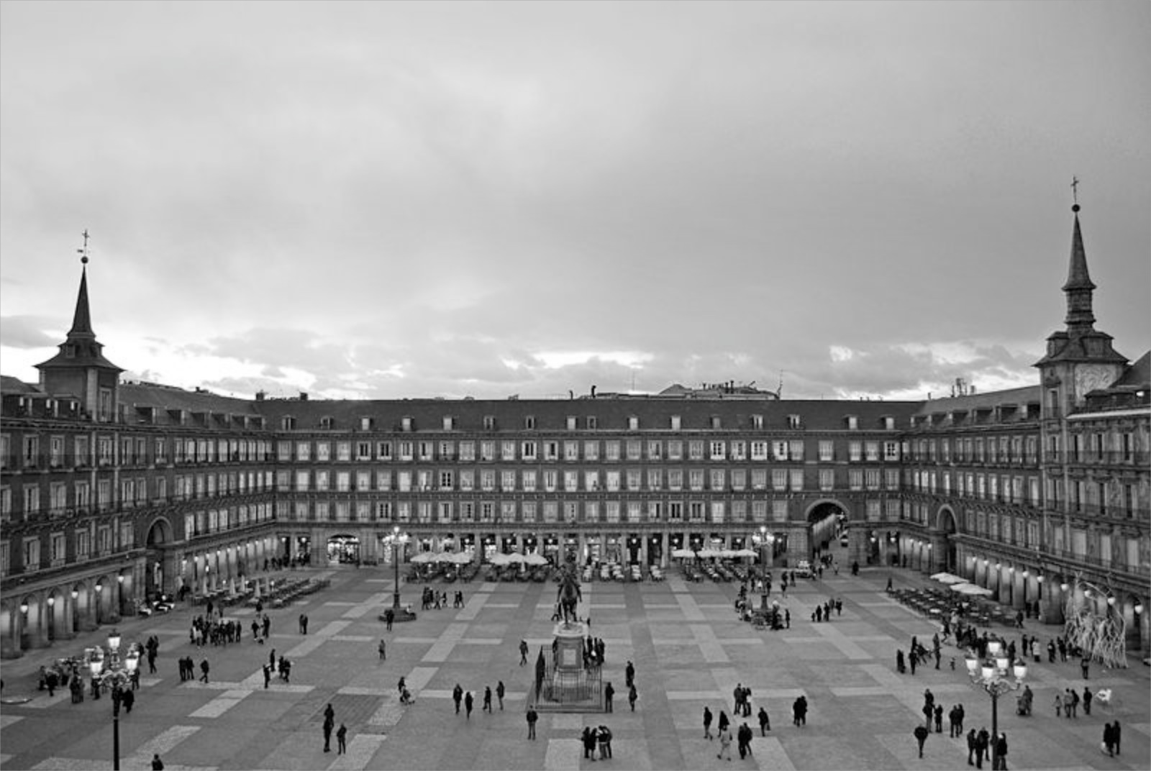
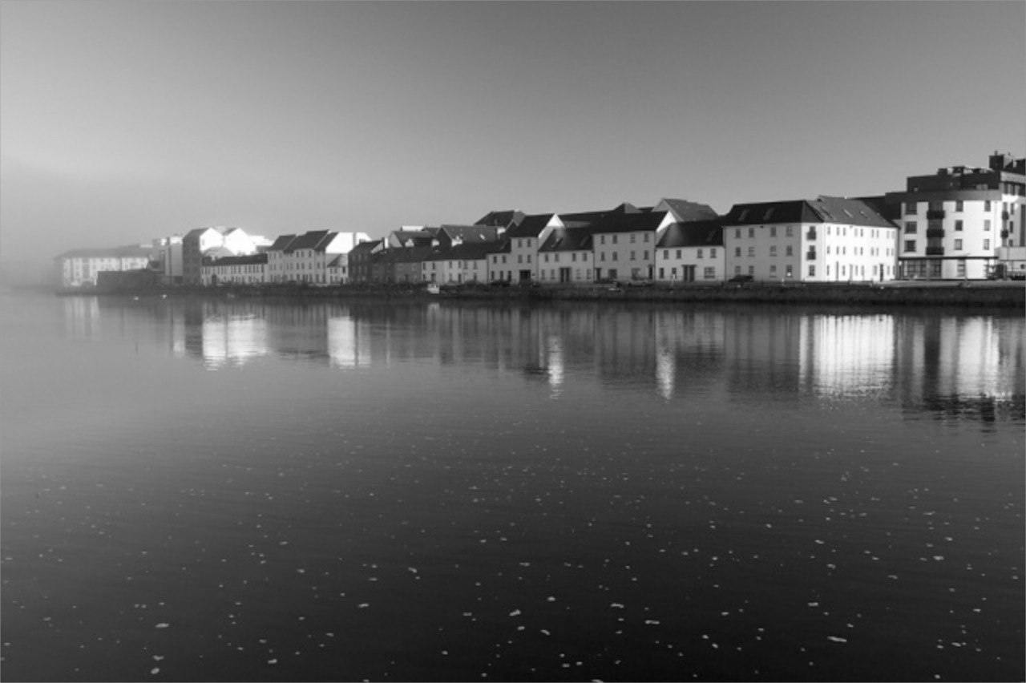
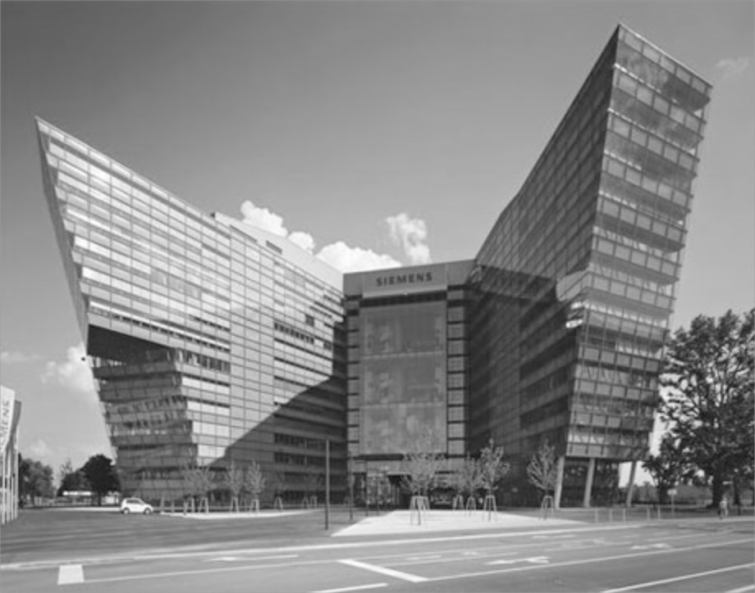

Career Path...
TU Wien
Univ. Innsbruck
Univ. Rey Juan Carlos Madrid
Wirschaftsuniversität Wien (WU)
DERI, NUI Galway, Ireland
Siemens AG Österreich
Notes:
1:37
(1:15)‏

Slide 3

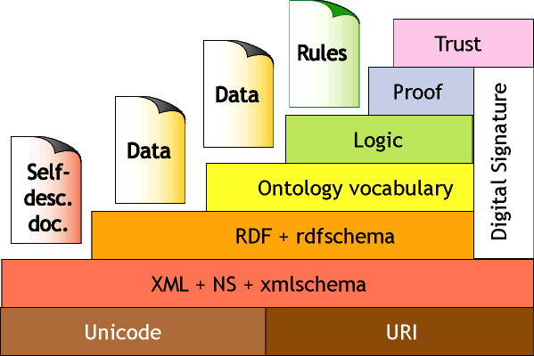
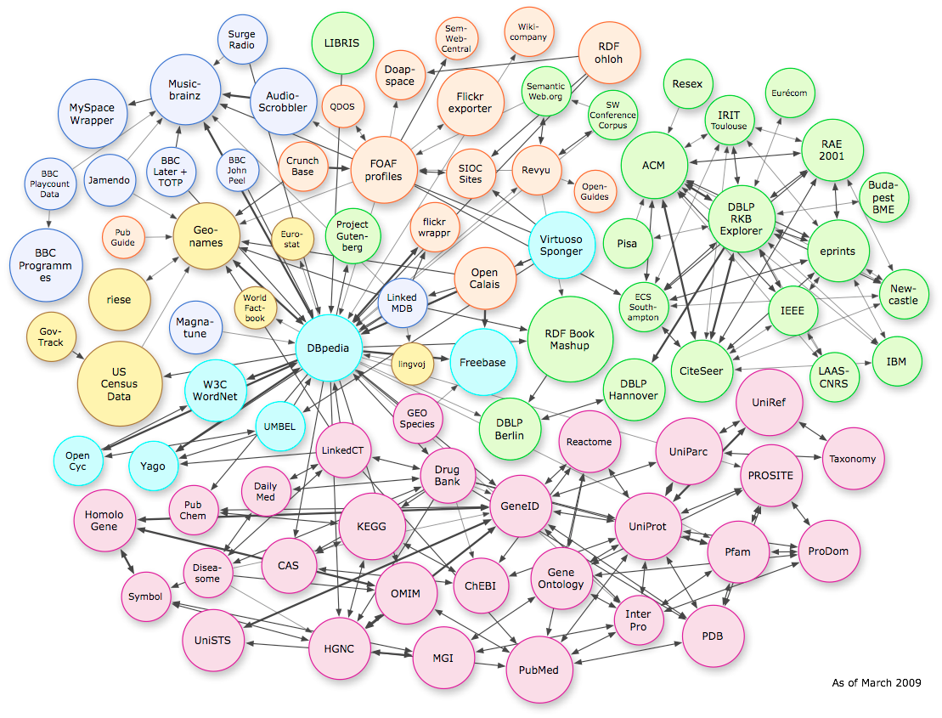

Introduction / Contents
What have You heard about
“Semantic Web Standards”?
  Many of you have probably heard about mostly OWL and Description Logics… not today.
  … in fact two other W3C standards related to Query Languages, namely Datalog:
  SPARQL – RDF Query language
  RIF – Rule Interchange Format
  In this Talk:
    How close are they to Datalog, where do they differ?
DESCRIPTION LOGICS

Slide 4
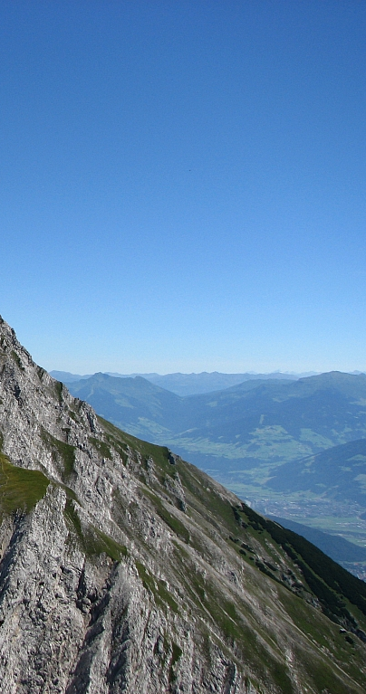
Semantic Web Standards?
Overview
  RDF and Datalog
  SPARQL and Datalog
  RIF and Datalog
  SPARQL1.1 and Datalog – What’s new?
© Siemens AG 2012. All rights reserved
http://de.wikipedia.org/wiki/Datei:Rumerspitze.jpg

Slide 5
RDF – The Resource Description Framework [W3C,2004]
dbpedia:Innsbruck dbpedia-ont:country dbpedia:Austria .
dbpedia:Innsbruck rdfs:label ”Innsbruck”@de .
_:x foaf:name ”Georg Moser" .
_:x foaf:based_near dbpedia:Innsbruck .
<http://dbpedia.org/resource/Innsbruck> <http://dbpedia.org/ontology/country>
<http://dbpedia.org/resource/Austria> .
<http://dbpedia.org/resource/Innsbruck> <http://www.w3.org/2000/01/rdf-schema#label>
”Innsbruck”@de .
_:x <http://xmlns.com/foaf/0.1/name> ”Georg Moser" .
_:x <http://xmlns.com/foaf/0.1/based_near> <http://dbpedia.org/resource/Innsbruck> .
Austria
country
Subject Predicate Object
Subject U U B
x
Predicate U
x
Object U U B U L
based_near
Ibk
label
”Innsbruck”@de
name
“Georg Moser”
URIs, e.g.
http://http://xmlns.com/foaf/0.1/name
http://dbpedia.org/resource/Innsbruck
http://dbpedia.org/resource/Austria
Various syntaxes, RDF/XML, Turtle, N3, RDFa,…
Blanknodes:
“existential variables in the data” to express incomplete information, written as _:x or []
Literals, e.g.
“2012”^^xsd:gYear
“Innsbruck”@de
“Tyrol”@en
“Georg Moser”

Slide 6
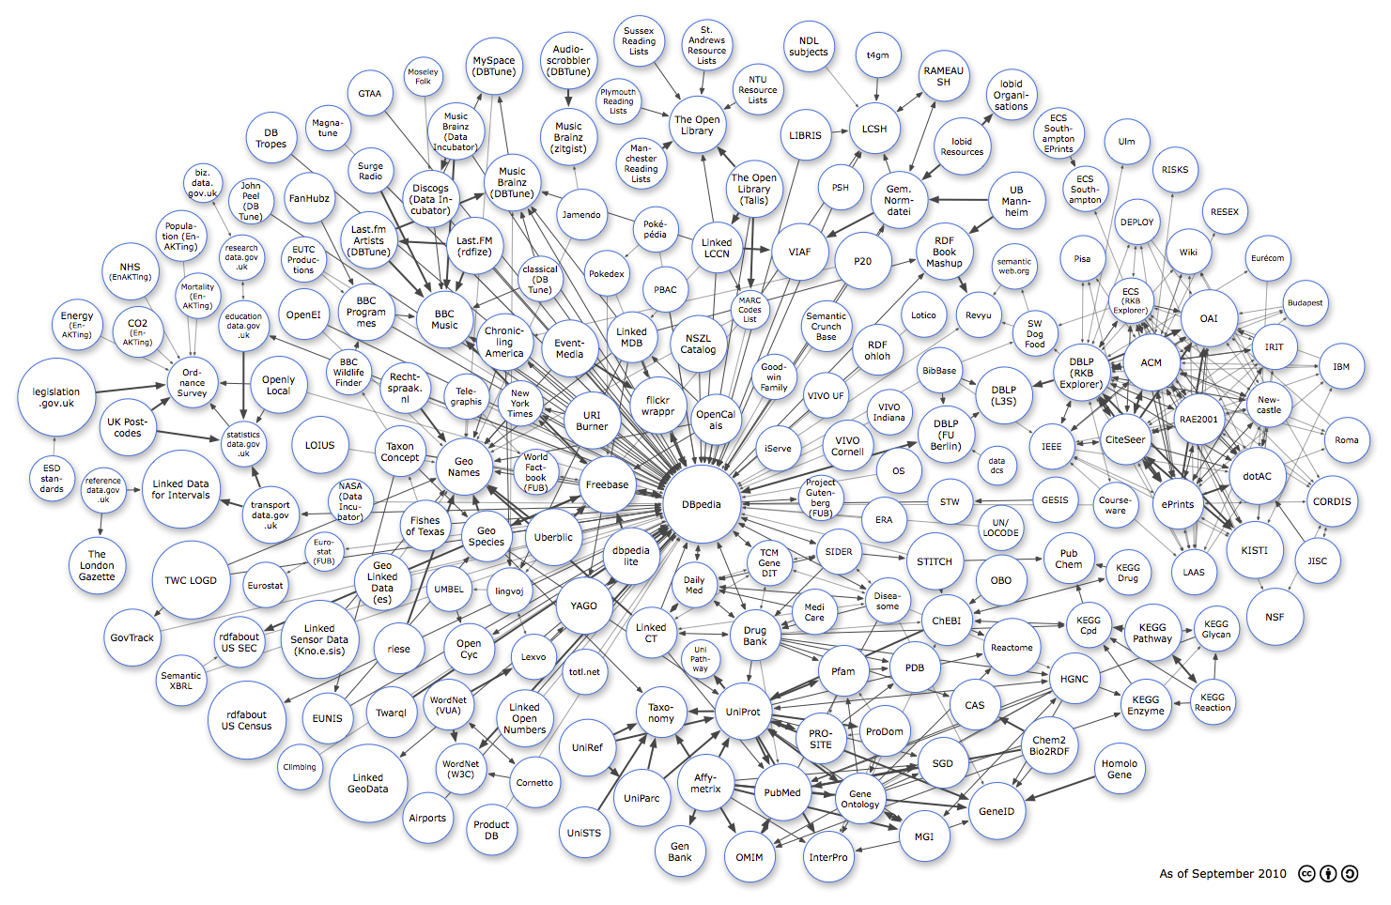









RDF – Adoption
6
Linking Open Data cloud diagram, by Richard Cyganiak and Anja Jentzsch. http://lod-cloud.net/

Slide 7
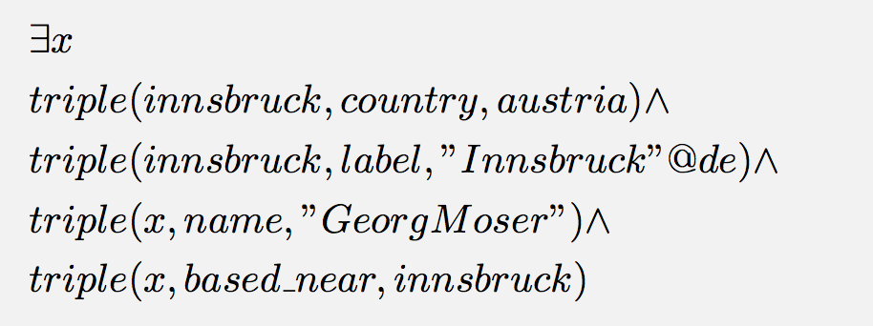
RDF in Datalog? (Almost) No problem
dbpedia:Innsbruck dbpedia-ont:country dbpedia:Austria .
dbpedia:Innsbruck rdfs:label ”Innsbruck”@de .
_:x foaf:name ”Georg Moser" .
_:x foaf:based_near dbpedia:Innsbruck .
Well
RDB (Datalog: EDB):
triple( innsbruck, country, austria ).
triple( innsbruck, label, “Innsbruck”@de ).
?
triple( b1, name, “Georg Moser”).
triple( b1, based_near, Innsbruck).
What about Blank nodes? …
… let’s just use local constants (“Skolemize”)

Slide 8
RDF Schema 1/2
dbpedia:Innsbruck dbpedia-ont:country dbpedia:Austria .
dbpedia:Innsbruck rdfs:label ”Innsbruck”@de .
_:x foaf:name ”Georg Moser" .
_:x foaf:based_near dbpedia:Innsbruck .
Even RDF Schema (RDFS) is easy with Datalog…
RDFS:
lightweight ontology language to infer new implicit information from RDF
formal semantics [W3C, 2004]
can be captured by (Datalog style) rules [W3C, 2004 §7], e.g. …
… with some caveats [ter Horst, 2005], [Muñoz+, 2009]
dbpediares:Austria rdf:type dbpedia-owl:Country .
_:x rdfs:label ”Georg Moser" .
foaf:name rdfs:subPropertyOf rdfs:label .
dbpedia-ont:country rdfs:range dbpedia-owl:Country .
IDB
triple( O, rdf:type, C) :- triple( P, rdf:range, C), triple(S,P,O) .
triple( S, Q, O) :- triple( P, rdfs:subPropertyOf, Q), triple(S, P, O) .

Slide 9
RDF Schema 2/2 – RDF(S) Entailment
Core problem described in RDF Semantics document is RDF(S) Entailment [W3C, 2004]
Is there a blank node homomorphism from G2 to G1 such that
RDFS Entailment checking can be easily done in Datalog [Bruijn&Heymans,2007], [Muñoz+, 2009] , [Ianni+, 2009], cf. also [Gutierrez+,2011].
?
G1
_:x foaf:name ”Georg Moser" .
foaf:name rdfs:subPropertyOf rdfs:label .
G2
_:x foaf:name ”Georg Moser" .
_:y rdfs:label ”Georg Moser" .
Encode G1 + RDFS Entailment rules in Datalog EDB+IDB
Encode G2 as boolean conjunctive query
triple(x, name, ”Reinhard” ) . triple(name rdfs:subPropertyOf, label).
EDB (G1)
triple( S, Q, O) :- triple( P,rdfs:subPropertyOf, Q), triple(S, P, O) .
...
IDB (RDFS)
answer :- triple(X, name,”Reinhard”), triple(Y, label, ”Reinhard” )
Query

Slide 10
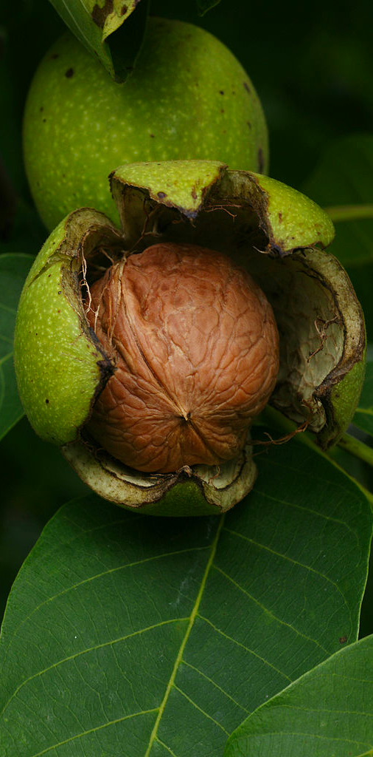
SPARQL1.0 [W3C, 2008] in a Nutshell...
Now how to query RDF?
… i.e.,
nonrecursive Datalog^{not} in a Nutshell...
[Angles, Gutierrez, 2008]
This Photo was taken by Böhringer Friedrich.

Slide 11
SPARQL + Linked Data give you
“Semantic search almost for free”
Query: Scientists born in Vienna? (Conjunctive Query)
How’d we do it in SQL?
Now how does it look in SPARQL?
SELECT t1.s
FROM triple t1, triple t2
WHERE t1.s = t2.s AND t1.p = dbpedia:birthPlace AND t1.o = Vienna
AND t2.p = rdf:type AND t2.o = dbpedia:Scientist
SELECT ?X
WHERE {
?X dbpedia:birthPlace <dbpedia.org/resource/Vienna> .
?X rdf:type dbpedia:Scientist.
}
Obiously, we know how to do that in Datalog...
answer(X) :-
triple( X, birthPlace , Vienna ) ,
triple( X, type , Scientist ) .
?X
dbpedia:birthPlace
dbpedia.org/resource/Vienna
rdf:type
dbpedia:Scientist
… and SPARQL looks quite similar!

Slide 12
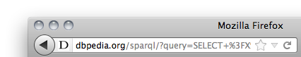
SPARQL – Standard RDF Query Language and Protocol
SPARQL 1.0 (2008):
  SQL “Look-and-feel” for the Web
  Essentially “graph matching” by basic graph patterns (BGPs)
  Allows conjunction (.) , disjunction (UNION), optional (OPTIONAL) patterns and filters (FILTER)
  Construct new RDF from existing RDF (CONSTRUCT)
  Solution modifiers (DISTINCT, ORDER BY, LIMIT, …)
  A standardized HTTP based protocol:
SELECT ?X
WHERE {
?X dbpedia:birthPlace <dbpedia.org/resource/Vienna> .
?X rdf:type dbpedia:Scientist.
}
Link

Slide 13
SPARQL Formal Semantics – Basic Graph Patterns [Perez et al. 2006]
Definition 1:
The evaluation of the BGP P over a graph G, denoted by eval(P,G), is the
set of all mappings μ: Var → V(G) such that:
dom(μ) is exactly the set of variables occurring in P and
μ(P)⊆G
Example RDF Graph (G):
:tim foaf:knows :jim .
:jim foaf:knows :tim .
:jim foaf:knows :juan .
Example Pattern (P):
SELECT * WHERE { ?X foaf:knows ?Y . }
eval(P,G) = { μ1 = { ?x → :tim , ?y → :jim } ,
μ2 = { ?x → :jim , ?y → :tim } ,
μ3 = { ?x → :jim, ?y → :juan }
?Y foaf:knows ?Z }.
{ μ1 = { ?x → :tim , ?y → :jim , ?z → :tim },
μ2 = { ?x → :jim, ?y → :tim , ?z → :jim } ,
μ3 = { ?x → :tim, ?y → :jim , ?z → :juan } }

Slide 14
SPARQL Algebra as per [Perez et al. 2006]
Definition 2:
mappings μ1, μ2 are compatible iff they agree in their shared variables.
Let M1, M2 be sets of mappings
Definition 3:
Join:
M1 M2 = { μ1∪μ2 | μ1∈ M1, μ2∈M2, and μ1, μ2 are compatible}
Union:
M1 ∪ M2 = { μ | μ ∈ M1 or μ ∈ M2}
Diff:
M1 \ M2 = {μ∈M1 | forall μ′ ∈M2, μ and μ′ are not compatible }
LeftJoin:
M1 M2 = (M1 M2) ∪ ( M1 \ M2 )
Filter:
M|_{R} = { μ | μ ∈ M and μ(R) = true}

Slide 15
Semantics full as per [Perez et al.2006]
eval(BGP,G) … see Definition 1
eval(P1 . P2,G) = eval(P1, G) eval(P2, G)
eval(P1 UNION P2,G) = eval(P1, G) ∪ eval(P2, G)
eval(P1 OPTIONAL P2, G) = eval(P1, G) eval(P2, G)
eval(P FILTER R,G) = eval(P, G) |_{R}
Example :
eval(P1,G) eval(P2,G)=
P = { ?X foaf:knows ?Y . ?Y foaf:knows ?Z }
X | Y
tim | jim
jim | tim
jim | juan
Y | Z
tim | jim
jim | tim
jim | juan
X | Y | Z
tim | jim | tim
tim | jim | juan
jim | tim | jim
=

Slide 16
Back to “real” SPARQL examples: UNION
Example RDF Graph:
:tim foaf:knows :jim .
:jim foaf:knows :tim .
:jim :worksWith :juan .
Example Query:
triple( :tim, knows, :jim ) .
triple( :jim, knows, :tim ) .
triple( :jim, worksWith, :juan ) .
SELECT ?X
WHERE {
{ :jim foaf:knows ?X }
UNION
{ :jim foaf:worksWith ?X }
}
evalP(X) :-
triple( :jim, knows, X ) .
evalP(X) :-
triple( :jim, worksWith, X ) .
answer(X) :- evalP(X).
X
tim
juan
X
tim
X
juan
U
=

Slide 17
Back to “real” SPARQL examples: UNION
Example RDF Graph:
:tim foaf:knows :jim .
:jim foaf:knows :tim .
:jim :worksWith :juan .
Example Query:
triple( :tim, knows, :jim ) .
triple( :jim, knows, :tim ) .
triple( :jim, worksWith, :juan ) .
SELECT ?X ?Y
WHERE {
{ :jim foaf:knows ?X }
UNION
{ :jim foaf:worksWith ?Y }
}
answer(X) :- evalP(X).
evalP(X) :-
triple( :jim, knows, X ) .
evalP(Y) :-
triple( :jim, worksWith, Y ) .
answer(X,Y) :- evalP(X,Y).
evalP(X,null) :-
triple( :jim, knows, X ) .
evalP(null,Y) :-
triple( :jim, worksWith, Y ) .
X | Y
tim
 | juan
X | Y
tim | null
null | juan
X
tim
Y
juan
U
=

Slide 18
Back to “real” SPARQL examples: OPTIONAL
Give me people who know somebody and OPTIONALLY their email address:
:tim foaf:knows :jim . :tim :email <mailto:timbl@w3.org> .
:jim foaf:knows :tim .
:jim :worksWith :juan .
Example Query:
triple( :tim, knows, :jim ) . triple(:tim, email, timbl@w3.org ) .
triple( :jim, knows, :tim ) .
triple( :jim, worksWith, :juan ) .
evalP(X,Y,M) :- triple( X, knows, Y ) , triple( X, email, M) .
evalP(X,Y,null) :- triple( X, knows, Y ) , not evalP1(X) .
evalP1(X) :- triple( X, email, M) .
SELECT ?X ?M
WHERE {
{ ?X foaf:knows ?Y }
OPTIONAL
{ ?X :email ?M }
}
answer(X,M) :- evalP(X,Y,M) .
X | M
tim | timbl@w3.org
jim
X | Y
tim | jim
jim | tim
X | Y
tim | jim
jim | tim
X | Y | M
tim | jim | timbl@w3.org
jim | tim
X | M
tim | timbl@w3.org
U
\
X | M
tim | timbl@w3.org
= ?
=

Slide 19
ATTENTION:
needs to be handled with care!
Eval(P1,G)
Eval(P2,G)
X | Y
a | c
b
Y | Z
 | e
d | f
X | Y
a | c
b | null
Y | Z
null | e
d | f
evalP(X,Y,Z) :- evalP1( X, Y ) , evalP2( Y, Z) .
Doesn’t work!
Recall (Definition 3):
Join:
M1 M2 = { μ1∪μ2 | μ1∈ M1, μ2∈M2, and μ1, μ2 are compatible}
Rather:
evalP(X,Y,Z) :- evalP1( X, Y ) , evalP2( Y1, Z), join(Y,Y1) .
join(X,X) :- HU_G(X).
join(X,null) :- HU_G(X).
join(null(X) :- HU_G(X).
… where HU_G(X) is a predicate defining the Herbrand Universe of G.

Slide 20
FILTERs 1/3
doesn’t contain
Give me people with an email address where the email contains “w3”:
:tim foaf:knows :jim . :tim :email <mailto:timbl@w3.org> .
:jim foaf:knows :tim . :jim :email <mailto:hendler@cs.rpi.edu> .
:jim :worksWith :juan .
Example Query:
SELECT ?X ?M
WHERE { ?X :email ?M .
FILTER( Regex(Str(?M), “w3” ) }
SELECT ?X ?M
WHERE { ?X :email ?M .
FILTER( ! Regex(Str(?M), “w3” ) }
Complex FILTER expressions allowed ( !, &&, || )
X | M
jim | hendler@cs.rpi.edu
X | M
tim | timbl@w3.org

Slide 21
FILTERs 2/3
People who know someone & optionally their email where the email doesn’t contain “w3”:
:tim foaf:knows :jim . :tim :email <mailto:timbl@w3.org> .
:jim foaf:knows :tim . :jim :email <mailto:hendler@cs.rpi.edu> .
:juan foaf:knows :jim .
Example Query:
SELECT ?X ?M
WHERE { ?X :email ?M .
FILTER( Regex(Str(?M), “w3” ) }
SELECT ?X ?M
WHERE { ?X foaf:knows ?Y
OPTIONAL {?X :email ?M . }
FILTER( ! Regex(Str(?M), “w3” ) }
X | M
jim | hendler@cs.rpi.edu
X | M
tim | timbl@w3.org
Note: FILTERs are evaluated under
a three-values semantics!
(True, False, Error), e.g.
A | !A
T | F
F | T
E | E

Slide 22
FILTERs 3/3
A special FILTER function is bound() – Can be used to “encode” Negation as failure in SPARQL1.0:
Give me people without an email address:
What about Datalog?
SPARQL FILTERs can in principle be encoded in Datalog,
            need built-ins (or be pre-compiled for HU_{G})
            bound(X) can be encoded by X != null.
            need to encode three-valued semantics for !, &&, ||
SELECT ?X ?M
WHERE { ?X foaf:knows ?Y
OPTIONAL {?X :email ?M . }
FILTER( ! bound(?M) ) }

Slide 23
SPARQL 1.0 = nonrecursive Datalog^{not}
[Polleres, 2007] shows that all of SPARQL 1.0 can be translated to (safe) nonrecursive Datalog^{not}.
In fact, [Angles&Gutierrez 2008] vice versa show that (safe) nonrecursive Datalog^{not} likewise be encoded into SPARQL.
PSPACE Program-Complexity for SPARQL 1.0 follows from
[Perez et al. 2006] or alternatively
[Angles&Gutierrez 2008] + [Dantsin et al. 2001].

Slide 24

Some notable peculiarities about SPARQL1.0 ...
from https://www.youtube.com/user/guywithcrazyideas
This Photo was taken by Böhringer Friedrich.

Slide 25
Notable about the official SPEC semantics 1/2
SPARQL allows duplicates !
A slightly modified RDF Graph:
:jim foaf:knows :tim .
:jim :worksWith :tim.
Example Query:
triple( :jim, knows, :tim ) .
triple( :jim, worksWith, :tim) .
SELECT ?X
WHERE {
{ :jim foaf:knows ?X }
UNION
{ :jim foaf:worksWith ?X }
}
evalP(X, u1) :-
triple( :jim, knows, X ) .
evalP(X, u2) :-
triple( :jim, worksWith, X ) .
answer(X,U) :- evalP(X, U).
X | Union1
tim | u1
tim | u2
X
tim
tim
!

Slide 26
Notable about the official SPEC semantics 2/2
FILTERS can make OPTIONAL non-compositional!
“Conditional OPTIONAL”
  “Give me emails, and the friends only of those whose email contains ‘W3’”
      SELECT ?N ?F
      WHERE{ ?X :email ?M
      OPTIONAL { ?X foaf:knows ?F
      FILTER ( regex( str(?M), ”w3" ) ) }
      }
OPTIONAL with FILTERs
is NOT modular/compositional
[Angles&Gutierrez, 2008] showed compositional semantics can be achieved by a rewriting, but non-compositional semantics can be actually be directly encoded in Datalog [Polleres&Schindlauer, 2007]…

Slide 27
Adapting [Perez et al. 2006] to match the W3C SPARQL1.0 specification
1) Algebra operations need to be adapted to multiset/bag semantics:
Let M1, M2 be multisets of mappings
Definition 3:
Join:
M1 M2 = { μ1∪μ2 | μ1∈ M1, μ2∈M2, and μ1, μ2 are compatible}
Union:
M1 ∪ M2 = { μ | μ ∈ M1 or μ ∈ M2}
Diff:
M1 \ M2 = {μ∈M1 | forall μ′ ∈M2, μ and μ′ are not compatible }
LeftJoin:
M1 M2 = (M1 M2) ∪ ( M1 \ M2 )
Filter:
M|_{R} = { μ | μ ∈ M and μ(R) = true}
Definition 3:
Join:
M1 M2 = μ1∪μ2 | μ1∈ M1, μ2∈M2, and μ1, μ2 are compatible
Union:
M1 ∪ M2 = μ | μ ∈ M1 or μ ∈ M2
Diff:
M1 \ M2 = μ∈M1 | forall μ′ ∈M2, μ and μ′ are not compatible
LeftJoin:
M1 M2 = (M1 M2) ∪ ( M1 \ M2 )
Filter:
M|_{R} = { μ | μ ∈ M and μ(R) = true}
{
{
{
{
2) non-compositionality of FILTERs in OPTIONAL
{
{
{
{
{
{
{
{

Slide 28
Adapting [Perez et al. 2006] to match the W3C SPARQL1.0 specification
eval(BGP,G) … see Definition 1
eval(P1 . P2,G) = eval(P1, G) eval(P2, G)
eval(P1 UNION P2,G) = eval(P1, G) ∪ eval(P2, G)
eval(P FILTER R,G) = eval(P, G) |_{R}
eval(P1 OPTIONAL {P2 FILTER R} , G) consists of all μ such that:
μ = μ1 ∪ μ2, such that
μ1 ∈ eval(P1,G) and μ2 ∈ eval(P2,G) are compatible and μ(R) = true, or
μ ∈ eval(P1,G) and
there is no compatible μ2 ∈ eval(P2,G) for μ, or
μ ∈ eval(P1,G) and
for any compatible μ2 ∈ eval(P2,G), μ ∪ μ2 does not satisfy R.
Addresses
2) non-compositionality of FILTERs in OPTIONAL

Slide 29
What again about Blank nodes?
Related to duplicates: Notably, blank nodes might also be considered surprising in SPARQL:
Blank nodes in the data:
Two RDF(S)-equivalent graphs can yield different answers, in SPARQL!
Blank nodes in query patterns:
Blank nodes in queries are behaving just like (distinguished) variables)
G1
_:x foaf:name ”Reinhard” .
G2
_:x foaf:name ”Reinhard" .
_:y foaf:name ”Reinhard" .
SELECT ?X ?Y
FROM G1
WHERE {
?X foaf:name ?Y.
}
SELECT ?X ?Y
FROM G2
WHERE {
?X foaf:name ?Y.
}
SELECT ?Y
FROM G2
WHERE {
?X foaf:name ?Y.
}
SELECT ?Y
FROM G2
WHERE {
_:x foaf:name ?Y.
}
X | Y
_:b1 | “Reinhard”
X | Y
_:b1 | “Reinhard”
_:b2 | “Reinhard”
Y
“Reinhard”
“Reinhard”
More on blank nodes [Mallea+,2011]

Slide 30
Summary:
What in SPARQL1.0 can/cannot NOT be done in Datalog?
We can encode SPARQL1.0 fairly straightforwardly in in nonrecursive Datalog^{not} . [Angle&Gutierrez, 2008] [Polleres&Schindlauer, 2007]
Duplicates a bit tricky, but
duplicates by UNION can be covered easily
we may consider procjection (SELECT) as postprocessing
Alternative: How about Datalog with bag semantics? [Singh, et al. 1993][Green+,2007]
…, bag semantics is problematic, even for conjunctive queries (containment undecidable, cf. [Jayram+, 2006])
Other features not encodable directly in Datalog:
LIMIT, ORDER BY, OFFSET
??? (Work-Arounds exist, not very elegant [Polleres, Wallner, 2013])

Slide 31

The Rule Interchange Format (RIF)
RIF and Datalog
[W3C, 2010]
from http://rossiter-designs.blogspot.co.at/2011/04/reading-is-fun.html
This Photo was taken by Böhringer Friedrich.

Slide 32
What is RIF?
RIF is a Rule Interchange Format (XML) to exchange rules
    different dialects (Core, Basic Logic (RIF-BLD), Production Rules (RIF-PRD)
    Closest to Datalog: RIF Core
RIF Core [W3C,2010a] is (essentially)
    Positive Datalog
    With equality (in facts).
    With a standard library of Built-in functions and predicates (RIF-DTB),[ W3C, 2010b]
    Interplays well with RDF+OWL [W3C, 2010c]

Slide 33
Example – RIF Core
Full name in FOAF from givenName, familyName
triple(F, foaf:name, N ) :-
triple(X, rdf:type, foaf:Person),
triple(X, foaf:givenName, F ),
triple(X, foaf:familyName S ), N = fn:concat(F, “ “, S) .
  Not expressible in SPARQL1.0 CONSTRUCT (neither in OWL, btw)
  CONSTRUCT { ?X foaf:name ?N }
  WHERE {?X a foaf:Person; foaf:givenName ?F ; foaf:familyName ?S FILTER (?N = fn:concat(?F, “ “, ?S)) }

Slide 34
Example – RIF Core
Full name in FOAF from givenName, familyName
?F[->foaf:name ?N] :-
?X[rdf:type->foaf:Person]
?X[foaf:givenName->?F],
?X[foaf:familyName->?S],
?N = fn:concat(?F, “ “, ?S) .
  We use a simplified version of RIF’s presentation syntax here.
  RIF has chosen F-Logic style Frames (e.g. FLORA-2) to represent RDF-Triples, cf.[W3C 2010c]
  Can just be viewed as “syntactic sugar” for the triple() predicate we used before

Slide 35
RIF and RDF
RDFS entailment rules encodable in RIF Core … obvious.
2) RIF Core Semantics has Datatype reasoning built-in!
RDF Graph:
document1 :language “en”^^xsd:language .
RIF Rule:
?X[ rdf:type -> :EngDocument ] :-
?X[ :language -> “en”^^xsd:string ] .
The RDF+RIF combined semantics [W3C,2010d] would entail
document1 rdf:type :EngDocument .

Slide 36
RIF and SPARQL
Can we Interpret SPARQL CONSTRUCT as a “rules language”?
[Polleres, 2007], [Schenk&Staab,2008], [Knublauch et al. 2011]
Would this rule language be exchangeable in RIF Core?
3 main obstacles:
1) Built-ins:
      A RIF dialect including SPARQL built-ins would need specific built-ins.
      (e.g. bound(), datatype() are not in DTB)
      The error semantics of complex FILTERs in SPARQL would need to be emulated in RIF.
2) Negation as failure or something like OPTIONAL would be needed (not in RIF Core)
3) Datatype Reasoning is built-in into RIF but not in SPARQL.
CONSTRUCT { ?X rdf:type :EngDocument }
WHERE { ?X[ :language “en”^^xsd:string } .
No results on the RDF graph of the previous slide!
Bottomline: It seems that SPARQL has both more and less than RIF-Core
RIF-SPARQL would need an own RIF-“Dialect”

Slide 37
RIF and Datalog – Summary:
Positive Datalog is in RIF Core.
To “cover” RIF Core, you’d need Datalog+Built-ins.
Termination problems, could be remedied by syntactic restrictions, e.g. “Strong safeness” [W3C, 2010a, §6,2], inspired by [Eiter+,2006]
Common extensions to Datalog would need an own RIF Dialect (e.g. not)
In combination with SPARQL, some obstacles would need to be overcome.

Slide 38

On stage since March 2013:
SPARQL1.1
© Siemens AG Österreich 2012. All rights reserved

Slide 39
Why SPARQL1.1 was needed…
In 2009, a new W3C SPARQL WG was chartered to common feature requests by the community in the query language:
  Negation
  Assignment/Project Expressions
  Property paths
  Subqueries
  Aggregate functions (SUM, AVG, MIN, MAX, COUNT, …)
  Simple query federation
  Entailment Regimes
      Goal: SPARQL 1.1 W3C Recommendation by end of this year

Slide 40
Negation
Negation can now be directly expressed in SPARQL1.1:
Give me people without an email address:
We know how to do that in Datalog…
Negation as failure (cf. OPTIONAL( ! Bound(…)) before…
SELECT ?X ?M
WHERE { ?X foaf:knows ?Y
OPTIONAL {?X :email ?M . }
FILTER( ! bound(?M) ) }
SELECT ?X ?M
WHERE { ?X foaf:knows ?Y
MINUS {?X :email ?M . }
}

Slide 41
  Assignment/Project Expressions
Adds the ability to create new values
  CONSTRUCT { ?X foaf:name ?N }
  WHERE { ?X a foaf:Person;
  ?X foaf:givenName ?F ; foaf:familyName ?S FILTER (?N = fn:concat(?F, “ “, ?S)) }
  CONSTRUCT { ?X foaf:name ?N }
  WHERE { ?X a foaf:Person;
  ?X foaf:givenName ?F ; foaf:familyName ?S BIND( fn:concat(?F, “ “, ?S) AS ?N ) }
We spoke about this already, in the context of RIF, need built-ins.

Slide 42
Property Paths in SPARQL1.1
SELECT ?X
WHERE {:tim foaf:knows+ ?X
}
SELECT ?X
WHERE {:tim foaf:knows* ?X
}
That’s transitive closure, we know how to do this!
answer(X) :- Path+(tim,knows,X) .
Path+(X,P,Y) :- triple(X, P, Y ) .
Path+(X,P,Z) :- triple(X, P, Y ), Path+(Y,P,Z) .
answer(X) :- Path*(tim,knows,X) .
Path*(X,P,X).
Path*(X,P,Y) :- Path+(X,P,Y) .
Path+(X,P,Y) :- triple(X, P, Y ) .
Path+(X,P,Z) :- triple(X, P, Y ), Path+(Y,P,Z) .
Remark1: Only linear recursion added!
Remark2: No duplicates for *,+ … An earlier WD of the SPARQL1.1 WG had defined a semantics for property paths with duplicates… caused difficulties for implementations and complexity explosion [Arenas et al., 2012], [Losemann&Martens, 2012]

Slide 43
Property Paths in SPARQL1.1 + RDFS
SELECT ?X ?L
WHERE { ?X rdf:type foaf:Person. ?X rdfs:label ?L
}
Remark3: Essential RDFS reasoning can be “encoded” in Property Paths.
cf. also PSPARQL [Alkateeb+,2009], nSPARQL [Perez+,2010]
SELECT ?X ?L
WHERE { ?X rdf:type/rdfs:subClassOf* foaf:Person.
?X ?P ?L . ?P rdfs:subPropertyOf* rdfs:label.
}

Slide 44
More on Duplicates in Property Paths in SPARQL1.1
An RDF Graph including RDF lists:
:s :p ( 1 1 2 ).
Example Query: Members of the list?
Expected result (by majority in the W3C WG):
:s :p _:b1.
_:b1 rdf:first 1 . _:b1 rdf:rest _:b2 .
_:b2 rdf:first 1 . _:b1 rdf:rest _:b3 .
_:b3 rdf:first 2 . _:b1 rdf:rest rdf:nil.
SELECT ?X
WHERE { :s :p/rdf:rest*/rdf:first ?X }
X
1
1
2
SELECT ?X
WHERE { :s :p ?P1. ?P1 rdf:rest* ?P2. ?P2 rdf:first ?X}
Again! Duplicates (by –implicit – projection)

Slide 45
Subqueries
“Give me a list of scientists (that have been born or died there) for cities in Austria”
SELECT ?X
{ ?Y dbpedia:country :Austria .
{ SELECT DISTINCT ?Y ?X
WHERE { { ?X dbpedia:birthPlace ?Y } UNION { ?X dbpedia:deathPlace ?Y }
?X rdf:type dbpedia:Scientist. }
}
}
Implications:
For one: adds “real” projection
Note that subqueries in SPARQL 1.1 are very simple [Angles&Gutierrez,2011]
Can be combined with other features of SPARQL (DISTINCT, LIMIT, ORDER…)

Slide 46
Why SPARQL1.1 was needed…
In 2009, a new W3C SPARQL WG was chartered to common feature requests by the community in the query language:
  Negation
  Assignment/Project Expressions
  Property paths
  Subqueries
  Aggregate functions (SUM, AVG, MIN, MAX, COUNT, …)
  related to aggregates in Datalog, e.g. [Faber+,2011]
  Simple query federation
  cf. e.g. [Arenas&Perez,2012], [Buil,et al., 2013]
  Entailment Regimes (extensions of BGP matching)
  RDFS essentially doable with Entailment Rules,
  OWL …
      … Reading W3C specifications is fun! Enjoy! ☺

Slide 47
References 1/5
[Polleres, Wallner, 2013] Axel Polleres, Johannes Peter Wallner: On the relation between SPARQL1.1 and Answer Set Programming. Journal of Applied Non-Classical Logics 23(1-2): 159-212 (2013)
[W3C, 2004] RDF Semantics. Pat Hayes (ed.) W3C Recommendation 10 February 2004. http://www.w3.org/TR/rdf-mt/
[Bruijn&Heymans,2007] Jos de Bruijn, Stijn Heymans: Logical Foundations of (e)RDF(S): Complexity and Reasoning. ISWC/ASWC 2007: 86-99
[Muñoz+, 2009] Sergio Muñoz, Jorge Pérez, Claudio Gutierrez: Simple and Efficient Minimal RDFS. J. Web Sem. 7(3): 220-234 (2009)
[Ianni+, 2009] Giovambattista Ianni, Thomas Krennwallner, Alessandra Martello, Axel Polleres: Dynamic Querying of Mass-Storage RDF Data with Rule-Based Entailment Regimes. International Semantic Web Conference 2009: 310-327
[Gutierrez+,2011] Claudio Gutierrez, Carlos A. Hurtado, Alberto O. Mendelzon, Jorge Pérez: Foundations of Semantic Web databases. J. Comput. Syst. Sci. 77(3): 520-541 (2011)
[W3C, 2008a] SPARQL Query Language for RDF. Eric Prud'hommeaux, Andy Seaborne (Eds.) W3C Recommendation 15 January 2008 http://www.w3.org/TR/rdf-sparql-query/
[W3C, 2008b] SPARQL Protocol for RDF. Kendall Grant Clark, Lee Feigenbaum, Elias Torres (Eds.) W3C Recommendation 15 January 2008 http://www.w3.org/TR/rdf-sparql-protocol/

Slide 48
References 2/5
[ter Horst, 2005] Herman J. ter Horst: Completeness, decidability and complexity of entailment for RDF Schema and a semantic extension involving the OWL vocabulary. J. Web Sem. 3(2-3): 79-115 (2005)
[Perez+, 2006] Jorge Pérez, Marcelo Arenas, Claudio Gutierrez: Semantics and Complexity of SPARQL. International Semantic Web Conference 2006: 30-43
[Perez+, 2009] Jorge Pérez, Marcelo Arenas, Claudio Gutierrez: Semantics and complexity of SPARQL. ACM Trans. Database Syst. 34(3): (2009)
[Angles&Gutierrez, 2008] Renzo Angles, Claudio Gutierrez: The Expressive Power of SPARQL. International Semantic Web Conference 2008: 114-129
[Dantsin+, 2001] Evgeny Dantsin, Thomas Eiter, Georg Gottlob, Andrei Voronkov: Complexity and expressive power of logic programming. ACM Comput. Surv. 33(3): 374-425 (2001)
[Mallea+,2011] Alejandro Mallea, Marcelo Arenas, Aidan Hogan, Axel Polleres: On Blank Nodes. International Semantic Web Conference (1) 2011: 421-437
[Singh+, 1993] Inderpal Singh Mumick and Oded Shmueli. Finiteness properties of database queries. In 4th Australian Database Conference, 1993.

Slide 49
References 3/5
[Green+,2007] Todd J. Green, Gregory Karvounarakis, Val Tannen: Provenance semirings. PODS 2007: 31-40
[Jayram+, 2006] T. S. Jayram, Phokion G. Kolaitis, Erik Vee: The containment problem for REAL conjunctive queries with inequalities. PODS 2006: 80-89
[Arenas+,2012] Marcelo Arenas, Sebastián Conca, Jorge Pérez: Counting beyond a Yottabyte, or how SPARQL 1.1 property paths will prevent adoption of the standard. WWW 2012: 629-638
[Losemann&Mrtens,2012] Katja Losemann, Wim Martens: The complexity of evaluating path expressions in SPARQL. PODS 2012: 101-112
[Alkhateeb+, 2009] Faisal Alkhateeb, Jean-François Baget, Jérôme Euzenat: Extending SPARQL with regular expression patterns (for querying RDF). J. Web Sem. 7(2): 57-73 (2009)
[Perez+,2010] Jorge Pérez, Marcelo Arenas, Claudio Gutierrez: nSPARQL: A navigational language for RDF. J. Web Sem. 8(4): 255-270 (2010)
[W3C, 2010] RIF Overview. Michael Kifer, Harold Boley (Eds.) W3C Working Group Note 22 June 2010 http://www.w3.org/TR/rif-overview/
[W3C 2010a] RIF Core Dialect. Harold Boley et al. (Eds.) W3C Recommendation 22 June 2010. http://www.w3.org/TR/rif-core/

Slide 50
References 4/5
[W3C 2010b] RIF Datatypes and Built-Ins 1.0. Axel Poleres et al. (Eds.) W3C Recommendation 22 June 2010 http://www.w3.org/TR/rif-dtb/
[W3C 2010c] RIF RDF and OWL Compatibility. Jos de Bruijn (Ed.) W3C Recommendation 22 June 2010 http://www.w3.org/TR/rif-rdf-owl/
[Knublauch+,2011] SPIN - Overview and Motivation. Holger Knublauch, James A. Hendler, Kingsley Idehen. W3C Member Submission 22 February 2011 http://www.w3.org/Submission/spin-sparql/
[Schenk&Staab, 2008] Simon Schenk, Steffen Staab: Networked graphs: a declarative mechanism for SPARQL rules, SPARQL views and RDF data integration on the web. WWW 2008: 585-594
[Polleres, 2007] Axel Polleres: From SPARQL to rules (and back). WWW 2007: 787-796
[Polleres&Schindlauer,2007] Axel Polleres, Roman Schindlauer: DLVHEX-SPARQL: A SPARQL Compliant Query Engine Based on DLVHEX. ALPSWS 2007
[Eiter+,2006] Thomas Eiter, Giovambattista Ianni, Roman Schindlauer, Hans Tompits: Effective Integration of Declarative Rules with External Evaluations for Semantic-Web Reasoning. ESWC 2006: 273-287
[Angles&Gutierrez,2011] Renzo Angles, Claudio Gutierrez: Subqueries in SPARQL. AMW 2011

Slide 51
References 5/5
[Faber+,2011] Wolfgang Faber, Gerald Pfeifer, Nicola Leone: Semantics and complexity of recursive aggregates in answer set programming. Artif. Intell. 175(1): 278-298 (2011)
[Arenas&Perez,2012] Federation and Navigation in SPARQL 1.1, In Reasoning Web 2012 (Springer)
[Buil,et al., 2013] Carlos Buil Aranda, Marcelo Arenas, Óscar Corcho, Axel Polleres: Federating queries in SPARQL 1.1: Syntax, semantics and evaluation. J. Web Sem. 18(1): 1-17 (2013)
The SPARQL1.1 specifications are available at:
http://www.w3.org/TR/sparql11-overview/ … SPARQL 1.1 Overview
http://www.w3.org/TR/sparql11-query/ … SPARQL 1.1 Query Language
http://www.w3.org/TR/sparql11-entailment/ … SPARQL 1.1 Entailment Regimes
http://www.w3.org/TR/sparql11-federated-query/ … SPARQL 1.1 Federated Query
http://www.w3.org/TR/sparql11-update/ …SPARQL 1.1 Update
http://www.w3.org/TR/sparql11-protocol/ … SPARQL 1.1 Protocol
http://www.w3.org/TR/sparql11-http-rdf-update/ … SPARQL 1.1 Graph Store HTTP Protocol

