Slide 1
The role of Web standards for (Linked) Open Government Data
Prof. Dr. Axel Polleres
web: http://polleres.net twitter: @AxelPolleres

Slide 2
Institute for Information Business
Research Areas:
Business
Process
Management
Knowledge
Management
Process
Knowledge
Data
...on the Web
Data
Management
Decisions
Decision
support

Slide 3
Career Path...
TU Wien
Univ. Innsbruck
Univ. Rey Juan Carlos Madrid
DERI, NUI Galway, Ireland
Siemens AG Österreich
Wirschaftsuniversität Wien (WU)
Notes:
1:37
(1:15)‏

Slide 4
Outline
Data on the Web
History
The idea of Tim Berners Lee „5-star Open Data“
Web Standards – The W3C
How W3C works
Related activities to Open Government Data
Open Government Data
EU
Austria
elsewhere
... The role of us/WU?

Slide 5
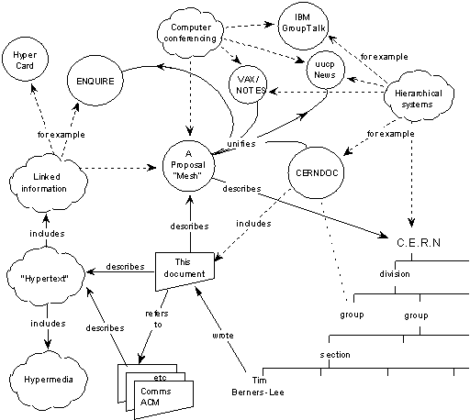
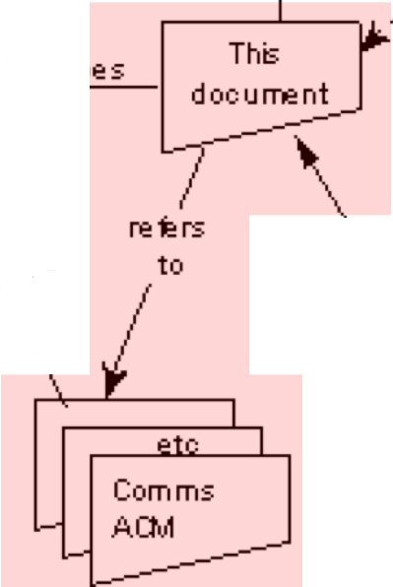
The Web 1989…
Globally Unique identifiers
Links between Documents (href)
A common protocol
URIs
“This proposal concerns the management of general information about accelerators and experiments at CERN
[…] based on a distributed hypertext system. “
HTTP
<p>I work <a href=“http://wu.ac.at”>here</a></p>

Slide 6
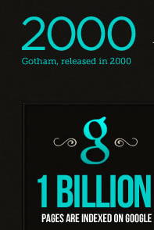
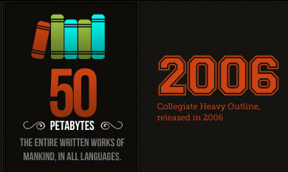
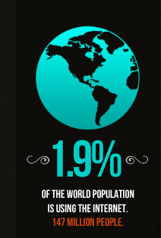
The Web
A downstripped version of the original idea!
Success factors:
Decentralized, global infrastructure
Simple protocol
→Allowed the development of a scale-free network...
... with various side-effects:
http://maxcdn.webappers.com/img/2011/10/web-standards.jpg

Slide 7
W3C – Shaping Standards for the Web
First WWW Conference:
First International Conference on the World-Wide Web May 1994
First W3 Consortium Meeting: Dec 1994
Since then the W3C set up many important standard recommendations like HTML, XML, CSS, … .
Both industrial key players and academic institutions
http://www.w3.org
Important: All standards by W3C are royalty-free, cf.
http://www.w3.org/Consortium/Patent-Policy-20040205/

Slide 8
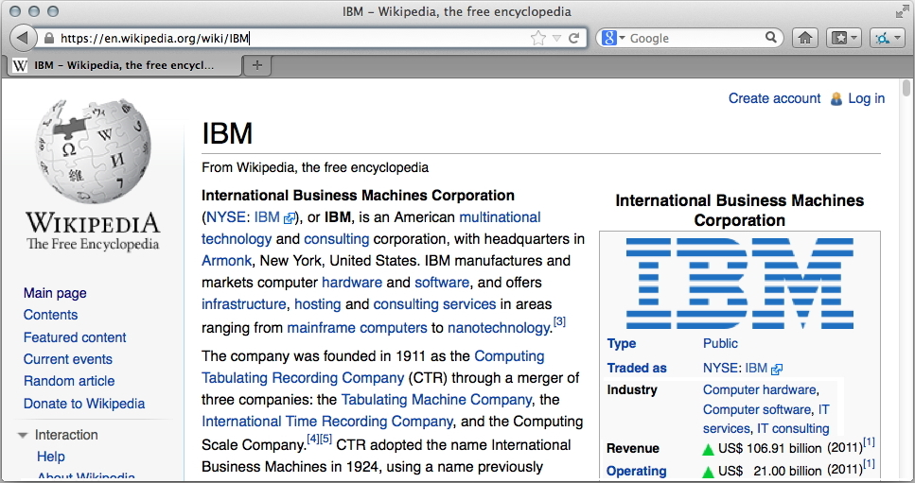
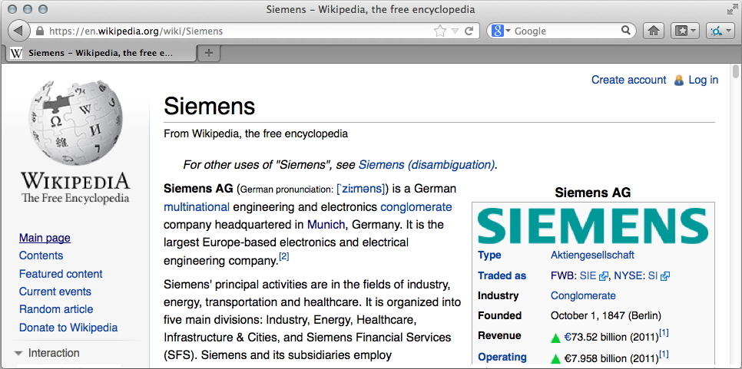
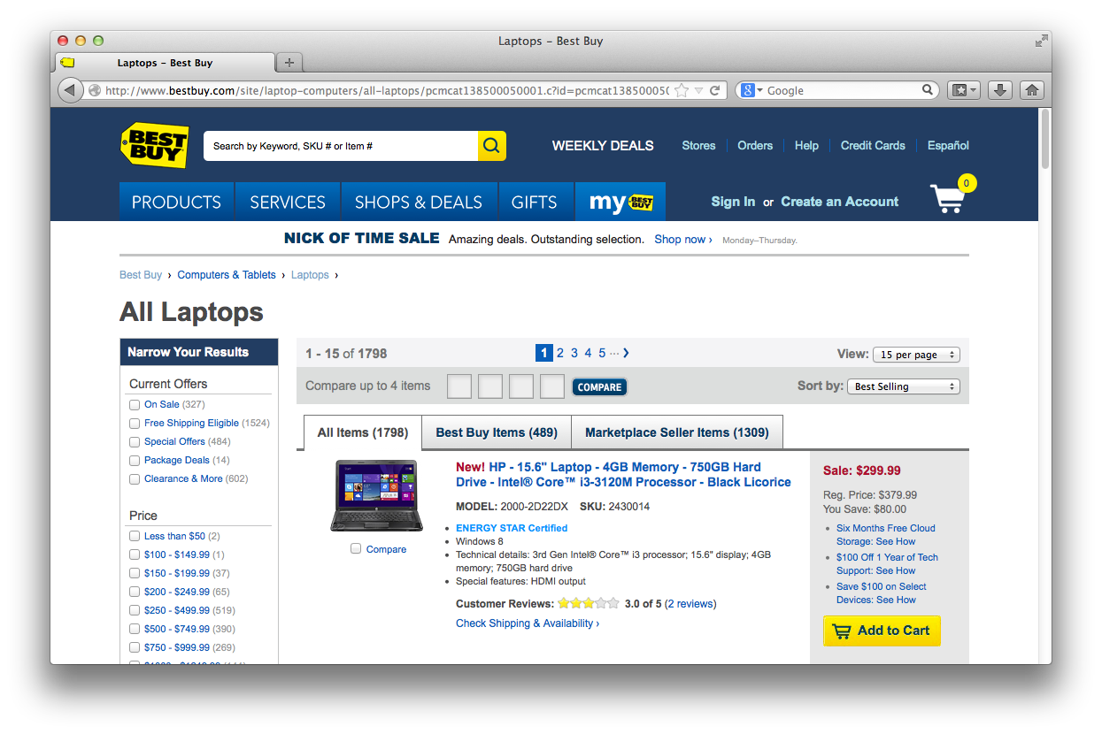
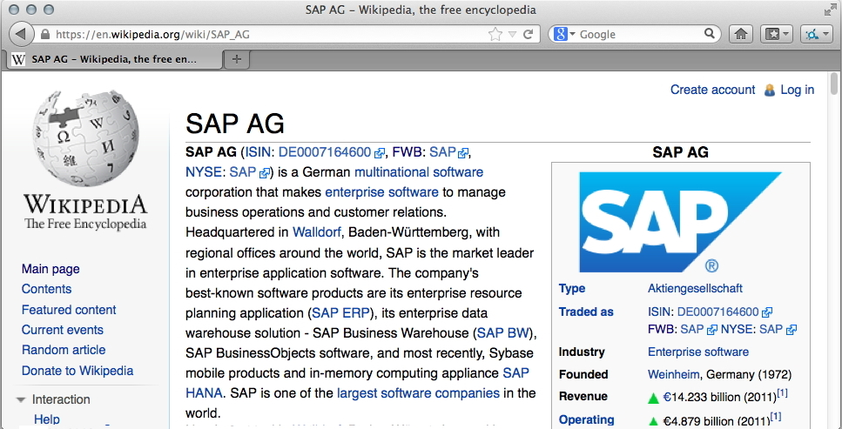
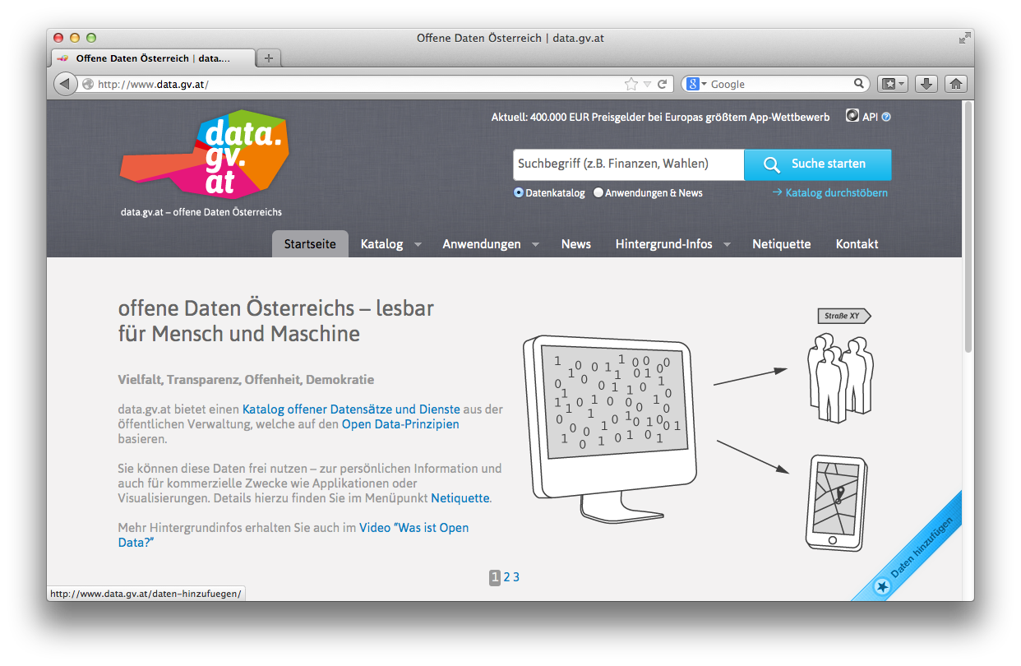
Data on the Web: the Web is not only a place for documents!
Most Web pages are created dynamically... From Data
Data from user-generated content...
Data from companies...
Data from public entities...
In the course of the trend for „Open Data“
a lot of this Data is being published
directly on the Web!

Slide 9
What is missing in terms of standards?
Standards to make data
machine readable
machine processable
Why?

Slide 10
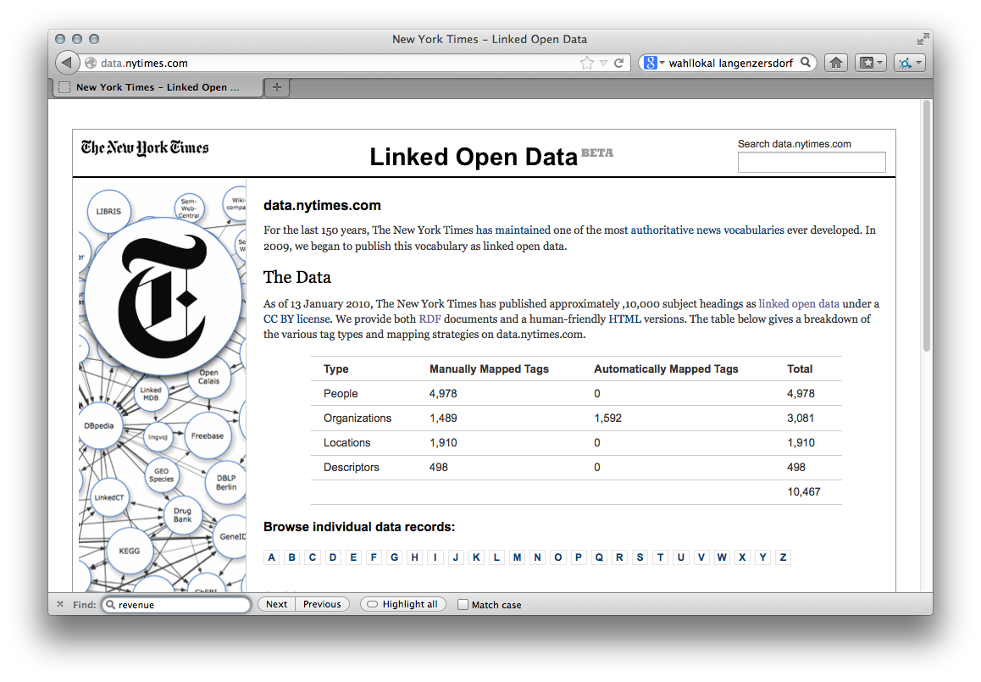
Try this in Bing/Google/Yahoo: “Latest News on NYT about technology companies with a revenue greater than 10B EUR”
The data is there!
Wikipedia
New York Times thesaurus
and article search API
Notes:
… however, the data for answering these queries is there on the Web and it’s actually available in structured form!
The New York Times offers a structured thesaurus where it has unique identifiers for over 3000 organizations and companies, and an API to retrieve that latest articles on these.
Wikipedia has structured information it its infoboxes, such as the revenue numbers and the particular business of companies.
So if I had a joint language to access and query this data, I could actually answer the first question!

Slide 11
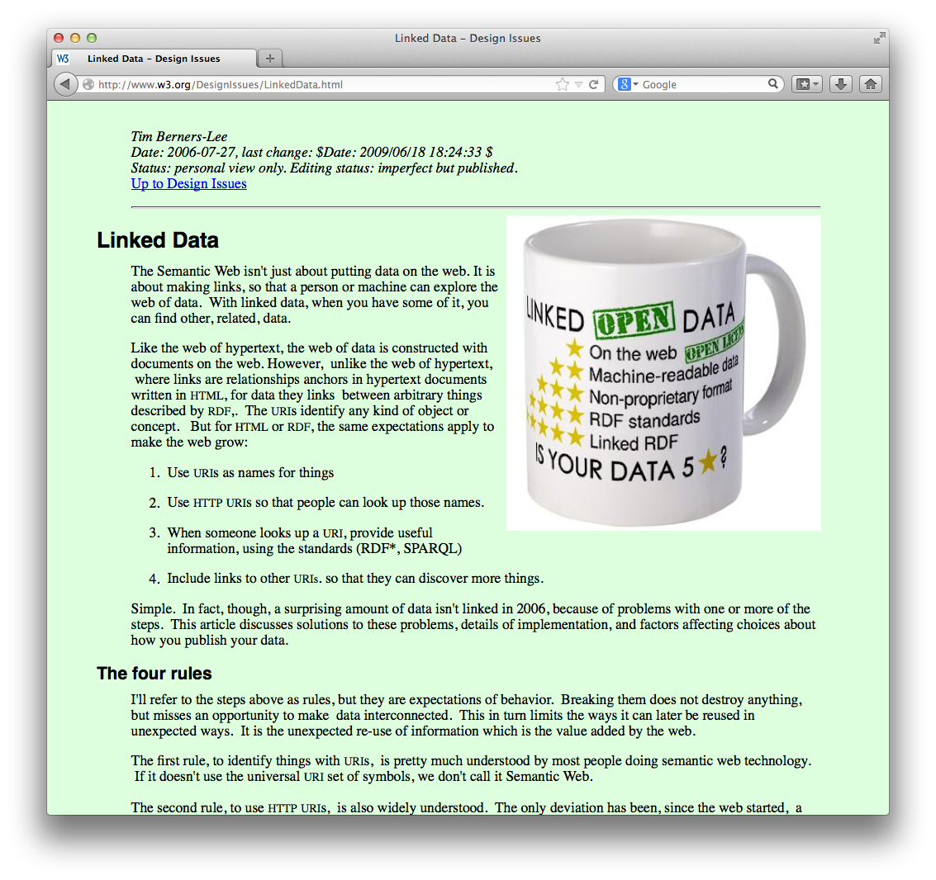
The Web of data ~1999…
“If HTML and the Web made all the online documents look like one huge book,
RDF, schema and inference languages will make all the data in the world look like
one huge database” Tim Berners-Lee, Weaving the Web, 1999

Slide 12
Standards for Linked Data:
Globally Unique identifiers
Links between Documents (href)
A common protocol
Globally Unique identifiers
Typed Links between Entities
A common protocol
URIs
RDF
HTTP
xmlns.com/foaf/0.1/wokplaceHomepage
wu.ac.at
<p about="#me">I work <a rel=“foaf:workplaceHomepage” href=“http://wu.ac.at”>here</a></p>
polleres.net#me
<p>I work <a href=“http://wu.ac.at”>here</a></p>
Person
University

Slide 13
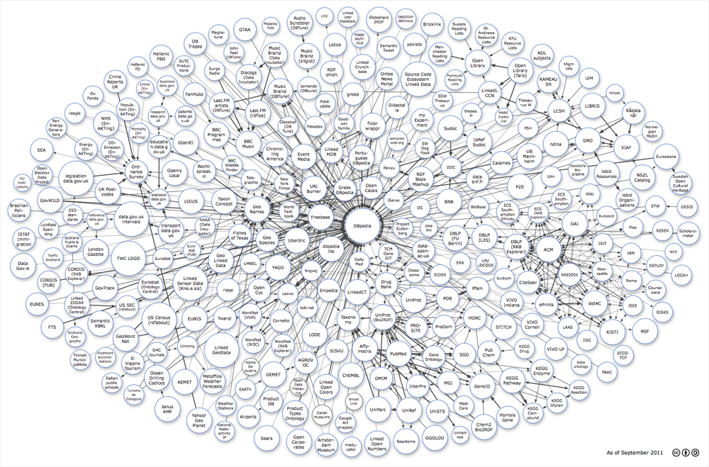
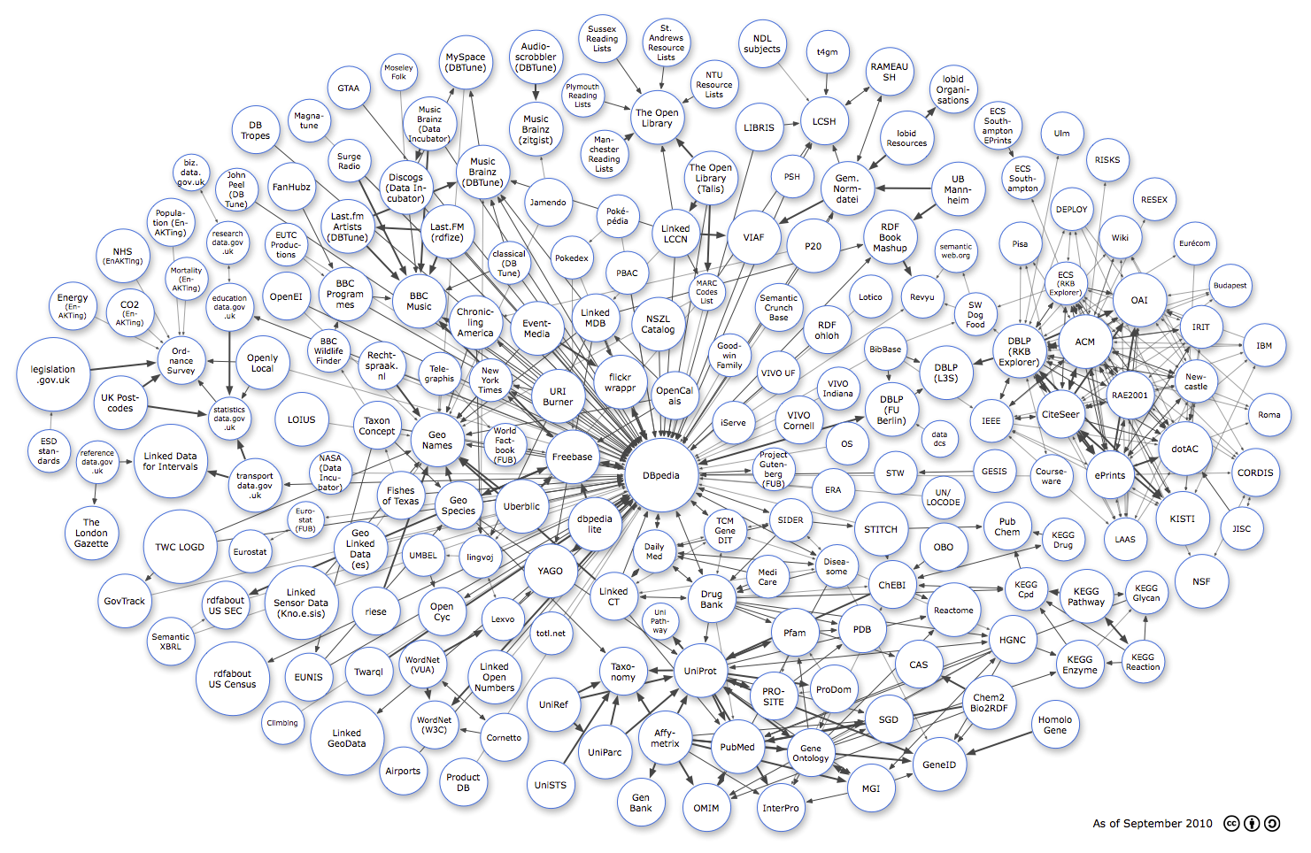
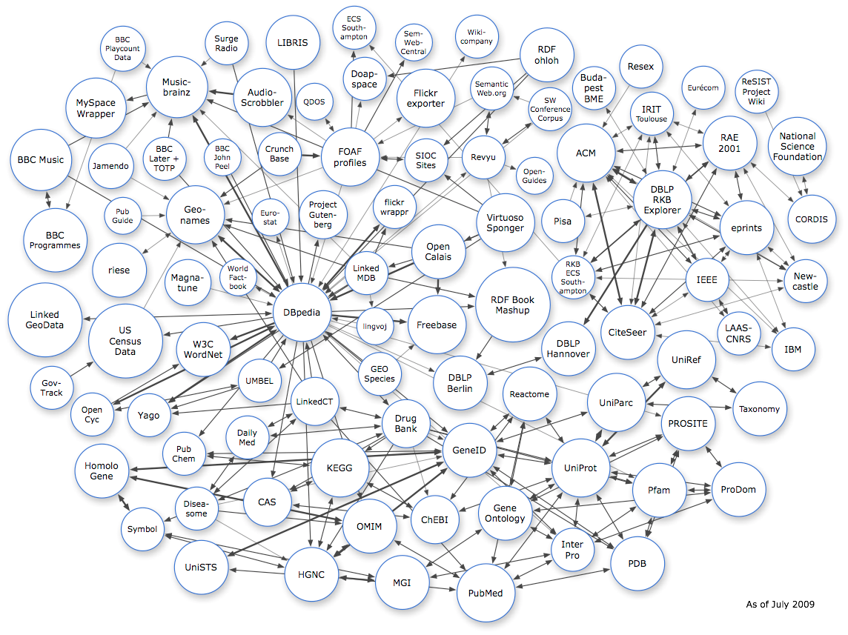
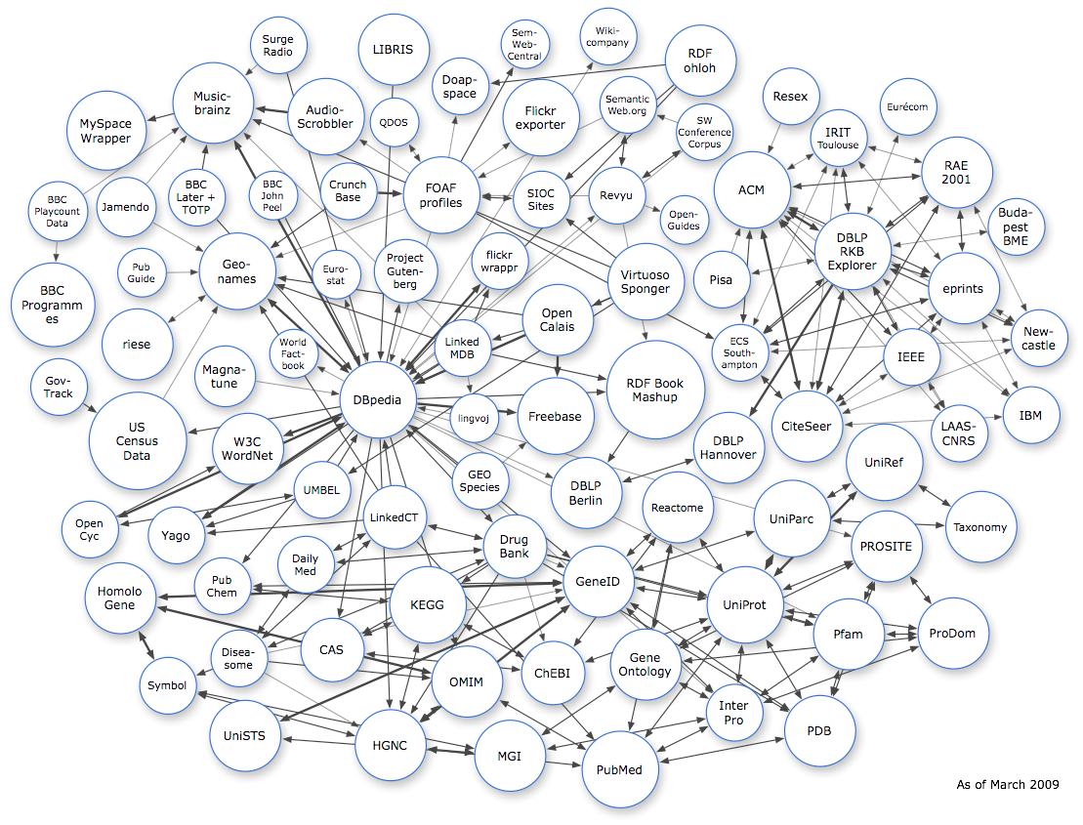
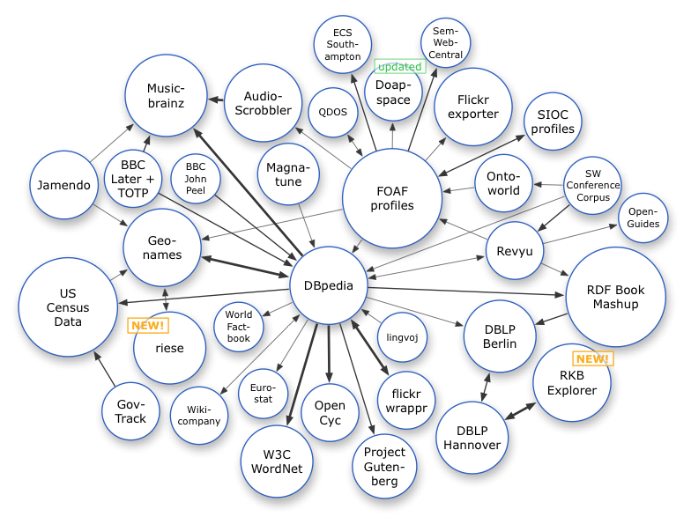
Linked Data on the Web: Adoption
Image from: http://lod-cloud.net/
March 2008
July 2009
March 2009
Sep. 2011
13
Sep. 2010

Slide 14
RDF ... The „HTML for data“

Slide 15
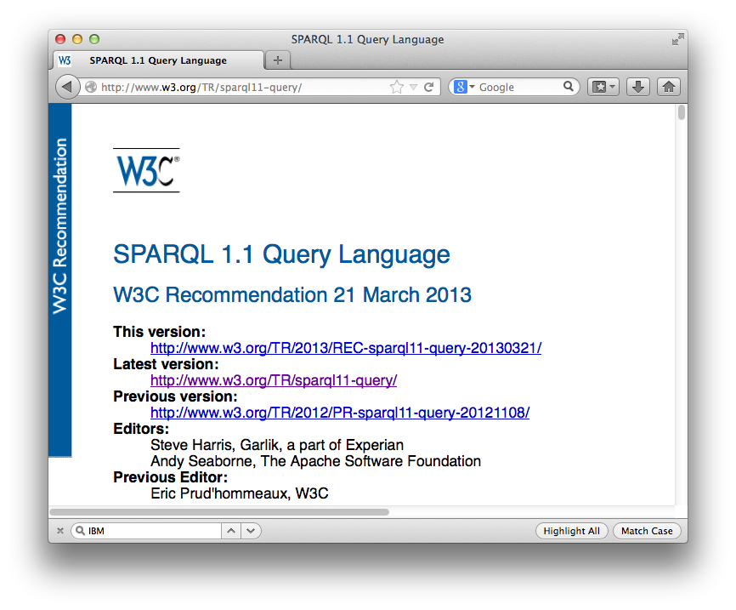
A standard Query language for Web Data: SPARQL
SPARQL
= SQL look-and–feel for Linked Data
SELECT * WHERE
{ ?C rdf:type NYT:Org .
?C dbpedia:revenue ?R .
?C NYT:latestArticle ?A .
FILTER( ?R > 10000000000 ) }
Link
Notes:
So, are we done. Well not quite.
Althought SWSE was a research prototype only, we had also another team in our group, which implemented a similar approach on bigger faster hardware, which now runs 24-7 in DERI called Sindice. It also runs a SPARQL endpoint and please feel free to go there and try out you SPARQL queries.
However, note we have still only addressed one of the queries, but let’s look at the other query we wanted to answer.
Unfortunately, this query can’t be appropriately answered with the approach we have taken so far.
We can formulate the query to SPARQL, but note that – in an infrastructure such as the one we have described so far – it will not deliver up-to-date results. The problem is that – in general – the crawl, index, reasoning pipeline will be too slow to deliver indeed the latest articles.
This is why we have also looked into an alternative approach, which is the last puzzle piece I want to present you today…

Slide 16
5-Star Schema for Open Data:
Full Linked Data might be asked „too much“ by data providers...

Slide 17
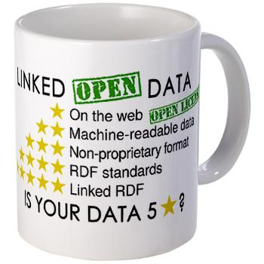
5-Star Schema for Open Data:
Full Linked Data might be asked „too much“ by data providers...
★ Make data/documents available on the Web
★★ Make it available as structured data (e.g., an Excel sheet instead of image scan of a table)
★★★ Use a non-proprietary format (e.g., a CSV file instead of an Excel sheet)
★★★★ Use linked data format (i.e., URIs to identify things, and RDF to represent data)
★★★★★ Link your data to other people’s data to provide context
Source: http://inkdroid.org/journal/2010/06/04/the-5-stars-of-open-linked-data/

Slide 18
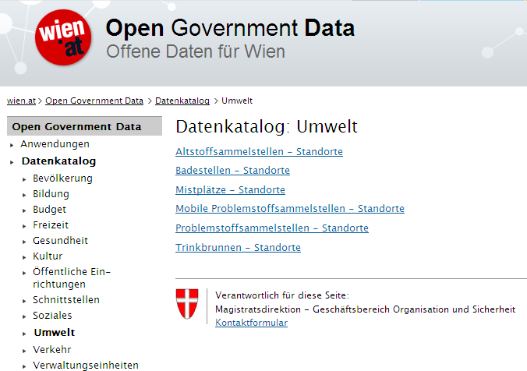
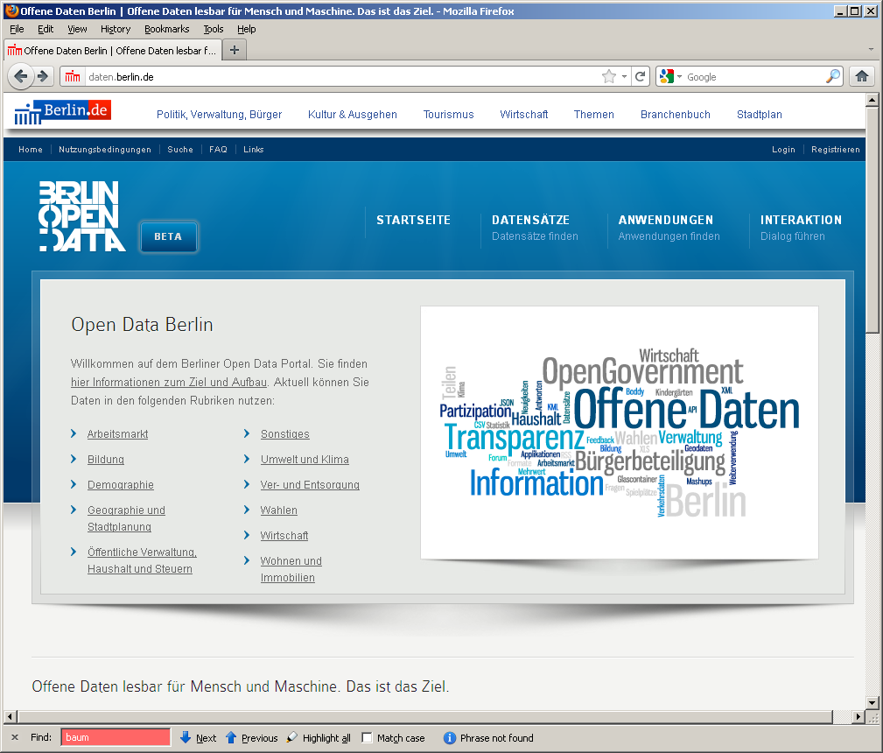
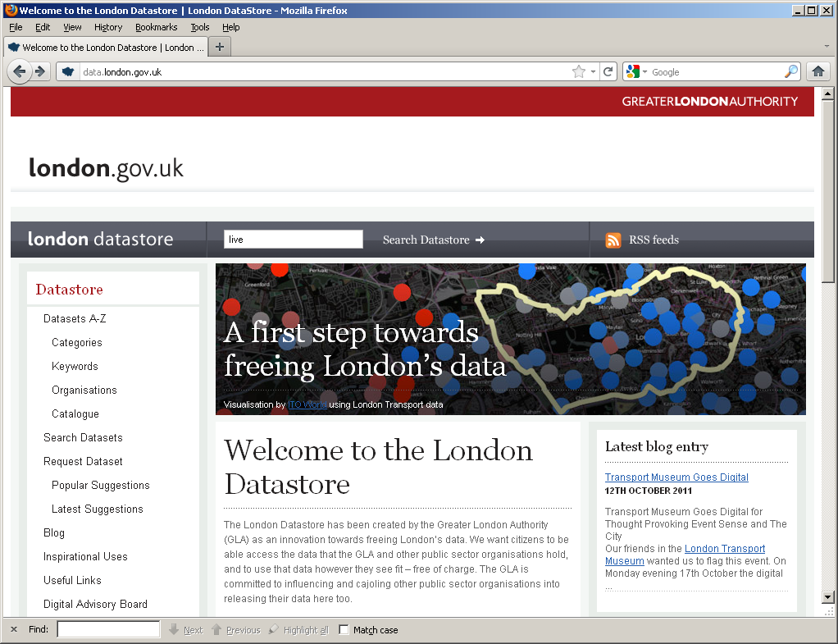
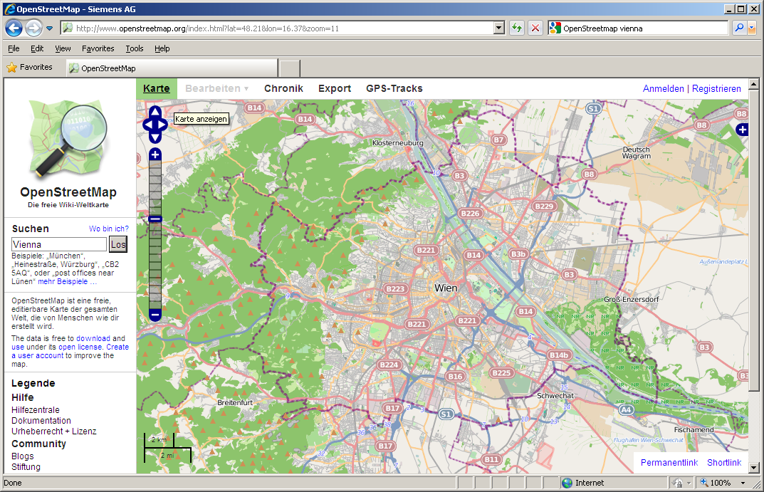
Open Data Trends & Future
DIRECTIVE 2007/2/EC INSPIRE
Open Data: Typically very liberal licenses (variants of CC), but still mixed
Many formats, varying quality, harmonization starting
Mostly by online communities or public bodies (cities, communities, governments, UN,…)
Currently focused mostly in SMEs to take advantage of that data
vs. Publicly available data: e.g. NYT is public but not free/not license free
vs. Enterprise (Linked) Data

Slide 19
Open Data – Status:
Mostly 3-star Open Data...
... RDF and Linked Data are starting to be adopted by Open Government Data.
Some exceptions: US, UK, EU

Slide 20
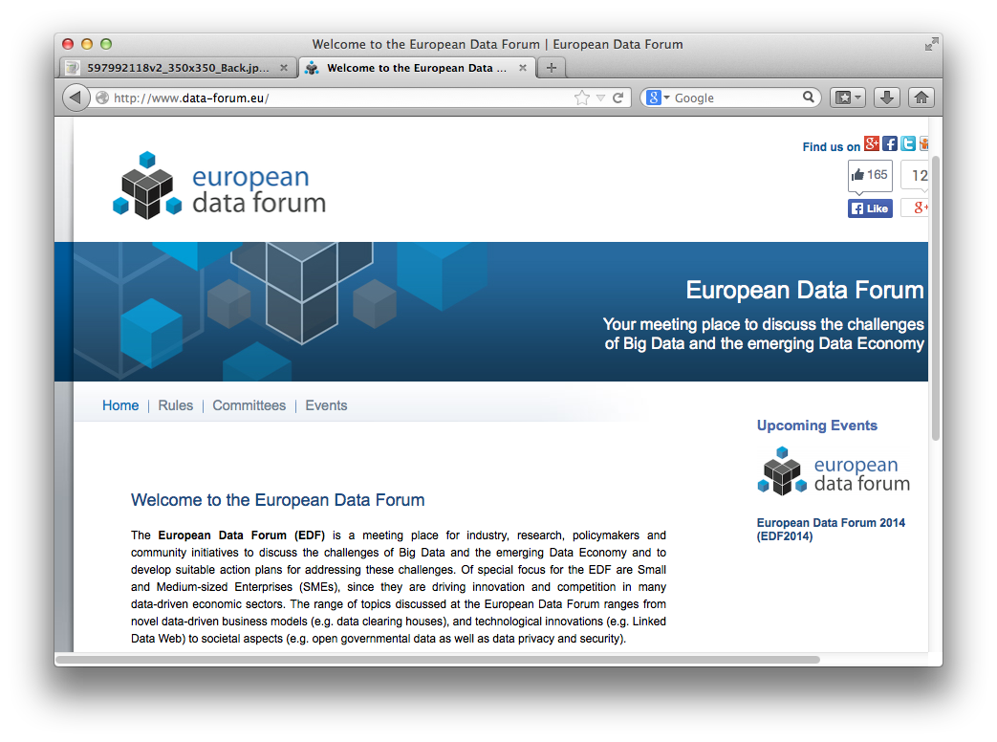
EU is pushing Linked Data Standards

Slide 21
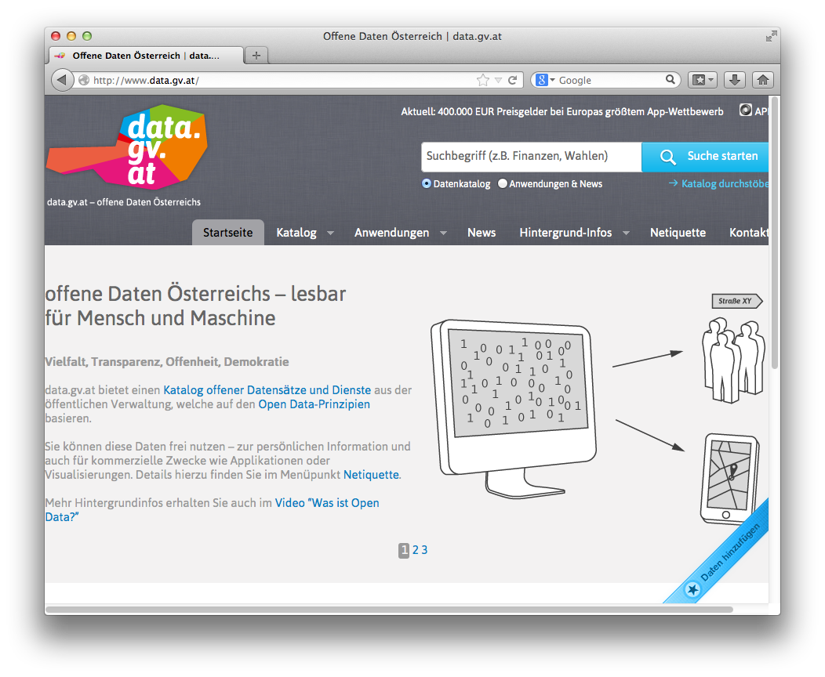
Open Government Data Austria:
Mostly 3-star
Various interesting aspects
Standard meta-data catalog
„grass-roots effort by various
public bodies (as opposed to e.g. UK)
Parallel (non-government)
Open data Platform underway
Unique license
Community meetings („BarCamps“)
E.g. transformation to 4/5-star discussed

Slide 22
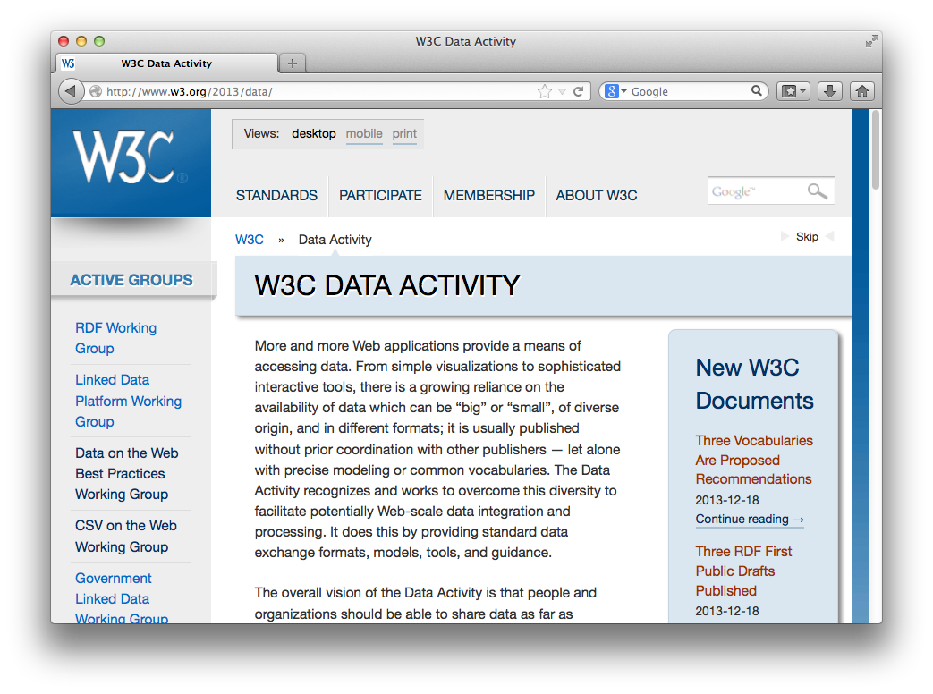
Recent Activities in W3C
W3C Data Activity launched (December 2013!!!)
Data on the Web Best Practices Group
CSV on the Web Group
Provenance WG (PROV)
Government Linked Data
Group
etc. ...

Slide 23
PROV WG
Model/Vocabulary for Metadata:
Provenance
Derivation/Aggregation of Data
Revisions
Dates
Roles
...

Slide 24
PROV Model
Not yet used on data.gv.at, but this is how it could look like:
datagvat:Vienna a prov:Entity;
datagvat:populationTotal "1731236"^^xsd:integer;
datagvat:areaTotal "414650000"^^xsd:double;
...
prov:wasGeneratedBy :measureActivity;
prov:wasAttributedTo :Alice.
:Alice a foaf:Person, prov:Agent;
foaf:givenName "Alice";
foaf:mbox <mailto:alice@example.org>;
prov:actedOnBehalfOf :OGDVienna.
:OGDVienna a foaf:Organization, prov:Agent;
foaf:name "Magistrat der Stadt Wien".
:measureActivity a prov:Activity;
prov:atTime "2012-01-01T01:01:01Z"^^xsd:dateTime;
prov:wasAssociatedWith :Alice;
prov:used :austrianCensusDataset.c

Slide 25
Various work ongoing on aligning/reconciling licenses for Open data:
Combining/using data published under different licenses is non-trivial: What licensing obligations apply for the aggregated data?
ISWC 2013

Slide 26
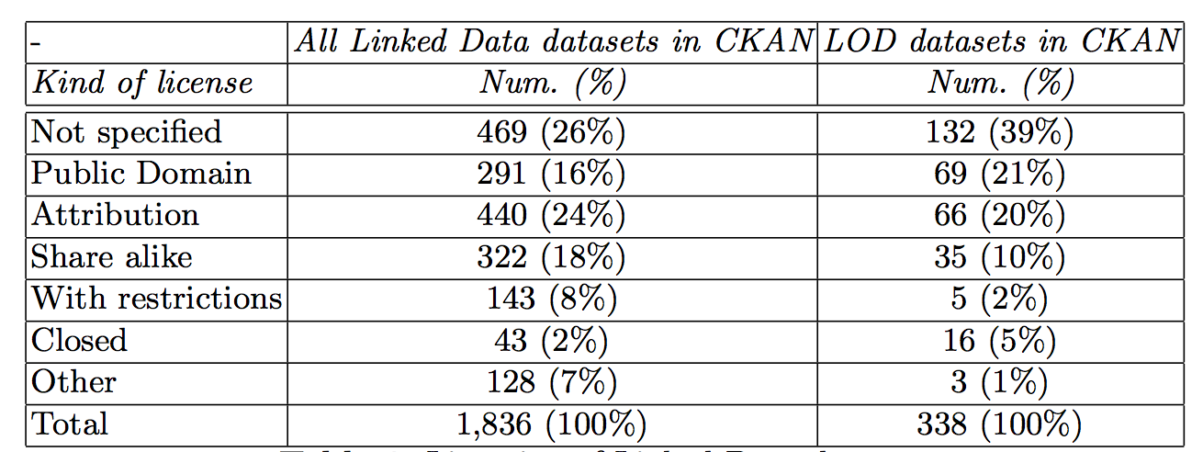
Various work ongoing on aligning/reconciling licenses for Open data:
Int‘l. Workshop on Consuming Linked Data 2013

Slide 27
Take-home messages & Challenges:
Take-home messages:
Push for Open Data on the Web
By public administration
By standardisation bodies
Interesting research topic:
Legal aspects
Technical aspects
Socio-economic aspects
Challenges:
Combining different licenses
Linked Data Quality
Commercial use
Quantifying added value

Slide 28
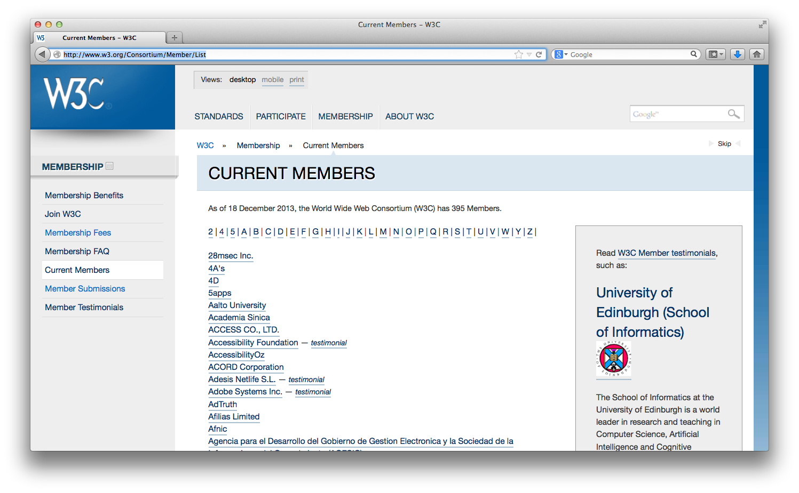
Advertisement
What does WU do? WU will join W3C from Jan 2014!
If you want to join
research in this area,
look at our Inst. & Dept.
Web page!
http://www.wu.ac.at/infobiz/
http://www.wu.ac.at/wuw/departments/ipm/

Slide 29
Institute for Information Business

