Slide 1
Linked (Open) Data for IoT
Axel Polleres
web: http://polleres.net twitter: @AxelPolleres

Slide 2
Outline
What is Open Data?
What is Linked (Open) Data?
Why does it matter for IoT?
Some examples…
Some projects…
OpenData@WU? Anybody interested?..

Slide 3

What is Open Data?
Availability and Access: the data must be available as a whole and at no more than a reasonable reproduction cost, preferably by downloading over the internet. The data must also be available in a convenient and modifiable form.
Reuse and Redistribution: the data must be provided under terms that permit reuse and redistribution including the intermixing with other datasets. The data must be machine-readable.
Universal Participation: everyone must be able to use, reuse and redistribute – there should be no discrimination against fields of endeavour or against persons or groups. For example, ‘non-commercial’ restrictions that would prevent ‘commercial’ use, or restrictions of use for certain purposes (e.g. only in education), are not allowed.
See more at: http://opendefinition.org/okd/
Open Knowledge Foundation

Slide 4








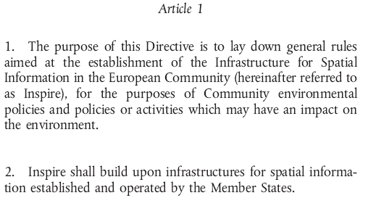
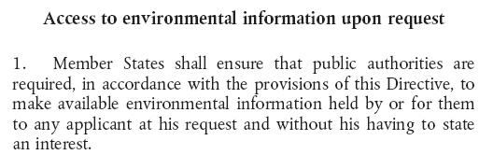
Open Data Providers & Motivations, examples:
  “Bottom-up”: UN, Worldbank, Wikipedia, Cities, Governments:
    “Top-down” e.g. EU INSPIRE directive, PSI directive, Eurostat, EEA,…
DIRECTIVE 2007/2/EC INSPIRE
Directive 2003/98/EC PSI Directive
DIRECTIVE 2003/4/EC Public Access to Environmental Information
Notes:
4

Slide 5
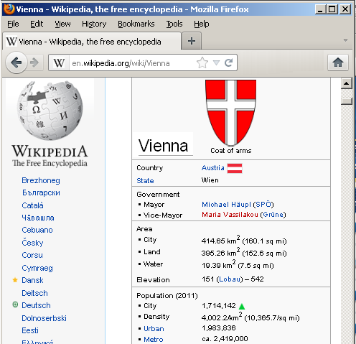
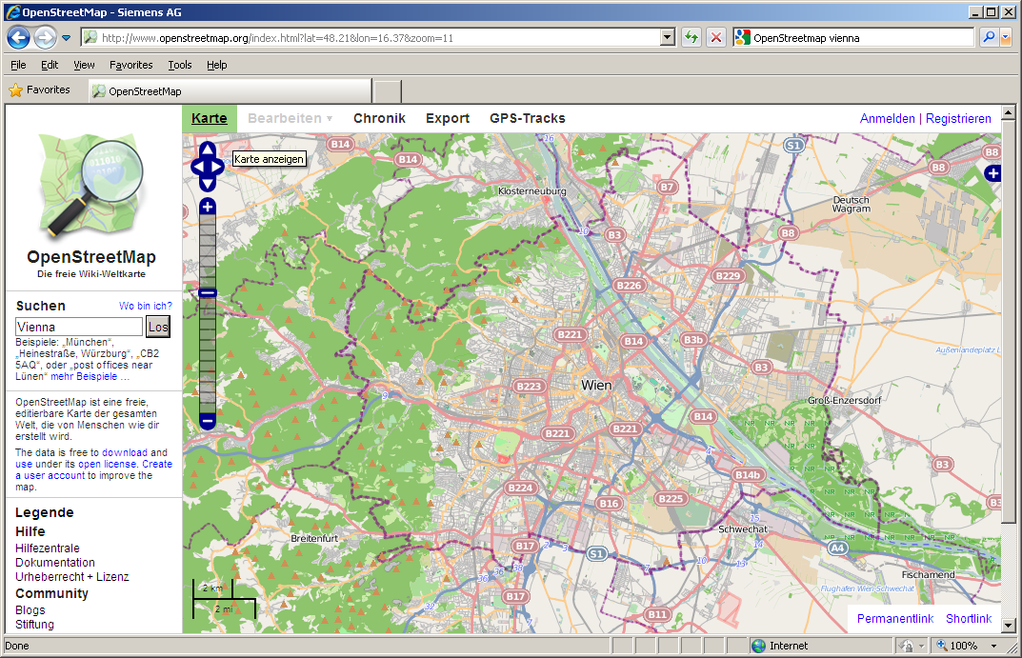
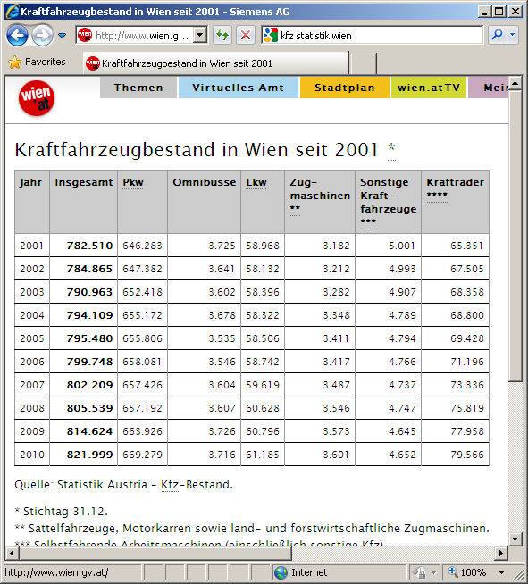
Example Open Data Sources: it’s not only governmental data!
Free GIS data for most countries & cities in the world (base information: area, land-use, administrative districts, …)
e.g. Structured information on most cities and points of interest in the world (location, population, economy, weather, climate, ...)
Open Government Data
5

Slide 6
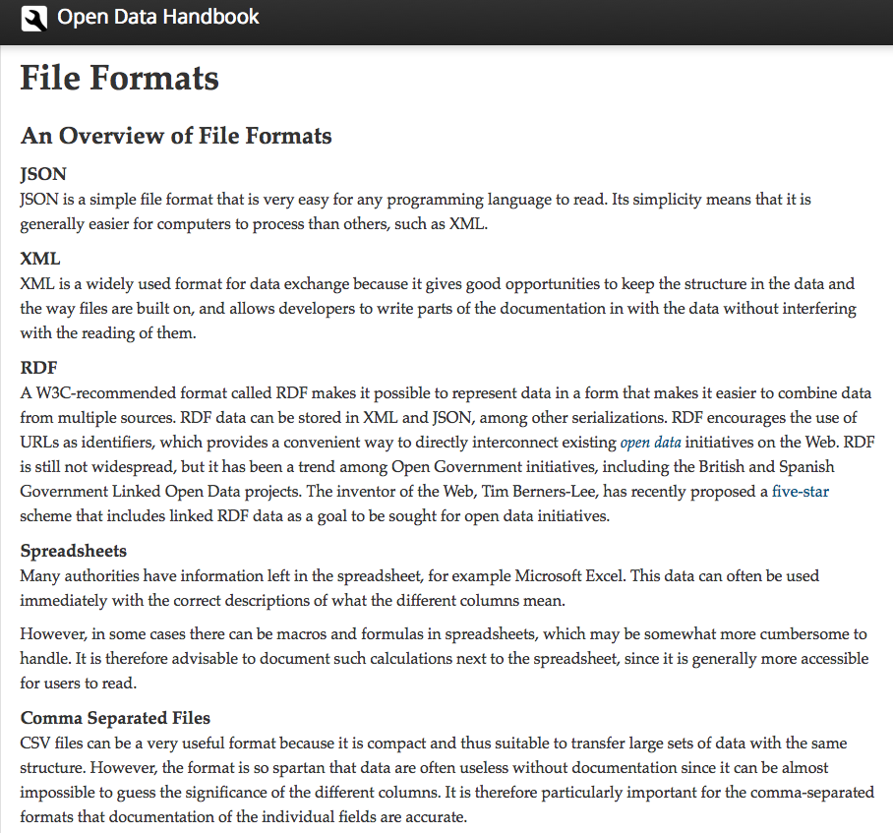
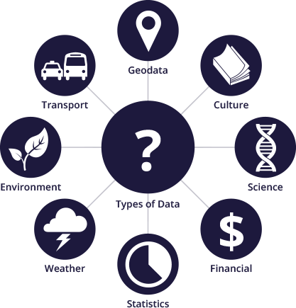
Domains and Types of Data:
http://assets.okfn.org/images/data-types.png
http://opendatahandbook.org/en/appendices/file-formats.html

Slide 7
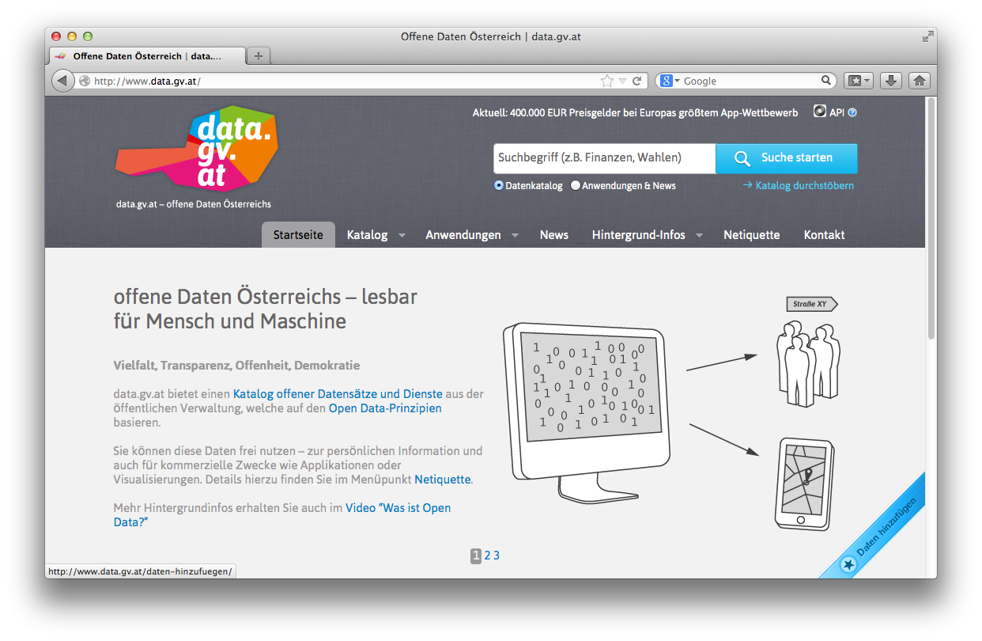
Open Data Portals
CKAN ... http://ckan.org/
almost „de facto“ standard for Open Data Portals
facilitates search, metadata (publisher, format, publication date, license, etc.) for datasets
http://data.gv.at/
http://datahub.io/
machine-processable? ...
... partially.

Slide 8
Towards more machine-processable Data: Linked Data!

Slide 9
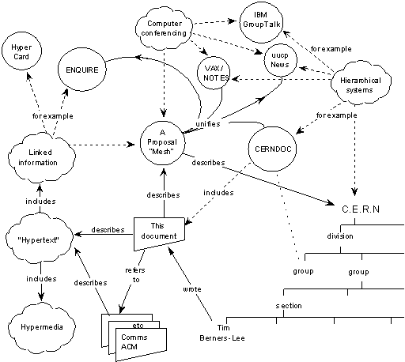

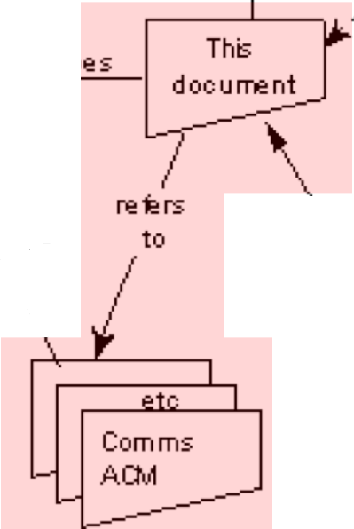

The Web 1989…
Globally Unique identifiers
Links between Documents (href)
A common protocol
URIs
“This proposal concerns the management of general information about accelerators and experiments at CERN
[…] based on a distributed hypertext system. “
HTTP
<p>I work <a href=“http://wu.ac.at”>here</a></p>

Slide 10
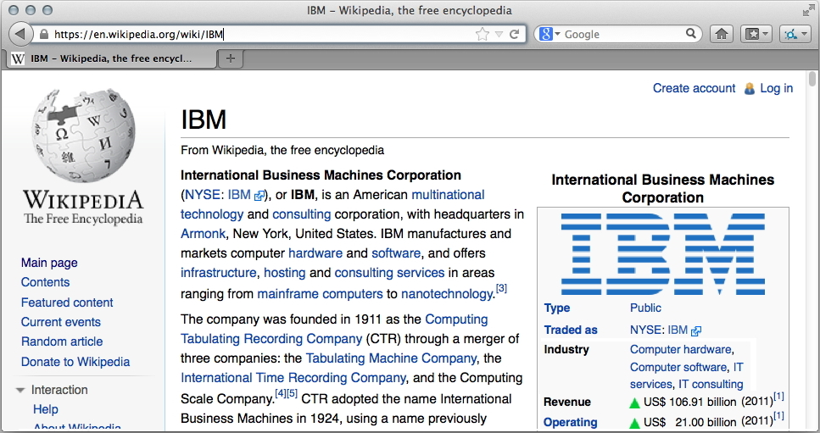
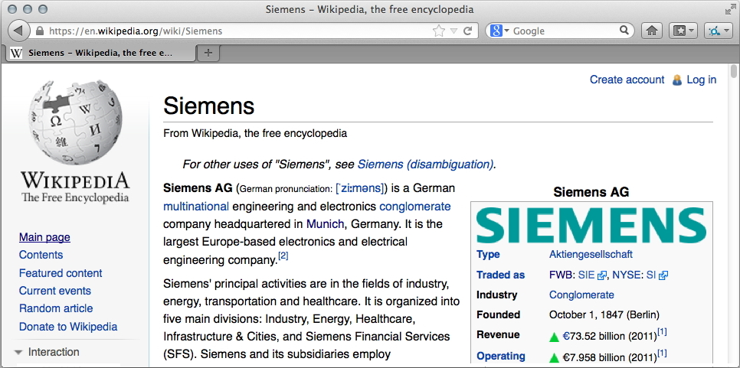
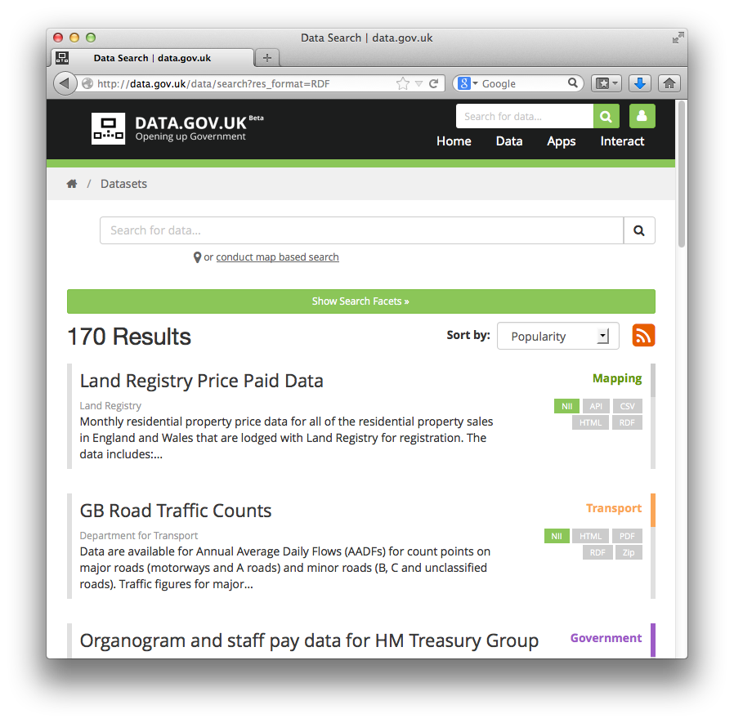
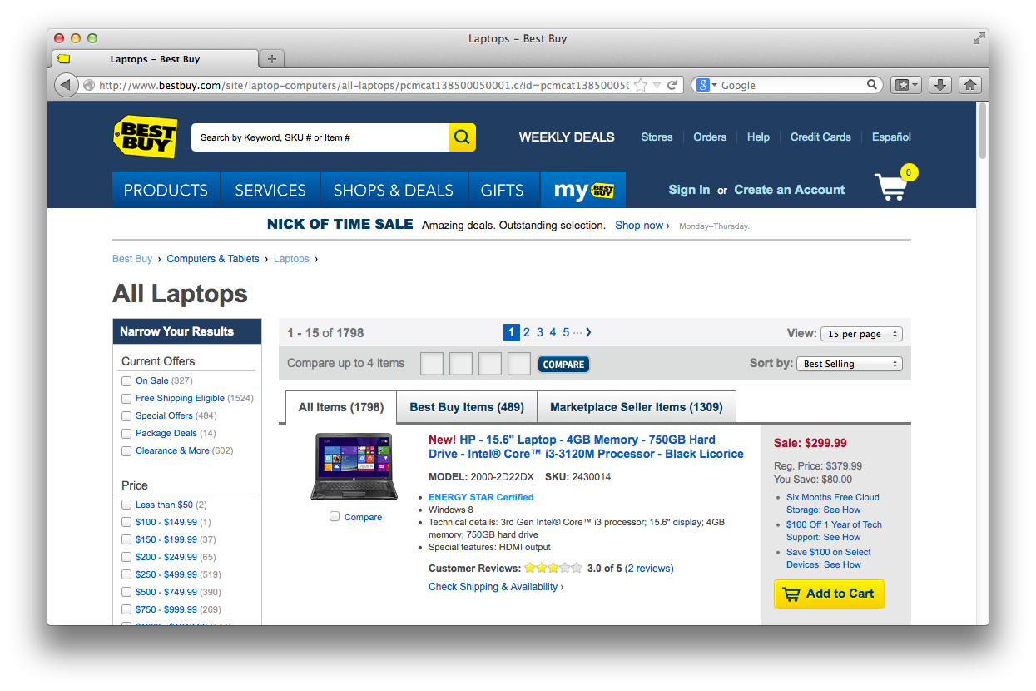
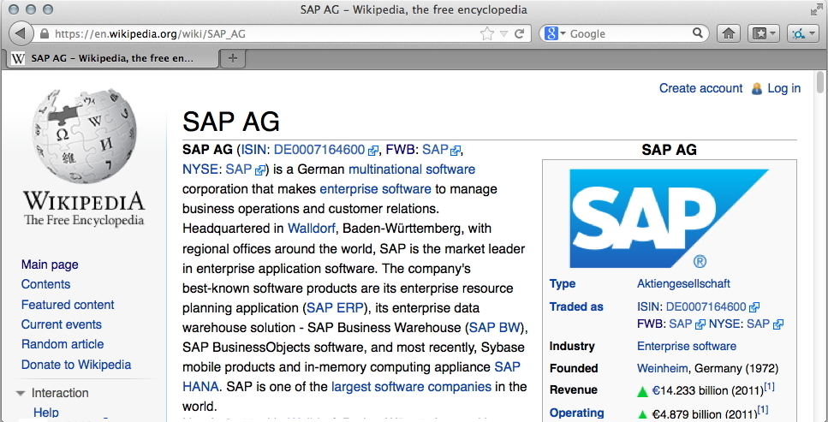
Data on the Web: the Web is not only a place for documents!
Most Web pages are created dynamically... from Data
  Data from user-generated content...
  Data from companies...
  Data from public entities...
In the course of the trend for „Open Data“
a lot of this Data is being published
directly on the Web!

Slide 11
What is the idea of Linked Data?
Standards to publish data on the Web
  machine readable
  machine processable
  Interlinked just as Web-pages!
Why?

Slide 12
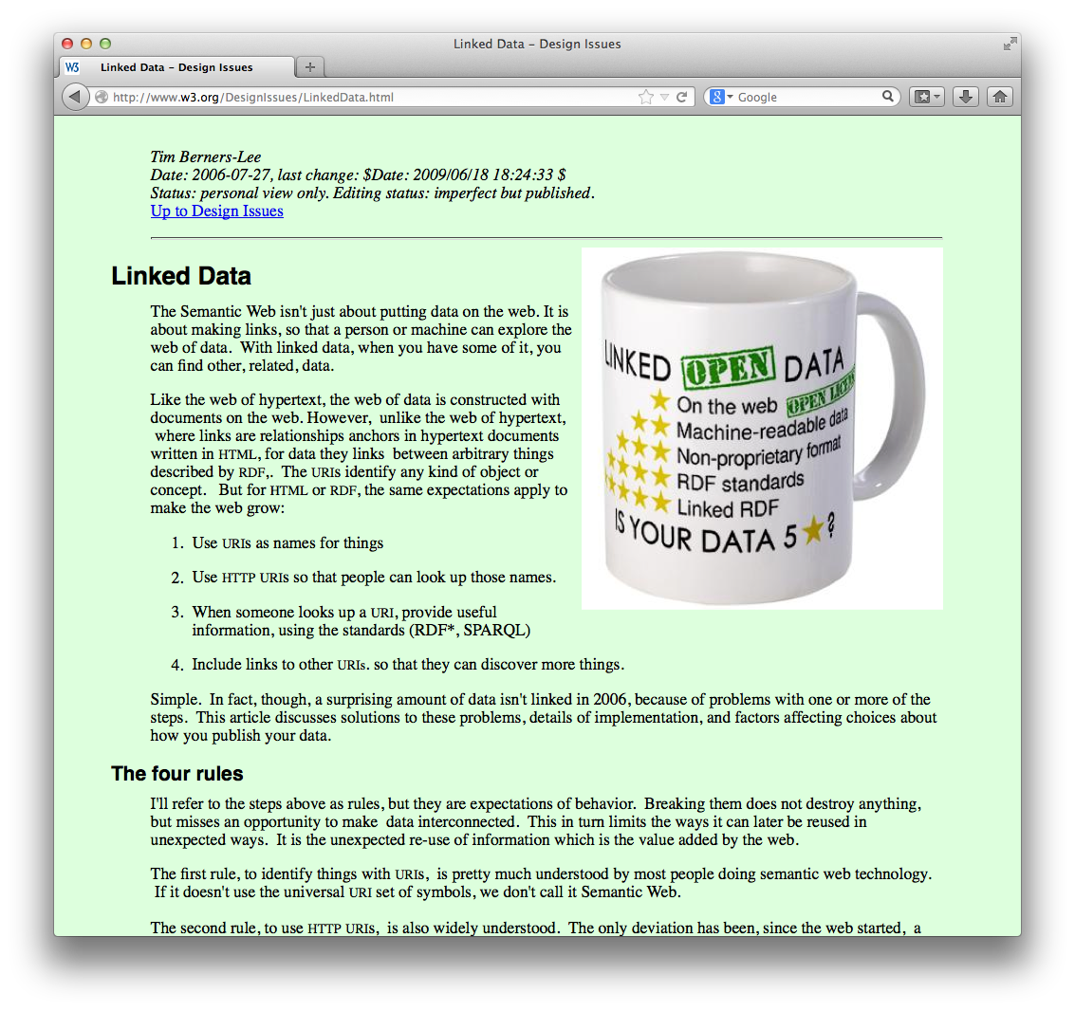
The Web of data ~1999…
  “If HTML and the Web made all the online documents look like one huge book,
  RDF, schema and inference languages will make all the data in the world look like
  one huge database” Tim Berners-Lee, Weaving the Web, 1999

Slide 13
Standards for Linked Data:
Globally Unique identifiers
Links between Documents (href)
A common protocol
Globally Unique identifiers
Typed Links between Entities
A common protocol
URIs
RDF
HTTP
xmlns.com/foaf/0.1/wokplaceHomepage
wu.ac.at
<p about="#me">I work <a rel=“foaf:workplaceHomepage” href=“http://wu.ac.at”>here</a></p>
polleres.net#me
<p>I work <a href=“http://wu.ac.at”>here</a></p>
Person
University

Slide 14
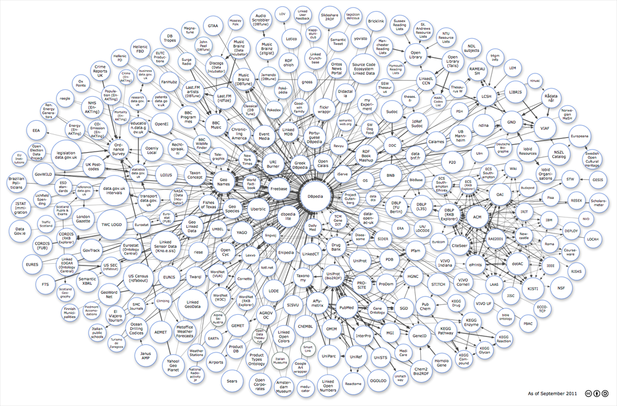


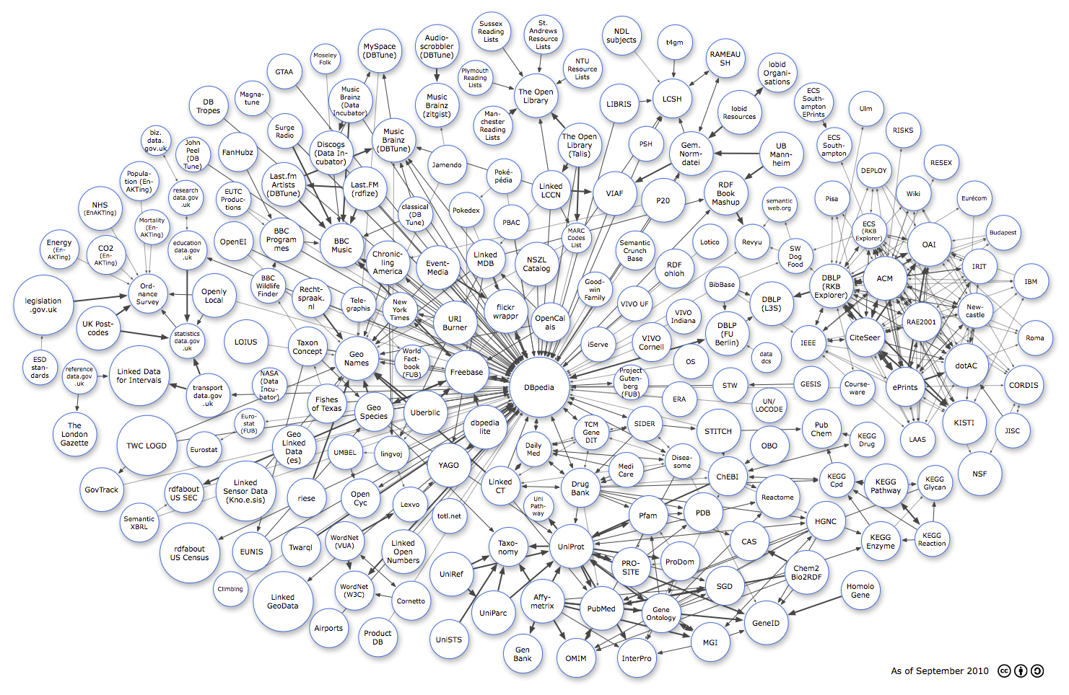
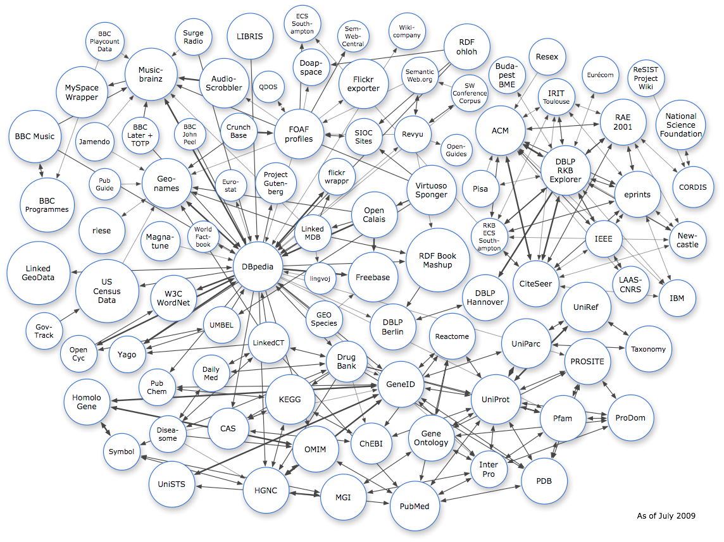
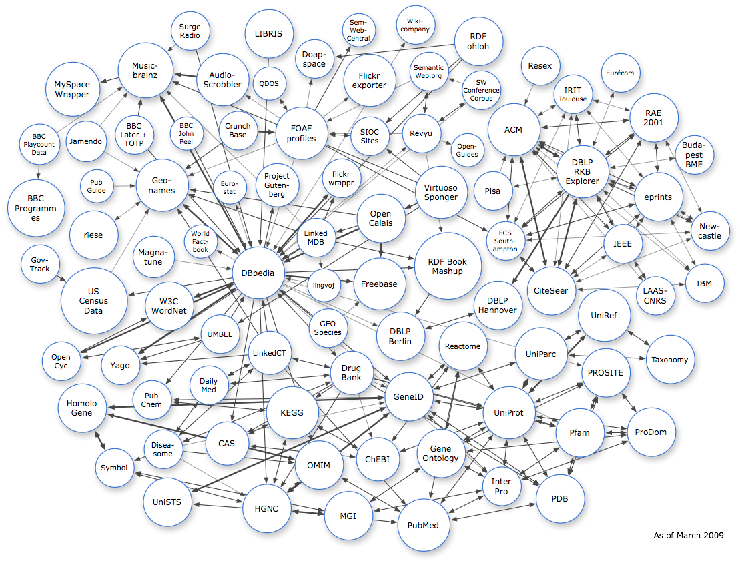
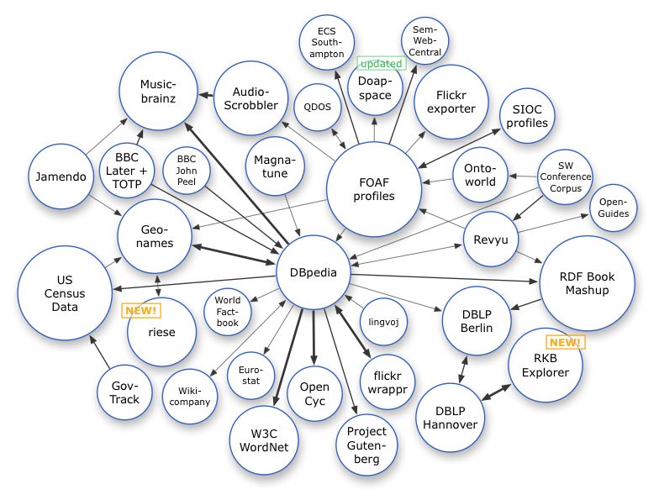






Linked Data on the Web: Adoption
Image from: http://lod-cloud.net/
March 2008
July 2009
March 2009
Sep. 2011
14
Sep. 2010

Slide 15
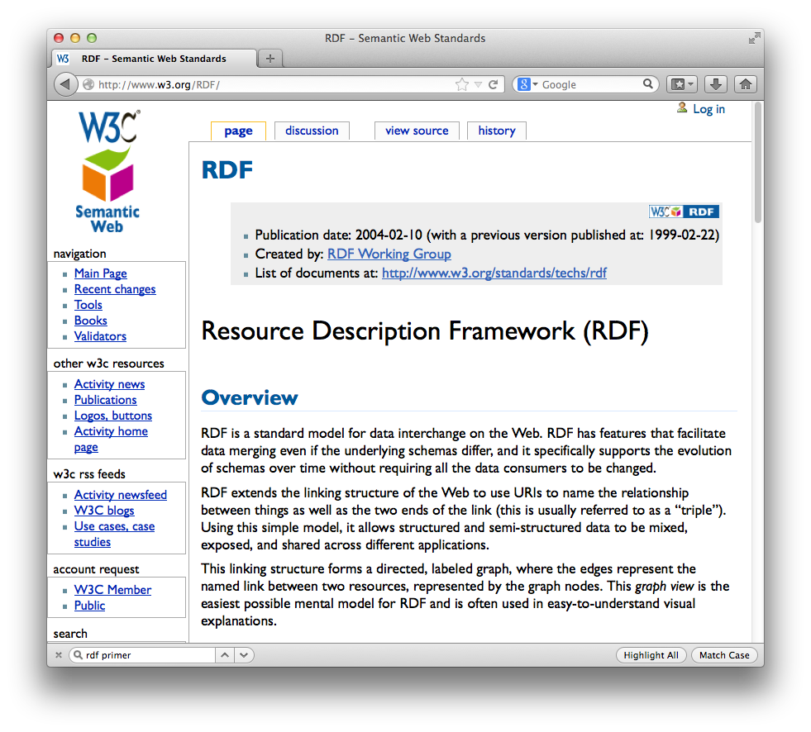
RDF ... The „HTML for data“

Slide 16
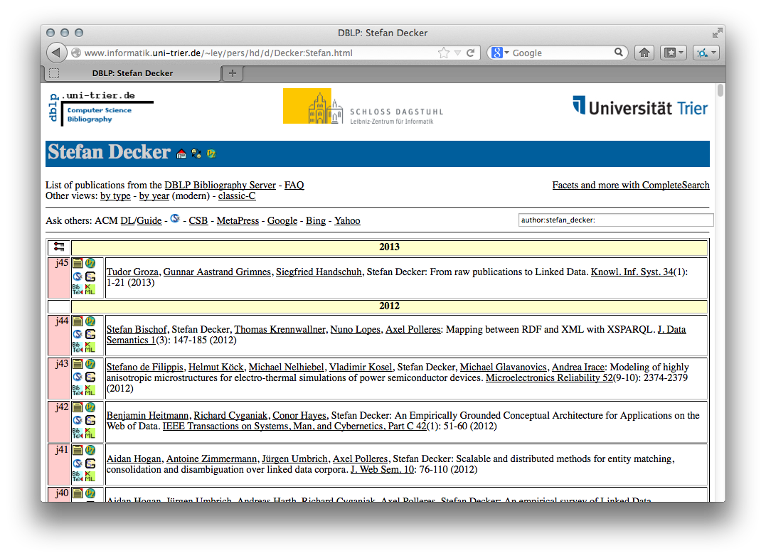
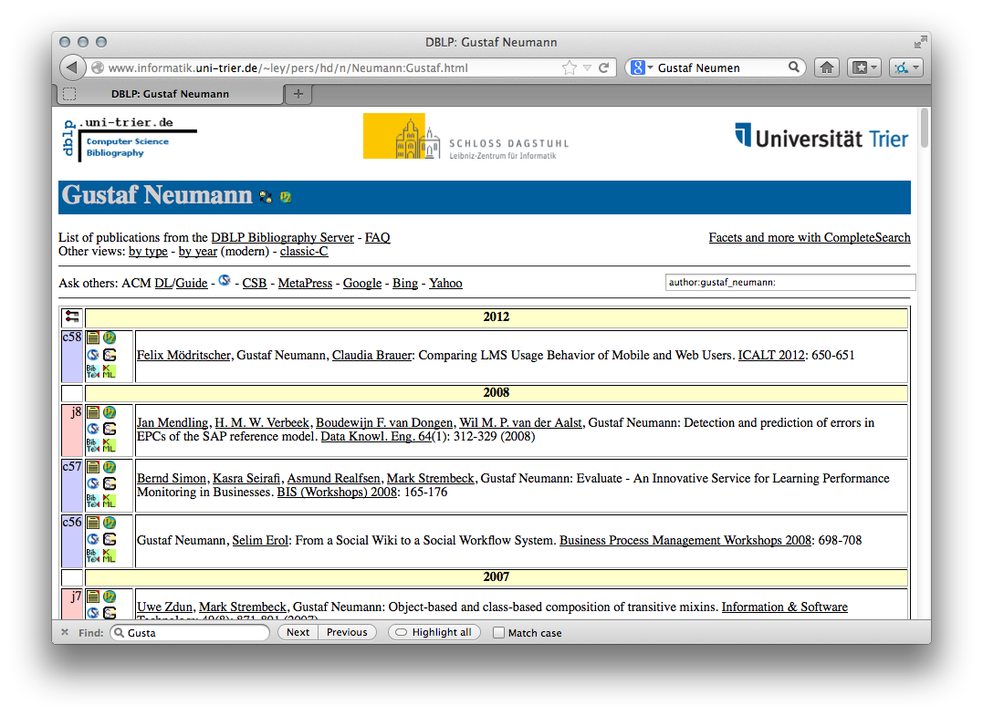
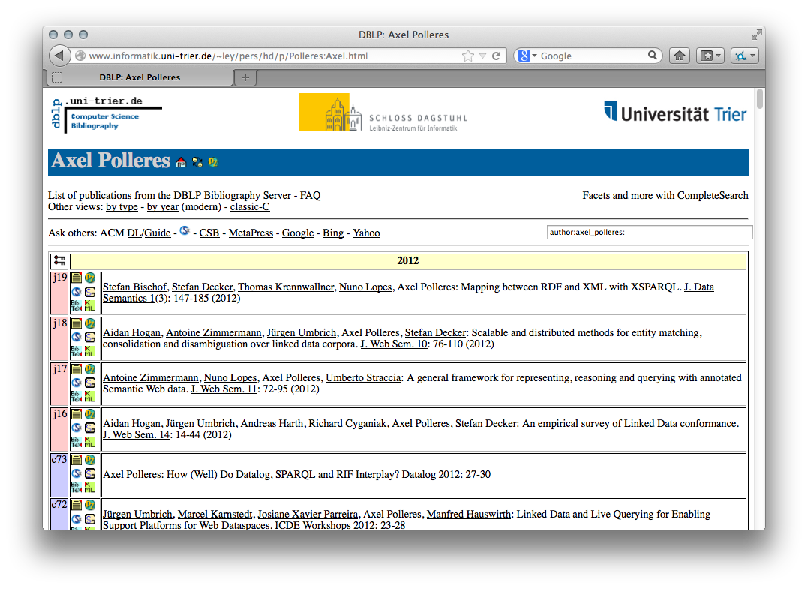
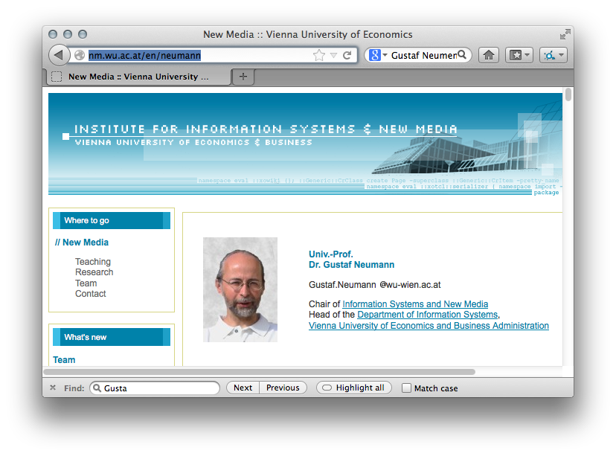
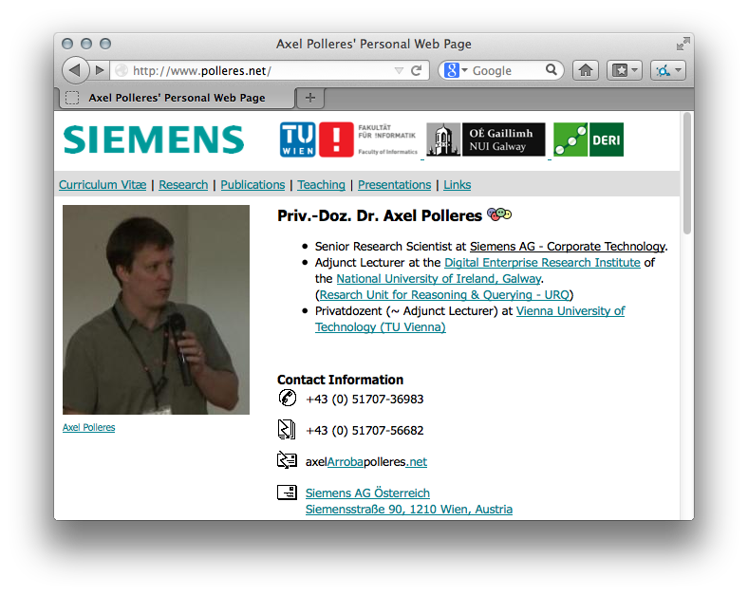

What can Linked Data do for you?
“Have my peers published with any colleagues from WU Wien
and how do these colleagues look like?”
… the data is there!
neumann.jpg
Notes:
Te explain what I mean here, let me start with a quote, which at the same time is one of the “big promises” of the Semantic Web and what its technologies shall enable. In 1999 Tim-Berners Lee, the creator of the Web wrote: “If HTML … “ Well, it’s almost 15 years from that now and so it should work by now, shouldn’t it? So let’s try that on google! Unfortunately google doesn’t answer these questions, because google doesn’t allow structured query answering…
For instance, take some market research questions such as the following:
What are the latest news on the new York times about companies with a revenue of over 10b EUR?
Or for my own preparation to this talk, I might have asked myself questions like the following: Who of my peers may have published with colleagues from WU Wien and how do these colleagues look like, such that I recognize them when I stand here in front of you today.

Slide 17

+ Linked Data Principles
allow standard access information items
RDF
polleres.net#me
dblp#UmbrichHPD12
Improving the Recall of Live LinkedData Querying…
made
title
made
dblp#Stefan_Decker
name
Stefan Decker
made
dblp#Deck+2005
TRIPLE - an RDF Rule Language with Context …
title
made
RDF Store
dblp#Gustaf_Neumann
name
Gustaf Neumann
Subject | Predicate | Object
polleres#me | foaf:made | Umb+2012
Umb+2012 | title | “Improving…”
Stefan_Decker | name | “Stefan Decker”
…
neumann#me | Img | neumann.jpg
homepage
nm.wu.ac.at/en/neumann
neumann.jpg
nm.wu.ac.at/en/neumann#me
img
Notes:
This idea of Linked data allows me, to answer my query for images of colleagues from WU linked to my coauthors just by traversing these typed links published over the Web…
That is, my Web pages says I’ve authored an article mentioned on DBLP, and DBLP mentions that Stefan has co-authored with me and also has co-authored with Gustaf Neumann, finally bringing me to his Webpage and image.
Fortunately, I don’t have to do this manually, but can crawl all this data into an RDF store (that is a new breed of Databases tailored for storing and querying this RDF data) and query this data from that data store in a structured query language

Slide 18
SPARQL
provides a standard query language
Query:
polleres.net#me
made
?Doc1
made
?CoAuth1
made
?Doc2
made
?CoAuth2
homepage
?H
img
?I
  SELECT ?H ?I WHERE
  { polleres#me foaf:made ?Doc1 .
  ?CoAuth1 foaf:made ?Doc1 .
  ?CoAuth1 foaf:made ?Doc2 .
  ?CoAuth2 foaf:made ?Doc2 .
  ?CoAuth2 foaf:homepage ?H .
  ?H foaf:img ?I .
  FILTER( contains(str(?H), “wuwien”))
  }
RDF Store
Subject | Predicate | Object
polleres#me | foaf:made | Umb+2012
Umb+2012 | dc:title | “Improving…”
Stefan_Decker | foaf:name | “Stefan Decker”
…
neumann#me | foaf:mg | neumann.jpg
SPARQL
= SQL look-and–feel for Linked Data
Notes:
… this standard query language for RDF is SPARQL, which I have also contributed to as chair of the respective W3C working. You see this language looks very similar to SQL, and allows you to write down the triple “patterns” matching answers you’re looking for very much like a “graph template”… With these ingredients structured queries over Linked data should be possible!

Slide 19







Linked Data is moving from academia to industry

Slide 20
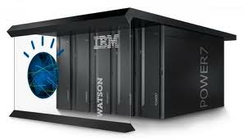



In the last few years, we have seen many successes …
Apple
Siri
Watson
Knowledge Graph

Slide 21
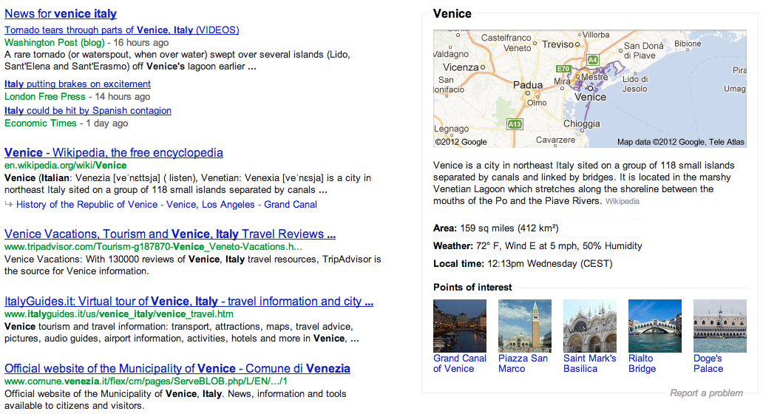
Google Knowledge Graph

Slide 22
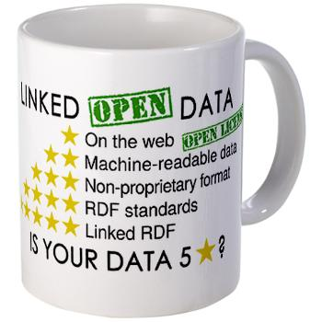
5-Star Schema for Open Data:
Full Linked Data might be asked „too much“ by data providers...
★ Make data/documents available on the Web
★★ Make it available as structured data
(e.g., an Excel sheet instead of image scan of a table)
★★★ Use a non-proprietary format
(e.g., a CSV file instead of an Excel sheet)
★★★★ Use linked data format
(i.e., URIs to identify things, and RDF to represent data)
★★★★★ Link your data to other people’s data to provide context
Source: http://inkdroid.org/journal/2010/06/04/the-5-stars-of-open-linked-data/

Slide 23
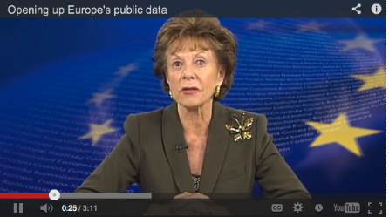
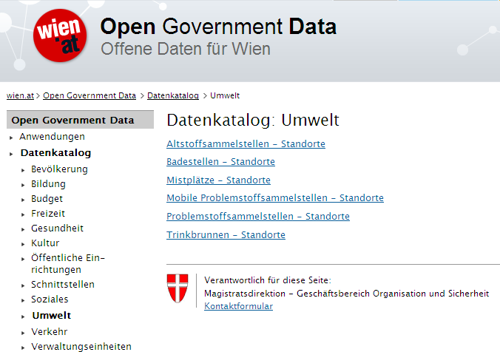
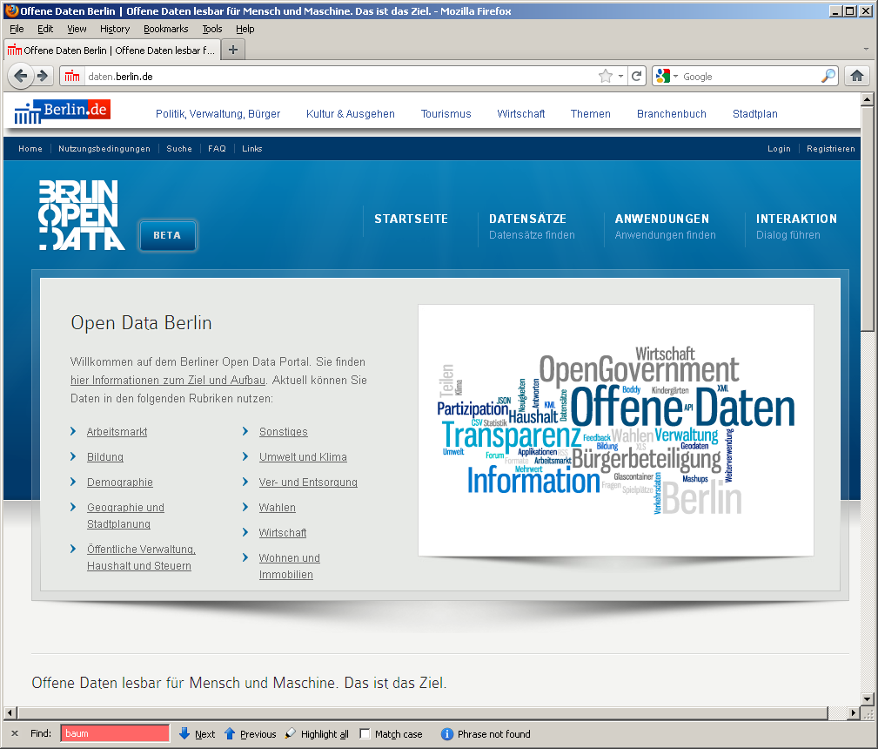
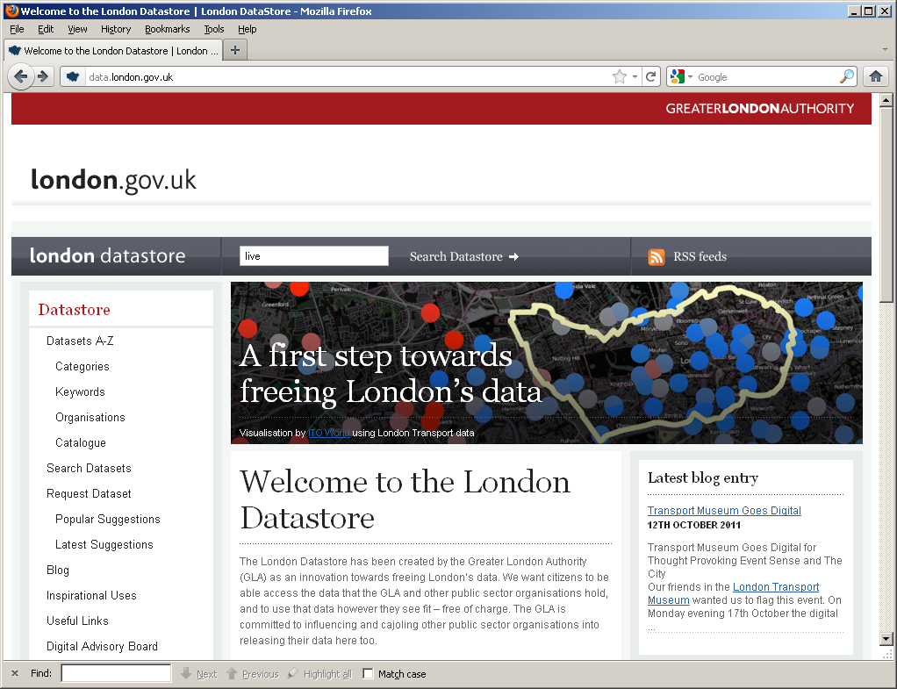

Open Data Trends & Future
DIRECTIVE 2007/2/EC INSPIRE
Open Data: Typically very liberal licenses (variants of CC), but still mixed
Many formats, varying quality, harmonization starting
Mostly by online communities or public bodies (cities, communities, governments, UN,…)
  Currently focused mostly in SMEs to take advantage of that data
vs. Publicly available data: e.g. NYT is public but not free/not license free
vs. Enterprise (Linked) Data

Slide 24
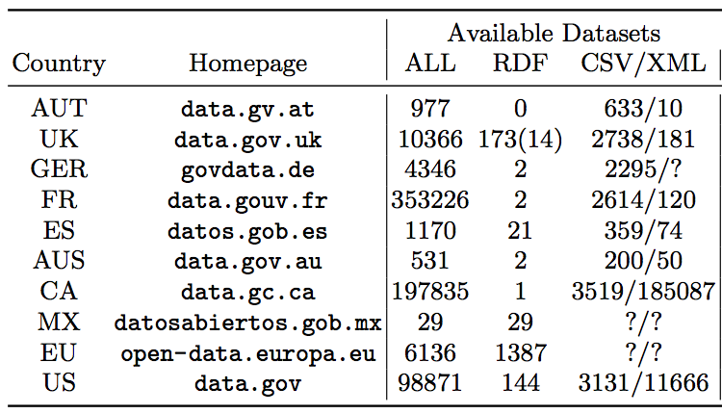
Open Data – Status:
Mostly 3-star Open Data...
... RDF and Linked Data are starting to be adopted by Open Government Data.
Some exceptions: US, UK, EU

Slide 25
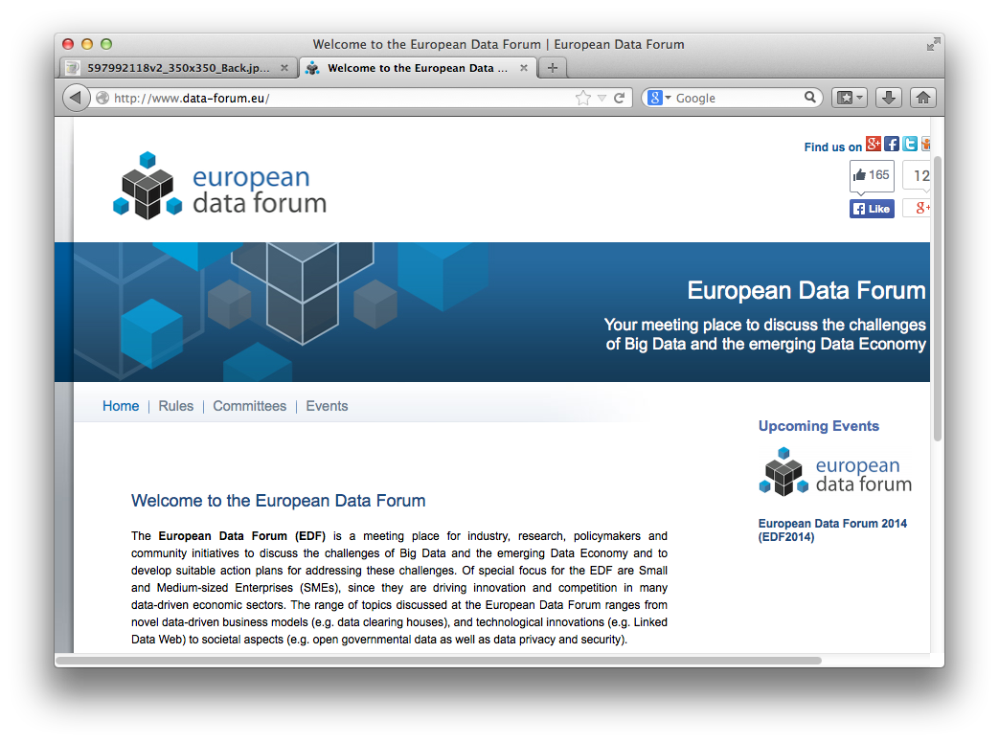
EU is pushing Linked Data Standards

Slide 26
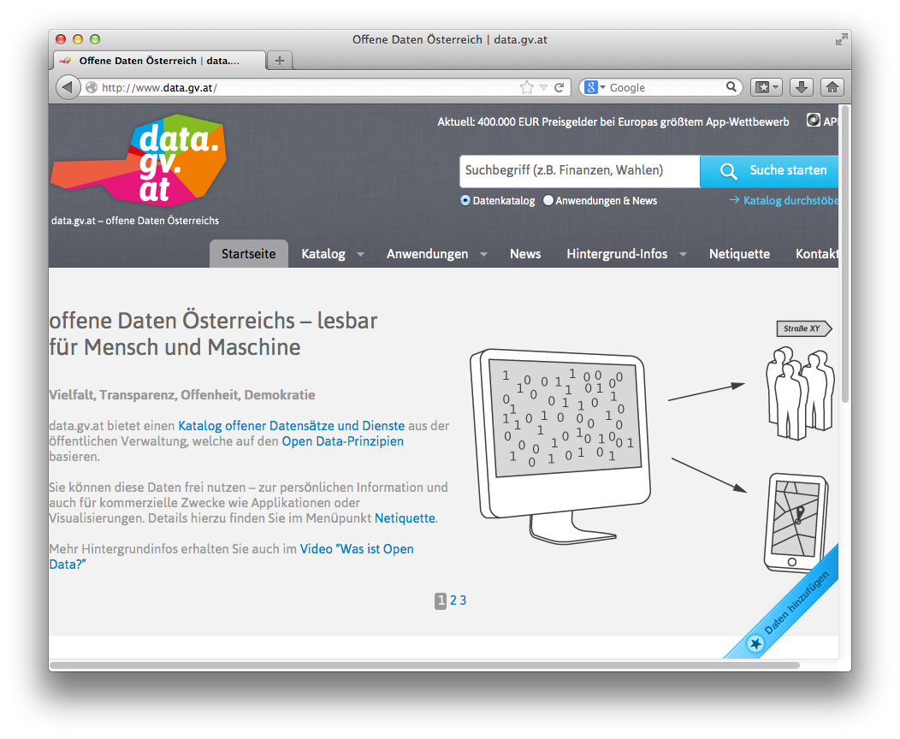
Open Government Data Austria:
Mostly 3-star
  Various interesting aspects
  Standard meta-data catalog
  „grass-roots effort by various
  public bodies (as opposed to e.g. UK)
  Parallel (non-government)
  Open data Platform underway
  Unique license
  Community meetings („BarCamps“)
    E.g. transformation to 4/5-star discussed

Slide 27
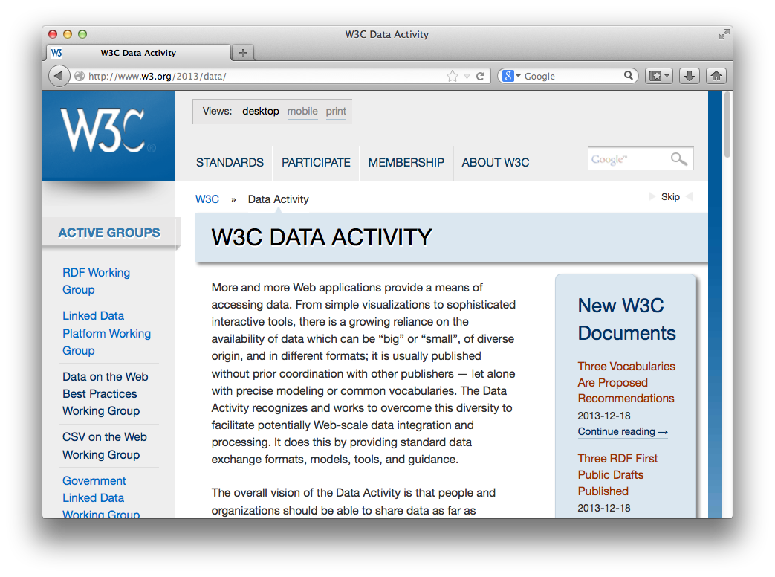
Recent Activities in W3C
W3C Data Activity launched (December 2013!!!)
  Data on the Web Best Practices Group
  CSV on the Web Group
  Provenance WG (PROV)
  Government Linked Data
  Group
  etc. ...

Slide 28

Moment... This lecture was about IoT, wasn‘t it?
Why should you care?

Slide 29
Linked Open Data for IoT?
A lot of this data is actually sensor data
Sensor data can be fruitfully combined with Open Data!

Slide 30
a) Example: Do I need a temperature weather sensor?
Open Data alternatives:
  ZAMG data on data.gv.at:
    http://www.zamg.ac.at/ogd/
  Get it using e.g. curl:
    curl --silent http://www.zamg.ac.at/ogd/ → CSV
BTW, there‘s a lot of Web data APIs that are not Open Data strictly speaking you could use:
  https://developer.yahoo.com/weather/
  Find APIs and mashups:
    http://www.programmableweb.com/
    E.g. Vienna weather:
      http://weather.yahooapis.com/forecastrss?w=551801&u=c
  Get Temperature from Yahoo weather for Vienna (Linux: extract temperature from RSS using XSLT):
    curl --silent "http://weather.yahooapis.com/forecastrss?w=551801&u=c" |xsltproc http://www.polleres.net/rssYahooWeather2Temp.xslt -
  However, take care of terms of use, licenses, etc., e.g. if you want to use the YAHOO API for finding the WOEID for a certain long/lat, you can use https://developer.yahoo.com/boss/geo/ where you need to sign up for an API key...

Slide 31
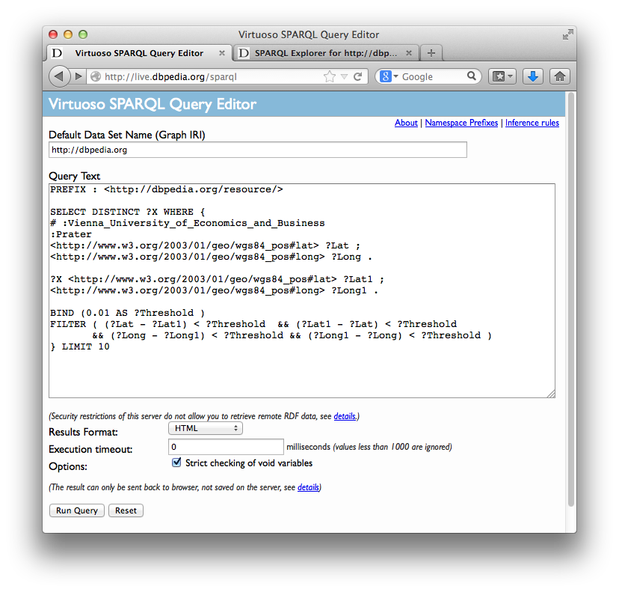
b) Example: Get PoIs from Open Data around your current location from Wikipedia...
Assume you have a GPS sensor... Tell me interesting points of interest around me from Wikipedia:
Example SPARQL query for dbpedia: Link

Slide 32
b) Example: Get PoIs from Open Data around your current location from Wikipedia...
Again, can be done form the commandline conveniently:
curl -H 'Accept: text/csv' --data-urlencode "query=PREFIX : <http://dbpedia.org/resource/>
SELECT DISTINCT ?X WHERE {
:Vienna_University_of_Economics_and_Business
<http://www.w3.org/2003/01/geo/wgs84_pos#lat> ?Lat ;
<http://www.w3.org/2003/01/geo/wgs84_pos#long> ?Long .
?X <http://www.w3.org/2003/01/geo/wgs84_pos#lat> ?Lat1 ;
<http://www.w3.org/2003/01/geo/wgs84_pos#long> ?Long1 .
BIND (0.01 AS ?Threshold )
FILTER ( (?Lat - ?Lat1) < ?Threshold && (?Lat1 - ?Lat) < ?Threshold
&& (?Long - ?Long1) < ?Threshold && (?Long1 - ?Long) < ?Threshold )
} LIMIT 10" --get http://live.dbpedia.org/sparql

Slide 33
Potentially interesting Linked Open Data for you:
http://data.gv.at, https://open.wien.at/
http://live.dbpedia.org/
http://eurostat.linked-statistics.org/sparql
...
SPARQL: find Tutorials and many examples on my Web page (http://polleres.net/presenations/ )

Slide 34
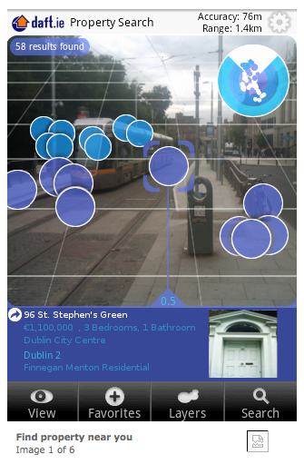
Augmented Reality with Web Data, example daft.ie:
http://www.daft.ie/layar
Similar portal in Austria:
  Zoomsquare.at (an „Open Data“
  startup)

Slide 35
Sensor data as Linked Data examples:
http://lsm.deri.ie/

Slide 36
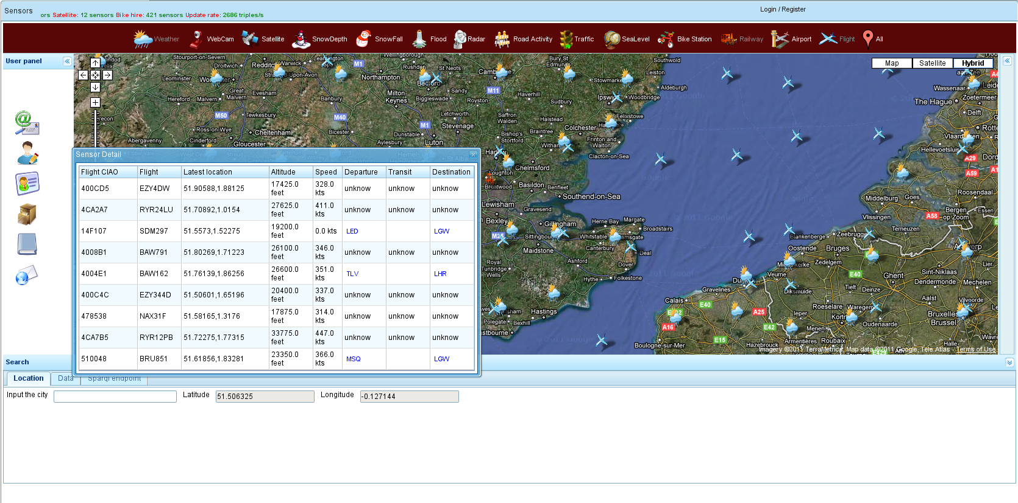
LSM: Live flights info

Slide 37
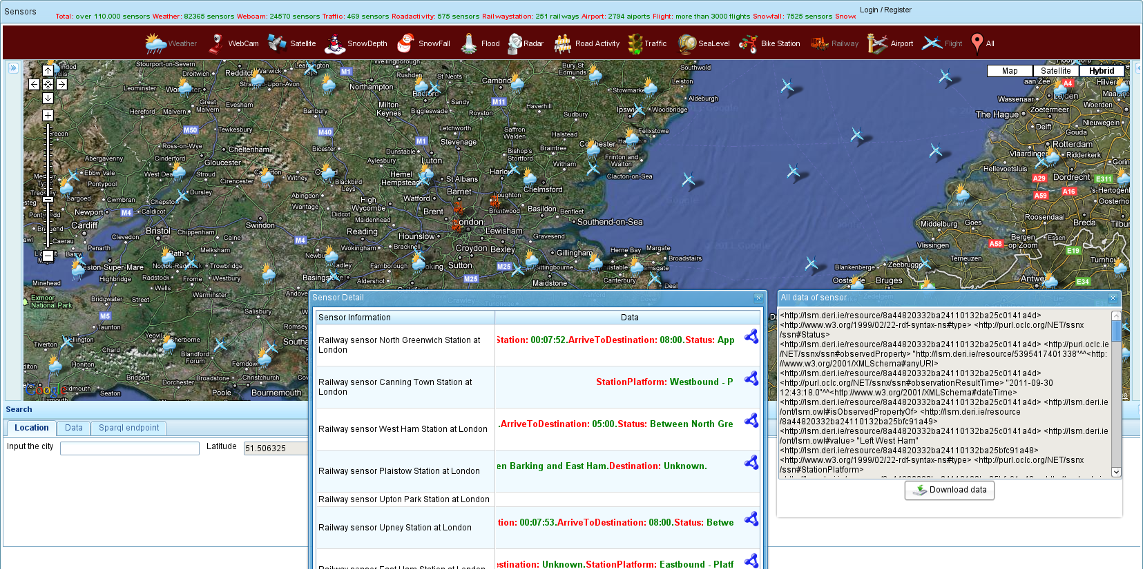
LSM: Live train info

Slide 38
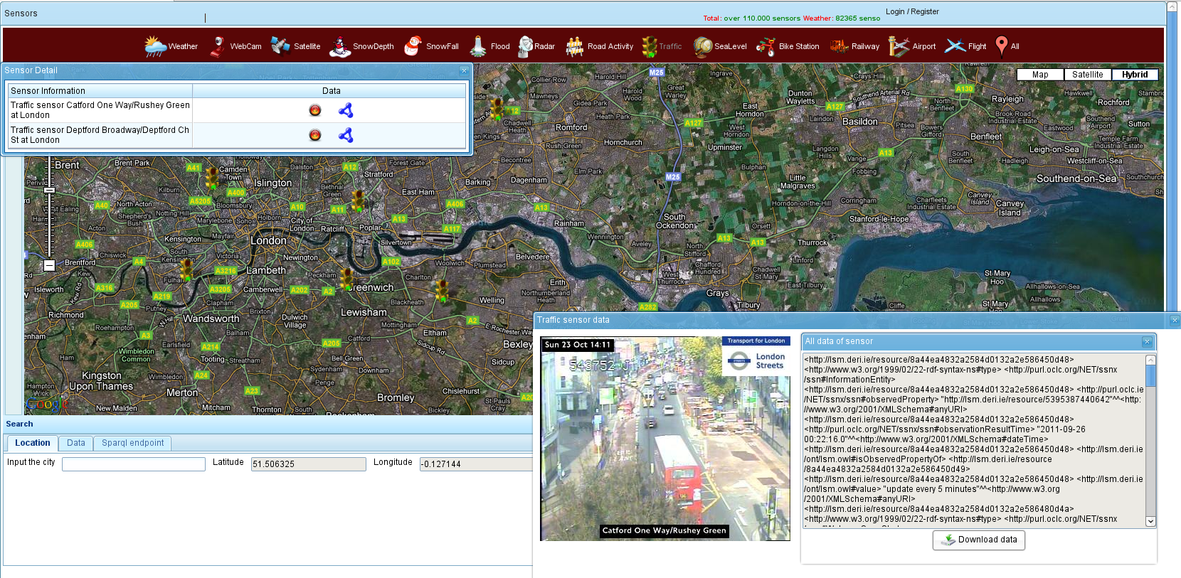
LSM: Live traffic info

Slide 39
Several IoT projects that use and promote Linked Data:
Excellent Examples e.g. by
Payam Barnaghi (Univ. surrey, UK):
http://www.slideshare.net/PayamBarnaghi/data-modeling-and-knowledge-engineering-for-the-internet-of-things
Manfred Hauswirth (NUI Galway, IE):
http://videolectures.net/eswc2013_hauswirth_data/
Various EU projects on IoT and Linked Data, e.g. CityPulse (Siemens)

Slide 40
Standards around IoT and RDF, Linked Data & Open Data in W3C
W3C RDF Stream Processing (RSP) Community Group
http://www.w3.org/community/rsp/
W3C Semantic Sensor Network Incubator Group
http://www.w3.org/2005/Incubator/ssn/
W3C CSV on the Web Working group
http://www.w3.org/2013/csvw
W3C Data on the Web Best Practices Working
http://www.w3.org/2013/dwbp/

Slide 41
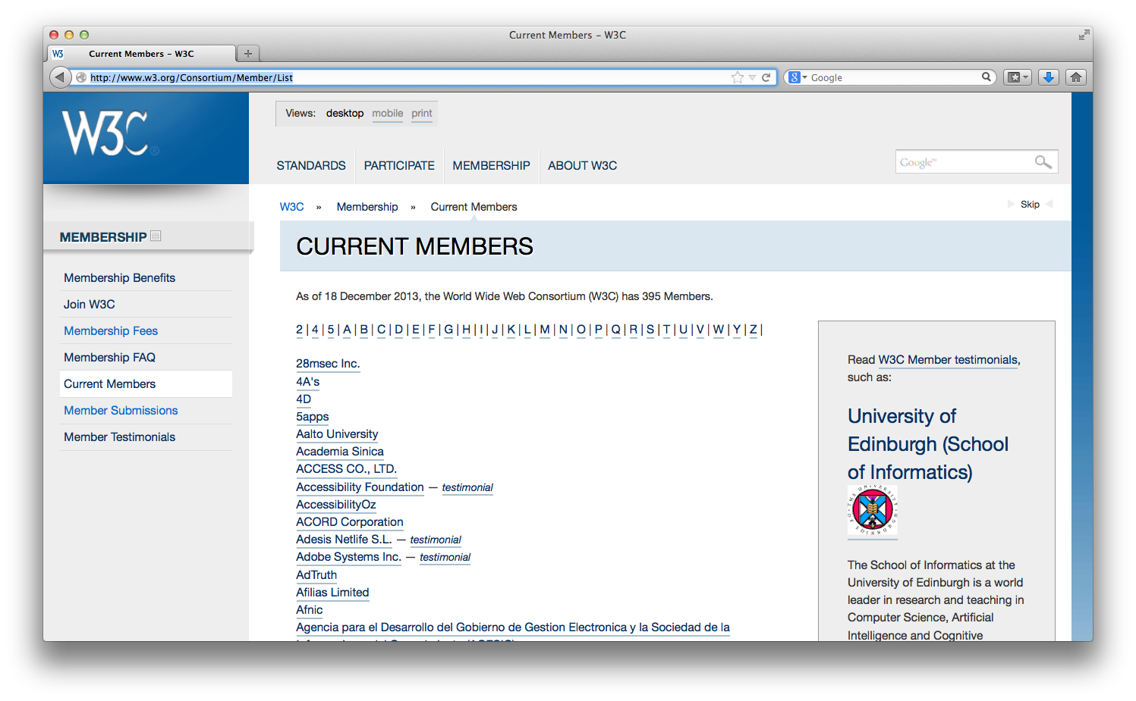
Advertisement
What does WU do in this area?
WU joined W3C from
Jan 2014!
If you want to join
research in this area,
look at our Inst. & Dept.
Web page!
Planned (theses, student projects):
OpenData@WU http://www.wu.ac.at/infobiz/

Slide 42
Acknowledgements:
Thanks to
Payam Bharaghi,
Hauswirth
Oscar Corcho
... for allowing me to re-use some of their slides!

