Slide 1
Web Standards and Technical Challenges for Publishing and Processing Open Data
Axel Polleres
web: http://polleres.net twitter: @AxelPolleres

Slide 2
Outline
Open Data != Big Data ... What is Open Data?
What is Linked (Open) Data?
Why do standards matter?
Challenges in Consuming Open Data

Slide 3

What is Open Data?
Availability and Access: the data must be available as a whole and at no more than a reasonable reproduction cost, preferably by downloading over the internet. The data must also be available in a convenient and modifiable form.
Reuse and Redistribution: the data must be provided under terms that permit reuse and redistribution including the intermixing with other datasets. The data must be machine-readable.
Universal Participation: everyone must be able to use, reuse and redistribute – there should be no discrimination against fields of endeavour or against persons or groups. For example, ‘non-commercial’ restrictions that would prevent ‘commercial’ use, or restrictions of use for certain purposes (e.g. only in education), are not allowed.
See more at: http://opendefinition.org/okd/
Open Knowledge Foundation

Slide 4
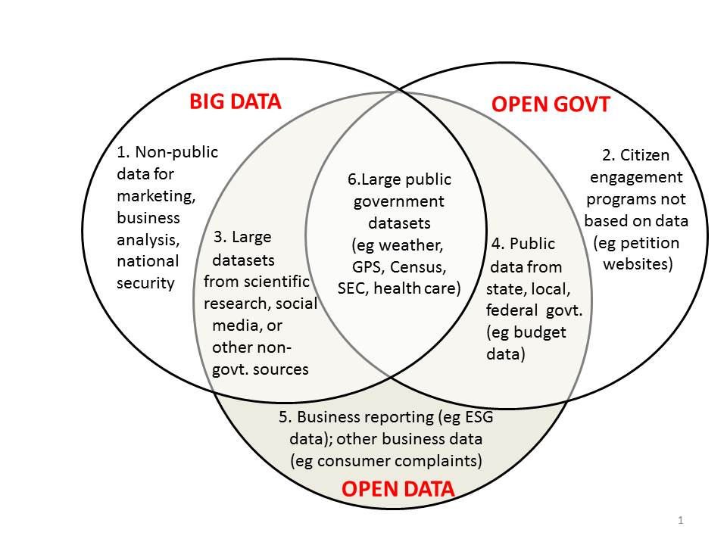
Open Data vs. Big Data
http://www.opendatanow.com/2013/11/new-big-data-vs-open-data-mapping-it-out/

Slide 5








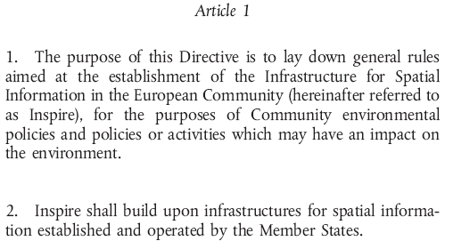
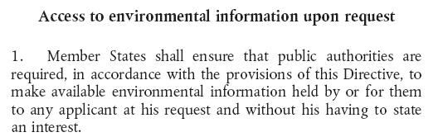
Open Data Providers & Motivations, examples:
  “Bottom-up”: UN, Worldbank, Wikipedia, Cities, Governments:
    “Top-down” e.g. EU INSPIRE directive, PSI directive, Eurostat, EEA,…
DIRECTIVE 2007/2/EC INSPIRE
Directive 2003/98/EC PSI Directive
DIRECTIVE 2003/4/EC Public Access to Environmental Information
Notes:
5

Slide 6
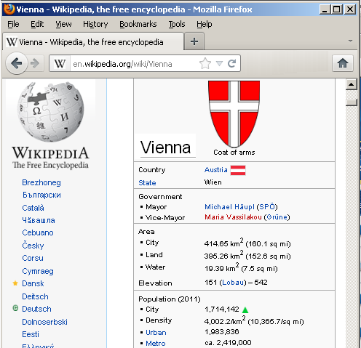
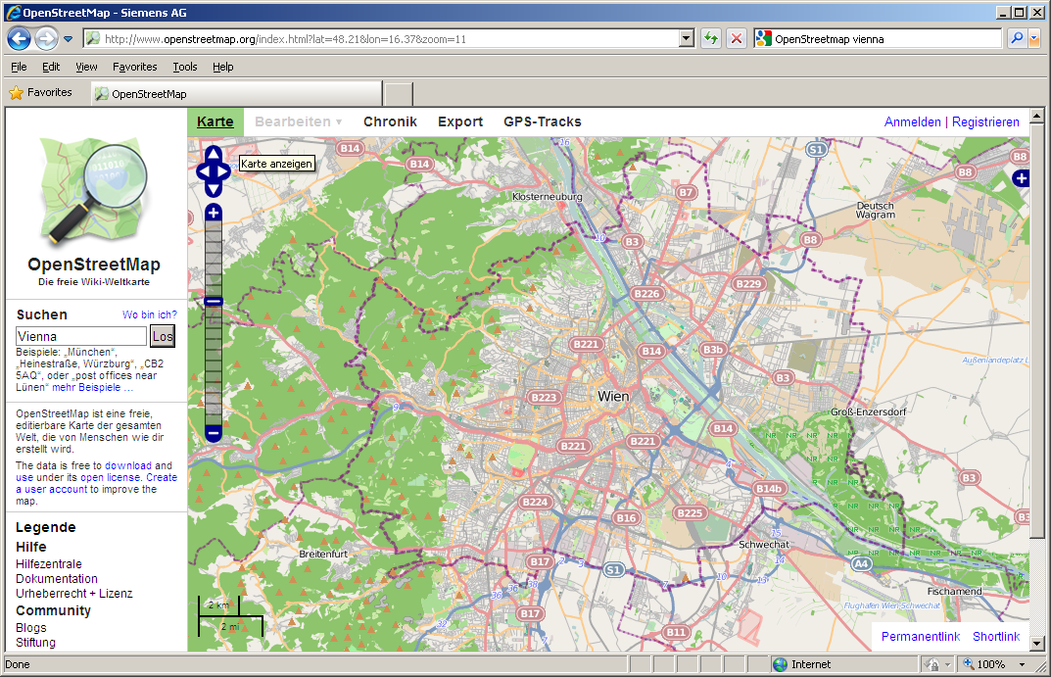
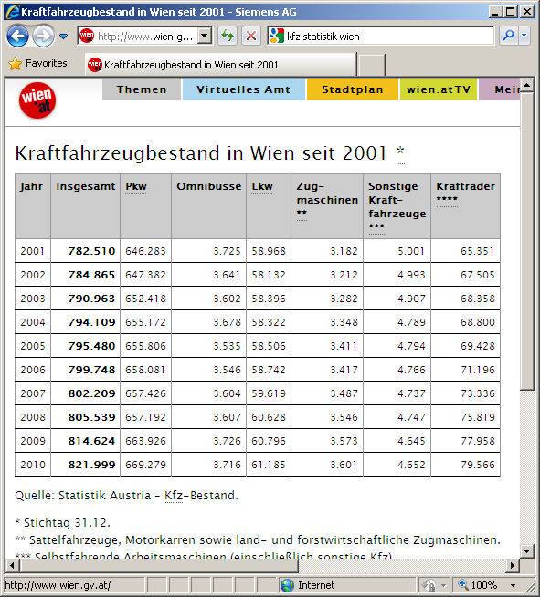
Example Open Data Sources: it’s not only governmental data… but also user-generated content!
Free GIS data for most countries & cities in the world (base information: area, land-use, administrative districts, …)
e.g. Structured information on most cities and points of interest in the world (location, population, economy, weather, climate, ...)
Open Government Data
6

Slide 7
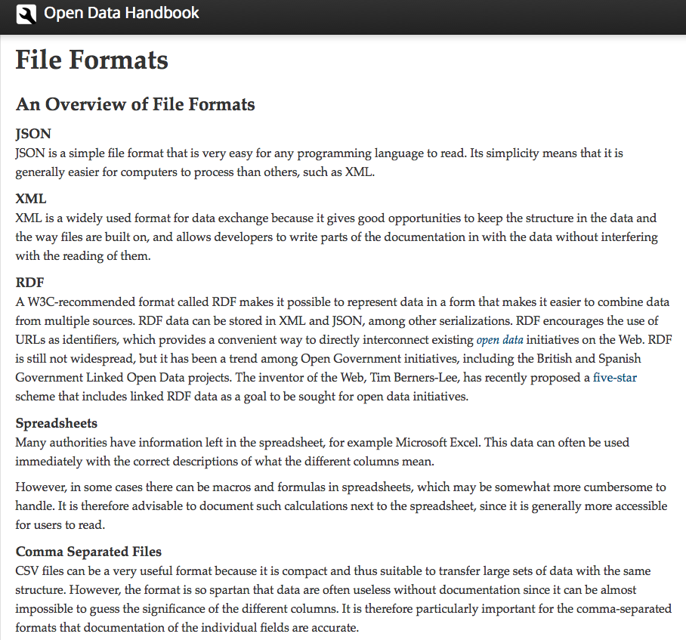
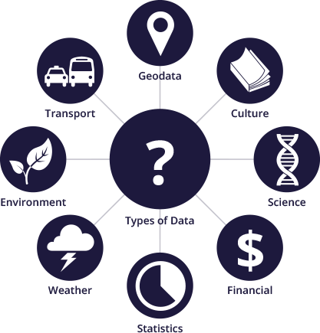
Domains and Types of Data:
http://assets.okfn.org/images/data-types.png
http://opendatahandbook.org/en/appendices/file-formats.html

Slide 8
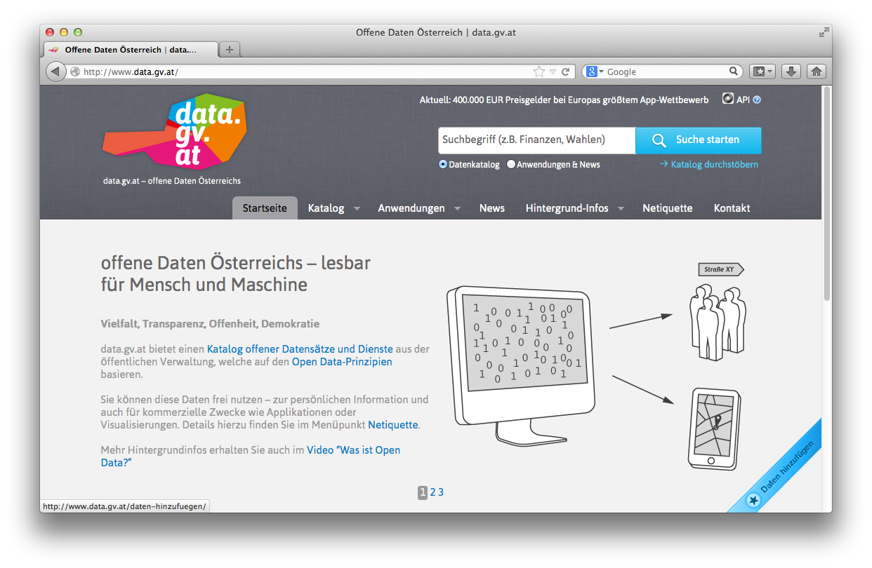
Open Data Portals
CKAN ... http://ckan.org/
almost „de facto“ standard for Open Data Portals
facilitates search, metadata (publisher, format, publication date, license, etc.) for datasets
http://datahub.io/
http://data.gv.at/
machine-processable? ...
... partially

Slide 9
Still... Challenges regarding machine-readability:
... Missing/wrong meta-data
related datasets are not linked
searching for the right dataset is difficult

Slide 10
Standards to the rescue:
Towards more machine-processable Data publishing: Linked Data!

Slide 11
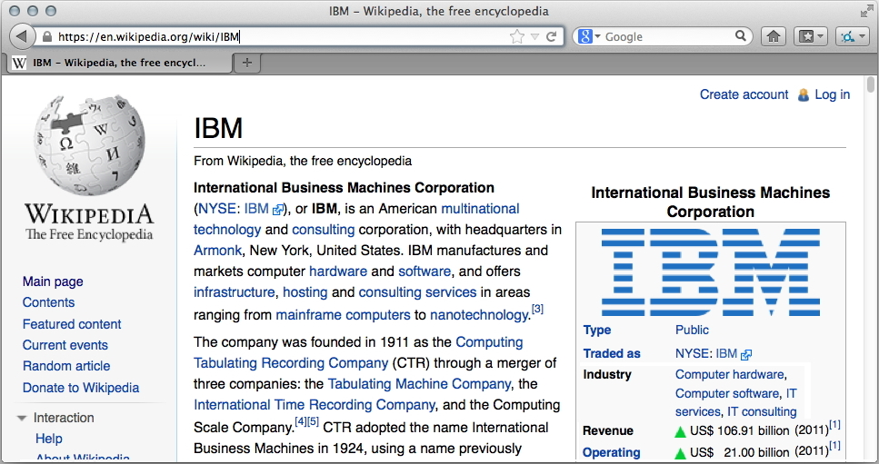
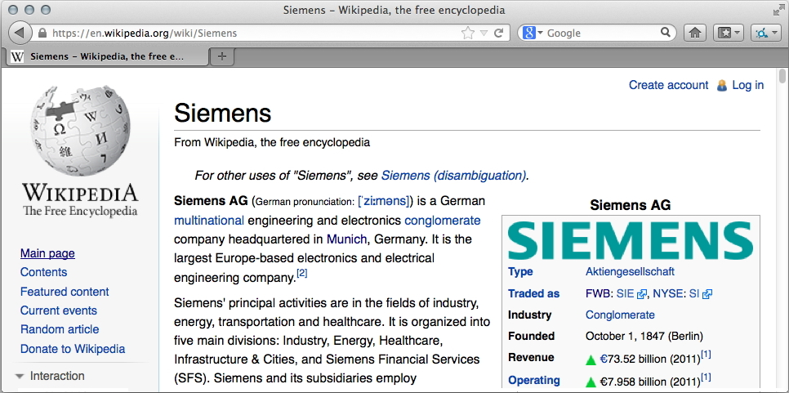
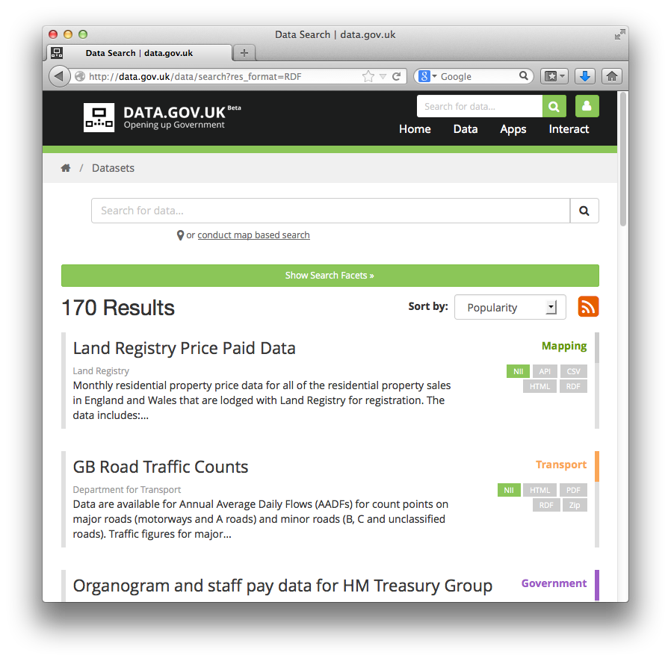
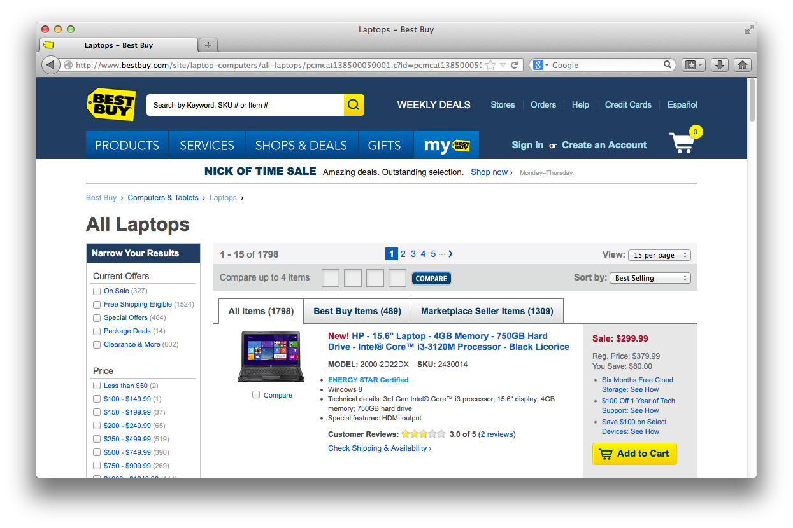
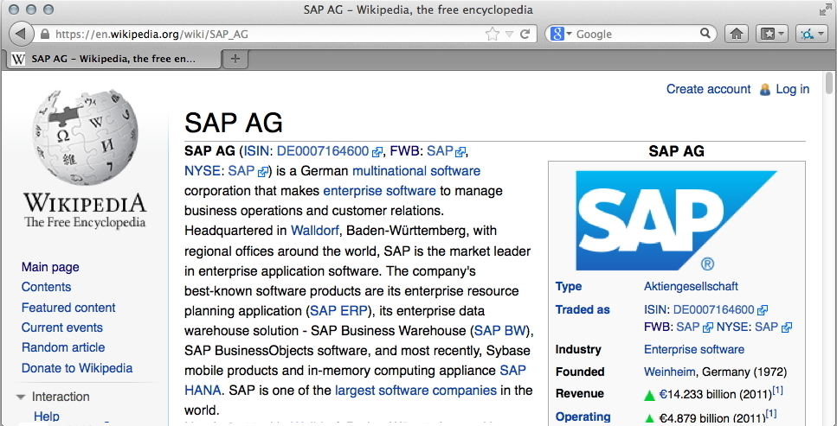
Data on the Web: the Web is not only a place for documents!
Most Web pages are created dynamically... from Data
  Data from user-generated content...
  Data from public administration...
  Data from companies...
In the course of the trend for „Open Data“
a lot of this Data is being published
directly on the Web, but rarely interlinked

Slide 12
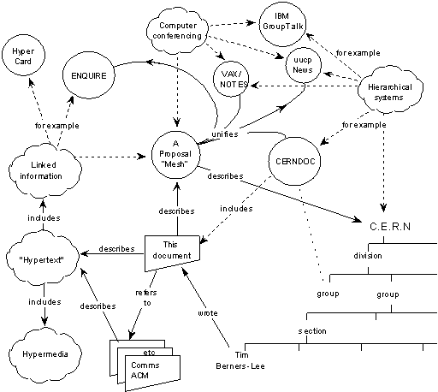

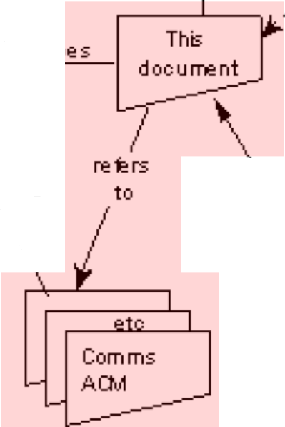

The Web 1989…
Globally Unique identifiers
Links between Documents (href)
A common protocol
URIs
“This proposal concerns the management of general information about accelerators and experiments at CERN
[…] based on a distributed hypertext system. “
HTTP
<p>I work <a href=“http://wu.ac.at”>here</a></p>

Slide 13
The Web of Data… RDF
Globally Unique identifiers
Links between Documents (href)
A common protocol
Globally Unique identifiers
Typed Links between Entities
A common protocol
URIs
RDF
HTTP
xmlns.com/foaf/0.1/wokplaceHomepage
wu.ac.at
<p about="#me">I work <a rel=“foaf:workplaceHomepage” href=“http://wu.ac.at”>here</a></p>
polleres.net#me
<p>I work <a href=“http://wu.ac.at”>here</a></p>
Person
University

Slide 14
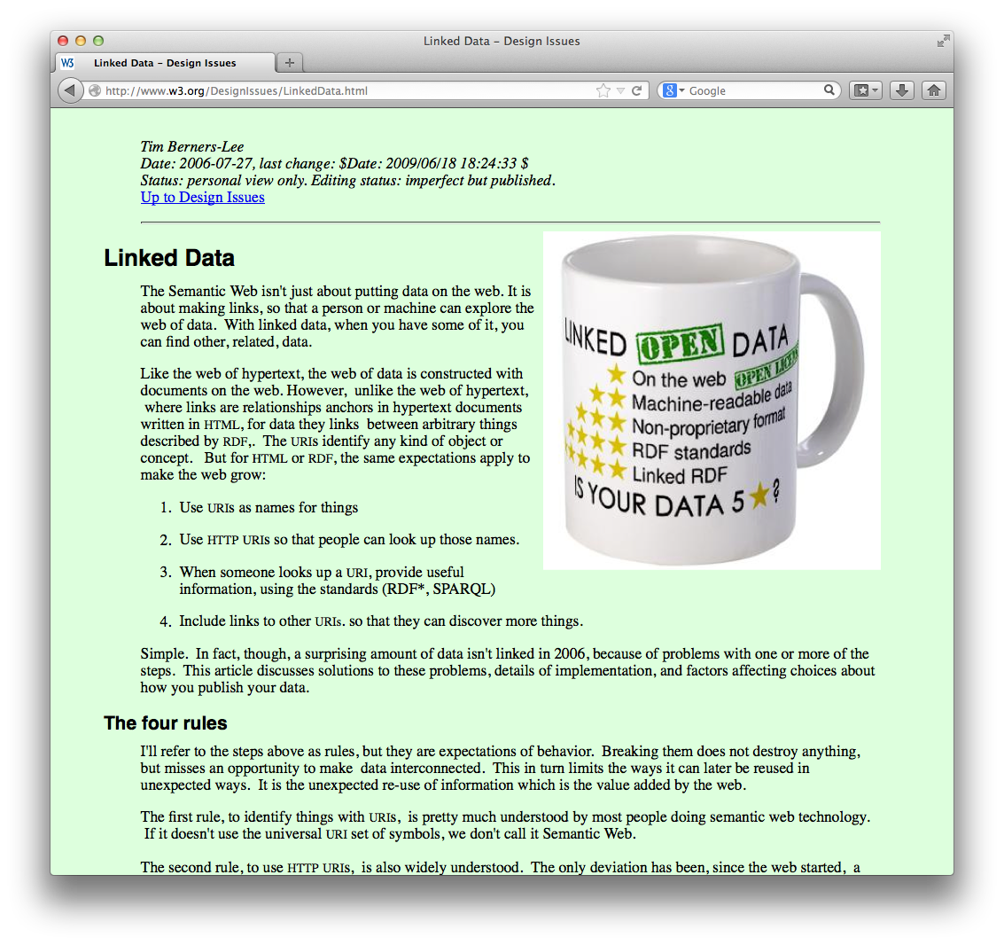
What is the idea of Linked Data?
Standards to publish data on the Web
  machine readable
  machine processable
  Make data interlinked just as Web-pages!

Slide 15
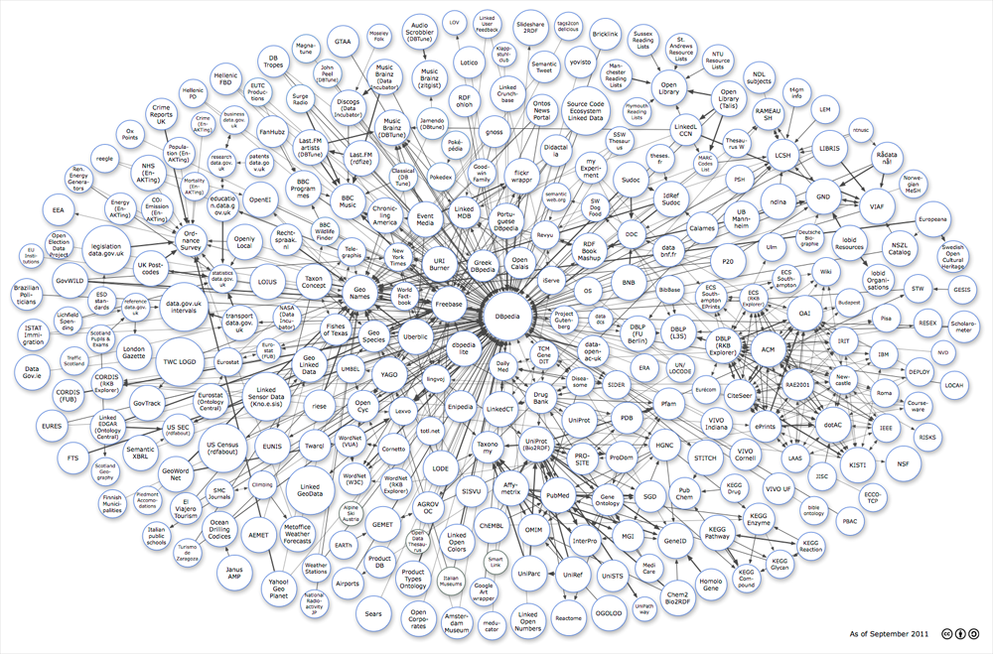


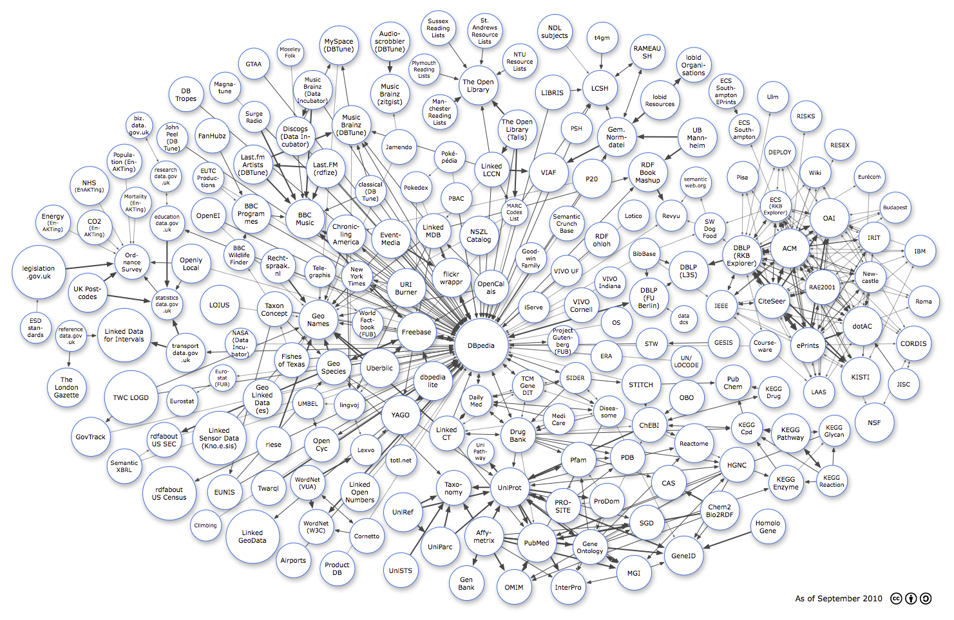
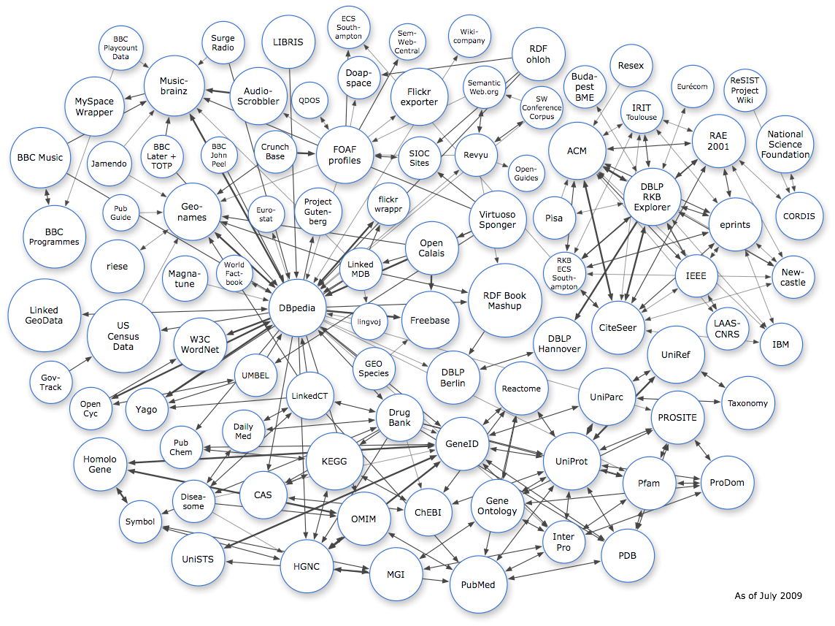
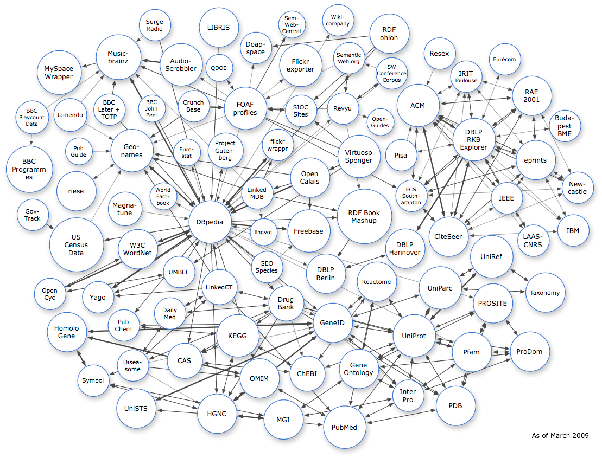
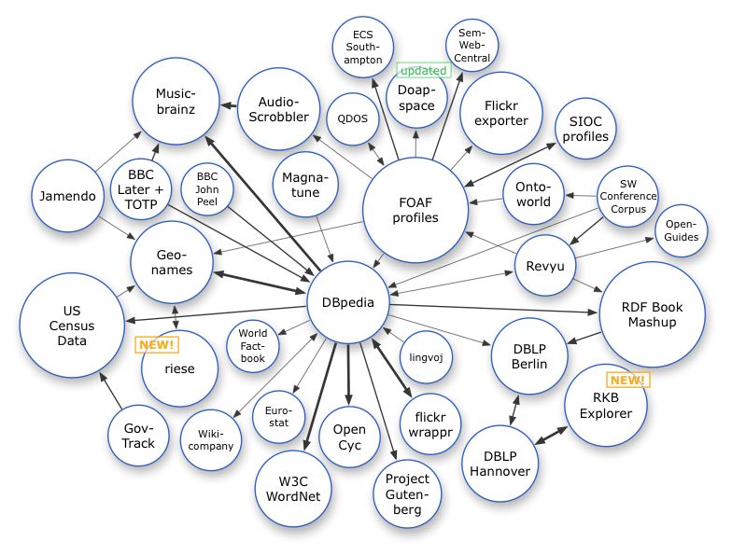






Linked Data on the Web: Adoption
Image from: http://lod-cloud.net/
March 2008
July 2009
March 2009
Sep. 2011
15
Sep. 2010

Slide 16







Linked Data is moving from academia to industry

Slide 17

In the last few years, we have seen many successes, e.g. …
Watson
Knowledge Graph

Slide 18
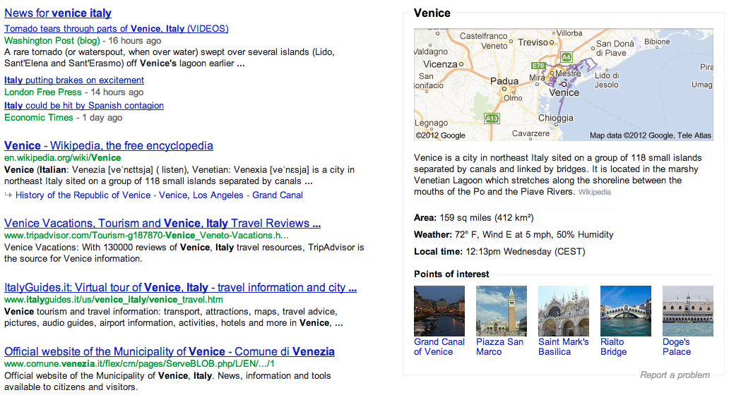
Google Knowledge Graph

Slide 19
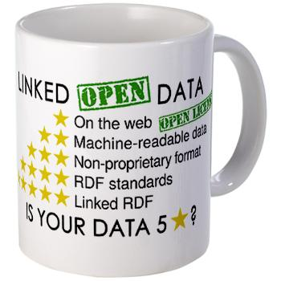
5-Star Schema for Open Data:
Still, full Linked Data might be asked „too much“ by Open data providers...
★ Make data/documents available on the Web
★★ Make it available as structured data
(e.g., an Excel sheet instead of image scan of a table)
★★★ Use a non-proprietary format
(e.g., a CSV file instead of an Excel sheet)
★★★★ Use linked data format
(i.e., URIs to identify things, and RDF to represent data)
★★★★★ Link your data to other people’s data to provide context
Source: http://inkdroid.org/journal/2010/06/04/the-5-stars-of-open-linked-data/

Slide 20
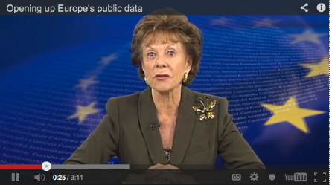
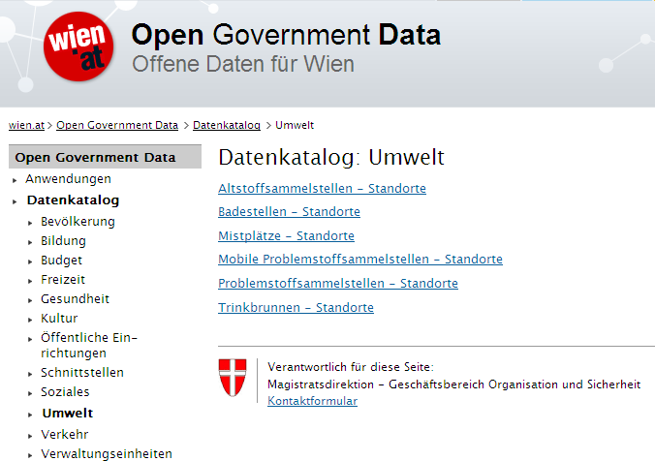
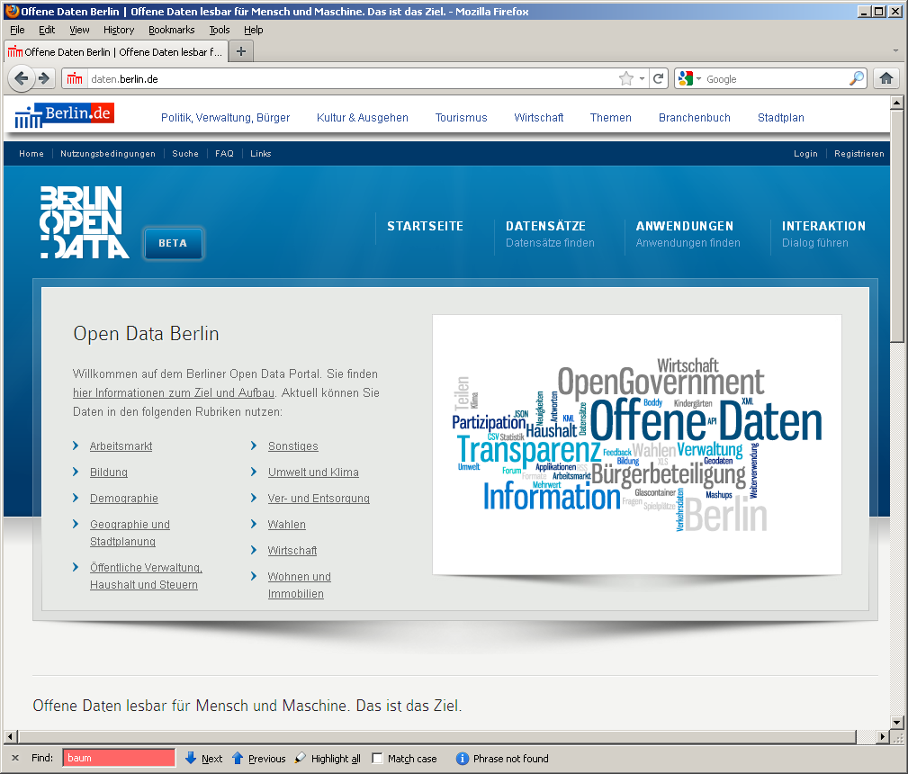
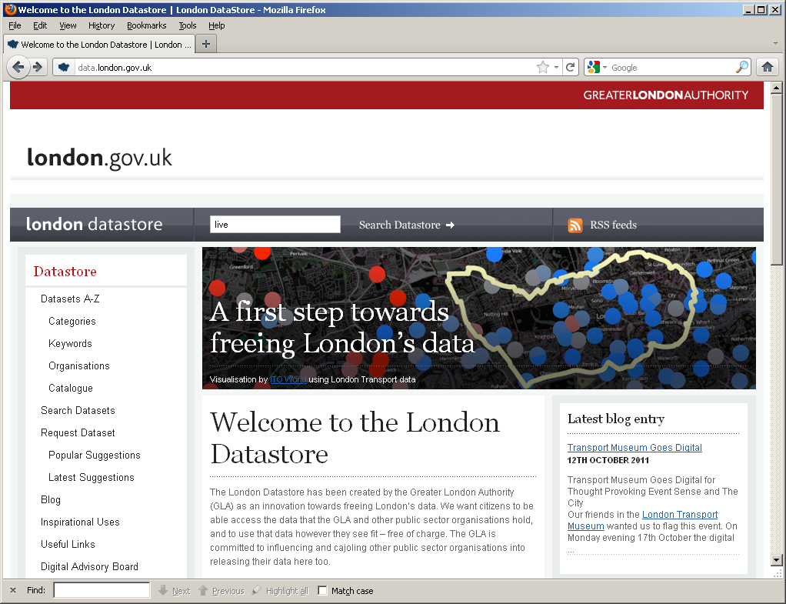

Open Data Trends, Future & Challenges
DIRECTIVE 2007/2/EC INSPIRE
Open Data: Typically very liberal licenses (variants of CC), but still mixed
Many formats, varying quality, harmonization starting
Mostly by online communities or public bodies (cities, communities, governments, UN,…)
  Currently focused mostly in SMEs to take advantage of that data
vs. Publicly available data: e.g. NYT is public but not free/not license free
vs. Enterprise (Linked) Data

Slide 21
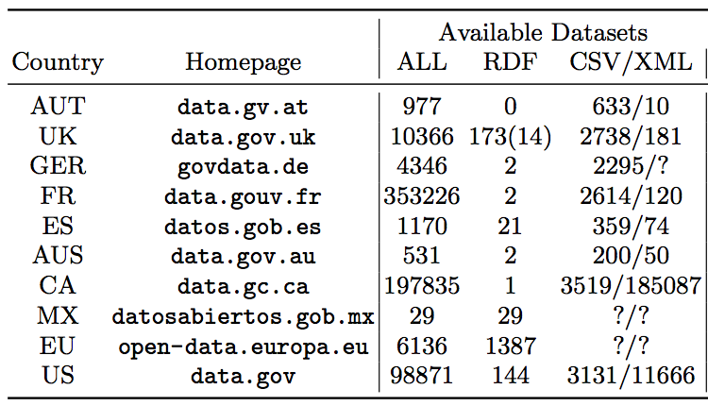
Open Data – Status:
Mostly 3-star Open Data...
... RDF and Linked Data are starting to be adopted by Open Government Data.
Some exceptions: US, UK, EU

Slide 22
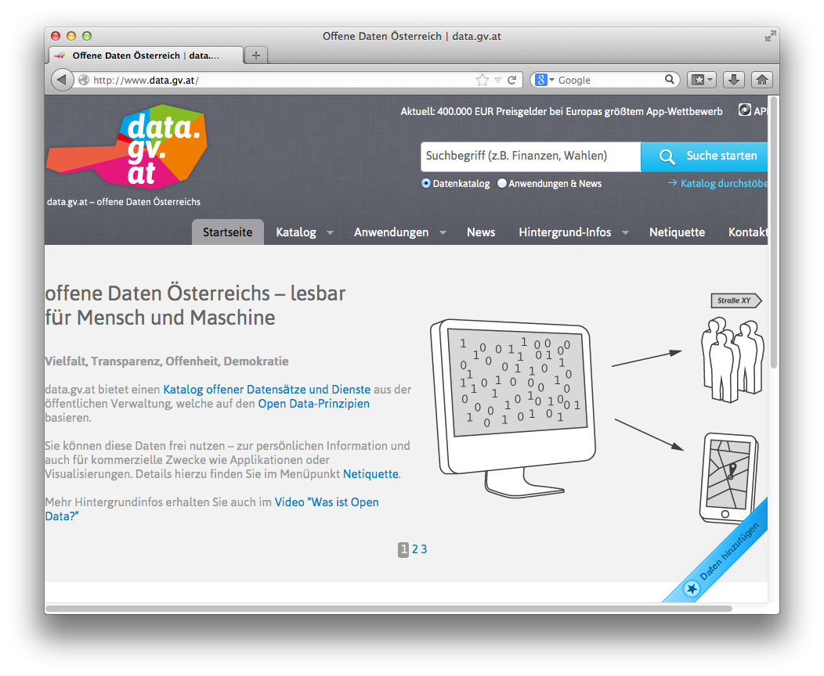

Open Government Data Austria:
Mostly 3-star
  Various interesting aspects
  Standard meta-data catalog
  „grass-roots effort by various
  public bodies (as opposed to e.g. UK)
  Parallel (non-government)
  Open data Platform underway
  Unique license
  Community meetings („BarCamps“)
    E.g. transformation to 4/5-star discussed
    The portal just won the UN Public Service Award 2014!

Slide 23
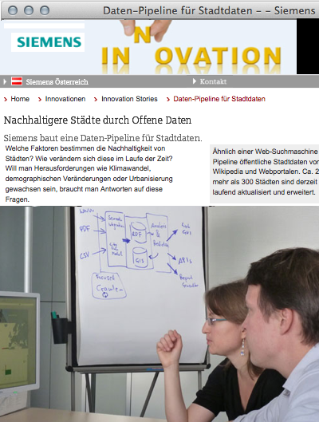
Can Open Data be used by industry?
Use Case: Building an Open City Data Pipeline...

Slide 24
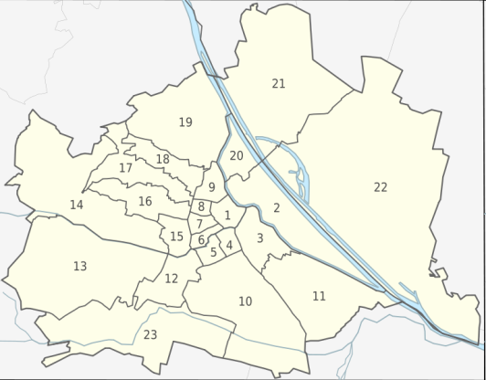
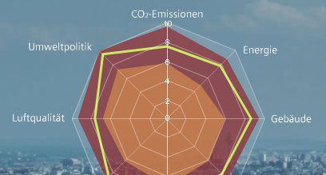
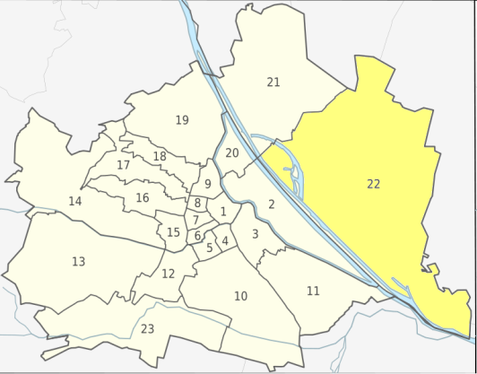





City Data Pipeline: Overview
Aspern
Donaustadt
Dynamic Calculation of KPIs at variable Granularity (City, District, Neighbourhood, Building)
3. Analysis/Statistical Correlation/Aggregation: Statistical Methods, Semantic Technologies, Constraints
Extensible CityData Model
2. Semantic Integration: Unified Data Model, Data Consolidation
1. Periodic Data Gathering of registered sources (“Focused Crawler”): Various Formats (CSV, HTML, XML … ) & Granularity (monthly, annual, daily)
Cities: + Open Data:
Berlin, Vienna, London, …

Slide 25
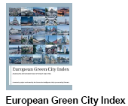
Collected Data vs. Green City Index Data: Overlaps
We identified 20 quantitative raw data indicators that are overlapping between the Siemens’ “Green City Index” and our current Data sources. The picture below visualizes the availability of data for these indicators for the cities of the European GCI:
>65% of raw date could be covered by publically available data that we have collected automatically
Data quality?
Not all indicators are 100% comparable (different scales, units, etc., sources of different quality)
for some indicators (e.g. Population) already less than 2% median error.
The more data we collect, the better the quality!

Slide 26
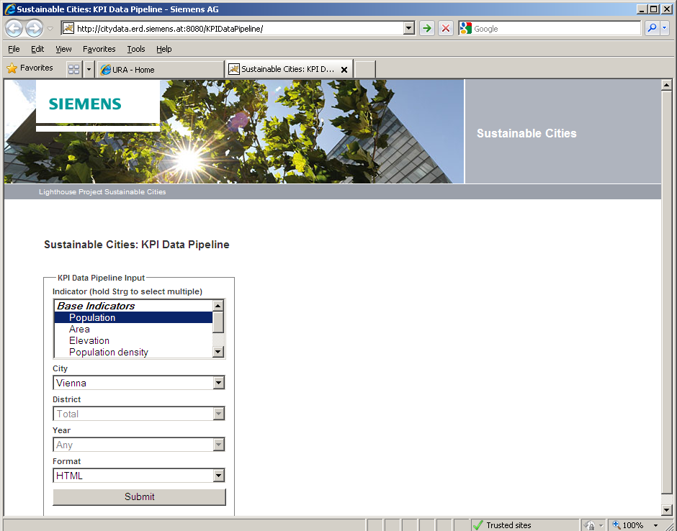
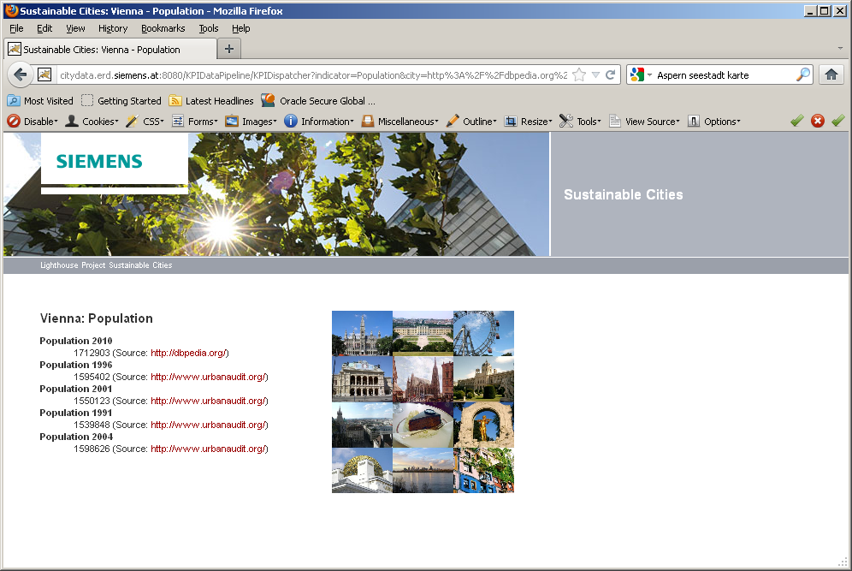
City Data Pipeline: Web Interface
    Our Web interface allows to browse data and download complex composed KPIs as Excel sheets (e.g. “Transport related CO2 emissions for Berlin”):
2
Browse available Open Data sources that contain the requested indicators

Slide 27
Challenges & Lessons Learnt –
Is Open Data fit for industry?
Base assumption (for our use case):
Added value comes from comparable Open datasets being combined
Notes:
Don‘t get me wrong! It‘s great to have so much open data around and available and increasingly so, but maybe

Slide 28
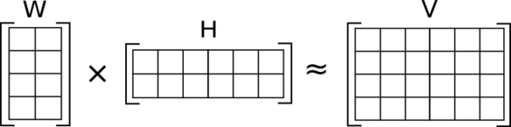
Challenges & Lessons Learnt –
Is Open Data fit for industry?
Incomplete Data: can be partially overcome
  By ontological reasoning (RDF & OWL) = formalizing "background knowledge"
  By statistical methods and data mining, e.g.Multi-dimensional Matrix Decomposition:
Incomparable Data:
    dbpedia:populationTotal
    dbpedia:populationCensus
Heterogeneity across Open Government Data efforts:
    Different Indicators, Different Temporal and Spatial Granularity
    Different Licenses of Open Data: e.g. CC-BY, country specific licences, etc.
    Heterogeneous Formats (CSV != CSV) ... Maybe the W3C CSV on the Web WG will solve this issue)
    Open Data needs strong standards to be useful
    Gaining Knowledge from Open Data has high potential, but still needs research!
Notes:
Goal of this project: Do things before we finish the dabate about the challenges and standards.
Metadata-standards for provenance and PROV might help, RDF1.1 might help, but not readily deployed.
Top-level ontologies needed...
Yesterday at OFK meetup: „We really want high-quality datasets out there.“
To summarize, problems arising from the data:
* 96% of all data entries are missing (or 70% when ignoring the year dimension)
* the data is not missing at random (e.g. smaller cities are less likely to have temperature data)
* (the majority of) indicators are correlated
* there may be multiple values for the same (city, indicator, year) coordinate.
No indicator is truly gaussian/normal distributed (using a negentropy measure [6], area/population indicators are close, while for example augSun is closer to linear)
The multiple input values for that same city x indicator x year
Idea of matrix decomposition is that indicators can be “grouped”
every city is then to some degree a linear combination of these categories
For the current algorithm we used a two-dimensional matrix (no time).
We applied this relatively naively now.
We have heard already in the keynote by Mr Wrobel this morning: that standards are eventually what we need to make Open data more usable comparable and processable
Not only interesting for SMEs

Slide 29
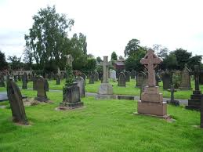
Open Data vs. Big Data
http://www.opendatanow.com/2013/11/new-big-data-vs-open-data-mapping-it-out/
Aggregated Open Data from various , heterogeneous sources and different portals will potentially become "Big Data" over time
Serving Open Data "at scale" might become a challenge the more Open Data is being used!
We need big data technologies to avoid creating yet another data graveyard

Slide 30
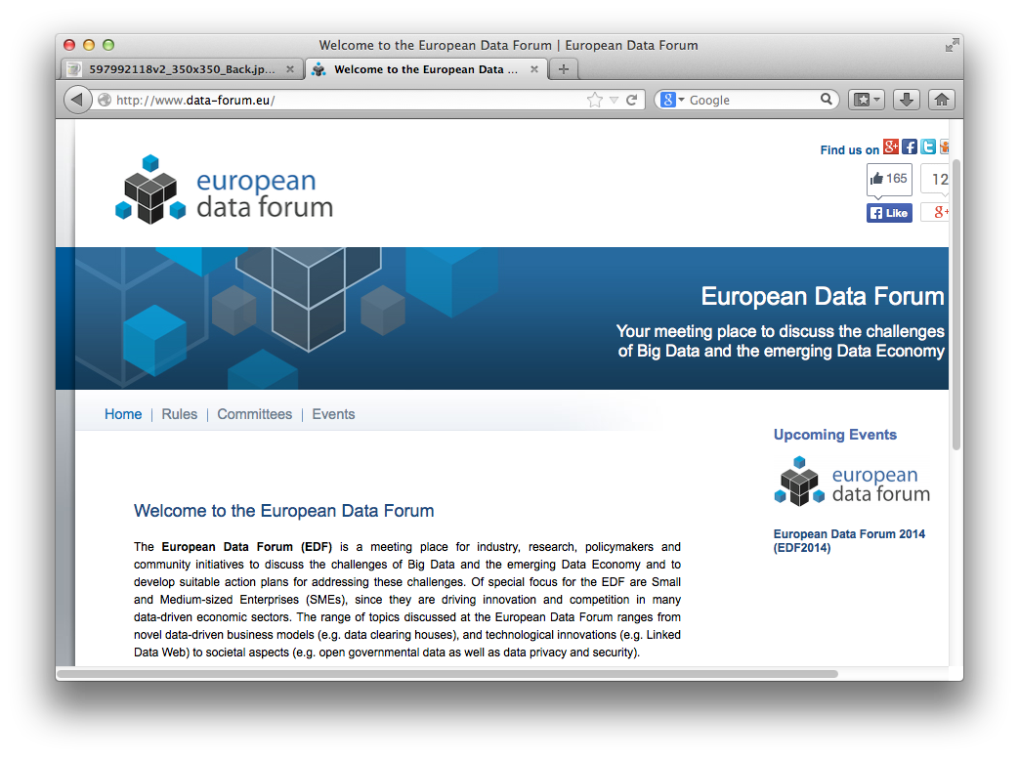
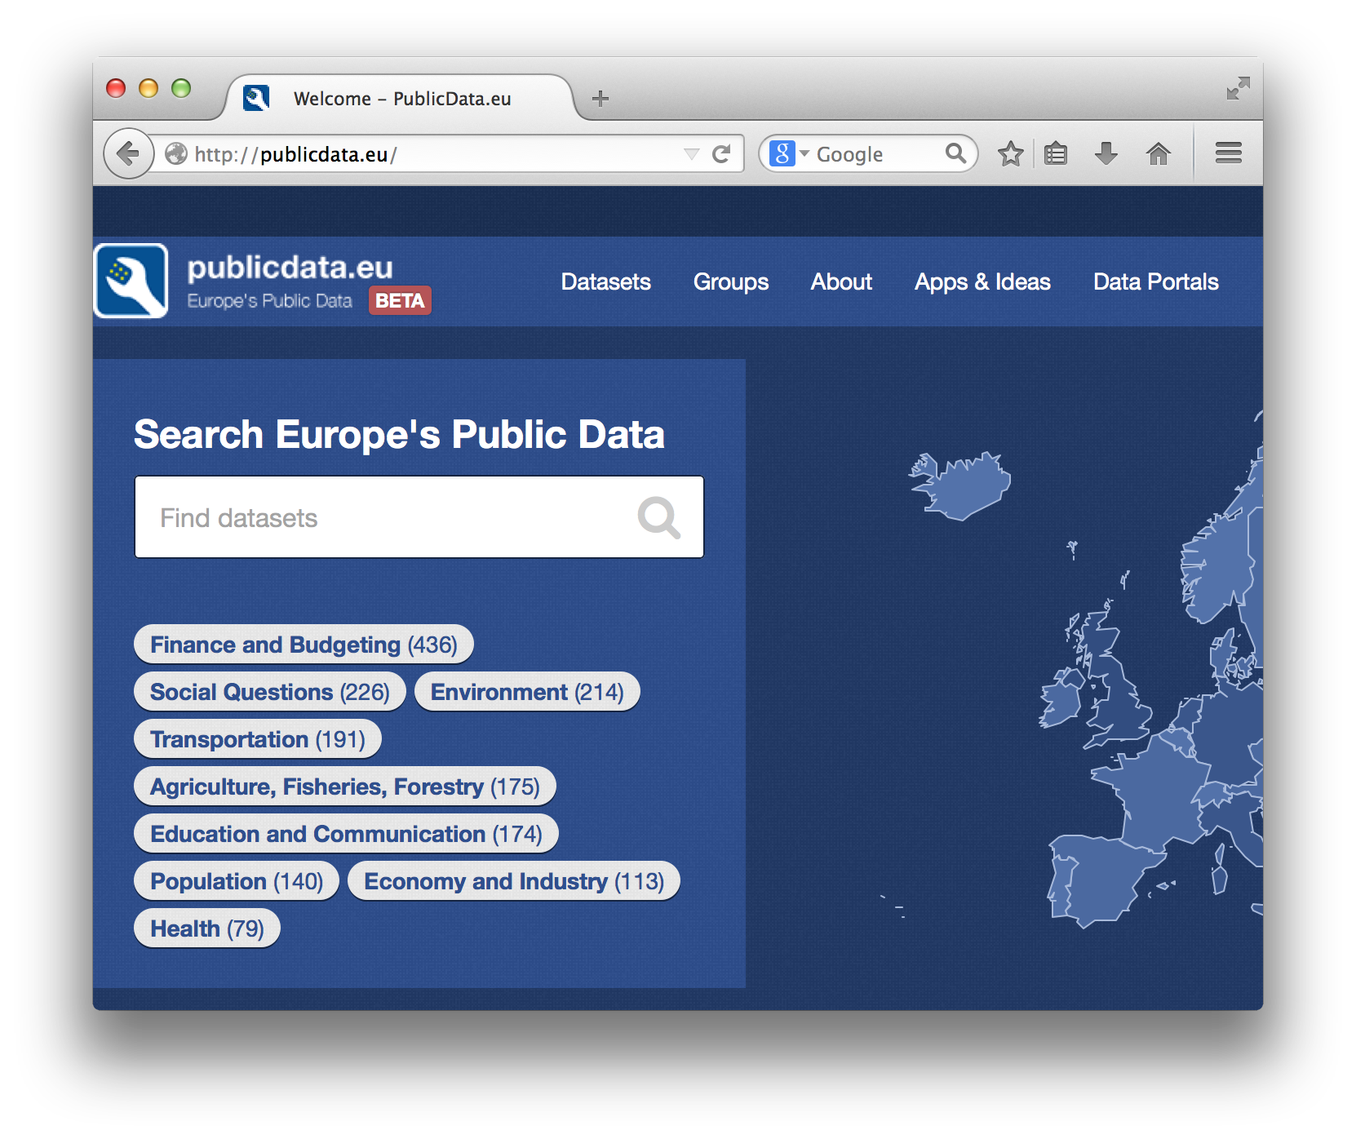
EU is pushing Linked Data Standards

Slide 31
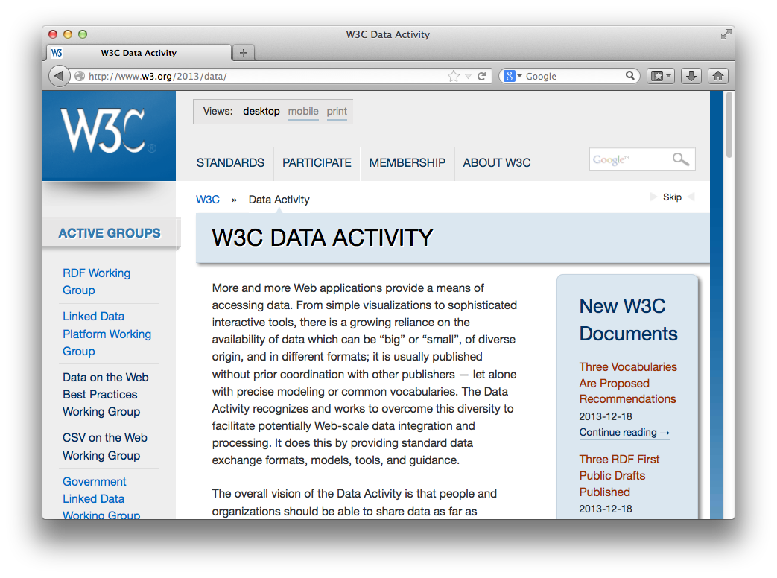

Recent Activities in Standardisation: W3C
W3C Data Activity launched (December 2013!!!)
  Data on the Web Best Practices Group
  CSV on the Web Group
  Provenance WG (PROV)
  Government Linked Data
  Group
  etc. ...
  Also just founded
  a data quality working group!

Slide 32

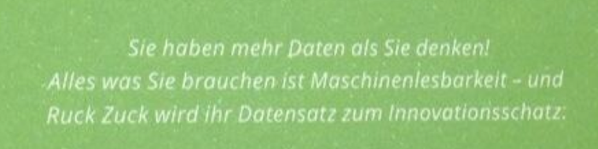
Open your data!
A "sister" portal for http://data.gv.at for non-governmental open data launching soon
1 July 2014
http://www.opendataportal.at/
Thank you!

