Slide 1
How can you use Open Data? ... And why you should!
Axel Polleres
web: http://polleres.net twitter: @AxelPolleres

Slide 2
What is Open Data?
Availability and Access: the data must be available as a whole and at no more than a reasonable reproduction cost, preferably by downloading over the internet. The data must also be available in a convenient and modifiable form.
Reuse and Redistribution: the data must be provided under terms that permit reuse and redistribution including the intermixing with other datasets. The data must be machine-readable.
Universal Participation: everyone must be able to use, reuse and redistribute – there should be no discrimination against fields of endeavour or against persons or groups. For example, ‘non-commercial’ restrictions that would prevent ‘commercial’ use, or restrictions of use for certain purposes (e.g. only in education), are not allowed.
See more at: http://opendefinition.org/okd/
Open Knowledge Foundation

Slide 3
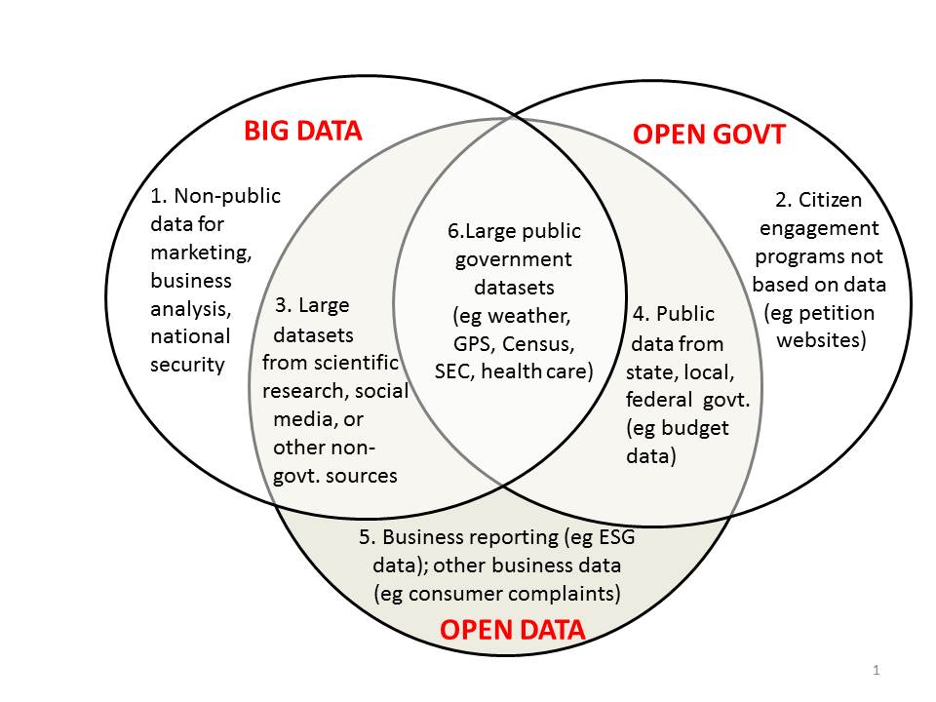
Open Data vs. Big Data
http://www.opendatanow.com/2013/11/new-big-data-vs-open-data-mapping-it-out/

Slide 4
Open Data is a global trend:
Cities, International Organizations, National and European Portals, Int'l. Conferences:
Notes:
4

Slide 5
In today's talk:
2 projects on recent projects at WU:
What is the status of Open Data and what are the challenges using Open Data?
OpenData PortalWatch – a project at WU
How can Open Data be used?
Open City Data Pipeline – a joint project with Siemens on using Open Data
What's next?
Improving Open Data Quality: ADEQUATE (FFG - project)
Why should you care?
WU can help you in your Open Data Strategy!

Slide 6
Challenges: Open Data also has the "Vs"
Volume:
It's growing! (we currently monitor 90 CKAN portals, 512543 resources/ 160069 datasets,
at the moment (statically) ~1TB only CSV files...
Variety:
different datasets (from different cities, countries, etc.), only partially comparable, partially not.
Different metadata
Different data formats
Velocity:
Open Data changes regularly (fast and slow)
New datasets appear, old ones disappear

Slide 7
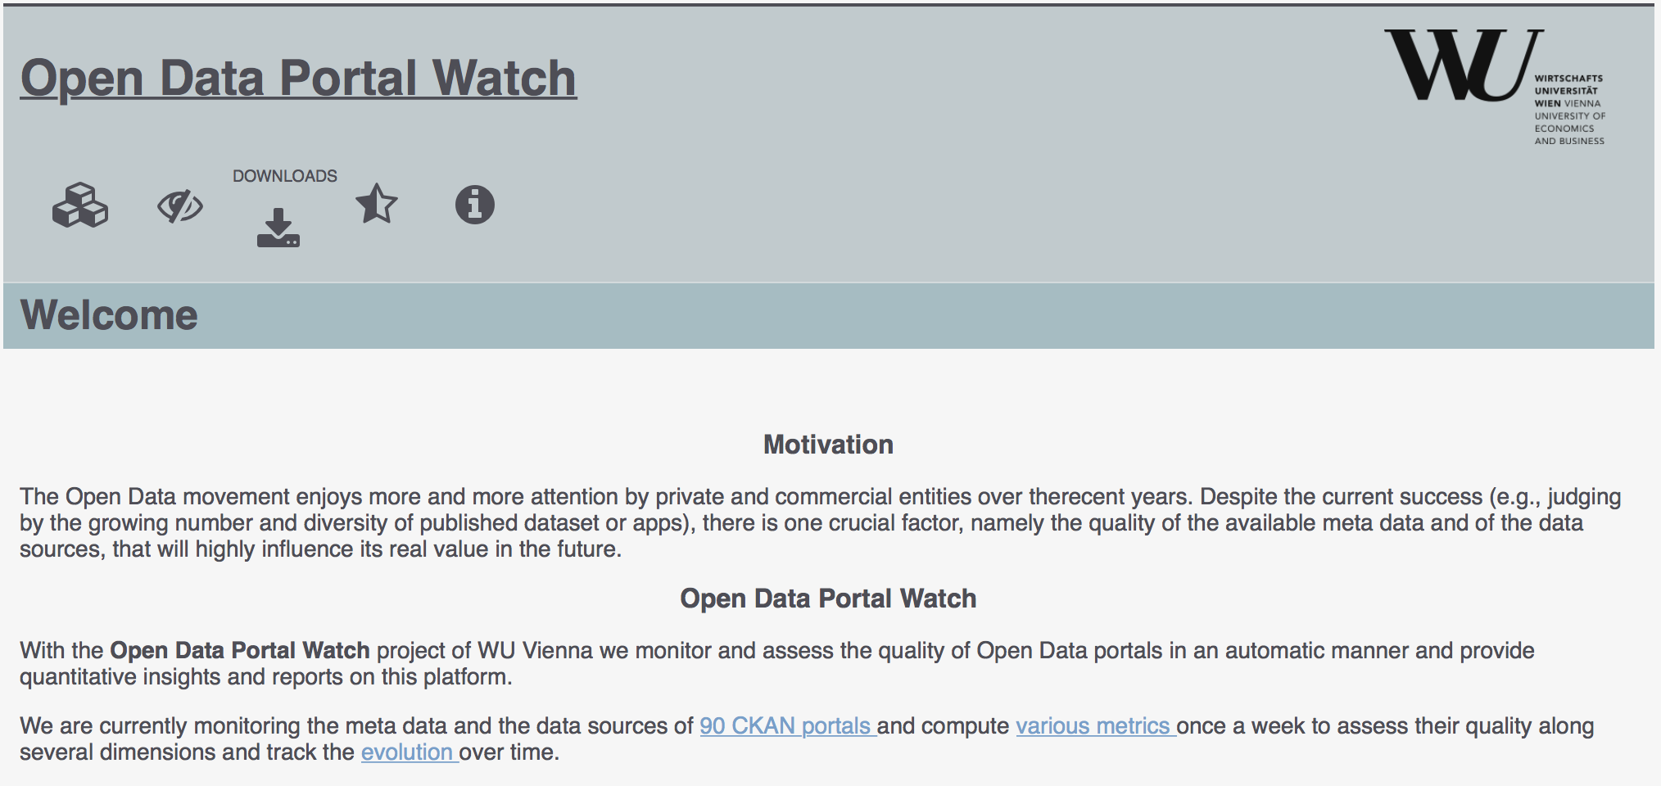
OPEN DATA PORTAL WATCH
http://data.wu.ac.at/portalwatch/
Periodically monitoring a list of Open Data Portals
90 CKAN powered Open Data Portals
Quality assessment
Evolution tracking
Meta data
Data

Slide 8
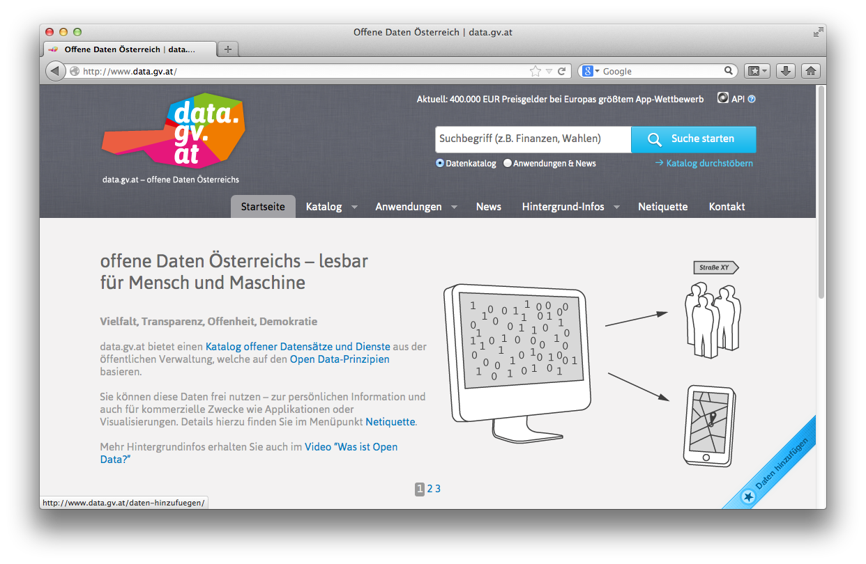
Open Data Portals
CKAN ... http://ckan.org/
almost „de facto“ standard for Open Data Portals
facilitates search, metadata (publisher, format, publication date, license, etc.) for datasets
http://datahub.io/
http://data.gv.at/
machine-processable? ...
... partially

Slide 9
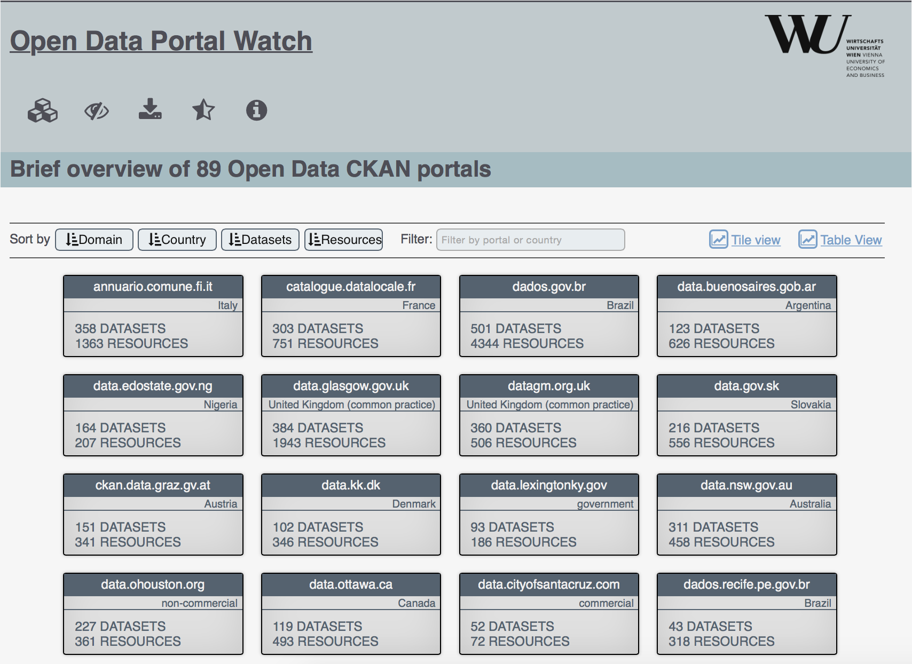
Open Data Portal list

Slide 10
QUALITY DIMENSIONS
DIMENSION | DESCRIPTION
Retrievability | The extent to which meta data and resources can be retrieved.
Usage | The extent to which available meta data keys are used to describe a dataset.
Completeness | The extent to which the used meta data keys are non empty.
Accuracy | The extent to which certain meta data values accurately describe the resources.
Openness | The extent to which licenses and file formats conform to the open definition.
Contactability | The extent to which the data publisher provide contact information.
Objective measures which can be automatically computed in a scalable way

Slide 11
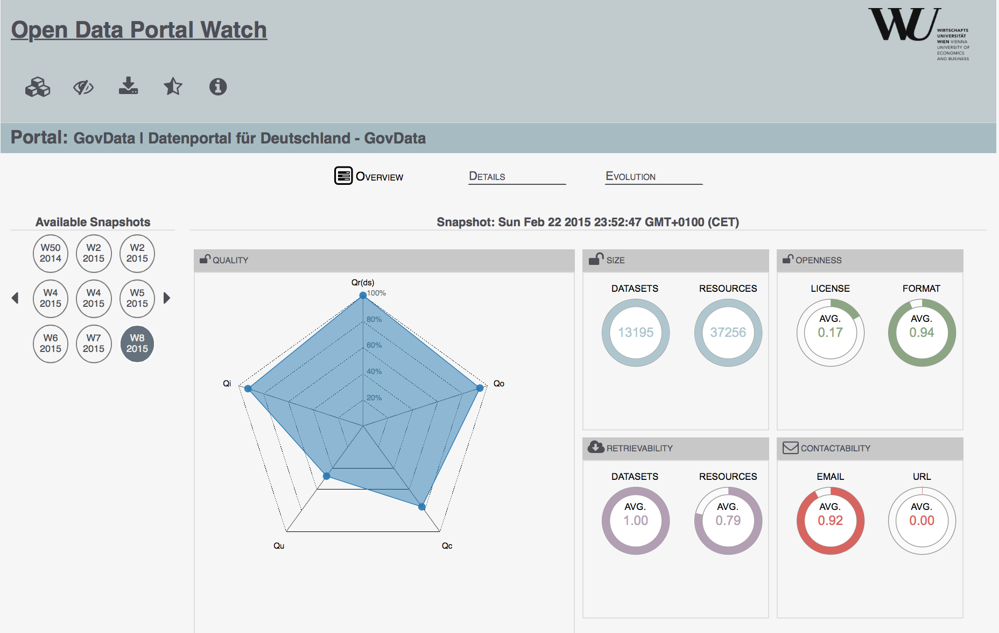
Portal Overview

Slide 12
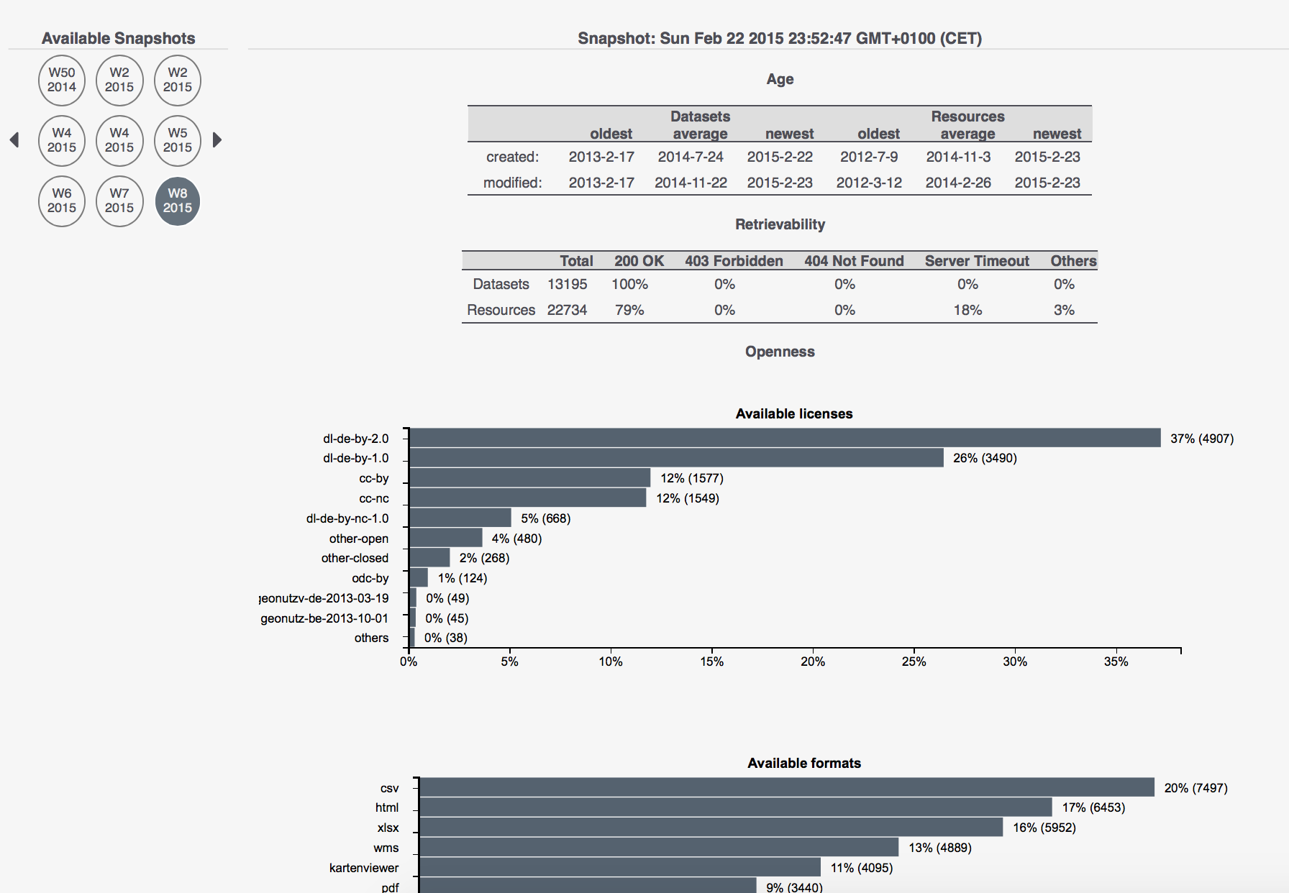
Portal Details

Slide 13
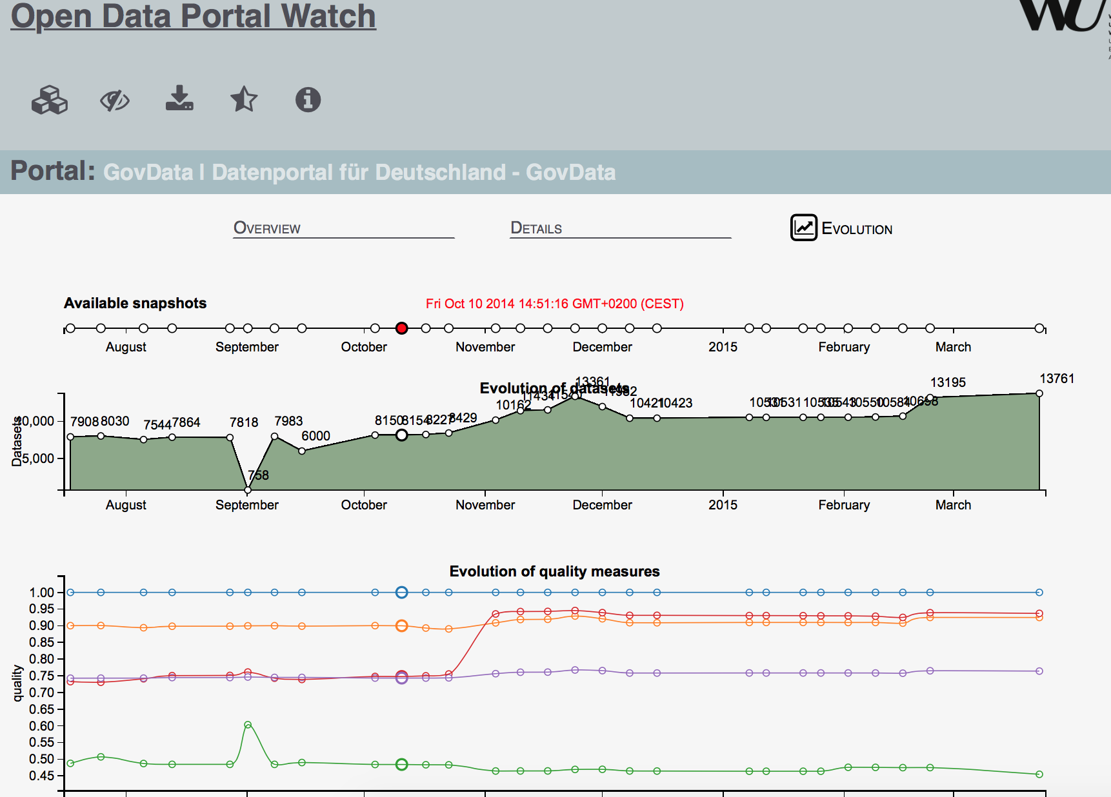
ODP Evolution

Slide 14
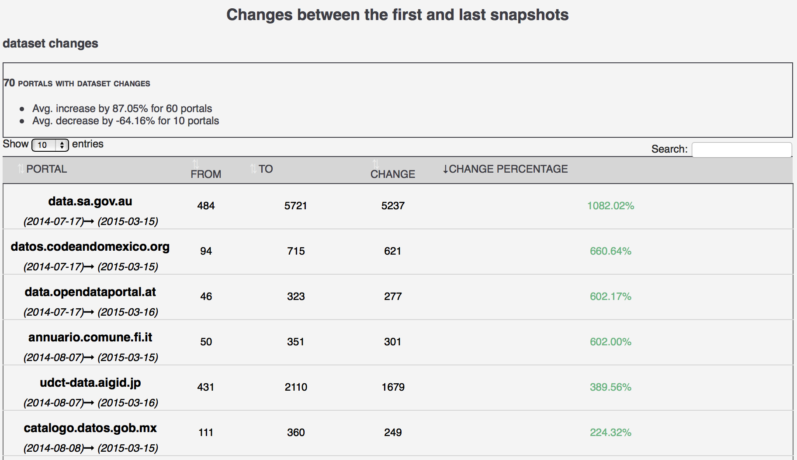
ODP CHANGES

Slide 15
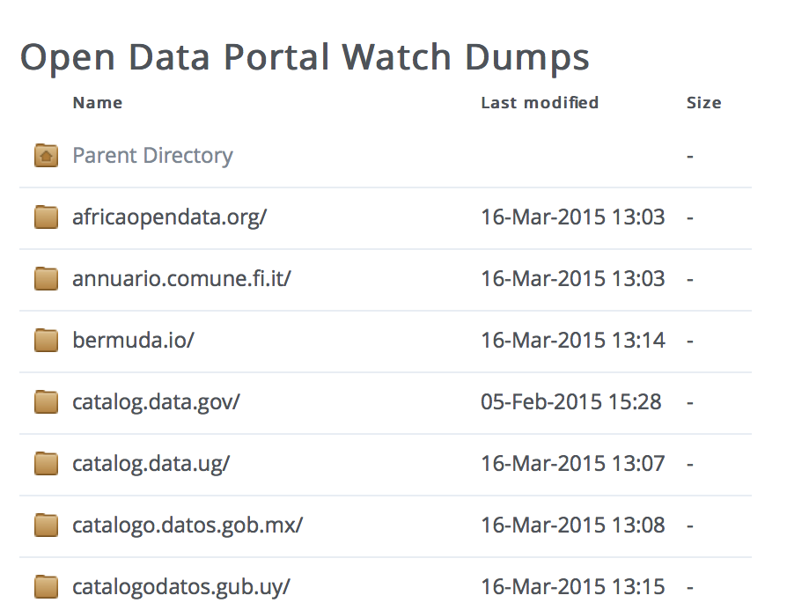
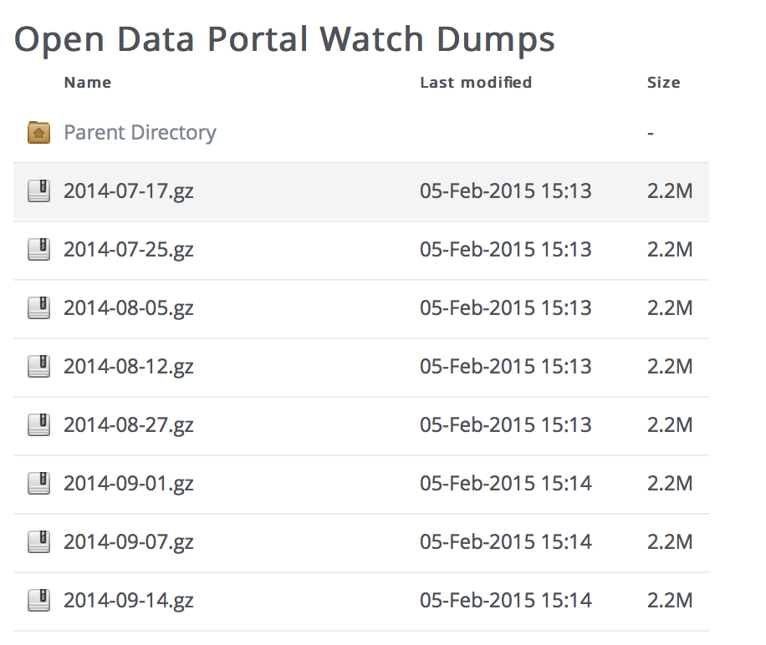
Data Dumps
OPEN DATA PORTAL WATCH provides an archive of Open Data portal crawls (weekly snapshots/dynamic crawling framework):

Slide 16
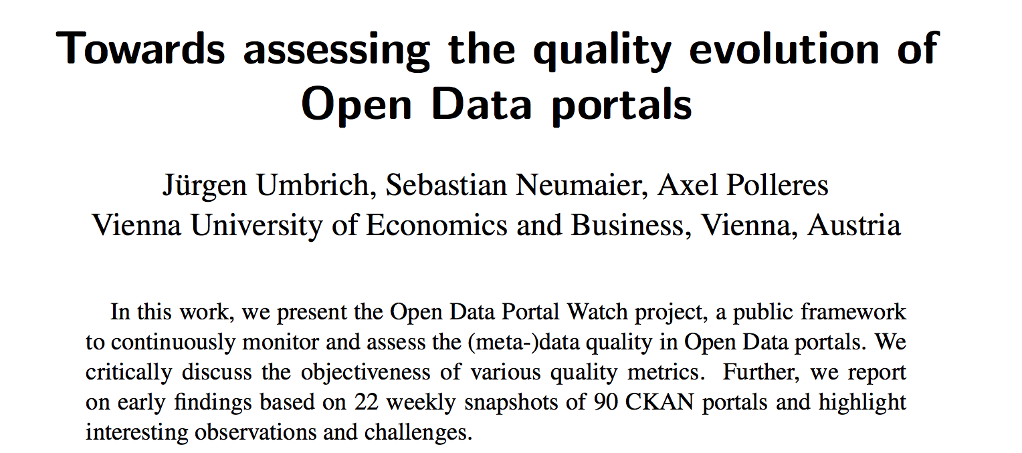
Open Data Portal Watch
ODQ2015
http://data.wu.ac.at/portalwatch/
Key findings:
Varying quality acrosss portals
Rapid growth for some portals
Huge variety and range of datasets

Slide 17
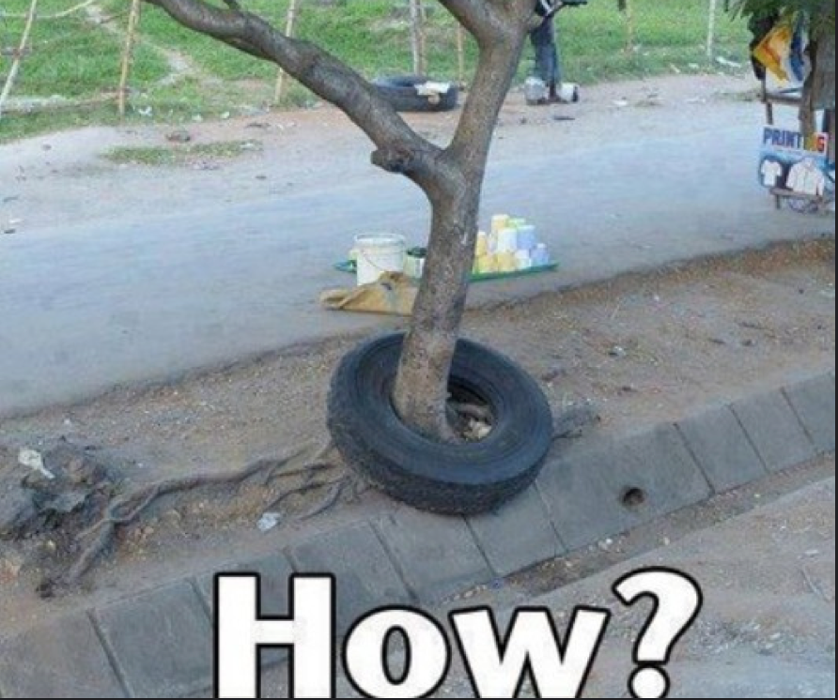
But: How to use all that Open Data?
More challenges:
How to find the right datasets?
How to integrate related datasets?
How to deal with heterogeneous/missing data

Slide 18
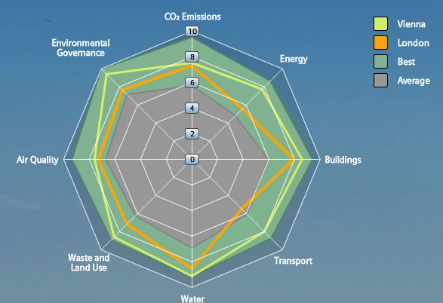
Use Case: City Data – Important for Infrastructure Providers & for City Decision Makers
City Assessment and Sustainability reports
Tailored offerings by Infrastructure Providers
… however, these are often outdated before even published!
Goal (short term):
Leverage Open Data for calculating a city’ performance from public sources on the Web automatically
Needs up-to-date City Data and calculates City KPIs in a way that allows to display the current state and run scenarios of different product applications.
e.g. towards a “Dynamic”
Green City Index:
Goal (long term):
Define and Refine KPI models to assess specific impact of infrastructural investments and gather/check input automatically
Notes:
18

Slide 19
City Data Pipeline
http://citydata.wu.ac.at/

Slide 20
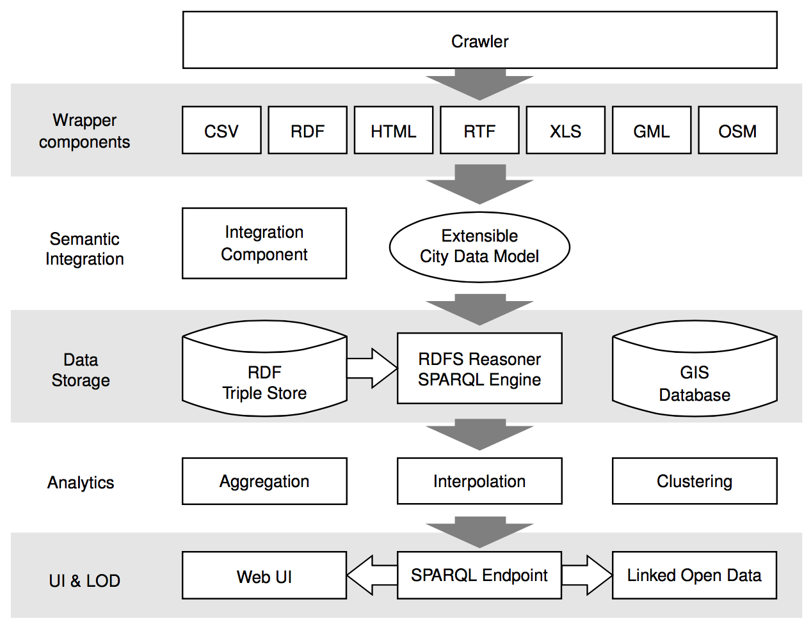
City Data Pipeline: Architecture
Crawl and integrate Open data sources with city data:
Wikipedia
Eurostat
UNData
USCencus
Etc.
Use statistical methods to approximate missing values
Re-publish as Linked Data (SPARQL endpoint, provenance information, etc.

Slide 21
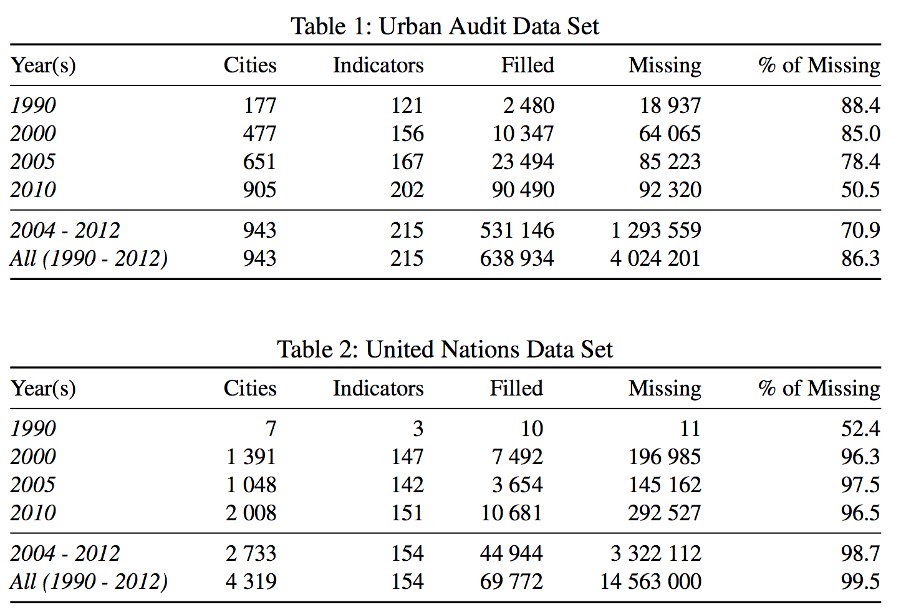
Challenges – Missing values
Found a large amount of missing values
Two Reasons:
Incomplete data published by providers (Tables 1+2)
The combination of different data sets with disjoint cities and indicators (later)

Slide 22
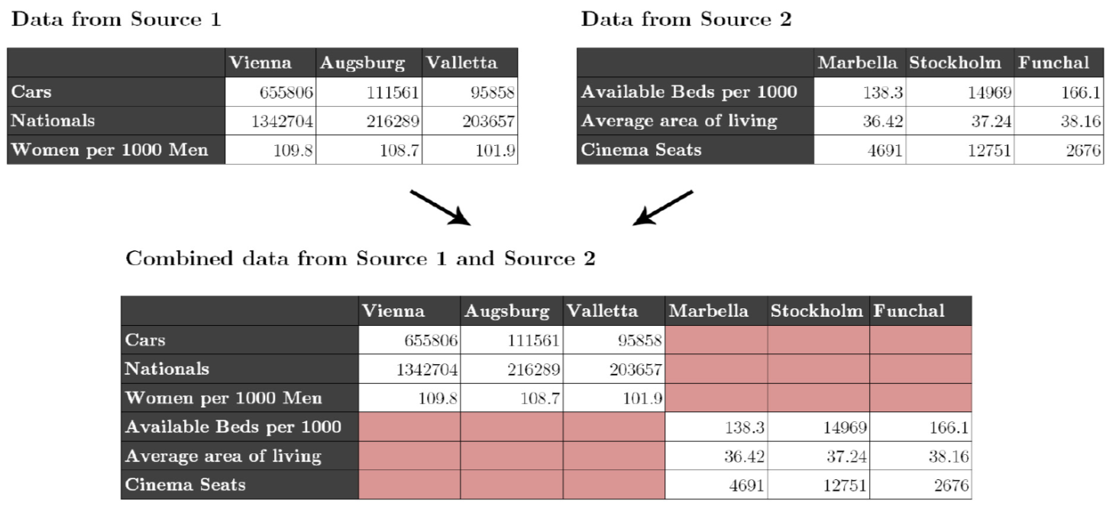
Challenges – Missing values
Individual datasets (e.g. from Eurostat) have missing values
Merging together datasets with different indicators/cities adds sparsity

Slide 23
Missing Values – Hybrid approach choose best prediction method per indicator:
Our assumption: every indicator has its own
distribution and relationship to others.
Basket of „standard“ regression methods:
K-Nearest Neighbour Regression (KNN)
Multiple Linear Regression (MLR)
Random Forest Decision Trees (RFD)

Slide 24
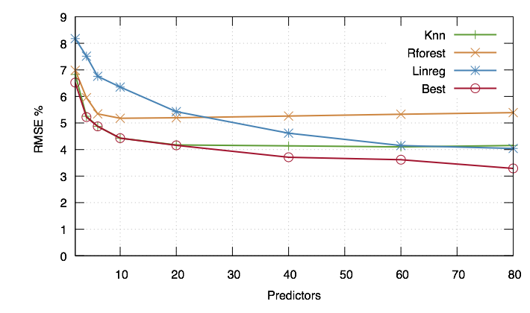
Missing Values – Hybrid approach choose best prediction method per indicator:
Instead of using indicators directly we use PCs, built from the indicators
For buidling the PCs, fill in missing data points with neutral values → predict all rows

Slide 25
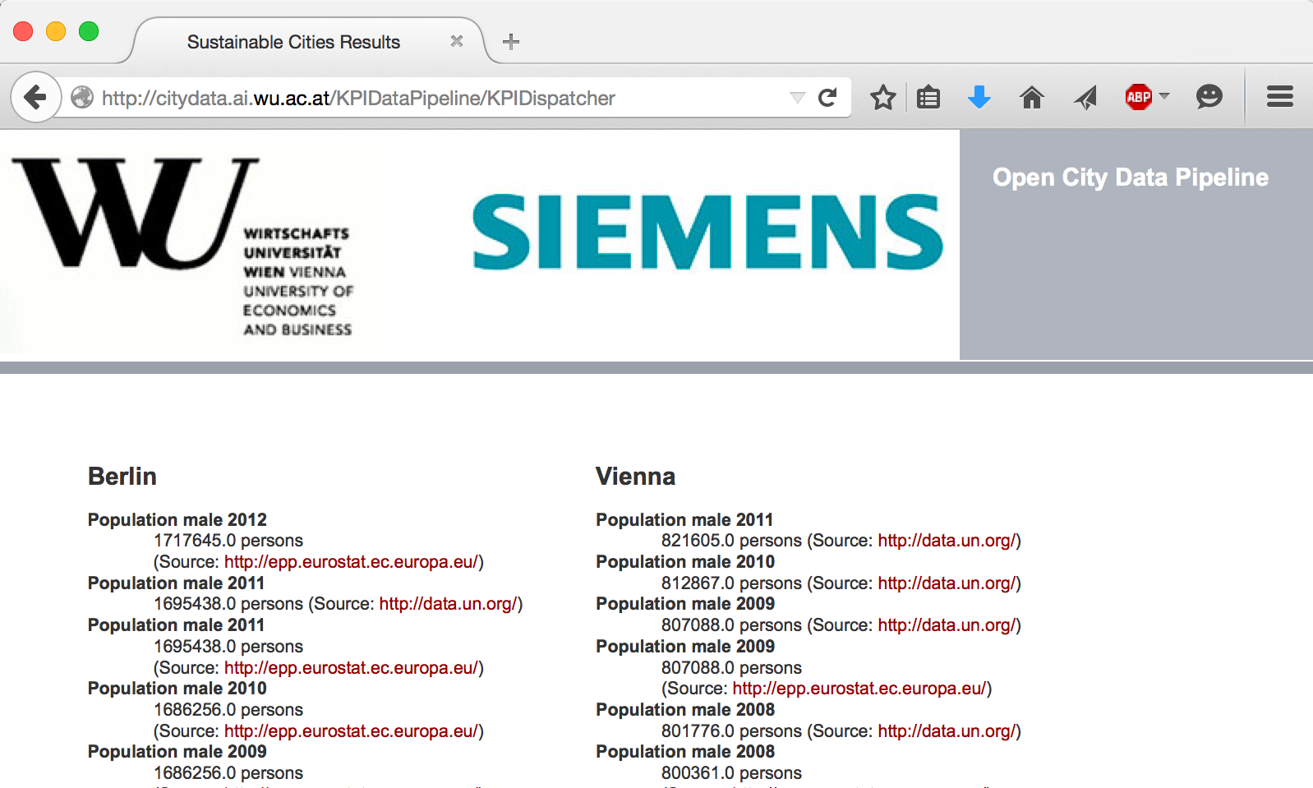
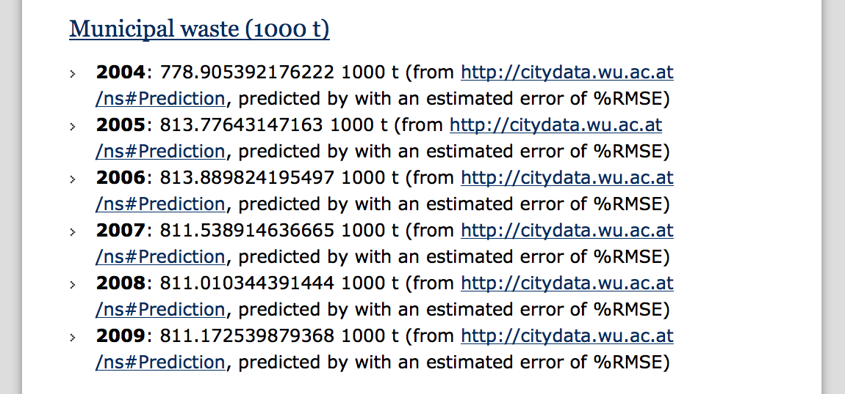
City Data Pipeline
citydata.wu.ac.at
Search for indicators & cities
obtain results incl. sources
Integrated data served as Linked Data
Predicted values for missing data...
...assumption: Predictions get better, the more Open data we integrate...
Open Data: The more, the merrier!

Slide 26
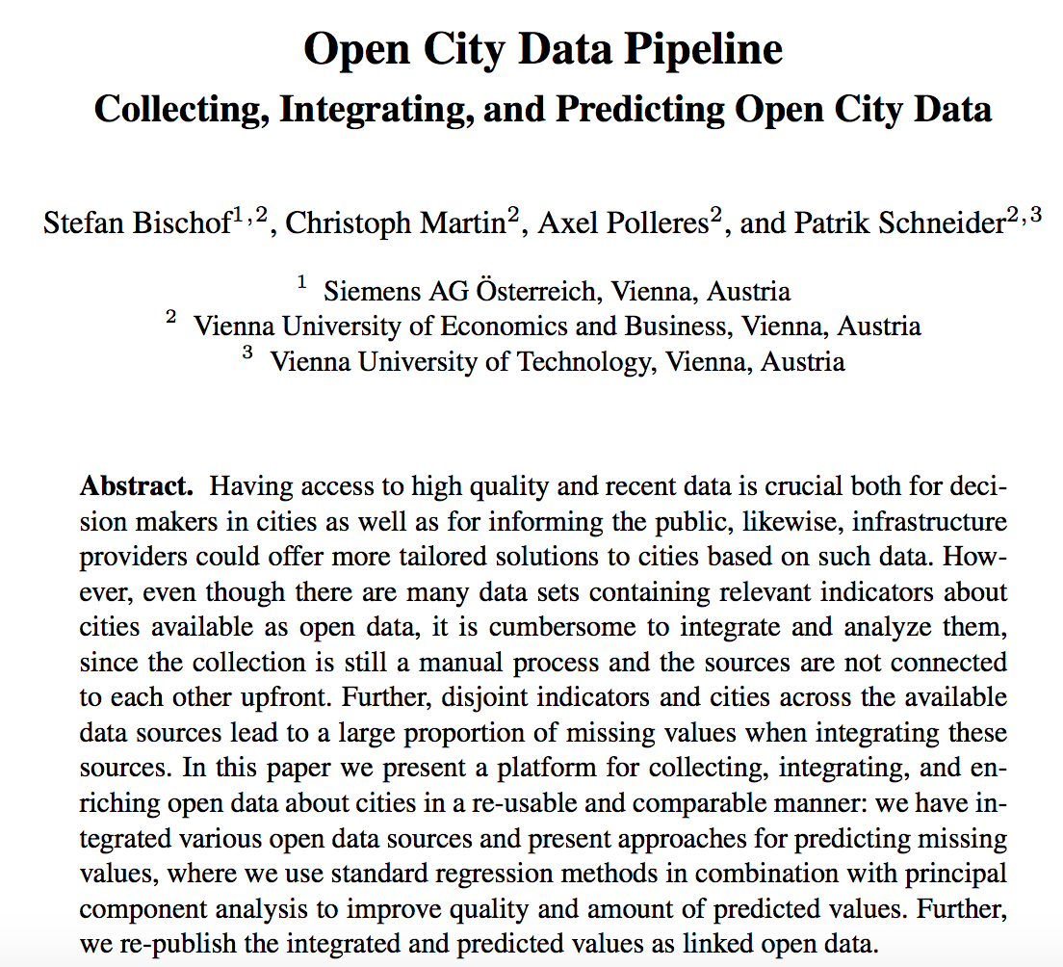
More Details:
Stefan Bischof, Christoph Martin, Axel Polleres, and Patrik Schneider. Open City Data Pipeline: Collecting, Integrating, and Predicting Open City Data. In 4th Workshop on Knowledge Discovery and Data Mining Meets Linked Open Data (Know@LOD), co-located with ESWC2015, Portoroz, Slovenia, May 2015.

Slide 27
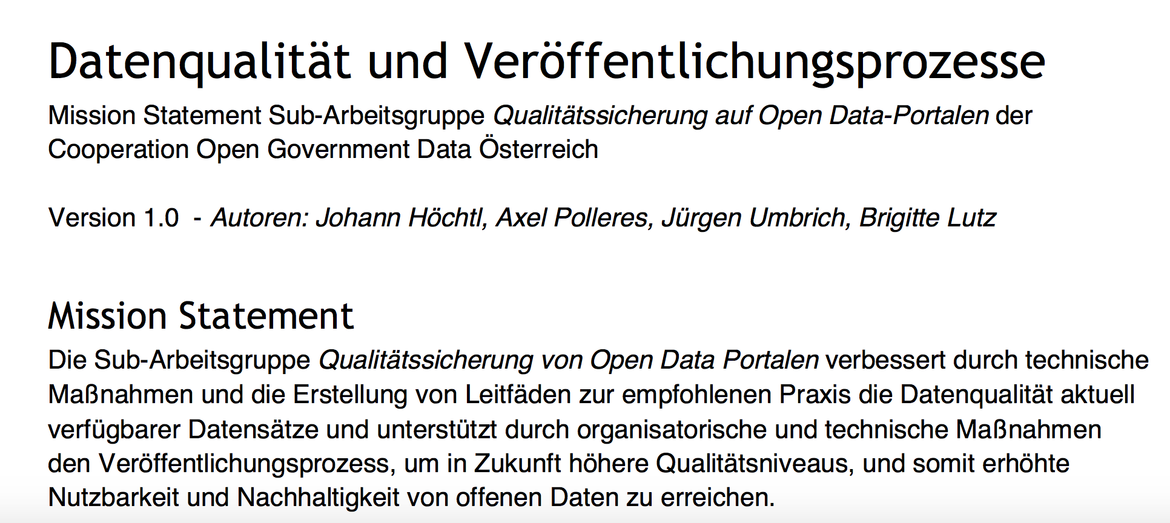
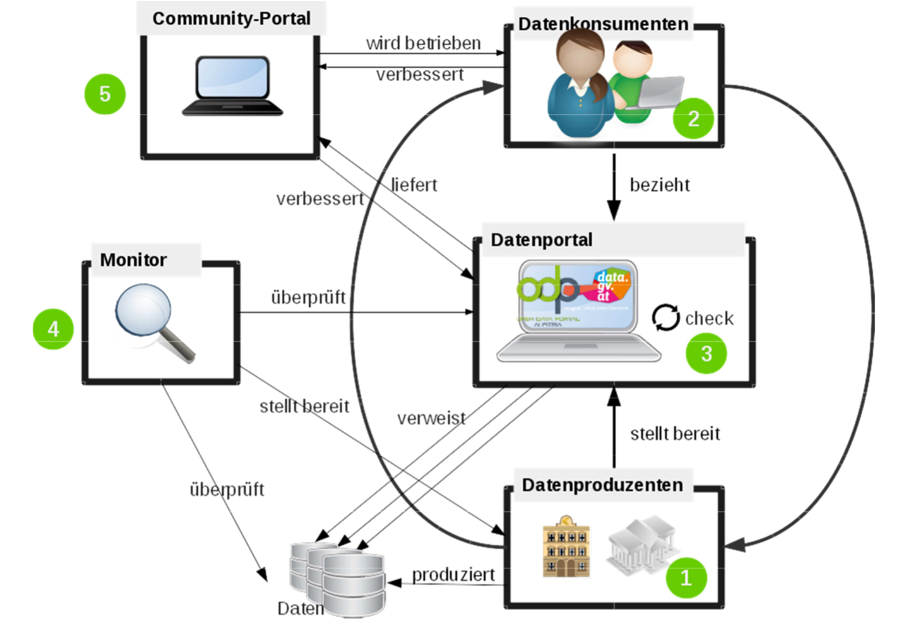
What's next? Collaborations to make Open Data usage more effective:
Improving Open Data Quality
https://www.data.gv.at/wp-content/uploads/2012/03/Mission-Statement-AG-Qualitaetssicherung-OpenData-Portale.pdf
Upcoming:
ADEQUATe: Analytics & Data
Enrichment to improve the
QUAliTy of Open Data
Project Start: Fall 2015

Slide 28
Open your data & include Open Data in your Data Strategy!
A "sister" portal for http://data.gv.at for non-governmental open data launched in 2014
http://www.opendataportal.at/
We can help you to use and publish Open Data! WU, TU, SWC, DUK have just founded a network node of the
Official Launch:
4. OGD D-A-CH-LI - Konferenz - Open X
24. Juni 2015,
Wiener Rathaus

Slide 29
Want to learn more?
→ Talk to me about Your Open Data Strategy!
Axel.Polleres@wu.ac.at Twitter: @AxelPolleres
http://wu.ac.at/infobiz/
Maybe see you at one of the following events:
http://2015.data-forum.eu/
http://semantics.cc/

