Slide 1
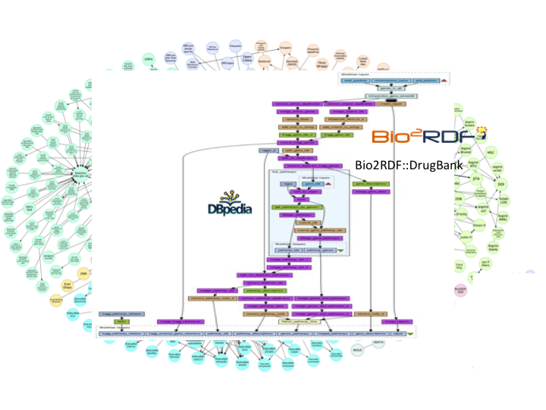
Data Workflows
Tutorial
Axel Polleres
Maria-Esther Vidal
http://polleres.net/presentations/

Slide 2
Outline
Motivation
  Integrating (Open) Data from different sources
  Not only Linked Data (NoLD)
  Data workflows and Open data in the context of rise of Big Data
What is a "Data Workflow"?
  Different Views of Data Workflows in the context of the Semantic Web
  Key steps involved
  Tools?
Data Integration Systems
  Wrappers vs. Mediators
  GAV vs. LAV
  Query rewriting vs. Materialisation
  Data Integration using Ontologies
Challenges:
  How to find Rules and ontologies?
  Data Quality & Incomplete Data
  Maintainance/Evolution/Sustainability of Data Workflows
  Break?
Open Problems – Research Tasks

Slide 3
Motivation
  Integrating (Open) Data from different sources

Slide 4











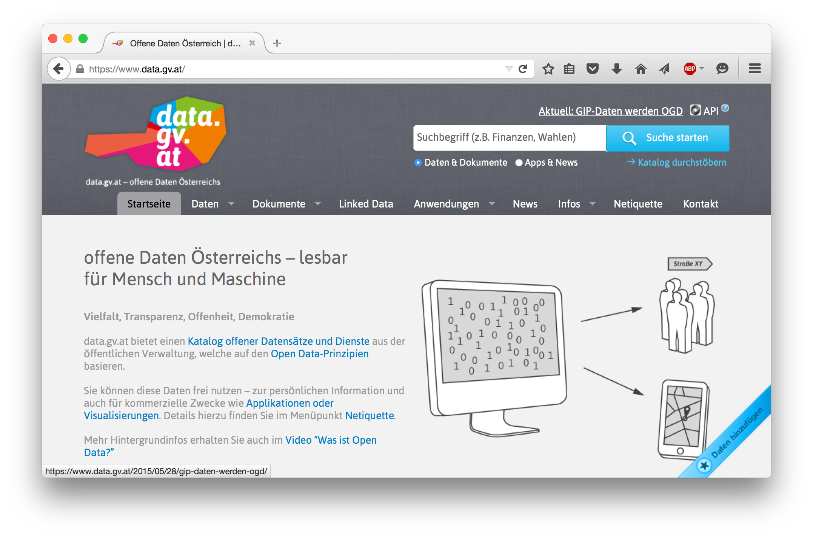
Open Data is a global trend – Good for us!
    Cities, International Organizations, National and European portals, etc.:
In general: more and more structured data available at our fingertipps
It's on the Web
It's open
  → no restrictions w.r.t. re-use
Notes:
4

Slide 5
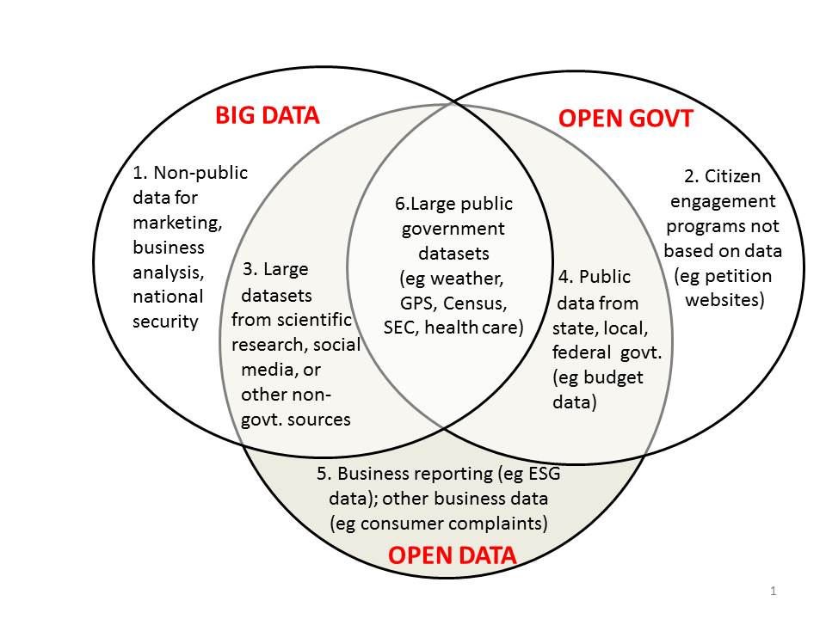
Buzzword Bingo 1/3:
Open Data vs. Big Data vs. Open Government
http://www.opendatanow.com/2013/11/new-big-data-vs-open-data-mapping-it-out/

Slide 6

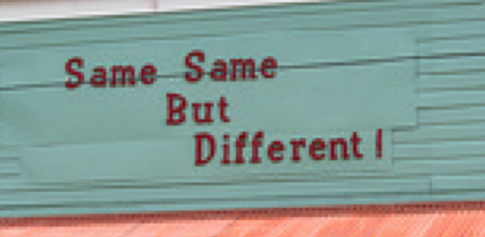



Buzzword Bingo 2/3:
Open Data vs. Big Data
Volume:
  It's growing! (we currently monitor 90 CKAN portals, 512543 resources/ 160069 datasets,
  at the moment (statically) ~1TB only CSV files...
Variety:
  different datasets (from different cities, countries, etc.), only partially comparable, partially not.
  Different metadata to describe datasets
  Different data formats
Velocity:
  Open Data changes regularly (fast and slow)
  New datasets appear, old ones disappear
Value:
  building ecosystems ("Data value chain") around Open Data is a key priority of the EC
Veracity:
  quality, trust

Slide 7

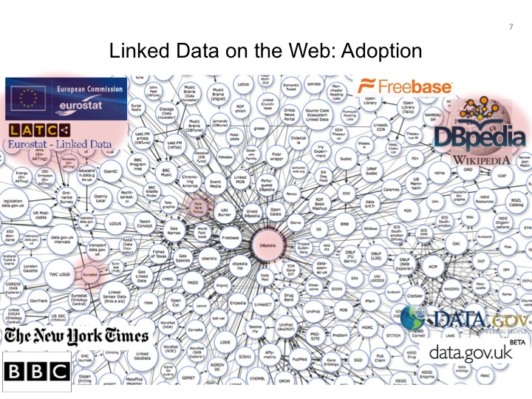
Buzzword Bingo 3/3:
Open Data vs. Linked Data
This talk is NOT about DL Reasoning over Linked Data:
cf.: [Polleres OWLED2013], [Polleres et al. Reasoning Web 2013]
LOD is till growing, but OD is growing faster and challenges aren't necessarily the exactly same…
So. let's focus on Open Data in general…
Alternatives in the meantime: (wikidata...)
LD efforts discontinued?!
LOD in OGD growing, but slowly

Slide 8
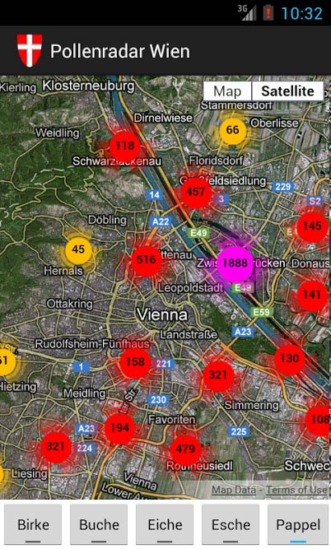
What makes Open Data useful beyond "single dataset Apps"...
Great stuff, but limited potential...
More interesting:
Data Integration & building Data Workflows
from different Open Data sources!!!

Slide 9
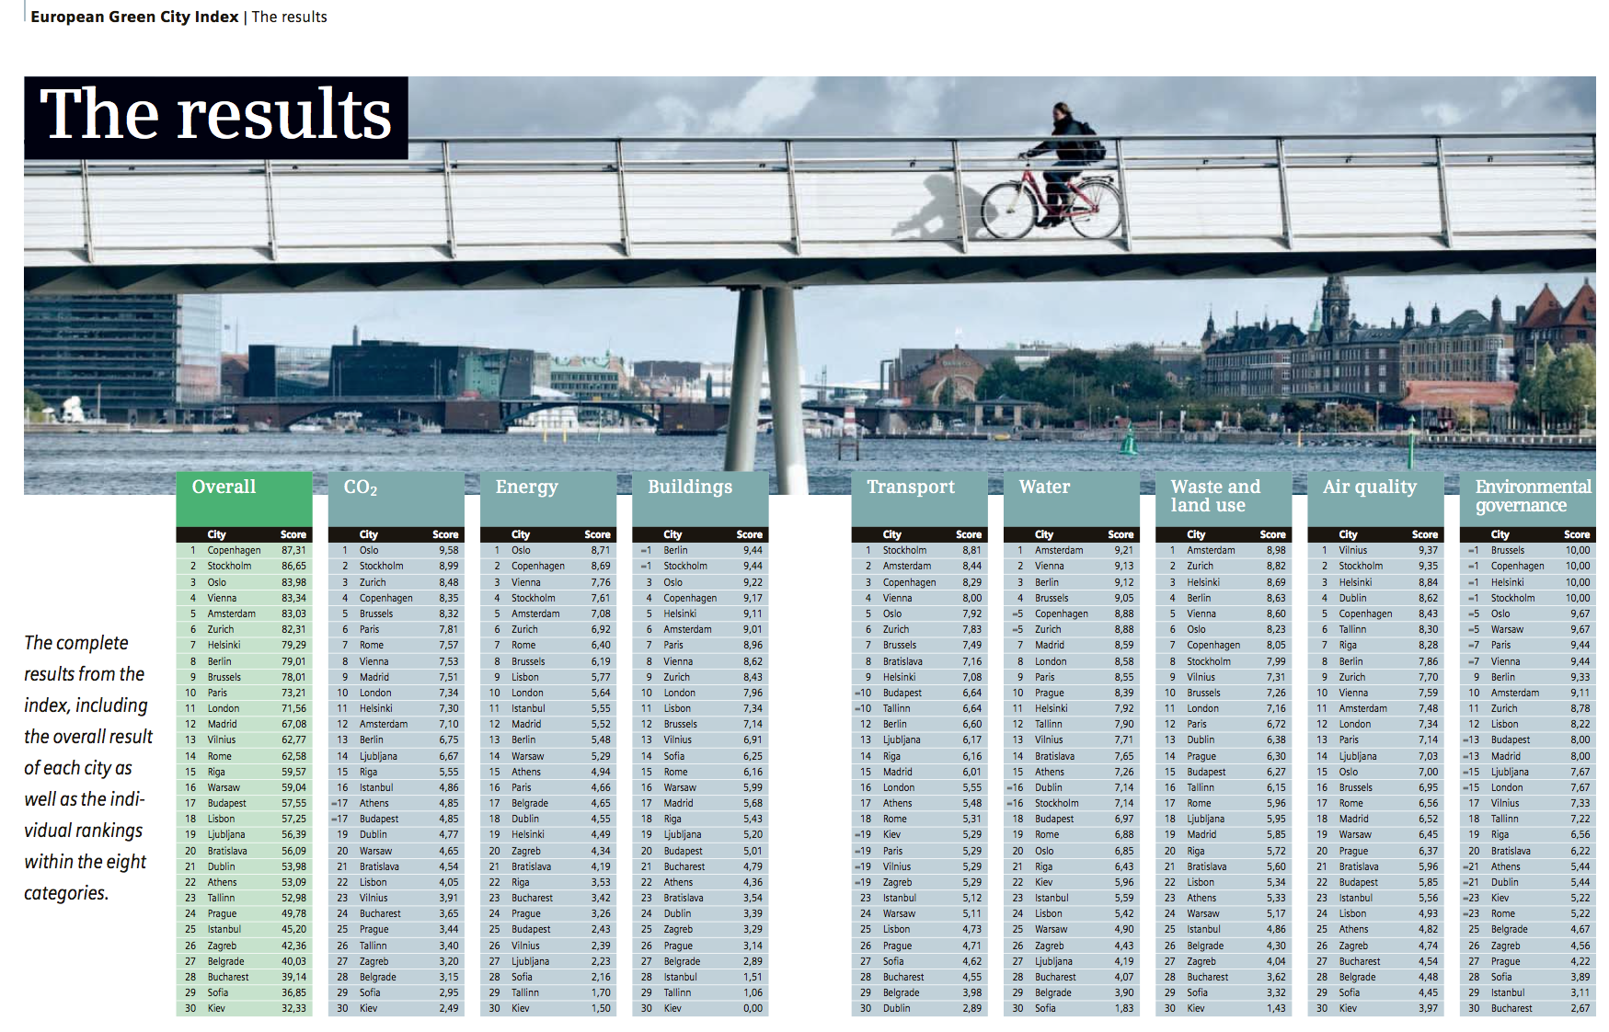
Open Data Integration -
A concrete use case:

Slide 10
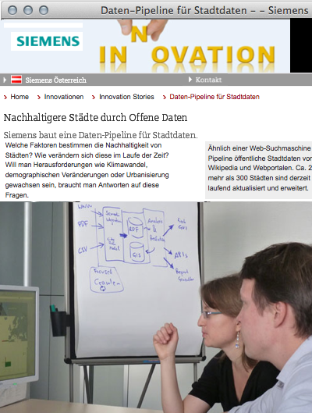
A concrete use case/running example:
The "City Data Pipeline"
Idea – a "classic" Semantic Web use case!
Regularly integrate various relevant Open Data sources (e.g. eurostat, UNData, ...)
Make integrated data available for re-use

Slide 11
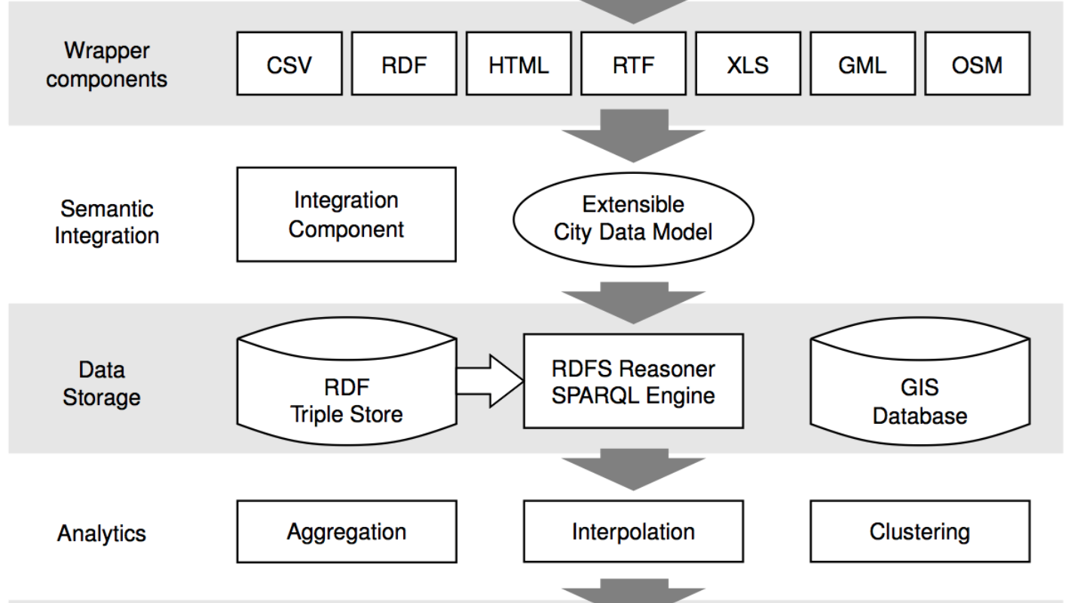


A concrete use case:
The "City Data Pipeline" – a "fairly standard" data workflow
That's a quite standard Data Workflow, isn't it?

Slide 12
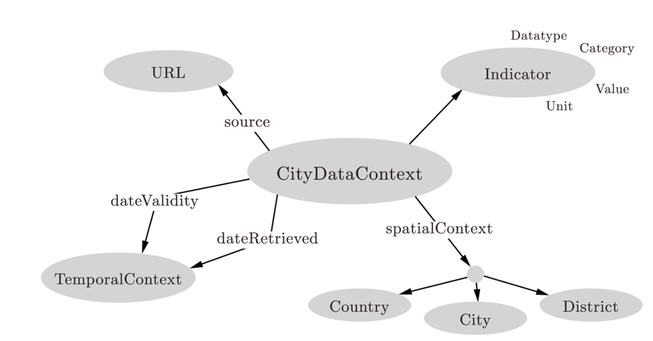
A concrete use case:
The "City Data Pipeline" – a "fairly standard" data workflow
City Data Model: extensible ALH(D) ontology:
Indicators, e.g. area in km2, tons CO2/capita
Provenance
But we use and flexible Semantic integration using ontologies and reasoning!
Temporal information
Spatial context

Slide 13
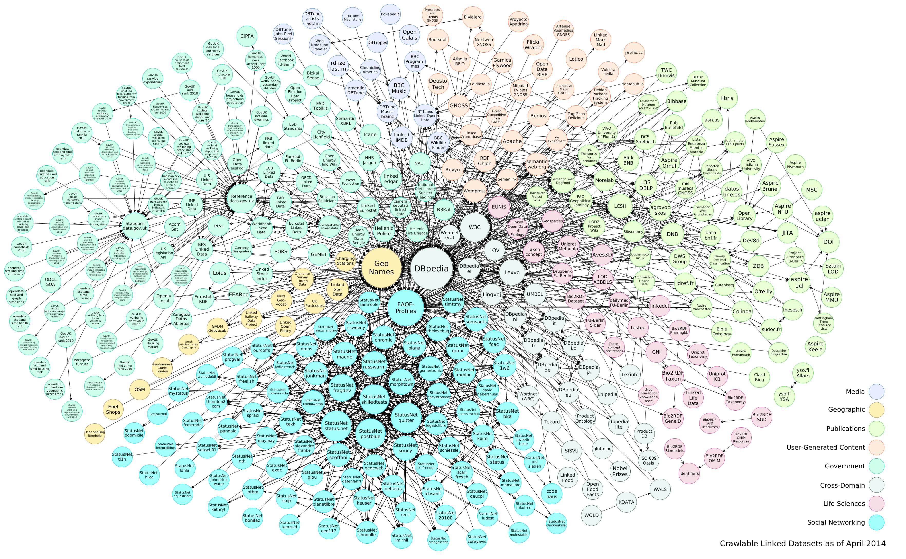





So: What is a "standard data workflow"?
Data

Slide 14
Data Workflows
Well-defined functional units.
Data is streamed between
units or activities.
Access
Transform
Deliver
Data

Slide 15
Different Views & Examples of "What is a Data Workflow:

Slide 16
Different Views & Examples:
1/5 „Classic" ETL-Process in Datawarehousing
Wikipedia:
In computing, Extract, Transform and Load (ETL) refers to a process in database usage and
especially in data warehousing that:
  Extracts data from homogeneous or heterogeneous data sources
  Cleansing: deduplication, inconsistencies, missing data,...
  Transforms the data for storing it in proper format or structure for querying and analysis purpose
  Loads it into the final target (database, more specifically, operational data store, data mart, or data warehouse)
Typically assumes: fixed, static pipeline, fixed final schema in the final DB/DW
Cleansing sometimes viewed as a part of Transform, sometimes not.
Typically assumes complete/clean data at the "Load" stage
Aggregation sometimes viewed as a part of tranformation, sometimes higher up in the Datawarehouse access layer (OLAP)
WARNING: At each stage, things can go wrong! Filtering/aggregation may bias the data!
References:[Golfarelli, Rizzi, 2009]
  https://en.wikipedia.org/wiki/Extract,_transform,_load
  https://en.wikipedia.org/wiki/Staging_%28data%29#Functions
"Hard-wired" Data integration

Slide 17
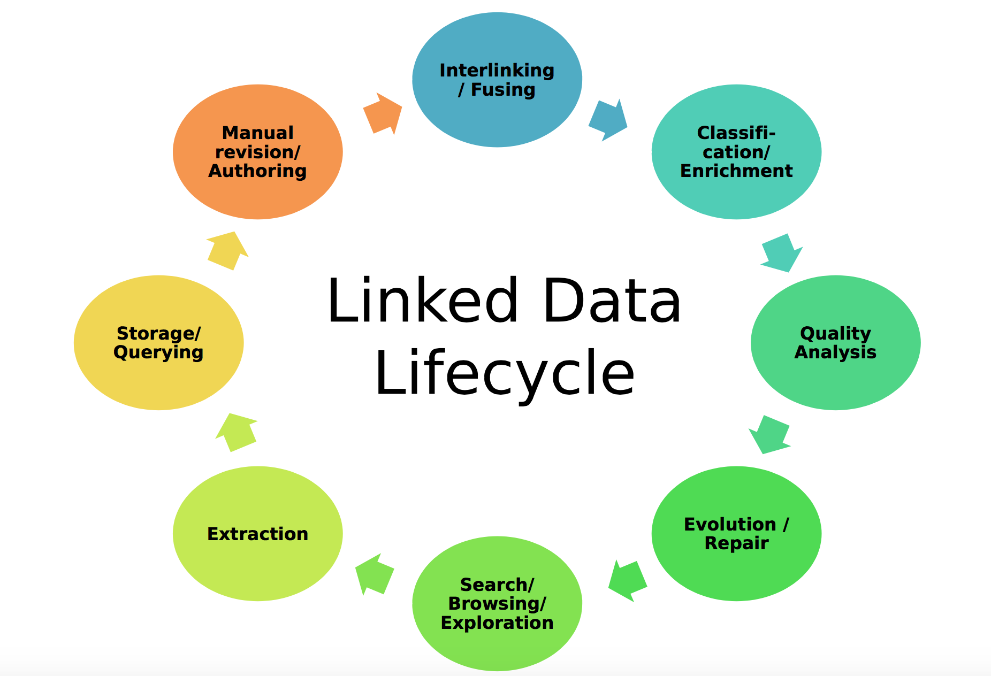
Different Views & Examples:
2/5 Or is it rather a Lifecycle...
E.g. good example: Linked Data Lifecycle
NOTE: Independent of whether Linked Data or other sources, you need to revisit/revalidate your workflow, either for improving it or for maintainance (sources changing, source formats changing, etc.)
Axel-Cyrille Ngonga Ngomo, Sören Auer, Jens Lehmann, Amrapali Zaveri. Introduction to Linked Data and Its Lifecycle on the Web. ReasoningWeb. 2014

Slide 18







Different views & examples:
3/5 Or Simply a "Physical Query Plan"?
Deliver
NL
Optional
Transform
NL
Optional
Bio2RDF::DrugBank
GJoin
GJoin
GJoin
Access

Slide 19
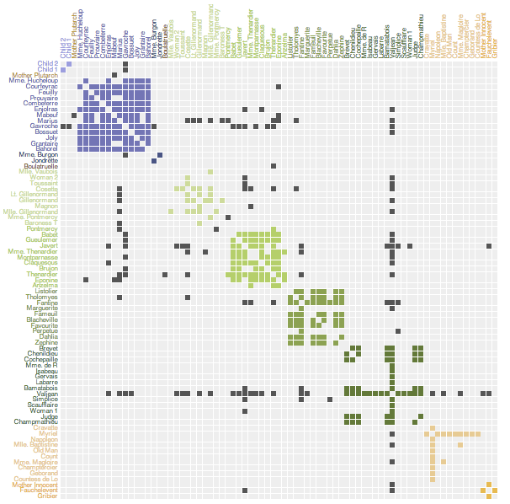
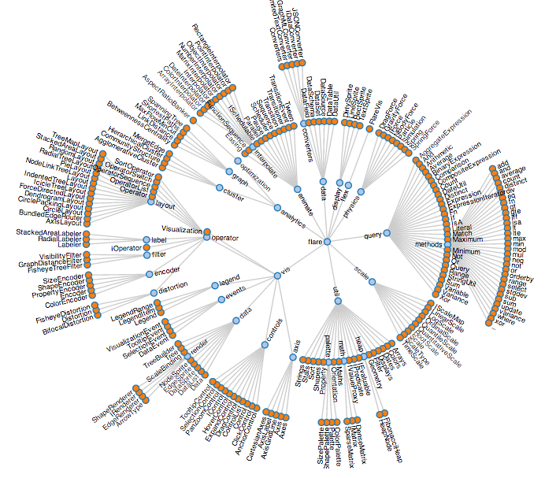
Different Views & Examples:
4/5 Linked Data Visualization Model
RDF Data
Access
Data Transformation
Analytical Extraction
Analytical Operators
Transform
Visualization Transformation
Visualization Abstraction
Visualization Operators
Visual Mapping Transformation
View
View Operators
Deliver
J. Brunetti , S. Auer, R. García,”The Linked Data Visualization Model’.

Slide 20
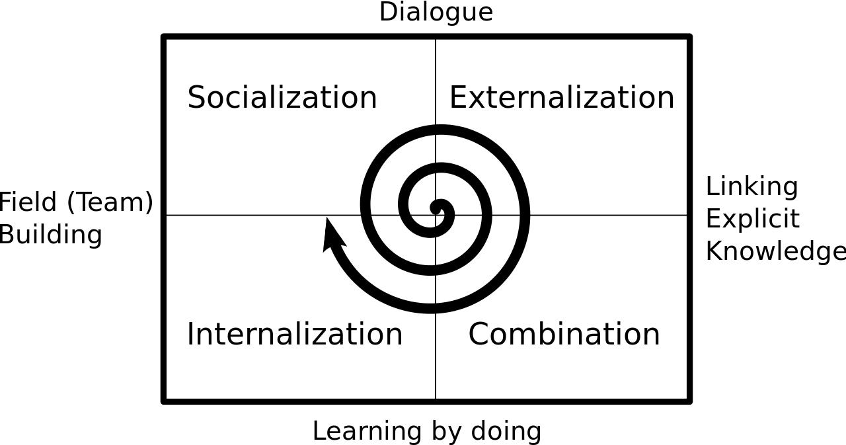
Different Views & Examples:
5/5 From a Knowledge-centric Approach…
[Nonaka & Takeuchi, 1995]
Notes:
Further, Knowledge encoded in formal models, discovery and prediction tools, Evaluation and Visualization, and support for clinical research are required.

Slide 21
Different Views & Examples:
5/5 ... towards a Data-centric Approach
Data
Knowledge Extraction
Discovery and Prediction
Evaluation and Visualization
Validation
Notes:
Further, Knowledge encoded in formal models, discovery and prediction tools, Evaluation and Visualization, and support for clinical research are required.

Slide 22
General challenges to be addressed
Distributed data sources
Non-standard processing
Semantic heterogeneity
Naming ambiguity
Uncertainty and evolving concepts

Slide 23
Specific Steps (non-exhaustive, overlapping!)
Extraction
Inconsistency handling
Incompleteness handling (sometimes called "Enrichment")
Data Integration (alignment, source reconciliation)
Aggregation
Cleansing (removing outliers)
Deduplication/Interlinking (could involve "triplification")
Change dedection (Maintainance/Evolution)
Validation (quality anaysis)
Visualization
Tools and current approaches support you partially in different parts of these steps.... Bad news: there is no "one-size-fits-all" solution.

Slide 24
Some Tools (again, exemplary):
Linux-commandline Tools: curl, sed, awk, + postgresql does a good job in many cases...
LOD2 stack, stack of tools for integrating and generating Linked Data, http://stack.lod2.eu/
  e.g., SILK http://silk-framework.com/ (Interlinking)
KARMA (extraction, data integration) http://usc-isi-i2.github.io/karma/
XSPARQL (extraction from XML and JSON/triplicifation) http://sourceforge.net/projects/xsparql/
  Seel also: https://ai.wu.ac.at/~polleres/20140826xsparql_st.etienne/

Slide 25
Outline
Motivation
  Integrating (Open) Data from different sources
  Not only Linked Data
  Data workflows and Open data in the context of rise of Big Data
What is a "Data Workflow"?
  Diefferent Views of Data Workflows in the context of the Semantic Web
  Key steps involved
  Tools?
Data Integration Systems
  Wrappers vs. Mediators
  LAV vs. GAV
  Data Integration using Ontologies – Query rewriting vs. Materialisation
Challenges:
  How to find Rules and ontologies?
  Data Quality & Incomplete Data
  Maintainance/evolution/sustainability of Data Workflows

Slide 26
Data Integration Systems[Lenzerini2002]
IS=<O,S,M>
Let O be a set of general concepts in a general schema (virtual).
Let S={S1,..,Sn} be a set of data sources.
Let M be a set of mappings between sources in S and general concepts in O.
cf. [Lenzerini 2002]

Slide 27
Global Schema
(financial rdf:type rdf:Property).
(climate rdf:type rdf:Property).
(rating rdf:type rdf:Property).
(financial rdfs:subPropertyOf rating).
(climate rdfs:subPropertyOf rating).
(euroCity rdf:type rdfs:Class).
(amCity rdf:type rdfs:Class)
(afCity rdf:type rdfs:Class)
Notes:
Suggest to change "financial" to "GrossGDP" and climate to "avgTemperature"

Slide 28
Global Schema
(financial rdf:type rdf:Property).
(climate rdf:type rdf:Property).
(rating rdf:type rdf:Property).
financial(C,R)
climate(C,R)
rating(C,R)

Slide 29
Global Schema
(financial rdf:type rdf:Property).
(climate rdf:type rdf:Property).
(rating rdf:type rdf:Property).
financial(C,R)
climate(C,R)
rating(C,R)
(financial rdfs:subPropertyOf rating).
(climate rdfs:subPropertyOf rating).

Slide 30
Global Schema
(financial rdf:type rdf:Property).
(climate rdf:type rdf:Property).
(rating rdf:type rdf:Property).
financial(C,R)
climate(C,R)
rating(C,R)
(financial rdfs:subPropertyOf rating).
(climate rdfs:subPropertyOf rating).
rdfs:subPropertyOf
rating(C,R)
rdfs:subPropertyOf
financial(C,R)
climate(C,R)

Slide 31
Global Schema
euroCity(C)
(euroCity rdf:type rdfs:Class).
(amCity rdf:type rdfs:Class)
(afCity rdf:type rdfs:Class)
amCity(C)
afCity(C)

Slide 32
Integration Systems
Global Schema
rdfs:subPropertyOf
rating(C,R)
rdfs:subPropertyOf
euroCity(C)
amCity(C)
financial(C,R)
climate(C,R)
afCity(C)

Slide 33



Source Schema
(amFinancial rdf:type rdf:Property).
(euClimate rdf:type rdf:Property).
(tunisRating rdf:type rdf:Property).
(similarFinancial rdf:type rdf:Property).
amFinancial(C,R) provides the financial rating R of an American city C.
euClimate(C,R) provides the climate rating R of an European city C.
tunisRating(T,R) tells the ratings R (T is climate and financial) of Tunis.
similarFinancial(C1,C1) relates two American cities C1 and C2 that have the same financial rating.

Slide 34
Integration Systems
euClimate(C,R)
similarFinancial(C1,C2)
amFinancial(C,R)
tunisRating(T,R)
amFinancial(C,R) provides the financial rating R of an American city C.
euClimate(C,R) provides the climate rating R of an European city C.
tunisRating(T,R) tells the ratings R (T is climate and financial) of Tunis.
similarFinancial(C1,C1) relates two American cities C1 and C2 that have the same financial rating.

Slide 35
Integration Systems
Global Schema
rdfs:subPropertyOf
rating(C,R)
rdfs:subPropertyOf
euroCity(C)
amCity(C)
financial(C,R)
climate(C,R)
afCity(C)
Local Schema
S={amFinancial(C,R), euClimate(C,R), tunisRating(T,R), similarFinancial(C1,C2) }

Slide 36
Integration Systems
IS=<O,S,M>
Global-as-View (GAV):
  Concepts in the Global Schema (O) are defined in terms of combinations of Sources (S).
Local-As-View (LAV):
    Sources in S are defined in terms of combinations of Concepts in O.
  Global- & Local-As-View (GLAV):
    Combinations of concepts in the Global Schema (O) are defined in combinations of Sources (S).

Slide 37
Global-As-View (GAV)
Global Schema
rdfs:subPropertyOf
rating(C,R)
rdfs:subPropertyOf
euroCity(C)
amCity(C)
financial(C,R)
climate(C,R)
afCity(C)
Local Schema
S={amFinancial(C,R), euClimate(C,R), tunisRating(T,R), similarFinancial(C1,C2) }
  α0: amCity(C):-amFinancial(C,R).
  α1: financial(C,R):-amFinancial(C,R).
  α2: euroCity(C):-euClimate(C,R).
  α3: climate(C,R):-euClimate(C,R).
  α4: financial(“Tunis”,R):-tunisRating(“financial”,R).
  α5: climate(“Tunis”,R):-tunisRating(“climate”,R)
  α6: afCity(“Tunis”).
  α7: amCity(C1):-similarFinancial(C1,C2).
  α8: amCity(C2):-similarFinancial(C1,C2).
  α9: financial(C1,R):-similarFinancial(C1,C2), amFinancial(C2,R).

Slide 38
Local-As-View (LAV)
Global Schema
rdfs:subPropertyOf
rating(C,R)
rdfs:subPropertyOf
euroCity(C)
amCity(C)
financial(C,R)
climate(C,R)
afCity(C)
Local Schema
S={amFinancial(C,R), euClimate(C,R), tunisRating(T,R), similarFinancial(C1,C2) }
  α0:amFinancial(C,R):-amCity(C),financial(C,R).
  α1:euClimate(C,R):-euCity(C),climate(C,R).
  α2:tunisRating(“financial”,R):-afCity(“Tunis”),financial(“Tunis”,R).
  α3:tunisRating(“climate”,R):-afCity(“Tunis”),climate(“Tunis”,R).
  α4:similarFinancial(C1,C2):-amCity(C1),amCity(C2),
  financial(C1,R),financial(C2,R).

Slide 39
Global and Local-As-View (GLAV)
Global Schema
rdfs:subPropertyOf
rating(C,R)
rdfs:subPropertyOf
euroCity(C)
amCity(C)
financial(C,R)
climate(C,R)
afCity(C)
Local Schema
S={amFinancial(C,R), euClimate(C,R), tunisRating(T,R), similarFinancial(C1,C2) }
  α0: amFinancial(C1,R),similarFinancial(C1,C2):-
  amCity(C1),amCity(C2),financial(C1,R),financial(C2,R).

Slide 40
Query Rewriting GAV
A query Q in terms of the global schema elements in O.
Problem: Rewrite Q into a query Q’ expressed in sources in S.
Example GAV:
query(C):-financial(C,R), amCity(C)
  α0: amCity(C):-amFinancial(C,R).
  α1: financial(C,R):-amFinancial(C,R).
  α2: euroCity(C):-euClimate(C,R).
  α3: climate(C,R):-euClimate(C,R).
  α4: financial(“Tunis”,R):-tunisRating(“financial”,R).
  α5: climate(“Tunis”,R):-tunisRating(“climate”,R)
  α6: afCity(“Tunis”).
  α7: amCity(C1):-similarFinancial(C1,C2).
  α8: amCity(C2):-similarFinancial(C1,C2).
  α9: financial(C1,R):-similarFinancial(C1,C2), amFinancial(C2,R).

Slide 41
Query Rewriting GAV
A query Q in terms of the global schema elements in O.
Problem: Rewrite Q into a query Q’ expressed in sources in S.
Example GAV:
query(C):-financial(C,R), amCity(C)
query1(C):-amFinancial(C,R),similarFinancial(C,C2).
Rewritings

Slide 42
Query Rewriting GAV
A query Q in terms of the global schema elements in O.
Problem: Rewrite Q into a query Q’ expressed in sources in S.
Example GAV:
query(C):-financial(C,R), amCity(C)
  α0: amCity(C):-amFinancial(C,R).
  α1: financial(C,R):-amFinancial(C,R).
  α2: euroCity(C):-euClimate(C,R).
  α3: climate(C,R):-euClimate(C,R).
  α4: financial(“Tunis”,R):-tunisRating(“financial”,R).
  α5: climate(“Tunis”,R):-tunisRating(“climate”,R)
  α6: afCity(“Tunis”).
  α7: amCity(C1):-similarFinancial(C1,C2).
  α8: amCity(C2):-similarFinancial(C1,C2).
  α9: financial(C1,R):-similarFinancial(C1,C2), amFinancial(C2,R).

Slide 43
Query Rewriting GAV
A query Q in terms of the global schema elements in O.
Problem: Rewrite Q into a query Q’ expressed in sources in S.
Example GAV:
query(C):-financial(C,R), amCity(C)
query1(C):-amFinancial(C,R),similarFinancial(C,C2).
Rewritings
query2(C):-similarFinancial(C,C2), amFinancial(C2,R),
similarFinancial(C,R1).

Slide 44
Query Rewriting LAV
  α0:amFinancial(C,R):-amCity(C),financial(C,R).
  α1:euClimate(C,R):-euCity(C),climate(C,R).
  α2:tunisRating(“financial”,R):-afCity(“Tunis”),financial(“Tunis”,R).
  α3:tunisRating(“climate”,R):-afCity(“Tunis”),climate(“Tunis”,R).
  α4:similarFinancial(C1,C2):-amCity(C1),amCity(C2),
  financial(C1,R),financial(C2,R).
Example LAV:
query(C):-financial(C,R), amCity(C)
query1(C):-amFinancial(C,R).
query2(C):-similarFinancial(C,C2).
Rewritings
query3(C):-similarFinancial(C1,C).

Slide 45
Query Rewriting GLAV
  α0: amFinancial(C1,R),similarFinancial(C1,C2):-
  amCity(C1),amCity(C2),financial(C1,R),financial(C2,R).
Example GLAV:
query(C):-financial(C,R), amCity(C)
query1(C):-: amFinancial(C,R),similarFinancial(C,C2)
Rewritings

Slide 46
Query Rewriting
DB is a Virtual Database with the instances of the elements in O.
Query Containment: Q’ ⊆Q ←→∀DB Q’(DB) ⊆Q(DB)
query1(C):-amFinancial(C,R),similarFinancial(C,C2).
⊆
query(C):-financial(C,R), amCity(C)

Slide 47
Query Rewriting
DB is a Virtual Database with the instances of the elements in O.
Query Containment: Q’ ⊆Q ←→∀DB Q’(DB) ⊆Q(DB)
query1(C):-amFinancial(C,R),similarFinancial(C,C2).
⊆
query(C):-financial(C,R), amCity(C)
Washington
NYC
Miami
Caracas
Lima
……
Bogota
College Park
Quito
Washington
NYC
Miami
Caracas
Lima
⊆
Source Database
Virtual Database

Slide 48
Existing Approaches for LAV Query Rewriting
Bucket Algorithm [Levy & Rajaraman & Ullman 1996]
Inverse Rules Algorithm [Duscka & Genesereth 1997]
MiniCom Algorithm [Pottinger & Halevy 2001]
MDCSAT [Arvelo & Bonet & Vidal 2006]
SSSAT [Izquierdo & Vidal & Bonet 2011]
GQR [Konstantinidis & Ambite, 2011]
IQR [Vidal & Castillo 2015]

Slide 49
The Mediator and Wrapper Architecture [Wiederhold92]
Query
Data Integration System
Mediator
Catalog
Wrapper
Wrapper
Wrapper
Wrapper
amFinancial(C,R)
euClimate(C,R)
similarFinancial(C1,C2)
tunisRating(T,R)
[Wiederhold92]Gio Wiederhold: Mediators in the Architecture of Future Information Systems. IEEE Computer 25(3): 38-49 (1992)

Slide 50
The Mediator and Wrapper Architecture [Wiederhold92]
Query
Wrappers:
Software components specific for each type of data source.
Export unique schema
for heterogeneous sources.
Mediator
Catalog
Wrapper
Wrapper
Wrapper
Wrapper
amFinancial(C,R)
euClimate(C,R)
similarFinancial(C1,C2)
tunisRating(T,R)
[Wiederhold92]Gio Wiederhold: Mediators in the Architecture of Future Information Systems. IEEE Computer 25(3): 38-49 (1992)

Slide 51
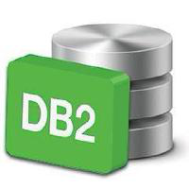



RDB2RDF Systems
Wrappers for RDF Data
RDF
Transformation Rules, e.g.,
R2RML
Cf. R2RML W3C standard: http://www.w3.org/TR/r2rml/ see also [Priyatna 2014]]
UltraWrap http://capsenta.com/ultrawrap/ [Sequeda & Miranker 2013],
D2RQ http://d2rq.org/

Slide 52
The Mediator and Wrapper Architecture [Wiederhold92]
Query
Mediators:
Export a unified schema.
Query Decomposition.
Identify relevant sources for each query.
Generate query execution plans.
Mediator
Catalog
Wrapper
Wrapper
Wrapper
Wrapper
amFinancial(C,R)
euClimate(C,R)
similarFinancial(C1,C2)
tunisRating(T,R)
[Wiederhold92]Gio Wiederhold: Mediators in the Architecture of Future Information Systems. IEEE Computer 25(3): 38-49 (1992)

Slide 53
Mediator
Query
Query Decomposer
Catallog
Wrapper
Wrapper
Wrapper
Wrapper

Slide 54
Mediator
Query
Query Decomposer
Query Optimizer
Catallog
Wrapper
Wrapper
Wrapper
Wrapper

Slide 55
Mediator
Query Results
Query
Query Decomposer
Query Optimizer
Query Execution
Engine
Catallog
Wrapper
Wrapper
Wrapper
Wrapper

Slide 56
Linked Data Mediators
[Stadtmüller et al. 2013]
Mediator
Sources
& Wrappers

Slide 57
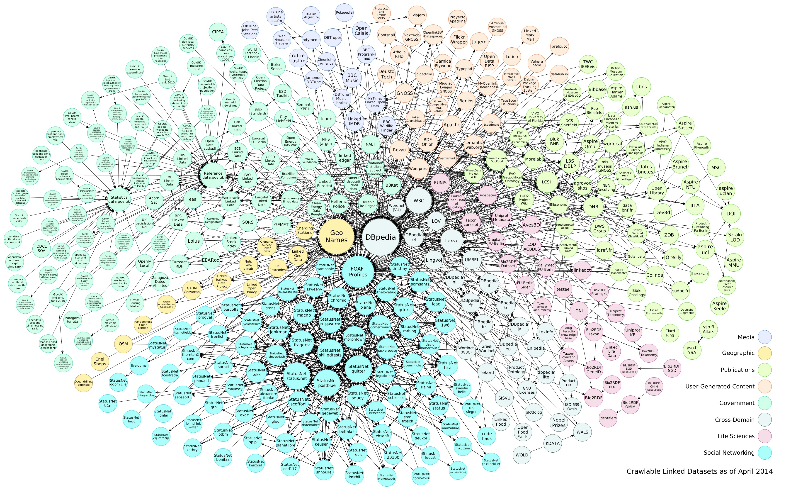



Linked Data Mediators: Federated Query Processing
Publicly available SPARQL endpoints
Federated
query processing
ANAPSID

Slide 58

The Mediator and Wrapper Architecture
Integration System
Query
Mediator
Catalog
Integration System
Mediator
Catalog
Wrapper
Wrapper
Wrapper
Wrapper
Wrapper
Wrapper
Wrapper

Slide 59
What is the role of ontologies here?

Slide 60
Linked Data integration using ontologies:
Also popular under the term Ontology-based data-access (OBDA) [Kontchakov et al. 2013]:
  Typically conisders a relational DB, mappings (rules), an ontology Tbox (typically OWL QL (DL-Lite), or OWL RL (rules))
Ontology (O)
OWL,RDFS
RDBMS
SQL
RDB2RDF Mappings
Datalog
OBDA
Query (Q)
SPARQL

Slide 61
Linked Data integration using ontologies:
Also popular under the term Ontology-based data-access (OBDA) [Kontchakov et al. 2013]:
  Typically conisders a relational DB, mappings (rules), an ontology Tbox (typically OWL QL (DL-Lite), or OWL RL (rules))
For simplicity, let's leave out the Relational DB part, assuming Data is already in RDF...
Ontology (O)
OWL,RDFS
Triple Store
RDF/SPARQL
OBDA
Query (Q)
SPARQL

Slide 62
Linked Data integration using ontologies (example)
"Places with a Population Density below 5000/km2"?

Slide 63
A concrete use case:
The "City Data Pipeline"

Slide 64
A concrete use case:
The "City Data Pipeline"
City Data Model: extensible ALH(D) ontology:
dbo:PopulatedPlace rdfs:subClassOf :Place.
dbo:populationDensity rdfs:subPropertyOf :populationDensity.
eurotstat:City rdfs:subClassOf :Place.
eurotstat:popDens rdfs:subPropertyOf :populationDensity.
dbpedia:areakm rdfs:subPropertyOf :area
eurostat:area rdfs:subPropertyOf :area
Indicators, e.g. area in km2, tons CO2/capita
Provenance
Temporal information
Spatial context

Slide 65

A concrete use case:
The "City Data Pipeline"
City Data Model: extensible ALH(D) ontology:
dbo:PopulatedPlace
:Place
Indicators, e.g. area in km2, tons CO2/capita
Provenance
dbo:populationDensity
:populationDensity
eurostat:City
:Place
eurostat:popDens
:populationDensity
dbo:areakm
:area
eurostat:area
:area
Temporal information
Spatial context

Slide 66
A concrete use case:
The "City Data Pipeline"
City Data Model: extensible ALH(D) ontology:
:Place(X)
Indicators, e.g. area in km2, tons CO2/capita
← dbo:PopulatedPlace(X)
Provenance
:populationDensity(X,Y)
← dbo:populationDensity(X,Y)
:Place(X)
← eurostat:City(X)
:populationDensity(X,Y)
← eurostat:popDens(X)
:area(X,Y)
← dbo:areakm(X,Y)
:area(X,Y)
← eurostat:area(X,Y)
Temporal information
Spatial context

Slide 67
A concrete use case:
The "City Data Pipeline"
"Places with a Population Density below 5000/km2"?
SELECT ?X WHERE { ?X a :Place . ?X :populationDensity ?Y .
FILTER(?Y < 5000) }
:Place(X)
← dbo:PopulatedPlace(X)
:populationDensity(X,Y)
← dbo:populationDensity(X,Y)
:Place(X)
← eurostat:City(X)
:populationDensity(X,Y)
← eurostat:popDens(X)
:area(X,Y)
← dbo:areakm(X,Y)
:area(X,Y)
← eurostat:area(X,Y)

Slide 68
Approach 1: Materialization
(input: triple store + Ontology output: materialized triple store)
SELECT ?X WHERE { ?X a :Place . ?X :populationDensity ?Y .
FILTER(?Y < 5000) }
:Vienna a dbo:PopulatedPlace.
:Vienna dbo:populationDensity 4326.1 .
:Vienna dbo:areaKm 414.65 .
:Vienna dbo:populationTotal 1805681 .
:Vienna a :Place.
:Vienna :populationDensity 4326.1 .
:Vienna :area 414.65
:Place(X)
← dbo:PopulatedPlace(X)
:populationDensity(X,Y)
← dbo:populationDensity(X,Y)
:Place(X)
← eurostat:City(X)
:populationDensity(X,Y)
← eurostat:popDens(X)
:area(X,Y)
← dbo:areakm(X,Y)
:area(X,Y)
← eurostat:area(X,Y)
RDF triple stores implement it naitively (OWLIM, Jena Rules, Sesame)
Can handle a large part of OWL: OWL 2 RL [Krötzsch, 2012]
OWL 2 RL covers most RDF/OWL usage on the Web in Linked Data! [Glimm et al. 2012]

Slide 69
Approach 2: Query rewriting
(input: conjunctive query (CQ) + Ontology output: UCQ)
SELECT ?X WHERE { ?X a :Place . ?X :populationDensity ?Y .
FILTER(?Y < 5000) }
:Vienna a dbo:PopulatedPlace.
:Vienna dbo:populationDensity 4326.1 .
:Vienna dbo:areaKm 414.65 .
:Vienna dbo:populationTotal 1805681 .
:Place(X)
← dbo:PopulatedPlace(X)
:populationDensity(X,Y)
← dbo:populationDensity(X,Y)
:Place(X)
← eurostat:City(X)
:populationDensity(X,Y)
← eurostat:popDens(X)
:area(X,Y)
← dbo:areakm(X,Y)
:area(X,Y)
← eurostat:area(X,Y)
SELECT ?X WHERE { { {?X a :Place . ?X :populationDensity ?Y . }
UNION {?X a dbo:Place . ?X :populationDensity ?Y . }
UNION {?X a :Place . ?X dbo:populationDensity ?Y . }
UNION {?X a dbo:Place . ?X dbo:populationDensity ?Y . }
UNION {?X a dbo:Place . ?X dbo:populationDensity ?Y . }
... }
FILTER(?Y < 5000) }

Slide 70
Approach 2: Query rewriting
(input: conjunctive query (CQ) + Ontology output: UCQ)
SELECT ?X WHERE { ?X a :Place . ?X :populationDensity ?Y .
FILTER(?Y < 5000) }
Observation: essentially, GAV-style rewriting
Can handle a large part of OWL (corresponding to DL-Lite [Calvanese et al. 2007]): OWL 2 QL
Query-rewriting- based tools and systems available, many optimizations to naive rewritings, e.g. taking into account mappings to a DB:
  REQUIEM [Perez-Urbina et al., 2009]
  Quest [Rodriguez-Muro, et al. 2012]
  ONTOP [Rodriguez-Muro, et al. 2013]
  Mastro [Calvanese et al. 2011]
  Presto [Rosati et al. 2010]
  KYRIE2 [Mora & Corcho, 2014]
Rewriting vs. Materialization – tradeoff: [Sequeda et al. 2014]
OBDA is a booming field of research!

Slide 71
Where to find suitable ontologies?
Ontology (O)
OWL,RDFS
Triple Store
RDF/SPARQL
OBDA
Query (Q)
SPARQL
Ok, so where do I find suitable ontologies?

Slide 72
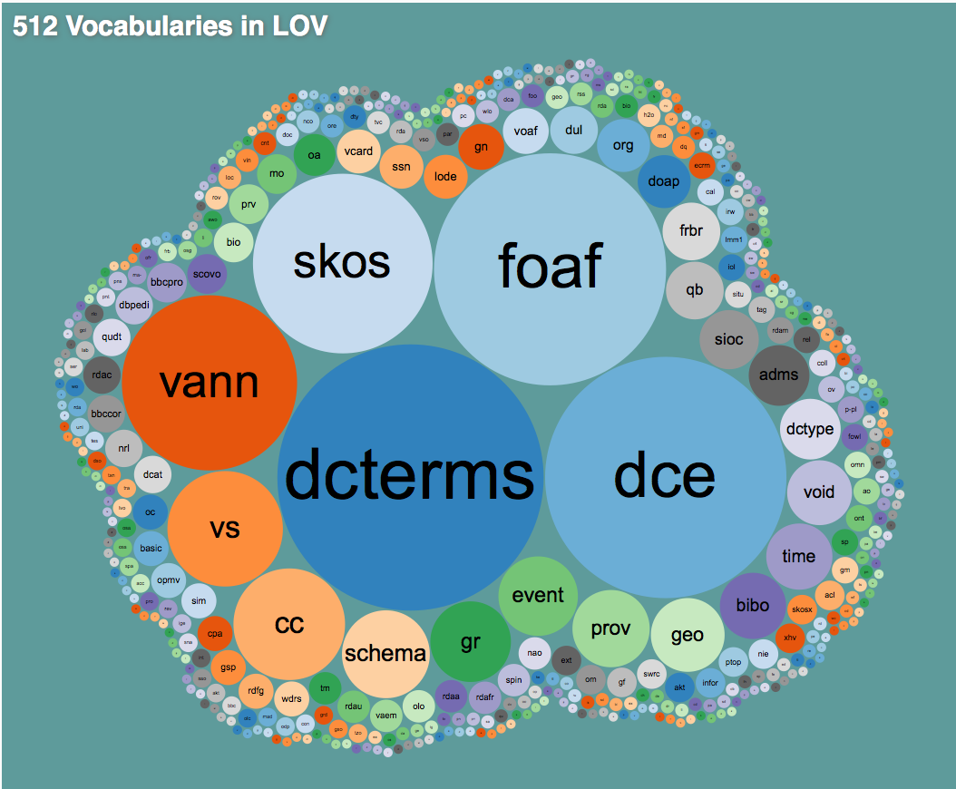
Ontologies and mapping between Linked Data Vocabularies
Good Starting point: Linked Open Vocabularies
    http://lov.okfn.org/dataset/lov/
Still, probably a lot of manual mapping...
  Literature search for suitable ontologies → don't re-invent the wheel, re-use where possible
  Crawl
  Ontology learning, i.e. learn mappings?
    e.g. using Ontology matching [Shvaiko&Euzenat, 2013]

Slide 73
Data quality

Slide 74
Data Quality [Lenz 2007]
Quality reflects the ability of an object to meet a purpose.
ISO Norm: Suitability for use relative to a given objective of usage.
Industry Quality: is the conformance to requirements.
Data is considered high quality if “they are fit for their intended uses in operations,
decision making, and planning” (J.M. Juran).
Fitness for use in intended purpose
Free of defects:
Accessible
Accurate
Current
Complete
Consistent with other sources
Possess desired features:
Relevant
Comprehensive
Proper level of detail
Easy-to-read
Easy-to-interpret

Slide 75
Data Quality Issues [Naumann02]
Data Errors
Single Source
Integrated Source
Schema Level
Data Level
Schema Level
Data Level
Structural Heterogeneity
Semantic Heterogeneity
Infeasible values
Attribute Dependency
Unsatisfied Integrity Constraints
Null values
Typos
False values
Inconsistent values
Transpositions
Duplicates and data
value conflicts
Inconsistent values
Duplicates and data
value conflicts
Notes:
Source?

Slide 76

Data Quality-Duplicated Resources
Venezuela
<http://worldbank.270a.info/classification/country/VE>
<http://eurostat.linked-statistics.org/dic/geo#VE>
<http://sws.geonames.org/3625428/>
<http://dbpedia.org/resource/Venezuela>

Slide 77
Taxonomy of Data Quality [Naumann02]
Class | Dimension
Intrinsic Data Quality | Believability Accuracy Objectivity Reputation
Contextual Data Quality | Value-added Relevancy Timeliness Completeness Amount of Data
Representation of Data Quality | Interpretability Understandibility Representational Consistency Conciseness
Accessibility | Accessibility
[Naumann02] Felix Naumann: Quality-Driven Query Answering for Integrated Information Systems. LNCS 2261, Springer 2002

Slide 78
Taxonomy of Data Quality [Zaveri2015]
Contextual
Representation
Completeness
Understandibility
Rep.
Conciseness
Relevancy
Amount of Data
Interpretability
Trust*
Rep.
Consistency
Reputation
Versatility*
Verifiability
Believability
Licensing*
Provenance
Intrinsic
Accuracy
Conciseness
Consistency
Validity of
Documents*
Dataset Dynamicity
Objectivity
Interlinking*
Timeliness
Accessibility
Availability
Currency
Security
Volatility
Performance*
Response Time

Slide 79
Duplicate Detection-Sorted Neighborhood Method [Hernandez&Stolfo, 1998]
Create Keys
Compute a key for each entry
Relevant attributes must be considered
Sort Data
Sort the records in the data list using the keys
Merge
Move a fixed size window through the sequential list of records limiting the comparisons

Slide 80
Consistency Detection
Semantic Rules
Integrity Constraints
ICs
User Defined
Constraints
Edits
Rules
Equations
Rules
Dependencies
Rules
Types
Key Dependencies
Inclusion Dependencies
Functional Dependencies
Multi-valued Dependencies
OWL
Or, alternatively, use statistics?
[Naumann02] Felix Naumann: Quality-Driven Query Answering for Integrated Information Systems. LNCS 2261, Springer 2002

Slide 81
Data Quality (back to our example)
Duplicates
Incomplete values (partially solved by inferences/OBDA)
  Are OWL+RDFS actually enough?
    Equations
    Statistics
Ambiguous/inconsistent values
  actually, by inferences and OBDA, even more duplicates values → more possible inconsistencies

Slide 82
Back to the example:
Are RDFS and OWL2 (RL/QL) enough?
SELECT ?X WHERE { ?X a :Place . ?X :populationDensity ?Y .
FILTER(?Y < 5000) }
:Vienna a dbo:PopulatedPlace.
:Vienna dbo:populationDensity 4326.1 .
:Vienna dbo:areaKm 414.65 .
:Vienna dbo:populationTotal 1805681 .
:Bologna a dbo:PopulatedPlace.
:Bologna dbo:areaKm 140.7 .
:Bologna dbo:populationTotal 386298 .
:Place(X)
← dbo:PopulatedPlace(X)
:populationDensity(X,Y)
← dbo:populationDensity(X,Y)
:Place(X)
← eurostat:City(X)
:populationDensity(X,Y)
← eurostat:popDens(X)
:area(X,Y)
← dbo:areakm(X,Y)
:area(X,Y)
← eurostat:area(X,Y)
?
:populationDensity = :population/:area
:area = 0,386102 * dbpedia:areaMi2
Probably not...
A possible solution: [Bischof & Polleres, 2013]

Slide 83


[Bischof&Polleres 2013] Basic Idea: Consider clausal form of all variants of equations and use Query rewriting with "blocking":
:Bologna dbo:population 386298 .
:Bologna dbo:areaKm 140.7 .
Finally, the resulting UCQs with assignments can be rewritten back to SPARQL using BIND
  SELECT ?PD WHERE { :Bologna dbo:popDensity ?PD}
… infinite expansion even if only 1 equation is considered.
Solution: “blocking” recursive expansion of the same equation for the same value.
  SELECT ?PD WHERE { {:Athens dbo:popDensity ?PD }
  UNION
  { :Athens dbo:population ?P ; dbo:area ?A .
  BIND (?P/?A AS ?PD )}
  }

Slide 84
A concrete use case:
The "City Data Pipeline"
Indicators, e.g. area in km2, tons CO2/capita
Provenance
Ok, so where do I find these equations?
Temporal information
Spatial context

Slide 85
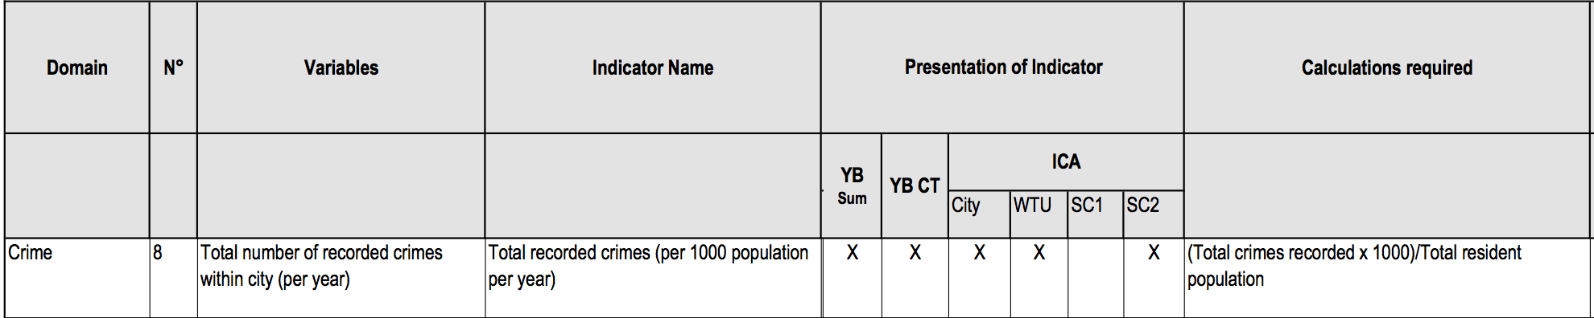
Equational knowledge:
Eurostat/Urbanaudit:
  http://ec.europa.eu/regional_policy/archive/urban2/urban/audit/ftp/vol3.pdf
Notes:
Not available as structured form, but ok, you can let a bachelor student write these down...

Slide 86
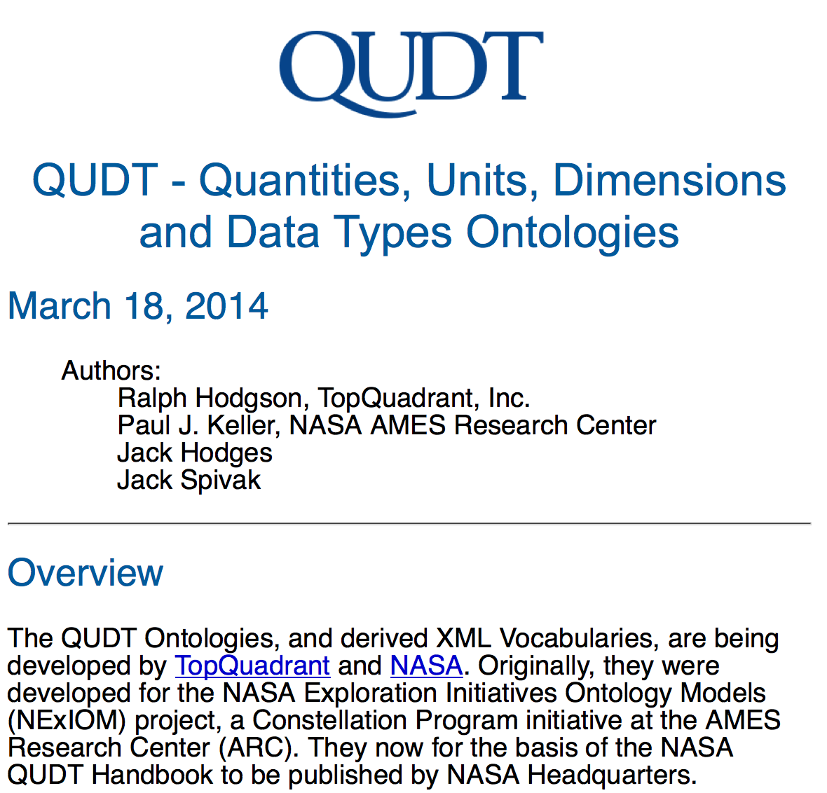
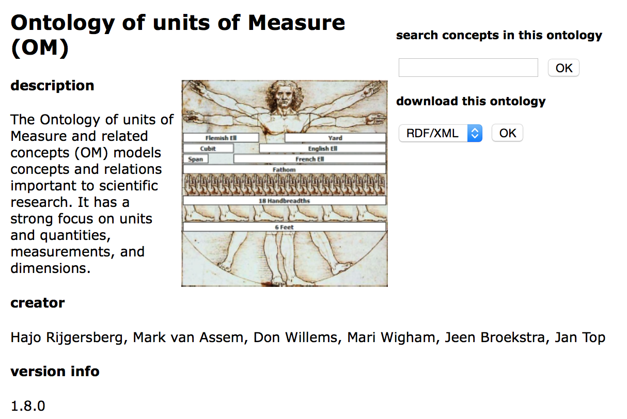
Equational knowledge:
Unit conversion
http://qudt.org/
http://www.wurvoc.org/vocabularies/om-1.8/
Notes:
Not available as structured form, but ok, you can let a bachelor student write these down...

Slide 87
Data Quality Data Quality (back to our example)
Duplicates
Incomplete values (partially solved by inferences/OBDA)
  Are OWL+RDFS actually enough?
    Equations
    Statistics
Ambiguous/inconsistent values
  actually, by inferences and OBDA, even more duplicates values → more possible inconsistencies

Slide 88
A concrete use case:
The "City Data Pipeline"
City Data Model: extensible ALH(D) ontology:
Hmmm... Still a lot of work to do, e.g. adding aggregates for statistical data (Eurostat, RDF Data Cube Vocabulary) ... cf. [Kämpgen, 2014, PhD Thesis]
Indicators, e.g. area in km2, tons CO2/capita
:avgIncome per country is the
population-weighted average income of all its provinces.
Provenance
Temporal information
But Eurostat data is incomplete... I don't have the avg. income for all provinces or countries in the EU!
Spatial context
Hmmm...
Notes:
Integration and Analysis of Distributed Multidimensional Datasets

Slide 89
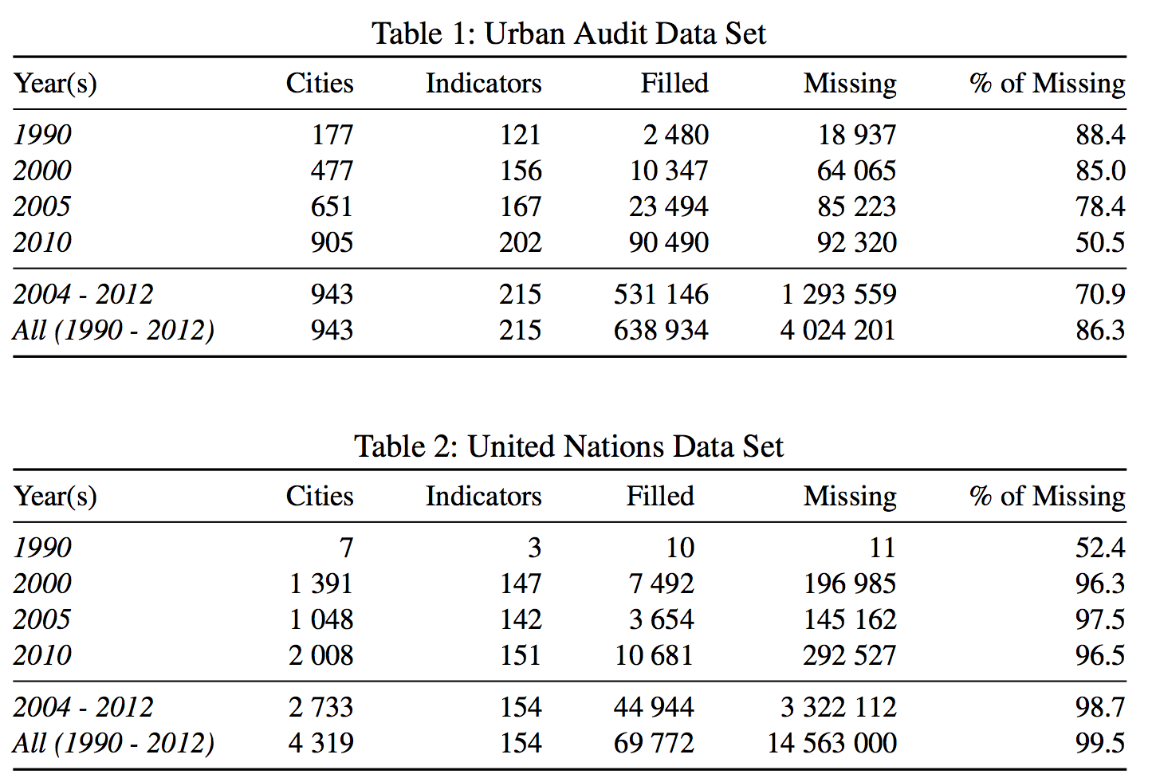
Challenge – Missing values [Bischof et al. 2015]
WARNING: In Open Data we find huge amounts of missing values
Two Reasons:
  Incomplete data published by providers (Tables 1+2)
  The combination of different data sets with disjoint cities and indicators (later)

Slide 90
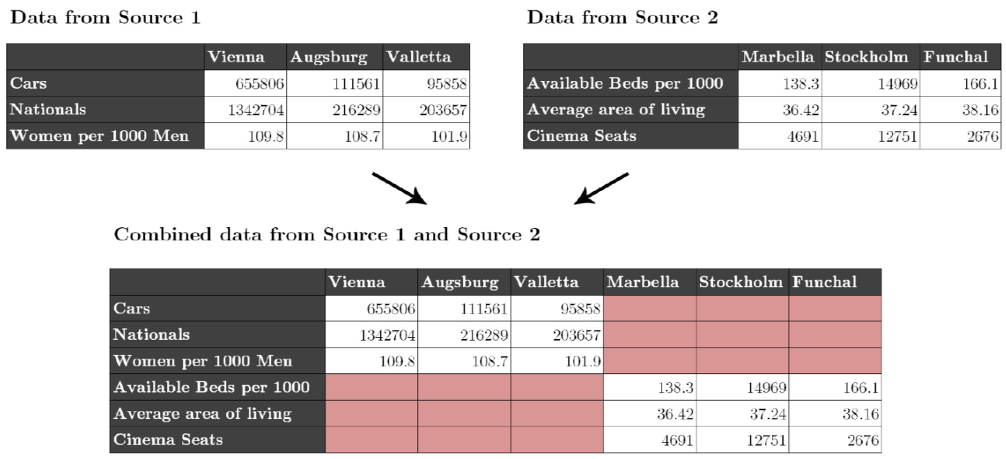
Challenges – Missing values
Individual datasets (e.g. from Eurostat) have missing values
Merging together datasets with different indicators/cities adds sparsity

Slide 91
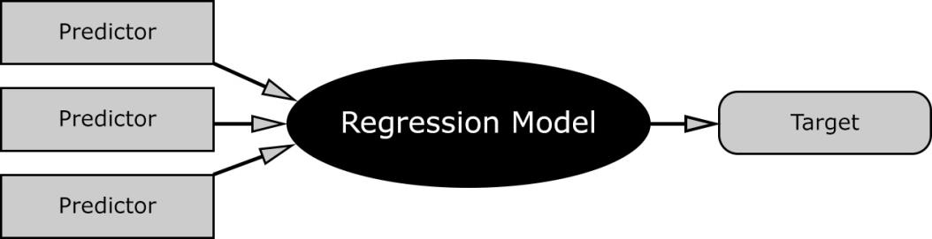
Missing Values – Hybrid approach choose best prediction method per indicator:
Our assumption: every indicator has its own
distribution and relationship to others.
Basket of „standard“ regression methods:
  K-Nearest Neighbour Regression (KNN)
  Multiple Linear Regression (MLR)
  Random Forest Decision Trees (RFD)

Slide 92
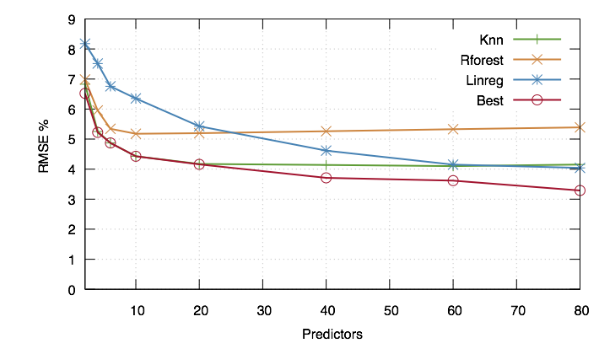
Missing Values – Hybrid approach choose best prediction method per indicator:
Instead of using indicators directly we use Principle Components, built from the indicators
For buidling the PCs, fill in missing data points with neutral values → predict all rows

Slide 93
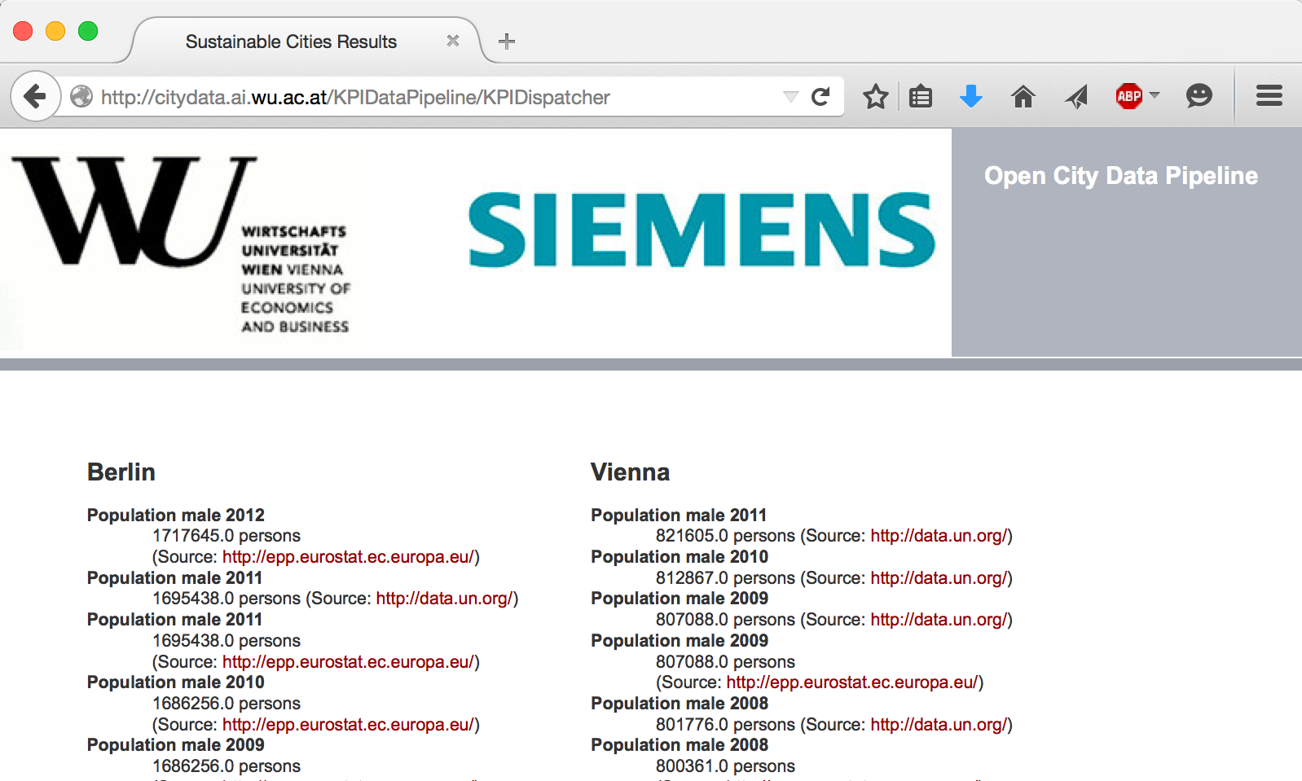

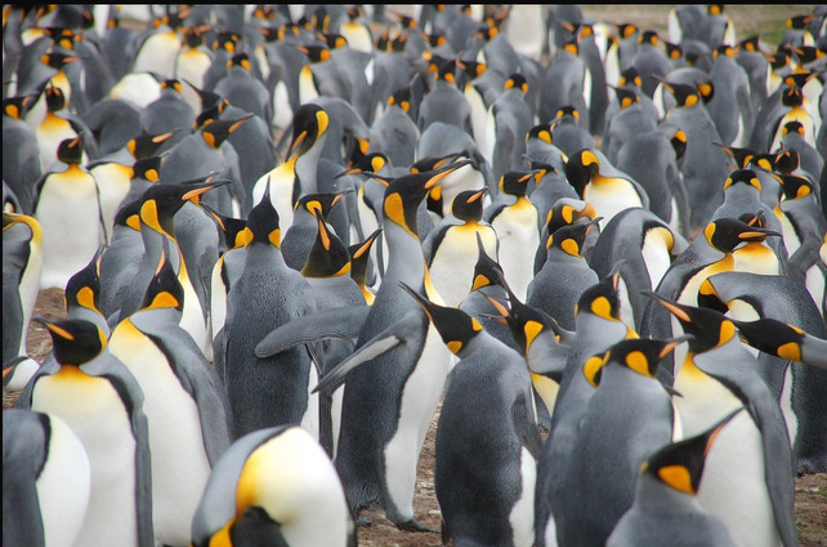
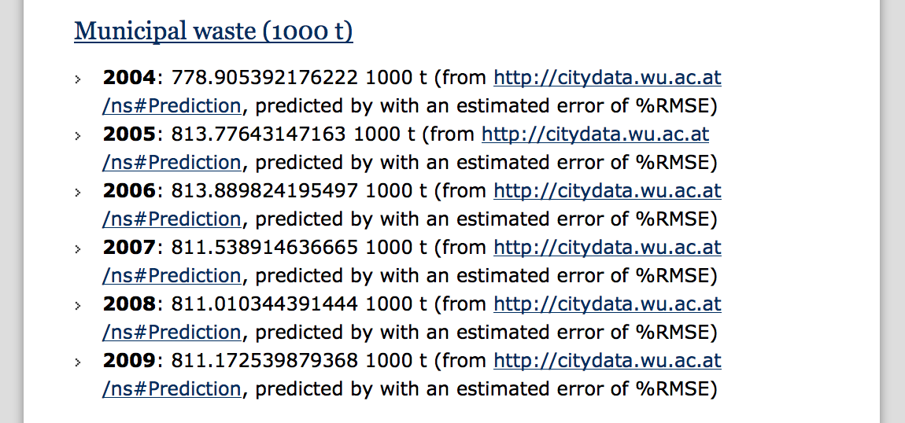
City Data Pipeline
citydata.wu.ac.at
Search for indicators & cities
obtain results incl. sources
Integrated data served as Linked Data
Predicted values AND estimated error (RMSE) for missing data...
...assumption: Predictions get better, the more Open data we integrate...
Open Data: The more, the merrier!

Slide 94
Data Quality
Duplicates
Incomplete values (partially solved by inferences/OBDA)
  Are OWL+RDFS actually enough?
    Equations
    Statistics
Ambiguous/inconsistent values
  actually, by inferences and OBDA, even more duplicates values → more possible inconsistencies

Slide 95



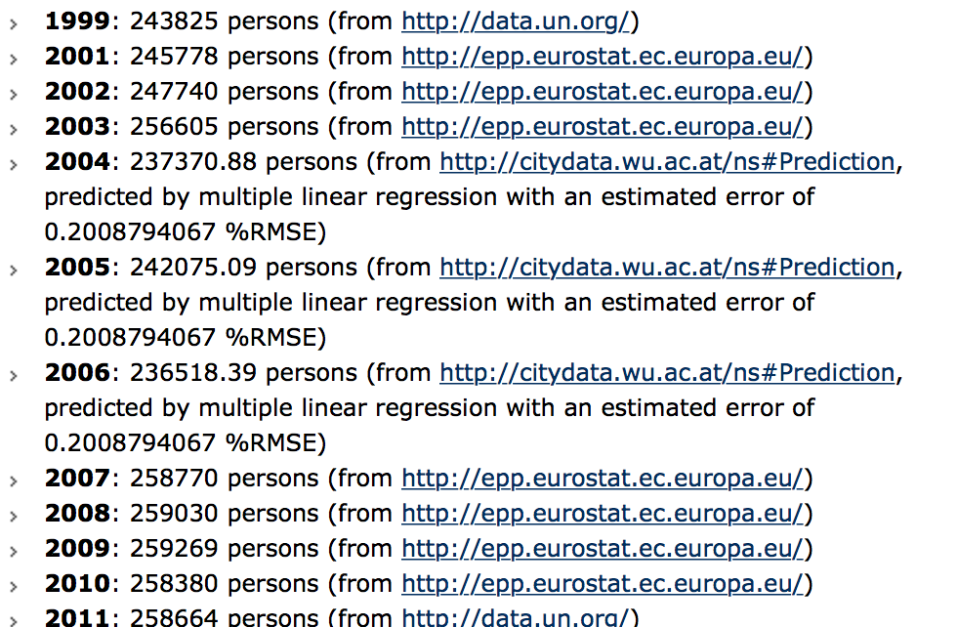
Still a lot to be done:
Time series analysis shows obvious inconsistencies
  Predictions on time series are partially very bad at the moment:
  Most of the data we look at is time series data/data changing over time.

Slide 96
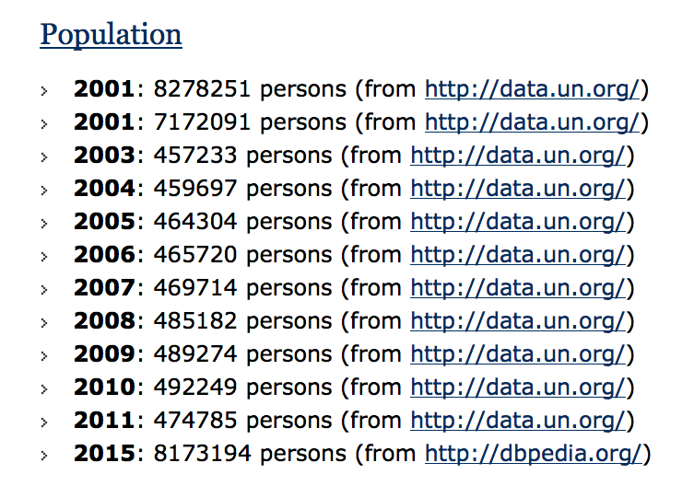
Still a lot to be done:
Open Data is incomparable/inconsistent in itself
Surprising maybe, how much obviously weird data you find:
  Inconsistencies across and within datasets

Slide 97

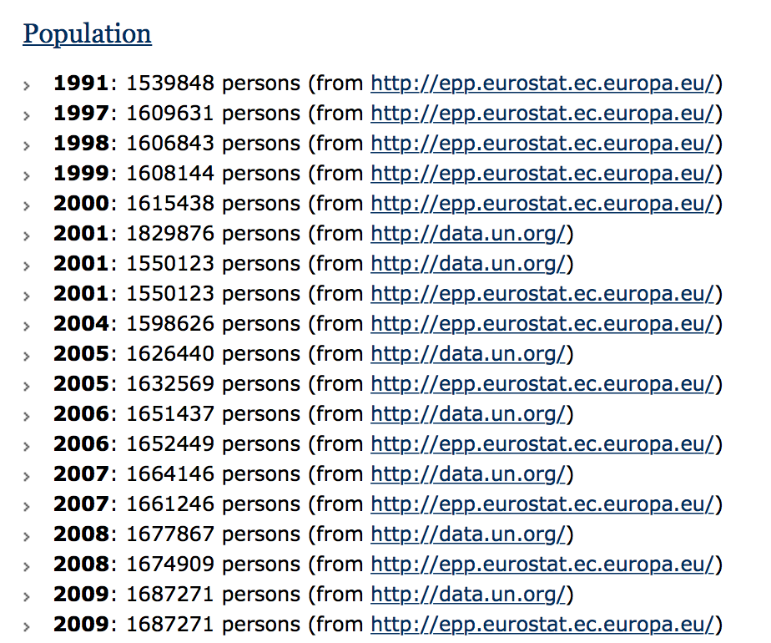
Still a lot to be done:
Open Data is incomparable/inconsistent in itself
Surprising maybe, how much obviously weird data you find:
  Inconsistencies across and within datasets
  Still, some datasets match quite well on certain indicators
  Open: (How) can we exploit this?
  → Ontology learning? Predicting values from one dataset into the other?
Notes:
Ontology learning, what we started looking into now was learning correlations ... Linear equations come "for free" with our completion/prediction method.

Slide 98
Conclusions

Slide 99

Conclusions
Heterogeneous Web Sources

Slide 100
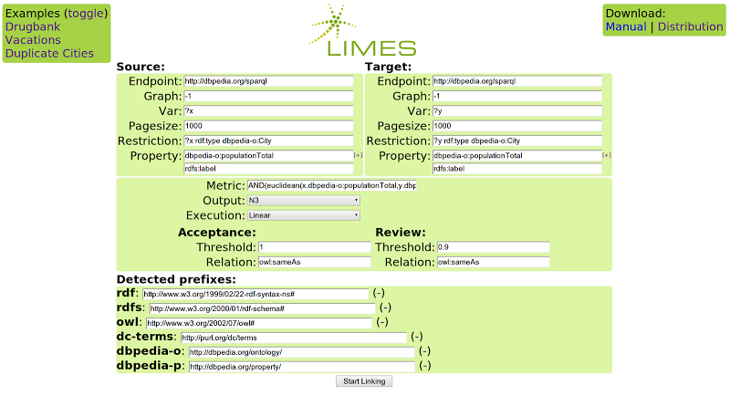
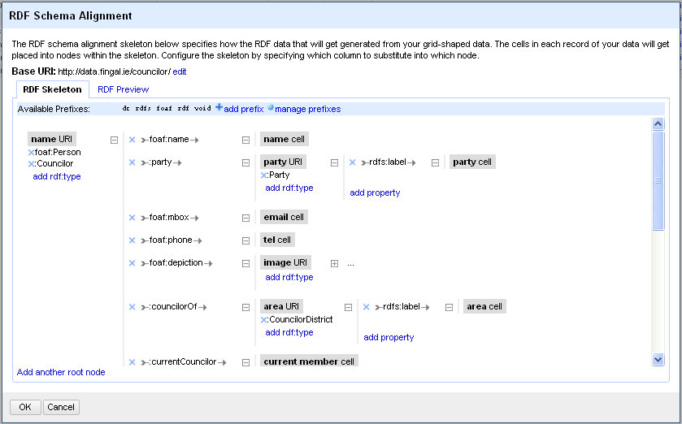
Conclusions
Heterogeneous Web Sources
Tools to Access/Integrate Web Sources
RDB2RDF
Systems

Slide 101
Conclusions
Query
Data Integration System
Mediator
Catalog
Wrapper
Wrapper
Wrapper
Wrapper
amFinancial(C,R)
euClimate(C,R)
similarFinancial(C1,C2)
tunisRating(T,R)
[Wiederhold92]Gio Wiederhold: Mediators in the Architecture of Future Information Systems. IEEE Computer 25(3): 38-49 (1992)

Slide 102
Integration Systems
Global Schema
rdfs:subPropertyOf
rating(C,R)
rdfs:subPropertyOf
euroCity(C)
amCity(C)
financial(C,R)
climate(C,R)
afCity(C)
GLAV
GAV
LAV
Local Schema
S={amFinancial(C,R), euClimate(C,R), tunisRating(T,R), similarFinancial(C1,C2) }

Slide 103
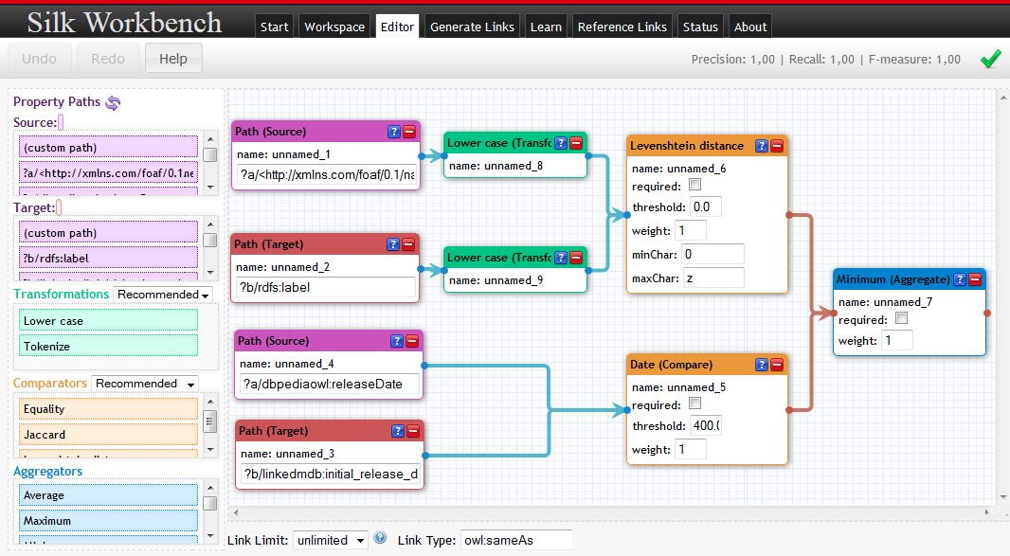

Slide 104
Take-home messages:
Semantic Web technologies help in Open Data Integration workflows and can add flexibility
It's worthwhile to consider traditional "Data Integration" approaches & literature!
Non-Clean Data requires: Statistics & machine learning (outlier detection, imputing missing values, resolving inconsistencies, etc.)
Many Thanks!
Questions

Slide 105
References

Slide 106
References 1
[Polleres 2013] Axel Polleres. Tutorial "OWL vs. Linked Data: Experiences and Directions" OWLED2013. http://polleres.net/presentations/20130527OWLED2013_Invited_talk.pdf
[Polleres et al. 2013] Axel Polleres, Aidan Hogan, Renaud Delbru, Jürgen Umbrich:
RDFS and OWL Reasoning for Linked Data. Reasoning Web 2013: 91-149
[Golfarelli,Rizzi,2009] Matteo Golfarelli, Stefano Rizzi. Data Warehouse Design: Modern Principles and Methodologies. McGraw-Hill, 2009.
[Lenzerini2002] Maurizio Lenzerini: Data Integration: A Theoretical Perspective. PODS 2002: 233-246
[Auer et al. 2012] Sören Auer, Lorenz Bühmann, Christian Dirschl, Orri Erling, Michael Hausenblas, Robert Isele, Jens Lehmann, Michael Martin, Pablo N. Mendes, Bert Van Nuffelen, Claus Stadler, Sebastian Tramp, Hugh Williams:
Managing the Life-Cycle of Linked Data with the LOD2 Stack. International Semantic Web Conference (2) 2012: 1-16 see also http://stack.lod2.eu/
[Taheriyan et al. 2012] Mohsen Taheriyan, Craig A. Knoblock, Pedro A. Szekely, José Luis Ambite: Rapidly Integrating Services into the Linked Data Cloud. International Semantic Web Conference (1) 2012: 559-574
[Bischof et al. 2012] Stefan Bischof, Stefan Decker, Thomas Kr ennwallner, Nuno Lopes, Axel Polleres:
Mapping between RDF and XML with XSPARQL. J. Data Semantics 1(3): 147-185 (2012)
  [Nonaka & Takeuchi, 1995] "The Knowledge-Creating Company - How Japanese Companies Create the Dynamics of Innovation" (Nonaka, Takeuchi, New York Oxford 1995)
  [Bischof et al. 2015] Stefan Bischof, Christoph Martin, Axel Polleres, and Patrik Schneider. Open City Data Pipeline: Collecting, Integrating, and Predicting Open City Data. In 4th Workshop on Knowledge Discovery and Data Mining Meets Linked Open Data (Know@LOD), Portoroz, Slovenia, May 2015.

Slide 107
References 2
[Levy & Rajaraman & Ullman 1996] Alon Y. Levy, Anand Rajaraman, Jeffrey D. Ullman: Answering Queries Using Limited External Processors. PODS 1996: 227-237
[Duscka & Genesereth 1997]
[Pottinger & Halevy 2001] Rachel Pottinger, Alon Y. Halevy: MiniCon: A scalable algorithm for answering queries using views. VLDB J. 10(2-3): 182-198 (2001)
[Arvelo & Bonet & Vidal 2006] Yolifé Arvelo, Blai Bonet, Maria-Esther Vidal: Compilation of Query-Rewriting Problems into Tractable Fragments of Propositional Logic. AAAI 2006: 225-230
[Konstantinidis & Ambite, 2011] George Konstantinidis, José Luis Ambite: Scalable query rewriting: a graph-based approach. SIGMOD Conference 2011: 97-108
[Izquierdo & Vidal & Bonet 2011] Daniel Izquierdo, Maria-Esther Vidal, Blai Bonet: An Expressive and Efficient Solution to the Service Selection Problem. International Semantic Web Conference (1) 2010: 386-401
[Wiederhold92] Gio Wiederhold: Mediators in the Architecture of Future Information Systems. IEEE Computer 25(3): 38-49 (1992)
[Stadtmüller et al. 2013] Steffen Stadtmüller, Sebastian Speiser, Andreas Harth, Rudi Studer: Data-Fu: a language and an interpreter for interaction with read/write linked data. WWW 2013: 1225-1236

Slide 108
References 3
[Priyatna et al. 2014] Freddy Priyatna, Óscar Corcho, Juan Sequeda:
Formalisation and experiences of R2RML-based SPARQL to SQL query translation using morph. WWW 2014: 479-490
[Sequeda & Miranker 2013] Juan Sequeda, Daniel P. Miranker. Ultrawrap: SPARQL execution on relational data. J. Web Sem. 22: 19-39 (2013)
[Krötzsch 2012] Markus Krötzsch: OWL 2 Profiles: An Introduction to Lightweight Ontology Languages. Reasoning Web 2012: 112-183
[Glimm et al. 2012] Birte Glimm, Aidan Hogan, Markus Krötzsch, Axel Polleres: OWL: Yet to arrive on the Web of Data? LDOW 2012
[Kontchakov et al. 2013] Roman Kontchakov, Mariano Rodriguez-Muro, Michael Zakharyaschev: Ontology-Based Data Access with Databases: A Short Course. Reasoning Web 2013: 194-229
[Calvanese et al. 2007] Diego Calvanese, Giuseppe De Giacomo, Domenico Lembo, Maurizio Lenzerini, Riccardo Rosati: Tractable Reasoning and Efficient Query Answering in Description Logics: The DL-Lite Family. J. Autom. Reasoning 39(3): 385-429 (2007)
[Perez-Urbina et al., 2009] Héctor Pérez-Urbina, Boris Motik and Ian Horrocks, A Comparison of Query Rewriting Techniques for DL-Lite, In Proc. of the Int. Workshop on Description Logics (DL 2009), Oxford, UK, July 2009.
[Rodriguez-Muro, et al. 2012] Mariano Rodriguez-Muro, Diego Calvanese:
Quest, an OWL 2 QL Reasoner for Ontology-based Data Access. OWLED 2012
[Rodriguez-Muro, et al. 2013] Mariano Rodriguez-Muro, Roman Kontchakov, Michael Zakharyaschev: Ontology-Based Data Access: Ontop of Databases. International Semantic Web Conference (1) 2013: 558-573
[Calvanese et al. 2011] Diego Calvanese, Giuseppe De Giacomo, Domenico Lembo, Maurizio Lenzerini, Antonella Poggi, Mariano Rodriguez-Muro, Riccardo Rosati, Marco Ruzzi, Domenico Fabio Savo:
The MASTRO system for ontology-based data access. Semantic Web 2(1): 43-53 (2011)
[Rosati et al. 2010] Riccardo Rosati, Alessandro Almatelli: Improving Query Answering over DL-Lite Ontologies. KR 2010
[Mora & Corcho, 2014] José Mora, Riccardo Rosati, Óscar Corcho: kyrie2: Query Rewriting under Extensional Constraints in ELHIO. Semantic Web Conference (1) 2014: 568-583
[Sequeda et al. 2014] Juan F. Sequeda, Marcelo Arenas, Daniel P. Miranker:
OBDA: Query Rewriting or Materialization? In Practice, Both! Semantic Web Conference (1) 2014: 535-551

Slide 109
References 4
[Acosta et al 2011] M. Acosta, M.-E. Vidal, T. Lampo, J. Castillo, and E. Ruckhaus. Anapsid: an adaptive query processing engine for sparql endpoints. ISWC 2011.
[Basca and Bernstein 2014] C. Basca and A. Bernstein. Querying a messy web of data with avalanche. In Journal of Web Semantics, 2014.
[Cohen-Boalaki and . Leser. 2013] S. Cohen-Boalakia, U. Leser. Next Generation Data Integration for the Life Sciences. Tutorial at ICDE 2013. https://www2.informatik.hu-berlin.de/~leser/icde_tutorial_final_public.pdf
[Doan et el. 2012] A. Doan, A. Halevy, Z. Ives, Data Integration. Morgan Kaukman 2012.
[Halevy et al 2006] A. Y. Halevy, A. Rajaraman, J. Ordille: Data Integration: The Teenage Years. VLDB 2006: 9-16.
[Halevy et al 2001] A. Y. Halevy. Answering queries using views: A survey. VLDB J., 2001.
[Hassanzadeh et al. 2013] Oktie Hassanzadeh, Ken Q. Pu, Soheil Hassas Yeganeh, Renée J. Miller, Lucian Popa, Mauricio A. Hernández, Howard Ho: Discovering Linkage Points over Web Data. PVLDB 2013
[Gorlitz and Staab 2011] O. Gorlitz and S. Staab. SPLENDID: SPARQL Endpoint Federation Exploiting VOID Descriptions. In Proceedings of the 2nd International Workshop on Consuming Linked Data, 2011.
[ Schwarte et al. 2011] A. Schwarte, P. Haase, K. Hose, R. Schenkel, and M. Schmidt. Fedx: Optimization techniques for federated query processing on linked data. ISWC 2011.
[Verborgh et al. 2014] Ruben Verborgh, Olaf Hartig, Ben De Meester, Gerald Haesendonck, Laurens De Vocht, Miel Vander Sande, Richard Cyganiak, Pieter Colpaert, Erik Mannens, Rik Van de Walle: Querying Datasets on the Web with High Availability. ISWC2014

Slide 110
References 5
[Acosta et al. 2015] Maribel Acosta, Amrapali Zaveri, Elena Simperl, Dimitris Kontokostas, Sören Auer, Jens Lehmann: Crowdsourcing Linked Data Quality Assessment. ISWC 2013
[Lenz 2007] Hans - J. Lenz. Data Quality Defining, Measuring and Improving. Tutorial at IDA 2007.
[Naumann02] Felix Naumann: Quality-Driven Query Answering for Integrated Information Systems. LNCS 2261, Springer 2002
[Ngonga et al. 2011] Axel-Cyrille Ngonga Ngomo, Sören Auer: LIMES - A Time-Efficient Approach for Large-Scale Link Discovery on the Web of Data. IJCAI 2011
[Saleem et al 2014] Muhammad Saleem, Maulik R. Kamdar, Aftab Iqbal, Shanmukha Sampath, Helena F. Deus, Axel-Cyrille Ngonga Ngomo: Big linked cancer data: Integrating linked TCGA and PubMed. J. Web Sem. 2014
[Soru et al. 2015] Tommaso Soru, Edgard Marx, Axel-Cyrille Ngonga Ngomo: ROCKER: A Refinement Operator for Key Discovery. WWW 2015
[Volz et al 2009] Julius Volz, Christian Bizer, Martin Gaedke, Georgi Kobilarov: Discovering and Maintaining Links on the Web of Data. ISWC 2009
[Zaveri,et al 2015] Amrapali J. Zaveri, Anisa Rula, Andrea Maurino, Ricardo Pietrobon, Jens Lehmann, and Sören Auer. Quality Assessment for Linked Data: A Survey. Semantic Web Journal 2015
[Hernandez&Stolfo, 1998] M. A. Hernández, S. J. Stolfo: Real-world Data is Dirty: Data Cleansing and The Merge/Purge Problem.
Data Min. Knowl. Discov. 2(1): 9-37 (1998)

Slide 111
trends & OPEN Research problems (some)

Slide 112
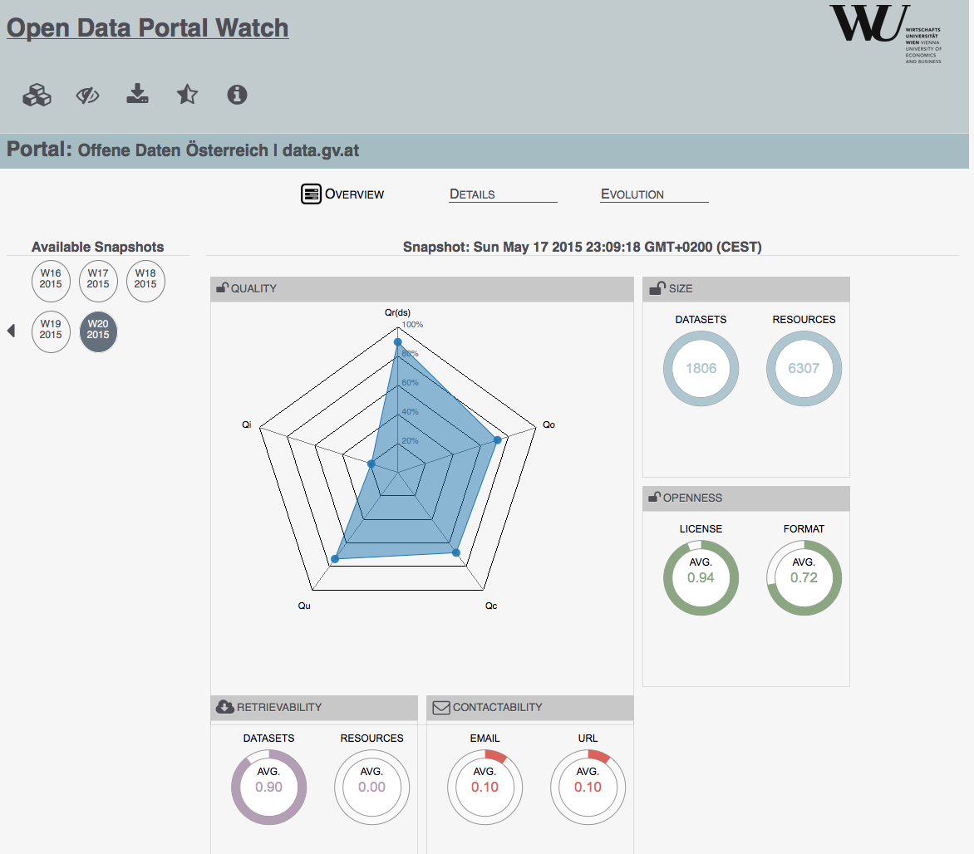
Data Source Quality in Integration Systems
IS=<O,S,M>
Sources in S are described in terms of Quality Metrics:
Coverage: measures the completeness of a source.
Accuracy: measures the correctness of a source.
Timeliness: time required for changes to appear in the source.
Position Bias: how positive or negative are the sentiment of entities in the source.
Possible use case:
http://data.wu.ac.at/portalwatch
Theodoros Rekatsinas, Xin Luna Dong, Lise Getoor and Divesh Srivastava. Finding quality in quantity: the challenge of discovering valuable
sources for integration.CIDR 2015

Slide 113
Uncertainty in Integration Systems
Data Integration with Uncertainty
Uncertain Schema Mappings
Uncertain Data
Uncertain Queries
Xin Luna Dong, Alon Y. Halevy, Cong Yu: Data integration with uncertainty. VLDB J.
18(2): 469-500 (2009)

Slide 114
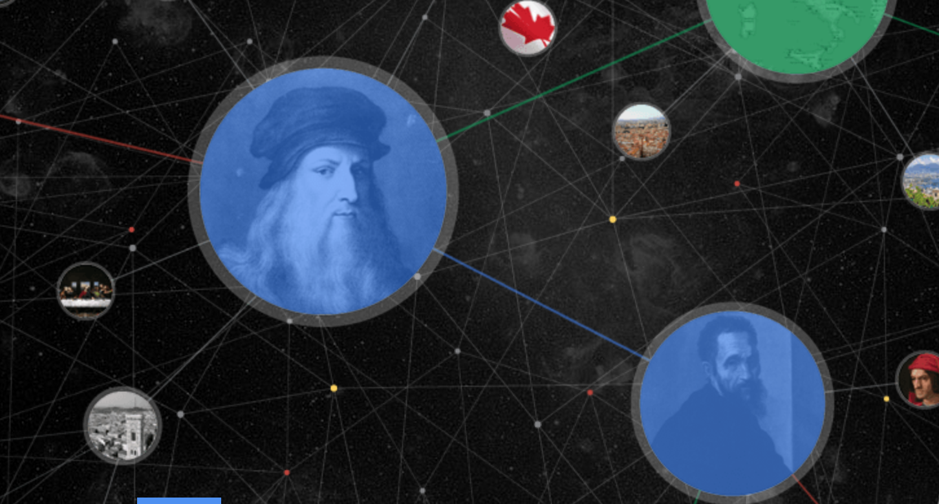


Knowledge Integration Systems
Knowledge Extraction
Knowledge Fusion
Integration System
Global KBs
Domain-specific KBs
Google knowledge graph
Global KBs:
  Covers a variety of knowledge across domains
  Intensional: Cyc, WordNet
  Extensional: Freebase, Knowledge Graph, Yago/Yago2, DeepDive, NELL, Prospera, ReVerb, Knowledge Vault
Knowledge Curation and Knowledge Fusion: challenges, models and applications. Xin Luna Dong and Divesh Srivastava.
Tutorial in Proceedings of the ACM SIGMOD 2015.

Slide 115
Big Data Integration Systems
Big Data Integration
Five V’s
Veracity
Volume
Variety
Velocity
Value
154 million high quality relational tables on
the web
  10s of millions of high quality deep web
  sources
  10s of millions of useful relational tables
  from web lists
Source: Xin Luna Dong, Divesh Srivastava. Big Data Integration. PVLDB2013
Serge Abiteboul, Xin Luna Dong, Oren Etzioni, Divesh Srivastava, Gerhard Weikum, Julia Stoyanovich and Fabian M. Suchanek.
The elephant in the room: getting value from big data. WebDB 2015
Xin Luna Dong, Divesh Srivastava. Big Data Integration. PVLDB2013
. Barna Saha and Divesh Srivastava. Data quality: the other face of big data Tutorial in ICDE 2014

Slide 116



Crowdsourcing LD Quality Assessment
2
{s p o .}
3
Dataset
Correct
{s p o .}
Quality Assessment Module
Incorrect +
Quality issue
1
Challenges
1
Selecting LD quality issues to crowdsource
Selecting the appropriate crowdsourcing approaches
Generating the interfaces to present the data to the crowd
2
3
Acosta et al. – Crowdsourcing Linked Data Quality Assessment. ISWC, 2013.

Slide 117
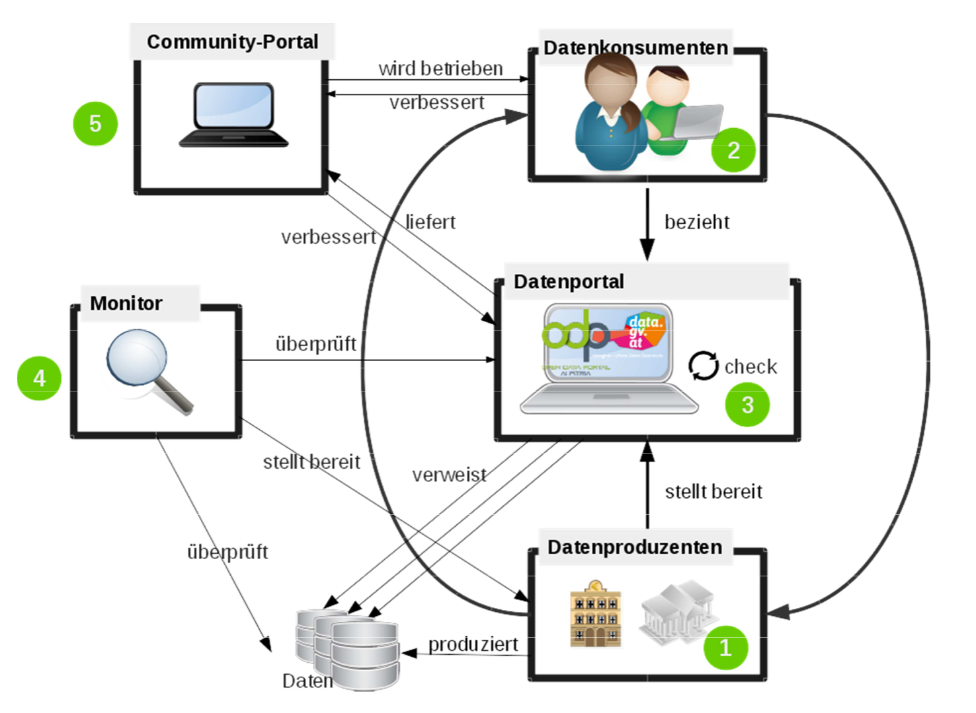

Crowdsourcing Open Quality Assessment
How to involve the users in CKAN portals?

Slide 118
SPARQL Query Execution using LAV views
Publicly available Linked Data Fragments (LAV views)
Servers
Mediator

Slide 119
Lower Bounds for the Space of Query Rewritings
CQs and OWL2QL-ontologies [Gottlob14]
  Exponential and Superpolynomial lower bounds on the size of pure rewritings.
  Polynomial-size under some restrictions.
[Gottlob14]
Georg Gottlob, Stanislav Kikot, Roman Kontchakov, Vladimir V. Podolskii, Thomas Schwentick, Michael Zakharyaschev: The price of query rewriting in ontology-based data access. Artif. Intell. 213: 42-59 (2014)

Slide 120
SPARQL Query Execution using LAV views.
Gabriela Montoya, Luis Daniel Ibáñez, Hala Skaf-Molli, Pascal Molli, Maria-Esther Vidal. SemLAV: Local-As-View Mediation for SPARQL Queries. T. Large-Scale Data- and Knowledge-Centered Systems 13: 33-58 (2014).
Ruben Verborgh, Olaf Hartig, Ben De Meester, Gerald Haesendonck, Laurens De Vocht, Miel Vander Sande, Richard Cyganiak, Pieter Colpaert, Erik Mannens, and Rik Van de Walle. Querying Datasets on the Web with High Availability. ISWC 2014.
Gabriela Montoya, Hala Skaf-Molli, Pascal Molli, Maria-Esther Vidal. Federated SPARQL Queries Processing with Replicated Fragments. Accepted at ISWC 2015.

Slide 121
Adaptive Execution of SPARQL Queries
NL
Optional
NL
Optional
Bio2RDF::DrugBank
Inter-operator adaptivity
GJOIN
GJoin
GJoin

Slide 122
Adaptive Execution of SPARQL Queries
NL
Optional
Intra-operator adaptivity
NL
Optional
Bio2RDF::DrugBank
GJOIN
GJoin
GJoin

Slide 123
Adaptive Execution of SPARQL Queries
  Maribel Acosta, Maria-Esther Vidal, Tomas Lampo, Julio Castillo, Edna Ruckhaus: ANAPSID: An Adaptive Query Processing Engine for SPARQL Endpoints. International Semantic Web Conference (1) 2011: 18-34.
Cosmin Basca, Abraham Bernstein: Querying a messy web of data with Avalanche. J. Web Sem. 26: 1-28 (2014)
Maribel Acosta and Maria-Esther Vidal. Networks of Linked Data Eddies: An Adaptive Web Query Processing Engine for RDF Data. Accepted at ISWC 2015.

Slide 124
Updates in OBDA
How to do updates in such a setting?
So far, we only scratched the surface:
Albin Ahmeti, Diego Calvanese, and Axel Polleres. Updating RDFS ABoxes and TBoxes in SPARQL. In Proceedings of the 13th International Semantic Web Conference (ISWC 2014), Lecture Notes in Computer Science (LNCS). Springer, October 2014.
Albin Ahmeti, Diego Calvanese, Vadim Savenkov, and Axel Polleres. Dealing with Inconsistencies due to Class Disjointness in SPARQL Update. In 28th International Workshop on Description Logics (DL2015), Athens, Greece, June 2015.
For details, cf.:
http://polleres.net/presentations/20150226SPARQL_Update_Entailment_Karlsruhe_Service_Summit.pptx
Ontology (O)
OWL,RDFS
Triple Store
RDF/SPARQL
OBDA
Query (Q)
SPARQL
Update (U)
SPARQL Update

Slide 125
Your Research Task(s) for the rest of the day:
Work on those in your mini-project groups!
Some of the overall Research Questions (too generic on purpose!!!!) from the slides before:
Quality: Handling Data Quality Issues in (Linked) (Open) Data Integration Systems
Uncertainty: Handling Uncertainty in (Linked) (Open) Data Integration Systems
Big Data: Handling Scalable Processing of Rapidly growing data in (Linked) (Open) Data Integration Systems
LAV vs. GAV for the Semantic Web: OBDA for SPARQL using LAV (SPARQL Query Execution using LAV)
Updates: Handling Updates in OBDA
For each problem you work on:
1) Problems: Why is this a difficult problem? Find obstacles, find literature. Define concrete (sub-)research questions!
2) Solutions: What could be strategies to overcome these obstacles?
3) Systems: What could be a strategy/roadmap/method to implement these strategies?
4) Benchmarks: What could be a strategy/roadmap/method to evaluate a solution?
Result: short written report per group addressing these 4 questions and findings.
Tips:
Think about how much time you dedicate to which of these four questions
Don’t start with 3)
Prepare some answers or discussions for the final plenary session!
mandatory
optional
→ Please email reports to axel[at]polleres.net

Slide 126
Backup slides
There are tons of things we did NOT talk about: e.g. stream data management, ontology evolution, federated query processing, etc. ...

Slide 127
Extraction-Transform-Load (ETL) Tools
Import Filters
Data Transformations
Deduplication
Profiling
Quality Management
Parsers for external file formats, or drivers to interact with third-party systems.

Slide 128
Extraction-Transform-Load (ETL) Tools
Import Filters
Data Transformations
Deduplication
Profiling
Quality Management
Schema mappings. Data may be joined, aggregated, and filtered.

Slide 129
Extraction-Transform-Load (ETL) Tools
Import Filters
Data Transformations
Deduplication
Profiling
Quality Management
Tools that detect when multiple records refer to the same entity.

Slide 130
Extraction-Transform-Load (ETL) Tools
Import Filters
Data Transformations
Deduplication
Profiling
Quality Management
Tools that characterize and describe data in the data warehouse, e.g., histograms.

Slide 131
Extraction-Transform-Load (ETL) Tools
Import Filters
Data Transformations
Deduplication
Profiling
Quality Management
Tools that enhance data quality, e.g., testing against a master list, validating known
business rules, record merging.

Slide 132
Wrappers for RDF Data
SPARQL Endpoints
Web services that implement the SPARQL protocol, and enable users to query particular datasets.
Linked Data Fragments[Verborgh2014]
Web services that access views of triple patterns.
[Verborgh2014]Ruben Verborgh, Olaf Hartig, Ben De Meester, Gerald Haesendonck, Laurens De Vocht,
Miel Vander Sande, Richard Cyganiak, Pieter Colpaert, Erik Mannens, and Rik Van de Walle. Querying Datasets
on the Web with High Availability. ISWC 2014.
Notes:
SPARQL Federation & LD Fragments can go to the Challenges part

Slide 133
Linked Data Mediators: Federated Query Processing
Publicly available SPARQL endpoints
Federated
query processing
ANAPSID

Slide 134
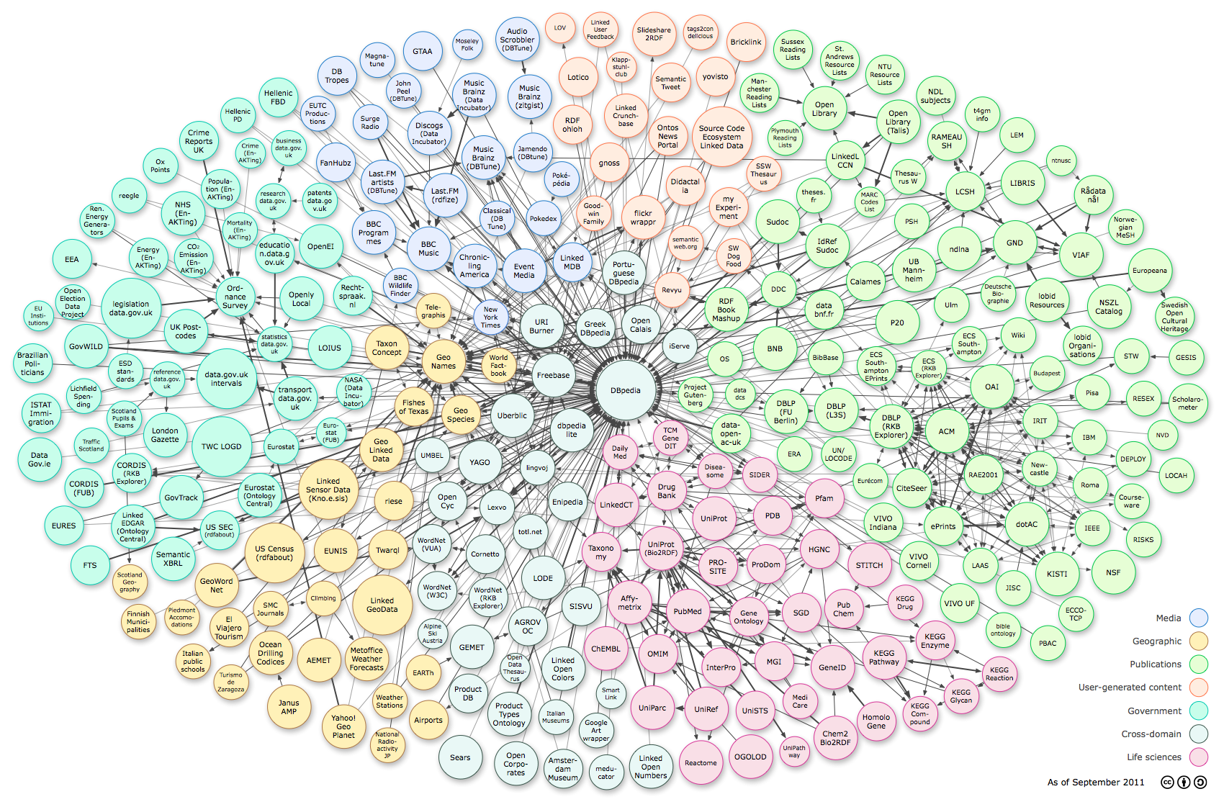
Federated Query Engine
Query
Federated Engine
Catalog

Slide 135
Federation of SPARQL Endpoints
http://data.linkedmdb.org/sparql := http://data.linkedmdb.org/resource/movie/personal_film_appearance;
http://www.w3.org/2002/07/owl#sameAs;
http://www.w3.org/1999/02/22-rdf-syntax-ns#type;
http://xmlns.com/foaf/0.1/based_near;
http://xmlns.com/foaf/0.1/name;
…..
http://dbtune.org/jamendo/sparql := http://www.w3.org/1999/02/22-rdf-syntax-ns#type;
http://purl.org/dc/elements/1.1/title;
http://xmlns.com/foaf/0.1/based_near;
http://xmlns.com/foaf/0.1/homepage;
http://purl.org/ontology/mo/biography;
….
http://dbpedia.org/sparql := http://xmlns.com/foaf/0.1/name;
http://dbpedia.org/ontology/award;
http://dbpedia.org/ontology/almaMater;
http://www.geonames.org/ontology#name;
http://www.geonames.org/ontology#parentFeatures;
….
http://www.lotico.com:3030/lotico/sparq := http://www.geonames.org/ontology#name;
http://www.geonames.org/ontology#parentFeatures;
http://www.geonames.org/ontology#officialName;
http://www.geonames.org/ontology#postalCode;
…..
Notes:
Move all stuff on federation to the challenges part!

Slide 136
Executing a Federated Query
@PREFIX foaf:<http://xmlns.com/foaf/0.1/>
@PREFIX geonames:<http://www.geonames.org/ontology#>
SELECT ?name ?location WHERE {
?artist foaf:name ?name .
?artist foaf:based_near ?location .
?location geonames:parentFeature ?germany .
?germany geonames:name 'Federal Republic of Germany’ .}
t2

Slide 137

Federated Engines: Architecture
Query Planner
SPARQL 1.0
Source Selection and Query
Decomposer
Query
Optimizer
Physical
Optimizer
Logical plan
SPARQL 1.1 Query
Physical plan
Query Executor
Endpoint Descriptions

Slide 138
Federated Query SPARQL 1.1
@PREFIX foaf:<http://xmlns.com/foaf/0.1/>
@PREFIX geonames:http://www.geonames.org/ontology#
SELECT ?name ?location WHERE {
{ SERVICE <http://data.linkedmdb.org/sparql> {
?artist foaf:name ?name . } }.
{ SERVICE <http://dbtune.org/jamendo/sparql>{
?artist foaf:based_near ?location .} }.
{ SERVICE <http://dbpedia.org/sparql> {
?location geonames:parentFeature ?germany } }.
{ SERVICE <http://www.lotico.com:3030/lotico/sparq> {
?germany geonames:name 'Federal Republic of Germany’ } }
}
t1
t2
t3
t3
t4

Slide 139
Federated Engines: Architecture
Query Planner
SPARQL 1.0
Source Selection and Query
Decomposer
Query
Optimizer
Physical
Optimizer
Logical plan
SPARQL 1.1 Query
Physical plan
Query Executor
Endpoint Descriptions

Slide 140
Executing a Federated Query
SPARQL 1.1
@PREFIX foaf:<http://xmlns.com/foaf/0.1/>
@PREFIX geonames:http://www.geonames.org/ontology#
SELECT ?name ?location WHERE {
{ SERVICE <http://data.linkedmdb.org/sparql> {
?artist foaf:name ?name . } }.
{ SERVICE <http://dbtune.org/jamendo/sparql>{
?artist foaf:based_near ?location .} }.
{ SERVICE <http://dbpedia.org/sparql> {
?location geonames:parentFeature ?germany } }.
{ SERVICE <http://www.lotico.com:3030/lotico/sparq> {
?germany geonames:name 'Federal Republic of Germany’ } }
}
S1
t1
S2
t2
S3
t3
t3
S4
t4

Slide 141
Query Rewriting Plan
S1
S2
S3
S4

Slide 142
Federated Engines: Architecture
Query Planner
SPARQL 1.0
Source Selection and Query
Decomposer
Query
Optimizer
Physical
Optimizer
Logical plan
Deliver
SPARQL 1.1 Query
Physical plan
Transform
Query Executor
Endpoint Descriptions
Collect

Slide 143
SPARQL Query Processing
@PREFIX foaf:<http://xmlns.com/foaf/0.1/>
@PREFIX geonames:http://www.geonames.org/ontology#
SELECT ?name ?location WHERE {
?artist foaf:name ?name .
?artist foaf:based_near ?location .
?location geonames:parentFeature ?germany .
?germany geonames:name 'Federal Republic of Germany’ .}
RDF Engines
{'news': '', 'name': 'Michael Bartels^^<http://www.w3.org/2001/XMLSchema#string>', 'location': 'http://sws.geonames.org/2911297/'}
{'news': '', 'name': 'Melophon^^<http://www.w3.org/2001/XMLSchema#string>', 'location': 'http://sws.geonames.org/2911297/'}
{'news': '', 'name': 'Remote Controlled^^<http://www.w3.org/2001/XMLSchema#string>', 'location': 'http://sws.geonames.org/2911297/'}
{'news': '', 'name': 'Arne Pahlke^^<http://www.w3.org/2001/XMLSchema#string>', 'location': 'http://sws.geonames.org/2911297/'}
{'news': '', 'name': 'Superdefekt^^<http://www.w3.org/2001/XMLSchema#string>', 'location': 'http://sws.geonames.org/2911297/'}
{'news': '', 'name': 'Chaos^^<http://www.w3.org/2001/XMLSchema#string>', 'location': 'http://sws.geonames.org/2911297/'}
{'news': '', 'name': 'The Gay Romeos^^<http://www.w3.org/2001/XMLSchema#string>', 'location': 'http://sws.geonames.org/2911297/'}
{'news': '', 'name': 'Der tollw\\u00FCtige Kasper^^<http://www.w3.org/2001/XMLSchema#string>', 'location': 'http://sws.geonames.org/2911297/'}
{'news': '', 'name': 'the ad.kowas^^<http://www.w3.org/2001/XMLSchema#string>', 'location': 'http://sws.geonames.org/2911297/'}
{'news': '', 'name': 'herr gau^^<http://www.w3.org/2001/XMLSchema#string>', 'location': 'http://sws.geonames.org/2911297/'}
{'news': '', 'name': 'The Rodeo Five^^<http://www.w3.org/2001/XMLSchema#string>', 'location': 'http://sws.geonames.org/2911297/'}
RDF Graphs

Slide 144
Data Quality-Duplicated Resources
<http://worldbank.270a.info/classification/country/VE>

Slide 145
Data Quality-Duplicated Resources
<http://dbpedia.org/resource/Venezuela>

Slide 146
Data Quality-Duplicated Resources
<http://sws.geonames.org/3625428/>

Slide 147
Mining Techniques to Predict Links and Discover Patterns

Slide 148
Mining Techniques to Predict Links and Discover Patterns
Ding, H., Takigawa, I., Mamitsuka, H., Zhu, S.: Similarity-based machine learning methods for predicting drug-target interactions: A brief review. Briefings in Bioinformatics (2013)
Fakhraei, S., Huang, B., Raschid, L., Getoor, L.: Network-based drug-target interaction prediction with probabilistic soft logic. In: IEEE/ACM Transactions on Computational Biology and Bioinformatics (2014)
Flores A., Vidal M.E., Palma G.: Exploiting Semantics to Predict Potential Novel Links from Dense Subgraphs. AMW 2015
Palma G., Vidal M.E., Raschid L.: Drug-Target Interaction Prediction Using Semantic Similarity and Edge Partitioning. Semantic Web Conference (1) 2014: 131-146

Slide 149
MATERIALIZED global schema- data warehouse

Slide 150
Data Warehouse-Materialized Global Schema
Global Schema
Data Integration System
amCity(C)
Data Warehouse
Engine
rdfs:subPropertyOf
rating(C,R)
rdfs:subPropertyOf
Catalog
financial(C,R)
climate(C,R)
euCity(C)
afCity(C)
GLAV rules
ETL
ETL
ETL
amFinancial(C1,R)
euClimate(C,R)
tunisIndicator(T,R)
This is a GLAV rule
similarFinancial(C1,C2)
  α0: amFinancial(C1,R),similarFinancial(C1,C2):-
  amCity(C1),amCity(C2),financial(C1,R),financial(C2,R).

Slide 151
Extraction-Transform-Load (ETL) Tools
Import Filters
Data Transformations
Deduplication
Profiling
Quality Management
Notes:
Not sure about this slide, shall we really show it?

