Slide 1
Stream Reasoning – Research and Use cases at the Institute of Information Business
Axel Polleres & Javier Fernandez, WU Wien

Slide 2
Outline
Disclaimer: NO concrete work on Stream Reasoning in my group at the moment, but still on 3 related topics...
Dynamic Linked Data & Open Data
Efficient RDF Stream Interchange (ERI)
SPARQL 1.1 Update & Entailment as a basis for Stream Reasoning Semantics?

Slide 3
1. Dynamic Linked Data & Open Data:
Collecting changes in Linked and Open Data:
Dynamic Linked Data Observatory
Open Data Portalwatch
The DBPedia Wayback machine

Slide 4
1.1 Dynamic Linked Data Observatory
Started in DERI since 2012, weekly snapshots of crawla of Linked Data... Interesting dataset for investigating LOD dynamics.
http://dyldo.deri.org/
Publications:
Tobias Käfer, Ahmed Abdelrahman, Jürgen Umbrich, Patrick O'Byrne, Aidan Hogan."Observing Linked Data Dynamics". In the Proceedings of the 10th Extended Semantic Web Conference (ESWC 2013), Montpellier, France, 26–30 May, 2013.
Tobias Käfer, Jürgen Umbrich, Aidan Hogan and Axel Polleres,
"Towards a Dynamic Linked Data Observatory", In the Proceedings of the Linked Data on the Web WWW2012 Workshop (LDOW 2012), Lyon, France, 16 April, 2012.

Slide 5
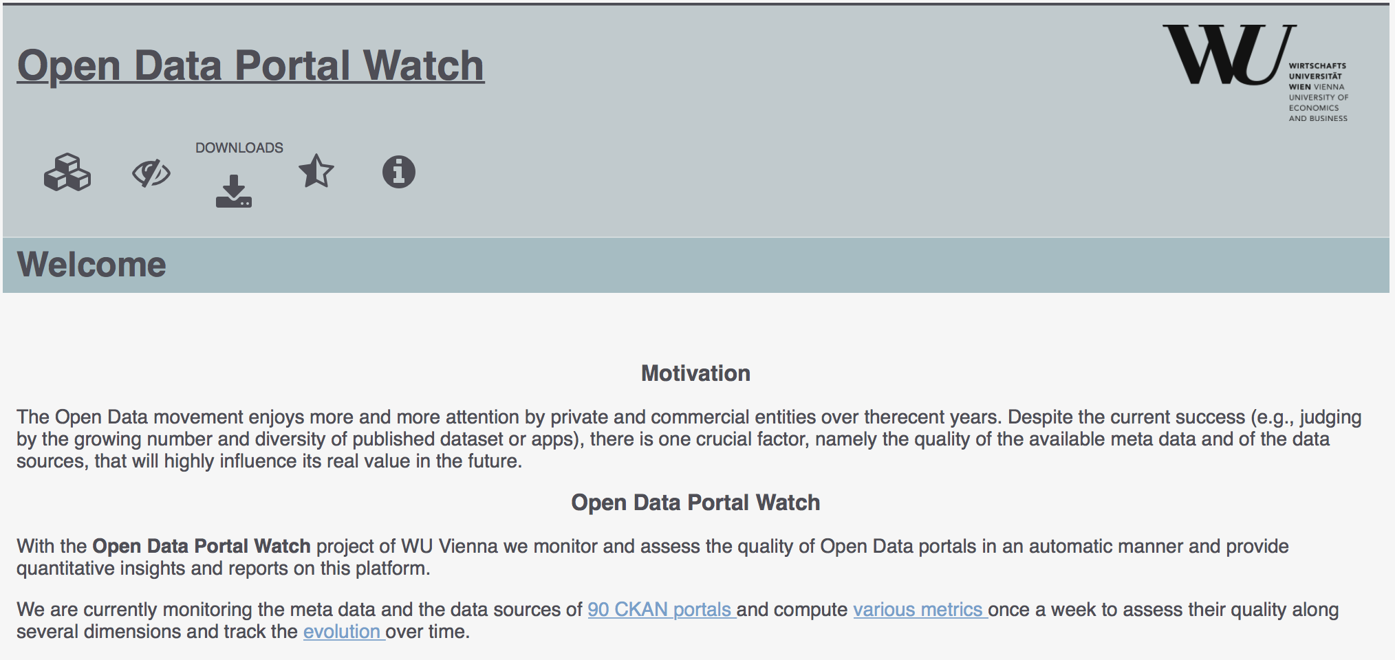
1.2 OPEN DATA PORTAL WATCH
http://data.wu.ac.at/portalwatch/
Started in 2014 – similar idea, different dataset:
  Weekly crawls of Data and Metadata from over 90 Open Data Portals (CKAN, Socrata, etc)
Goal: Quality assessment
Evolution tracking
  Meta data
  Data
  Jürgen Umbrich, Sebastian Neumaier, and Axel Polleres. Quality assessment & evolution of open data portals. In IEEE International Conference on Open and Big Data, Rome, Italy, August 2015. Best paper award.

Slide 6
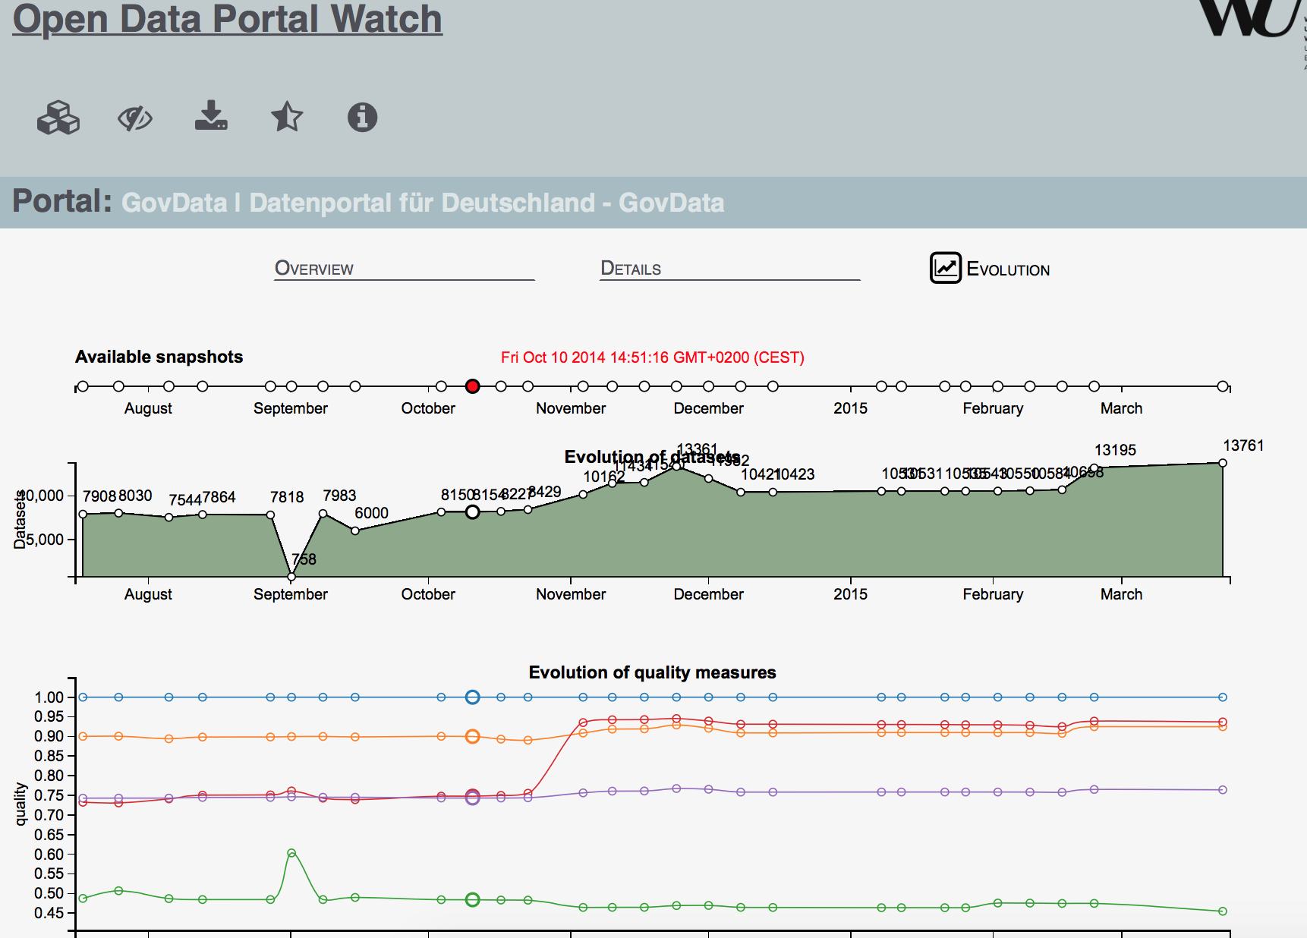
1.2 Open Data Portal Watch

Slide 7
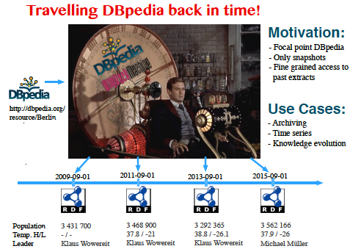
Dbpedia Wayback Machine
http://data.wu.ac.at/wayback/ ... Different concept: create historical
RDF Data from wikipedia/dbpedia revision history
"The DBpedia wayback machine" by Javier Fernandez, Patrik Schneider, Jürgen Umbrich, September 2015, SEMANTiCS2015 (Best Poster).

Slide 8
Motivation: Data Integration and System Interoperation at Scale
Update rate
Virtual/Augmented
Reality
ROS
Internet
of Things
second
Disaster Monitoring with Wikipedia and Online Social Networking Sites: Structured Data
and Linked Data Fragments to the Rescue?Thomas Steiner, Ruben Verborgh
2015 AAAI Spring Symposium Series.
http://wikistream.wmflabs.org/
minute
hour
day
week
Dyldo
month
year
DBpedia
BTC
Number of sources
10⁰
10¹
10²
10³
10⁴
10⁵
10⁶
Notes:
Number of sources 1…n (hyperlinks)
Update rates 1 year … 10 ms
Read-only vs. Read-write (write requires semantics for descriptions?)
Ok to not have descriptions for read (we just do a lookup and see what we get)
Not ok for write (need to know what to send – whether you need descriptions or hard-code what to send is another matter)

Slide 9
1. Dynamic Linked Data & Open Data – Discussion:
Stream Reasoning related questions:
How can we efficiently store and query archival data?
Where does reasoning help us? (e.g. detect anomalies, conflicts, assume defaults in case of missing crawls, etc.)
Javier D. Fernández, Axel Polleres, and Jürgen Umbrich. Towards efficient archiving of dynamic linked open data. In Managing the Evolution and Preservation of the Data Web - First Diachron Workshop at ESWC 2015, pages 34-49, Portorož, Slovenia, May 2015

Slide 10



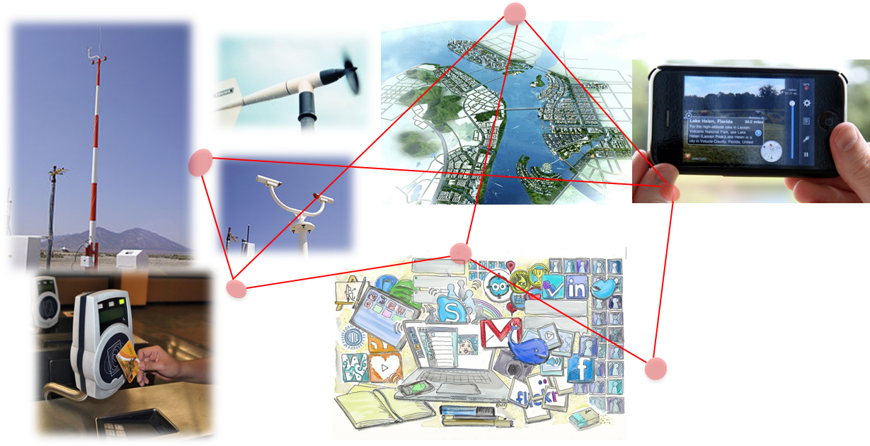
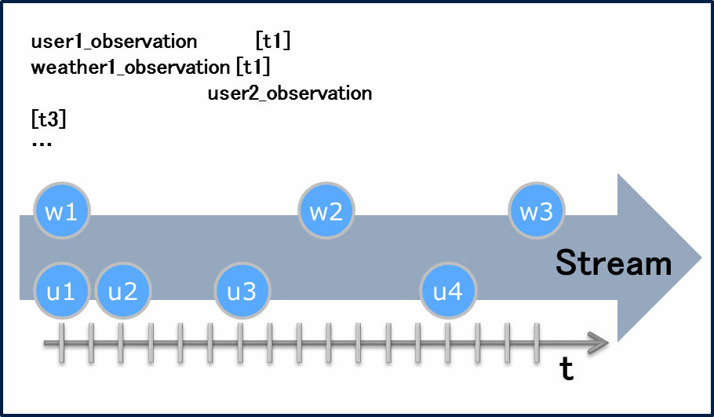
2. Efficient RDF Stream Interchange (ERI)
  Lightweight Binary RDF (HDT)
    Highly compact serialization of RDF (slightly bigger than GZIP)
    compact RDF store (without prior decompression)
    Basics for successfully projects
      Linked Data fragments
      LOD Laundromat
  RDF Data Streams
  Efficient RDF Interchange
  (ERI) Format

Slide 11
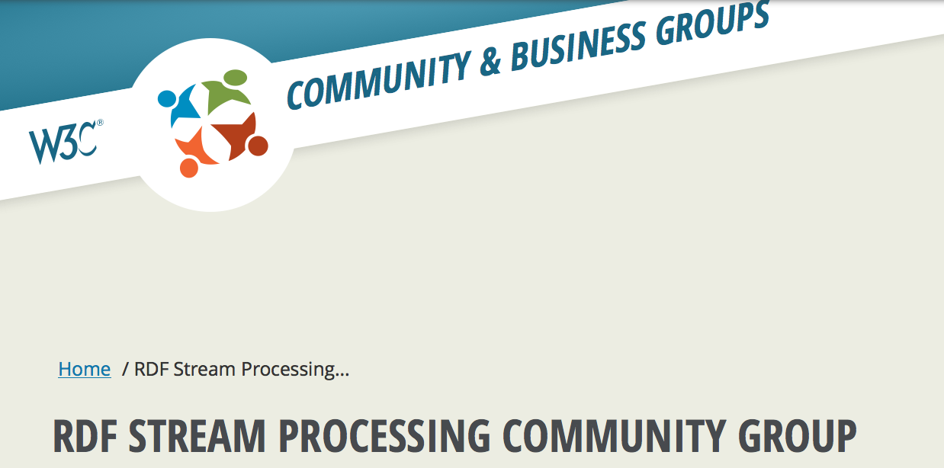

Querying & Efficient Serialization of streams of LD
In the light of IoT/Industry 4.0, etc. ...
We are monitoring the W3C RSP (RDF Stream Processing) CG, but also EXI (Efficient XML Interchange and WoT WG

Slide 12
Efficient Serialization of streams of LD
 | Plain: Turtle/ Trig/ JSON-LD | Plain +Compression (e.g. gzip) | HDT | Streaming HDT | RDSZ | RDF/XML + EXI | ERI
Streamable | Yes | Yes | No | Yes | Yes | Yes | Yes
Scalable | Limited | Yes | Yes | No | Yes | Yes | Yes
Easy (fast) to create and parse | Yes | Limited | Limited | Yes | Limited | Limited | Yes
Compact | No | Yes | Yes | Limited | Yes | Yes | Yes
Parametrizable: compression/time | No | Limited | Yes | No | Limited | Limited | Yes
12

Slide 13
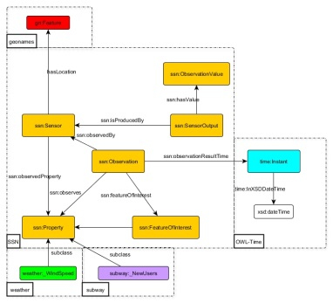

Efficient RDF Interchange (ERI) Format – Basic Concepts
(Assumption) Most RDF streams are well structured
  the is well-known by the data provider
  the number of in the structure are limited
Efficient RDF Interchange (ERI) Format encodes the information at two levels:
  A sliding dictionary of structures: Structural Dictionary
  The concrete value for each predicate
structure
variations
13

Slide 14

Efficient RDF Interchange (ERI) Format – Basic Concepts
…
…
weather: TemperatureObservation
rdf:type
Casual user
Anual pass
temperature
wind
…
weather:
AirTemperature
ssn:observedProperty
ID-31
ID-32
ex:CelsiusValue
ID-30
ID-33
???
Structural Dictionary
…
molecule
“7.7”^^xsd:float
“9.4”^^xsd:float
w1
w2
w3
Stream
u1
u2
u3
u4
t
14

Slide 15
2. Efficient RDF Stream Interchange (ERI)– Discussion:
Stream Reasoning related questions:
Where does Reasoning help us? (e.g. compact representation by stripping off implicit information)
Vague idea what could be related here:
Reinhard Pichler, Axel Polleres, Sebastian Skritek, and Stefan Woltran. Complexity of redundancy detection on rdf graphs in the presence of rules, constraints, and queries. Semantic Web - Interoperability, Usability, Applicability (SWJ), 4(4), 2013.

Slide 16
3. SPARQL 1.1 Update & Entailment as a basis for Stream Reasoning Semantics?
SPARQL 1.1 can update a stream and do entailment regimes, however...
Standardization of SPARQL 1.1 Update, and SPARQL 1.1 Entailment Regimes with triple stores implementing those standards (rewriting- or materialization-based) is silent about their interaction

Slide 17
What's been done already?
What do off-the-shelf triple stores do?
  Entailment typically handled
    at (bulk) loading by materialization , or
    at query time by rewriting
  but not in the context of Updates.
  no “standard” behavior for Delete & Insert upon materialized stores.
  interplay of Entailments and Update left out in the SPARQL 1.1 spec.
What does the literature say?
Approaches in the literature on updates and RDFS (or also DLs) limited to atomic update operations…
  [Gutierrez et al., ESWC2011] ABox deletions in the context of RDFS
  [Calvanese et al., ISWC2010] ABox & TBox insertions in the context of DL-Lite (incl. inconsistency repair)
Also related:
  Deductive DBs: [Gupta et al., SIGMOD93]: DRed (delete and re-derive), applied by [Kotowski et al.2011] and [Urbani et al. 2013] in the context of RDF/RDFS…
  KB evolution, Belief revision, etc.: Various works in classical AI and philosophy
Particularly, none of these considers the interplay between DELETE, INSERT based on a joint WHERE clause as in SPARQL

Slide 18
Particularly:
RDF Stream Reasoning/Stream Processing could be likewise viewed as stream of updates adding or removing triples, but:
What does it meant to remove implicit triples?
Is overdeletion of effects (Dred) always the right thing to do?
What about the interplay between DELETE, INSERT based on a joint WHERE clause as in SPARQL Updates?

Slide 19
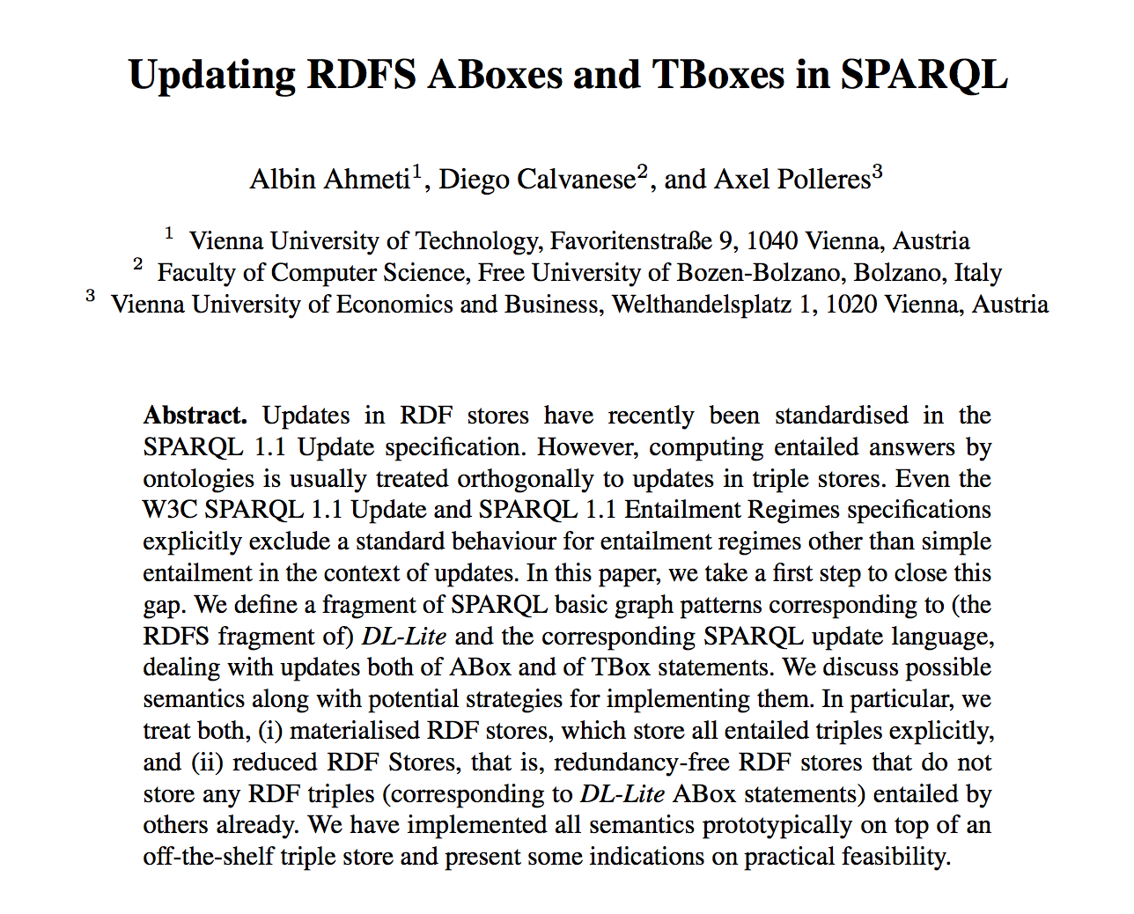
Our initial thoughts on this problem...

Slide 20
Exploring possible ABox update semantics
Materialized-preserving semantics
  Sem₀^{mat} … baseline semantics
  Sem_{1a}^{mat}
  Sem_{1b}^{mat}
  Sem₂^{mat} … delete incl. causes and rewrite upon inserts
}
inspired by DRed: delete (incl. effects) and re-derive new effects upon inserts

Slide 21
  Sem₀^{mat}: Naïve Update followed by re-materialization
DELETE { ?X a :Child . }
INSERT { ?Y a :Mother . }
WHERE { ?X :hasParent ?Y . }
S | P | O
:Mother | rdfs:subClassOf | :Parent
:hasMother | rdfs:subPropertyOf | :hasParent
:hasMother | rdfs:range | :Mother
:hasParent | rdfs:domain | :Child
:hasParent | rdfs:range | :Parent
...
...
DELETE { :marie a :Child . }
INSERT { :maria_t a :Mother . }
?X=:marie
?Y=:maria_t
S | P | O
:marie | :hasMother | :maria_t
:marie | :hasParent | :maria_t
:maria_t | a | :Mother
:maria_t | a | :Parent
S | P | O
:marie | :hasMother | :maria_t
:marie | a | :Child
:marie | :hasParent | :maria_t
:maria_t | a | :Mother
:maria_t | a | :Parent
S | P | O
:marie | :hasMother | :maria_t
:marie | a | :Child
:marie | :hasParent | :maria_t
:maria_t | a | :Mother
:maria_t | a | :Parent
No effect!
materialize(G)

Slide 22
Alternative Materialized-pres. semantics
Sem_{1a}^{mat}
  “Delete and rederive”
1. DELETEs triples incl. Effects
2. INSERT triples
3. Re-materialize
Notes:
delete the instantiations of P_{d} plus “dangling” effects, i.e., effects of deleted triples that after deletion are not implied any longer by any non-deleted triples;
insert the instantiations of P_{i} plus all their effects

Slide 23
  Sem_{1a}^{mat}: Delete and rederive
DELETE { :marie :hasMother :maria_t. }
S | P | O
:Mother | rdfs:subClassOf | :Parent
:hasMother | rdfs:subPropertyOf | :hasParent
:hasMother | rdfs:range | :Mother
:hasParent | rdfs:domain | :Child
:hasParent | rdfs:range | :Parent
...
DELETE { :marie :hasMother :maria_t .
:marie :hasParent :maria_t .
:marie a Child .
:maria_t a Mother.
:maria_t a Parent. }
...
S | P | O
:marie | :hasMother | :maria_t
:marie | a | :Child
:marie | :hasParent | :maria_t
:maria_t | a | :Mother
:maria_t | a | :Parent
S | P | O
S | P | O
May be viewed quite "radical"
materialize(G)

Slide 24
  Sem_{1a}^{mat}: Delete and rederive
DELETE { :marie :hasParent :maria_t. }
S | P | O
:Mother | rdfs:subClassOf | :Parent
:hasMother | rdfs:subPropertyOf | :hasParent
:hasMother | rdfs:range | :Mother
:hasParent | rdfs:domain | :Child
:hasParent | rdfs:range | :Parent
...
DELETE { :marie :hasParent :maria_t .
:marie a Child .
:maria_t a Parent. }
...
S | P | O
:marie | :hasMother | :maria_t
:maria_t | a | :Mother
S | P | O
:marie | :hasMother | :maria_t
:marie | a | :Child
:marie | :hasParent | :maria_t
:maria_t | a | :Mother
:maria_t | a | :Parent
S | P | O
:marie | :hasMother | :maria_t
:marie | a | :Child
:marie | :hasParent | :maria_t
:maria_t | a | :Mother
:maria_t | a | :Parent
Again: no effect!
materialize(G)

Slide 25
Alternative Materialized-pres. semantics
Sem_{1b}^{mat}
  Variant of Sem_{1a}, that makes a distinction between explicit and implicit triples.
  Re-materialization from scratch from

Slide 26
  Sem_{1b}^{mat}: Delete and rederive with separating "explicit" and "implicit" ABox
DELETE { :marie :hasParent :maria_t. }
S | P | O
:Mother | rdfs:subClassOf | :Parent
:hasMother | rdfs:subPropertyOf | :hasParent
:hasMother | rdfs:range | :Mother
:hasParent | rdfs:domain | :Child
:hasParent | rdfs:range | :Parent
...
...
ABox_{expl}
S | P | O
:marie | :hasMother | :maria_t
S | P | O
:marie | :hasMother | :maria_t
:marie | :hasParent | :maria_t
ABox_{impl}
Abox'_{impl}
Again: no effect!
S | P | O
:marie | :hasMother | :maria_t
:marie | a | :Child
:marie | :hasParent | :maria_t
:maria_t | a | :Mother
:maria_t | a | :Parent
S | P | O
:marie | :hasMother | :maria_t
:marie | a | :Child
:marie | :hasParent | :maria_t
:maria_t | a | :Mother
:maria_t | a | :Parent
materialize(G)

Slide 27
Alternative Materialized-pres. semantics
Sem₂^{mat}
  Delete the instantiations of 𝑃_{𝑑} plus all their causes;
  Insert the instantiations of 𝑃_{𝑖} plus all their effects.
Notes:
Say that set of causes in RDFS (if you assume acyclic Tbox) is uniquely determined.

Slide 28
3. SPARQL 1.1 Update & Entailment as a basis for Stream Reasoning Semantics? – Discussion:
A first step to close the gap left by the current standards (SPARQL1.1 Update vs. SPARQL1.1 Entailment Regimes)
  Seemingly no “one-size fits all” semantics: Particularly, DRed not intuitive in all cases!
  Query rewriting may in some cases be more efficient then re-materialization
  Non-intuitive corner cases in each possible semantics
  → depends on use case?
  Which stream scenarios scenarios warrant which semantics?

