Slide 1
Open Data on the Web as the fuel for Cognitive Computing Das Potenzial von Open Data für Cognitive Computing
Axel Polleres
web: http://polleres.net twitter: @AxelPolleres

Slide 2
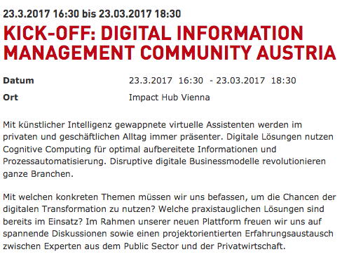
Why are we here today?
künstliche Intelligenz
Cognitive Computing
Mit welchen Themen sollten wir uns befassen?
Welche Lösungen sind im Einsatz?
Notes:
Danke für Die Einladung!
Lassen Sie mich beginnen mit der Ankündigung zum heutigen event…. Hier stechen einige Begriffe ins Auge:
Es geht um “Cognitive Computing” ... Was ist das überhaupt?
Es hat offensichtlich etwas mit künstlicher Intelligenz zu tun... Was ist das überhaupt? Wie wir feststellen ist Artificial Intelligence im Rahmen der “:Digitalen Transformation“ selbst im Wandel und hat in den letzen Jahren einige Veränderungen durchlebt...
Eine Frage die gestellt wird ist die welche Lösungen bereits im Einsatz sind worauf ich versuchen werde zumindest aus meiner Forschungsperspektive – der Erforschung von Daten am und aus dem Web – ein paar Antworten zu geben...
Last, but not least, ist eine Frage in der Ankündigung, mit welchen Themen wir uns befassen sollten, und ich werde versuchen, Sie bis zum Ende dieses Vortrages davon zu überzeugen, dass Open Data, also offene Daten ein solches Thema sind!

Slide 3
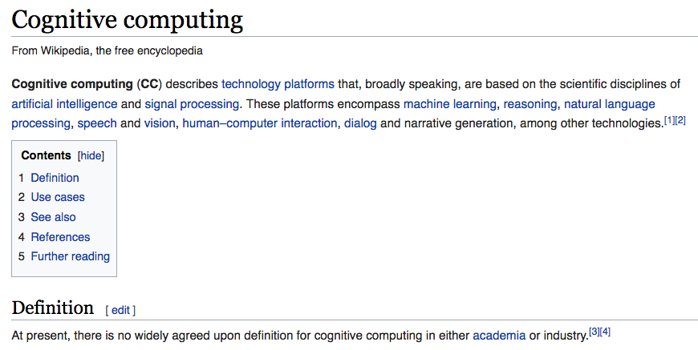
1. What is Cognitive Computing?

Slide 4
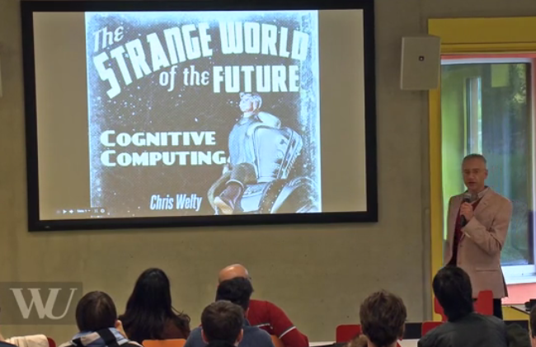
1. What is Cognitive Computing?
Dr. Chris Welty, now Google, formerly IBM Research (Watson team)
“Help computers perform tasks we can do really quickly, at a scale that humans can’t”
“Computational tasks that require inexact solutions that combine multiple methods in unpredictable ways.”
“Machine intelligence is not human intelligence, the difference lies in the errors it makes.”
https://www.wu.ac.at/wutv/show/clip/20141024-welty/

Slide 5
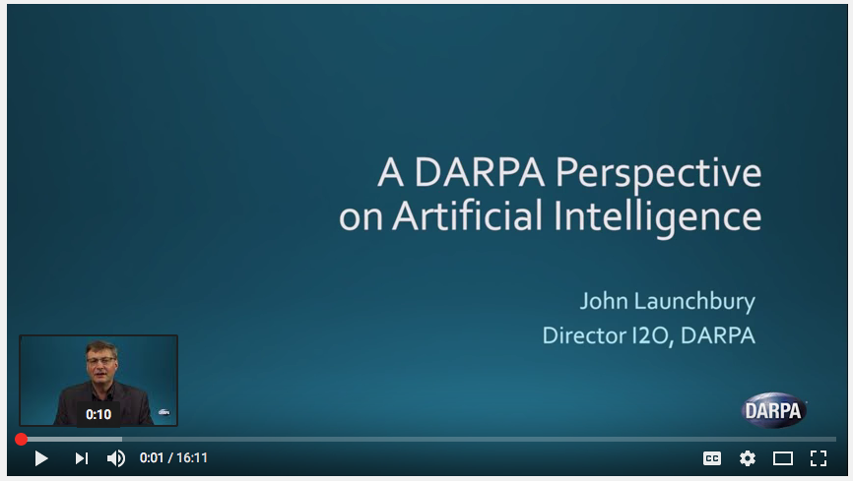
2. What is Artificial Intelligence?
John Launchbury, the Director of DARPA's Information Innovation Office
Video, published on Feb 15, 2017
“demistify” Artificial Intelligence

Slide 6
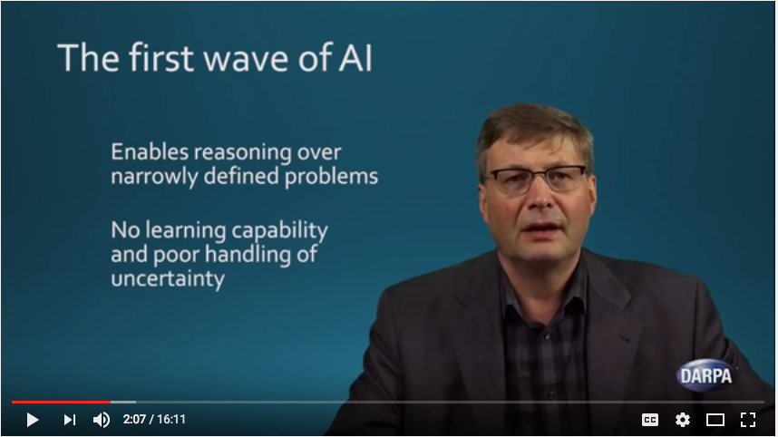
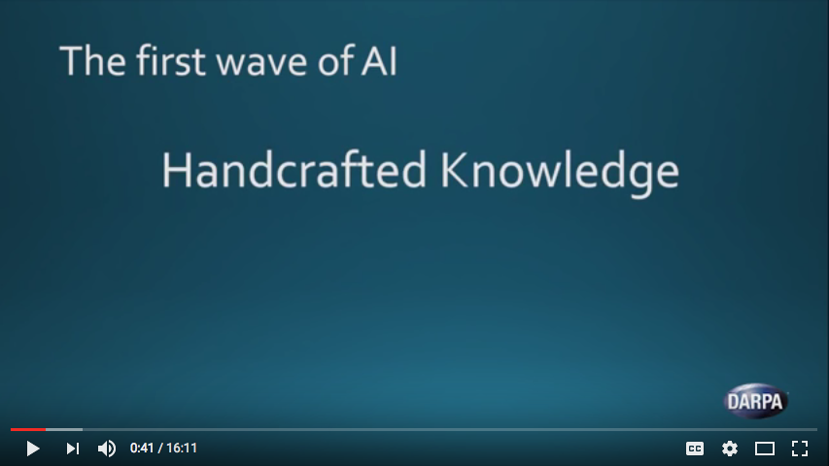
2. What is Artificial Intelligence?
John Launchbury, the Director of DARPA's Information Innovation Office
Video, published on Feb 15, 2017

Slide 7
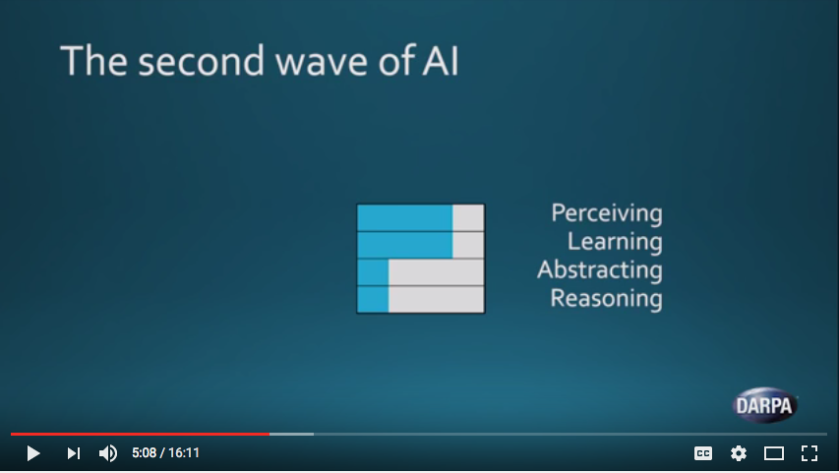
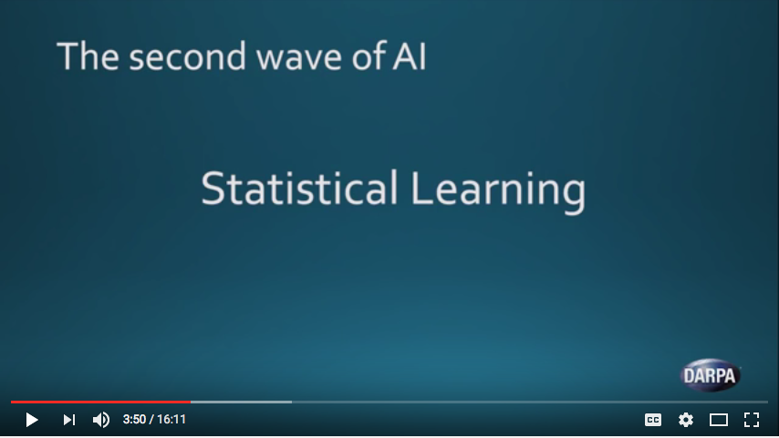
2. What is Artificial Intelligence?
John Launchbury, the Director of DARPA's Information Innovation Office
Video, published on Feb 15, 2017
“learn from data, like spreadsheets on steroids”

Slide 8
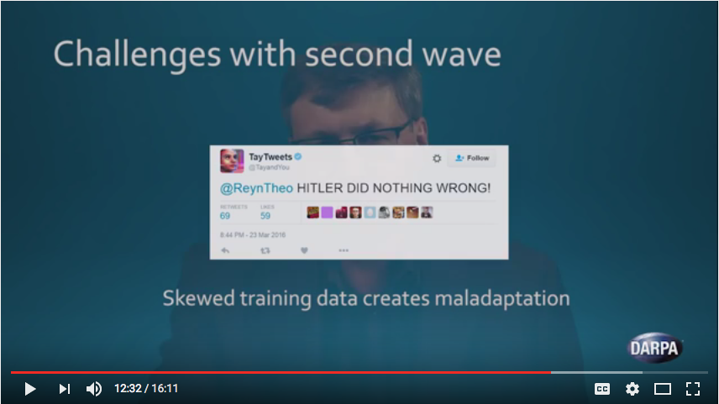
2. What is Artificial Intelligence?
John Launchbury, the Director of DARPA's Information Innovation Office
Video, published on Feb 15, 2017
Recall: “Machine intelligence is not human intelligence, the difference lies in the errors it makes.” is it?

Slide 9
2. What is Artificial Intelligence?
John Launchbury, the Director of DARPA's Information Innovation Office
Video, published on Feb 15, 2017
needs – if you want a combination of first and second wave AI – rules/explanations to model common sense and act in new contexts
Again, data is at it’s heart!

Slide 10
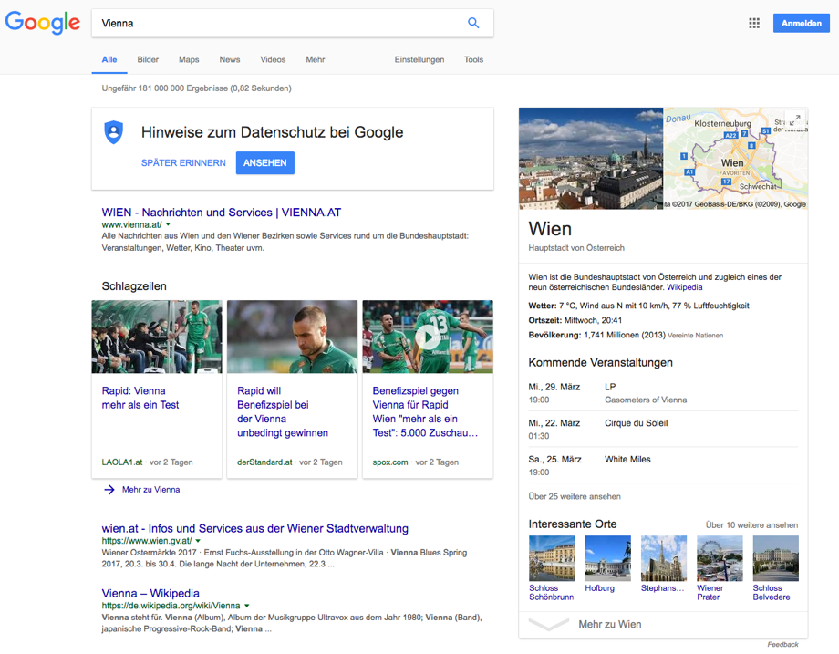
Which solutions exist now on the Web?
Welche Lösungen sind im Einsatz?
Example 1: Google’s Knowledge Graph

Slide 11
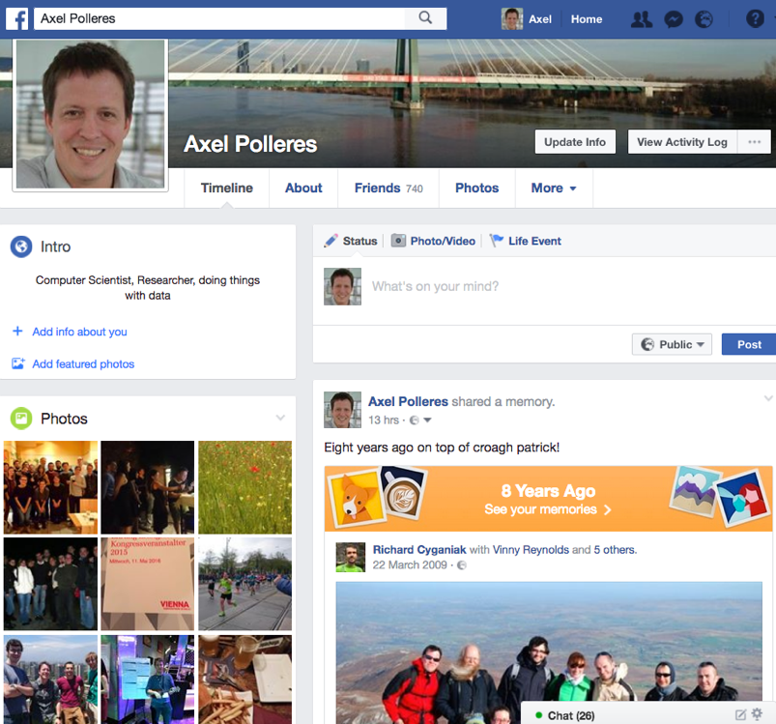
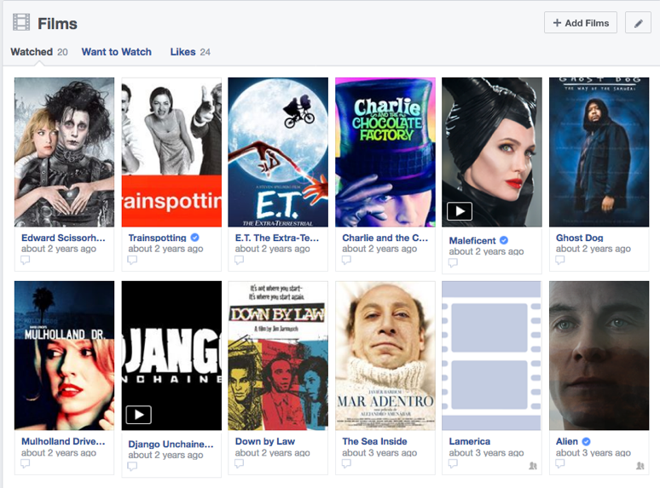
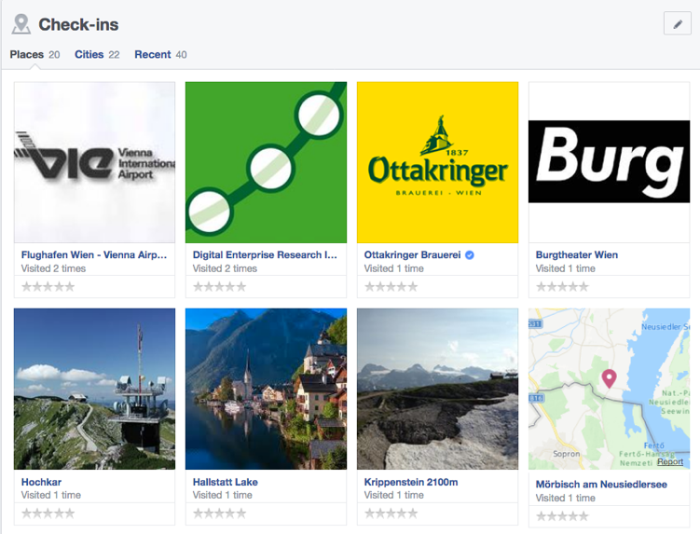
Which solutions exist now on the Web?
Welche Lösungen sind im Einsatz?
Example 2: FB’s Social Graph & News Recommendations
Also uses a knowledge graph...

Slide 12
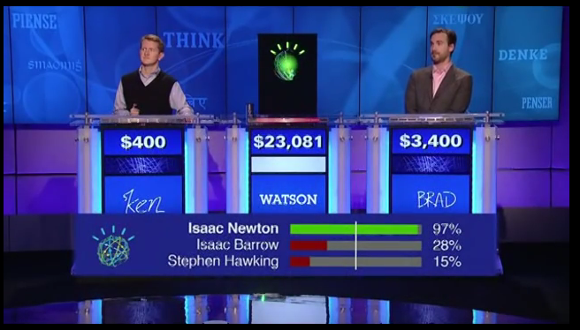
Which solutions exist now on the Web?
Welche Lösungen sind im Einsatz?
Example 3: IBM Watson!
Also uses a knowledge graph...
https://youtu.be/P0Obm0DBvwI?t=951

Slide 13
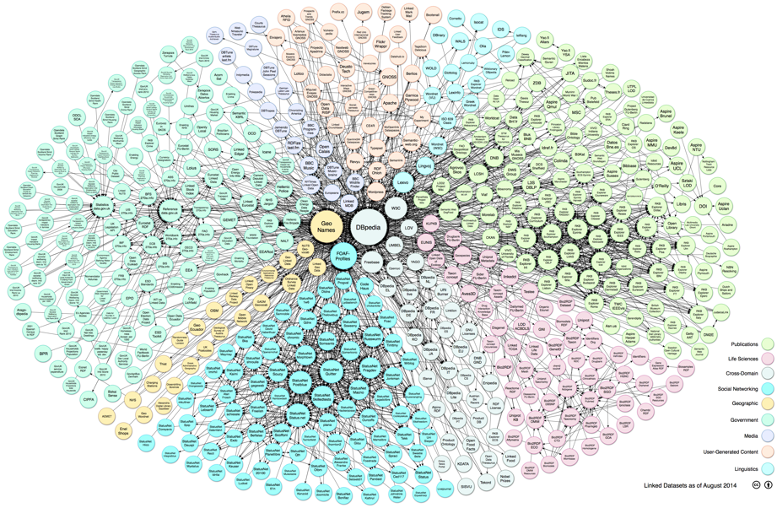
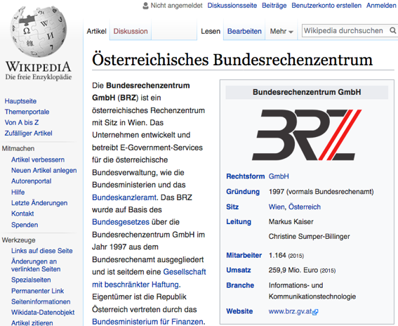
This is the knowledge Graph that IBM Watson used:
Open Data from the Web!
Linking Open Data cloud diagram 2017, by Andrejs Abele, John P. McCrae, Paul Buitelaar, Anja Jentzsch and Richard Cyganiak. http://lod-cloud.net/

Slide 14
3. What is Open Data?
Availability and Access: data must also be available in a convenient and modifiable form, at no more than a reasonable reproduction cost.
Reuse and Redistribution: data must be provided under terms that permit reuse and redistribution and must be machine-readable.
Universal Participation: everyone must be able to use, reuse and redistribute it (no discrimination)
See more at: http://opendefinition.org/okd/
Open Knowledge Foundation

Slide 15
Open Data is a global trend:
Cities, International Organizations, National and European Portals, Int'l. Conferences:
Notes:
15

Slide 16
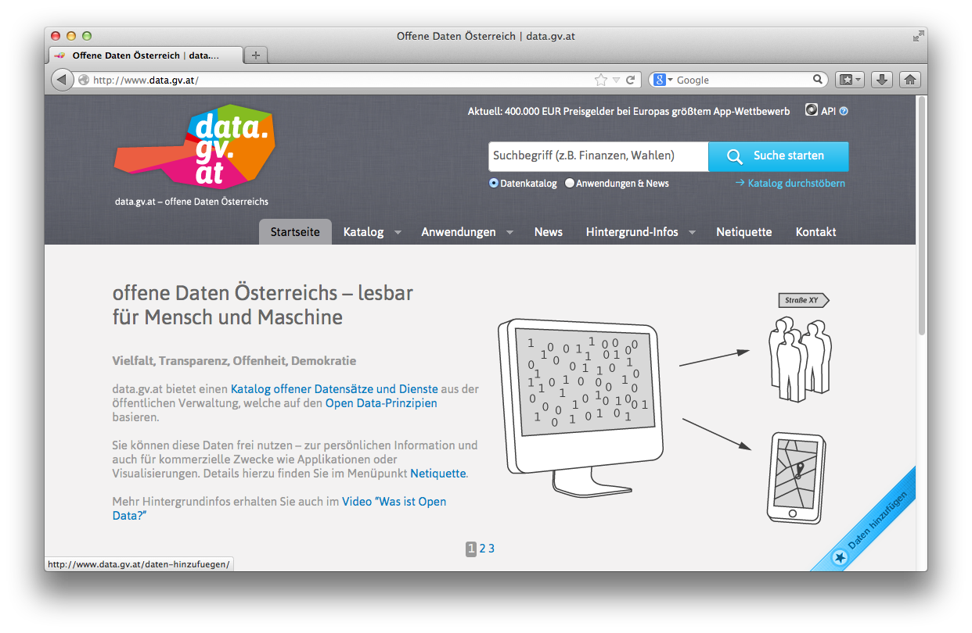
Open Data Portals
CKAN ... http://ckan.org/
almost „de facto“ standard for Open Data Portals
facilitates search, metadata (publisher, format, publication date, license, etc.) for datasets
http://opendataportal.at/
http://data.gv.at/
machine-processable? ...
... partially

Slide 17
Our research: data.wu.ac.at
What is the status of Open Data and what are the challenges using Open Data?
OpenData PortalWatch – a project at WU
How can Open Data be used by enterprises?
Open City Data Pipeline – a joint project with Siemens on using Open Data in an Enterprise context!
What's next?
Improving Open Data Quality and Access: ADEQUATE (FFG - project)
Making Open Data Searchable
Building an Open Data Knowledge Graph!
A striving Data Economy needs no silos… re-democratise the Web by Congitive Intelligence based on Open Data?

Slide 18
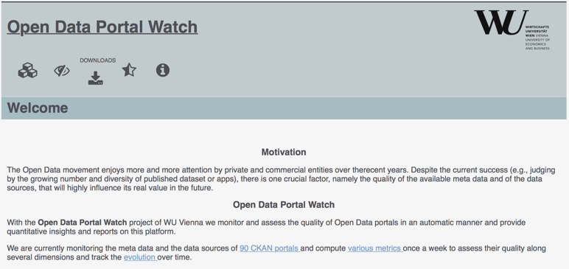
OPEN DATA PORTAL WATCH
http://data.wu.ac.at/portalwatch/
Periodically monitoring a list of Open Data Portals
260 CKAN powered Open Data Portals worldwide
Quality assessment
Evolution tracking
Meta data
Data
Formats, growth

Slide 19
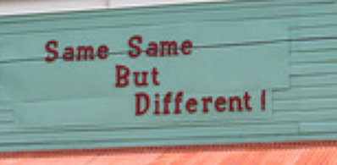
What have we learnt? Open Data also has the "Vs"
Volume:
It's growing! (we currently monitor 90 CKAN portals, 512543 resources/ 160069 datasets,
at the moment (statically) ~1TB only CSV files...
Variety:
different datasets (from different cities, countries, etc.), only partially comparable, partially not.
Different metadata
Different data formats
Velocity:
Open Data changes regularly (fast and slow)
New datasets appear, old ones disappear

Slide 20
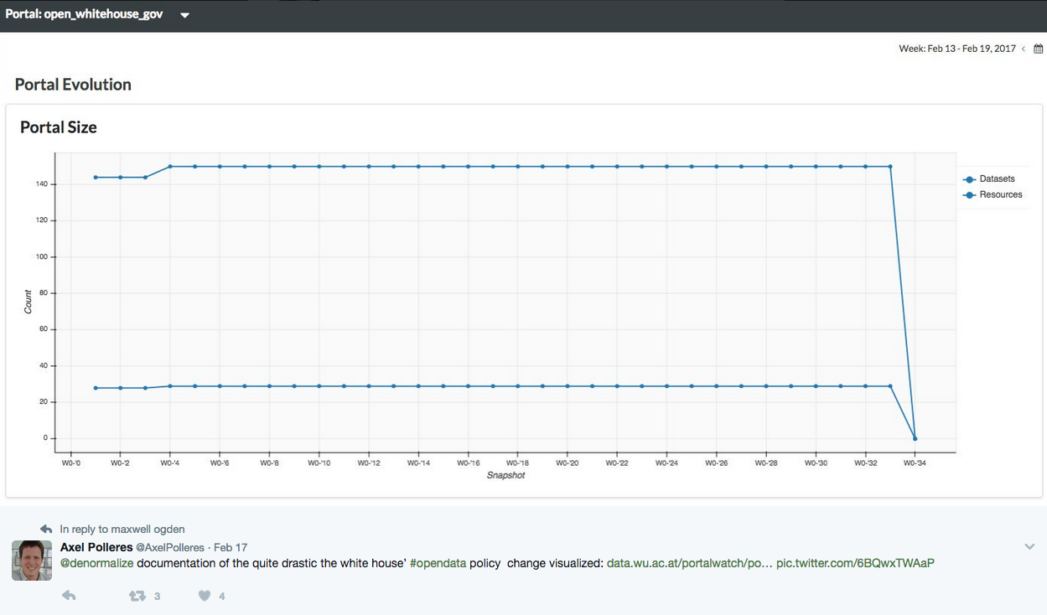
Portalwatch Example:

Slide 21
Our research: data.wu.ac.at
What is the status of Open Data and what are the challenges using Open Data?
OpenData PortalWatch – a project at WU
How can Open Data be used by enterprises?
Open City Data Pipeline – a joint project with Siemens on using Open Data in an Enterprise context!
What's next?
Improving Open Data Quality and Access: ADEQUATE (FFG - project)
Making Open Data Searchable
Building an Open Data Knowledge Graph!
A striving Data Economy needs no silos… re-democratise the Web by Congitive Intelligence based on Open Data?

Slide 22
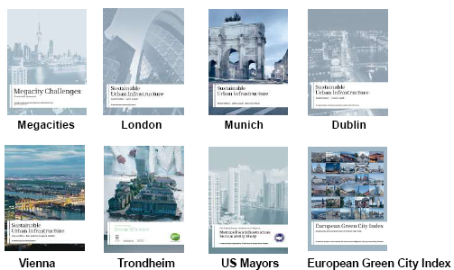
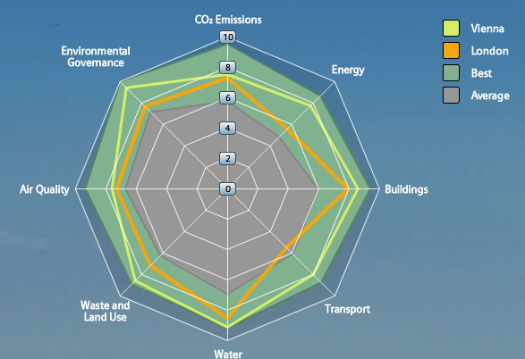
Use Case: City Data – Important for Infrastructure Providers & for City Decision Makers
City Assessment and Sustainability reports
Tailored offerings by Infrastructure Providers
… however, these are often outdated before even published!
Goal (short term):
Leverage Open Data for calculating a city’ performance from public sources on the Web automatically
Needs up-to-date City Data and calculates City KPIs in a way that allows to display the current state and run scenarios of different product applications.
e.g. towards a “Dynamic”
Green City Index:
Goal (long term):
Define and Refine KPI models to assess specific impact of infrastructural investments and gather/check input automatically
Notes:
22

Slide 23
City Data Pipeline (started 2012)
http://citydata.wu.ac.at/

Slide 24
City Data Pipeline: could be viewed as a cognitive computing use case
Indicators
Goal: understanding, combining, enriching, different open datasets
using both first-wave and second wave AI methods
Cities
Notes:
Note that so far we have considered the whole thing as an integrated single dataset.
Now lets focus on these white spots specifially
The question is: can we predict the indicators of eurostat for cities that are not in europoe, the green arrow, or the un indicators for cities which are only in eurostat the blue arrow
We again used aproach 2 to fill in the missing values of a single dataset and use that as training set for the indicatosr of the other dataset.

Slide 25
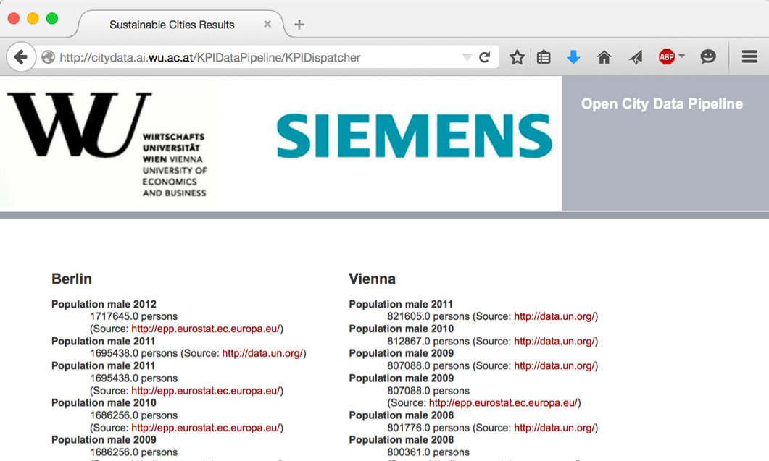
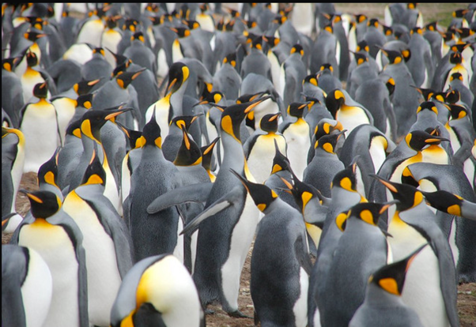
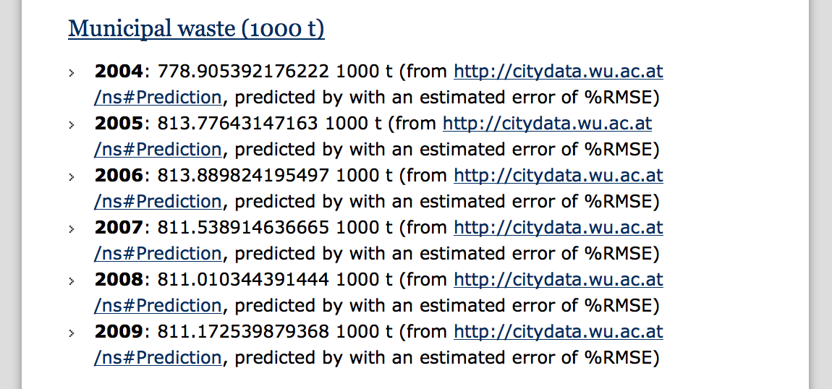
City Data Pipeline
citydata.wu.ac.at
Search for indicators & cities
obtain results incl. sources
Integrated data served as Linked Open Data
Predicted values AND estimated error rates for missing data...
...it‘s not finished, but:
assumption: Predictions get better, the more Open data we integrate...
Open Data: The more, the merrier!

Slide 26
Our research: data.wu.ac.at
What is the status of Open Data and what are the challenges using Open Data?
OpenData PortalWatch – a project at WU
How can Open Data be used by enterprises?
Open City Data Pipeline – a joint project with Siemens on using Open Data in an Enterprise context!
What's next?
Improving Open Data Quality and Access: ADEQUATE.at
Making Open Data Searchable
Building an Open Data Knowledge Graph!
A striving Data Economy needs no silos… re-democratise the Web by Congitive Intelligence based on Open Data?

Slide 27
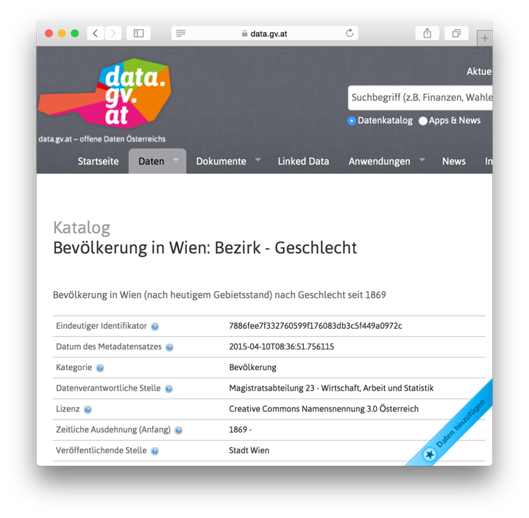
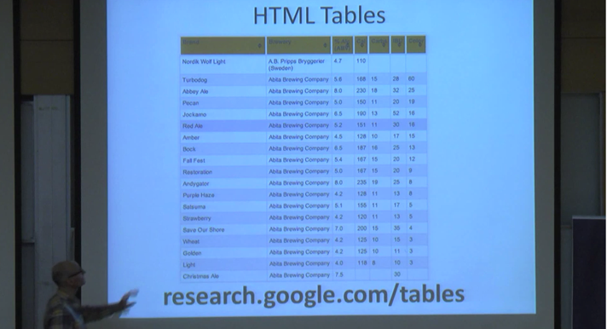
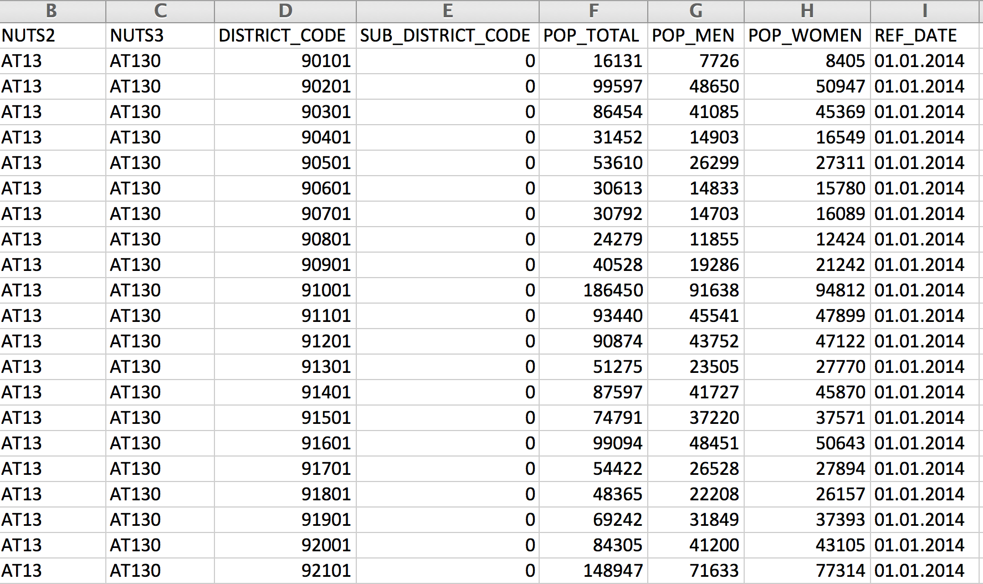
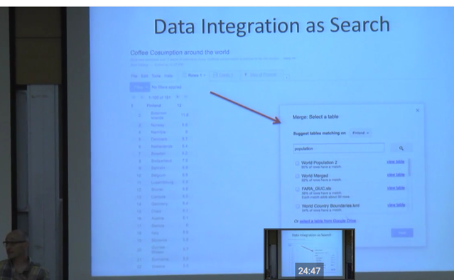
Why is Search in Open Data a problem?
https://www.youtube.com/watch?v=kCAymmbYIvc
Structured Data in Web Search by Alon Halevy
vs.
Open Data Search is hard...
No natural language „cues“ like in Web tables...
Existing knowledge graphs don‘t cover the domain of "Open Data“
Open Data is not properly geo-referenced

Slide 28
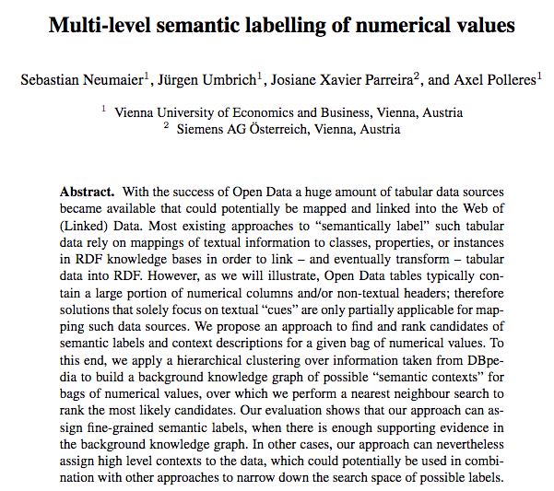
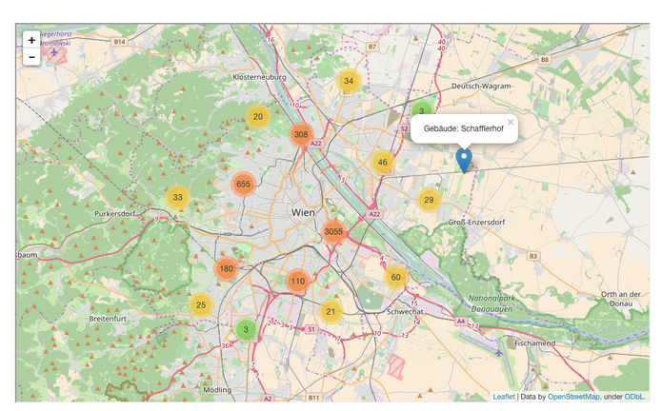
Some starting points:
First baby steps on building an Open Data Knowledge Graph:
Ongoing work to make
Open Data geo-searchable e.g. in our project communidata.at:
International Semantic Web conference 2016:

Slide 29
Ongoing Projects (data.wu.ac.at)

Slide 30
Our research: data.wu.ac.at
What is the status of Open Data and what are the challenges using Open Data?
OpenData PortalWatch – a project at WU
How can Open Data be used by enterprises?
Open City Data Pipeline – a joint project with Siemens on using Open Data in an Enterprise context!
What's next?
Improving Open Data Quality and Access: ADEQUATE.at
Making Open Data Searchable
Building an Open Data Knowledge Graph!
A striving Data Economy needs no silos… re-democratise the Web by Congitive Intelligence based on Open Data?

Slide 31
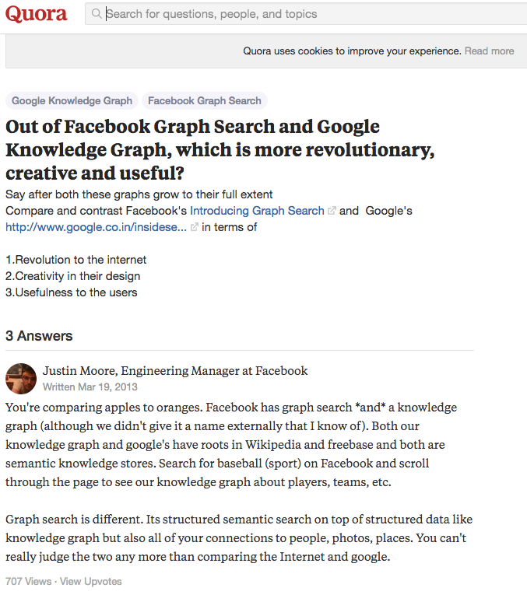
This is the knowledge Graph that IBM Watson used:
“Both our knowldege graph and google’s habe roots in Wikipedia and freebase” – but none of Google and FB make their knowledge graphs freely and openly available again as Open Data!
Open Data from the Web!
Linking Open Data cloud diagram 2017, by Andrejs Abele, John P. McCrae, Paul Buitelaar, Anja Jentzsch and Richard Cyganiak. http://lod-cloud.net/

Slide 32
This is a fundamental threat to the Web itself:
https://www.theguardian.com/technology/2017/mar/11/tim-berners-lee-web-inventor-save-internet
1) We’ve lost control of our personal data
2) It’s too easy for misinformation to spread on the web
3) Political advertising online needs transparency and understanding

Slide 33
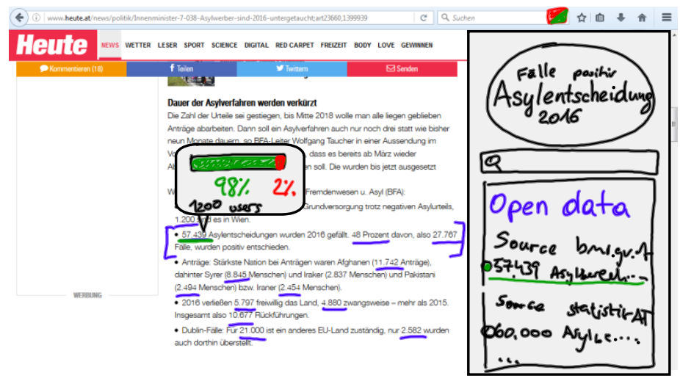
Open-Data-Fueled Cognitive Computing to the rescue!
http://www.communidata.at/austrian-open-data-day-students-co-create-open-data-ideas/

Slide 34
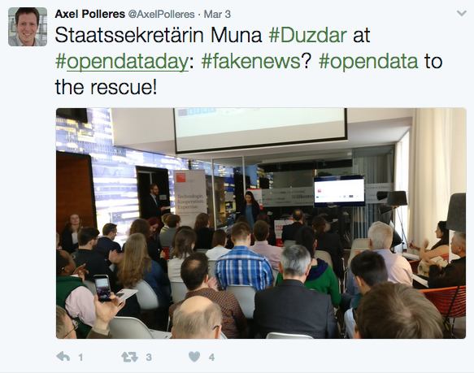
Open-Data-Fueled Cognitive Computing to the rescue!

Slide 35
Bottomline: Let’s build Open Knowledge Graphs as a basis for Cognitive Computing for all businesses!
#OpenData
künstliche Intelligenz
Cognitive Computing
Mit welchen Themen sollten wir uns befassen?
Welche Lösungen sind im Einsatz?
Danke!

Slide 36
Eine Einladung…
Wenn Sie mehr zu den Themen Semantic Web, Cognitive Computing, Linked Open Data erfahren wollen:
https://iswc2017.semanticweb.org/
Wir veranstalten von 21.-25.10. an der WU die
16. International Semantic Web Conference (ISWC2017)

Slide 37
Things I did NOT have time to talk about:
Open Data and licences → DALICC
Open Data adoption barriers → see our recent paper to be presented at CEDEM2017
Privacy and data on the Web → http://privacylab.at

