Slide 1
Data Integration for (Linked?) Open Data on the Web
Axel Polleres, Sebastian Neumaier 13th Reasoning Web Summer School, 2017

Slide 2
Target audience…
My vague assumptions:
  You all know about Logics, you know about Semantics and Reasoning…
  … probably also about this thing called the “Semantic Web”
  … maybe even about Linked Data?
  But what if you actually start integrating (Open) data from the Web? … Problems start at least one level below already

Slide 3
Goal of today’s lecture: Talk about things which we have NOT yet solved!
Part I:
  Where to find Open Data?
  Dealing with “Low-level” data heterogeneity – Which formats are there on the Web?
  Licenses and Provenance – Which data is actually “open”?
  Quality Issues in Open Data
  How to find Open data: Search over Open Data
Part II:
  How does reasoning help? A motivating Use Case.
  Let’s discuss how Rules & Reasoning can help? Group work!

Slide 4


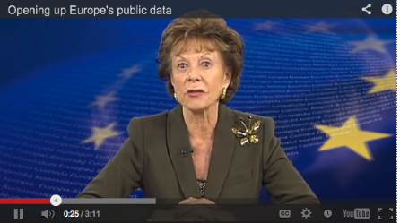
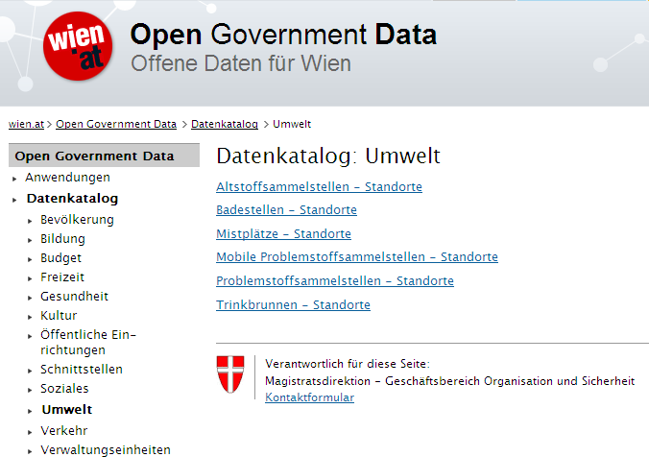
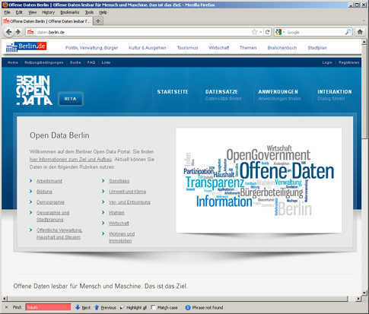
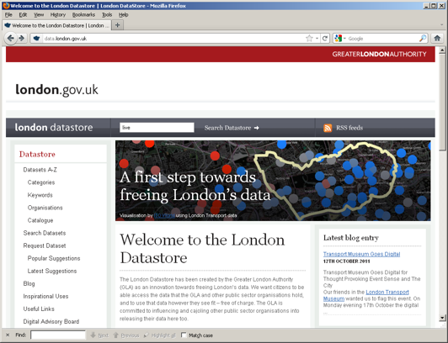
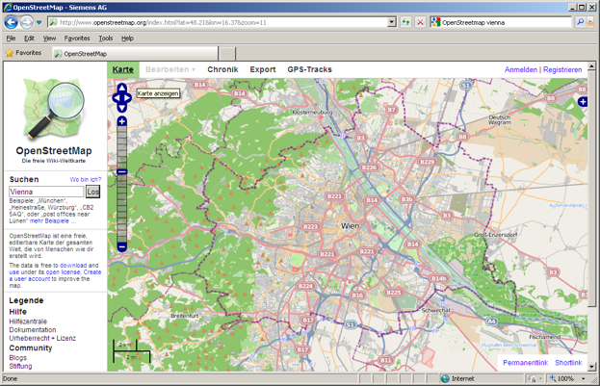



Open Data is a Global Trend!
EU & Austria are pushing Open Data!
DIRECTIVE 2007/2/EC INSPIRE

Slide 5





Open Data – Linked Data?
Available data is only partially structured and not linked [1]:
CSV (3-star)
Excel (2-star)
RDF? Not signicfiant
PDF (1start)
Unknown format (1-star)
82 data portals 160K datasets
[1] | Umbrich, J., Neumaier, S., Polleres, A.: Quality assessment & evolution of open data portals. International Conference on Open and Big Data (2015)

Slide 6
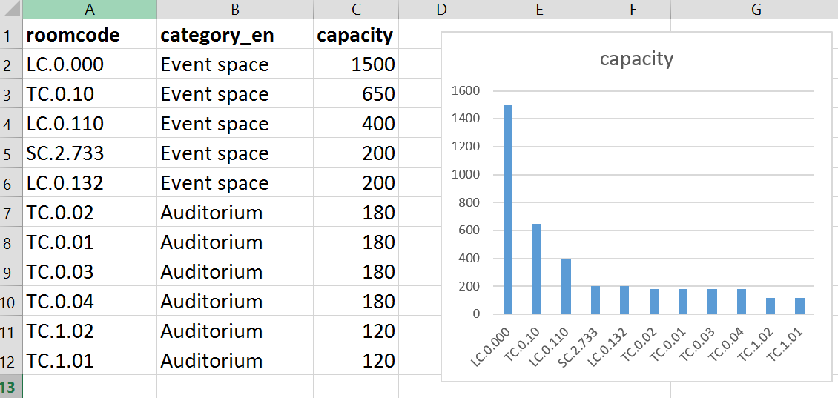
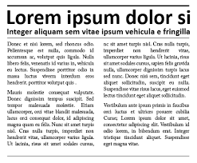
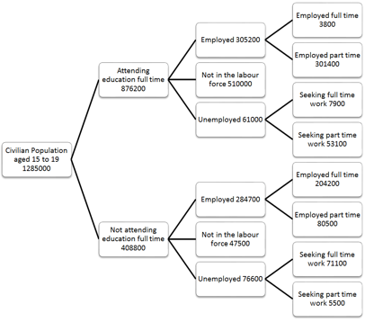
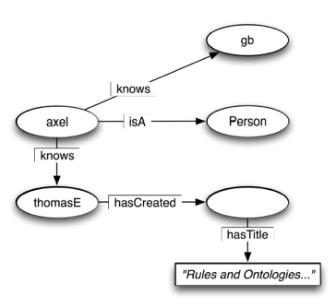
Data Formats on the Web

Slide 7

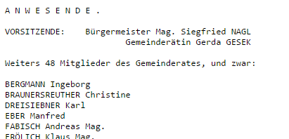
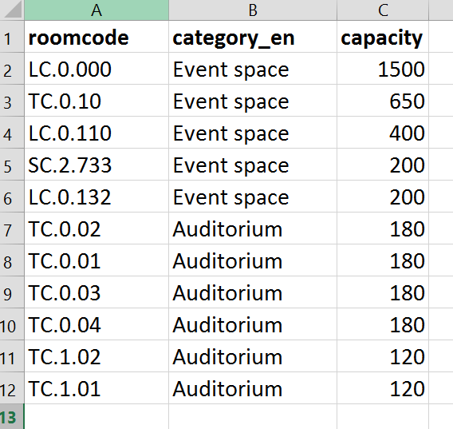
Different Formats
graph-shaped
tabular
plain text
tree-shaped

Slide 8
Tabular
CSV
  Comma-separated values
  Plain text
  Variations on the format
Excel
  .xls, .xlsx, .xlsm, … (binary)
  Widely used but proprietary
  Built-in visualisation
course_id,semester,name
4000,15S,Marketing
4001,15S,Marketing
4002,15S,"Personal, Führung, Organisation"
4004,15S,Grundlagen der Volkswirtschaftslehre
4006,15S,Mathematik
4007,15S,Statistik

Slide 9
Tree-based: Hierachies
XML
  Markup language
  Tag based (not predefined like HTML)
  Human readable
JSON
  JavaScript Object Notation
  Identical to JavaScript objects
  Name/value pairs
  Easy-to-use alternative to XML
<Gemeindedaten>
<Gemeinde>
<bgmname>Mag. Siegfried NAGL</bgmname>
<email>stadtverwaltung@graz.at</email>
<gemfax>+43 (316) 872-2369</gemfax>
<gemname>Graz</gemname>
<gemtel>+43 (316) 872-0</gemtel>
<ort>Graz</ort>
<plz>8010</plz>
<strasse>Hauptplatz 1</strasse>
<vbgmname>Mag.a Dr.in Martina SCHRÖCK</vbgmname>
<webadr>http://www.graz.at</webadr>
</Gemeinde>
</Gemeindedaten>
{
id: "UNIVERSITAETOGD.762955",
geometry: {
type: "Point",
coordinates: [
16.408860446502068,
48.21384341856702
]
},
properties: {
NAME: "Wirtschaftsuniversität Wien",
BEZEICHNUNG: "LC - Hauptgebäude"
}
}

Slide 10
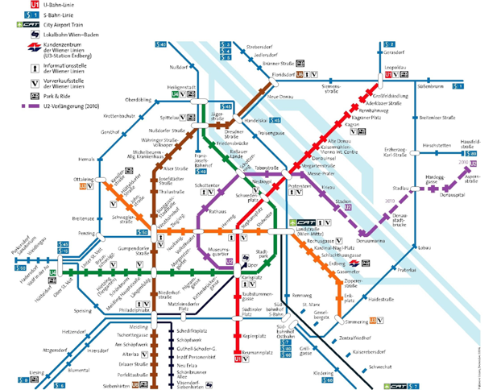
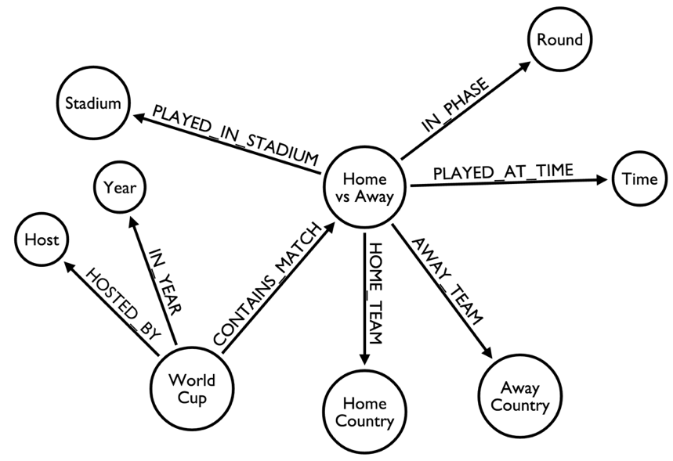

Graph-shaped data formats

Slide 11
Graph representation
Edge-list
1 2
1 3
2 3
2 4
Adjacency-list
1: 2,3
2: 3,4
Matrix
 | 1 | 2 | 3 | 4
1 | 0 | 1 | 1 | 0
2 | 1 | 0 | 1 | 1
3 | 1 | 1 | 0 | 0
4 | 0 | 1 | 0 | 0
2
1
4
3

Slide 12
Graph
RDF (Resource Description Framework)
  Describing resources per triples/statements
  Subject Predicate Object
axel isA Person .
axel hasName “Axel Polleres”.
axel knows gb .
axel knows thomas.
thomas hasCreated an Article
titled “Rules and Ontologies …”.

Slide 13
RDF
Different syntaxes for RDF:
  RDF/XML
  Turtle
  RDFa
  JSON-LD
  HDT (compressed)
Accessing RDF:
  Query language: SPARQL
  Parser
<?xml version="1.0" encoding="UTF-8"?>
<rdf:RDF
xmlns:rdf="http://www.w3.org/1999/02/22-rdf-syntax-ns#"
xmlns:foaf="http://xmlns.com/foaf/0.1/" >
<foaf:Person rdf:ID="me">
<foaf:name>Axel Polleres</foaf:name>
<foaf:title>Dr</foaf:title>
<foaf:firstName>Axel</foaf:firstName>
<foaf:lastName>Polleres</foaf:lastName>
<foaf:knows>
<foaf:Person>
<foaf:name>Thomas Eiter</foaf:name>
</foaf:Person>
</foaf:knows>
</foaf:Person>
</rdf:RDF>
RDF/XML

Slide 14
RDF
Different syntaxes for RDF:
  RDF/XML
  Turtle
  RDFa
  JSON-LD
  HDT (compressed)
Accessing RDF:
  Query language: SPARQL
  Parser
@prefix : <http://polleres.net/foaf.df> .
@prefix rdfs: <http://…> .
@prefix foaf: <http://…> .
@prefix dc: <http://…>
:me a Person .
:me foaf:name “Axel Polleres”.
:me foaf:knows gb .
:me dc:creator _:b
_:b rdfs:label “Rules and Ontologies …”
@prefix : <http://polleres.net/foaf.df> .
@prefix rdfs: <http://…> .
@prefix foaf: <http://…> .
@prefix dc: <http://…>
:me a Person .
:me foaf:name “Axel Polleres”.
:me foaf:knows gb .
:me dc:creator [ rdfs:label “Rules and Ontologies …” ] .
RDF/XML

Slide 15
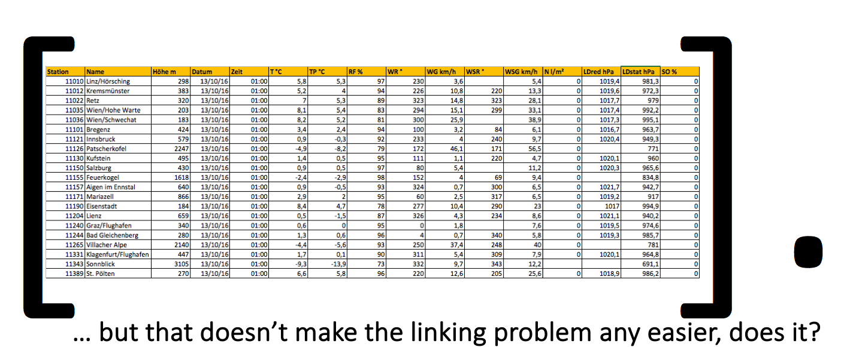
All formats are intertranslateable, but…
Does this make sense to translate everything to RDF triples?
e.g., I can trivially turn tabular data into RDF/Turtle
@prefix : <http://www.example.org/mynamespace/> .
:col1 rdfs:label "Station".
:col2 rdfs:label "Name".
[ :col1 "10010" ; :col2 "Linz/Hörsching"; … ].
https://polleres.net/presentations/20161018COL2016D_Panel.pdf

Slide 16
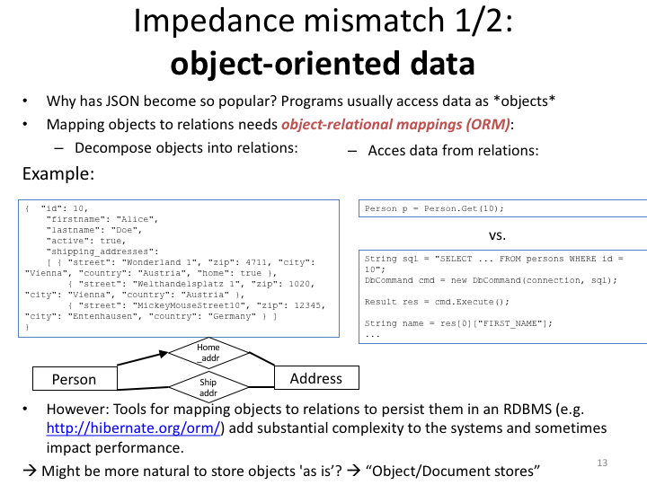
All formats are intertranslateable, but…
Does it make sense to translate everything to tables?
Does it make sense to translate everything to trees?
  Probably neither… (recall your Databases 101: Impedance mismatch)
  Bottomline: it makes sense to use and query data “as is” in many cases!

Slide 17
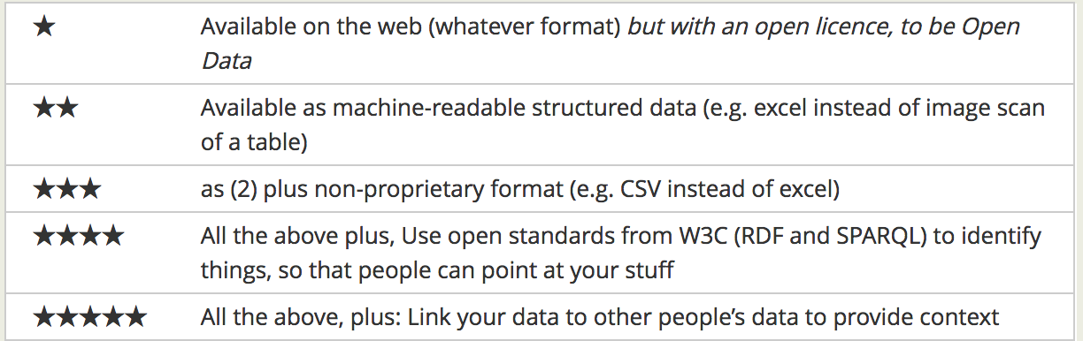
Linked Data…?
https://www.w3.org/community/webize/2014/01/17/what-is-5-star-linked-data/
Linked Data Principles
LDP1: use URIs as names for things
LDP2: use HTTP URIs so those names can be dereferenced
LDP3: return useful – RDF? – information upon dereferencing those URIs
LDP4: include links using externally dereferenceable URIs.
+
https://www.w3.org/DesignIssues/LinkedData.html

Slide 18
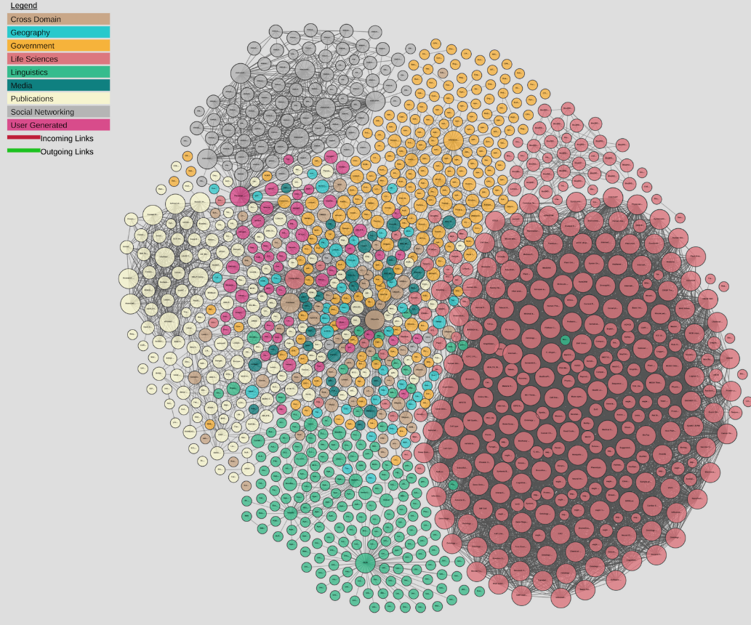
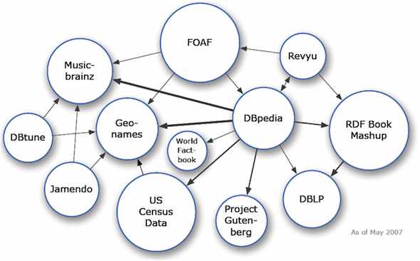
Linked Data… growth since ~10 years
Linking Open Data cloud diagram 2007-2017, by Andrejs Abele, John P. McCrae, Paul Buitelaar, Anja Jentzsch and Richard Cyganiak. http://lod-cloud.net/

Slide 19
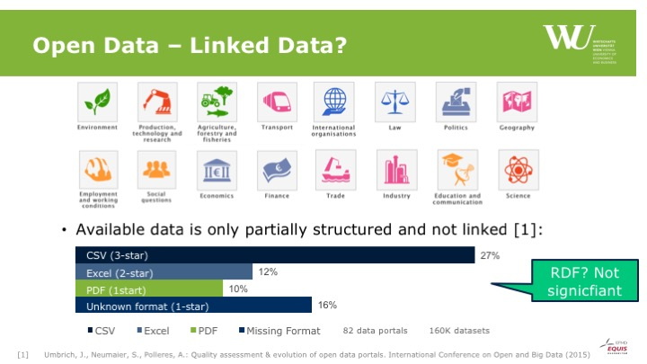

Open Data… growing faster!
149,423,660,620 triples according to LODSTATS (325GB in compressed HDT format, cf. https://datahub.io/dataset/lod-a-lot)
413GB ... Tabular CSV data only, on Open Data Portals, cf. http://data.wu.ac.at/portalwatch/
Linking Open Data cloud diagram 2007-2017, by Andrejs Abele, John P. McCrae, Paul Buitelaar, Anja Jentzsch and Richard Cyganiak. http://lod-cloud.net/

Slide 20
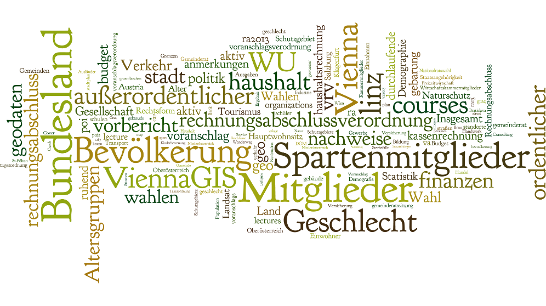
Where to find Web Data?

Slide 21
Open Data Portals
Catalogues for datasets
  “rich” meta data about the content of the data
Offer search & filter functionality
  Search about datasets (tags, license, title)
  No search in datasets (e.g., datasets containing the word “Bloomsbury”)
E.g. >140 CKAN instances around the world, in total we index E.g. over 260 active Open Data catalogues in our portalwatch project: http://data.wu.ac.at/portalwatch/

Slide 22



Open Data Portals
Single point of access
  APIs
Meta data
  Licenses, Provenance, Formats, …
Typical software
Open Data Portal
CSV
title
license
...
JSON
XML
Dataset
CSV
CSV
CSV
Resource
Notes:
CKAN: OpenSource portal by OKF
Socrata: A company offering portal software and hosting of data, mainly in US
OpenDataSoft: small France-based company, very similar to Socrata

Slide 23

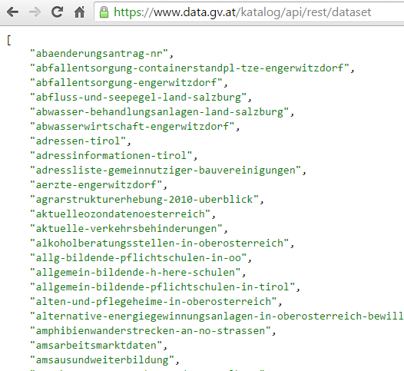
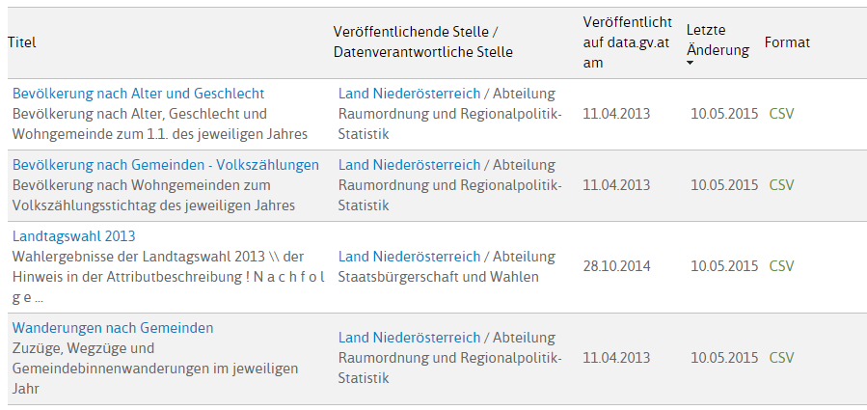
E.g.: data.gv.at (CKAN)
Open Data Portal by the Austrian Government

Slide 24
CKAN Metadata (JSON)
{
  "license_title": "Creative Commons Namensnennung",
  "maintainer": "Stadtvermessung Graz",
  "author": "",
  "author_email": "stadtvermessung@stadt.graz.at",
  "resources": [
    {
    "size": "6698",
    "format": "CSV",
    "mimetype": "",
    "url": "http://data.graz.gv.at/.../Bibliothek.csv"
    }
  ],
  "tags": [
  "bibliothek", "geodaten", "graz", "kultur", "poi"
  ],
  "license_id": "CC-BY-3.0",
  "organization": null,
  "name": "bibliotheken",
  "notes": "Standorte der städtischen Bibliotheken...",
  "extras": {
  "Sprache des Metadatensatzes": "ger/deu Deutsch"
  },
"license_url": "http://creativecommons.org/.../by/3.0/at/",
}
Possible challenges?
core keys
resource keys
extra keys
Notes:
Possible challenges: core keys are used differently in different portals or by differnt providers, contain natural language text, contain wrong information, extra keys are arbitrary (heterogeneous) across portal installations, different resources per dataset… how are they distributed? Is it different versions or different parts of one dataset?

Slide 25
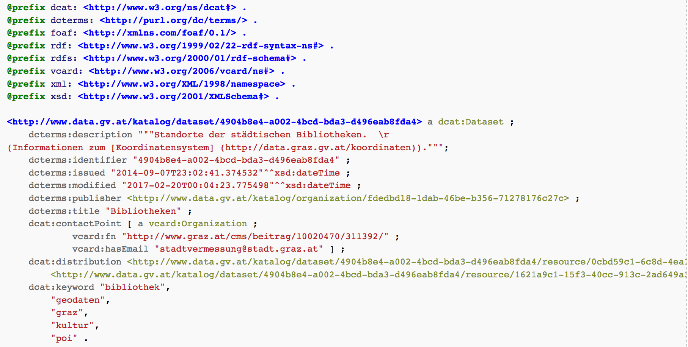
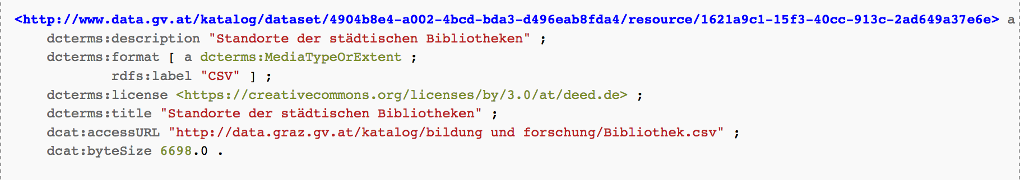
CKAN Metadata mapped to RDF (DCAT)
http://data.wu.ac.at/portalwatch/api/v1/memento/data_gv_at/4904b8e4-a002-4bcd-bda3-d496eab8fda4/dcat
Notes:
Not all can be mapped to DCAT!

Slide 26



Selected CKAN Examples
Datahub.io
  Free, powerful data management platform
  Many public datasets
European Data Portal
  Single point of access to data from several national CKAN data portals
OpenData@WU
  First open data portal of an Austrian University

Slide 27

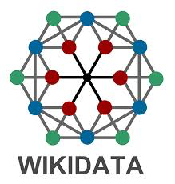


Many other interesting Open Data sources, examples:
DBpedia: Structured data from Wikipedia
WIKIDATA: Open, shared database of the world’s knowledge
GEONAMES: geographical database covers all countries and contains over eight million placenames
OPENSTREETMAP: Free, editable map of the world

Slide 28
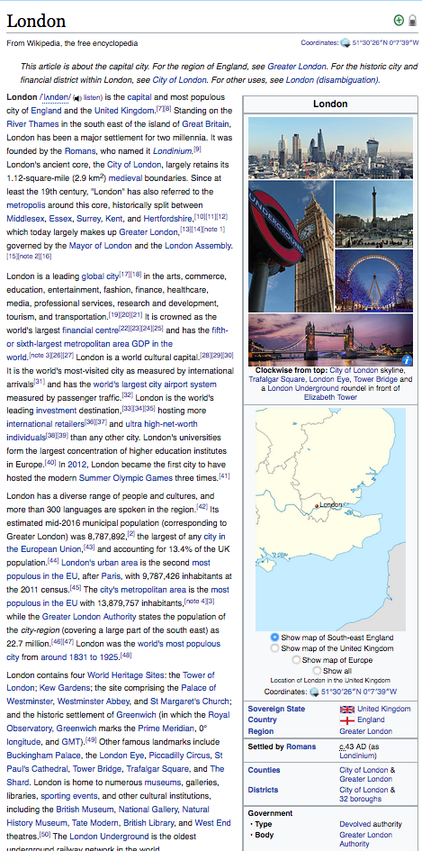
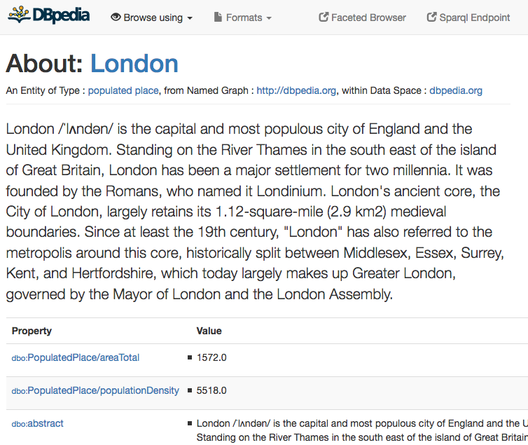
DBpedia
One of the central datasets of the LOD-Cloud
RDF extracted from Wikipedia-Infoboxes
SPARQL endpoint, e.g.:
  „Cities in the UK with more than 1M population“:
Structured queries (SPARQL):
http://dbpedia.org/sparql
https://en.wikipedia.org/wiki/London
http://dbpedia.org/resource/London
PREFIX : <http://dbpedia.org/resource/>
PREFIX dbo: <http://dbpedia.org/ontology/>
PREFIX yago: <http://dbpedia.org/class/yago/>
SELECT DISTINCT ?city ?pop WHERE {
?city a yago:City108524735 .
?city dbo:country :United_Kingdom.
?city dbo:populationTotal ?pop
FILTER ( ?pop > 1000000 )
}
Automatic Exctractors

Slide 29
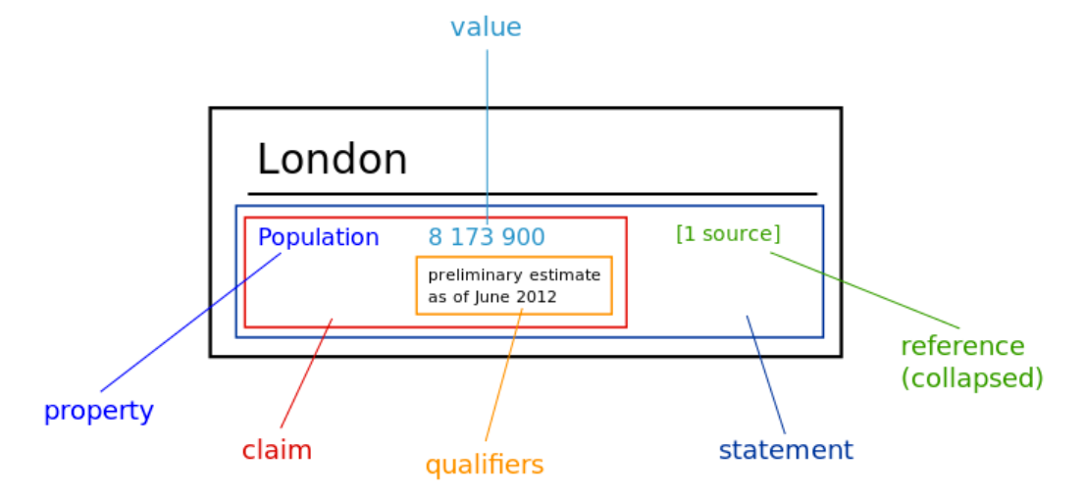
Wikidata
Different concept:
  “data for infoboxes", instead of "data from infoboxes"
  Crowd-curated database of observations
Statememnts
  Entity-attribute-value observations, plus
  versioning, ie. timestamps
  provenance, ie. Who? Source?
  Export to RDF (needs reification!)
https://de.slideshare.net/_Emw/an-ambitious-wikidata-tutorial/

Slide 30
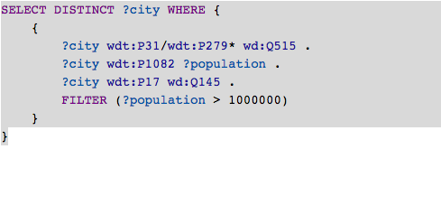

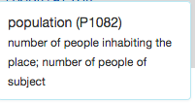
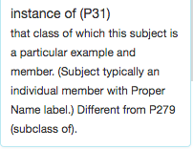
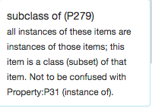


Wikidata as RDF … can be queried by SPARQL
“Simple” surface query:
  What’s this?

Slide 31
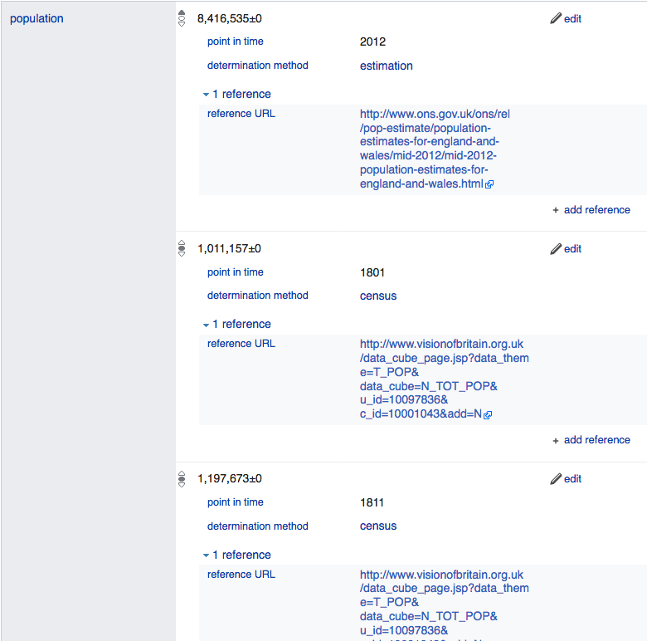
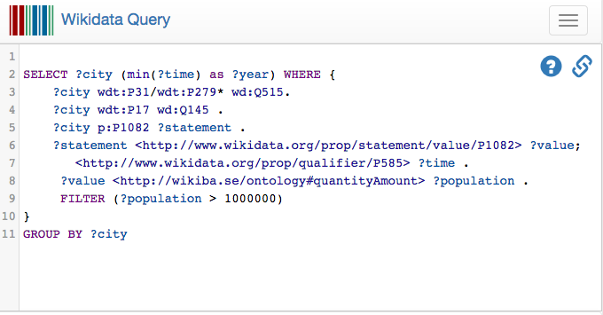
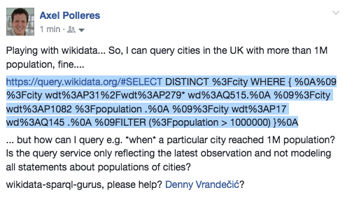
Wikidata as RDF … can be queried by SPARQL
What do we learn?
Data and meta-data (context/ provenance) at the same level → one RDF graph, mixing reification and plain data, cf. [Hernandez et al. 2015]
Quite some Knowledge about the ontology required!
However, Wikidata has more complex info: (temporal context, provenance,…)
  London: https://www.wikidata.org/wiki/Q84
Yes!
  … Can I query that with SPARQL?
Notes:
Not so easy, despite it’s Linked Data… no “common semantics by names”? And as far as I know in the Linked Data realm this is the exception, not the rule…

Slide 32
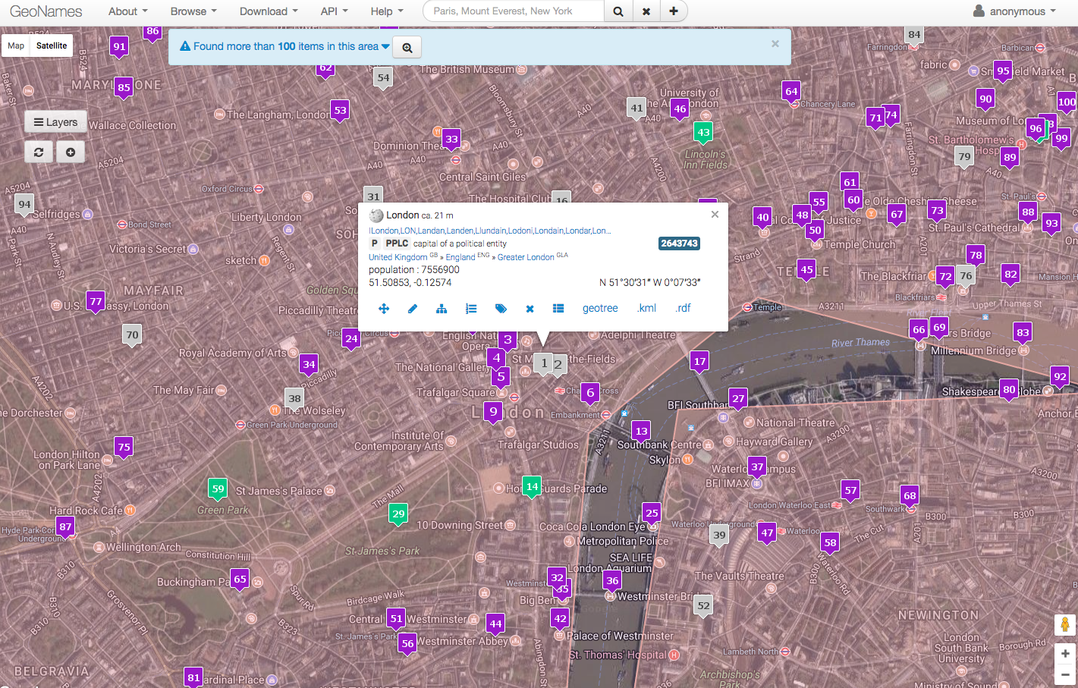
Geonames
Also might help for various use cases, API for geo-search:
  Coordinates, shapes, also population data
  Plus, it contains an implicit taxonomy of spatial entities (regions, countries, etc.)
  Accessible via an API (XML, JSON, partially also RDF)

Slide 33
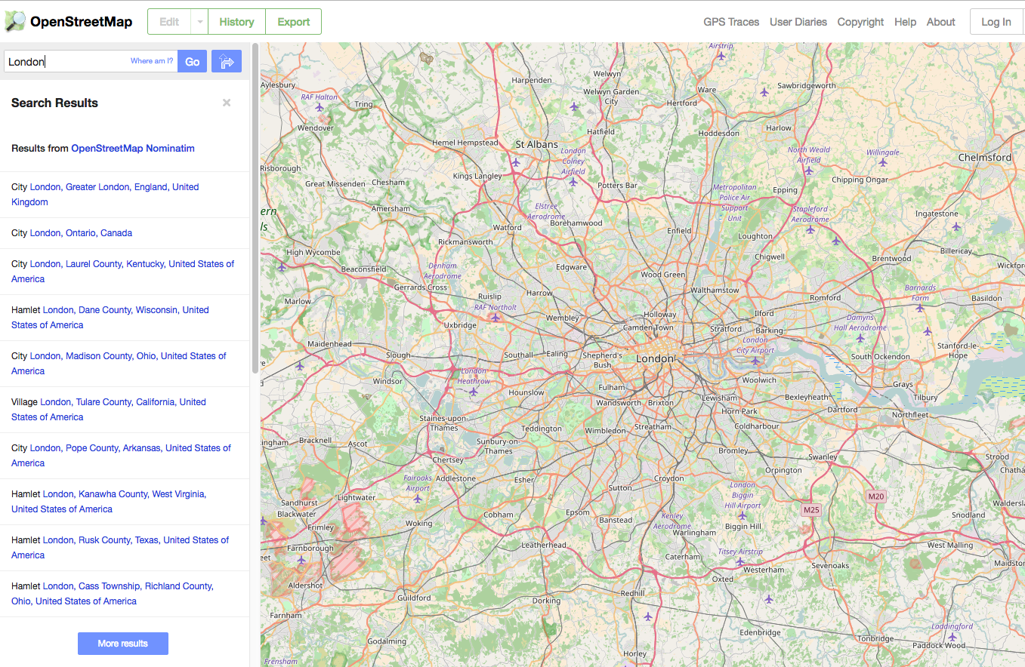
Open Streetmap
  Richer Sourcem, many more features than geonames, available via an XML API
  Land use,
  Road network,
  etc.

Slide 34
Licensing and Provenance of Data

Slide 35
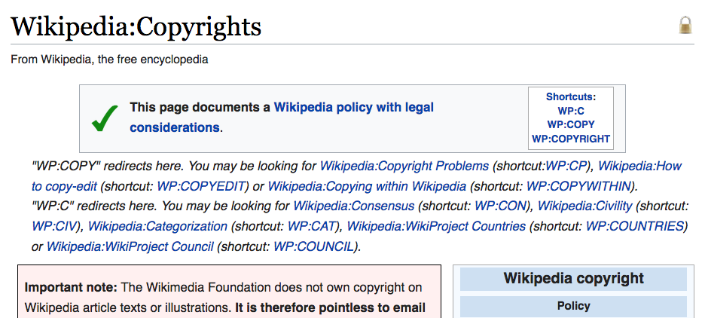
Motivation: Who does the data on Wikipedia belong to? What license is it?
https://en.wikipedia.org/wiki/Wikipedia:Copyrights

Slide 36
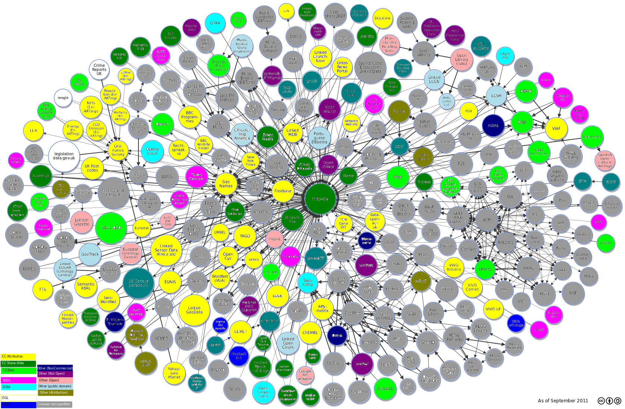
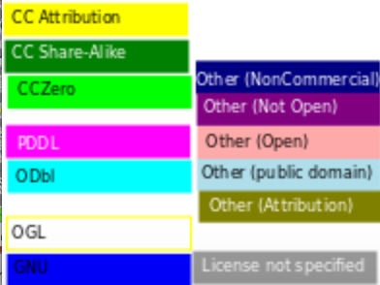
Open Data on the Web is great... But not all data is, or ever will be open.
http://ns.inria.fr/l4lod/v2/l4lod_v2.html

Slide 37
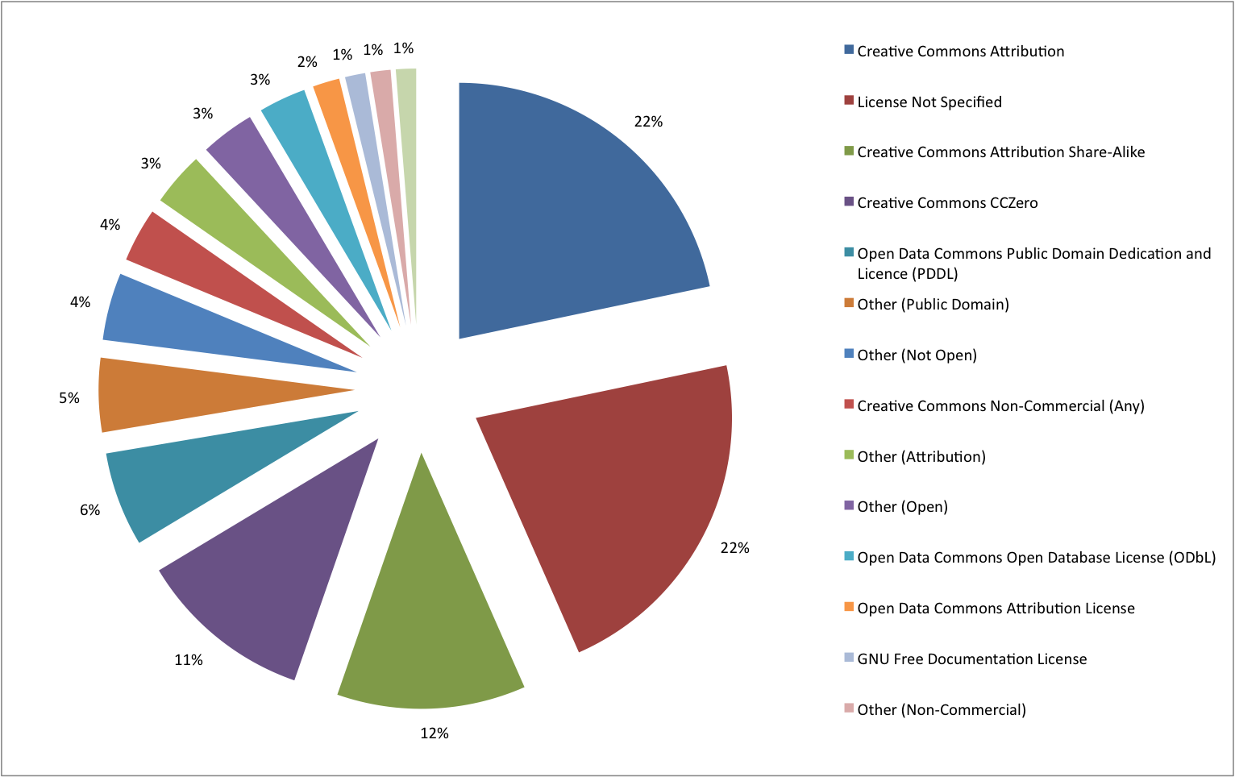
Different Licences in Open Data: Open != Open - LOD
Most widely used OD-licences in LOD:
https://opendatacommons.org/licenses/pddl/
https://creativecommons.org/
(CC-BY)
(CC-BY-SA)
(CC0)
http://ns.inria.fr/l4lod/v2/l4lod_v2.html

Slide 38
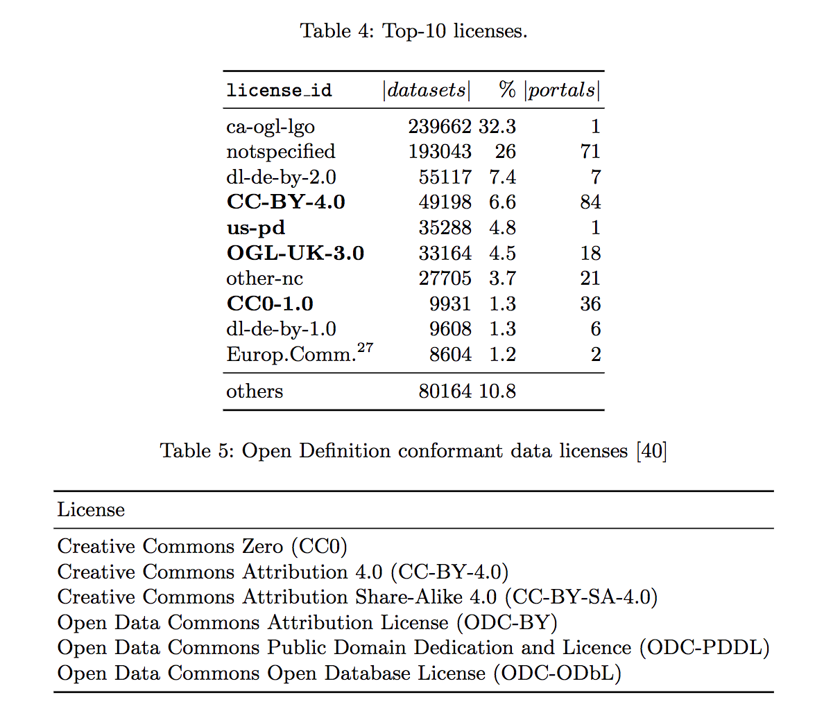
Different Licences in Open Data– OD portals
Note: many country-specific versions of
https://creativecommons.org/, e.g. CC-BY-AT,
OGL-UK, ca-ogl-lgo
(Austrian version of CC-BY, UK Open Government Data License, etc)

Slide 39











Problem: How to License Derivativ/combined Works?
ODbL
CC-BY
CC-BY-SA
IMDB License
TomTom License
License Spectrum
Public Domain
Strongly Protective
Weakly Protective
Permissive
Proprietary
No rights reserved
------------------------- Some rights reserved -------------------
All rights reserved
Notes:
https://opendatacommons.org/licenses/odbl/
https://creativecommons.org/licenses/by/2.0/
https://creativecommons.org/licenses/by-sa/2.0/
http://www.imdb.com/licensing/
https://www.tomtom.com/en_us/legal/third-party-license/

Slide 40
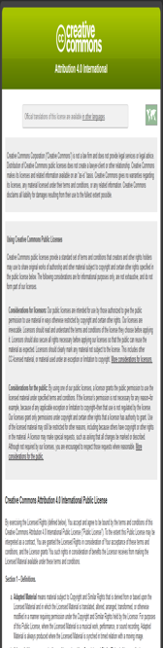
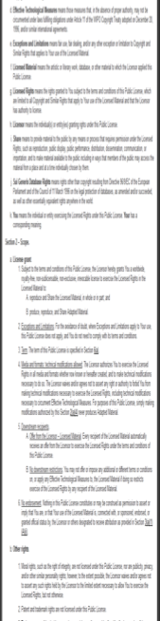
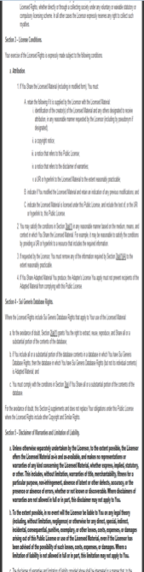
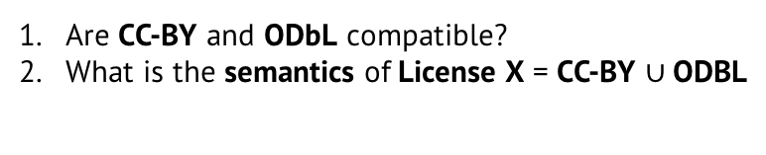
Problem: How to License Derivativ/combined Works?
The reuse of data, software or content is often accompanied with legal uncertainty with respect to intellectual property rights and privacy issues.
CC-BY
ODbL
License X
CC-BY
Are CC-BY and ODbL compatible?
What is the semantics of License X = CC-BY $∪$ODBL

Slide 41
Data Licence Representation

Slide 42
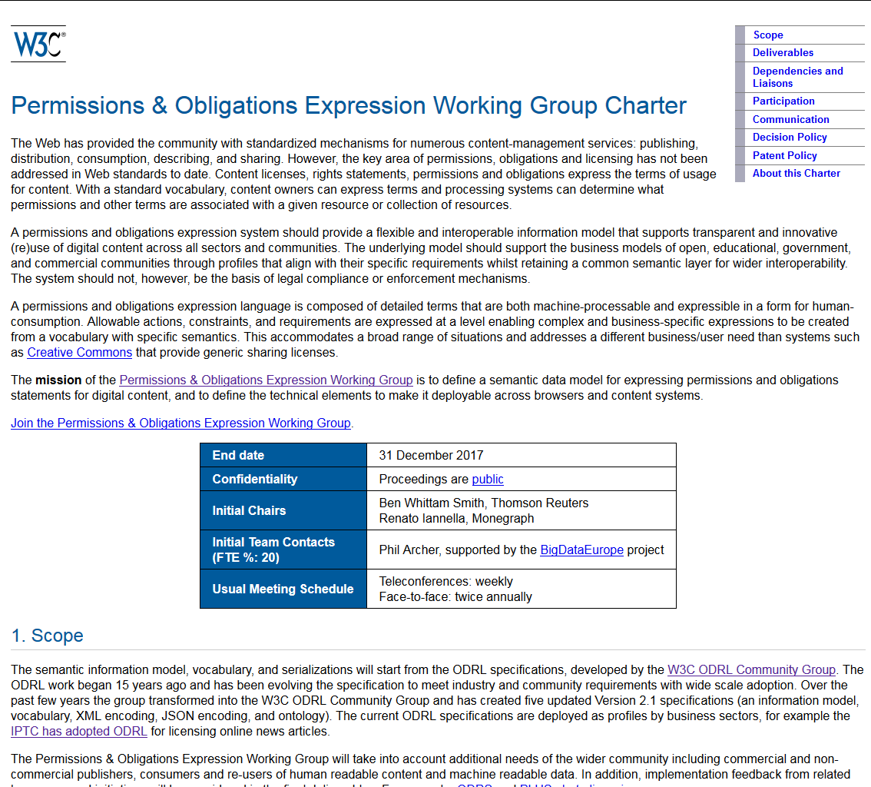
Open Digital Rights Language (ODRL)

Slide 43
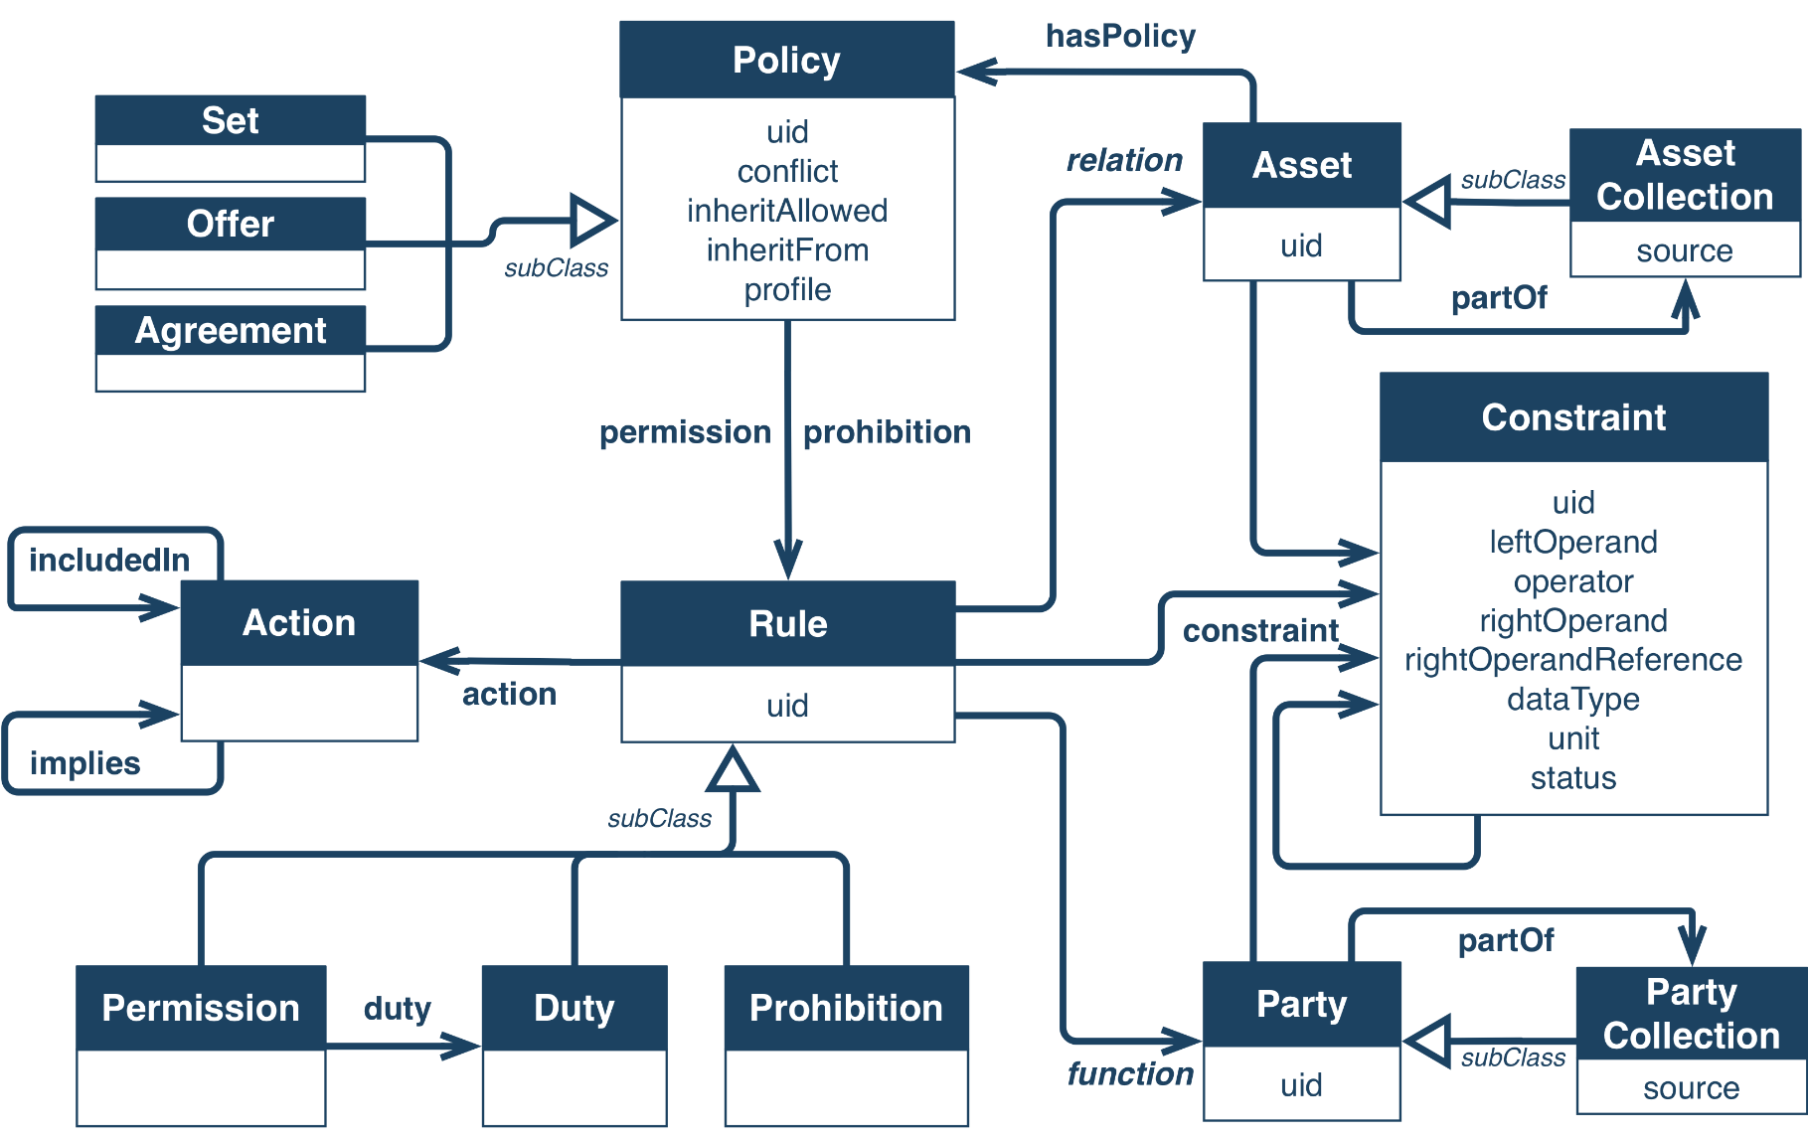
Open Digital Rights Language (ODRL)
http://w3c.github.io/poe/model/

Slide 44
ODRL Concepts 1/5
Policy
Policy Types
A Policy is the central entity that forms ODRL policy expressions. It can refer to Permissions and Prohibitions which hold for that Policy and be further distinguished into several subtypes such as:
Offer
Agreement
A Policy which proposes terms of usage from an Assigner to possible Assignees.
Alice allows anyone who pays her 20€ to read her dataset.
A Policy which contains all terms of usage between both an Assigner and an Assignee about an Asset.
Alice allows Bob to read her dataset if he pays her 20€.
Request
Set
A Policy which proposes terms of usage from an Assignee to an Assigner (owner of the Asset).
Bob wants to pay Alice 20€ if she allows him to read her dataset.
A Policy which defines Prohibitions, Permissions and/or Duties for a certain Asset.
Dataset XY is licensed under CC-BY.
(i.e. duty to attribute asset owner)

Slide 45
ODRL Concepts 2/5
Permission, Prohibition, and Duty
Permission
A Permission specifies Actions which are allowed to be executed on a certain Asset.
Alice allows Bob to read her dataset.
Prohibition
Prohibitions are used to forbid specific Actions on an Asset and cannot refer to Duties.
Alice prohibits Bob to distribute her dataset.
Duty
Duties define Actions that have to be perfomed so that sorrounding Permissions or Policies become valid.
Alice allows Bob to read her dataset if he pays her 20€.
Permission
Duty

Slide 46

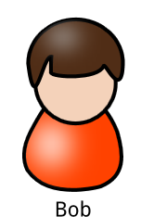
ODRL Concepts 3/5
Asset and Party
Asset
An Asset is the entity whose terms of usage are restricted by its surrounding policy expression. In the domain of Linked Data an Asset usually represents a dataset or parts of a dataset (triples) .
Party
A Party can be distinguished into Assigners (the parties who propose the policy statements) and Assignees (the ones who receive the policy statements).
Assigner
Asset
Assignee
owns
uses

Slide 47
ODRL Concepts 4/5
Action
Action
Actions are operations on Assets that a potential Assignee is allowed (if related to a Permission), is prohibited (if related to a Prohibition) or has (if related to a Duty) to perform. In a Linked Data scenario actions could be, e.g.:
use – generic action for use of an assset
transfer – generic action of transferring the ownership of the asset (e.g. sell).
Others more specific actions (non-ODRL core, ODRL „common vocabulary“ profile):
aggregate – can be used to express the action of querying different datasets and aggregate the retrieved data.
read – the act of obtaining data from the asset (e.g. via SPARQL query).
copy - the action of copying data is fundamental when defining copyright restrictions and necessary for certain license definitions.
write - can be used to represent SPARQL INSERT queries, since it specifies the action of writing to an asset.
…

Slide 48
ODRL Concepts 5/5
Constraint
Constraint
Constraints offer the possibility to restrict and limit the scope of Permissions, Prohibitions and Duties, using a simple mathematical structure with
two operands and one operator:
The number of query requests must be less or equal than 100 per day.
Additionally a specific Purpose of the constrained Action can be defined:
Reading from a dataset using ASK queries shall be restricted to 100 executions.
operand
operator
operand
action
purpose
constraint

Slide 49
Machine-readable License - Example:
CC-BY-SA 3.0
<http://purl.org/NET/rdflicense/cc-by-sa3.0>
a odrl:Policy ;
rdfs:label "Creative Commons CC-BY-SA" ;
dct:source <http://creativecommons.org/licenses/by-sa/3.0/> ;
dct:hasVersion "3.0" ;
dct:language <http://www.lexvo.org/page/iso639-3/eng> ;
dct:publisher "Creative Commons" ;
odrl:permission [
odrl:action cc:Distribution, cc:Reproduction, cc:DerivativeWorks;
odrl:duty [
odrl:action cc:Notice, cc:ShareAlike, cc:Attribution
]
] .

Slide 50
Reasoning about Licences

Slide 51


Example Reasoning Task: Policy compatibility
Conflict Detection
Conflict Resolution
CC-BY
ODbL
CC0
CC-BY-SA
CC-BY
$$∪$$
ODbL
CC0
$$∪$$
CC-BY-SA
CC0
CC-BY-SA

Slide 52

Dependencies between ODRL Actions
Policies govern execution of actions over assets.
Does the permission of one action conflict with the prohibition of another action?
Direct Conflict:
Implicit Conflict (odrl:share → odrl:distribute)
Partial Conflict (odrl:display odrl:narrowerThan odrl:use)
?
:ex1 a odrl:Set;
odrl:permission odrl:read.
:ex2 a odrl:Set;
odrl:prohibition odrl:read.
?
:ex1 a odrl:Set;
odrl:permission odrl:share.
:ex2 a odrl:Set;
odrl:prohibition odrl:distribute.
?
:ex1 a odrl:Set;
odrl:permission odrl:present.
:ex2 a odrl:Set;
odrl:prohibition odrl:display.
(:ex1 $∪$ :ex2) a odrl:Set;
odrl:permission odrl:print.

Slide 53
Conflict:
:ex1 a odrl:Set;
odrl:permission odrl:read.
:ex2 a odrl:Set;
odrl:prohibition odrl:read.
How to deal with conflicting evaluation results?
ODRL defines three different conflict resolution strategies
  perm … Permmission overrides,
  Prohibit … Prohibition overrides
  Invalid … inconsistent
@prefix odrl: <http://w3.org/ns/odrl/2/> .
@prefix : <http://www.example.com/> .
:policy1 a odrl:Agreement ;
odrl:permission [
a odrl:Permission;
odrl:assigner :owner;
odrl:assignee :alice;
odrl:action odrl:read;
odrl:target :dataset1;
@prefix odrl: <http://w3.org/ns/odrl/2/> .
@prefix : <http://www.example.com/> .
:policy2 a odrl:Agreement ;
odrl:prohibition [
a odrl:Prohibition;
odrl:assigner :owner;
odrl:assignee :alice;
odrl:action odrl:read;
odrl:target :dataset1;

Slide 54
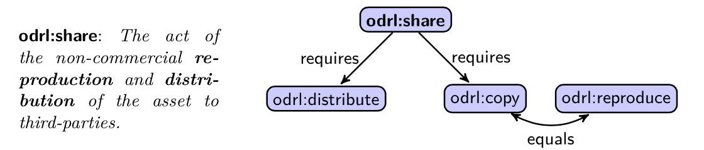
Implicit Dependencies between Actions
:ex1 a odrl:Set;
odrl:permission odrl:share.
:ex2 a odrl:Set;
odrl:prohibition odrl:distribute.
Other dependencies are only implicitly expressed as part of the natural language description of ODRL actions.
e.g. odrl:share
  Prohibition of either odrl:reproduce/odrl:copy or odrl:distribute would cause a conflict, if odrl:share would be permitted at the same time.

Slide 55



Vertical Hierarchy of Actions
:ex1 a odrl:Set;
odrl:permission odrl:present.
:ex2 a odrl:Set;
odrl:prohibition odrl:display.
$$\frac{\begin{matrix}ρ \text{o}\text{drl}\text{:}\text{action} β & α \text{odrl}\text{:}\text{narrowerThan} β \end{matrix}}{ρ \text{odrl}\text{:}\text{action} α}$$

Slide 56

Details:
For a formalization of conflict resolution strategies and reasoning:
Simon Steyskal and Axel Polleres. Towards formal semantics for ODRL policies. In 9th International Web Rule Symposium (RuleML2015), August 2015. Springer.

Slide 57
Provenance
www.provbook.org/tutorial/provenanceweek2014/

Slide 58
Motivation: Where does the data on wikidata come from? How was it generated?

Slide 59

Provenance Definition
Provenance is a record that describes the people, institutions, entities, and activities, involved in producing, influencing, or delivering a piece of data or a thing in the world
Provenance is crucial in deciding:
  where information is coming from
  whether information is to be trusted,
  how it should be integrated with other sources, and
  how to give credit to its originators when reusing it.
Provenance can help users to make trust judgments.

Slide 60
“Provenance” is not a new subject
There has been lot of work around provenance in:
  workflow systems
  Databases (“lineage”)
  knowledge representation
  information retrieval
There are communities and vocabularies out there
  Open Provenance Model (OPM)
  Dublin Core
  Provenir ontology
  Provenance vocabulary
  SWAN provenance ontology
  etc.

Slide 61
The fundamental notions of PROV
Entity
  the “things” whose provenance we want to describe
Activity
  describes how entities are created, changed.
Agent
  are responsible for the activities.
Usage, generation, derivation, attribution,..
  connections describing how entities, agents, and activities interact

Slide 62

Three Views of Provenance

Slide 63
PROV example:
ex:observation123 a prov:Entity ;
prov:generatedAtTime "2017-01-01T01:01:01"^^xsd:dateTime;
prov:wasGeneratedBy ex:activity456 ;
prov:wasDerivedFrom ex:obs789 .
ex:activity456 a prov:Activity;
prov:qualifiedAssociation [ a Association ;
prov:wasAssociatedWith ex:fred ;
prov:hadPlan ex:rule397 . ] .
Goal: standardized vocabulary to track how data was created, add references, for which purpose, etc.
Not yet widely used e.g. on OD portals. ☹
Neither completely implemented in Wikidata (own vocabulary, only partially uses PROV…)

Slide 64



PROV Formal Semantics?
http://www.w3.org/TR/prov-constraints/
http://www.w3.org/TR/prov-constraints/
More or less only “conformance/validity” of PROV descriptions…
i.e. practical reasoning tasks over PROV descriptions is – AFAIK – a relatively open space!

Slide 65
Metadata Quality Issues and Vocabularies in Open Data Portals

Slide 66


http://data.wu.ac.at/portalwatch

Slide 67

Open Data Portal Watch Project
Monitoring and QA over evolving data portals (weekly snapshots)
3/2015 [1]:
- 90 portals
- Only CKAN
8/2015 [2]:
- 6 quality metrics
- QA
6/2016 [3]:
- 260 portals
- Socrata, OpenDataSoft
- 18 metrics
[1] | Towards assessing the quality evolution of open data portals. In ODQ2015: Open Data Quality Workshop, Munich, Germany
[2] | Quality assessment & evolution of open data portals. In: International Conference on Open and Big Data, Rome, Italy (2015)
[3] | Automated quality assessment of metadata across open data portals. ACM Journal of Data and Information Quality (2016)

Slide 68
Quality Assessment
5 Quality Dimensions:
Existence
Conformance
Retrievability
Accuracy
Open Data

Slide 69


Open Data & Conformance dimension

Slide 70


Existence & Accuracy dimension

Slide 71

Data Quality, example data.gov.uk:
http://data.wu.ac.at/portalwatch/portal/data_gov_uk/1725/quality

Slide 72
CKAN (mostly) exports DCAT
CKAN provides extension to export DCAT
  Mapping of datasets and resources to
  dcat:Dataset and dcat:Distribution
  Recent version of extension supports DCAT-AP
93 of 133 CKAN portals provide DCAT export

Slide 73

CKAN provides “extra” keys
CKAN can include additional metadata keys
  Added by portal provider, or other CKAN extension
Example from: https://data.gov.uk/dataset/river-water-quality-regions

Slide 74


What “extra” keys are available?
3607 different extra keys in 514k datasets
Extra keys in multiple portals:
Most frequent extra keys:

Slide 75
Current mapping of “extra” keys
3 different cases, depending on version and configuration of CKAN-to-DCAT extension:
  Portal-specific mapping:
  Portal defines mapping for metadata key to property, e.g.:
  Generic mapping by extension:
  Pattern for exporting all available extra keys, e.g.:
  No mapping:
  Retrieved DCAT description returns no mapping for extra keys
"temporal_coverage" → dct:temporal
dc:relation [
rdfs:label "geographic_coverage" ;
rdf:value "101000: England, Wales"
]

Slide 76
How to model CKAN resources?
DCAT distribution:
  dataset might be available in different forms, these forms might represent different formats or endpoints
Use of resources in CKAN:
DCAT distribution
Example from: https://data.gov.uk/dataset/river-water-quality-regions

Slide 77
Identified challenges
Metadata is heterogeneous and (partially) messy
  Software-specific metadata (CKAN vs Socrata vs …)
  Portal-specific metadata
  Missing metadata (file formats, API descriptions, …)
Metadata not available as Linked Data
  Only partially in DCAT vocabulary
  No mappings for additional metadata fields
Poor discoverability of datasets
  No content information in metadata (e.g., CSV headers)
  Datasets’ metadata not optimized for search engines
Notes:
Metadata still in silos -> bring it to the Web

Slide 78

Lifting Data Portals to the Web of Data

Slide 79
Approach
Mapping to
standard vocabularies
DCAT, Schema.org
Enrich the datasets
DQV, CSVW, PROV
Enable access
SPARQL, Memento, sitemap.xml

Slide 80
Mapping to standard vocabularies
DCAT export of metadata from CKAN, Socrata and OpenDataSoft portals
  Mapping of most frequent (portal/domain specific) extra-metadata fields
Mapping and publishing of Schema.org:
  Mapping of DCAT to Schema.org‘s dataset vocabulary
  Enabling integration into knowledge graphs of major search engines

Slide 81

Enrich the datasets
Portal Watch quality dimensions:
  Data Quality vocabulary
Metadata for tables:
  CSV on the Web vocabulary
Record provenance:
  PROV ontology

Slide 82

CSV on the Web metadata
Dialect properties:
  HTTP Content-Type
  → dcat:mediaType
  Encoding detection
  → csvw:encoding
  Delimiter detection
  → csvw:delimiter
Schema properties:
  CSV header line
  → csvw:name
  Column type detection
  → xsd:datatype

Slide 83

Portal Watch quality measures
Existence
  Is certain metadata available
Conformance
  Valid emails/URLs/dates
Open Data
  Open format
  Machine-readable
  Open license

Slide 84

Add provenance information
We annotate:
  Mapped DCAT description
  Quality measurements
  CSVW metadata
PROV-Activities:
  „fetch“-activity
  „csvw“-activity

Slide 85

The big picture
Notes:
Bold arraws _> cross vocab links

Slide 86
Please use it!
You can Access portalwatch via APIs!
SPARQL endpoint [1]:
  Three versions in RDF triple store (as named graphs)
  120 million triples each
Archival information to provide access to weekly sneapshots via the Memento framework:
  Datetime negotiation on “Accept-Datetime” HTTP header
  Access to original metadata, DCAT, and DQV measures
Schema.org via sitemap.xml [2]:
  Publishing of all 850k datasets as HTML-embedded Schema.org
[1] | http://data.wu.ac.at/portalwatch/sparql
[2] | http://data.wu.ac.at/odso/

Slide 87
Searchability and Semantic Annotation

Slide 88
Semantic Search History…
A bit of history on Semantic Search…
  Various research prototypes of Search Engines specifically for RDF and Linked Data…

Slide 89

Semantic Search history 1/4
Swoogle (2004-2007): http://swoogle.umbc.edu/
Li Ding et al., "Finding and Ranking Knowledge on the Semantic Web", Proceedings of the 4th International Semantic Web Conference, November 2005.

Slide 90

Semantic Search history 2/4
Watson … no, not THAT Watson…
http://watson.kmi.open.ac.uk/WatsonWUI/
(2007 - ??? … also “frozen” since a while)
Mathieu d'Aquin, Enrico Motta:
Watson, more than a Semantic Web search engine. Semantic Web 2(1): 55-63 (2011)

Slide 91


Semantic Search history 3/4
SWSE (2007-2011?
VisiNav (2010-2011?)
Aidan Hogan, Andreas Harth, Jürgen Umbrich, Sheila Kinsella, Axel Polleres, and Stefan Decker. Searching and browsing linked data with SWSE: The semantic web search engine. Journal of Web Semantics (JWS), 9(4):365--401, 2011.

Slide 92

Semantic Search history 4/4
2007-2014, now offline
Eyal Oren, Renaud Delbru, Michele Catasta, Richard Cyganiak, Holger Stenzhorn, Giovanni Tummarello:
Sindice.com: a document-oriented lookup index for open linked data. IJMSO 3(1): 37-52 (2008)

Slide 93
Semantic Search History…
A bit of history on Semantic Search…
  Various research prototypes of Search Engines specifically for RDF and Linked Data:
    “entity search” through labels and “graph neighbourhoods”
    Specific “snippet“ representation of common entities and properties based on entity types
    BTW: Both SWSE and Sindice used (tailored, LIGHTweight) RDFS and OWL reasoning → cf. our RW2013 lecture notes for details!!!
  So, what happened to Semantic Search?
… it has become a commodity!

Slide 94

Semantic Search History
Semantic Search: Google‘s knowledge graph & rich snippets

Slide 95

Semantic Search History
Semantic Search: Yahoo‘s knowledge graph…

Slide 96
So, how about search in Open Data?

Slide 97

Limited Search on Open Data portals (CKAN)

Slide 98

Limited Search on Open Data portals (CKAN)
Search only in metadata descriptions
No search in data (e.g., CSVs)
Quick fix:
  Full-text search index over datasets
  Reproducing Google?

Slide 99

How to achieve Semantic annotation of tabular data?
Web/HTML tables differ from typical Open Data tables:
  Domain: e.g., public administration data, statistical data, weather data, elections, …
  Structure: OD tables
  contain large amount
  of numerical columns

Slide 100

Approach 1: use „hard-wired“ heuristics
Our own work in progress: Location Search
There are all kind of location labels in Open Data…
… but no semantics ☹
… let’s fix it by rules/heuristics to recognize location labels!

Slide 101

Approach 2: Automatically linking Open Data Tables to a Knowledge Graph?
Attempt to link numeric Open data to the dbpedia knowledge graph…
International Semantic Web conference 2016:

Slide 102
Web table example
dpo:Stadium
dpo:City
dpo:Country
dbp:capacity
stadium name | capacity | city | country
Emirates Stadium | 60361 | London | England
Villa Park | 42785 | Birmingham | England
Ewood Park | 31154 | Blackburn | England
… | … | … | …

Slide 103
Web table example
stadium name | capacity | city | country
Emirates Stadium | 60361 | London | England
Villa Park | 42785 | Birmingham | England
Ewood Park | 31154 | Blackburn | England
… | … | … | …
Notes:
Deliberatly ignore surrounding information

Slide 104
Open Data tables
 | TOTAL | DISTRICT_CODE | ISO_2
Emirates Stadium | 60361 | N7 7AJ | GB
Villa Park | 42785 | B6 6HE | GB
Ewood Park | 31154 | BB2 4JF | GB
… | … | … | …
Notes:
Deliberatly ignore surrounding information

Slide 105
Use numeric values for labelling
Identifying the most likely semantic label for a bag of numerical values
Deliberately ignore surroundings
 | TOTAL | DISTRICT_CODE | ISO_2
Emirates Stadium | 60361 | N7 7AJ | GB
Villa Park | 42785 | B6 6HE | GB
Ewood Park | 31154 | BB2 4JF | GB
… | … | … | …

Slide 106
Use numeric values for labelling
Identifying the most likely semantic label for a bag of numerical values
Deliberately ignore surroundings
Emirates Stadium | 60361 | N7 7AJ | GB
Villa Park | 42785 | B6 6HE | GB
Ewood Park | 31154 | BB2 4JF | GB
… | … | … | …

Slide 107
Use numeric values for labelling
Identifying the most likely semantic label for a bag of numerical values
Deliberately ignore surroundings
60361
42785
31154
…

Slide 108
Use numeric values for labelling
Identifying the most likely semantic label for a bag of numerical values
Deliberately ignore surroundings
  capacity <a stadium> <country England>
 | 60361
 | 42785
 | 31154
 | …

Slide 109
Our Approach
Hierarchical clustering over an RDF knowledge base
  to build background knowledge graph (BKG)
  nodes consist of typical numerical values, annotated with context information, i.e.:
  grouped by properties and their shared domain (subject) pairs
k-nearest neighbors search
Aggregation of the results at different levels to find the most likely context:
  property
  type
  context

Slide 110

1. Background Knowledge Graph
Find properties with
numerical range
Hierarchical clustering approach
Two hierarchical layers:
  Type hierarchy
  (using OWL classes)
  Property-object hierarchy
  (shared property-object pairs)

Slide 111


2. k-Nearest neighbor search
Mapping bags of numerical value to vector space (feature vector)

Slide 112



2. k-Nearest neighbor search
Compute & rank k-nearest neighbours for input values
1) input: [ 187, 201, 199, 198, 195, 199, 203, … ]
2) mapping:
3) compute distance to neighbours
4) select K nearest
2
4
3
6
5
1

Slide 113

3. Result Aggregation
2
4
3
6
5
1

Slide 114
Experimental OD Column labelling
Works well for “dbpedia-like” data
Data from two selected Open Data portals
  1170 CSV tables
Manual inspection of top 100 tables
Lessons learned:
  Missing domain knowledge
  Timeline data
  Combine with (existing) complementary approaches

Slide 115
Part I:
  Where to find Open Data?
  Dealing with “Low-level” data heterogeneity – Which formats are there on the Web?
  Licenses and Provenance
  Quality Issues in Open Data
  How to find Open data: Search over Open Data
Part II:
  How does reasoning help? A motivating Use Case.
  Let’s discuss how Rules & Reasoning can help? Group work!

Slide 116


A motivating use case…
    City Assessment and Sustainability reports
    Tailored offerings by Infrastructure Providers
    … however, these are often outdated before even published!
Goal (short term):
Leverage Open Data for calculating a city’ performance from public sources on the Web automatically
    Needs up-to-date City Data and calculates City KPIs in a way that allows to display the current state and run scenarios of different product applications.
    e.g. towards a “Dynamic”
    Green City Index:
Goal (long term):
Define and Refine KPI models to assess specific impact of infrastructural investments and gather/check input automatically

Slide 117


… City Data Pipeline (started 2012)
http://citydata.wu.ac.at/

Slide 118





A concrete use case:
The "City Data Pipeline"
That's a standard ETL pipeline, isn't it?

Slide 119

A concrete use case:
The "City Data Pipeline"
City Data Model: extensible ALH(D) ontology:
Indicators, e.g. area in km2, tons CO2/capita
Provenance
But we use and flexible Semantic integration using rules, ontologies and reasoning!
Temporal information
Spatial context

Slide 120

A concrete use case:
The "City Data Pipeline"
City Data Model: extensible ALH(D) ontology:
dbpedia:areakm
:area
eurostat:area
:area
Indicators, e.g. area in km2, tons CO2/capita
Provenance
Ok, we only need role hierarchies here? Are we done?
Temporal information
Spatial context

Slide 121
A concrete use case:
The "City Data Pipeline"
City Data Model: extensible ALH(D) ontology:
dbpedia:areakm2
:area
eurostat:area
:area
Indicators, e.g. area in km2, tons CO2/capita
Provenance
?
:populationDensity = :population/:area
:area = 0,386102 * dbpedia:areaMi2
Temporal information
Spatial context
Hmmm, not quite... Let me come up with a solution...

Slide 122

Can equational knowledge co-exist with OWL?
Stefan Bischof, Axel Polleres. ESWC2013

Slide 123
Can equational knowledge co-exist with OWL?
Can equational knowledge co-exist with OWL?
  We need a syntax & define a formal semantics
Syntax:
Semantics:
  Requirements:
    “Fit” with common model-theoretic semantics for OWL and RDFS
    Treat equivalent equations equivalently, combine with query rewriting and rule-based reasoning techniques:
:populationDensity = :population/:area
:area = 0,386102 * dbpedia:areaMi2
:populationDensity :defineByEquation “population/:area” .
:area :defineByEquation “areaMi2 * 0,386102 ” .
dbPedia:populationTotal :rdfs:subPropertyOf :population.
:area = 0,386102 * dbpedia:areaMi2
:areaMi2 = 2,589988 * :area

Slide 124

This is more or less where our RW2013 lecture ends…
 | Axel Polleres, Aidan Hogan, Renaud Delbru, and Jürgen Umbrich. RDFS & OWL reasoning for linked data. In Sebastian Rudolph, Georg Gottlob, Ian Horrocks, and Frank van Harmelen, editors, Reasoning Web. Semantic Technologies for Intelligent Data Access (Reasoning Web 2013), volume 8067 of Lecture Notes in Computer Science (LNCS), pages 91--149. Springer, Mannheim, Germany, July 2013.

Slide 125


Next Challenge – Too many Missing values
Indicators
Goal: equational knowledge is not enough…
Idea: using both rules and “second wave AI” (machine learning, statistical inference…) methods
Notes:
Note that so far we have considered the whole thing as an integrated single dataset.
Now lets focus on these white spots specifially
The question is: can we predict the indicators of eurostat for cities that are not in europoe, the green arrow, or the un indicators for cities which are only in eurostat the blue arrow
We again used aproach 2 to fill in the missing values of a single dataset and use that as training set for the indicatosr of the other dataset.

Slide 126

Challenges – Too many Missing values
Individual datasets (e.g. from Eurostat) have missing values
Merging together datasets with different indicators/cities adds sparsity

Slide 127

Missing Values – Hybrid approach choose best prediction method per indicator:
Our assumption: every indicator has its own
distribution and relationship to others.
Basket of „standard“ regression methods:
  K-Nearest Neighbour Regression (KNN)
  Multiple Linear Regression (MLR)
  Random Forest Decision Trees (RFD)

Slide 128

Missing Values – Hybrid approach choose best prediction method per indicator:
Instead of using indicators directly we use Principle Components, built from the indicators
For buidling the PCs, fill in missing data points with neutral values → predict all rows

Slide 129

More Details:
Stefan Bischof, Christoph Martin, Axel Polleres, and Patrik Schneider. Open City Data Pipeline: Collecting, Integrating, and Predicting Open City Data. In 4th Workshop on Knowledge Discovery and Data Mining Meets Linked Open Data (Know@LOD), co-located with ESWC2015, Portoroz, Slovenia, May 2015.
Next step:
Combine ML and equations “iteratively” (under submission)
http://epub.wu.ac.at/5438/

Slide 130




City Data Pipeline
citydata.wu.ac.at
Search for indicators & cities
obtain results incl. sources
Integrated data served as Linked Open Data
Predicted values AND estimated error rates for missing data...
...it‘s not finished, but:
assumption: Predictions get better, the more Open data we integrate...
Open Data: The more, the merrier!

Slide 131
A good start, but… many open questions:
Open Questions:
How can I automate finding relevant open data?
What is Open Data? i.e., which data am I allowed to use freely?
How can I assess the quality of Open Data?
Eventually:
  How can I build a scalable repository of Open Data? (search engine, archive, etc.)
(Strong)Limitations:
We combined 3-4 specific OD sources (there are 100s of Open Data Portals out there)
We manually created an ontology for mapping those sources and set of equations from eurostat?

Slide 132

BTW, hope to see many of you in Vienna!
ISWC2017 21-25 October
Workshop paper submissions July 21, 2017
Maybe you jointly develop a nice idea for a workshop paper still here!?
We’re here to help ☺
Plus: we’re hiring a PhD student on an exciting Enterprise Linked Data Integration Project starting in autumn;-)
Check Twitter: @AxelPolleres or e-mail
me: axel.polleres@wu.ac.at
https://iswc2017.semanticweb.org/

Slide 133
Data Integration for (Linked?) Open Data on the Web
Challenges and Open Problems – Group Work!
Axel Polleres, Sebastian Neumaier 13th Reasoning Web Summer School, 2017

Slide 134
What did we hear today?
What is Open Data
No Linked Data available on (governmental) data portals
Issues relating to licensing and provenance of data
High heterogeneity and quality issues
Attempts to bring structure to the “Web of Open Data”

Slide 135
Group Work
4-6 students per group
Brainstorm on one of the presented problems
How can you (your work/ideas) help to overcome the problems
Outcome:
  How would you tackle it, relevant literature, evaluations…
  No in-depth solutions
  Discuss and hear about the work of your colleagues
  Get out of your comfort zone: work on topic not related to your area
  Present discussion and findings ether in a slide (e.g. Google slides) or ideally present a workshop paper abstract (for ISWC ;))
  (2-5 minutes)

Slide 136

P1: How to build and formalize an ontology for open data?
What we saw: the City Data Model ontology
Your task:
Come up with an approach to increase interoperability of Open Data portals:
The above model is clearly incomplete if we take all Open Data
Does it make sense to come up with an general ontology?

Slide 137


P2: Apply information extraction?
Your task:
Extract important dimensions for governmental Open Data
Spatial
  Location labels, identifiers (postal codes, NUTS), coordinates, …
Taxonomic
Temporal
  date/time information, regular updates to datasets

Slide 138

P3: How to assess provenance and trustworthy of a data source?
Populations from different sources? Who to trust?
  Can we come up with a confidentiality measure for a data source?
    Weighted aggregation or choose one source?
Can (description?) logics or rules help?
  E.g. inconcistency detection/resolution?

Slide 139
P4: Can you relate?
Bridge the gap between what you saw in the lecture and your PhD/research topic!
Can you (your work/ideas) help to overcome a certain problem discussed in the lecture?
Notes:
Could be also you own… which formal language is good for KR on the Web? OWL? DLs? DataLog?

Slide 140




Acknowledgements
This work has been partially funded
  by the Austrian Federal Ministry of Transport, Innovation and Technology (BMVIT) under the program "ICT of the Future”
  by the European Commission under the H2020 Programme

Slide 141

Let‘s get started!
goo.gl/YhR5cQ

