Slide 1
Metadata Quality: Learning from Open Data Portalwatch
Axel Polleres twitter: @AxelPolleres web: polleres.net
web: http://polleres.net twitter: @AxelPolleres

Slide 2


Linked Data
SPARQL
Open
Data
2
Latest release 04-30-2018- 1184 Datasets

Slide 3
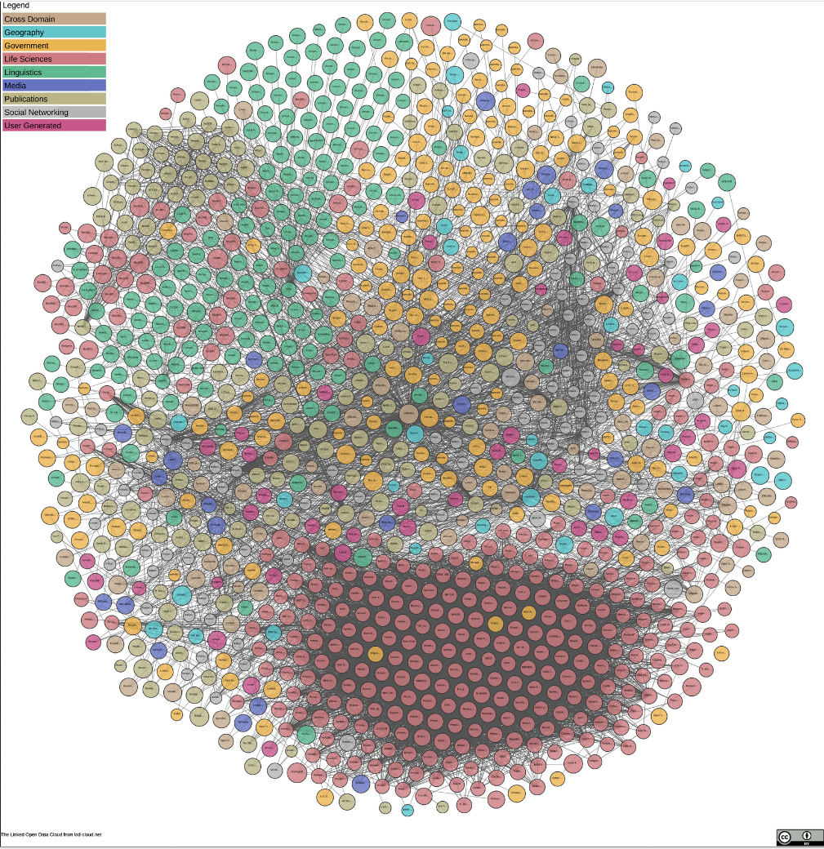
Linked Data
But: Open Data is more than Linked Open Data…
3
Latest release 04-30-2018- 1184 Datasets

Slide 4


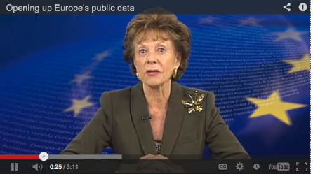
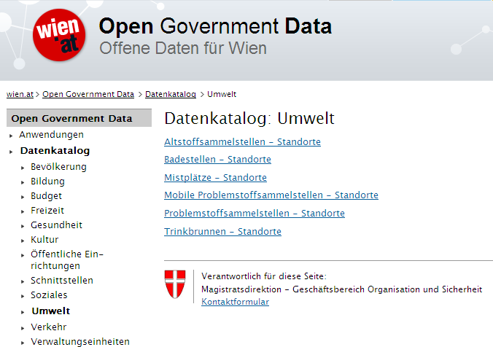
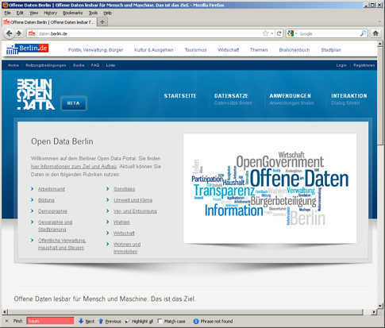
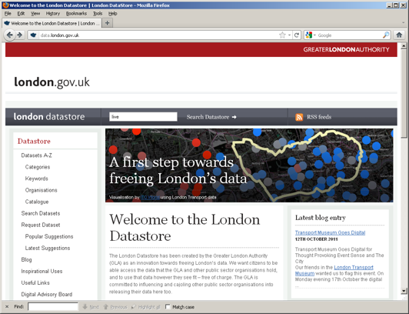
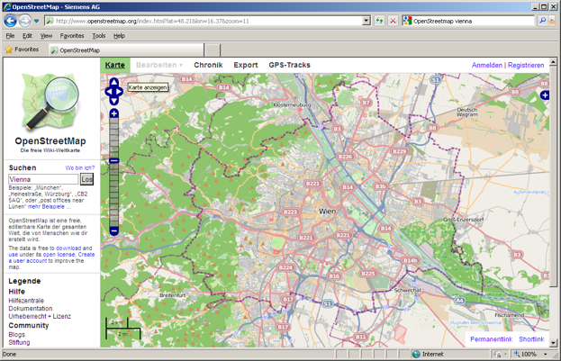

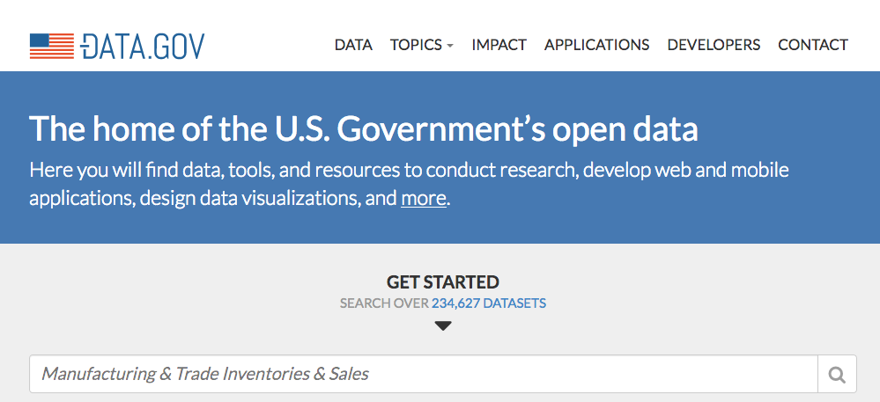


Open Data is a Global Trend!
EU & Austria, but also the (previous) US and UK administration are/were pushing Open Data!
DIRECTIVE 2007/2/EC INSPIRE
4

Slide 5












A lot of Open Data is not Linked Data
    Cities, International Organizations, National and European Portals, Int'l. Conferences:
We are aware of currently
260 active such portals worldwide.
Notes:
5

Slide 6
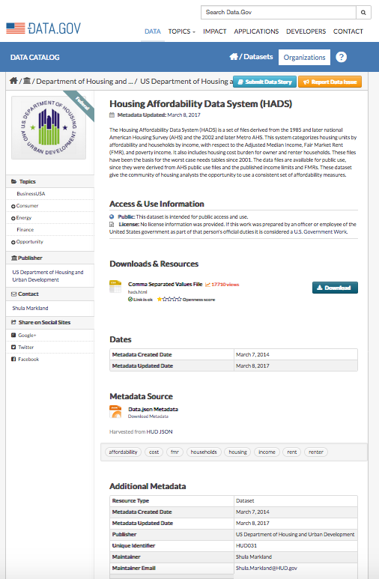
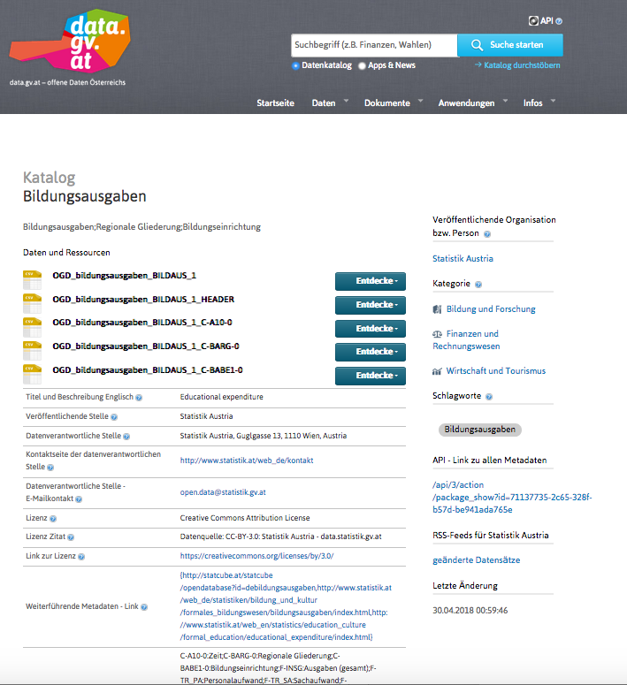
Different portals…

Slide 7
What’s the problem(s)?
Metadata is heterogeneous and (partially) messy
  Software-specific metadata (CKAN vs Socrata vs …)
  Portal-specific metadata
  Missing metadata (file formats, API descriptions, …)
Metadata not available as Linked Data
  Only partially in DCAT vocabulary
  No mappings for additional metadata fields
Poor discoverability of datasets
  No content information in metadata (e.g., CSV headers)
  Datasets’ metadata not optimized for search engines
(Meta-)data becomes stale/offline/outdated
Notes:
Metadata still in silos -> bring it to the Web
Different portals use different metadata
Data sources become offline or stale
Meta-data doesn’t reflect reality
Data is hardly searchable

Slide 8
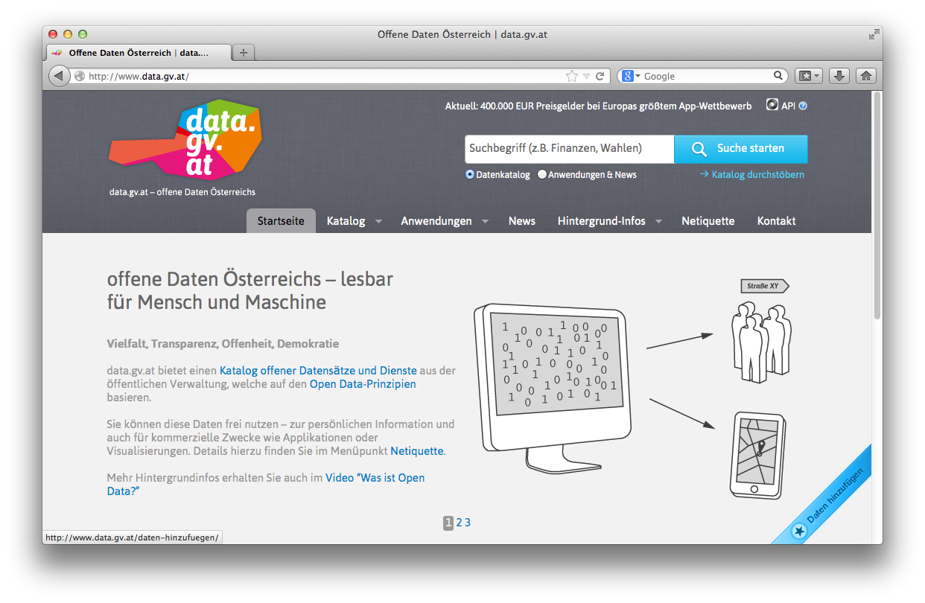
Open Data Portal Software
CKAN ... http://ckan.org/
almost „de facto“ standard for Open Data Portals
facilitates search, metadata (publisher, format, publication date, license, etc.) for datasets
http://data.gov/
http://data.gv.at/
machine-processable? ...
... partially

Slide 9
Our solution:
Open Data Portalwatch
  Monitoring Metadata quality
  Mapping to standard vocabularies
  Enriching Metadata to improve search

Slide 10
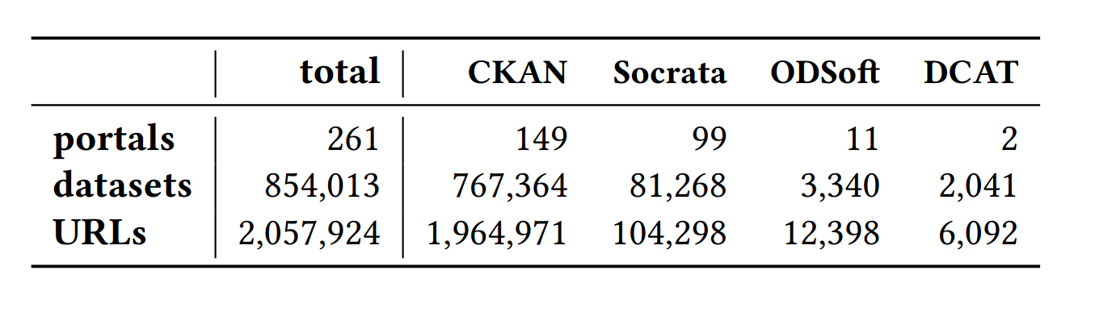
1) Monitoring and QA over evolving data portals
3/2015 [1]:
- 90 portals
- Only CKAN
8/2015 [2]:
- 6 quality metrics
- QA
6/2016 [3]:
- 260 portals
- CKAN, Socrata, OpenDataSoft
- 18 metrics
[1] | Towards assessing the quality evolution of open data portals. In ODQ2015: Open Data Quality Workshop, Munich, Germany
[2] | Quality assessment & evolution of open data portals. In: International Conference on Open and Big Data, Rome, Italy (2015)
[3] | Automated quality assessment of metadata across open data portals. ACM Journal of Data and Information Quality (2016)

Slide 11
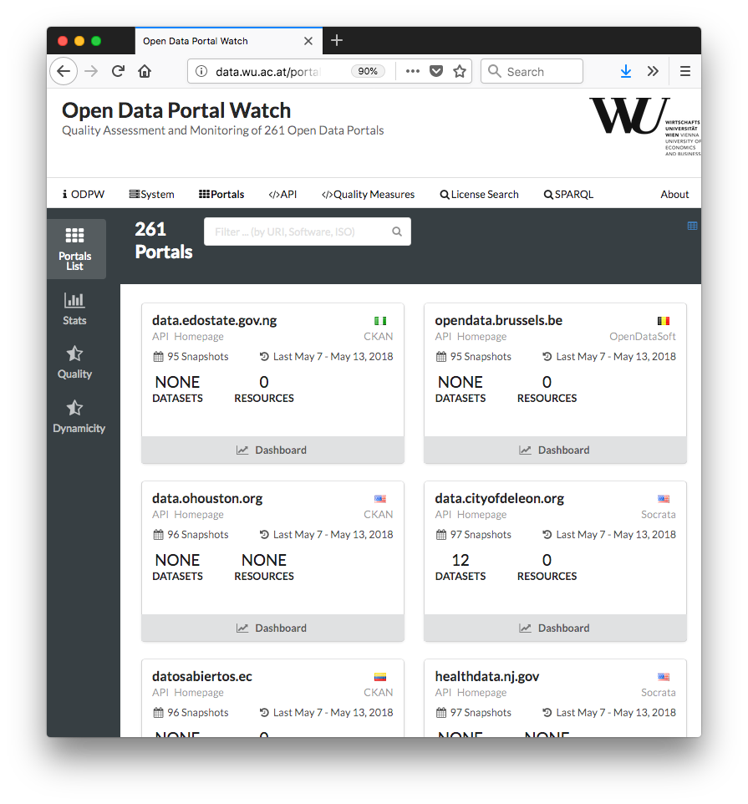
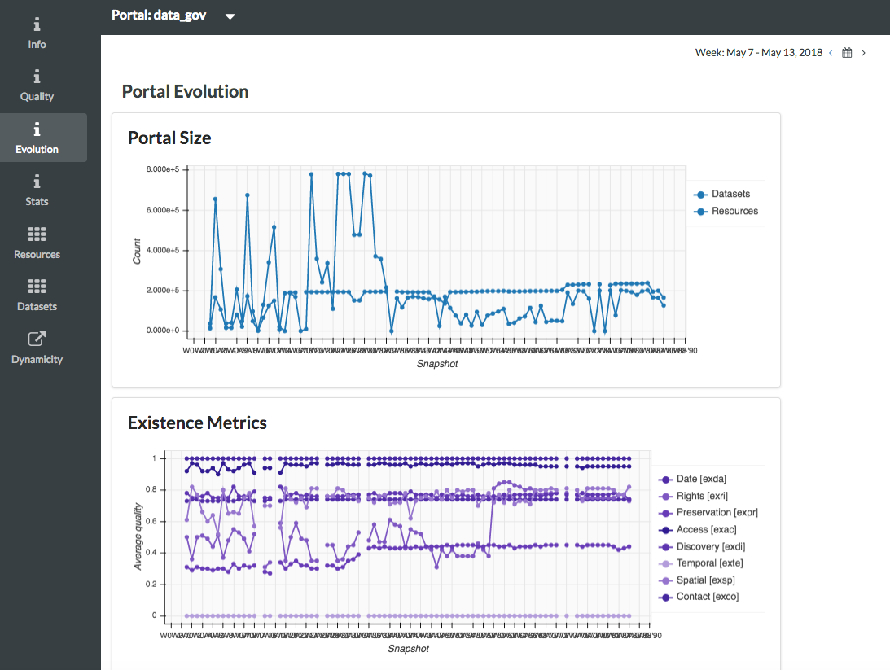
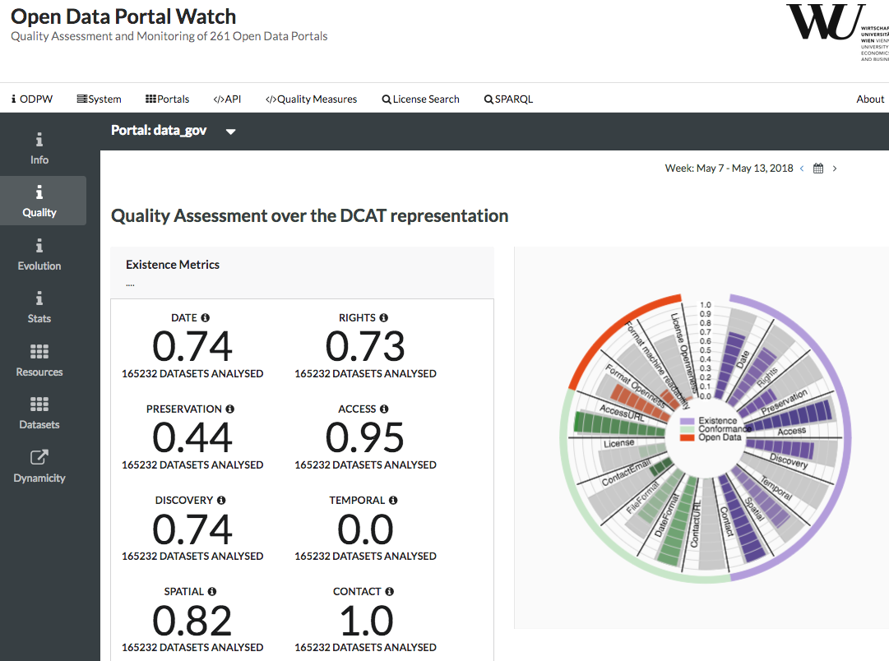
Demo:
http://data.wu.ac.at/portalwatch/portal/data_gov/1818

Slide 12
2) Mapping to Standard vocabularies & Linked Data
Mapping & Heuristic Enrichment
  DCAT
  PROV
  CSVW
  Schema.org
Enable uniform access:
  →SPARQL endpoint
  → Linked Data & Memento Protocol
[1] | http://data.wu.ac.at/portalwatch/sparql
[2] | http://data.wu.ac.at/odso/

Slide 13
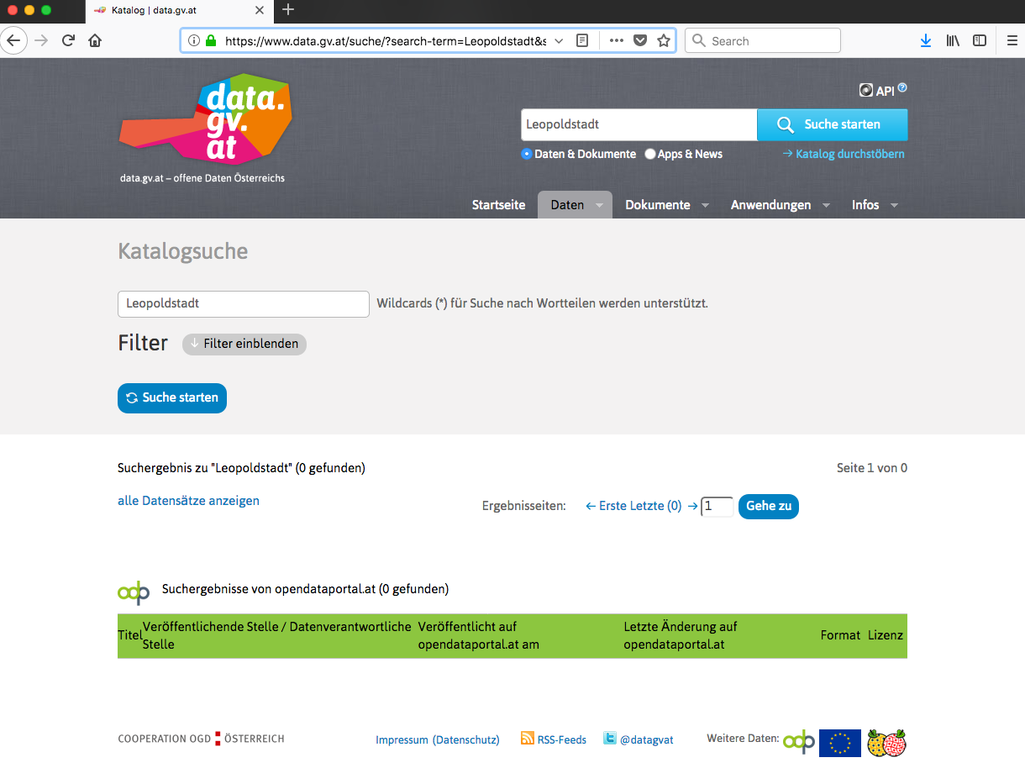

Finally:
3) Why is Search in Open Data a problem?

Slide 14
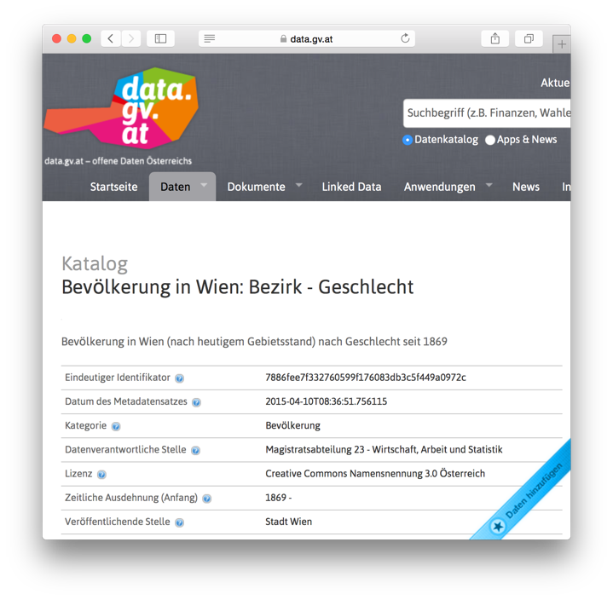
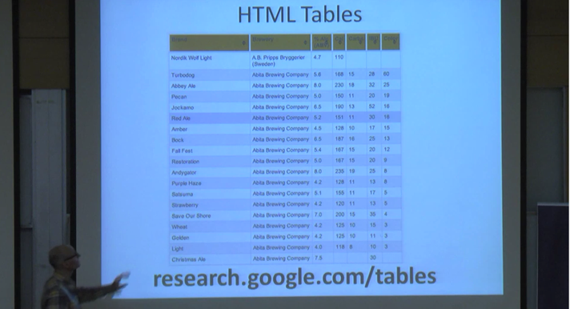
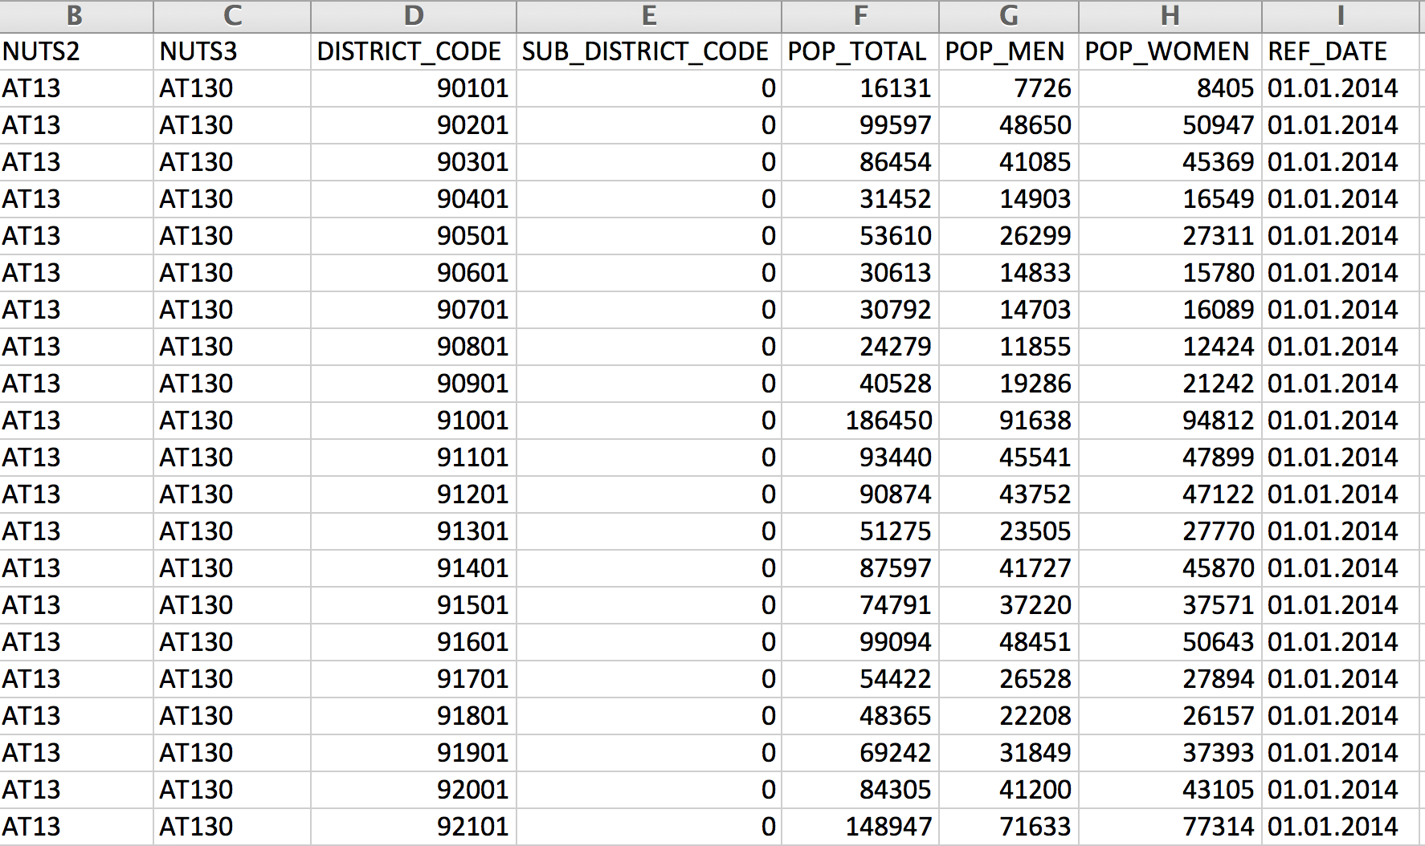
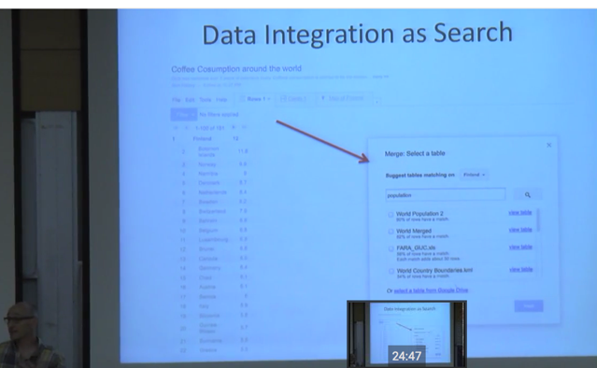
Why is Search in Open Data a problem?
https://www.youtube.com/watch?v=kCAymmbYIvc
Structured Data in Web Search by Alon Halevy
vs.
Open Data Search is hard...
No natural language „cues“ like in Web tables...
Existing knowledge graphs don‘t cover the domain of "Open Data“
Open Data is not properly geo-referenced

Slide 15
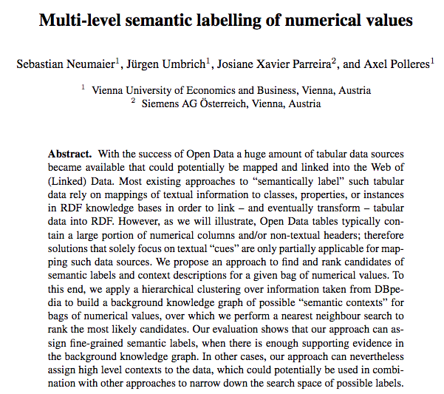
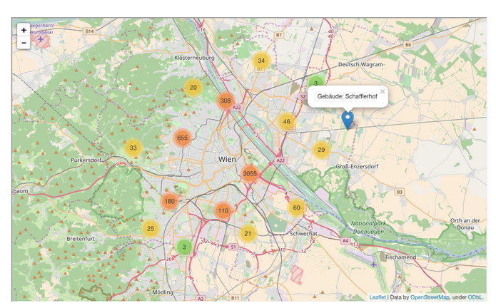
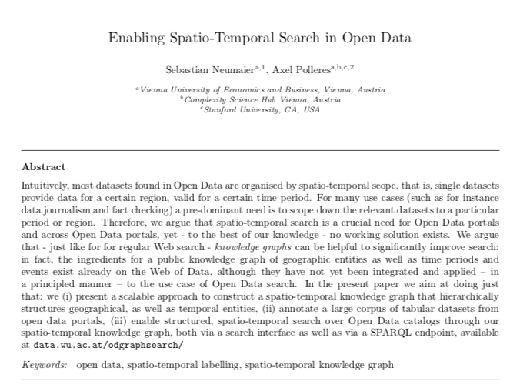
Some starting points:
First baby steps on building an Open Data Knowledge Graph:
Ongoing work to enable spatio-temporal search in Open Data e.g. in our project communidata.at (just submitted to JWS)
International Semantic Web conference 2016:

Slide 16
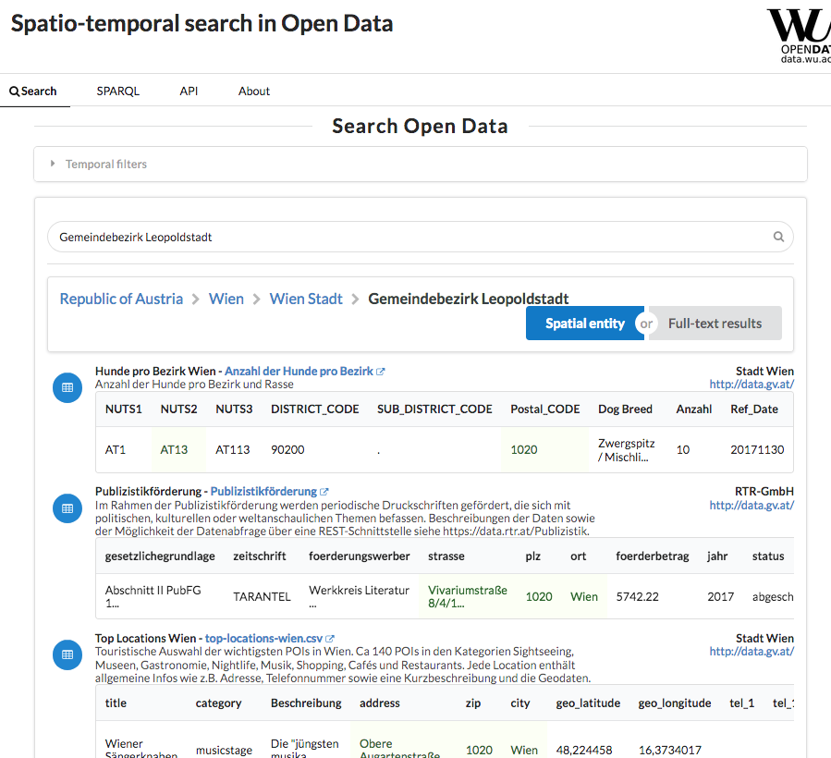
Demo:
http://data.wu.ac.at/odgraphsearch/
Idea:
Link OD to geospatial and temporal Knowledge bases:
Geonames
OpenStreetMap
Perio.do
Wikidata
…

Slide 17
Take-home messages:
Scalable monitoring of metadata quality and evolution is possible and useful
Meta-Data Quality can be improved by IE and looking into the data
Linked Data and standard protocols (SPARQL, Memento)
  helps to provide an integrated view
  Enable combination with other sources to improve search

Slide 18

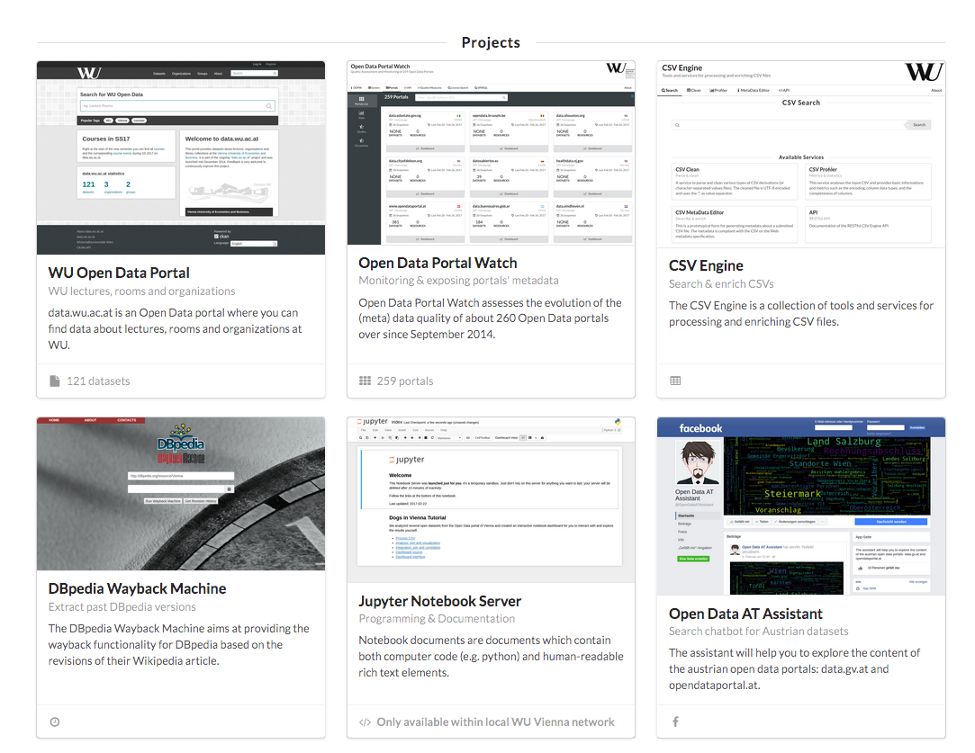
Other Ongoing Projects (data.wu.ac.at)

