Slide 1
Toward
Natural Data Understanding
Axel Polleres
Notes:
This talk is more about problems than about solutions…

Slide 2
What is ”Natural Data”?
”Natural Data” = “Data as it occurs in the wild”
Heterogenous data assets
From different sources and origins
Different Formats
Different Semantics
Sparse descriptive metadata
Raw/not necessarily for human consumption
→ Hard to search and integrate!
Notes:
But probably very valuable and interesting overlaps and links to discover in the data!

Slide 3
Where does ”Natural Data” occur?
Example 1: Open (Government) Data

Slide 4
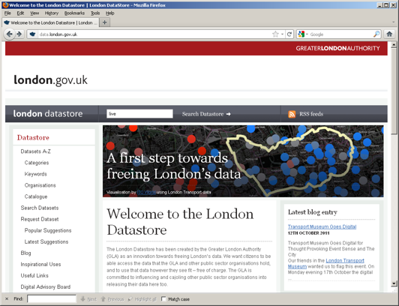


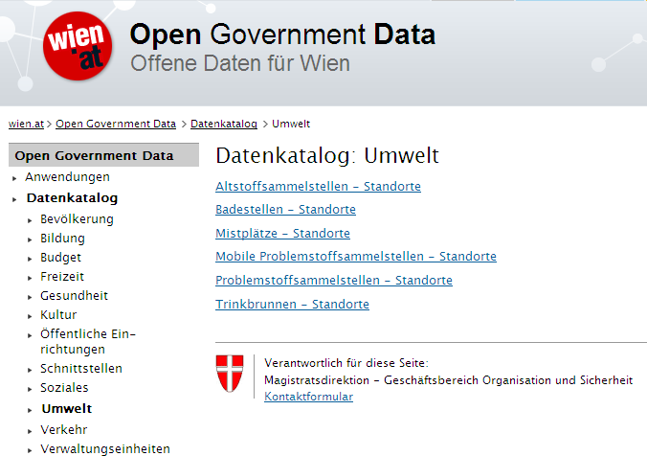
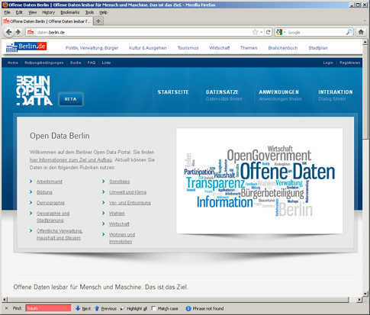
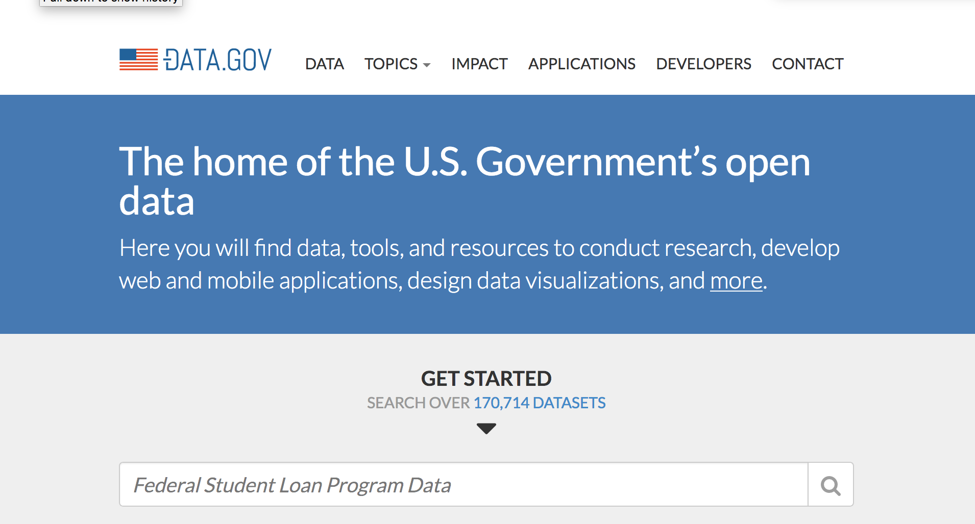
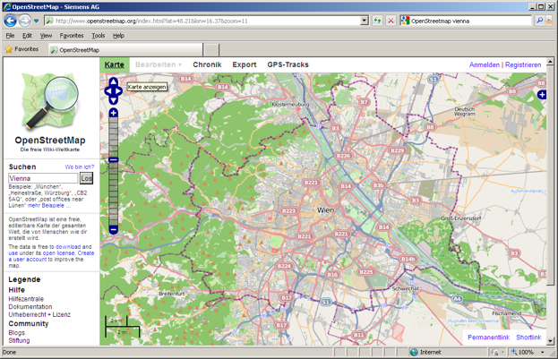

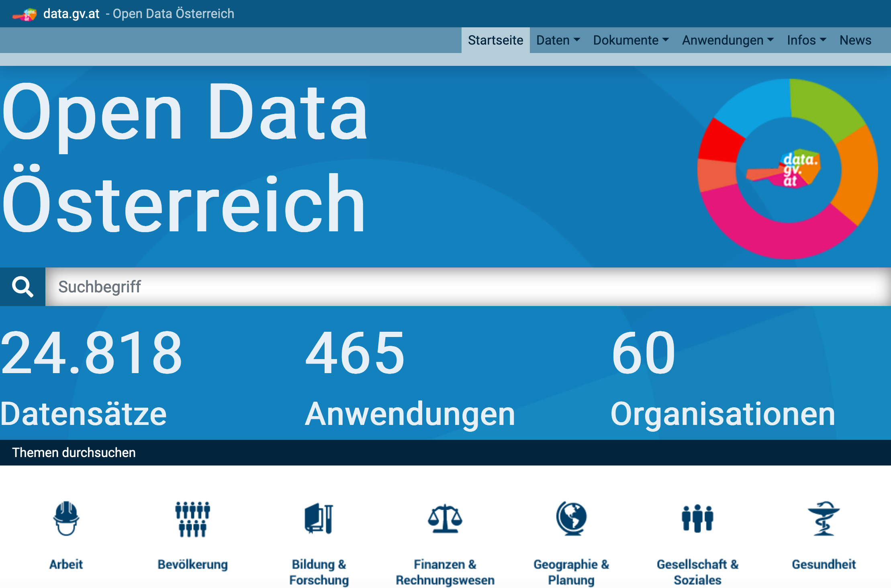


Open Data is a Global Trend!
EU & Austria, but also the (previous) US and UK administration are/were pushing Open Data!
DIRECTIVE 2007/2/EC INSPIRE

Slide 5





(Structured) Open Data comes in various ways
Available data is only partially structured and not linked [1]:
CSV (3-star)
Excel (2-star)
PDF (1start)
Unknown format (1-star)
82 data portals 160K datasets
[1] | Umbrich, J., Neumaier, S., Polleres, A.: Quality assessment & evolution of open data portals. International Conference on Open and Big Data (2015)

Slide 6
Open Data as a Global Trend:
Country | URL | Datasets
United States | data.gov | 170.7k
Canada | open.canada.ca | 79.1k
UK | data.gov.uk | 45.1k
France | www.data.gouv.fr | 34.2k
Russia | opengovdata.ru | 30.3k
Japan | data.go.jp | 21k
Italy | dati.gov.it | 20.4k
Germany | govdata.de | 19.8k
Data portals of the G8 countries

Slide 7
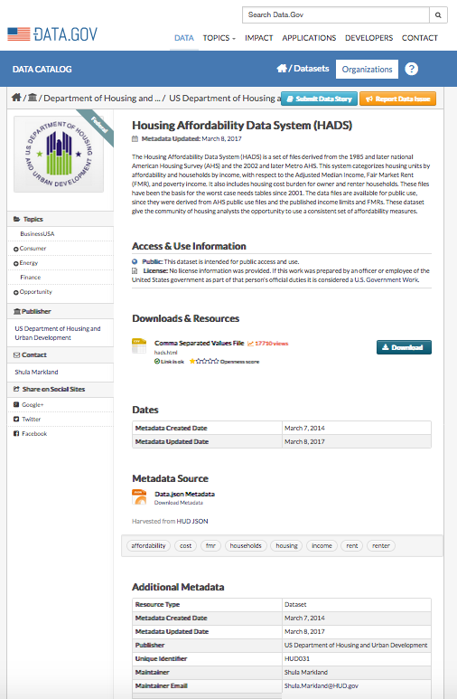
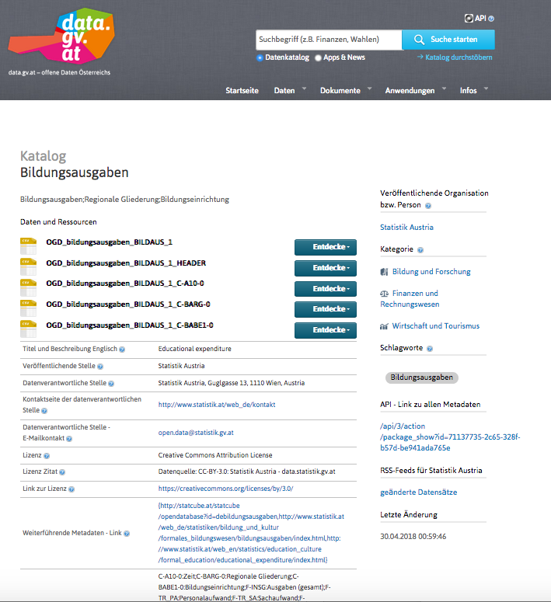
Different portals…
Notes:
Different datesets, different metadata, even different portal software used.

Slide 8
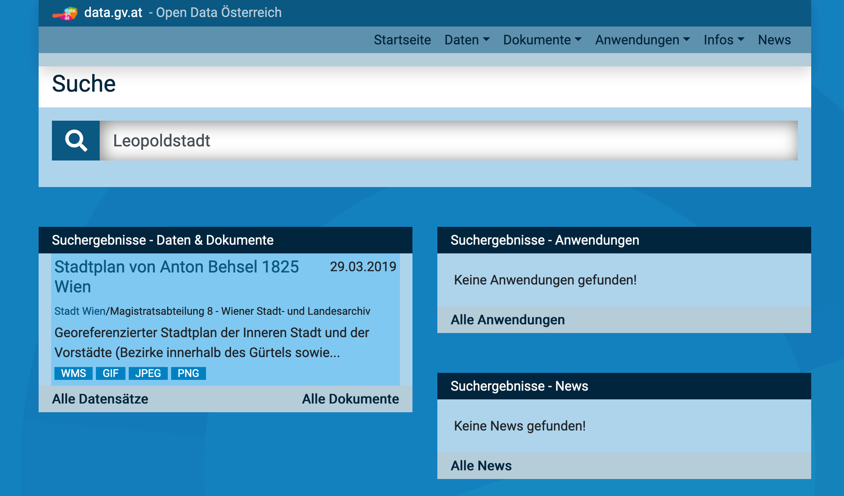

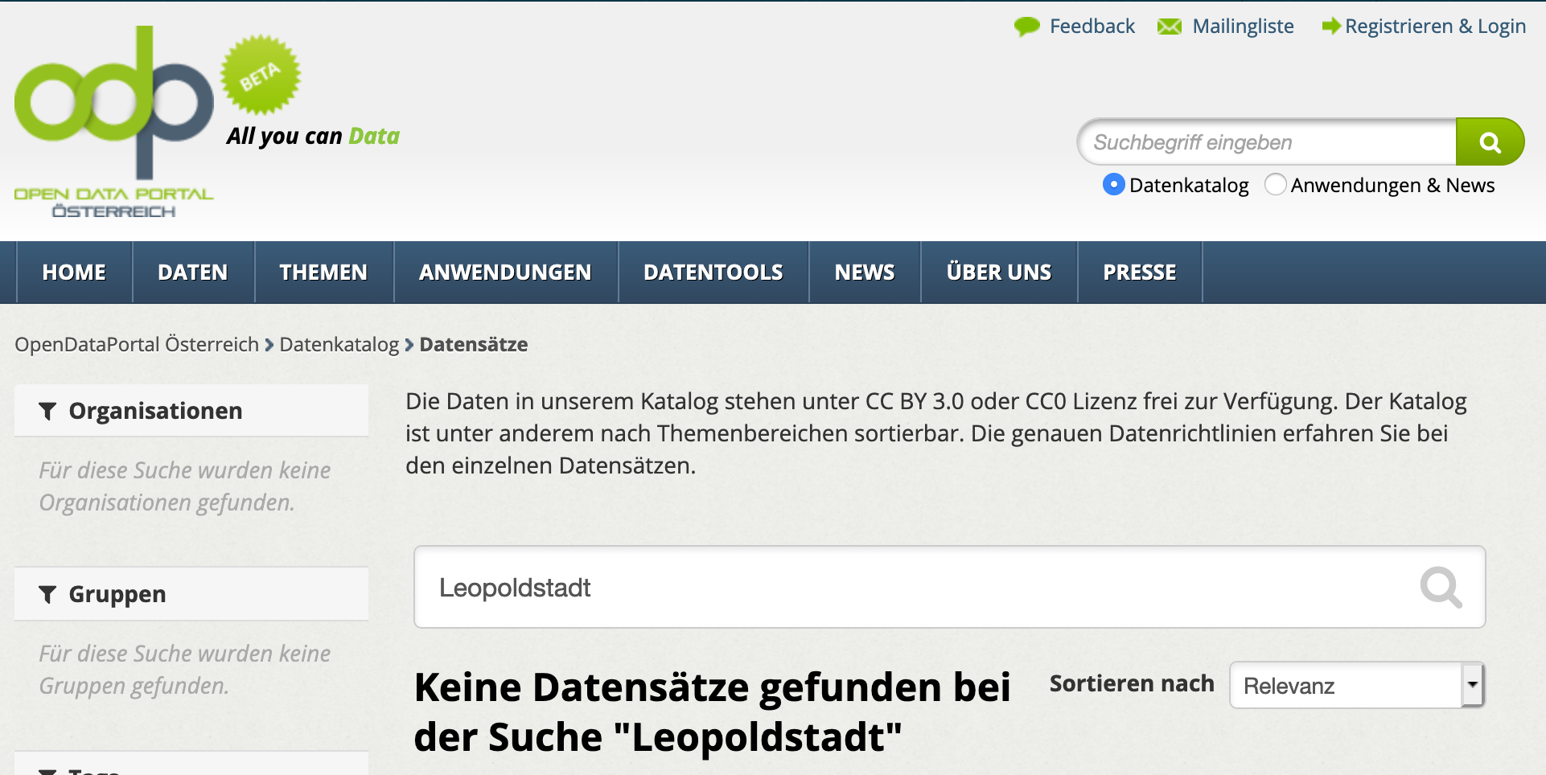
What do you find on Open Data Portals?
Not too much!

Slide 9

Where does ”Natural Data” occur?
Example 2: Large Enterprise Data!?
Probably similar issues:
30.10.2006
Management-Erkenntnisse aus der Bibel
https://www.handelsblatt.com/politik/konjunktur/oekonomie/wissenswert/neue-bwl-studie-management-erkenntnisse-aus-der-bibel/2725926.html
Nur dann habe die Vision eines Unternehmens, in dem alle Mitarbeiter ihr Wissen teilen, eine Chance. […] Dass sich das lohnen dürfte, ahnte Heinrich von Pierer schon 1995. „Wenn Siemens wüsste, was Siemens weiß“, seufzte der damalige Vorstandschef vor elf Jahren auf der Bilanzpressekonferenz, „dann wären unsere Zahlen noch besser.“

Slide 10

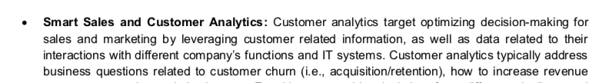
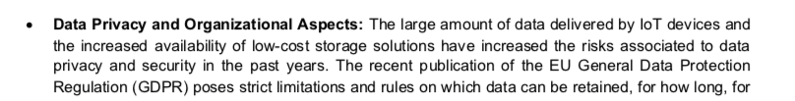
Data Challenges in Siemens?
(How) can customer data be leveraged for novel, complex analytics, machine learning, and finally decision making?
(How) can customer data be leveraged in a privacy-aware, legally compliant manner? I.e., how can we enable re-use of “insights” across systems, across projects, etc.)

Slide 11
What is ”Natural Data”?
”Natural Data” = “Data as it occurs in the wild”
Heterogenous data assets
From different sources and origins
Different Formats
Different Semantics
Sparse descriptive metadata
Raw/not necessarily for human consumption
Policies forbid to re-share sensitive Data
Data Catalogs not even existing yet
→ Hard to search and integrate!

Slide 12
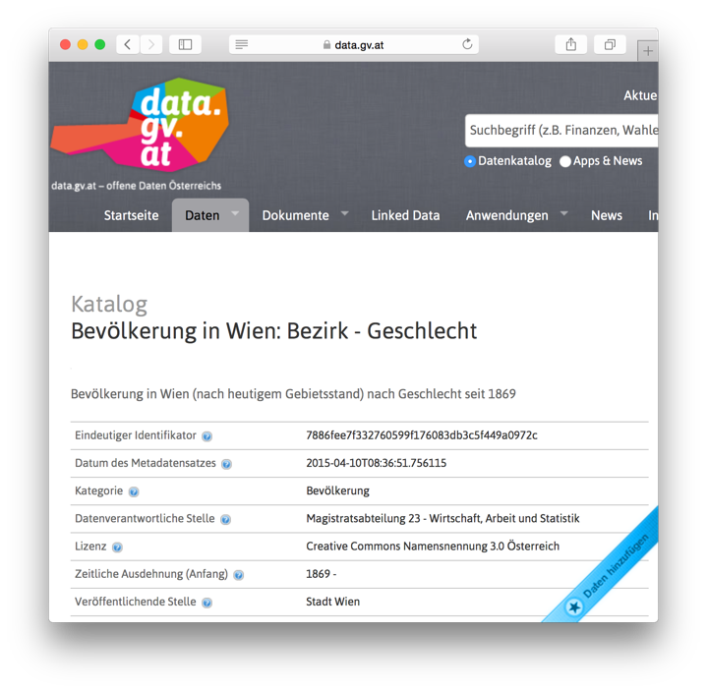
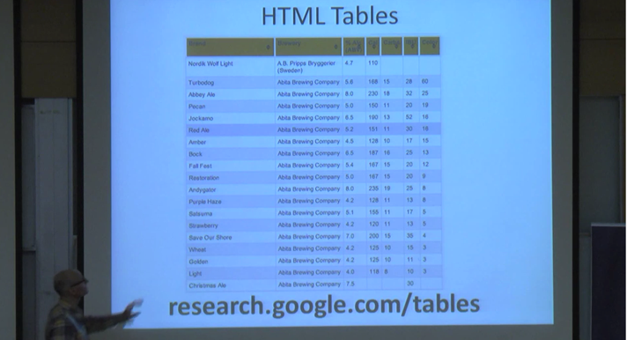
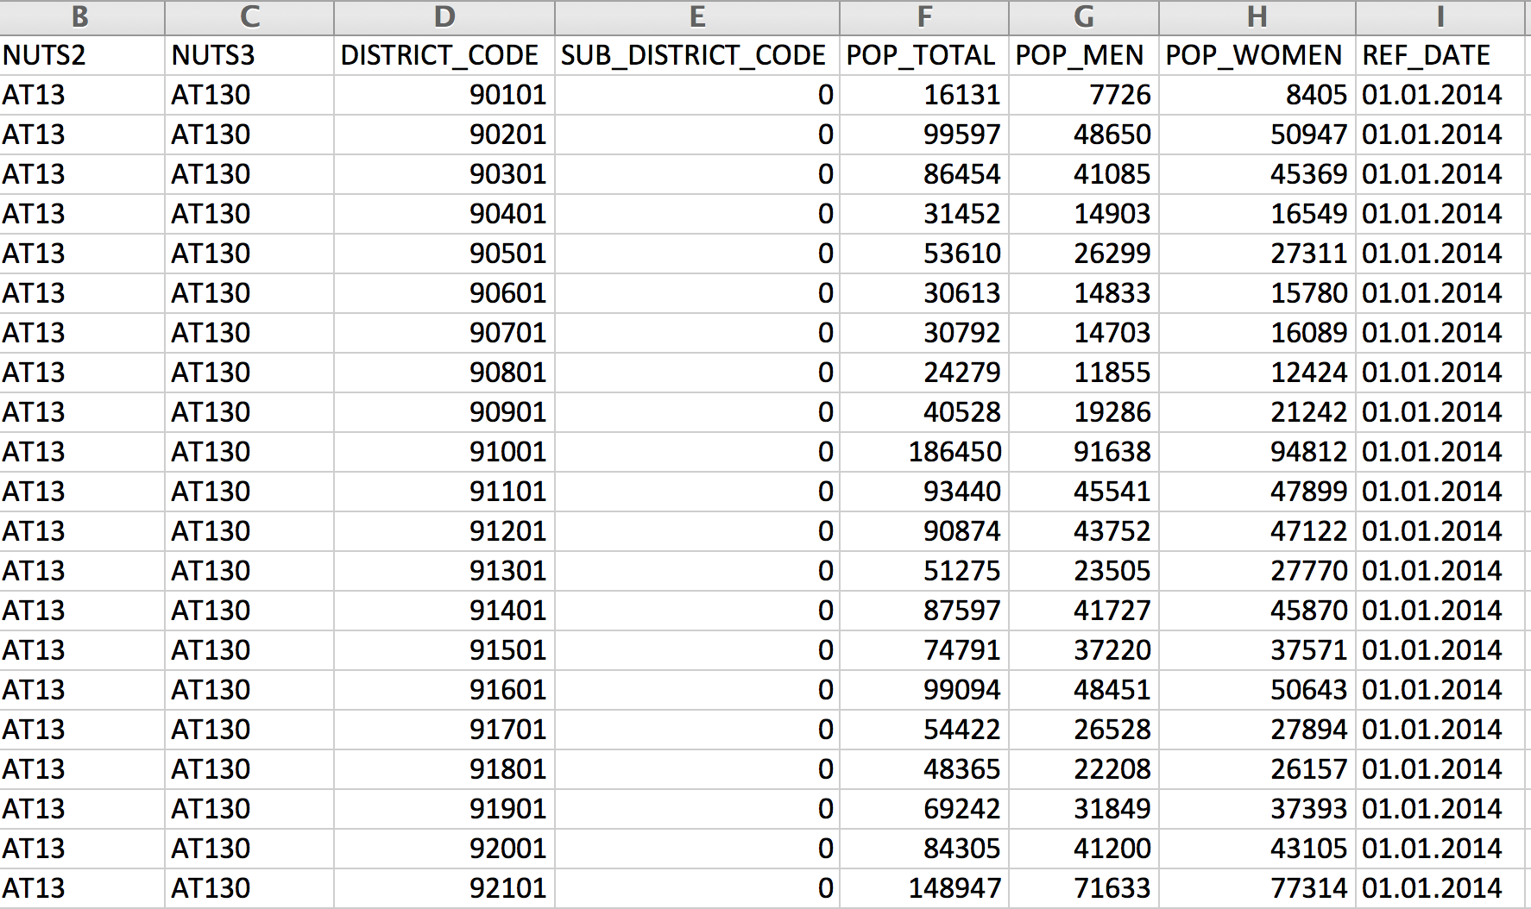
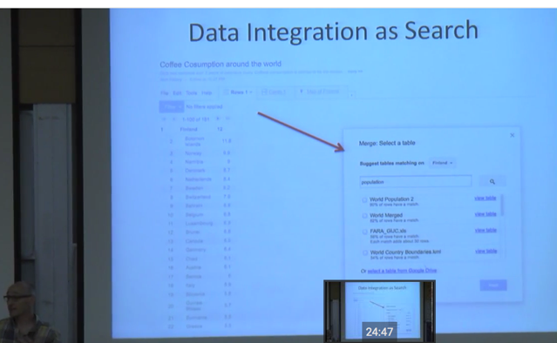
Why is Search & Integration of Natural Data a problem?
https://www.youtube.com/watch?v=kCAymmbYIvc
Structured Data in Web Search by Alon Halevy
vs.
Open Data Search is hard...
No natural language „cues“ like in Web tables...
Existing knowledge graphs don‘t cover the domain of "Open Data“ well
Open Data is not properly geo-referenced

Slide 13
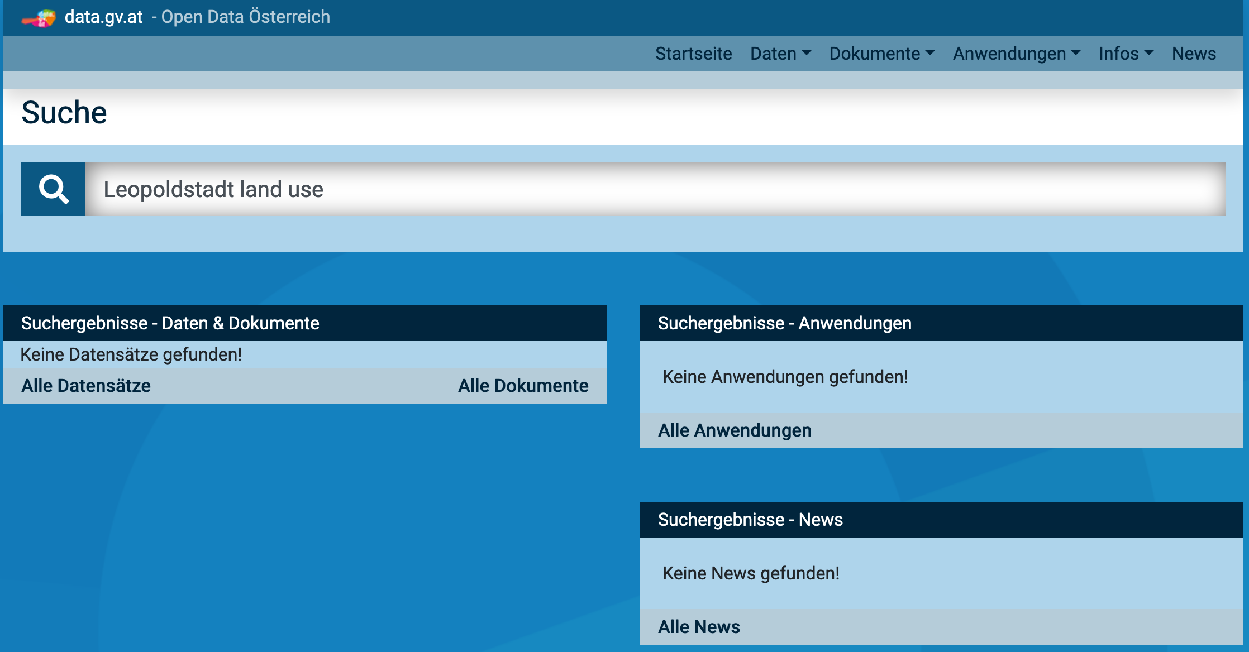
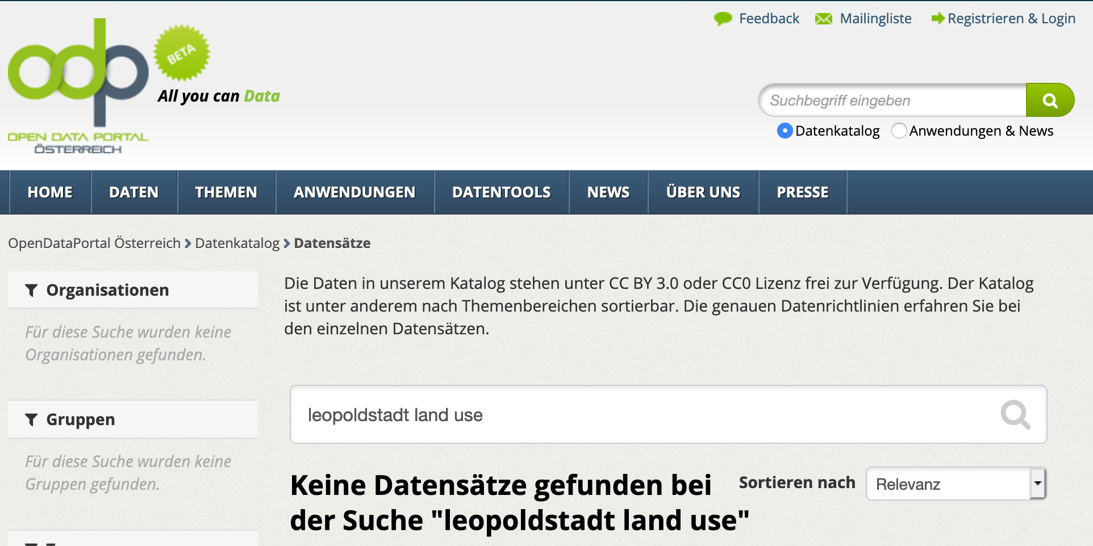
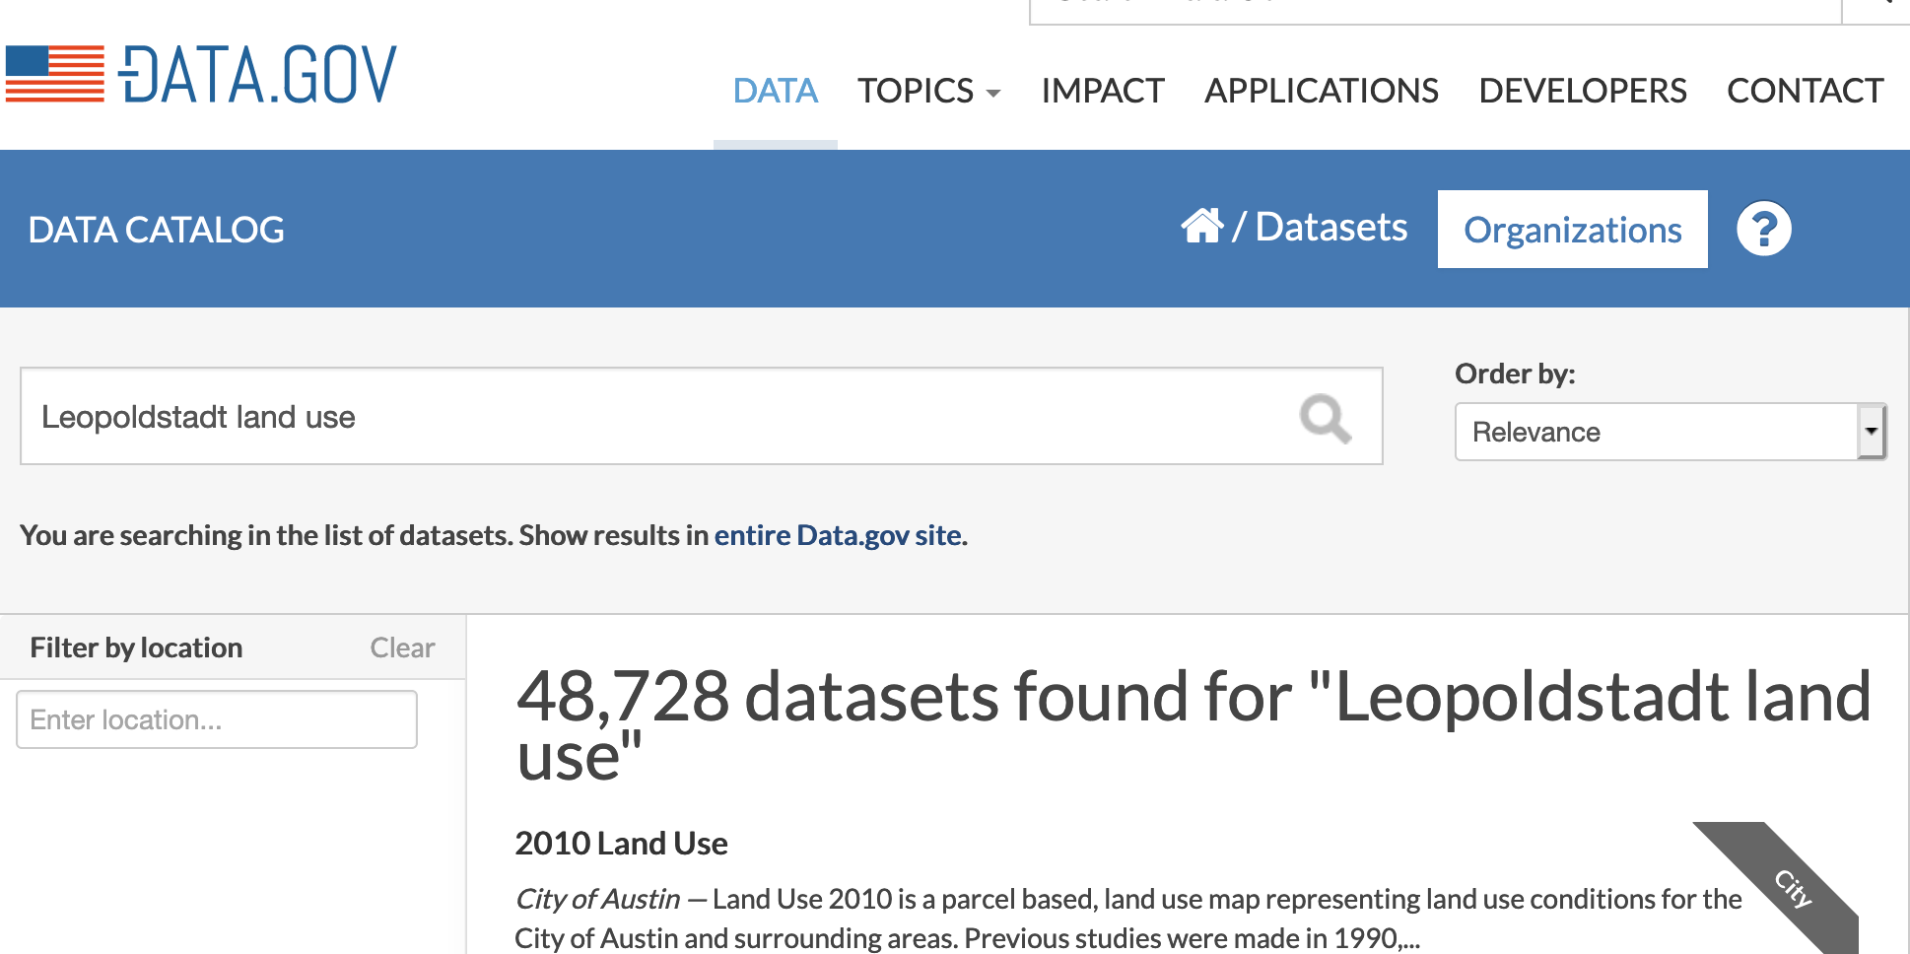
“Natural Data” Search: How would a human approach this problem?
e.g. you wouldn’t probably search in data.gov …

Slide 14
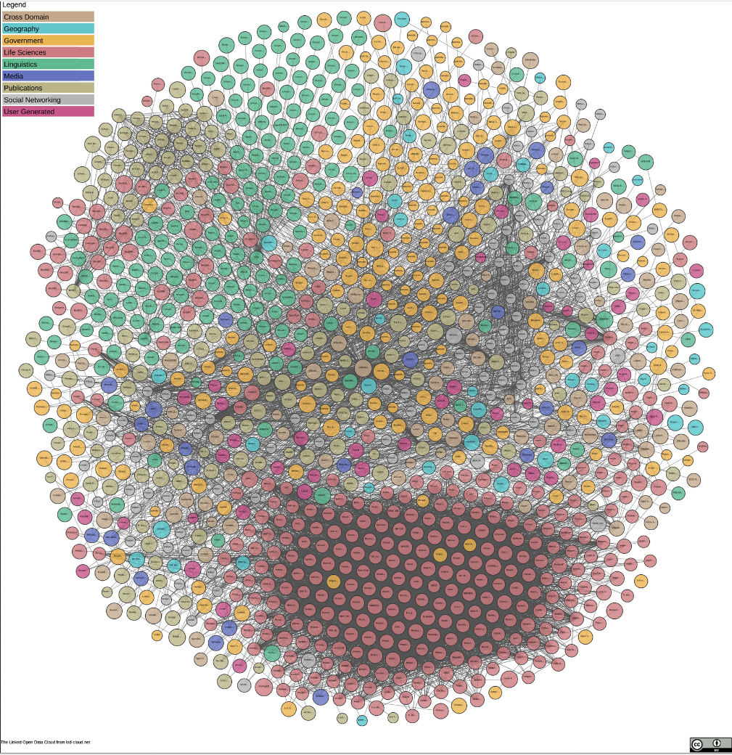
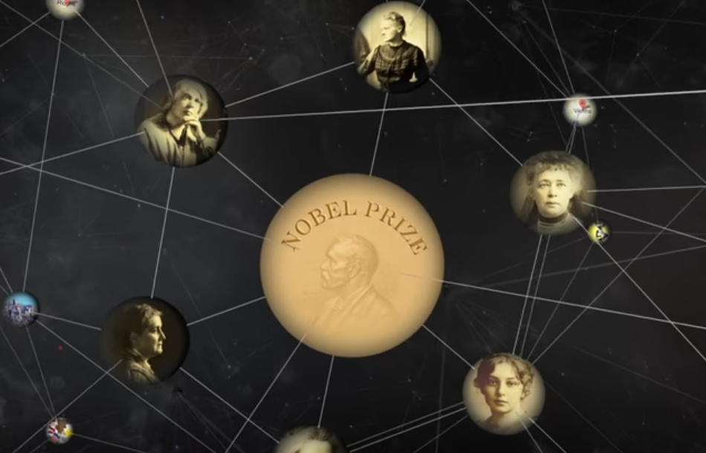

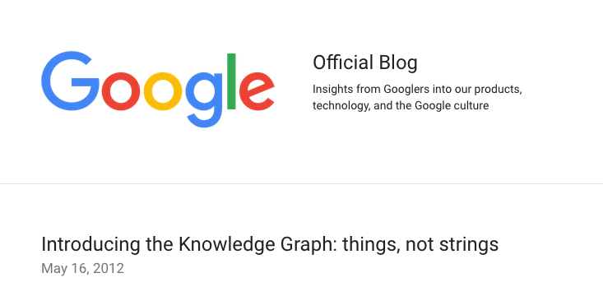

Our research:
Knowledge Graphs for Natural Data Search & Integration!

Slide 15
Our research:
Knowledge Graphs for Natural Data Search & Integration!
2 approaches how knowledge graphs could help to solve the Open Data search problem (aside the obvious):
    Hierarchical labelling of Labeling of numeric data
    Hierarchical labelling of Spatio-Temporal entities

Slide 16
Example Table
federal state | district | year | sex | population
Upper Austria | Linz | 2013 | male | 98157
Upper Austria | Steyr | 2013 | male | 18763
Upper Austria | Wels | 2013 | male | 29730
… | … | … | … | …

Slide 17
Open Data CSVs look more like this
NUTS2 | LAU2_NAME | YEAR | SEX | P_TOTAL
AT31 | Linz | 2013 | 1 | 98157
AT31 | Steyr | 2013 | 1 | 18763
AT31 | Wels | 2013 | 1 | 29730
… | … |  | … | …
Source: https://www.data.gv.at/katalog/dataset/e108dcc3-1304-4076-8619-f2185c37ef81
Notes:
What are the difference? Non-speaking column names, numeric values instead of labels.

Slide 18
Why not use the numeric values?
Identifying the most likely semantic label for a bag of numerical values
Deliberately ignore surroundings
NUTS2 | LAU2_NAME | YEAR | SEX | P_TOTAL
AT31 | Linz | 2013 | 1 | 98157
AT31 | Steyr | 2013 | 1 | 18763
AT31 | Wels | 2013 | 1 | 29730
… | … |  | … | …

Slide 19
Why not use numeric values?
Identifying the most likely semantic label for a bag of numerical values
Deliberately ignore surroundings
  population (a district) (country Austria)
98157
18763
29730
…

Slide 20
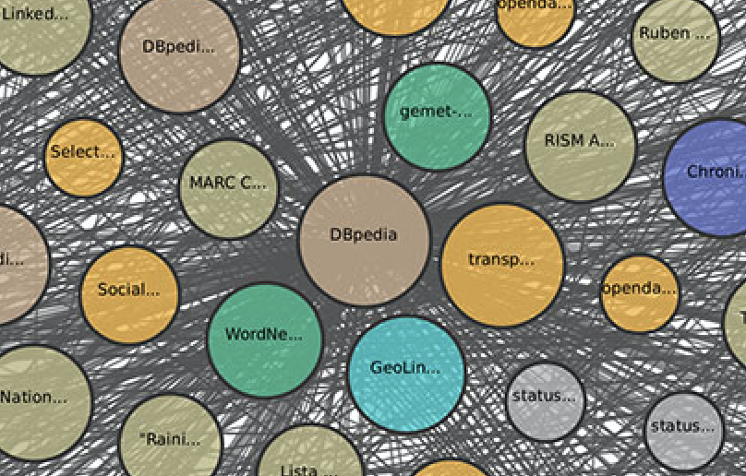
Background Knowledge Graph
Cities
  Population
  Area
  Country
  Location (Coordinates)
  Economic indicators
  …
Organisations:
  Revenues
  Board members
  …
Persons (e.g. celebrities, sports)
  Name
  Profession
  Height
Landmarks (e.g. famous buildings)
  Country
  Location
  Height
Events
  Dates
  Location
What’s in there?

Slide 21
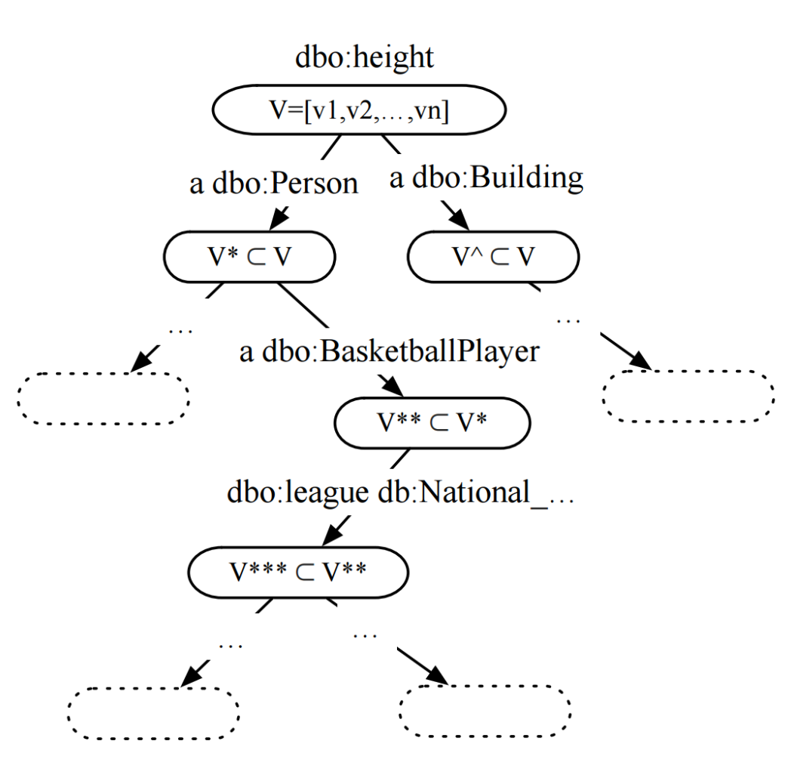
Background Knowledge Graph
Find properties with
numerical range
Hierarchical clustering approach
Two hierarchical layers:
  Type hierarchy
  (using OWL classes)
  Property-object hierarchy
  (shared property-object pairs)

Slide 22
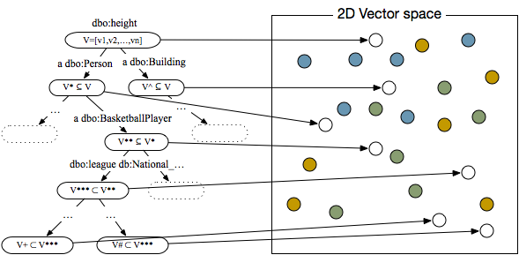
Label based on Nearest Neighbors
2
4
3
6
5
1
Notes:
Kolmogorov-Smirnov Test (Distribution similarity of samples with sistributions), other alternatives: min/max, overlapping value ranges, value SD, standard descriptive statistics)

Slide 23
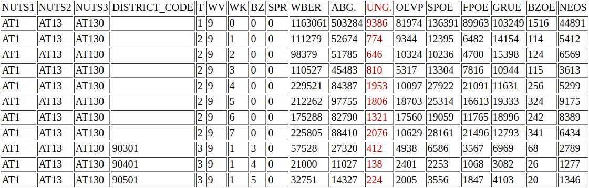
Example OD Labelling
  populationTotal (a Settlement)
  populationDensity (a City)
23
Source: http://data.wu.ac.at/iswc2016_numlabels/submission/col14.html
Notes:
Election results…. Number of invalid votes… not surprisingly correlated with population numbers or densities (although sure not directly matching).

Slide 24
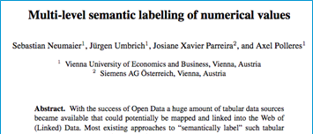
Lessons learned
We can assign fine-grained semantic labels
  if there is enough evidence in Background Knowledge Graph
However: Missing domain knowledge for labelling OD
Future work:
Complementary to existing approaches (column header labeling, entity linking and relation extraction)
Combined approaches may improve results
Focusing on core dimensions of specific domains e.g. city data, maybe more promising than “general” value labeling.

Slide 25
What else can we do/use?
Focus on specific dimensions:
  Particularly temporal and geospatial queries require better support [2]
NUTS2 | LAU2_NAME | YEAR | SEX | AGE_TOTAL
AT31 | Linz | 2013 | 1 | 98157
AT31 | Steyr | 2013 | 1 | 18763
AT31 | Wels | 2013 | 1 | 29730
… | … |  | … | …
[2] | Emilia Kacprzak, et al.: A Query Log Analysis of Dataset Search. International Conference on Web Engineering (2017)

Slide 26
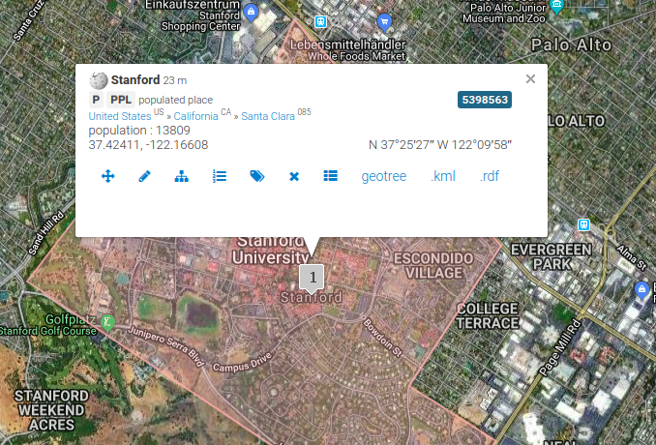
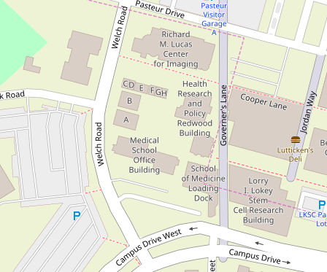


Available Geospatial Knowledge Bases

Slide 27
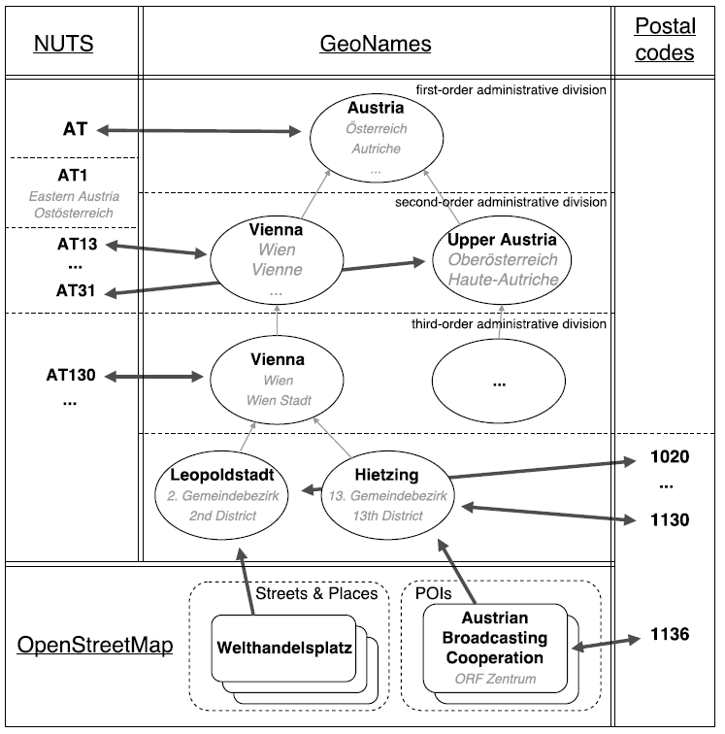
Geo-Knowledge Graph Construction
European Classification of Territorial Units
Wikidata, GeoNames
Wikidata links
Mapping OSM entities to GeoNames regions
Wikidata links
Extracting OSM streets and places

Slide 28
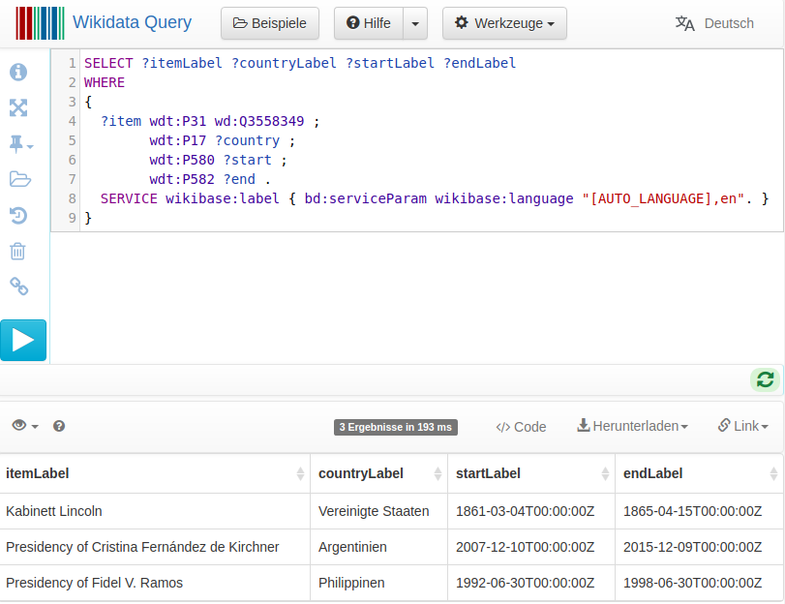
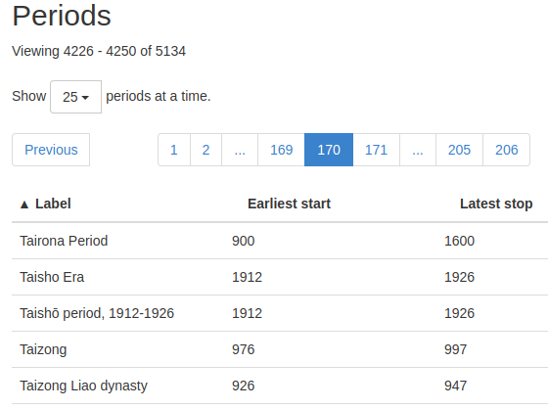


Available Temporal Knowledge

Slide 29
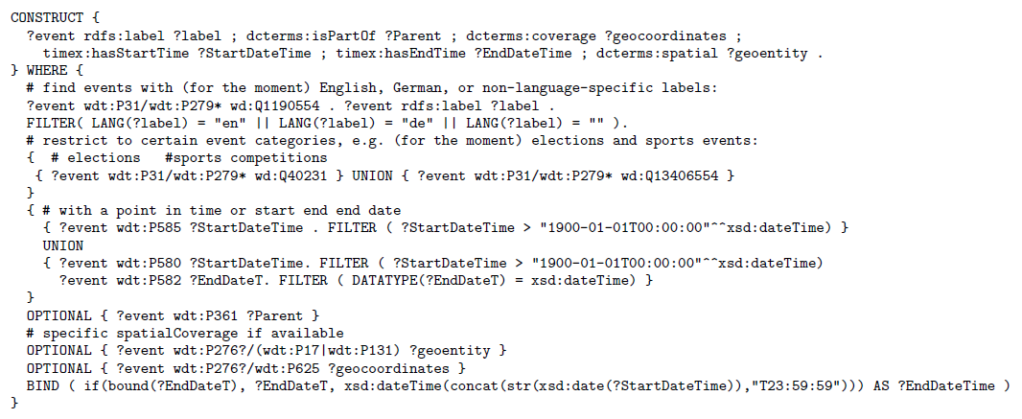
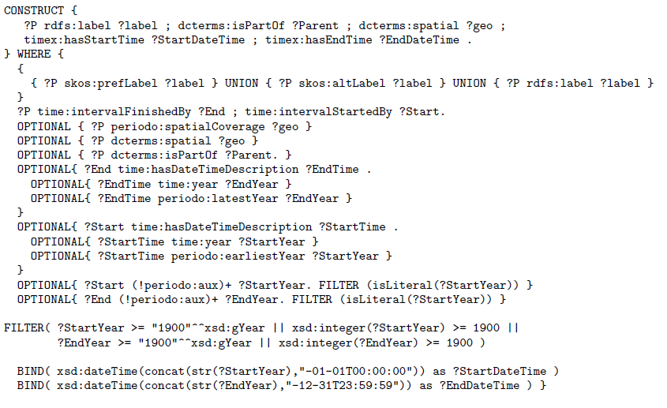
Temporal Knowledge Graph Construction
}
}
Named events and their labels
Links to parent periods
Temporal extent:
a single beginning and end date
Links to the spatial coverage

Slide 30
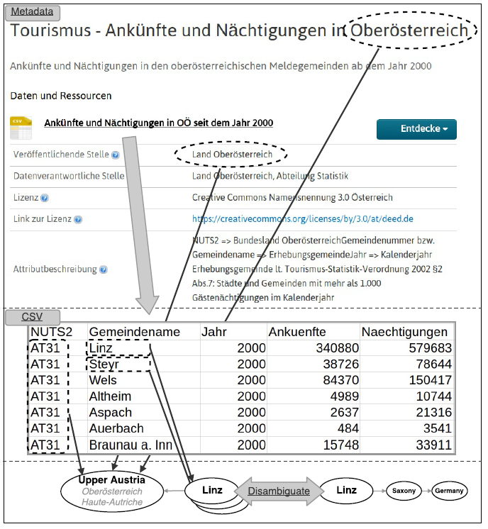
Dataset Labelling
Metadata descriptions
Geo-entities in titles, descriptions, organizations
Restricted to „origin“ country of the dataset (from portal)
Temporal tagging using Heideltime framework [3]
CSV cell value disambiguation
Row context:
  Filter candidates by potential parents (if available)
Column context:
  Least common ancestor of the spatial entities
[3] | Strötgen, Gertz: Multilingual and Cross-domain Temporal Tagging. Language Resources and Evaluation, 2013.
Notes:
Example China…

Slide 31
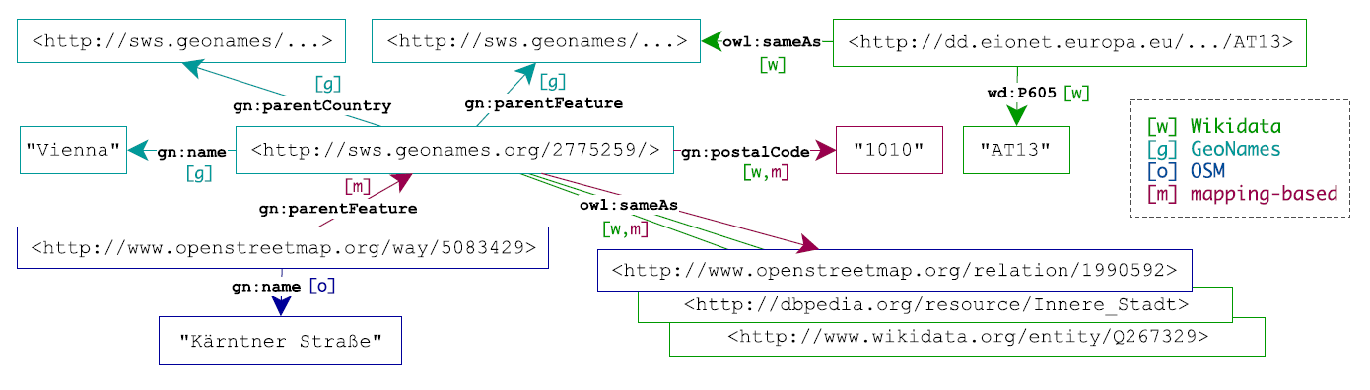
RDF Export 1/2:
Knowledge Graph
Spatial and temporal base knowledge graph
Annotated data points in metadata and CSV cells
CSV metadata using CSVW vocabulary
  e.g., delimiter, encoding, header, …

Slide 32
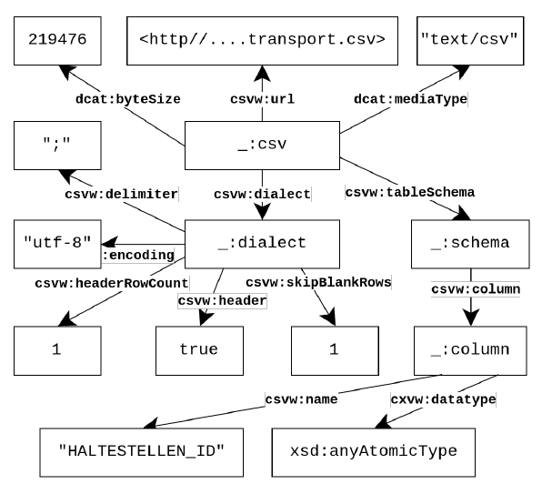
RDF Export 2/2: Annotate Datasets →
CSV on the Web Metadata [4]
Note: no real cell level annotaitons, we needed to add those!
E.g.:
  csvwx:cell
    csvwx:hasTime
    csvw:refersToEntity
  …
  Details: cf.: http://data.wu.ac.at/ns/csvwx
[4] | R. Pollock et al., Metadata Vocabulary for Tabular Data, W3C CSV on the Web (2015)

Slide 33
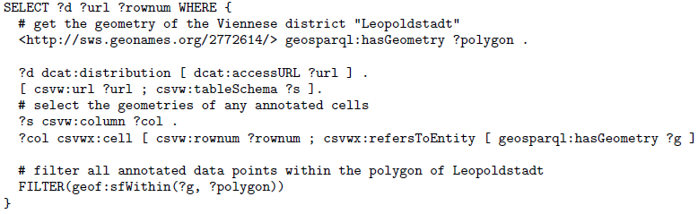
Enable e.g. Search by GeoSPARQL Queries:
Standard for representation and querying of geospatial linked data
(Almost) no complete implementations of GeoSPARQL

Slide 34
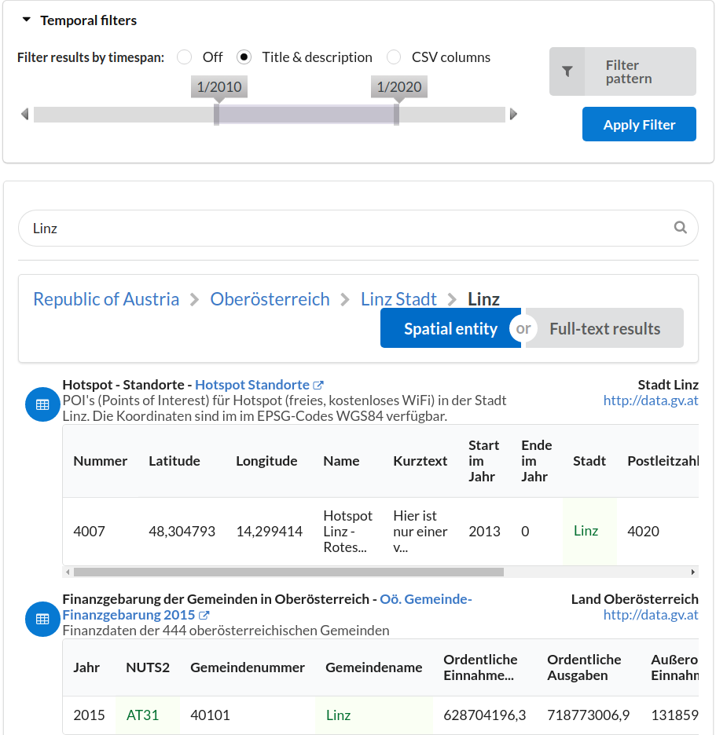
Search Interface
Faceted query interface:
Timespan
Time pattern
Geo-entities
Full-text queries
Back end:
MongoDB for efficient key look-ups
ElasticSearch for indexing and full-text queries
Virtuoso as a triple store

Slide 35
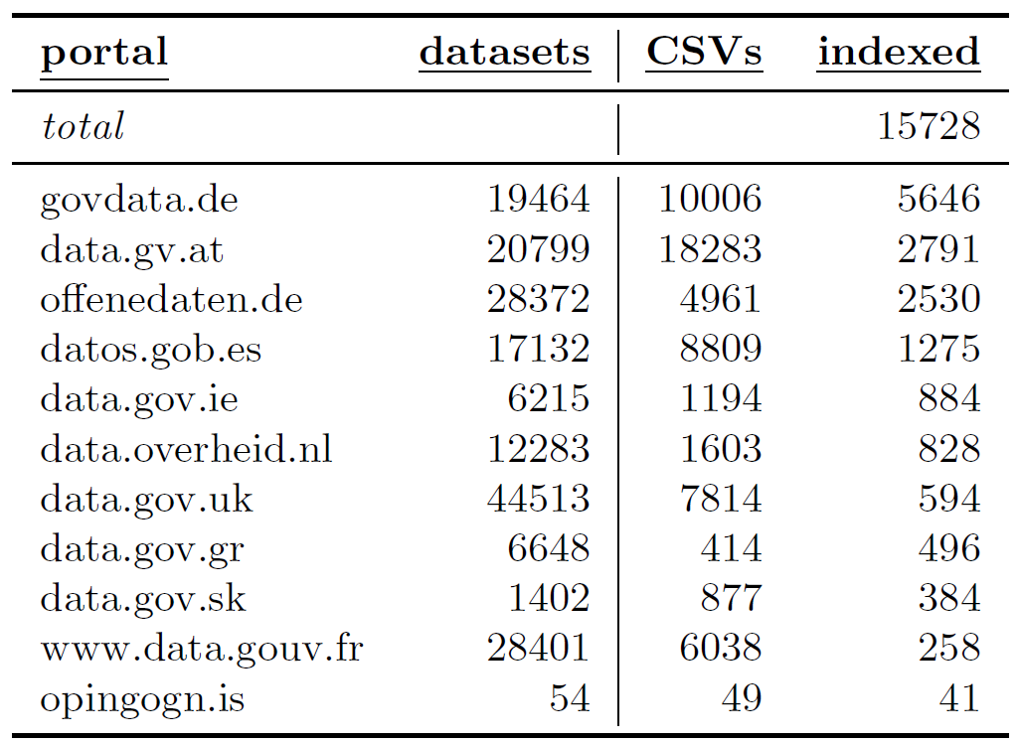
How well does it work? Indexed Datasets

Slide 36
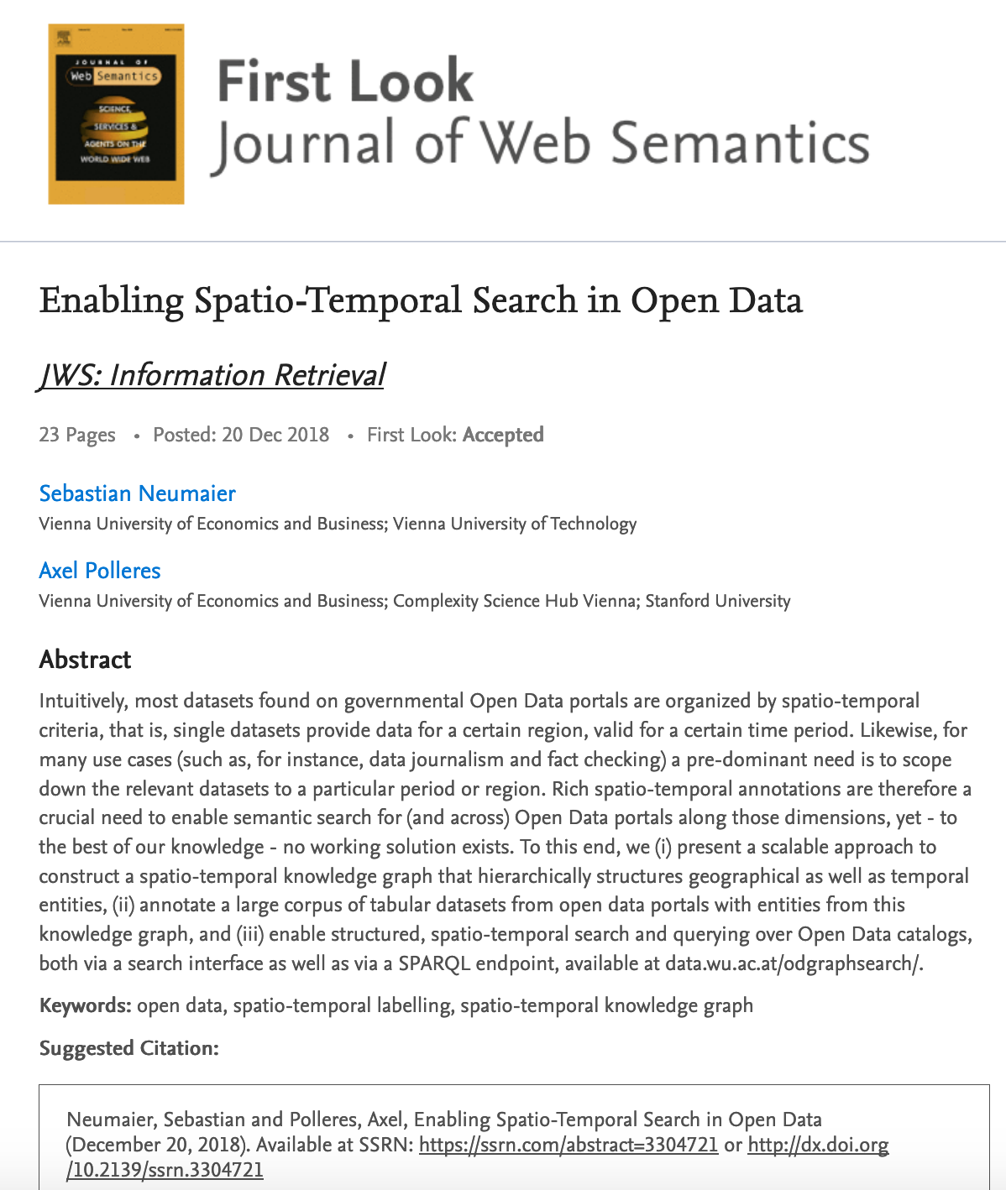
Lessons learned
Geospatial and Temporal scope is the most useful search feature for Open Data
Respective Hierarchical Knowledge Graphs can be built from existing Linked Data Sources
Our algorithms annotate CSV tables and their metadata descriptions
KGs improve search (with some extra work)
Main Problem still persists: coverage of openly available KGs for Open Data

Slide 37
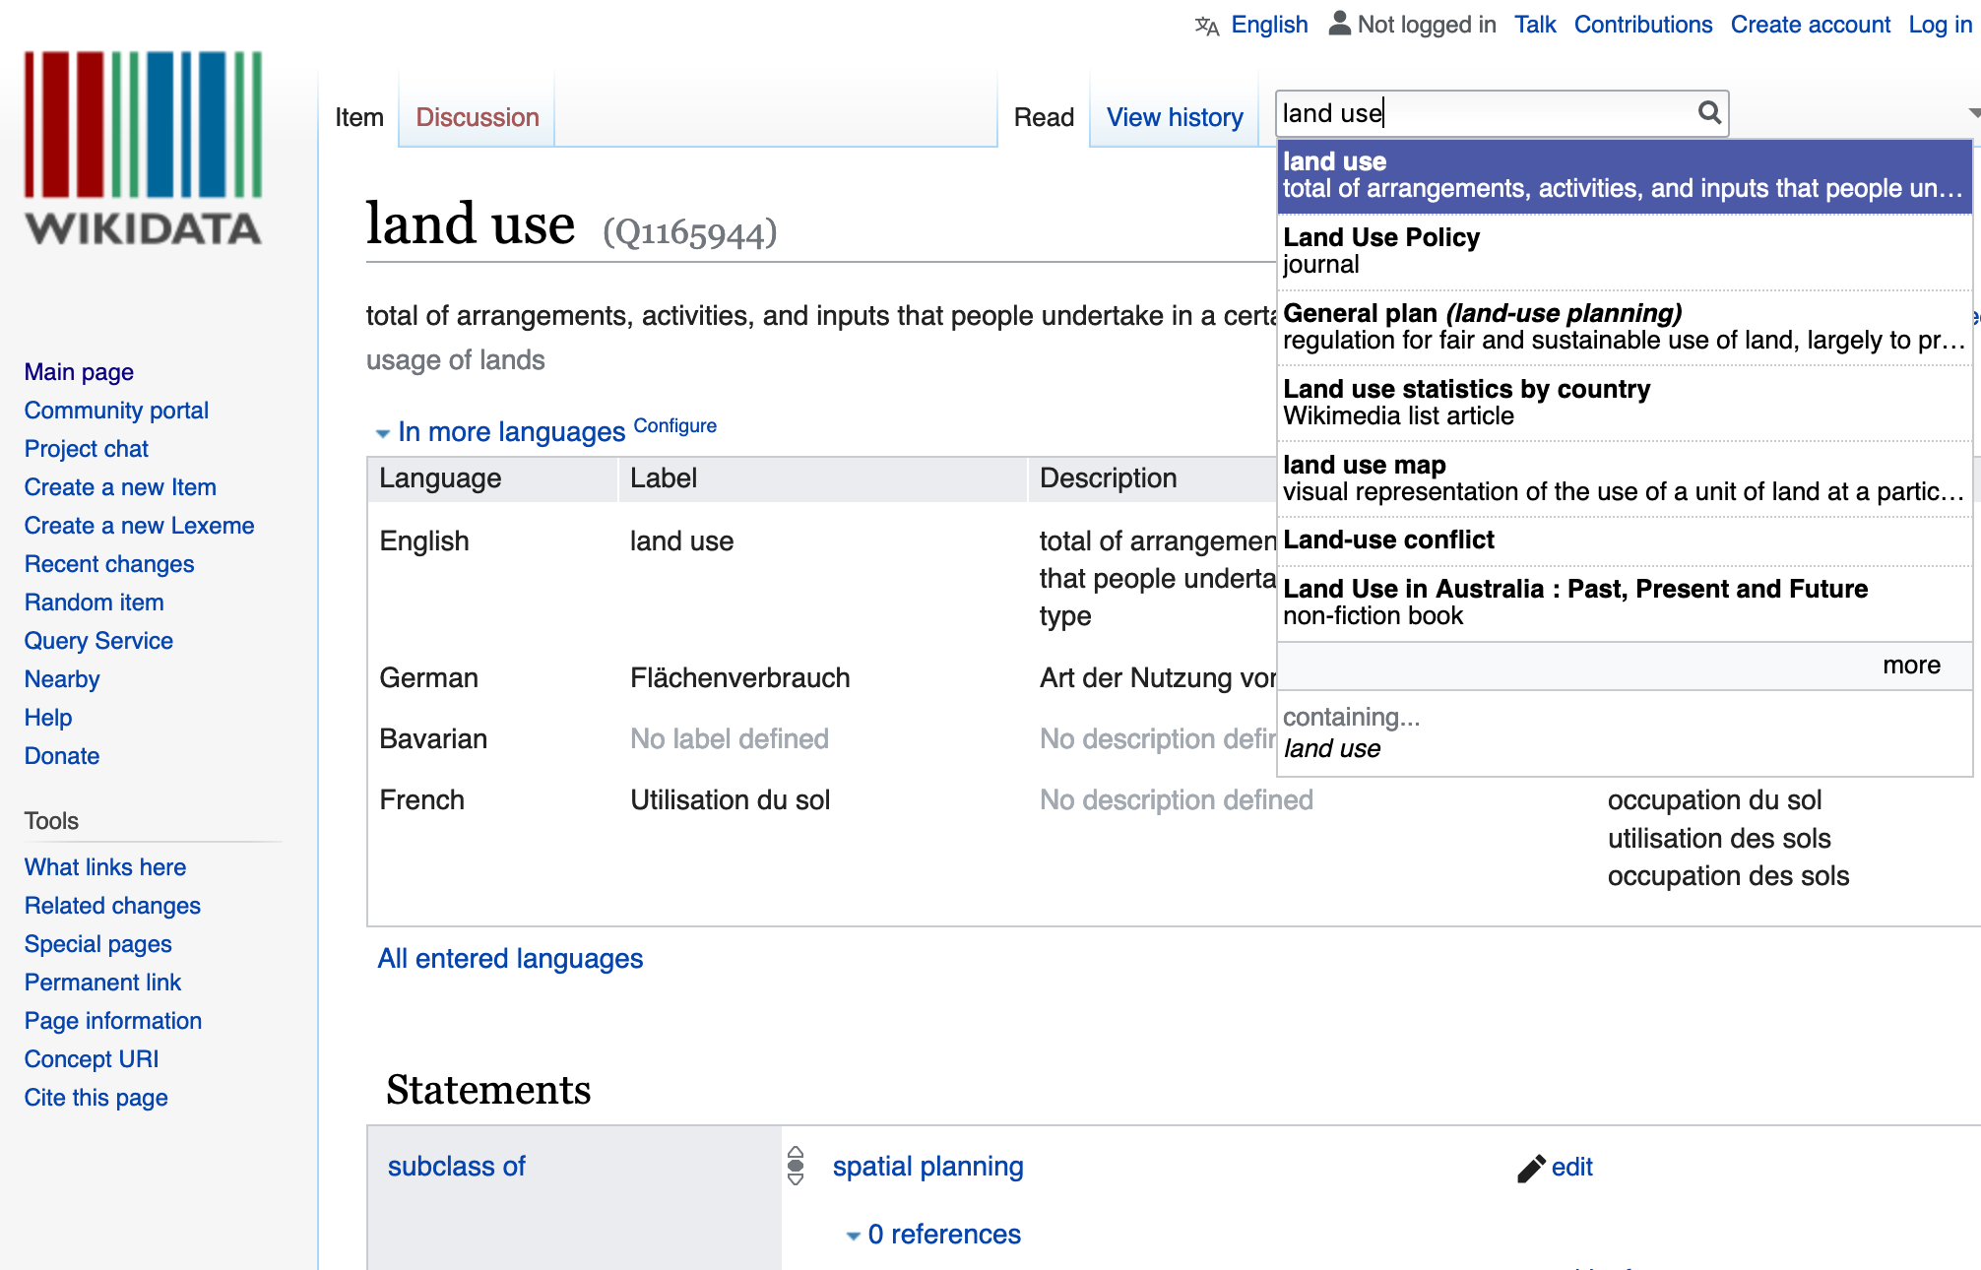
Coverage of openly available KGs for Open Data - example
We need better ontologies…

Slide 38
What’s next?
Which ontologies? What are other core dimensions to build knowledge graphs for?
How to build Knowledge Graphs from the data itself?
Which Background knowledge do human experts use to understand data?
  → May need qualitative research!
How to combine both scalable data integration and machine learning?
  → How to efficiently find tables that can be joined?
  → How to find patterns in the data?
Can we adopt Research from Natural Language Processing?
How can we enable search, integration and analytics on sensitive Data?
  respecting Data Usage Policies?
  +
  developing novel Data Anonymization/Synthetization techniques?

Slide 39
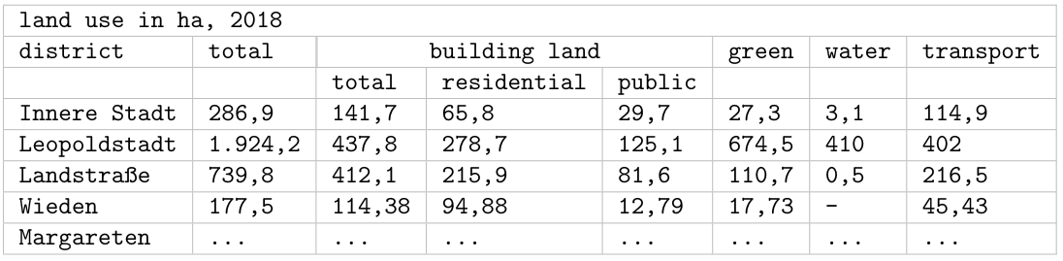
Which Background knowledge do human experts use to understand data?
A human looking at an arbitrary table is able to...
recognize districts of Vienna, although term “Vienna” not mentioned
understand that the sum of the area sizes relates to Vienna
understand the different land use (sub-)properties

Slide 40
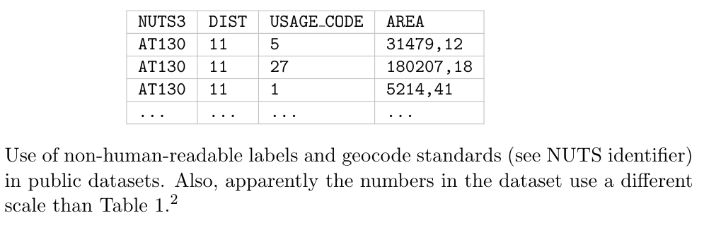
Which Background knowledge do human experts use to understand data?
compare with other datasets, e.g., US cities and their land use, even if it’s provided in different units such as square miles
combine with other related datasets:

Slide 41


What’s next?
Which ontologies?
What are other core dimensions to build knowledge graphs for?
How to build Knowledge Graphs from the data itself?
Which Background knowledge do human experts use to understand data?
  → May need qualitative research!
How to combine both scalable data integration and machine learning?
  → How to efficiently find tables that can be joined?
  → How to find patterns in the data?
Can we adopt Research from Natural Language Processing?
How can we enable search, integration and analytics on sensitive Data?
  respecting Data Usage Policies?
  +
  developing novel Data Anonymization/Synthetization techniques?
How can we learn/train patterns that humans “see”?
How can we use embeddings, “n-Grams” for structured data?

Slide 42

PhD topics

Slide 43
Backup slides:

Slide 44

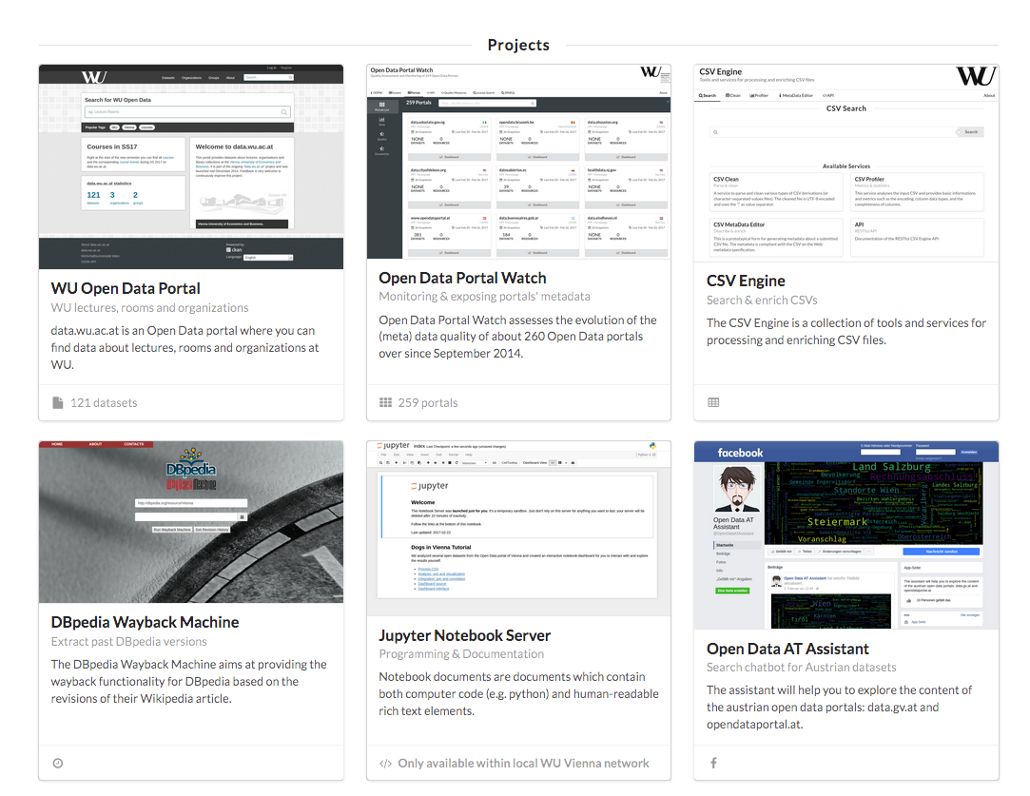
Other Ongoing Projects (data.wu.ac.at)

Slide 45
What else are we working on?
Open Data Portalwatch
  1) Monitoring Metadata quality
  2) Mapping to standard vocabularies
  3) Enriching Metadata to improve search (talked about that already)
45

Slide 46
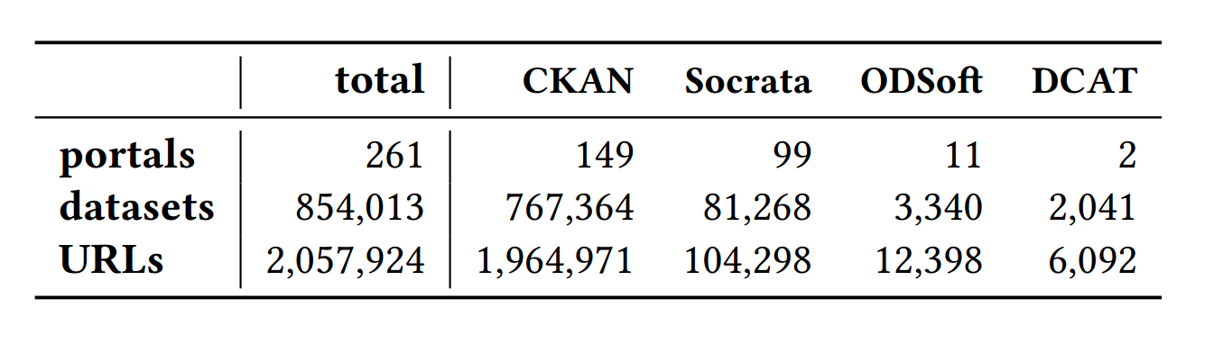
1) Monitoring and QA over evolving data portals
3/2015 [1]:
- 90 portals
- Only CKAN
8/2015 [2]:
- 6 quality metrics
- QA
6/2016 [3]:
- 260 portals
- CKAN, Socrata, OpenDataSoft
- 18 metrics
[1] | Towards assessing the quality evolution of open data portals. In ODQ2015: Open Data Quality Workshop, Munich, Germany
[2] | Quality assessment & evolution of open data portals. In: International Conference on Open and Big Data, Rome, Italy (2015)
[3] | Automated quality assessment of metadata across open data portals. ACM Journal of Data and Information Quality (2016)

Slide 47
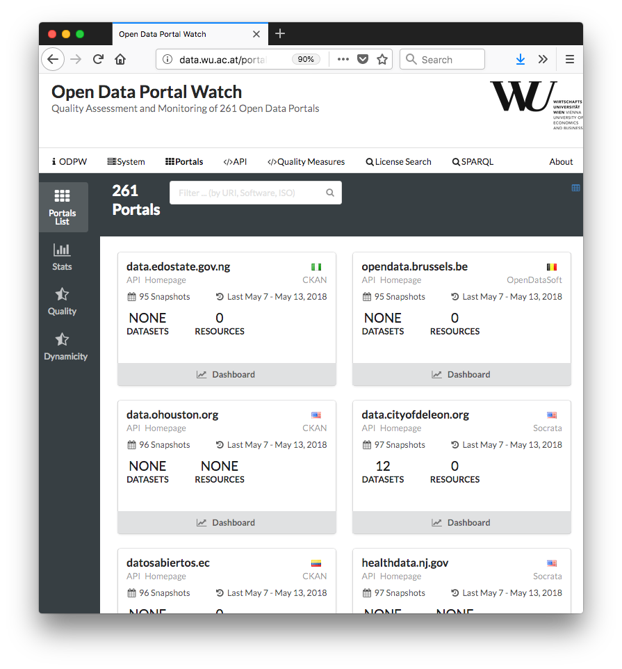
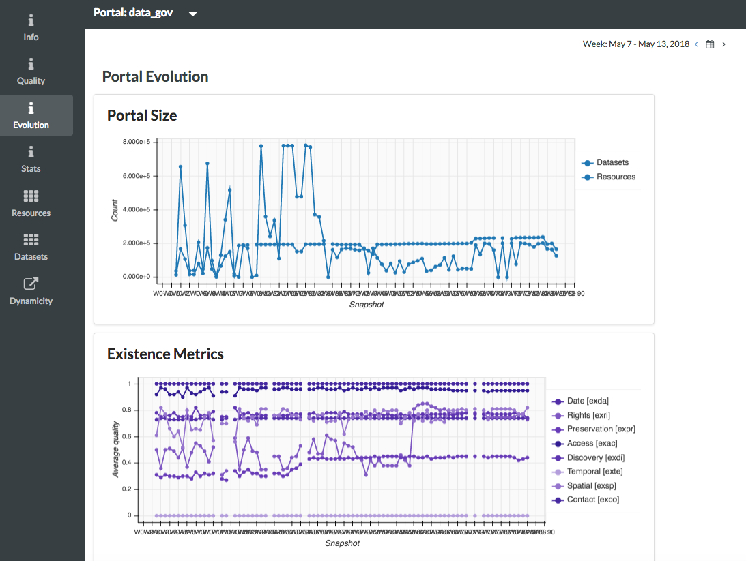
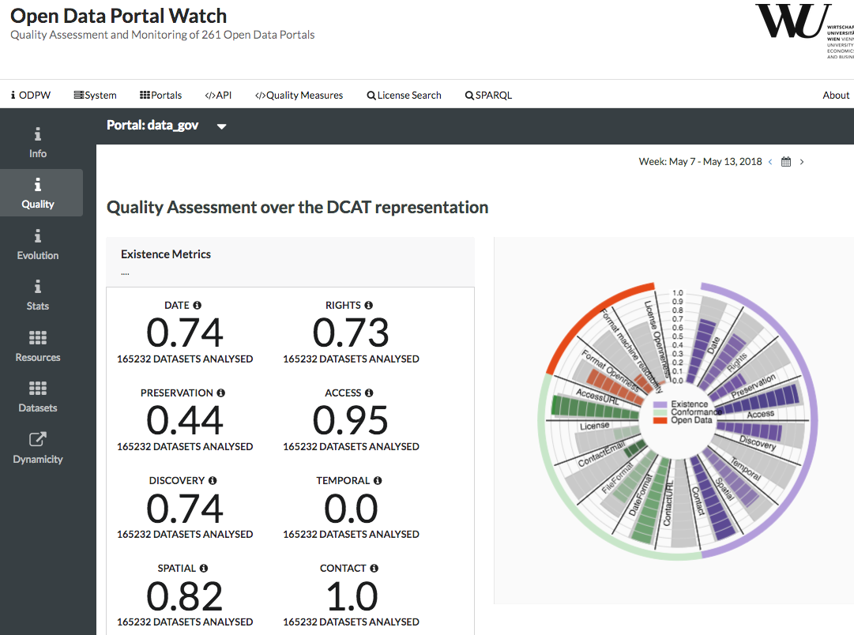
Demo:
http://data.wu.ac.at/portalwatch/portal/data_gov/1818
47

Slide 48
2) Mapping to Standard vocabularies & Linked Data
Mapping & Heuristic Enrichment
  DCAT
  PROV
  CSVW
  Schema.org
Enable uniform access:
  →SPARQL endpoint
  → Linked Data & Memento Protocol
[1] | http://data.wu.ac.at/portalwatch/sparql
[2] | http://data.wu.ac.at/odso/
48

Slide 49
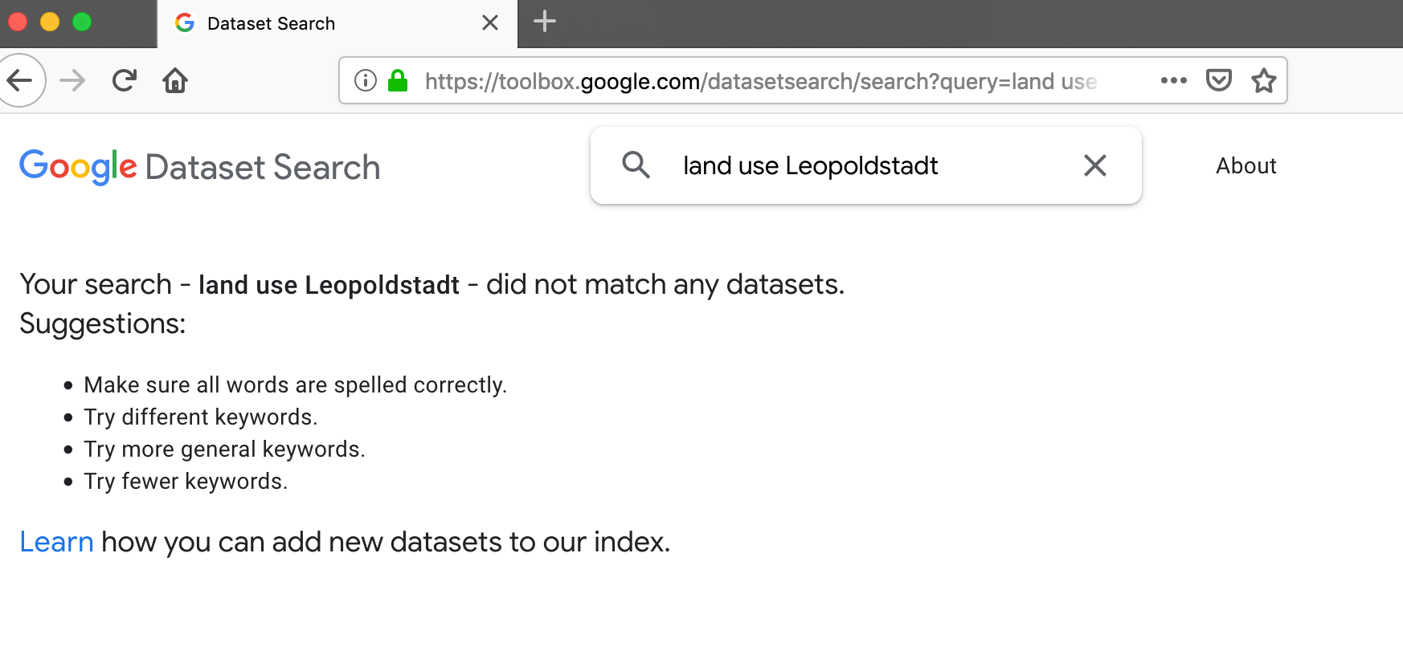
Google Dataset Search?
https://toolbox.google.com/datasetsearch/

