Slide 1
How do Semantic Web, Linked Data, Open Data, and Knowledge Graphs interplay?
Axel Polleres
Notes:
Thanks for the invitation to give this keynote at DEXA, a conference that is running already for 30 years and probably has seen lots of developments in AI and Web technologies come and go…

Slide 2
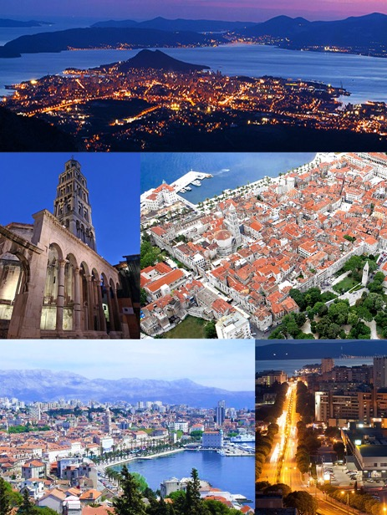
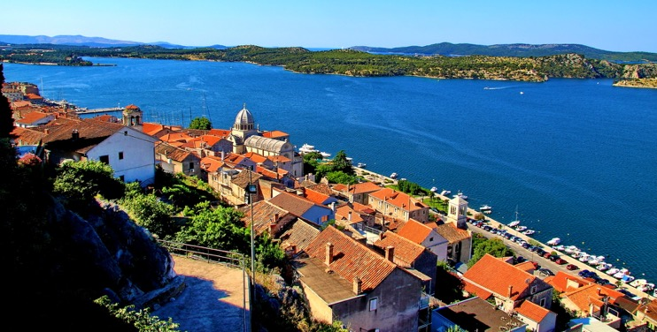
Semantic Web, Linked Data, Open Data, Knowledge Graphs … travel report from a personal journey
Disclaimer: just like any trip report, this talk might be opinionated and influenced by personal experiences
Notes:
So, since I just returnd from a nice vacation to Slovenia and Croatia, I thought I might slightly adapt the title slide and formulate my talk as a trip report – a trip report on a personal journey…

Slide 3
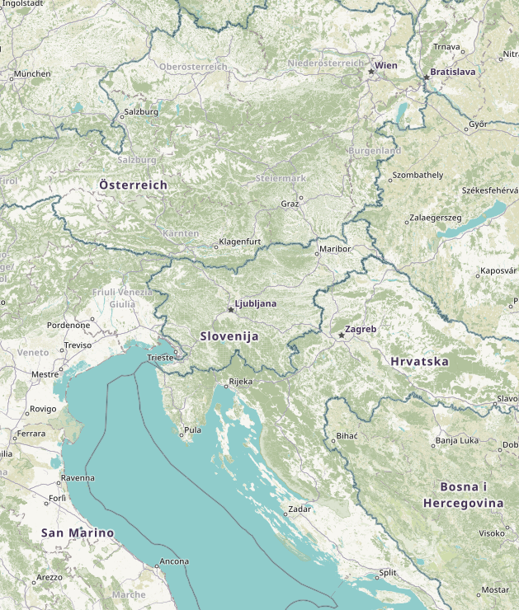
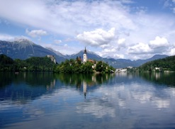
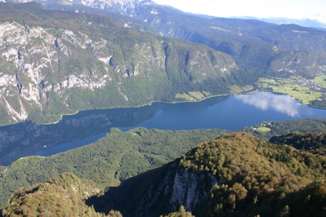
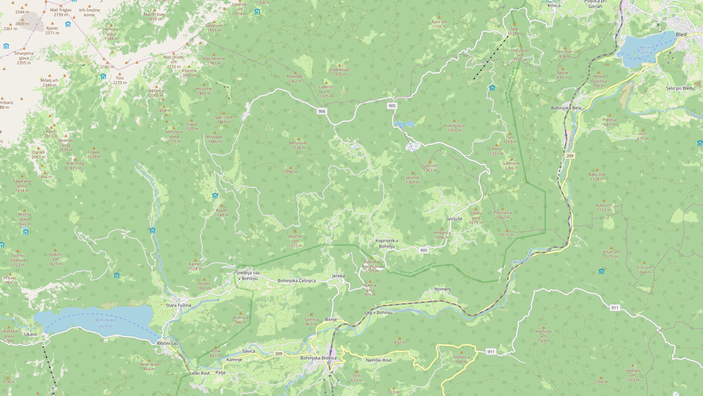
Trip map… (incl. some “data lakes”)
From Semantic Web to Linked Data
From Linked Data to Open Data
From Linked Data to Knowledge Graphs
From Knowledge Graphs to Semantic Web
Semantic Web
(Linked) Open Data
Linked Data
Open Data
Knowledge Graphs

Slide 4
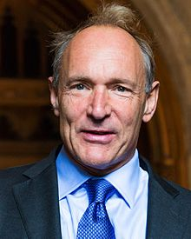
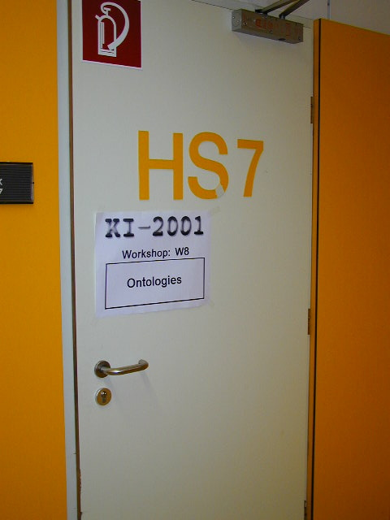
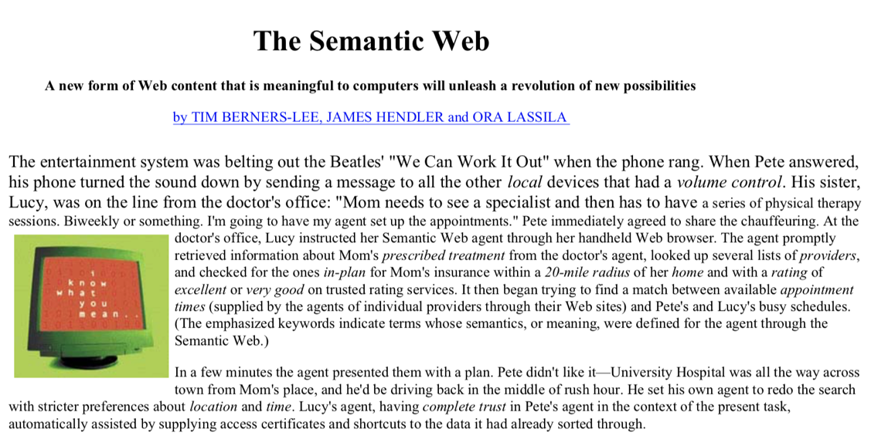
From Semantic Web to Linked Data
(early 2000s)
Expressing Meaning
Knowledge Representation
Ontologies
Agents
Evolution of Knowledge
https://1n.pm/A5psO

Slide 5
From Semantic Web to Linked Data
(early 2000s)
Evolution of Knowledge
Agents
Ontologies
Knowledge Representation
Expressing Meaning
Expressing Meaning
Knowledge Representation
Ontologies
Agents
Evolution of Knowledge
https://1n.pm/A5psO

Slide 6
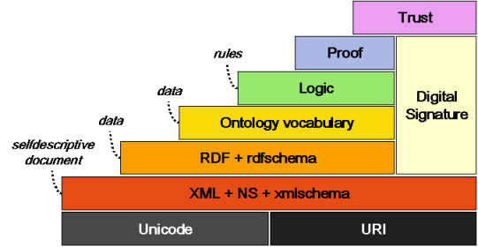
From Semantic Web to Linked Data
(early 2000s)
Evolution of Knowledge
Agents
Ontologies (OWL)
Knowledge Representation (RDFS)
Expressing Meaning (URLs and RDF)
Semantic Web Activity
https://www.w3.org/2001/12/semweb-fin/w3csw

Slide 7
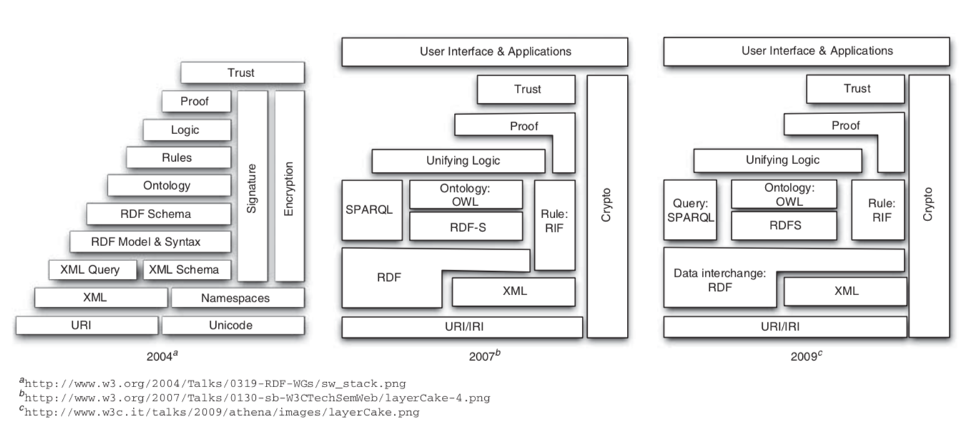
From Semantic Web to Linked Data
(2000s - ca. 2009)
Semantic Web Activity
Olivier Boissier, Marco Colombetti, Michael Luck, John-Jules Meyer, and Axel Polleres. Norms, organizations, and semantics. The Knowledge Engineering Review, 28(1):107--116, March 2013.

Slide 8
From Semantic Web to Linked Data
My Web site is about thrillers,
Psycho is a thriller
all thrillers are movies
(2000s - ca. 2009)
Main (distracting?) question: what is the “right” knowledge representation and logic to express “Knowledge on the Web”?
Description Logics?
Rules? (Datalog, Deductive Databases)
Nonmonotonic Logic Programming/Default Reasoning
Open World Assumption vs. Closed World Assumption?
“Local Closed–World assumption”/”Contextually scoped negation”
Unique Names Assumption vs. Non-unique names
All horror movies except comedies are thrillers
Is Nightmare
on Elm Street
a comedy?
www.imdb.com/title/tt0175142/
vs. en.wikipedia.org/wiki/Scary_Movie
All horror movies listed on my Website except comedies listed on IMDB are thrillers

Slide 9
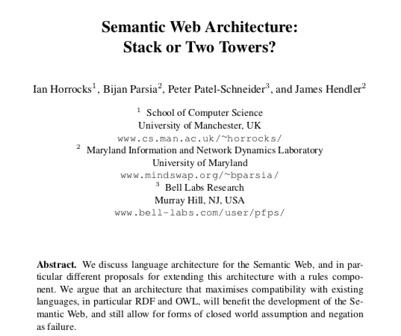
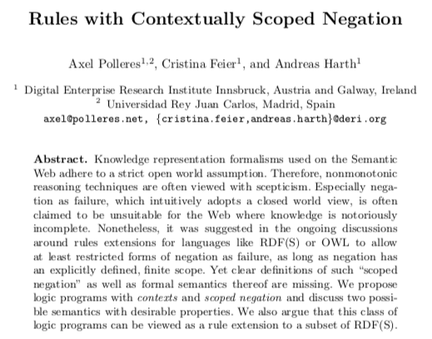
From Semantic Web to Linked Data
My Web site is about Thrillers, all thrillers are movies
(2000s - ca. 2009)
Main (distracting?) question: what is the “right” knowledge representation and logic to express “Knowledge on the Web”?
Description Logics?
Rules? (Datalog, Deductive Databases)
Nonmonotonic Logic Programming/Default Reasoning
Open World Assumption vs. Closed World Assumption?
Unique Names Assumption vs. Non-unique names
“Local Closed–World assumption”/”Contextually scoped negation”
All horror movies except comedies are thrillers
Work on Unified Logics?
Keep DL and Rules separate?
Is Nightmare
on Elm Street
a comedy?
Contextualized Reasoning?
Good news! Boost in KR research:
We know very well which ontological reasoning
approaches are decidable and how they scale
→ OWL2, OBDA
All horror movies listed on my Website except comedies listed on IMDB are thrillers
www.imdb.com/title/tt0175142/
vs. en.wikipedia.org/wiki/Scary_Movie

Slide 10
From Semantic Web to Linked Data
(2000s - ca. 2009)
What about the data???
Semantic Web Activity
How much ontological Reasoning and Expressivity does the Web actually need?

Slide 11
From Semantic Web to Linked Data
(ca. 2006/7 – ca. 2013)
Main (distracting?) question: what is the “right” knowledge representation and logic to express “Knowledge on the Web”?
Main question: How can I publish “Knowledge on the Web” in order to enable answering structured queries?
What about the data???

Slide 12
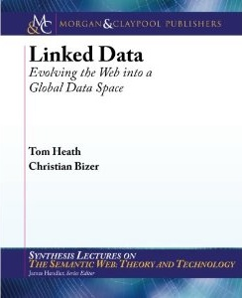
From Semantic Web to Linked Data
(ca. 2006/7 – ca. 2013)
Main question: How can I publish “Knowledge on the Web” …
Linked Data Principles
LDP1: use URIs as names for things
LDP2: use HTTP URIs so those names can be dereferenced
LDP3: return useful – RDF? – information upon dereferencing those URIs
LDP4: include links using externally dereferenceable URIs.
https://www.w3.org/DesignIssues/LinkedData.html (originally published 2006-07-27)
“A Little Semantics Goes a Long Way” (Jim Hendler)
http://linkeddatabook.com/editions/1.0/
https://www.cs.rpi.edu/~hendler/LittleSemanticsWeb.html
Notes:
So, how does this work? Strong reliance on standards and standard formats and query languages, such as SPARQL which make it eas to compile and aggregate these connected knowledge graphs to new special purpose knowledge graphs for your application!

Slide 13
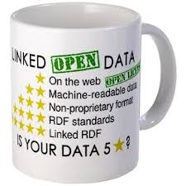
From Semantic Web to Linked (Open) Data
(ca. 2006/7 – now)
Main question: How can I publish “Knowledge on the Web” …
Linked Data Principles
LDP1: use URIs as names for things
LDP2: use HTTP URIs so those names can be dereferenced
LDP3: return useful – RDF? – information upon dereferencing those URIs
LDP4: include links using externally dereferenceable URIs.
+
https://www.w3.org/community/webize/2014/01/17/what-is-5-star-linked-data/
Notes:
So, how does this work? Strong reliance on standards and standard formats and query languages, such as SPARQL which make it eas to compile and aggregate these connected knowledge graphs to new special purpose knowledge graphs for your application!

Slide 14
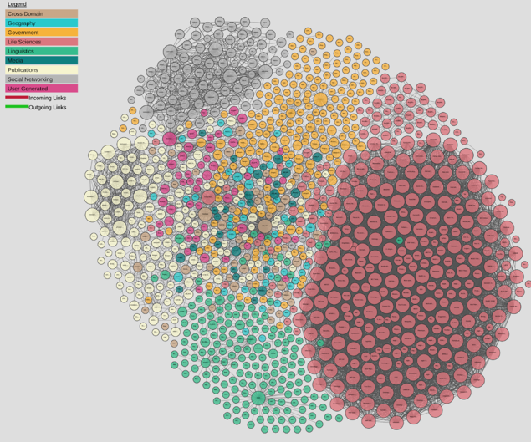
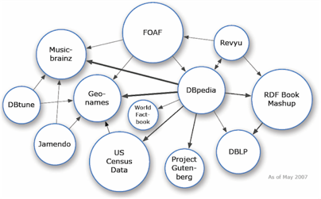
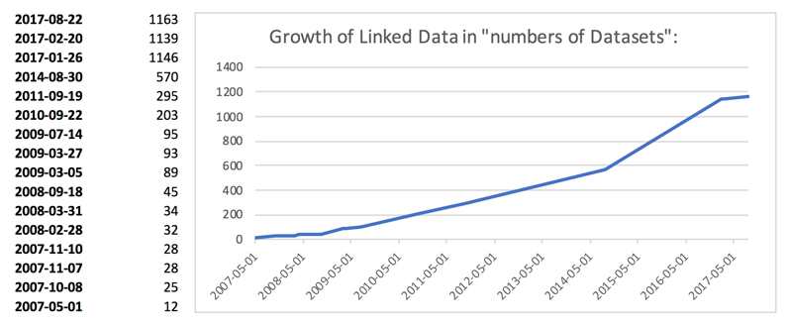
From Semantic Web to Linked (Open) Data
(ca. 2006/7 – now)
Main question: How can I publish “Knowledge on the Web” …
Linked Open Data… growth since ~10 years
A lot of active developments to publish and link RDF Data
http://lod-cloud.net/
Axel Polleres, Maulik R. Kamdar, Javier D. Fernández, Tania Tudorache, and Mark A. Musen. A more decentralized vision for linked data. In Decentralizing the Semantic Web (Workshop of ISWC2018).

Slide 15
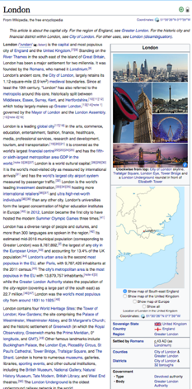
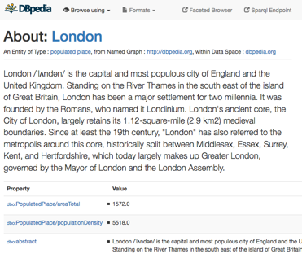
From Semantic Web to Linked (Open) Data
(ca. 2006/7 – now)
Main (distracting?) question: what is the “right” knowledge representation and logic to express “Knowledge on the Web”?
Main question: How can I publish “Knowledge on the Web” …
in order to enable answering structured queries?
→
SPARQL
Which cities in the UK have more than 1M people?
http://yasgui.org/short/UVOyhX8ft
PREFIX : <http://dbpedia.org/resource/>
PREFIX dbo: <http://dbpedia.org/ontology/>
PREFIX yago: <http://dbpedia.org/class/yago/>
SELECT DISTINCT ?city ?pop WHERE {
?city a yago:City108524735 .
?city dbo:country :United_Kingdom.
?city dbo:populationTotal ?pop
FILTER ( ?pop > 1000000 )
}
Automatic exctractors
http://dbpedia.org/resource/London

Slide 16
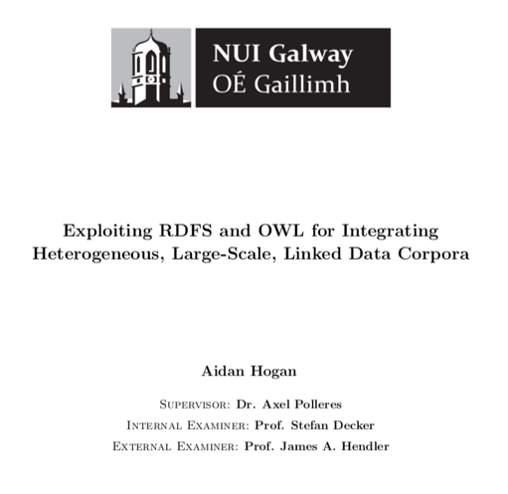
From Semantic Web to Linked (Open) Data
(ca. 2006/7 – now)
Linked Open Data… growth since ~10 years
A lot of active developments to publish and link RDF Data
How much ontological Reasoning and Expressivity does the Web actually need?

Slide 17
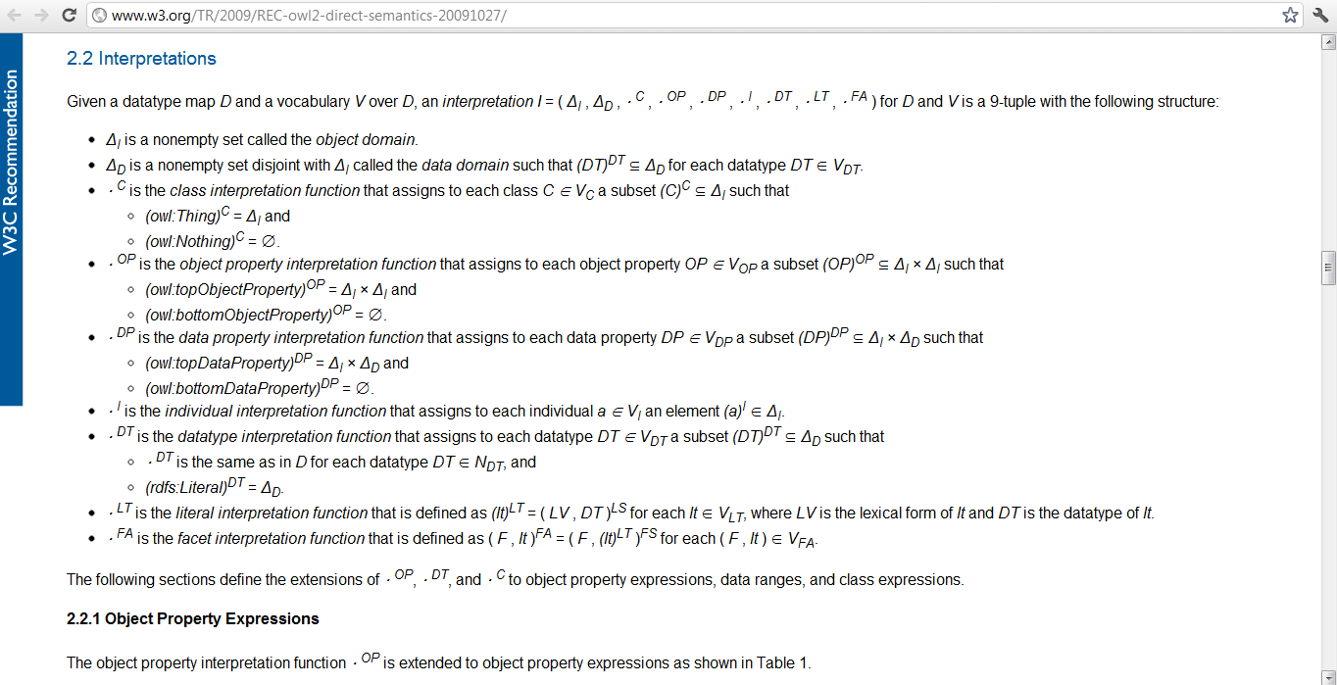
…for Linked Data publishers
Main insight: OWL is (too?) hard
(…to learn, to understand, to implement, to compute, to teach, to represent in RDF, to publish, to parse, to use appropriately...)
How much ontological Reasoning and Expressivity does the Web actually need?
Linked Data publishers only use a little bit of OWL …
… they still manage to make mistakes ☺
Cautious OWL inference can still help to enrich Linked Data!

Slide 18
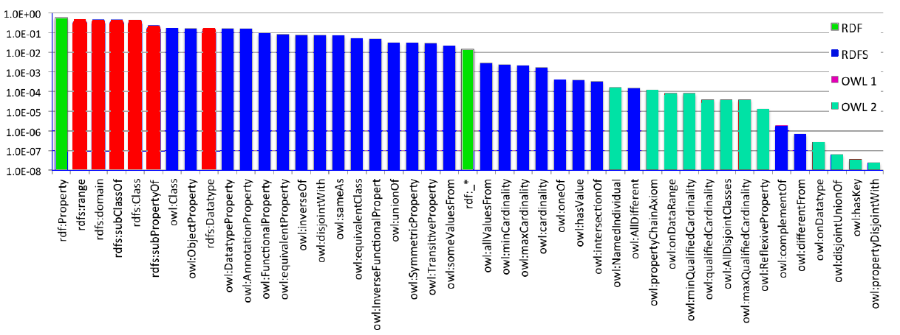
Linked Data publishers only use a little bit of OWL …
RDFS features amongst the most prominently used
OWL 2 features hardy used
The commonly used features are a fragment of OWL RL (i.e., fragment of OWL where Description Logics and Datalog Rules coincide)
RDF | RDFS | OWL | OWL 2
x-axis is log-scale!
How much ontological Reasoning and Expressivity does the Web actually need?

Slide 19
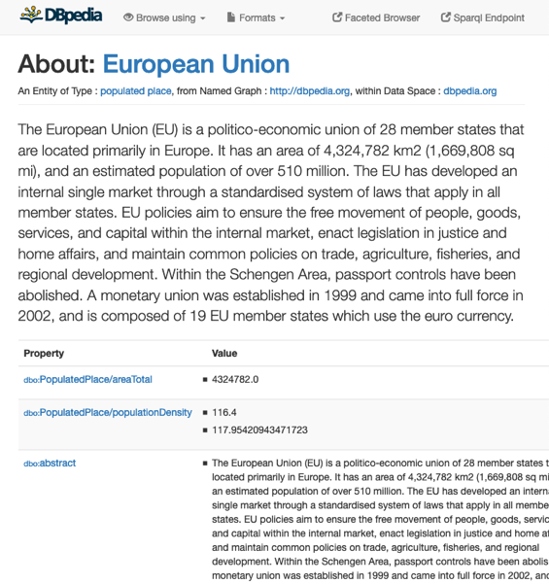
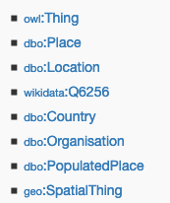
Linked Data publishers still manage to make mistakes ☺
E.g.
Other issue: Ontology “Hijacking”
i.e., publishers re-defining others’ ontologies by adding inconsistent axioms
DBpedia Ontology:
dbo:Agent owl:disjointWith dbo:Place.
dbo:Country rdfs:subClassOf dbo:Place.
dbo:Organisation rdfs:subClassOf dbo:Agent.
How much ontological Reasoning and Expressivity does the Web actually need?

Slide 20
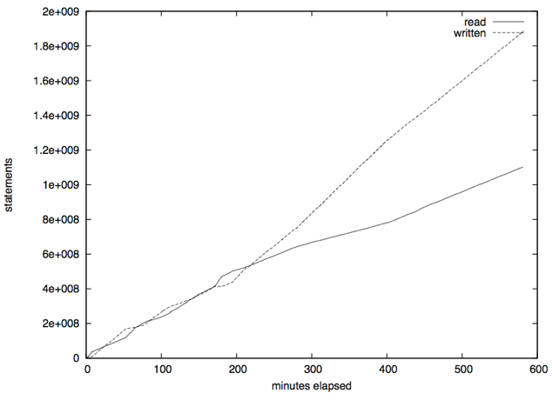
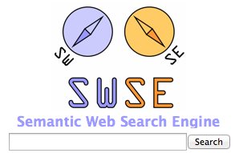
Cautious OWL inference can still help to enrich Linked Data and can be implemented in a scalable manner!
… based on these insights we have implemented a Semantic Web Search Engine (SWSE)
robust & scalable inference for Linked data:
Good News!
Cautious OWL inference =
deductive, rule-based inference, plus some heuristics on provenance and confidence to avoid non-sensual inferences and resolve inconsistencies
enables Semantic Search and Querying over (5-star) Linked Open Data!
SPARQL
On disk
RAM
Crawling
Indexing
Parallel,
rule-based
OWL Reasoning
How much ontological Reasoning and Expressivity does the Web actually need?

Slide 21
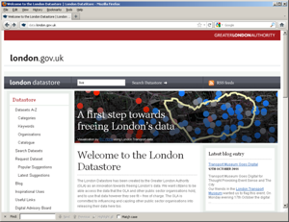
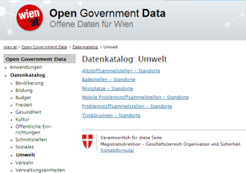
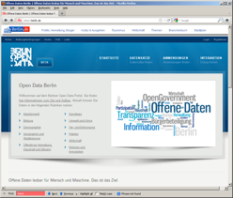
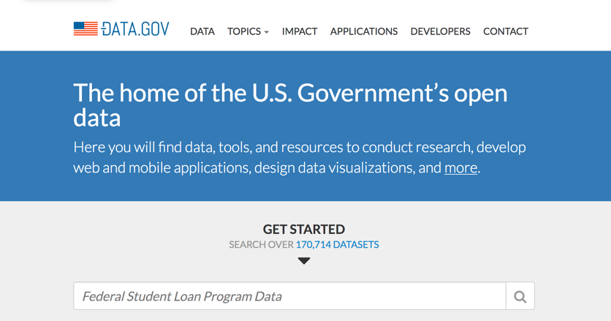
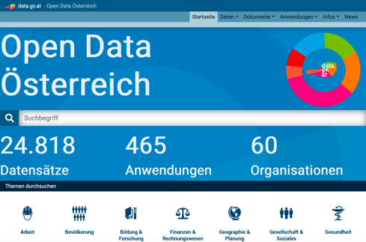
From Linked Data to Open Data
(ca. 2009 - now)
Open Data has become a global trend!
EU & Austria, but also the (previous) US and UK administrations are/were pushing Open Data!

Slide 22
From Linked Data to Open Data
However…
Available data is only partially structured and not linked [1]:
CSV (3-star)
Excel (2-star)
PDF (1-star)
Unknown format (1-star)
82 data portals 160K datasets [1]
Non-Linked Open Data is growing still much faster than Linked Open Data on the Web
[1] | Umbrich, J., Neumaier, S., Polleres, A.: Quality assessment & evolution of open data portals. International Conference on Open and Big Data (2015)

Slide 23
Open Data as a Global Trend:
Actually, over 235k!
Country | URL | Datasets
United States | data.gov | 170.7k
Canada | open.canada.ca | 79.1k
UK | data.gov.uk | 45.1k
France | www.data.gouv.fr | 34.2k
Russia | opengovdata.ru | 30.3k
Japan | data.go.jp | 21k
Italy | dati.gov.it | 20.4k
Germany | govdata.de | 19.8k
Data portals of the G8 countries

Slide 24
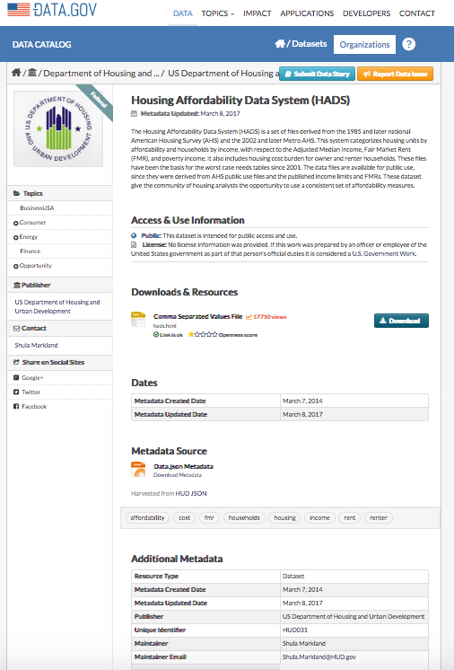
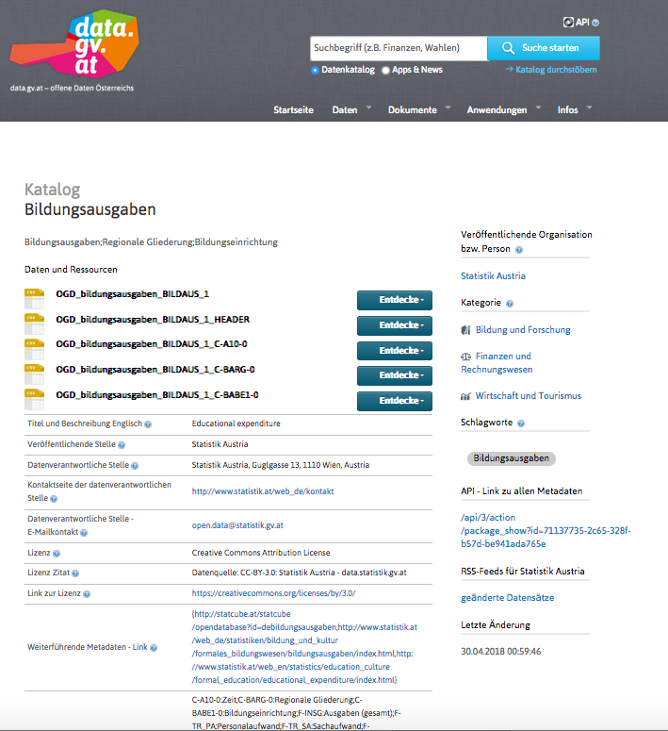
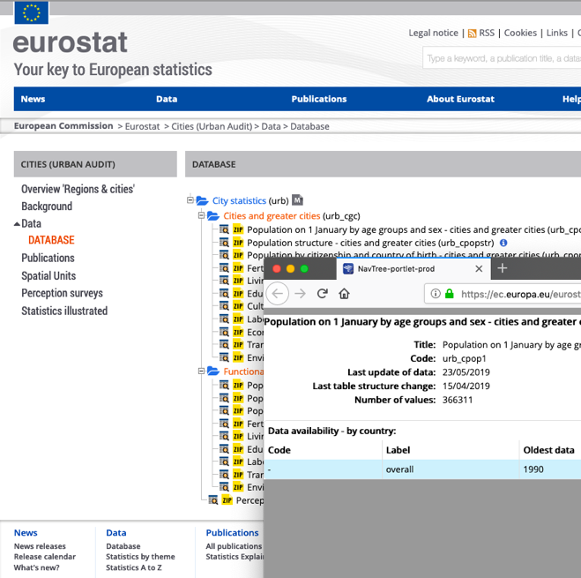
Open Data portals…
Uniform metadata, accessible via common APIs (JSON), mostly not yet RDF.
Notes:
Different datesets, different metadata, even different portal software used.

Slide 25
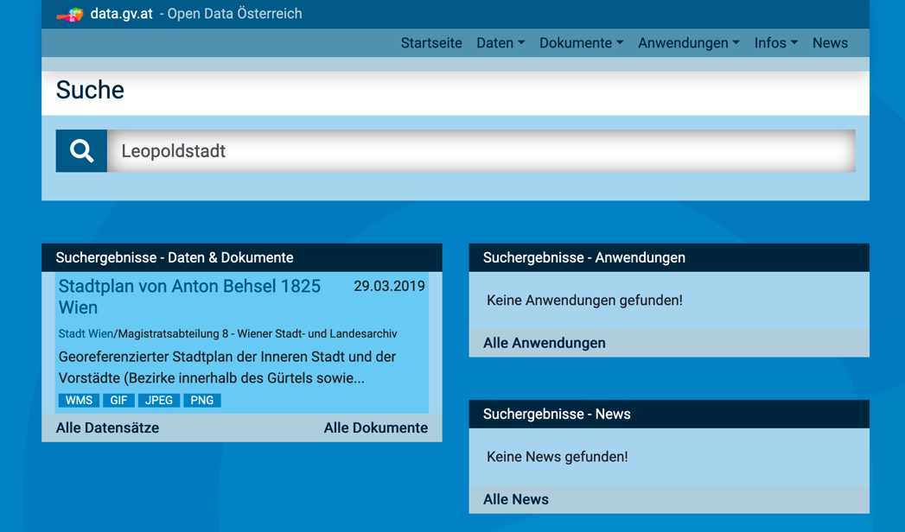
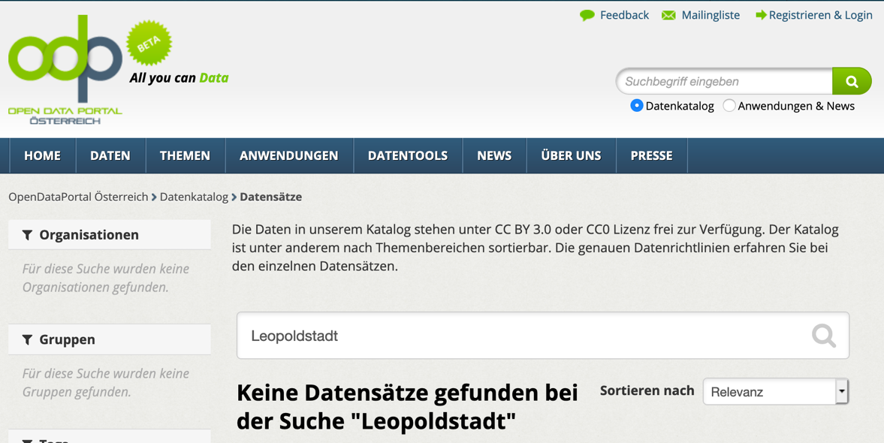
What do you find on Open Data Portals?
Not too much!

Slide 26
From (Linked) Open Data to Knowledge Graphs
Needs some more explanation…
Interlude: What is a Knowledge Graph?
What is (new) a(bout) Knowledge Graph(s)?

Slide 27
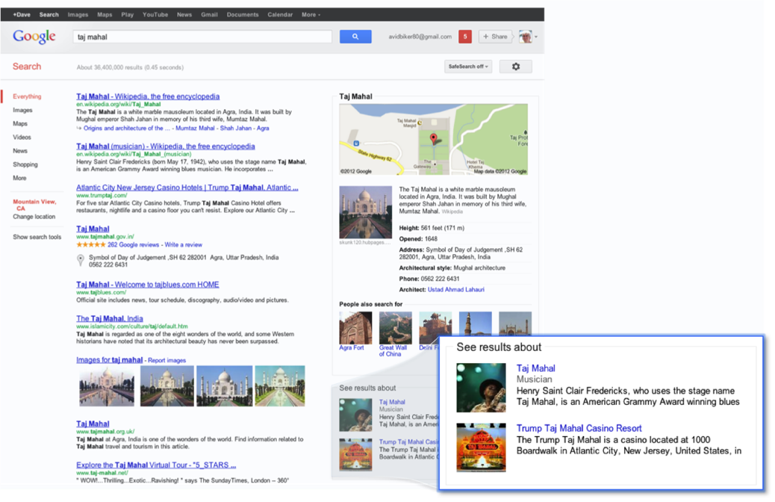
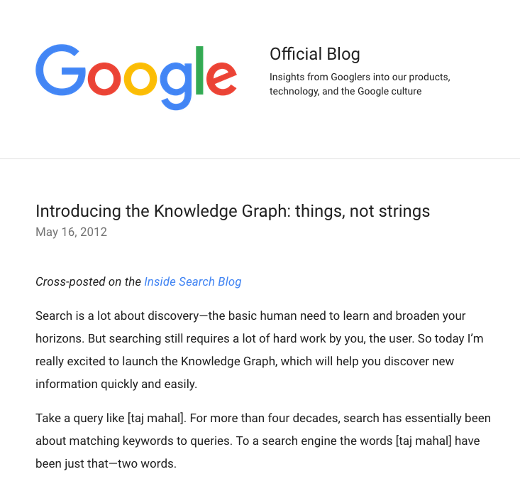
What is a Knowledge Graph?
… good question!
The announcement says more what a KG does
than what it is…
“[graph of] interesting things and [understanding their] relationships [for search]”

Slide 28
What is a Knowledge Graph? More examples and Definitions:
Other companies with (closed) knowledge graphs:
Facebook
Bing
Yandex‘ Object Answer
Baidu
LinkedIn
Amazon
NASA
Some free open knowledge graphs:
DBpedia
WikiData
Some Definitions:
McCusker, Chastain, Erickson, and McGuinness. What is a Knowledge Graph? (unpublished, 2016).
“principled” aggregation of Linked Data? p.7
Rospocher, van Erp, Vossen, Fokkens, Aldabe, Rigau, Soroa, Ploeger, Bogaard. Building event-centric knowledge graphs from news. JWS (2016)
“knowledge-base of facts about entities typically [Remark: often automatically] obtained from structured repositories [such as Freebase]”
Lisa Ehrlinger and Wolfram Wöß Towards a Definition of Knowledge Graphs (SEMANTiCS2016)
”A knowledge graph acquires and integrates information into an ontology and applies a reasoner to derive new knowledge.”

Slide 29
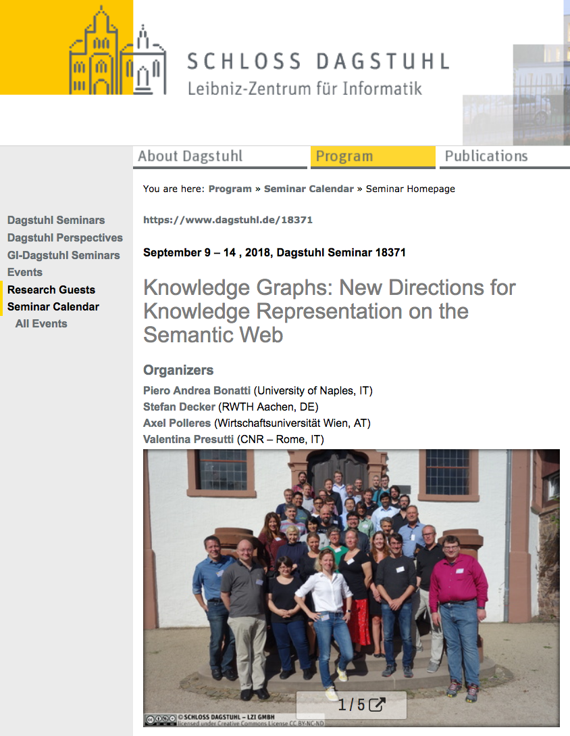
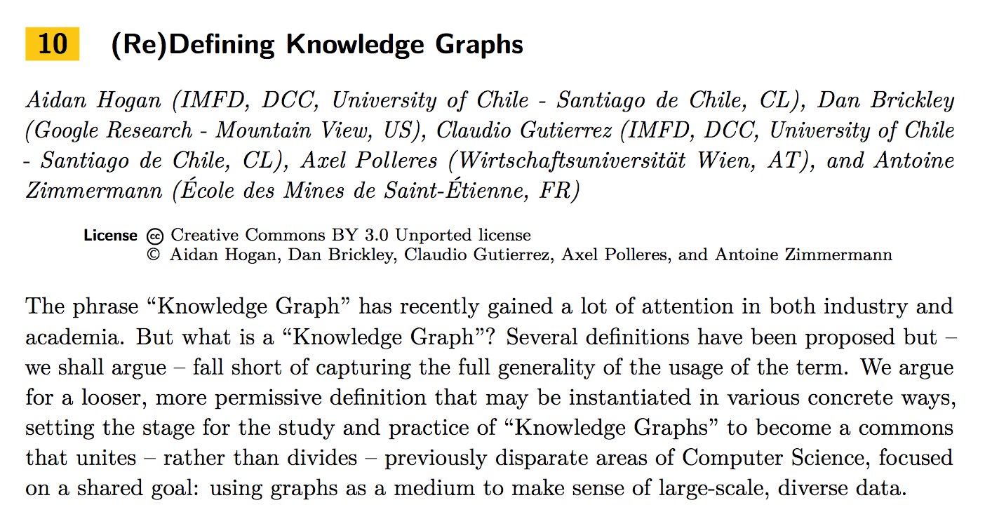
What is a Knowledge Graph? More examples and Definitions:
Other companies with (closed) knowledge graphs:
Facebook
Bing
Yandex‘ Object Answer
Baidu
LinkedIn
Amazon
NASA
Some free open knowledge graphs:
DBpedia
WikiData
Some Definitions:
McCusker, Chastain, Erickson, and McGuinness. What is a Knowledge Graph? (unpublished, 2016).
“principled” aggregation of Linked Data? p.7
Rospocher, van Erp, Vossen, Fokkens, Aldabe, Rigau, Soroa, Ploeger, Bogaard. Building event-centric knowledge graphs from news. JWS (2016)
“knowledge-base of facts about entities typically [Remark: often automatically] obtained from structured repositories [such as Freebase]”
Lisa Ehrlinger and Wolfram Wöß Towards a Definition of Knowledge Graphs (SEMANTiCS2016)
”A knowledge graph acquires and integrates information into an ontology and applies a reasoner to derive new knowledge.”
29
http://polleres.net/publications/bona-etal-DagstuhlReport18371.pdf

Slide 30
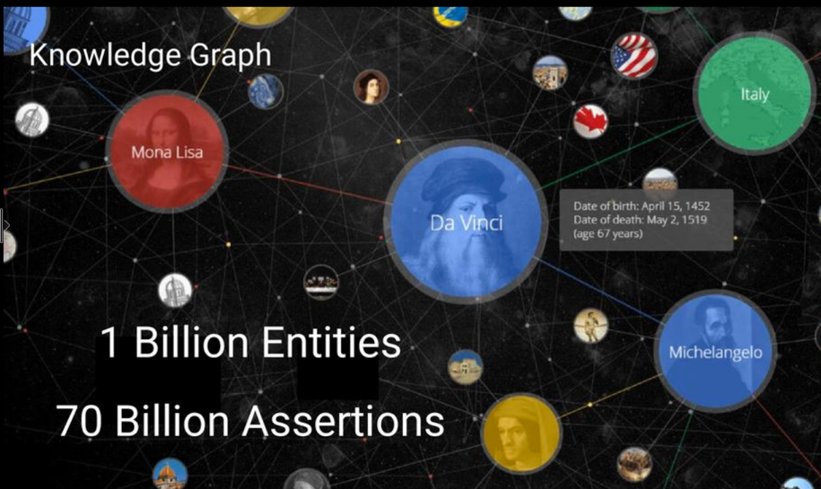
What is new/different about Knowledge Graphs?
Jamie Taylor, Google, Inc., Keynote ISWC2017
Actors, Directors, Movies
Art Works & Museums
Cities & Countries
Islands, Lakes, Lighthouses
Music Albums & Music Groups
Planets & Spacecraft
Roller Coasters & Skyscrapers
Sports Teams [...]
Answer whether (something like) RDF and/or triple stores are used under the hood answered vaguely…

Slide 31
What is new/different about Knowledge Graphs?
We have good reasons to assume that they use similar methods under the hood….
Jamie Taylor, Google, Inc., Keynote ISWC2017
Cautious deductive, rule-based inference, plus heuristics on provenance and confidence to avoid non-sensual inferences and resolve inconsistencies works.
What’s (probably) new?
statistical methods/learning more central:
→ lots of data enables
more accurate confidence scores
rule mining (not restricted to OWL)
Actors, Directors, Movies
Art Works & Museums
Cities & Countries
Islands, Lakes, Lighthouses
Music Albums & Music Groups
Planets & Spacecraft
Roller Coasters & Skyscrapers
Sports Teams [...]
Answer whether (something like) RDF and/or triple stores are used under the hood answered vaguely…

Slide 32
We have good reasons to assume that they use similar/ the same methods under the hood…
creator
creator
creator
creator
creator
creator
creator
migratedTo
creator
creator
R I F
used

Slide 33
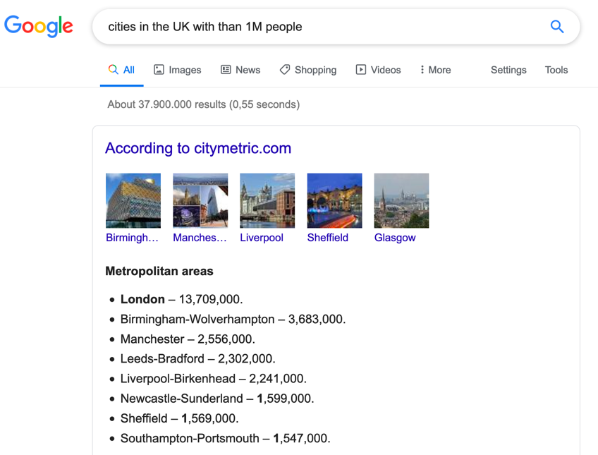
… and have extended/improved them!
Which cities in the UK have more than 1M people?
http://yasgui.org/short/UVOyhX8ft
PREFIX : <http://dbpedia.org/resource/>
PREFIX dbo: <http://dbpedia.org/ontology/>
PREFIX yago: <http://dbpedia.org/class/yago/>
SELECT DISTINCT ?city ?pop WHERE {
?city a yago:City108524735 .
?city dbo:country :United_Kingdom.
?city dbo:populationTotal ?pop
FILTER ( ?pop > 1000000 )
}

Slide 34
Summary: What is new/different about Knowledge Graphs?
Large-scale (data-focused rather than schema-focused)
Monolithic, rather than linked
Knowledge extraction rather than Knowledge engineering
Collectively created (automated or curated)
Purpose-driven: knowledge necessary to power applications
(Logical) consistency not a must
Ontological expressivity not central – BUT: Expresssing context is!
Jamie Taylor, Google, Inc., Keynote ISWC2017
Actors, Directors, Movies
Art Works & Museums
Cities & Countries
Islands, Lakes, Lighthouses
Music Albums & Music Groups
Planets & Spacecraft
Roller Coasters & Skyscrapers
Sports Teams [...]
Answer whether (something like RDF and/or triple stores are used under the hood answered vaguely…
For instance:
Provenance
Temporal context
Confidence

Slide 35
From Knowledge Graphs (back) to Semantic Web
What closed KGs already enable:
Semantic Search
Appointment detection in emails
Ratings of products/services
However,
most of these KGs and applications are closed
they often cover either only generic, or domain-specific “knowledge”

Slide 36
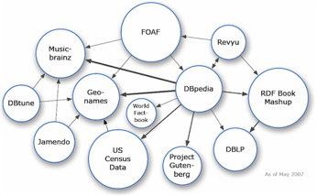
From Knowledge Graphs (back) to Linked (Open) Data:
Good news:
There are also open KGs & They use RDF, SPARQL & Linked Data!
Open Knowledge Graphs can be used to link Open Data!
Open Knowledge Graphs can be used for many other AI applications!
Bad news:
Open KGs don’t/only partially cover Knowledge in Open Data!
Decentralised Open KGs are hard to maintain and serve
Managing context makes things harder!
Other companies with (closed) knowledge graphs:
Facebook
Bing
Yandex‘ Object Answer
Baidu
LinkedIn
Amazon
NASA
Some free open knowledge graphs:
DBpedia
WikiData
GeoNames
…
Some Definitions:
McCusker, Chastain, Erickson, and McGuinness. What is a Knowledge Graph? (unpublished, 2016).
“principled” aggregation of Linked Data? p.7
Rospocher, van Erp, Vossen, Fokkens, Aldabe, Rigau, Soroa, Ploeger, Bogaard. Building event-centric knowledge graphs from news. JWS (2016)
“knowledge-base of facts about entities typically [Remark: often automatically] obtained from structured repositories [such as Freebase]”

Slide 37
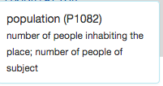
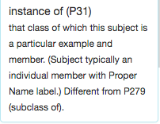
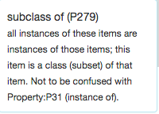
From Knowledge Graphs (back) to Linked Open Data:
There are also open KGs & They use RDF, SPARQL & Linked Data!
Wikidata as RDF … can be queried by SPARQL
“Simple” surface query:
Which cities in the UK have more than 1M people?
What’s this?
SELECT DISTINCT ?city WHERE {
?city wdt:P31/wdt:P279* wd:Q515.
?city wdt:P1082 ?population .
?city wdt:P17 wd:Q38 .
FILTER (?population > 1000000) }

Slide 38
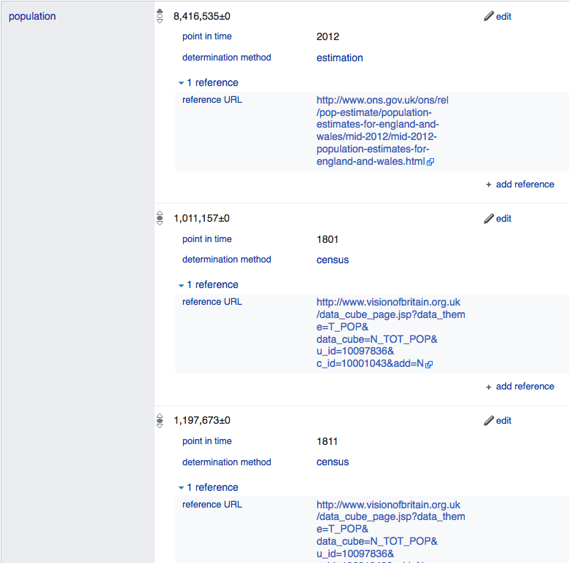
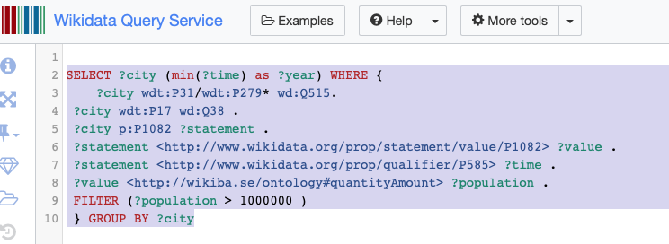
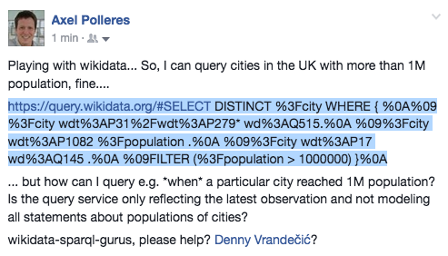
From Knowledge Graphs (back) to Linked Open Data:
Managing context makes things harder! → but is also doable!
However, Wikidata has more complex info: (temporal context, provenance,…)
Which cities in the UK have reached 1M in which year?
Yes!
… Can I query that with SPARQL?
BTW, seemingly not yet doable in
38
Notes:
Not so easy, despite it’s Linked Data… no “common semantics by names”? And as far as I know in the Linked Data realm this is the exception, not the rule…

Slide 39
Recall: What do you find on Open Data Portals?
From Knowledge Graphs (back) to Linked Open Data:
(Open) Knowledge Graphs can be used to link Open Data!
Not too much!
Notes:
Not so easy, despite it’s Linked Data… no “common semantics by names”? And as far as I know in the Linked Data realm this is the exception, not the rule…

Slide 40
From Knowledge Graphs (back) to Linked Open Data:
(Open) Knowledge Graphs can be used to link Open Data!
Leopoldstadt
A good start, but
not much better either!
Notes:
Not so easy, despite it’s Linked Data… no “common semantics by names”? And as far as I know in the Linked Data realm this is the exception, not the rule…

Slide 41
From Knowledge Graphs (back) to Linked Open Data:
(Open) Knowledge Graphs can be used to link Open Data!
A good start, but
not much better either!
Can we do better (using KGs)?
Notes:
Not so easy, despite it’s Linked Data… no “common semantics by names”? And as far as I know in the Linked Data realm this is the exception, not the rule…

Slide 42
Example Open Data Table:
From Knowledge Graphs (back) to Linked Open Data:
Open Knowledge Graphs can be used to link Open Data!
federal state | district | year | sex | population
Upper Austria | Linz | 2013 | male | 98157
Upper Austria | Steyr | 2013 | male | 18763
Upper Austria | Wels | 2013 | male | 29730
… | … | … | … | …

Slide 43
Open Data CSVs look more like this
From Knowledge Graphs (back) to Linked Open Data:
Open Knowledge Graphs can be used to link Open Data!
NUTS2 | LAU2_NAME | YEAR | SEX | P_TOTAL
AT31 | Linz | 2013 | 1 | 98157
AT31 | Steyr | 2013 | 1 | 18763
AT31 | Wels | 2013 | 1 | 29730
… | … |  | … | …
Source: https://www.data.gv.at/katalog/dataset/e108dcc3-1304-4076-8619-f2185c37ef81
Notes:
What are the difference? Non-speaking column names, numeric values instead of labels.

Slide 44
What can we do to make Open Data better searchable?
From Knowledge Graphs (back) to Linked Open Data:
Open Knowledge Graphs can be used to link Open Data!
Particularly temporal and geospatial search requires better support [2]
NUTS2 | LAU2_NAME | YEAR | SEX | AGE_TOTAL
AT31 | Linz | 2013 | 1 | 98157
AT31 | Steyr | 2013 | 1 | 18763
AT31 | Wels | 2013 | 1 | 29730
… | … |  | … | …
[2] | Emilia Kacprzak, et al.: A Query Log Analysis of Dataset Search. International Conference on Web Engineering (2017)

Slide 45
Geospatial Linked Data:
From Knowledge Graphs (back) to Linked Open Data:
Open Knowledge Graphs can be used to link Open Data!

Slide 46
From Knowledge Graphs (back) to Linked Open Data:
Open Knowledge Graphs can be used to link Open Data!
European Classification of Territorial Units
Wikidata, GeoNames
Wikidata links
Mapping OSM entities to GeoNames regions
Wikidata links
Extracting OSM streets and places

Slide 47
Temporal Knowledge Bases
From Knowledge Graphs (back) to Linked Open Data:
Open Knowledge Graphs can be used to link Open Data!

Slide 48
Dataset Labelling
From Knowledge Graphs (back) to Linked Open Data:
Open Knowledge Graphs can be used to link Open Data!
Metadata descriptions
Geo-entities in titles, descriptions, organizations
„Origin“ country of the dataset (from portal)
Temporal tagging
CSV cell value disambiguation
Row context:
Filter candidates by potential parents (if available)
Column context:
Least common ancestor of the spatial entities
Notes:
Example China…

Slide 49
How well does it work? Indexed Datasets
From Knowledge Graphs (back) to Linked Open Data:
Open Knowledge Graphs can be used to link Open Data!

Slide 50
Search Interface: https://data.wu.ac.at/odgraphsearch/
From Knowledge Graphs (back) to Linked Open Data:
Open Knowledge Graphs can be used to link Open Data!
Faceted query interface:
Timespan
Time pattern
Geo-entities
Full-text queries
SPARQL endpoint
Back end:
MongoDB for efficient key look-ups
ElasticSearch for indexing and full-text queries
Virtuoso as a triple store

Slide 51
Lessons learned
From Knowledge Graphs (back) to Linked Open Data:
Open Knowledge Graphs can be used to link Open Data!
Geospatial and Temporal scope is the most useful search feature for Open Data
Respective Hierarchical Knowledge Graphs can be built from existing Linked Data Sources
Our algorithms annotate CSV tables and their metadata descriptions
KGs improve search (with some extra work)
Plus: RDF and SPARQL allow us to build application-specific KGs as ‘“principled” aggregation(s) of Linked Data’ (cf. Def. slide 29)

Slide 52
How can we also use numeric values?
From Knowledge Graphs (back) to Linked Open Data:
Open Knowledge Graphs can be used to link Open Data!
NUTS2 | LAU2_NAME | YEAR | SEX | P_TOTAL
AT31 | Linz | 2013 | 1 | 98157
AT31 | Steyr | 2013 | 1 | 18763
AT31 | Wels | 2013 | 1 | 29730
… | … |  | … | …

Slide 53
From Knowledge Graphs (back) to Linked Open Data:
Open Knowledge Graphs can be used to link Open Data!
How can we also use numeric values?
Identifying the most likely semantic label for a bag of numerical values
Deliberately ignore surroundings
Map to labels from a KG
population (a district) (country Austria)
98157
18763
29730
…

Slide 54
Numeric Values in Open KGs?
From Knowledge Graphs (back) to Linked Open Data:
Open Knowledge Graphs can be used to link Open Data!
Cities
Population
Area
Country
Location (Coordinates)
Economic indicators
…
Organisations:
Revenues
Board members
…
Persons (e.g. celebrities, sports)
Name
Profession
Height
Landmarks (e.g. famous buildings)
Country
Location
Height
Events
Dates
Location
What’s in DBpedia?

Slide 55
Background Knowledge Graph
From Knowledge Graphs (back) to Linked Open Data:
Open Knowledge Graphs can be used to link Open Data!
properties with numerical range
Hierarchical clustering approach:
Two hierarchical layers:
Type hierarchy (using OWL classes)
Property-object hierarchy (shared property-object pairs)

Slide 56
Label based on Nearest Neighbors
From Knowledge Graphs (back) to Linked Open Data:
Open Knowledge Graphs can be used to link Open Data!
2
4
3
6
5
1
Notes:
Kolmogorov-Smirnov Test (Distribution similarity of samples with sistributions), other alternatives: min/max, overlapping value ranges, value SD, standard descriptive statistics)

Slide 57
Example Labelling:
From Knowledge Graphs (back) to Linked Open Data:
Open Knowledge Graphs can be used to link Open Data!
Open KGs don’t/only partially cover Knowledge in Open Data!
populationTotal (a Settlement) populationDensity (a City)
57
Source: http://data.wu.ac.at/iswc2016_numlabels/submission/col14.html
Notes:
Election results…. Number of invalid votes… not surprisingly correlated with population numbers or densities (although sure not directly matching).

Slide 58
Lessons learned:
From Knowledge Graphs (back) to Linked Open Data:
Open Knowledge Graphs can be used to link Open Data!
Open KGs don’t/only partially cover Knowledge in Open Data!
We can assign fine-grained semantic labels
if there is enough evidence in Background Knowledge Graph
However: Missing domain knowledge for labelling OD
Future work:
Complementary to existing approaches (column header labeling, entity linking and relation extraction)
Combined approaches may improve results

Slide 59
The journey doesn’t end here…
Open Knowledge Graphs can be used for many other AI applications!
E.g. Open KG Question Answering
Pre-print (accepted at CIKM2019)
creator
Combining Graph Algorithms and ML/Neural Networks
used
Notes:
Novel methods, no longer focusing on mapping questions to SPARQL, but rather on Graph Algorithms and ML/Neural networks

Slide 60
The journey doesn’t end here…
Open Knowledge Graphs can be used for many other AI applications!
E.g. Open KG Question Answering
Pre-print (accepted at CIKM2019)
More examples of active research topics:
Using ML/NN for KG population/extraction
Graph embeddings for automated KG enrichment/repair
Combining Graph Algorithms and ML/Neural Networks
Notes:
Novel methods, no longer focusing on mapping questions to SPARQL, but rather on Graph Algorithms and ML/Neural networks

Slide 61
Last but not least, some bad news…
Bad news: Decentralized Open KGs are hard to maintain and serve
Hosting federated SPARQL endpoints is (too) expensive
Many Linked Data datasets are not maintained sustainably.
Linked Datasets difficult to crawl and process automatically
DESEMWEB 2018
Actually: Good news!
Still more research needed and actively being conducted!
Examples:
Federated SPARQL querying
Client-Server Load-Balancing (LDF, SAGE, etc.)
Efficient/lightweight triple stores (e.g. HDT)
Graph Databases in the Cloud
Automated Linked Data Quality checking
(BTW, real applications often also need access-control, policies)

Slide 62
Time for a postcard…

Slide 63
Time for a postcard…
RDF, Ontologies, Linked Data are a solid basis for Knowledge graphs.
Focus has shifted from schema-centric to data-centric.
Focus has shifted from knowledge engineering to knowledge extraction.
For companies thinking about investing in KGs it makes sense to invest in open, standard technologies for KGs.
Confirmed by yesterday’s keynote:
Hybrid Reasoning needed (rules + heuristics + inductive/statistical inference (ML)
Take-home Messages
It is not enough to rely on centralized/closed KGs!
Looking forward to the onward journey! lot of research left to be done in this space (decentralization, contextualization, federation)!
Notes:
One note on Hybrid Reasoning: the shift away from Logics towards bespoke algorithms and ML does not only have advantages – Explainability/Transparency. Logical semantics defines a common ground/reduces ambiguity of interpretations, which is a good thing, We may need to re-think this.
Many of the recent methods coming out of the Big company AI research labs are very resource hungry.

Slide 64
Some references for the mentioned works (thanks to my co-authors!):
Axel Polleres, Cristina Feier, and Andreas Harth. Rules with contextually scoped negation. In Proceedings of the 3rd European Semantic Web Conference (ESWC2006), volume 4011 of Lecture Notes in Computer Science (LNCS), pages 332--347, Budva, Montenegro, June 2006. Springer.
Aidan Hogan, Andreas Harth, and Axel Polleres. Scalable authoritative owl reasoning for the web. International Journal on Semantic Web and Information Systems (IJSWIS), 5(2):49--90, 2009.
Birte Glimm, Adian Hogan, Markus Krötzsch, and Axel Polleres. OWL: Yet to arrive on the web of data? In WWW2012 Workshop on Linked Data on the Web (LDOW2012), Lyon, France, April 2012.
Aidan Hogan, Andreas Harth, Jürgen Umbrich, Sheila Kinsella, Axel Polleres, and Stefan Decker. Searching and browsing linked data with SWSE: The semantic web search engine. Journal of Web Semantics (JWS), 9(4):365--401, 2011.
Sebastian Neumaier, Jürgen Umbrich, and Axel Polleres. Automated quality assessment of metadata across open data portals. ACM Journal of Data and Information Quality (JDIQ), 8(1):2, November 2016.
Sebastian Neumaier, Jürgen Umbrich, and Axel Polleres. Lifting data portals to the web of data. In 10th Workshop on Linked Data on the Web (LDOW2017), Perth, Austrialia, April 2017.
Sebastian Neumaier and Axel Polleres. Enabling spatio-temporal search in open data. Journal of Web Semantics (JWS), 55, March 2019.
Sebastian Neumaier, Jürgen Umbrich, Josiane Parreira, and Axel Polleres. Multi-level semantic labelling of numerical values. In Proceedings of the 15th International Semantic Web Conference (ISWC 2016) - Part I, volume 9981 of Lecture Notes in Computer Science (LNCS), pages 428--445, Kobe, Japan, October 2016. Springer.
Axel Polleres, Maulik R. Kamdar, Javier D. Fernández, Tania Tudorache, and Mark A. Musen. A more decentralized vision for linked data. In Decentralizing the Semantic Web (Workshop of ISWC2018), volume 2165 of CEUR Workshop Proceedings. CEUR-WS.org, October 2018.
Svitlana Vakulenko, Javier Fernández, Axel Polleres, Maarten de Rijke, and Michael Cochez. Message passing for complex question answering over knowledge graphs. In 28th ACM International Conference on Information and Knowledge Management (CIKM2019, Beijing, China, November 2019. to appear.
Sabrina Kirrane, Marta Sabou, Javier D. Fernández, Francesco Osborne, Cécile Robin, Paul Buitelaar, Enrico Motta, and Axel Polleres. A decade of semantic web research through the lenses of a mixed methods approach. Semantic Web -- Interoperability, Usability, Applicability (SWJ), 2019. to appear (accepted for publication).
(Links for download on http://polleres.net/publications/ )

