Slide 1
AI & Law – a technical perspective
Prof. Dr. Axel Polleres

Slide 2
What is (the state of the art in) AI?
What is AI?
Types of (Artificial) Intelligence
(Deep) Neural Networks
Some examples:
  Question Answering
  Surveilance, face recognition (mood, sexual orientation)
  Diagnosis based on images
  Image Creation
  Text Creation
  Deep Fakes

Slide 3
What is Artificial Intelligence?

Slide 4
What is Intelligence?
A very general mental capability that, among other things, involves the ability to reason, plan, solve problems, think abstractly, comprehend complex ideas, learn quickly and learn from experience. It is not merely book learning, a narrow academic skill, or test-taking smarts. Rather, it reflects a broader and deeper capability for comprehending our surroundings — "catching on," "making sense" of things, or "figuring out" what to do - Wall Street Journal, 1994
Intelligence ...
  Perception (sound, images…)
  Abstraction (Language understanding, Vision: situation, object detection)
  Decision Making
  Problem solving
  Planning
  Creativity
  Emotional knowledge
  Self-awareness/Consciousness
Involves Increasingly complex tasks

Slide 5
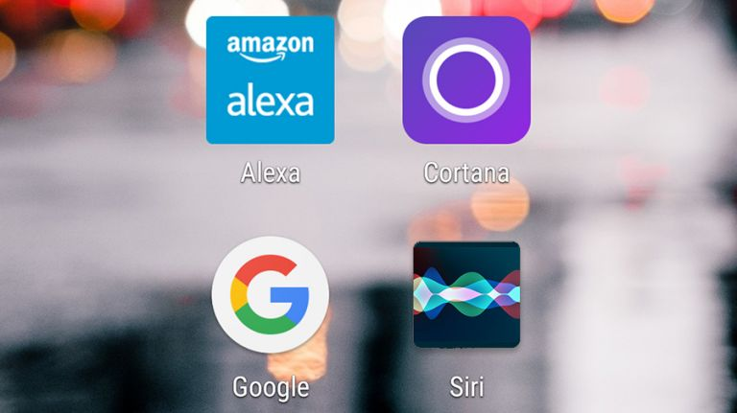
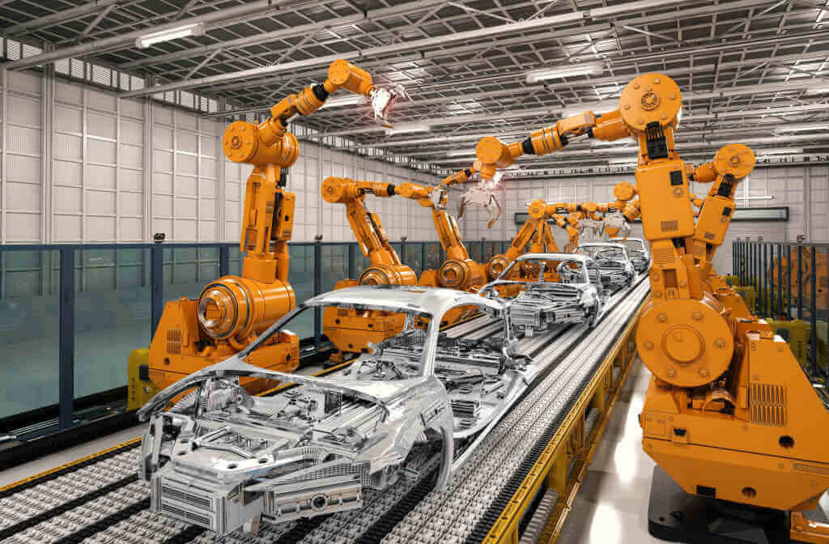
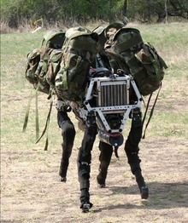

What is Artificial Intelligence? – in Daily life
What makes these products “intelligent”?
Siri/Alexa/Google Now
iRobot cleaners
Robot Grass Cutters
Fingerprint recognizers
Collision avoidance systems
Loan Scoring/”AMS-Algorithmus”
Face recognition/surveillance
Stock market predictor
Industry automation
military/defense
More examples you heard of?
Notes:
AI in Diagnostics
melanoma dedection in images
Generated Articles?
https://www.bloomberg.com/news/articles/2019-02-14/the-ai-that-can-write-a-fake-news-story-from-a-handful-of-words

Slide 6
“Types” of AI:
What is (the state of the art in) AI?
Weak AI refers to narrow embodiments of an AI – AI as a tool
Strong AI refers to a a machine with consciousness, sentience and mind
Artificial general intelligence (AGI) (a machine with the ability to apply intelligence to any problem, rather than just one specific problem).
We are not yet there… and it will probably still take a while!
Have you ever tried having a reasonable conversation with Alexa?

Slide 7
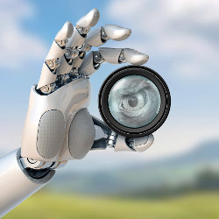
What is (the state of the art in) AI?
Distinction between “AI main strands”
  Model-based vs. Function-Based AI
Boost of Machine Learning/Deep Learning:
  Data, Hardware, Algorithms
    Lots of data and the ability to store/process it
    GPUs
    New Neural eEtwork architectures Deep Neural Networks, LSTMs …etc.
"What just happened is the successful employment of AI technology in some widespread applications, aided greatly by developments in related fields, and by new modes of operation that can tolerate lack of robustness or intelligence."
A. Darwiche. Human-Level Intelligence or Animal-Like Abilities?
https://cacm.acm.org/magazines/2018/10/231373-human-level-intelligence-or-animal-like-abilities/fulltext

Slide 8
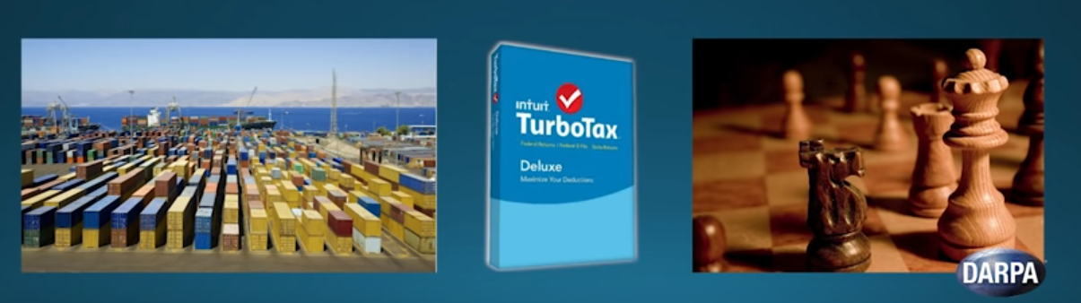
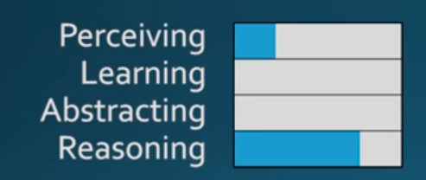
Model-Based AI (or Rule-based AI)
Up to large-scale real-world applications:
Works very well in structured, regulated domains:
Automated Verification of chips
Scheduling and logistics,
Production planning in automated plants
Playing games with a finite, discrete search space and finite rules (Chess, but not Go – why?)
Tax declarations
→ big advantage: Declarative Rules and constraints are “explainable by design”.

Slide 9
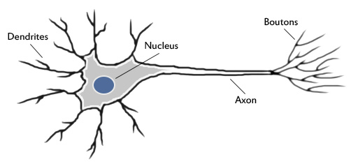
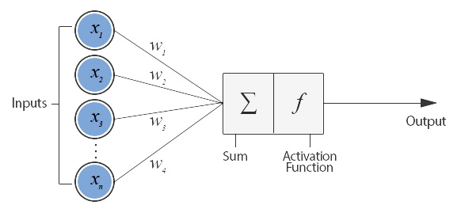
Function-Based AI (or (Deep) Learning)
  The original ideas are not so new, starting around the 1950s, around the idea of the perceptron (a simplified mathematical model of a neuron):
  Rosenblatt, Frank (1957), The Perceptron - a perceiving and recognizing automaton. Report 85-460-1, Cornell Aeronautical Laboratory.

Slide 10
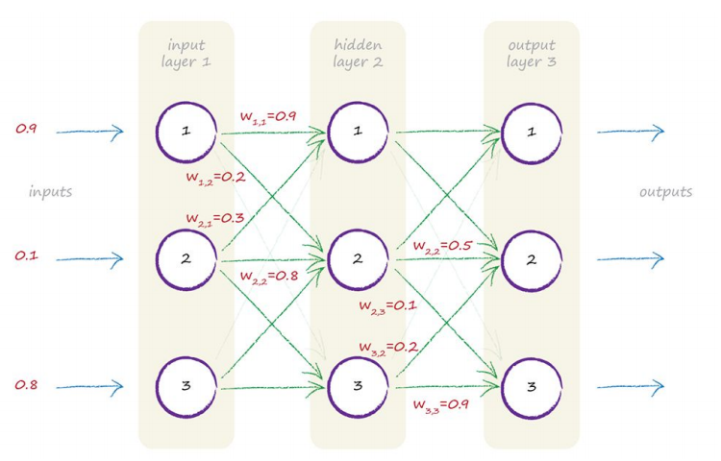
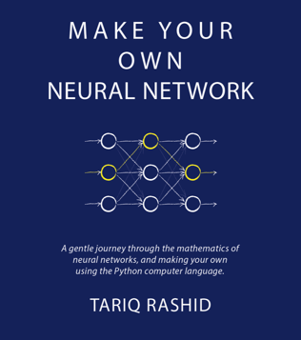

Function-Based AI (or (Deep) Learning)
(Deep) Neural Networks Learning:
  Pro:
    Given enough example data, a neural network can “learn” any function [1]
    Works great for: predictions from large amounts of training data, can even re-create new data itself!
  Con: Can’t explain what it does, not easy to “train” constraints, works only with enough training data
Source: http://makeyourownneuralnetwork.blogspot.com/
  1. Kurt Hornik, Maxwell B. Stinchcombe, Halbert White: Multilayer feedforward networks are universal approximators. Neural Networks 2(5): 359-366 (1989)

Slide 11
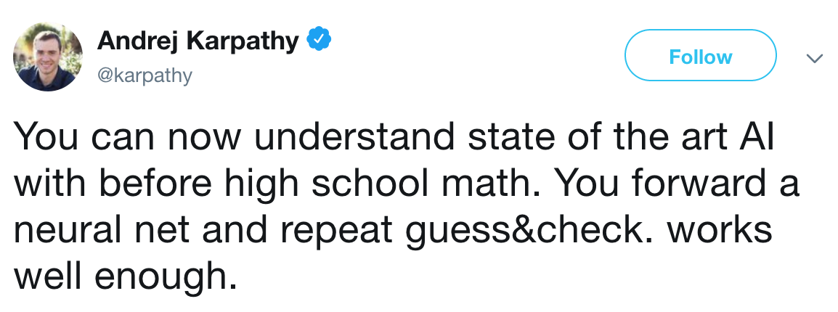
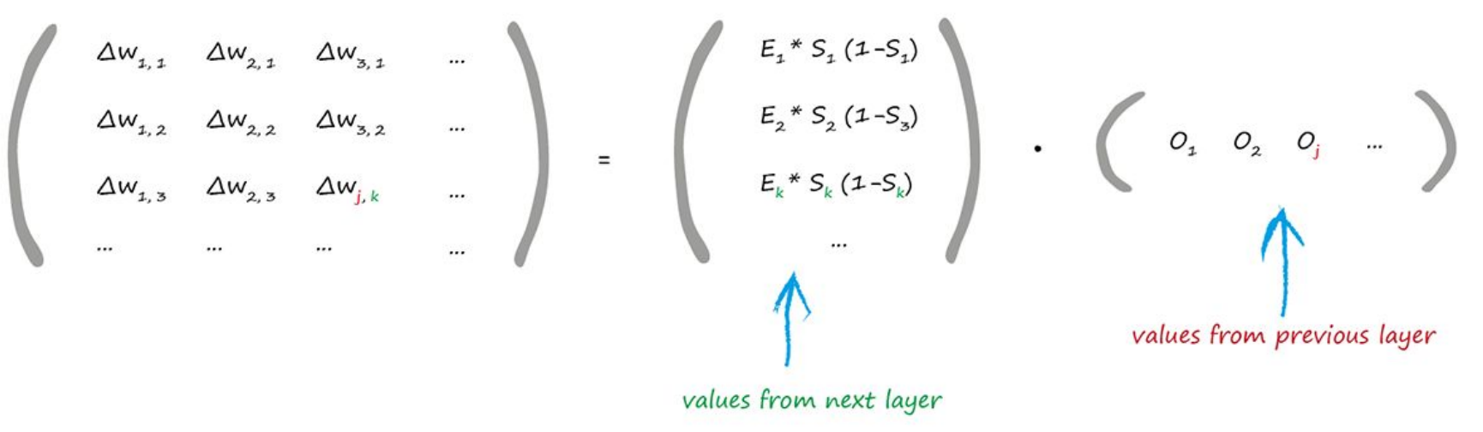
What is (the state of the art in) AI?
Use of (function-based) AI got a lot easier (many new software tools, easy access to cloud infrastructure)
https://twitter.com/karpathy/status/841739127796125696?lang=en

Slide 12
Why (now) Neural Networks?
Data, Hardware, Algorithms!
Some Milestones (non-chronological):
Multi-Layer (feedforward) networks with one hidden layer have been proven to be able to approximate essentially any functions:
  Kurt Hornik, Maxwell B. Stinchcombe, Halbert White: Multilayer feedforward networks are universal approximators. Neural Networks 2(5): 359-366 (1989)
Specialized architectures with multiple layers - inspired by nature:
Convolutional Neural Networks (CNN) (nowadays often used for image recognition)
  Hubel, David H., and Torsten N. Wiesel. "Receptive fields of single neurones in the cat's striate cortex." The Journal of physiology 148.3 (1959): 574-591.
  Fukushima, Kunihiko. "Neocognitron: A self-organizing neural network model for a mechanism of pattern recognition unaffected by shift in position." Biological cybernetics 36.4 (1980): 193-202.
Long-Short-Term Memory Networks (LSTM) (nowadays often used for sequential data (speech, text)
  Hochreiter, Sepp, and Jürgen Schmidhuber. "Long short-term memory." Neural computation 9.8 (1997): 1735-1780.
Generative Adversarial Networks (GAN):
  Goodfellow, Ian, Jean Pouget-Abadie, Mehdi Mirza, Bing Xu, David Warde-Farley, Sherjil Ozair, Aaron Courville, and Yoshua Bengio. "Generative adversarial nets." In Advances in neural information processing systems, pp. 2672-2680. 2014.

Slide 13
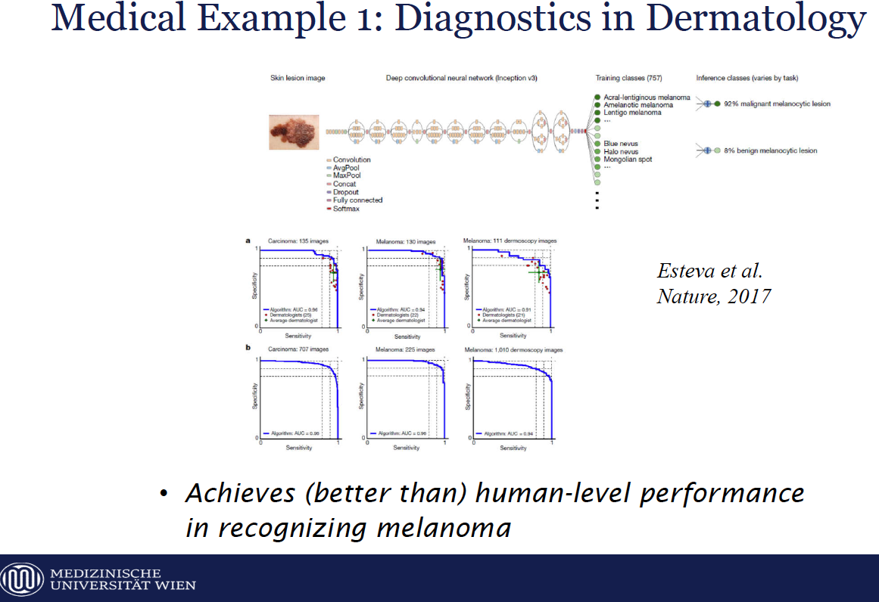
Function-Based AI: Example
Thanks to Prof. Georg Dorffner (MedUni Wien)
Image recognition in diagnosis. Typical example use of Convolutional NNs

Slide 14
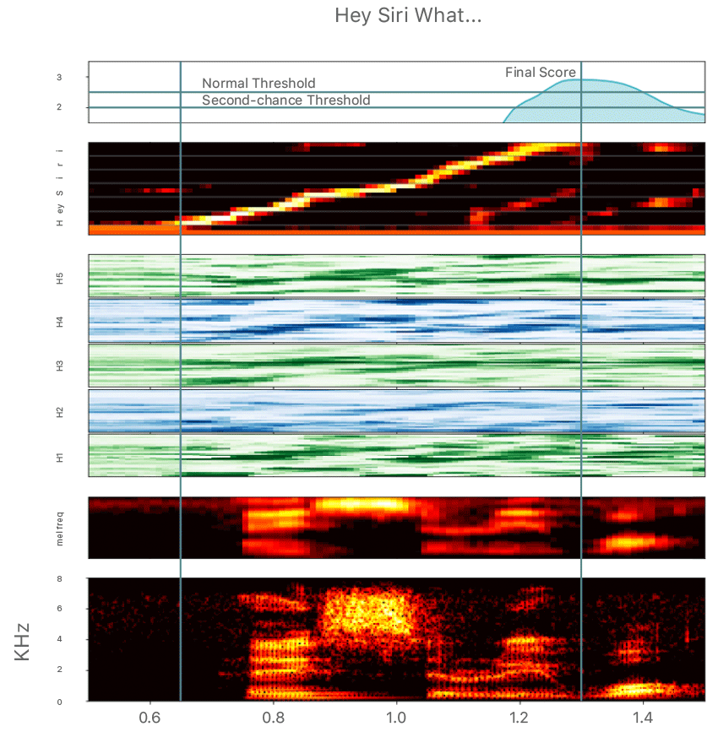
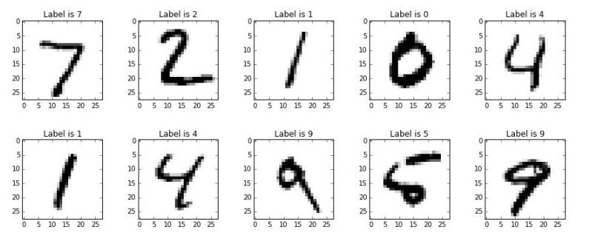
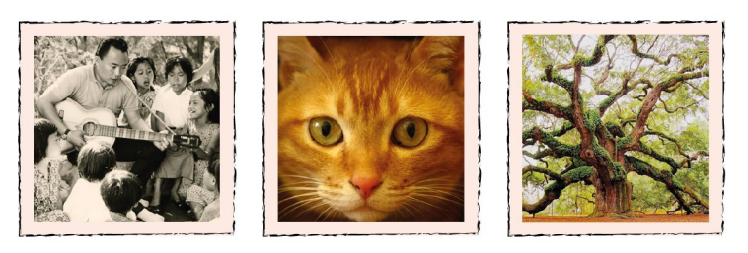
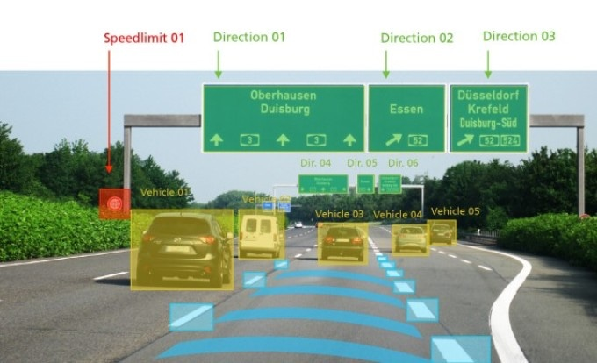
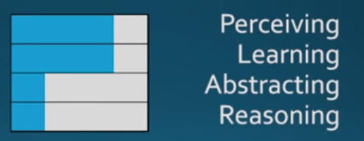
Function-Based AI other examples:
Many useful applications:
https://machinelearning.apple.com/2017/10/01/hey-siri.html

Slide 15
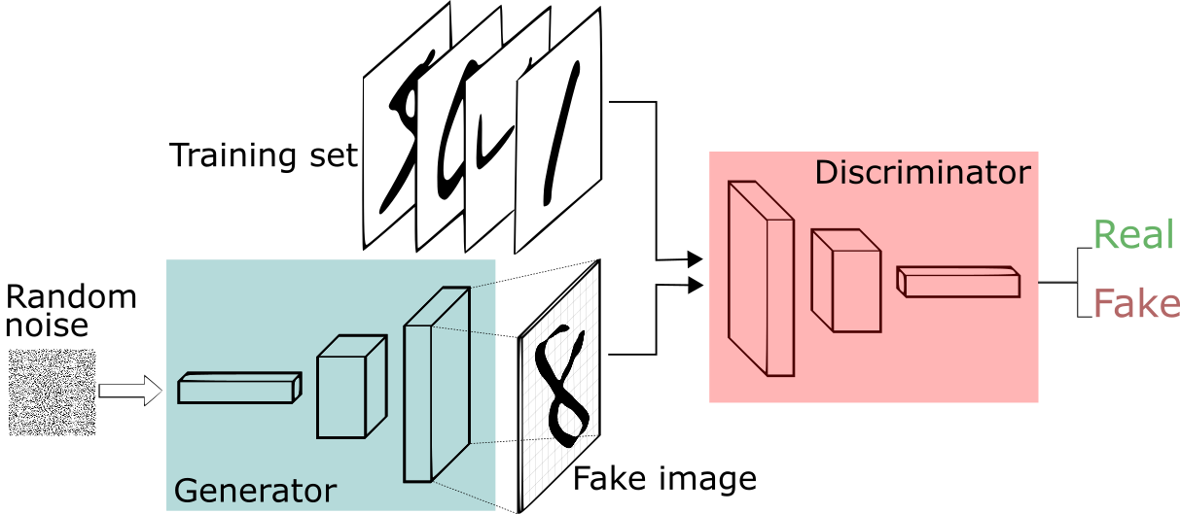
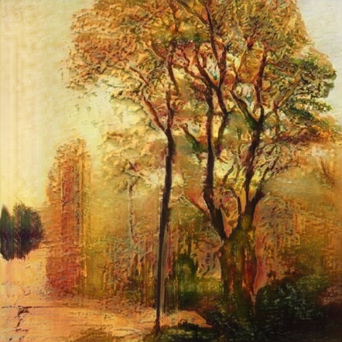
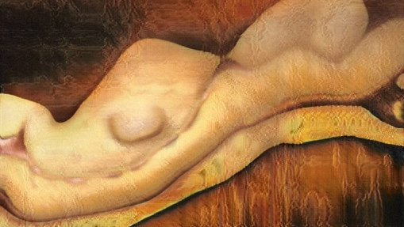
Function-Based AI : “Creating” Data… Example:
Examples from https://twitter.com/drbeef for usage of a Generative Adversarial Networks (GAN): Image Generation
    Example - Landscape paintings
  Pro:
    Not only learns patterns, but also re-creates (similar) new data itself!
    Works quite well already for texts!
  Con:
    not easy to “train” constraints
    Again, needs a lot of training data
    Example – Nude paintings

Slide 16
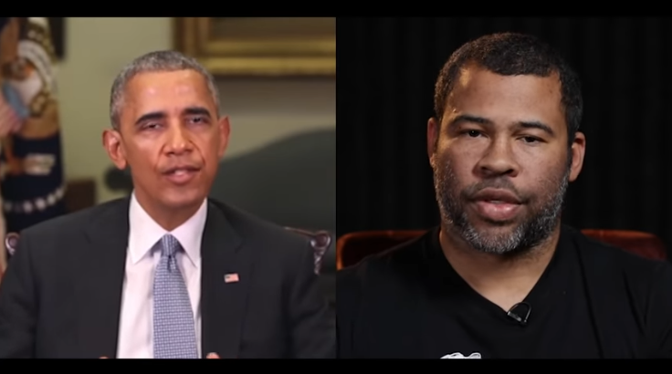
Function-Based AI other examples:
Also problematic applications (fake manipulation of video content or generation of voice characteristics: https://en.wikipedia.org/wiki/Deepfake

Slide 17
So, what is current AI?
Learning patterns from massive data.
Making predictions from learnt patterns.
Generating similar data according to these patterns.
What about making decisions from learnt patterns?
  Machines make less error than humans vs.
  Machines make different errors than humans vs.
  Machines make errors because of humans (programmers or data)

Slide 18
Where’s the IP?
Traditional view:
Programming = Data + Algorithms
vs.
AI = Data + (Deep) Neural Networks
+ Data Preparation + Parameter Tuning

Slide 19
Related Questions:
Where we need better regulations…
Data ownership:
  Data Ownership and IP … what about synthesized data?
  Data Licenses
Personal Data Protection and Bias:
  GDPR is a good start, but (how) can we automate it?
    Challenges: Consent, Trusted Computing, Sticky Policies
Explainability and Responsibility
  Knowledge Graphs & Hybrid AI

Slide 20


Digital Rights Management
A Data Licensing Perspective…
Model-based AI for Data ownership & Licensing: Machine-readable policies
https://www.dalicc.net/
https://pixabay.com/en/data-computer-businessmen-monitor-2899902/
DALICC is funded by the Austrian Federal Ministry of Transport, Innovation and Technology (BMVIT) under the program "ICT of the Future" between November 2016 - October 2018. More information https://iktderzukunft.at/en/
Notes:
Checking licenses and compatibility is a time consuming task… This is where DALICC comes in.
The DALICC project takes is looking into how do we support data publishers and consumers via technical means

Slide 21
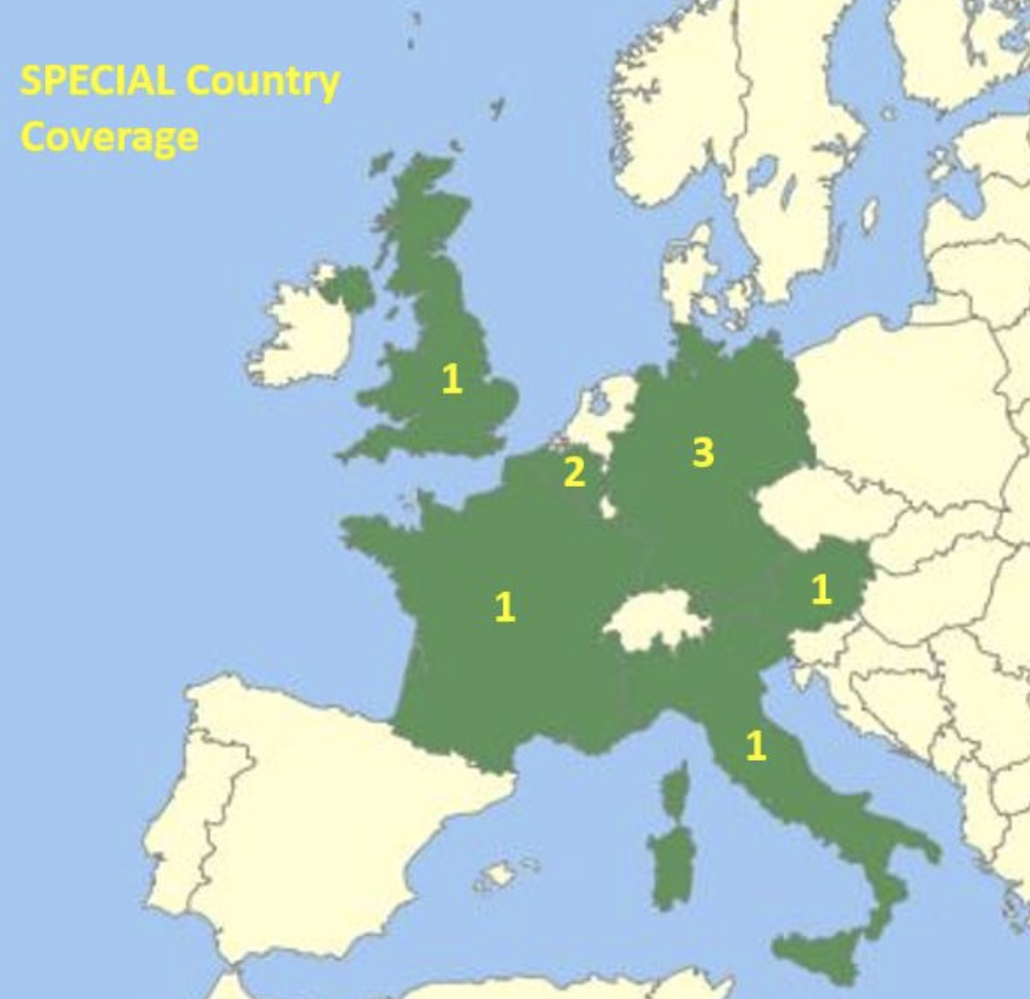











Scalable Policy-awarE Linked Data arChitecture for prIvacy, trAnsparency and compLiance
Model-based AI for Personal Data Protection: Machine-readable policies
Research and innovation Action
9 partners from 6 countries
January 2017 to December 2019
3,991,389 €
https://www.specialprivacy.eu/

Slide 22
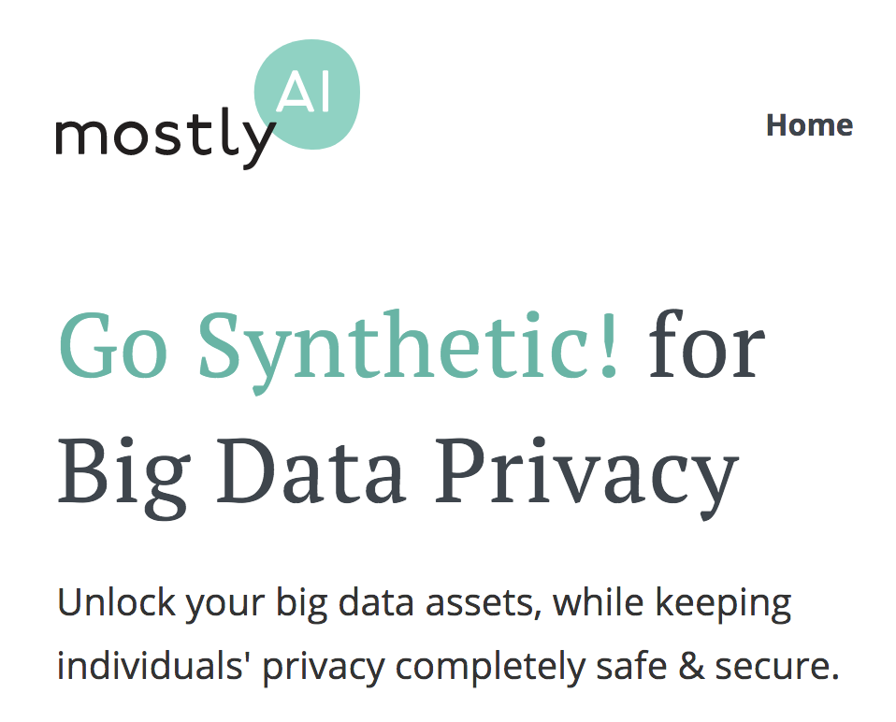
Can GANs be used as a way to anonymize data?
Function-Based AI for Personal Data Protection:

Slide 23
Last, but not least: Bias and Explainability
This article relates to a computer program that generates a score predicting the likelihood of criminals committing a future crime.
In 2014, then U.S. Attorney General Eric Holder warned that the risk scores might be injecting bias into the courts.
ProPublica did, as part of a larger examination of the powerful, largely hidden effect of algorithms in American life.
https://www.propublica.org/article/machine-bias-risk-assessments-in-criminal-sentencing
Still largely unresolved – Subject of research:
Solution? Hybrid AI – i.e., combining Model-based and funciton-based AI

Slide 24
Image references:
http://makeyourownneuralnetwork.blogspot.com/
https://twitter.com/drbeef
https://www.youtube.com/watch?v=cQ54GDm1eL0
John Launchbury: A DARPA Perspective on Artificial Intelligence - https://www.youtube.com/watch?v=-O01G3tSYpU
A. Darwiche. Human-Level Intelligence or Animal-Like Abilities? Communications of the ACM, October 2018, Vol. 61 No. 10, Pages 56-67 https://cacm.acm.org/magazines/2018/10/231373-human-level-intelligence-or-animal-like-abilities/fulltext
Acknowledgements:
Thanks to Sabrina Kirrane, Georg Dorffner for some of the slides.

