Slide 1
Knowledge Graphs have unfinished business…
@AxelPolleres
http://polleres.net/presentations
Notes:
This talk is more about problems than about solutions…

Slide 2
• What are the problems of current KG approaches? • What are your visions or thoughts about KG applications in academia and industry • What are the future directions for KG
Panel Questions - Short answers:
Knowledge Graphs have unfinished business…
i.e., we can't just go along, without solving some core problems
(that don't go away by rebranding Semantic Web and Linked Data)!
Decentralised Data Eco-Systems beyond centralised KGs!
Natural Data Understanding, i.e. "NoNLP"!
Contextualisation … still ;-)
Scalable Linked Data Processing… now for real!

Slide 3
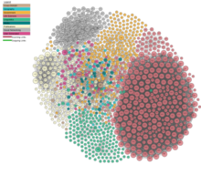
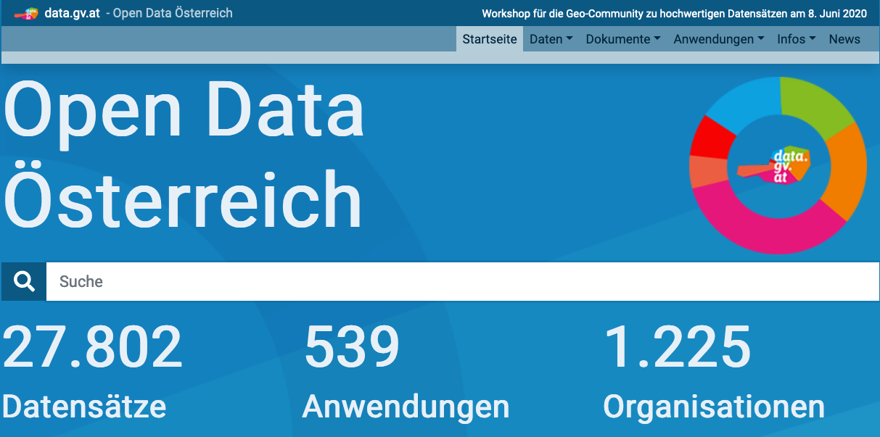
Knowledge Graphs have unfinished business…
You and I have unfinished business!
… with Linked Open Data
more specifically, with BOTH
Linked Data
AND
Open Data

Slide 4
Knowledge Graphs and Linked Data
Beyond Dbpedia and Wikidata… we had the vision of a Web of Open KGs that would be interlinked and queryable
Did it produce more than this lovely picture?
Yet: we are left with tons of issues [1]!
… e.g.
linkage between KGs still sparse [2],
but also others, e.g. availability & sustainability
(beyond a PhD lifetime) of Open KGs!
[1] Axel Polleres, Maulik Rajendra Kamdar, Javier D. Fernández, Tania Tudorache, and Mark A. Musen. A more decentralized vision for linked data. 11(1):101--113, January 2020. SWJ 10-years special issue. [ http ]
[2] Armin Haller, Javier D. Fernández, Maulik R. Kamdar, and Axel Polleres. What are links in linked open data? a characterization and evaluation of links between knowledge graphs on the web. ACM Journal of Data and Information Quality (JDIQ), to appear, Pre-print available https://epub.wu.ac.at/7193/.

Slide 5
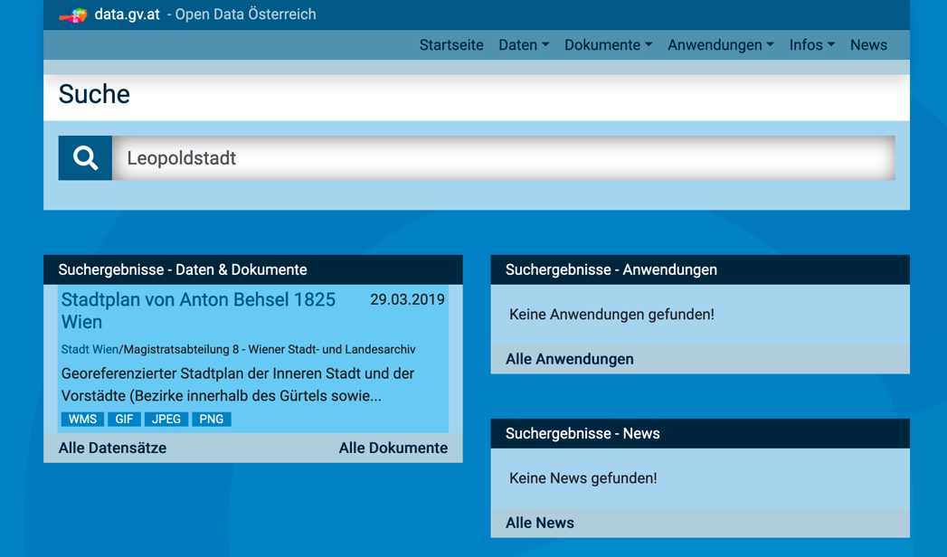
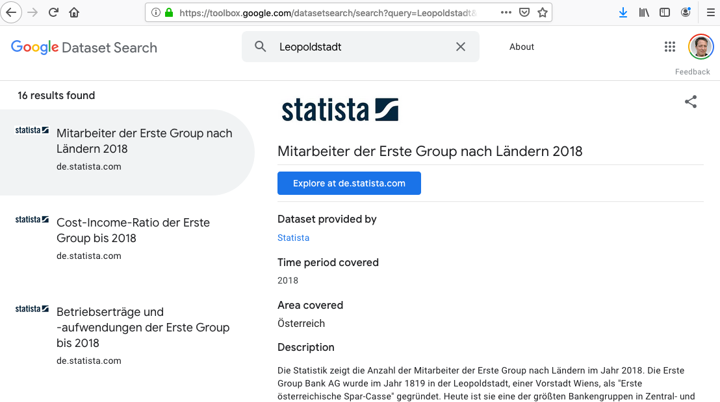
Knowledge Graphs and Open Data
Open Data had a boost some years ago and is still trending, esp. for Government Data & Transparency!
Yet: hardly any of this data is linked/linkable or even findable!
A good start, but
not much better either!
Leopoldstadt
Leopoldstadt

Slide 6
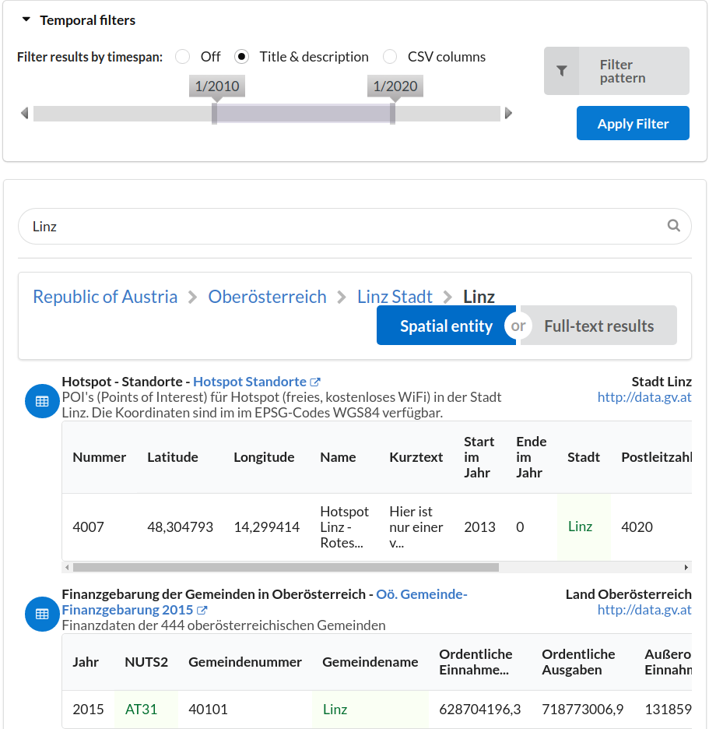
Knowledge Graphs and Open Data
Open Data had a boost some years ago and is still trending, esp. for Government Data & Transparency!
Yet: hardy any of this data is linked/linkable or even findable!
(Open) Knowledge Graphs can be used to link Open Data!
challenges: Coverage, numeric data, OD Quality/KG Quality
Keynote "How do Linked Data, Open Data, and Knowledge Graphs interplay?" at
DEXA 2019, August 2019, Linz, Austria. polleres.net/presentations/20190827DEXA_keynote.pdf

Slide 7
What are your vision or thoughts about KG applications in academia and industry
We need to build on our strength!
Rather than (more) centralised KGs ….
Make a Decentralised
Data Eco-Systems work!
enable trusted data sharing
enable FAIR principles
Applications galore!
You
SME
SME
e.g.: bring together personal data spaces and industrial data spaces!
Govern-ment
…
…

Slide 8
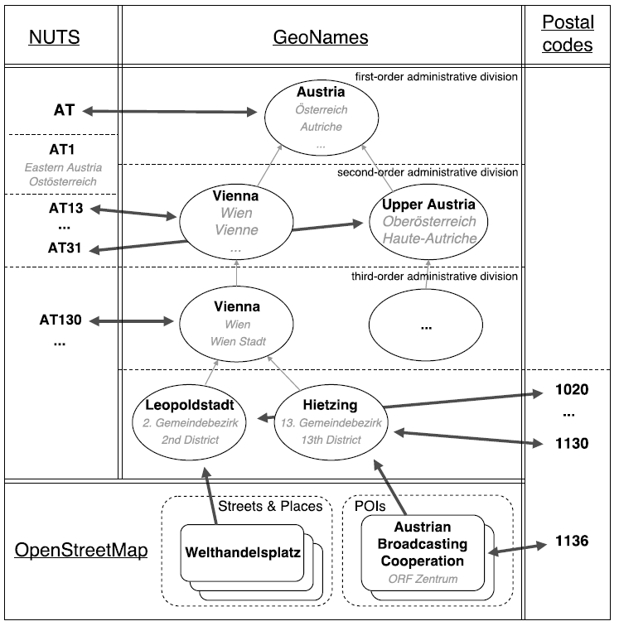
Towards "Natural Data Understanding"
What are the future directions for KG 1/3
”Natural Data” = “Structured Data as it occurs in the wild”
Heterogenous data assets
From different sources and origins
Different Formats
Different Semantics
Sparse descriptive metadata
Raw/not necessarily for human consumption
→ (Still) Hard to search and integrate!
[3] Sebastian Neumaier and Axel Polleres. Enabling spatio-temporal search in open data. Journal of Web Semantics (JWS), 55, March 2019.
[4] Sebastian Neumaier, Jürgen Umbrich, Josiane Parreira, and Axel Polleres. Multi-level semantic labelling of numerical values. (ISWC2016)
Notes:
But probably very valuable and interesting overlaps and links to discover in the data!

Slide 9
What are the future directions for KG 2/3
Scalable Linked Data Processing… now for real!
(SPARQL EP, TPF, SMART-KG --> there's something moving here!
Contextualisation … still ;-)
next step: Represent and query at scale contextualised KGs
Provenance, Policy-constrained Graphs/Triples, Property Graphs, SPARQL*

Slide 10
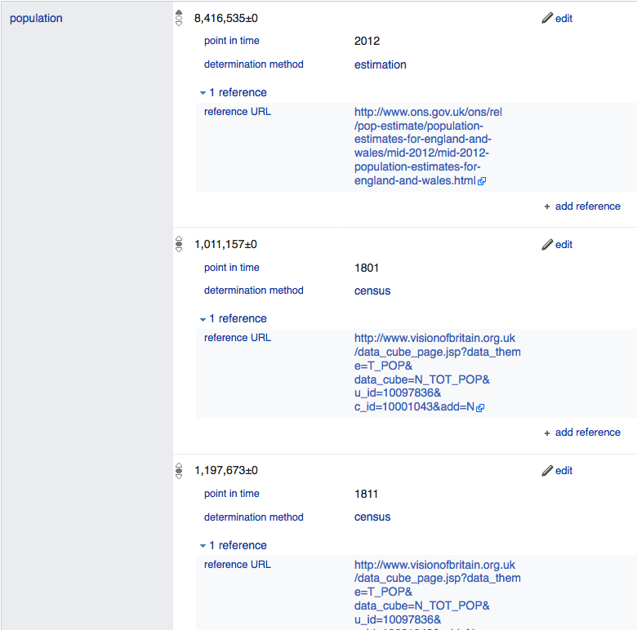
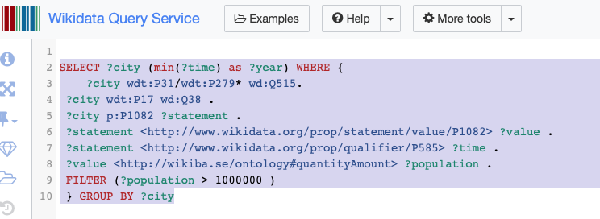
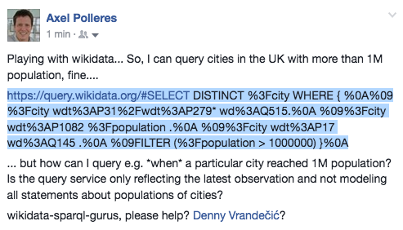
What are the future directions for KG 3/3
Managing context makes things even harder! → but is also doable!
However, Wikidata has more complex info: (temporal context, provenance,…)
Which cities in the UK have reached 1M in which year?
Yes!
… Can I query that with SPARQL?
BTW, seemingly not yet doable in
10
Notes:
Not so easy, despite it’s Linked Data… no “common semantics by names”? And as far as I know in the Linked Data realm this is the exception, not the rule…

Slide 11
Take-home summary
if I could predict the future, I wouldn't be here…
... rather an invitation (especially to young researchers):
There's still a lot of unfinished business and unfuilfilled promises from
Semantic Web, Linked Data, etc. that (despite "rebranding" into KGs)
haven't been solved
should and could be solved/tackled with more research!
Let's do this together!
https://www.cost.eu/cost-action/distributed-knowledge-graphs/ COST Action
https://knowgraphs.eu/ ITN
p.s.: Don't only work on DL, I know you do anyway, there's plenty of other stuff to do ;-)
Notes:
may not all sound very forward looking to you, but I wanted to make a point!

