Slide 1
Knowledge Graphs: Explainable Data Ecosystems as a prerequisite for Explainable AI
Axel Polleres
Institute for Data, Process & Knowledge Management
http://www.polleres.net/

Slide 2
Outline
From Semantic Web to KGs … what's actually new?
From KGs to (Explainable) AI
Revance and Potential for Product Configuration
Notes:
WE HAVE HEARD A LOT ABOUT KGS, but we all may havee a different conception what KG actually is…
Close the gap between symbolic and subsymbolic AI.

Slide 3
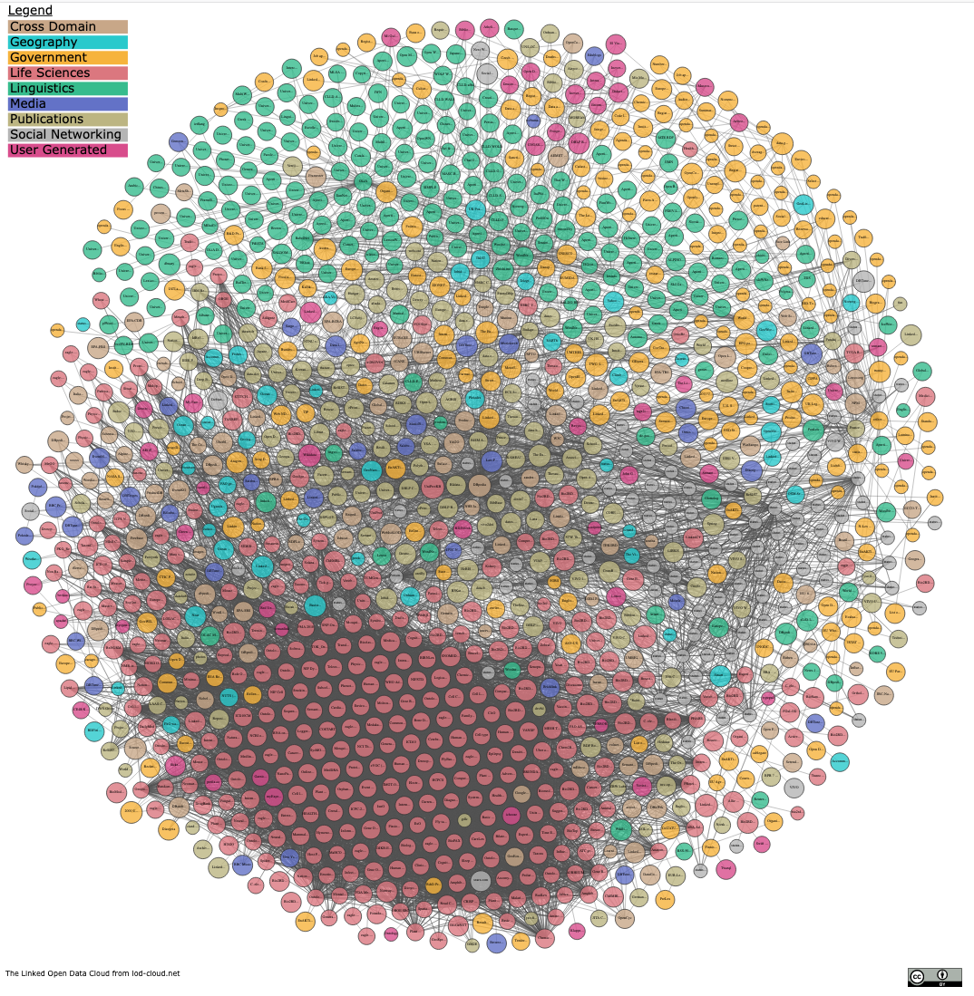
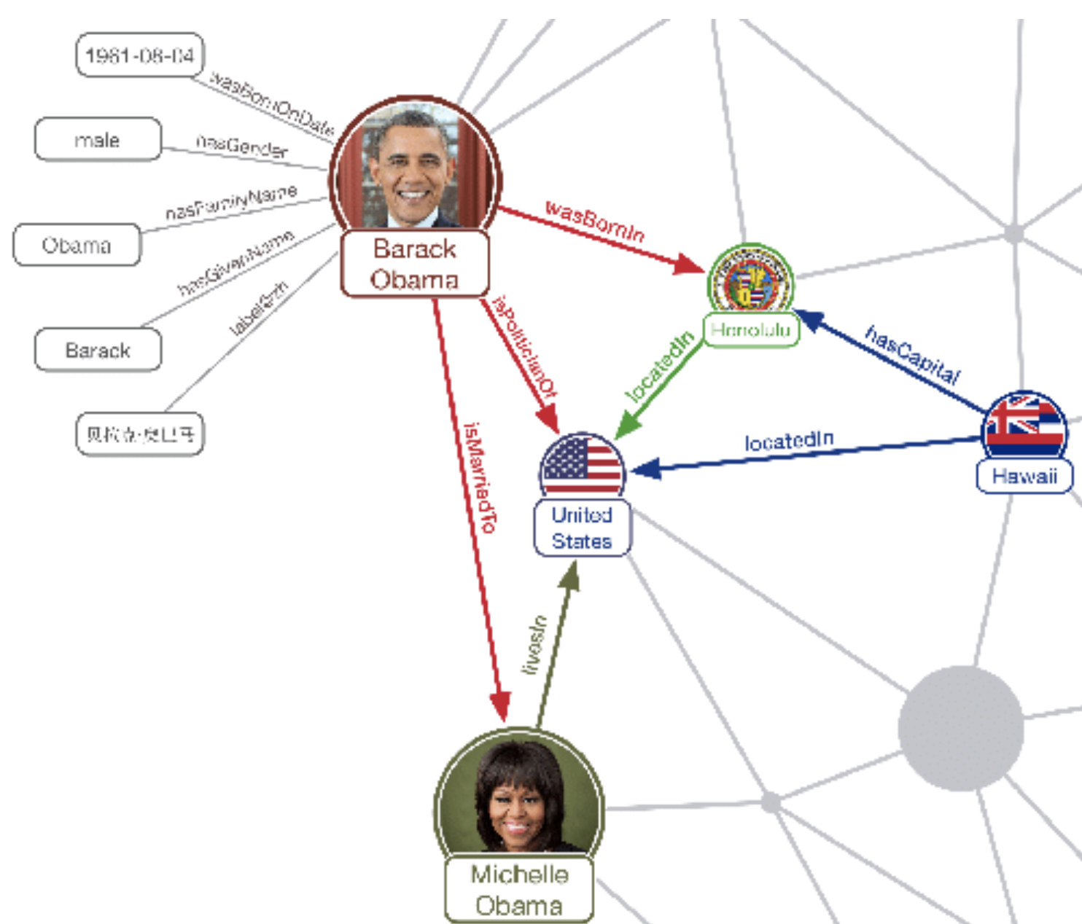
My background - The "Web of Data"
past ~15 years research in Semantic Web and Linked (Open) Data
Standards (RDF, SPARQL, etc.) for
machine-readable
based on (collaboratively) agreed, evolving schemata (ontologies)
decentralized
Data Publishing & Processing
… which has led to a network of distributed
partially connected Data Graphs
Armin Haller, Javier D. Fernández, Maulik R. Kamdar, and Axel Polleres. What are links in linked open data? a characterization and evaluation of links between knowledge graphs on the web. ACM Journal of Data and Information Quality (JDIQ), to appear, accepted for publication, 2020. Pre-print available at https://epub.wu.ac.at/7193/.
Knowledge
SLIDE 3
Notes:
particularly I mean…
The goal here was to beuild a "Web of Data", where, if we see the Web as an information space and ecosystem, the main question is how we could best use this ecosystem to share/exchange data and schemata.
Standards for data sharing, decentralized querying and publishing, as well as processingm which has grown into the – you all know it LOD cloud.
Each of these nodes represents a separate RDF knowledge graph, these knowledge graps are linked which

Slide 4
My background - The "Web of Data"
state of affairs:
+ common data and meta-data format (RDF)
+ Ontologies are reused widely (~ i.e., widely reused meta—data schemata)
+ fairly scalable methods for distributed processing and querying
+ widely used "centernodes" around which knowledge can "chrystalize"
(while maybe less expressive than originally expected)
(still a very active, stimulating academic research area!)
Armin Haller, Javier D. Fernández, Maulik R. Kamdar, and Axel Polleres. What are links in linked open data? a characterization and evaluation of links between knowledge graphs on the web. ACM Journal of Data and Information Quality (JDIQ), to appear, accepted for publication, 2020. Pre-print available at https://epub.wu.ac.at/7193/.
SLIDE 4

Slide 5
My background - The "Web of Data"
state of affairs:
lack of inter links
28% of datasets do not link to external instances)
schema definitions disappear, or exist multiple times,
little business interest to contribute
… while too hard to maintain by academics
Findability, (machine-)Accessability, Interoperability and
Reuse/Reusability only partially given…
? https://www.go-fair.org/fair-principles/
SLIDE 5

Slide 6
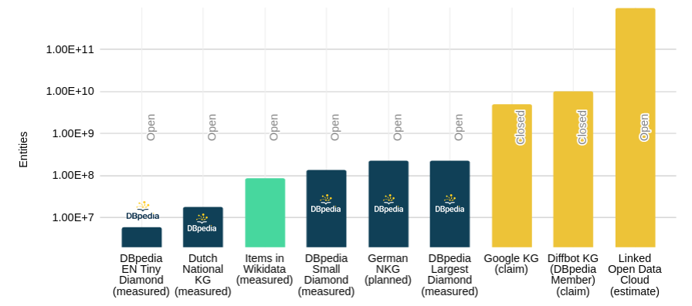
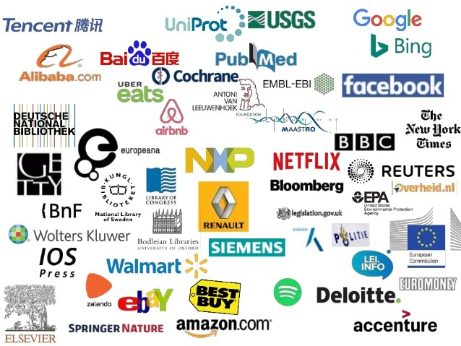
Some things worked different than expected
Still: growing interest of Enterprises in KGs
Success stories of mainly monolithic (but huge) Knowledge Graphs rather than a network of Linked small KGs:
https://www.slideshare.net/Frank.van.Harmelen/adoption-of-knowledge-graphs-late-2019
https://www.dbpedia.org 2021
Notes:
https://www.slideshare.net/Frank.van.Harmelen/adoption-of-knowledge-graphs-late-2019

Slide 7
Some things worked different than expected
Large, monolithic KGs
more shallow semantics vs more complex graph model
inherently inconsistent
constantly evolving
Different "kinds" of KGs
purpose-built KGs
generic "encyclopedic" KGs

Slide 8
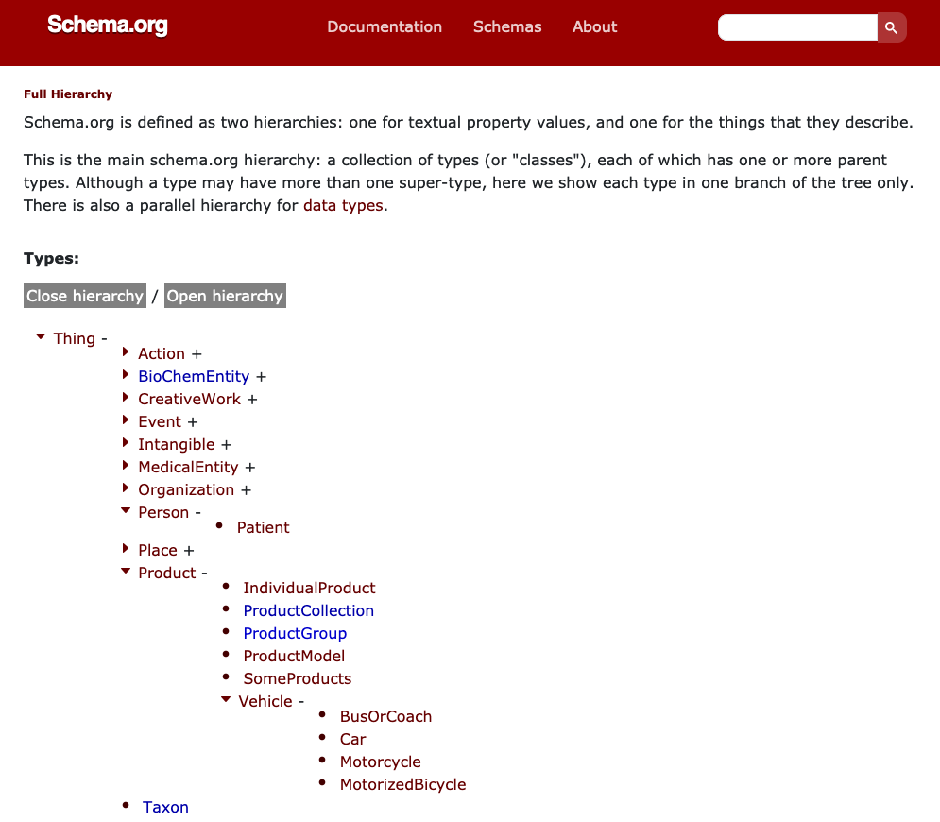
Some things worked different than expected
These large KGs
more shallow semantics vs more complex graph model
inherently inconsistent
constantly evolving
Different "kinds" of KGs
purpose-built KGs
generic "encyclopedic" KGs
Since when is Rome the capital of Rome?
Does the statement come from a trustworthy source?
Rome
Italy
capitalOf
Q220
Q38
"noOWL"
Q5119
type: capitalOf
added: 2019-06-12
author: @Bob
validityrFrom: 1861
Name: Rome
Type: City
added: 2019-06-11
author: @Alice
Name: Italy
Type: Country
added: 2019-06-11
author: @Chalrlie
RDF Graph vs. Property Graph (Neo4J, BlazeGraph, etc.)
Notes:
in reference to noSQL, just simple class and propert hierarchies … Semantics "by use" rather than "by axioms", greetings from history very similar yo our findings from the past on the usage of OWL properties on the Web… the complex stuff is simply not used.

Slide 9
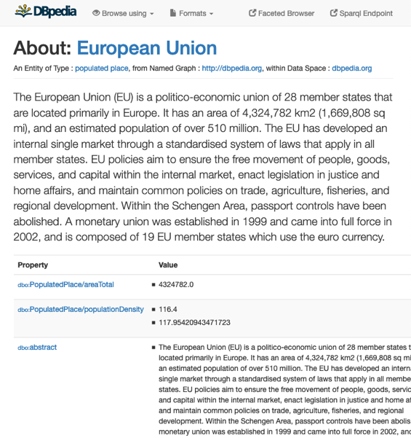
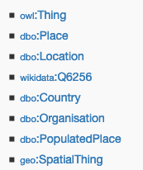
Some things worked different than expected
These large KGs
more shallow semantics vs more complex graph model
inherently inconsistent
constantly evolving
Different "kinds" of KGs
purpose-built KGs
generic "encyclopedic" KGs
Ontology:
dbo:Agent owl:disjointWith dbo:Place.
dbo:Country rdfs:subClassOf dbo:Place.
dbo:Organisation rdfs:subClassOf dbo:Agent.
Stefan Bischof, Markus Krötzsch, Axel Polleres, and Sebastian Rudolph. Schema-agnostic query rewriting in SPARQL 1.1. In Proceedings of the 13th International Semantic Web Conference (ISWC 2014), Lecture Notes in Computer Science (LNCS). Springer, October 2014. [ .pdf ]
Notes:
In large, collaboratively edited, or partially automatically generated KGs such issues are inevitable, but probably the sheer mass of data can help us resolve such inconsistencies! We have done several works in these respects with my students.

Slide 10
Some things worked different than expected
These large KGs
more shallow semantics vs more complex graph model
inherently inconsistent
constantly evolving
Different "kinds" of KGs
purpose-built KGs
generic "encyclopedic" KGs
How to deal with consolidation of the schema over time?
"According to the Wikidata Query Service, the election class (Q40231) has 787 subclasses in total"
Notes:
For instance we saw in wikidata:

Slide 11
Some things worked different than expected
These large KGs
more shallow semantics vs more complex graph model
inherently inconsistent
constantly evolving
Different "kinds" of KGs
purpose-built KGs vs. generic "encyclopedic" KGs
"World knowledge"/ "Reference Data"
"Domain-specific" KGs

Slide 12
Outline – So what does this all have to do with AI?
From Semantic Web to KGs … what's actually new?
From KGs to (Explainable) AI
Revance and Potential for Product Configuration

Slide 13
KG-Based AI is "explainable by design"
KGs provide human-interpretable Knowledge
to enrich AI models
to enable (interpretable QA)
a basis for true Hybrid AI!
AI and Deep learning can help to build up and enrich KGs
Notes:
my personal opinion: Too much focus still on this side

Slide 14
KG-Based AI is "explainable by design"
KGs provide human-interpretable Knowledge
to enrich AI models
to enable (interpretable QA)
a basis for true Hybrid AI!
AI and Deep learning can help to build up and enrich KGs
Link prediction, KG embeddings
Notes:
my personal opinion: Too much focus still on this side

Slide 15
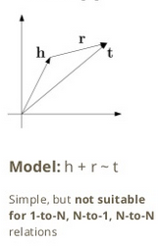
KG-Based AI is "explainable by design"
AI and Deep learning can help to build up and enrich KGs
Link prediction, KG embeddings [*] use Graph Neural Networks to learn missing links
ATTENTION: Works only if there is redundacy (rules?) in the graph!
Example:
Maria Theresia
married_to
Elizabeth II
Franz Stephan von Lothringen
Prince Philipp, Duke of Edinburgh
Tiwari, S., Bansal, I., Rivero, C.R.: Revisiting the evaluation protocol of knowledge graph completion methods for link prediction. In: Proceedings of the Web Conference 2021. pp. 809{820. Ljubljana, Slovenia (April 2021)
Notes:
my personal opinion: Too much focus still on this side

Slide 16
KG-Based AI is "explainable by design"
KGs provide human-interpretable Knowledge
to enrich AI models
"self-curating" collaboratively built symbolic knowledge bases
to enable QA and search
semantic search over Data and Documents
interpretable Question Answering
a basis for true Hybrid AI!
Notes:
my personal opinion: Too much focus still on this side

Slide 17
Potential of Enterprise KGs for Explainable AI & Product Configuration
Product Search and Asset Optimization
Managing inconsistencies in Data Processing
B2B/B2G/G2B/B2R/R2B Data Ecosystems!

Slide 18
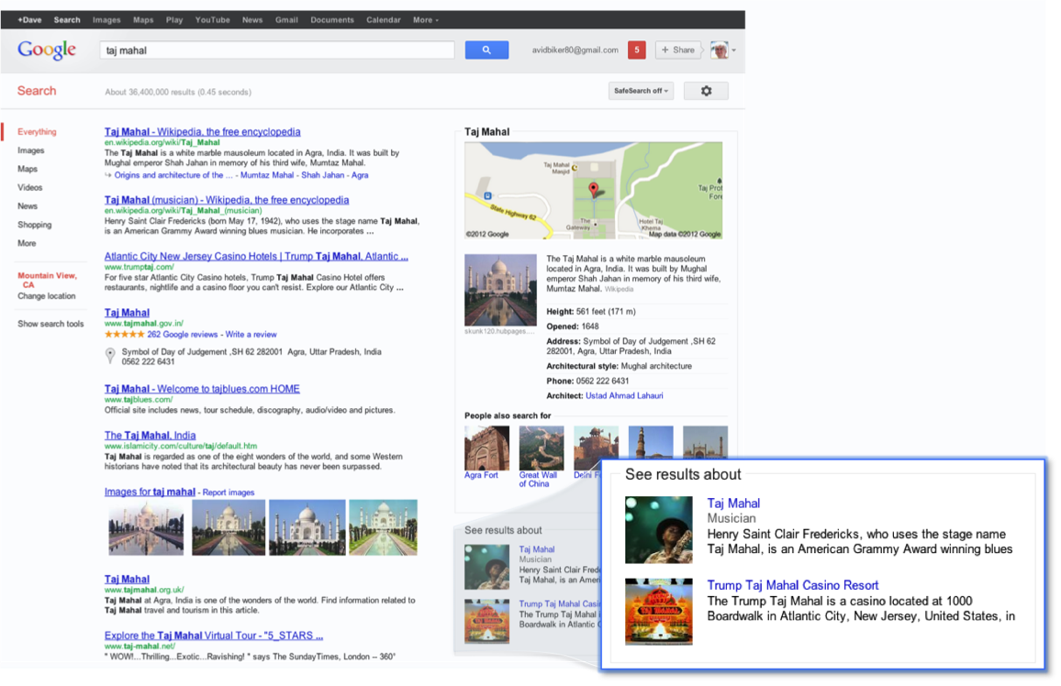
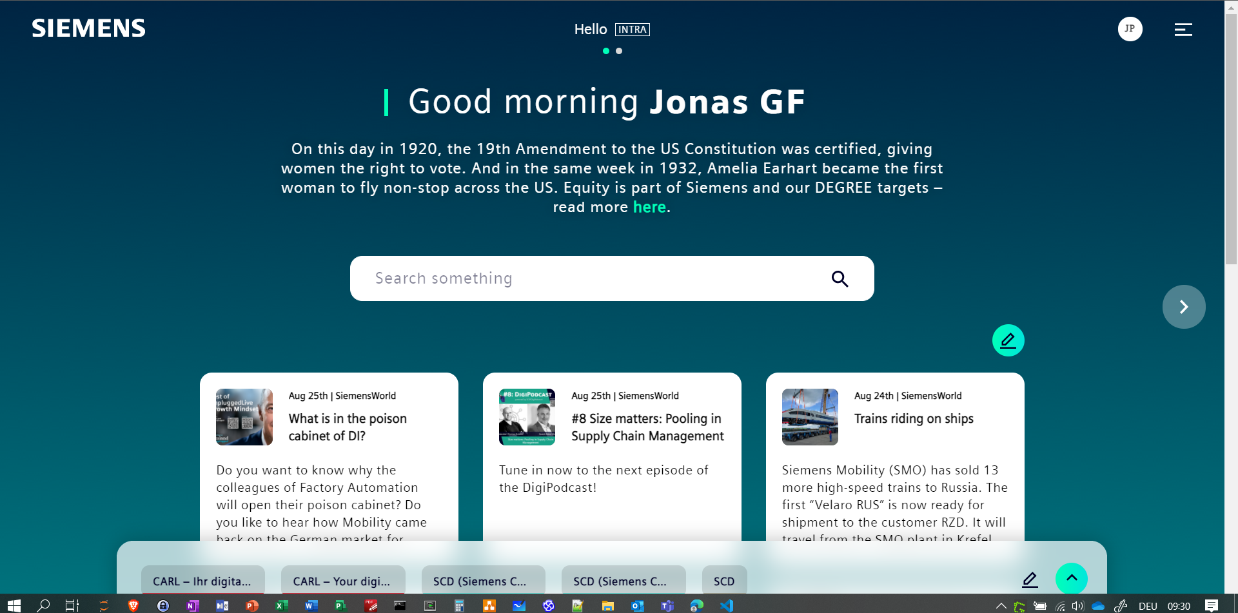
Semantic Search powered by KG-based AI:
Semantic Search becomes important in Companies beyond "rich snippets":

Slide 19
Semantic Search– Is Google good enough?
Spatio-temporal search
Question Answering?
Knowledge Graphs help!
Leopoldstadt
Who is the head of Government of the largest province in Austria?
SLIDE 19

Slide 20
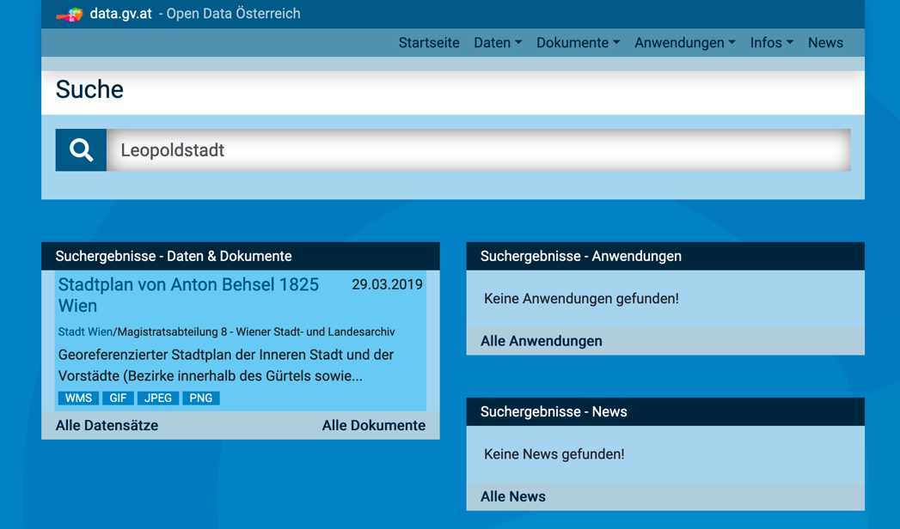
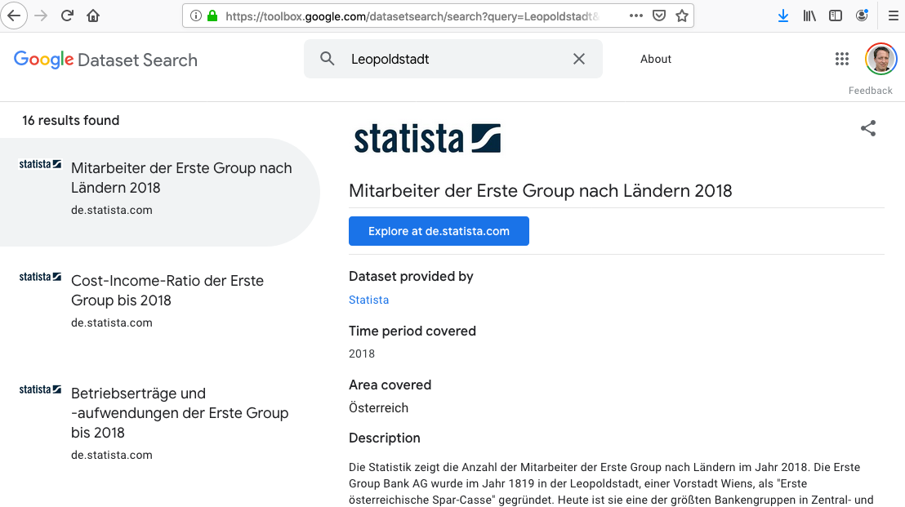
Semantic Search– Is Google good enough?
Findability,
Accessability
Interoperability
Reuse/Reusability
Leopoldstadt
Solution:
look into data, not only metadata!
link to Existing Knowledge Graphs!
Knowledge Graphs help!
Sebastian Neumaier and Axel Polleres. Enabling spatio-temporal search in open data. Journal of Web Semantics (JWS), 55:21--36, March 2019. [ DOI | http ]
SLIDE 20
PhD thesis 2019

Slide 21
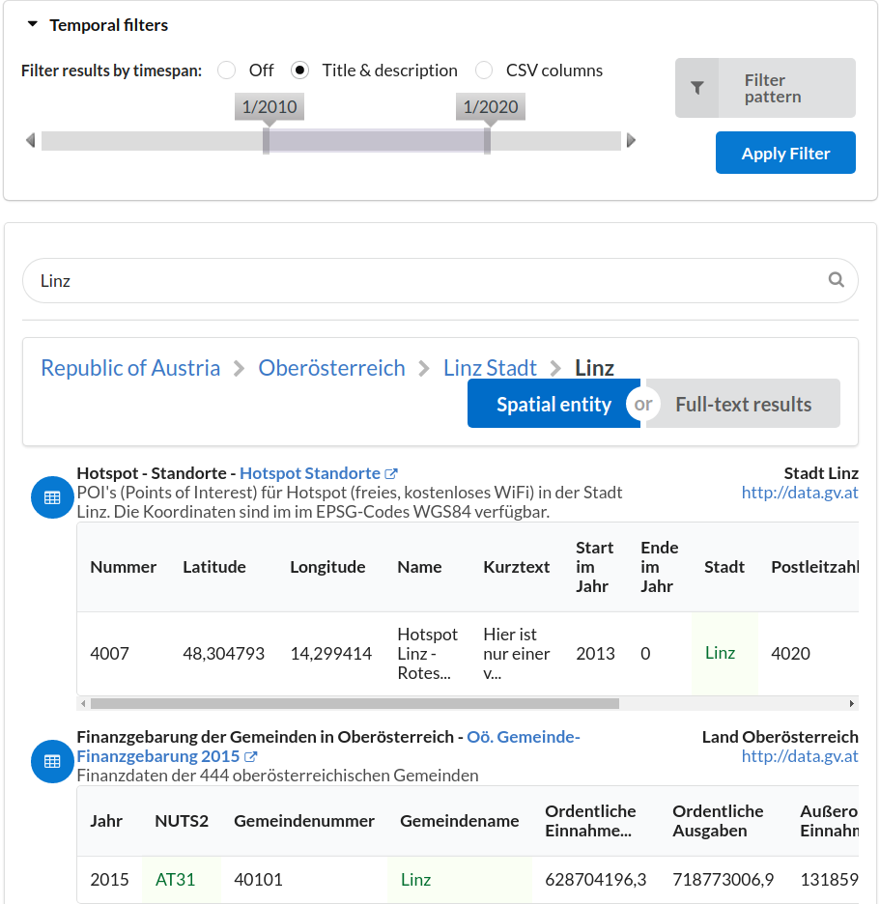
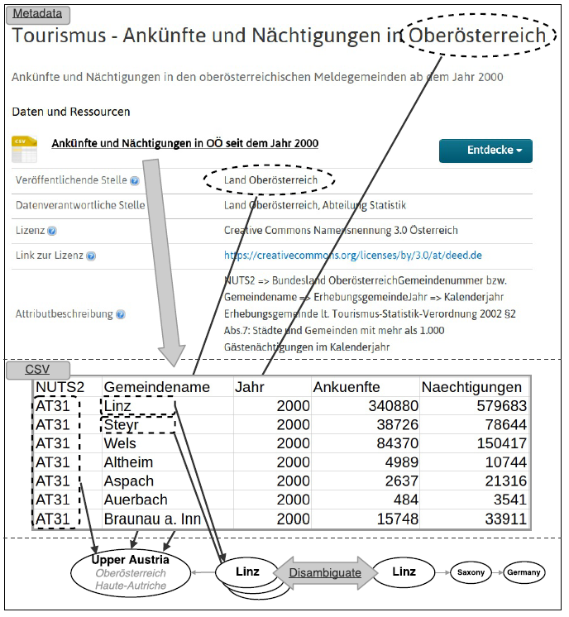
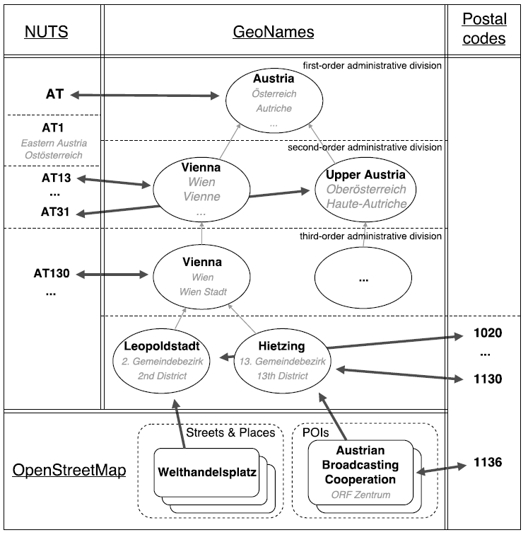
Semantic Search– Is Google good enough?
Findability,
Accessability
Interoperability
Reuse/Reusability
Dataset Labelling
GeoKnowledgeGraph
Knowledge Graphs help!
SLIDE 21

Slide 22
Semantic Search– Is Google good enough?
Spatio-temporal search
Question Answering?
Done!
Knowledge Graphs help!
Leopoldstadt
Who is the head of Government of the largest province in Austria?
SLIDE 22

Slide 23
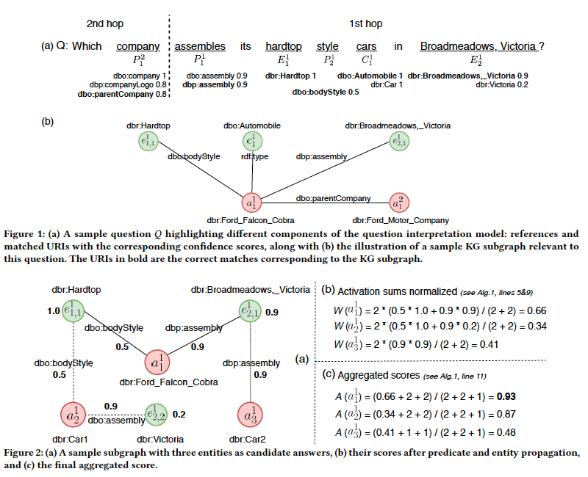
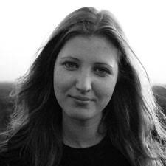
Semantic Search– Is Google good enough?
Question Answering:
PhD thesis 2019
Idea: use unsupervised message passing to propagate confidence scores obtained by parsing an input question and matching terms in the knowledge graph to a set of possible answers.
S.Vakulenko, J.Fernández, A. Polleres, M. de Rijke, and M. Cochez. Message passing for complex question answering over knowledge graphs. CIKM2019,

Slide 24
Potential of Enterprise KGs for Explainable AI & Product Configuration
Product Search and Asset Optimization
Managing inconsistencies in Data Processing
B2B/B2G/G2B/B2R/R2B Data Ecosystems!
Combined Reasoning AND Machine Learning to "fix" and maintain large-scale KGs!
e.g. Constraints (SHACL) & Deep Learning to clean up and automatically integrate and construct KGs
fix Kopwledge graphs to fit constraints

Slide 25
Combined Reasoning AND Machine Learning to "fix" and maintain large-scale KGs!
Stefan Bischof, Axel Polleres, and Simon Sperl. City data pipeline - a system for making open data useful for cities. In I-SEMANTICS 2013 Posters & Demonstrations Track, volume 1026 of CEUR Workshop Proceedings, pages 45--49, Graz, Austria, September 2013. CEUR-WS.org. [ .pdf ]
PhD thesis 2017
Answer:
partially,
manual integration of a handful of sources
lots of missing data
We can develop new methods for automatic, scalable integration and model building (using Semantic Web technologies and Machine Learning!)
Hope:
The more data becomes available,
the better (data quality & amount ) it will work!
Can we collect and use Open Data to answer relevant questions?
e.g. developments of Cities
(in Europe, worldwide)
SLIDE 25

Slide 26
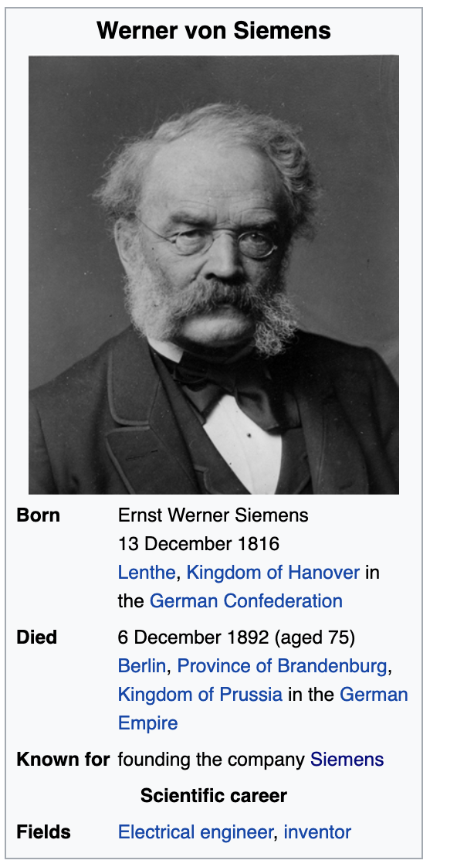
Combined Reasoning AND Machine Learning to "fix" and maintain large-scale KGs!
Albin Ahmeti, Javier D. Fernández, Axel Polleres, Vadim Savenkov: Updating Wikipedia via DBpedia Mappings and SPARQL. ESWC (1) 2017: 485-501
PhD thesis 2020
Use OBDA and statistical distributions of Data to update sources over changes in the KG.
INSERT { Werner_von_Siemens workplaceHomepage htttp://siemens.com }
SLIDE 26
Notes:
Albin Ahmeti, Javier D. Fernández, Axel Polleres, Vadim Savenkov: Updating Wikipedia via DBpedia Mappings and SPARQL. ESWC (1) 2017: 485-501

Slide 27
Potential of Enterprise KGs for Explainable AI & Product Configuration
Product Search and Asset Optimization
Managing inconsistencies in Data Processing
B2B/B2G/G2B/B2R/R2B Data Ecosystems!
C
B
Businesses
R
G
Research
Governments

Slide 28
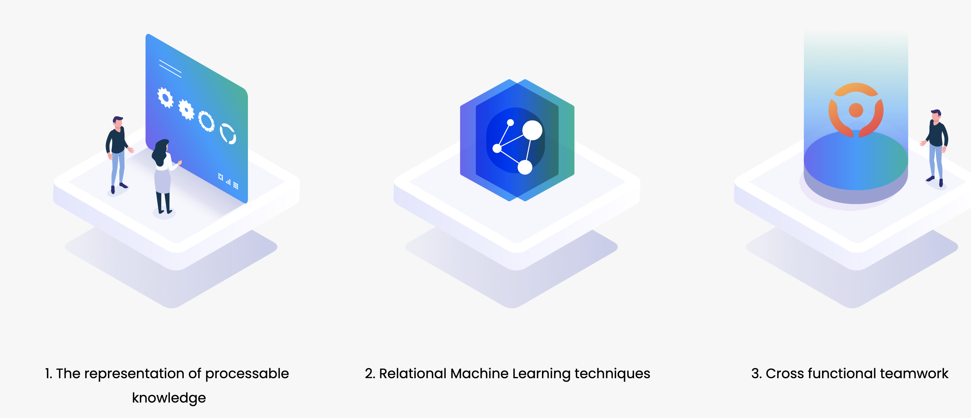
What's next? KGs in Industry/Production:
enable collaboration between AI and people
KGs to model processes, behaviours, optimization strategies
EU project TEAMING.AI https://www.teamingai-project.eu/
This project receives funding from the European Union’s Horizon 2020 Research and Innovation Programme under Grant Agreement Number 957402

Slide 29
What's next? How to enable Data Ecosystems?
Findability,
Accessability
Interoperability
Reuse/Reusability
How to enable Data Ecosystems?
To really leverrage cross-department/enterprise use cases the concepts of KGs and data sharing need to be be realized like in Open Science
semantically enabled "data portals" with "the cloud"
KG-enabled
+ decentralized
+ ensure data sovereignty
https://www.go-fair.org/fair-principles/
Bernhard Moser, Georg Dorffner, Thomas Eiter, Wolfgang Faber, Günther Klambauer, Robert Legenstein, Bernhard Nessler, Axel Polleres, and Stefan Woltran. Österreichische AI Strategie aus Sicht der Wissenschaft: Forderungen der ASAI zu einer konkreten AI Strategie in Österreich. OCG Journal, 01/2020:14--17, 2020. Invited article (in German). [ http ]
SLIDE 29

Slide 30
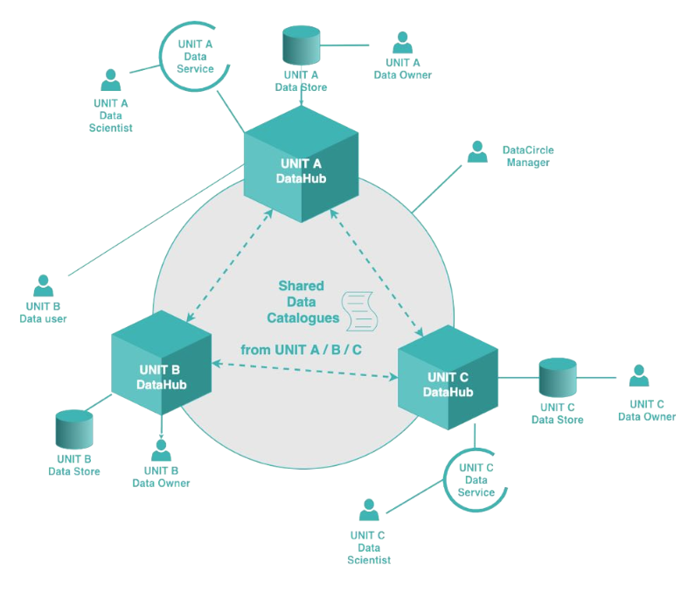
Vision: What’s next? Data-Ecosystem for Controlled Decentralized Data Sharing:
FAIR (findable, accessible, interoperable and re-usable) Data
enabled by KGs
Data Sharing & Daten-Pooling ("Datenkreise")
Keep data sovereignty & trust
Decentralisation
Out of the box Data Science Pipelines & distributed Learning, Cloud Services
Knowledge Graph & Shared Data Catalogs are a key coart!
B
Businesses
R
G
Upcoming FFG project:
Research
Governments
SLIDE 30

Slide 31
Take-home Summary…
Knowledge Graphs are the large-scale evolution of Semantic Web..
… adding raw contextual and statistical information
… feeding into various AI applications (e.g. search, QA, Data analytics)
… evolving towards "self-curating" collaboratively built symbolic knowledge bases.
… Their real potential lies in inerlinking these within and across th entrprise
… towards Decentralized, FAIR Data Ecosystems!
@AxelPolleres
Thank you! Questions? data.wu.ac.at

