Slide 1
How Does Knowledge Evolve in Open Knowledge Graphs?
Axel Polleres
Vienna University of Economics and Business

Slide 2
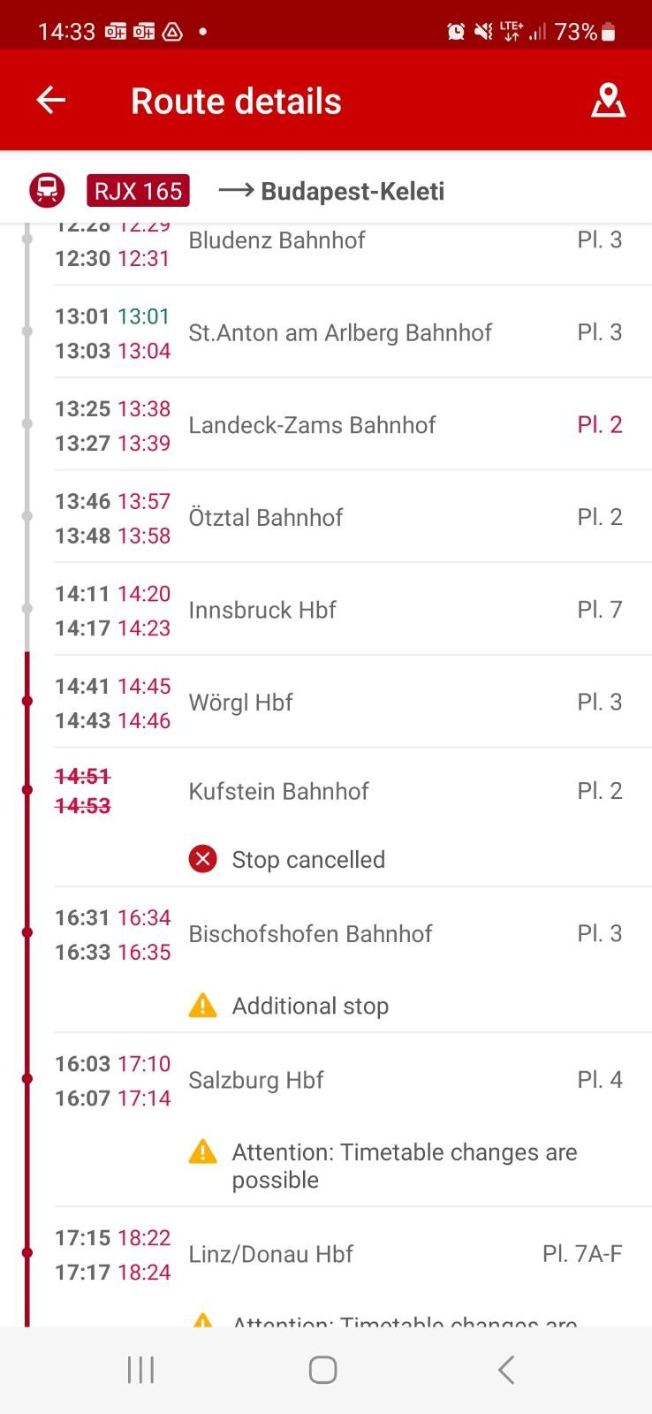
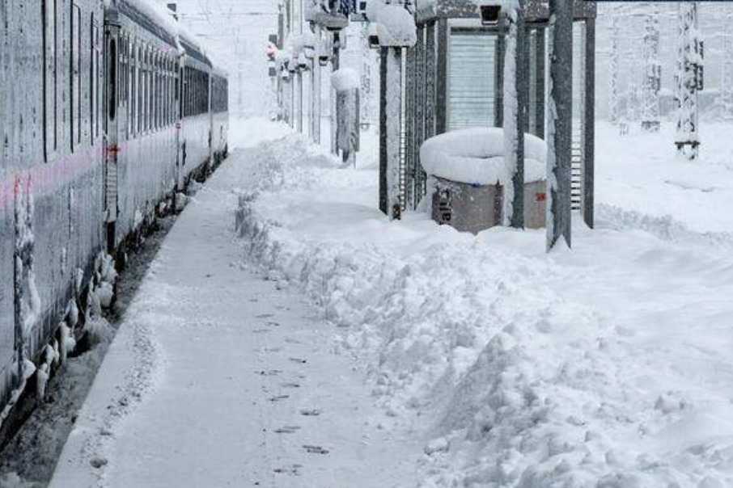
wish I had more time to prepare for the talk…
… but I was hit by dynamic events

Slide 3
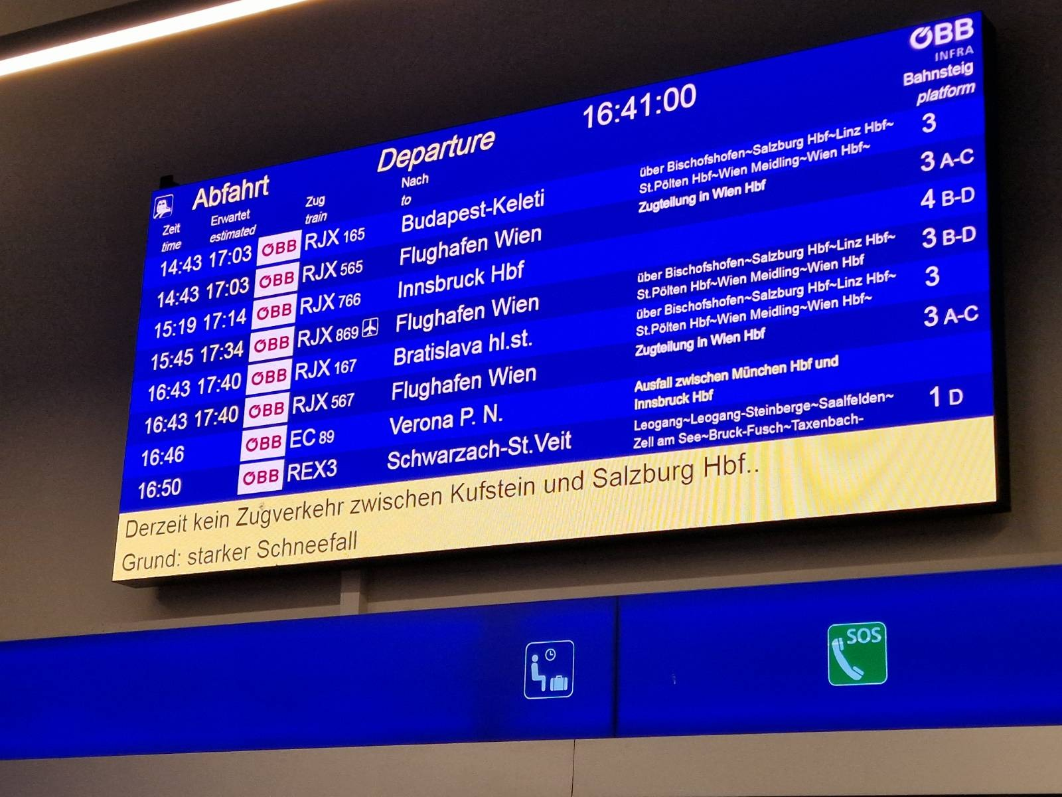
wish I had more time to prepare for the talk…
… but I was hit by dynamic events
Instance data changing in a highly dynamic fashion:
Not only the route, but also temporal information:

Slide 4
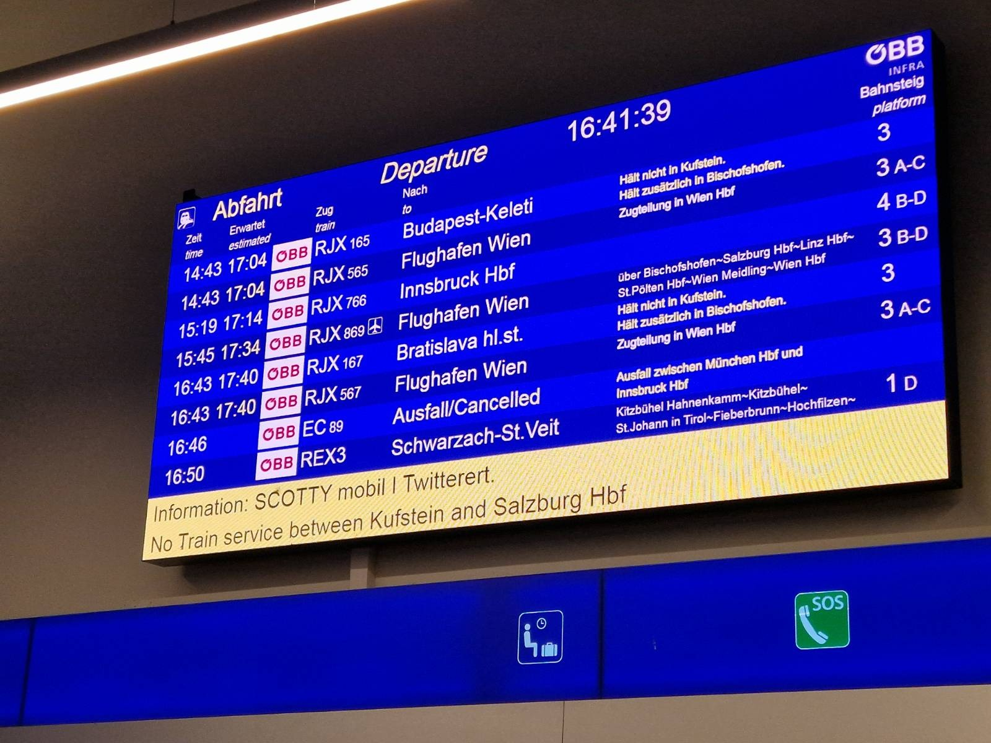
wish I had more time to prepare for the talk…
… but I was hit by dynamic events
Instance data changing in a highly dynamic fashion:
Not only the route, but also temporal information:

Slide 5
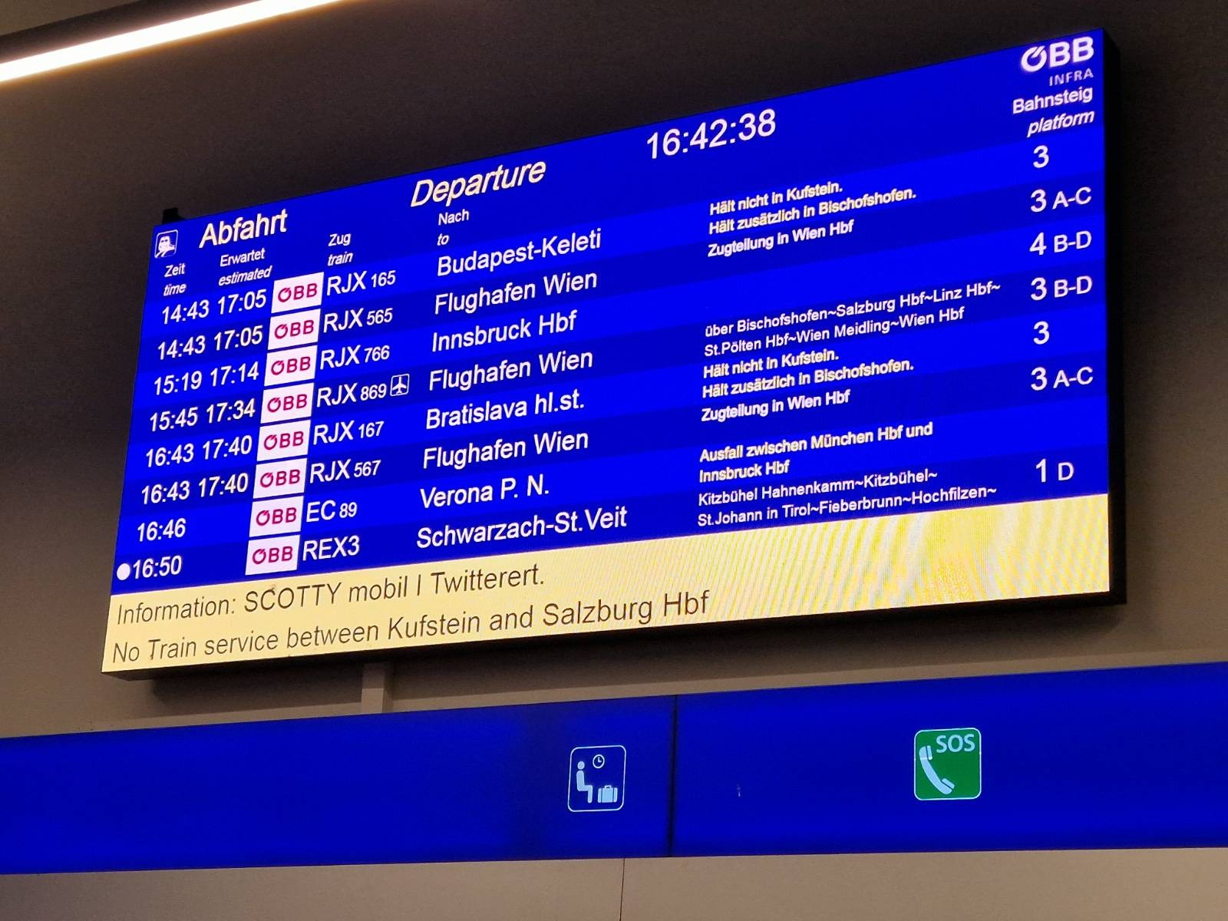
wish I had more time to prepare for the talk…
… but I was hit by dynamic events
Instance data changing in a highly dynamic fashion:
Not only the route, but also temporal information:

Slide 6
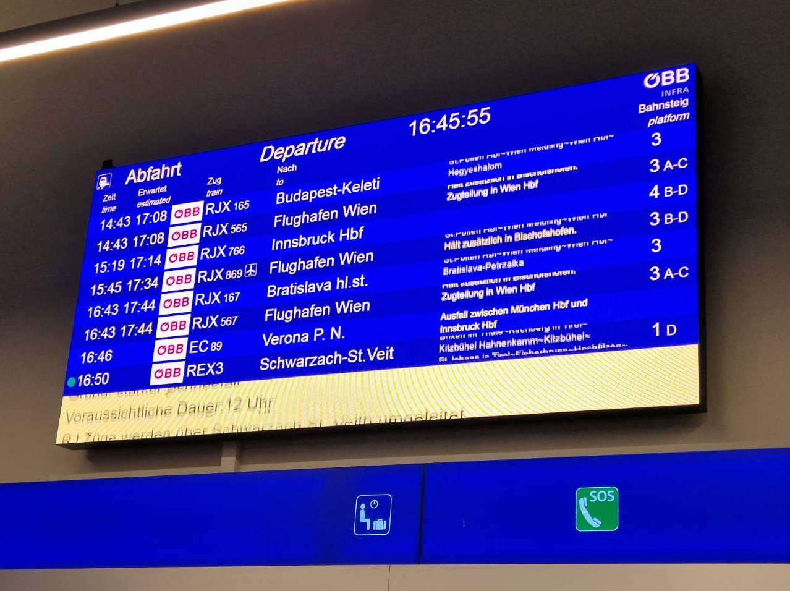
wish I had more time to prepare for the talk…
… but I was hit by dynamic events
Instance data changing in a highly dynamic fashion:
Not only the route, but also temporal information:

Slide 7
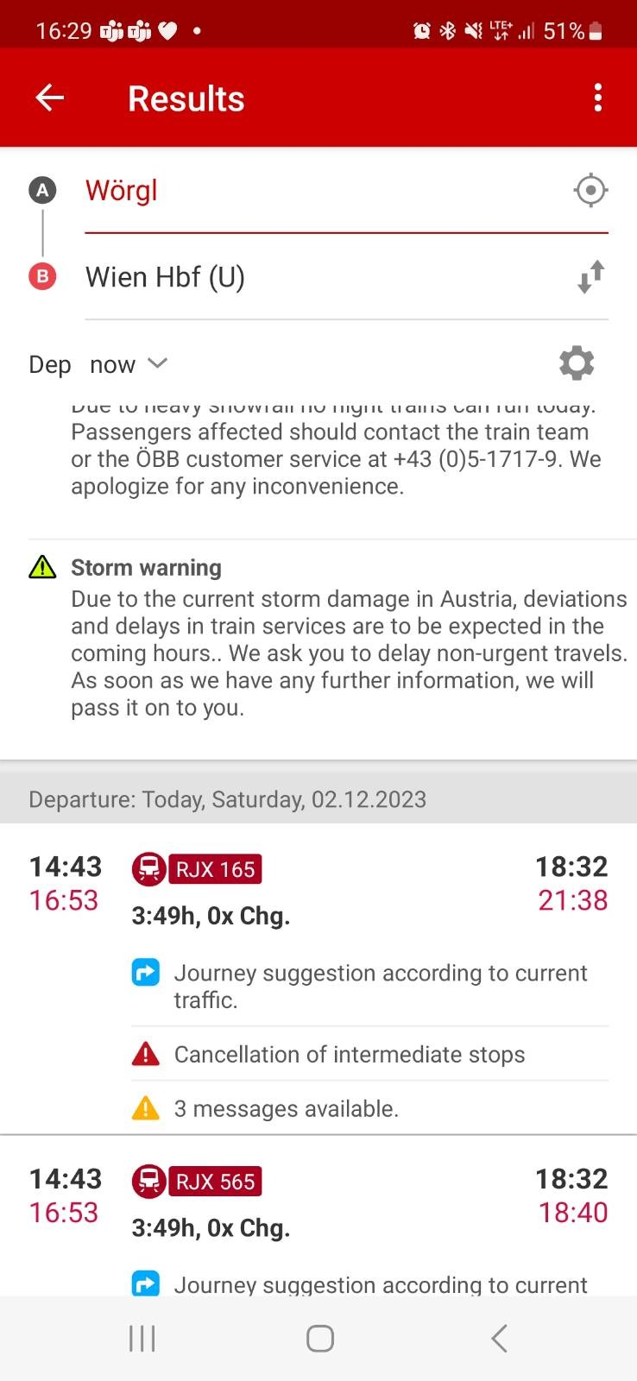
wish I had more time to prepare for the talk…
… but I was hit by dynamic events
Instance data changing in a highly dynamic fashion:
Dynamic constraints violated
(inconcistency via dynamics!):

Slide 8
wish I had more time to prepare for the talk…
… but I was hit by dynamic events
Even seemingly static data no longer valid:
Train RJX565
hasCar
type
Car26
Car27
Car37
Car36
…
…
RailjetExpress
hasSeat
103

Slide 9
wish I had more time to prepare for the talk…
… but I was hit by dynamic events
Even seemingly static data no longer valid…
Train RJX565
hasCar
type
Car26
Car27
…
…
RailjetExpress
103

Slide 10
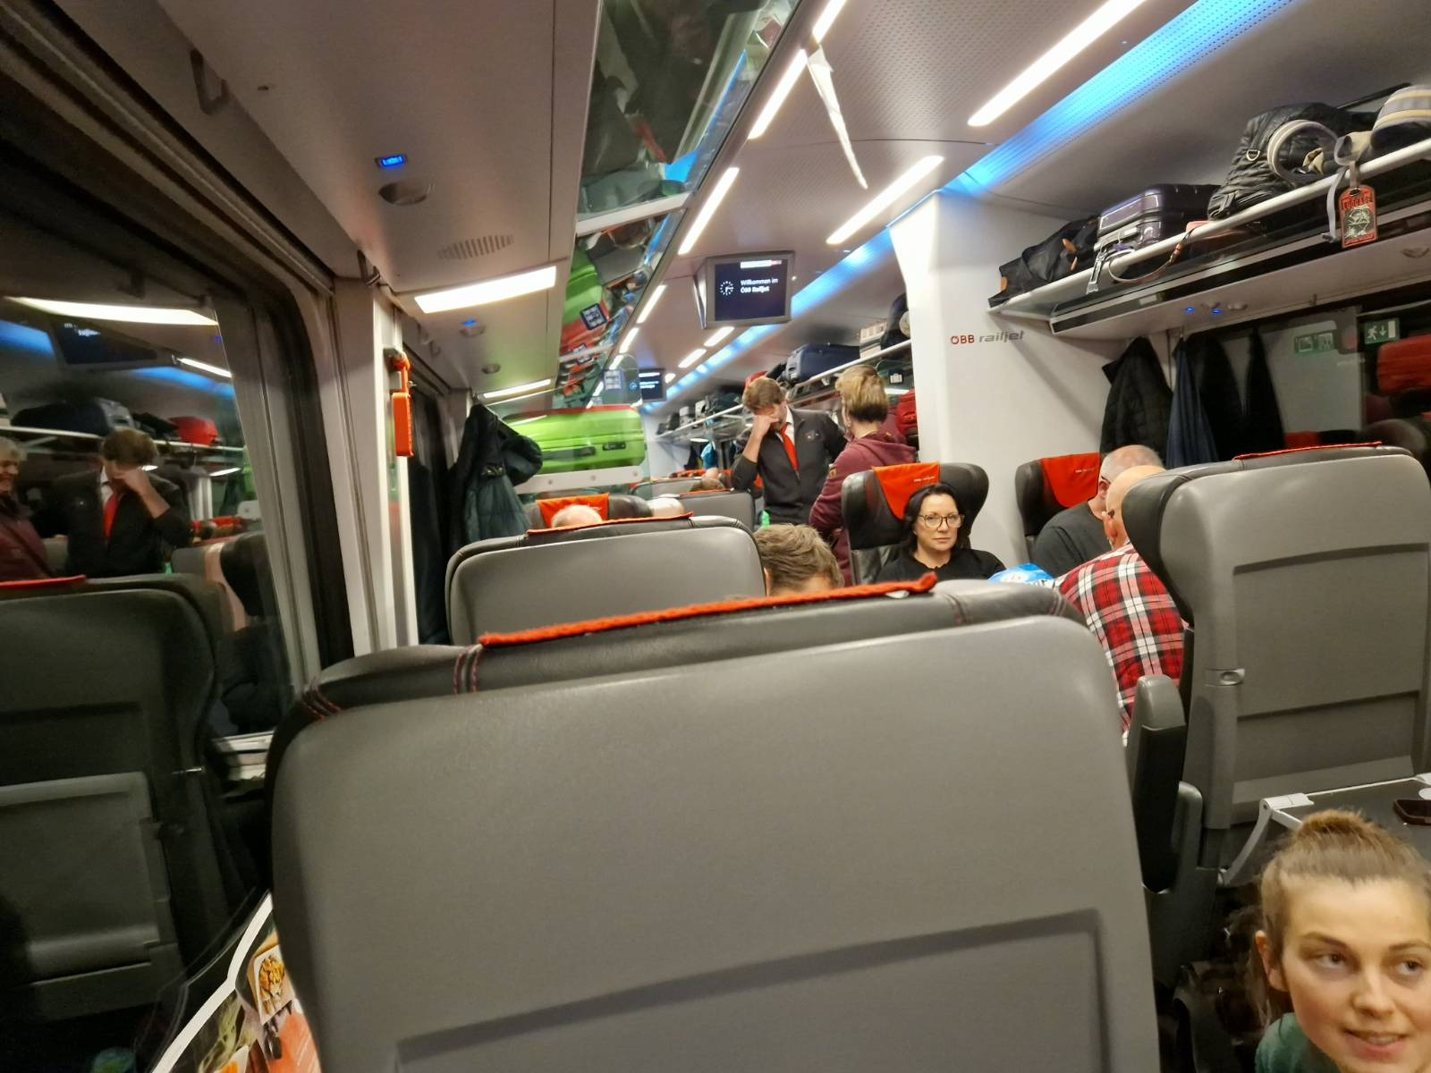
wish I had more time to prepare for the talk…
… but I was hit by dynamic events
Train RJX565
hasCar
type
Car26
Car27
…
…
RailjetExpress
… working on the train as planned not possible :-S
103

Slide 11
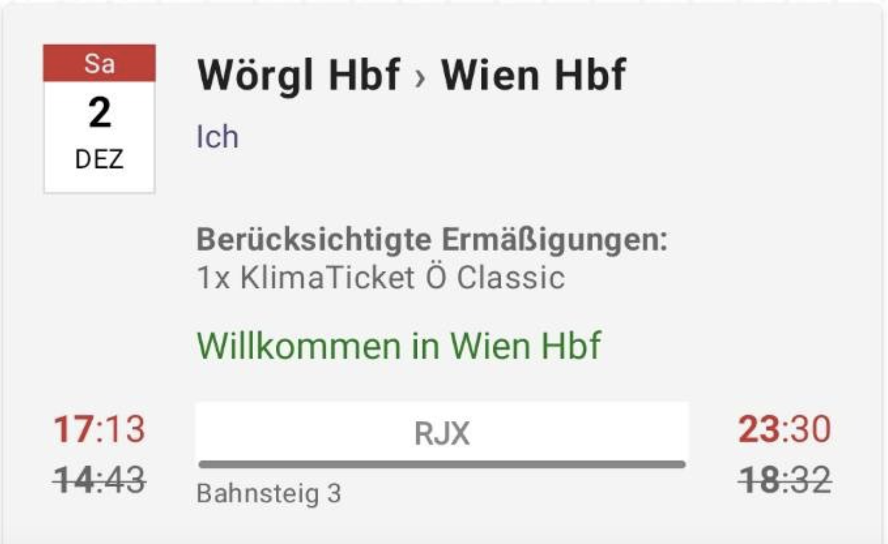

wish I had more time to prepare for the talk…
… but I was hit by dynamic events…
…after a 5hrs delay arrival …
… just to realize the next morning, this:
Train RJX565
hasCar
type
Car26
Car27
…
…
RailjetExpress
…which perfectly motivates a talk about dynamics and evolution in KGs!

Slide 12
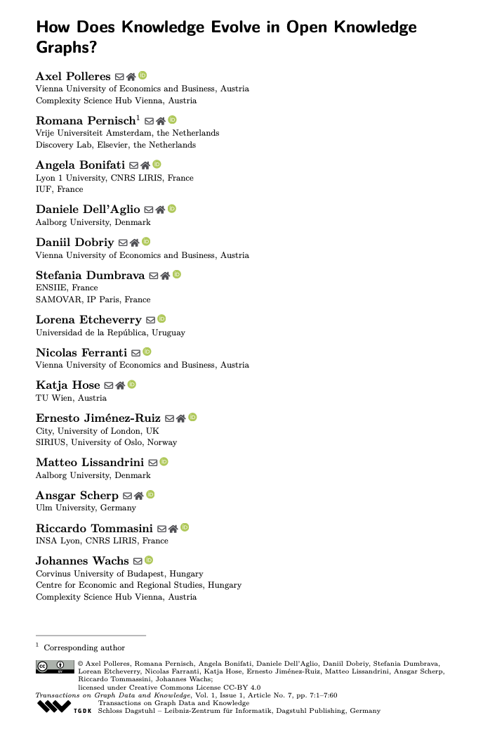
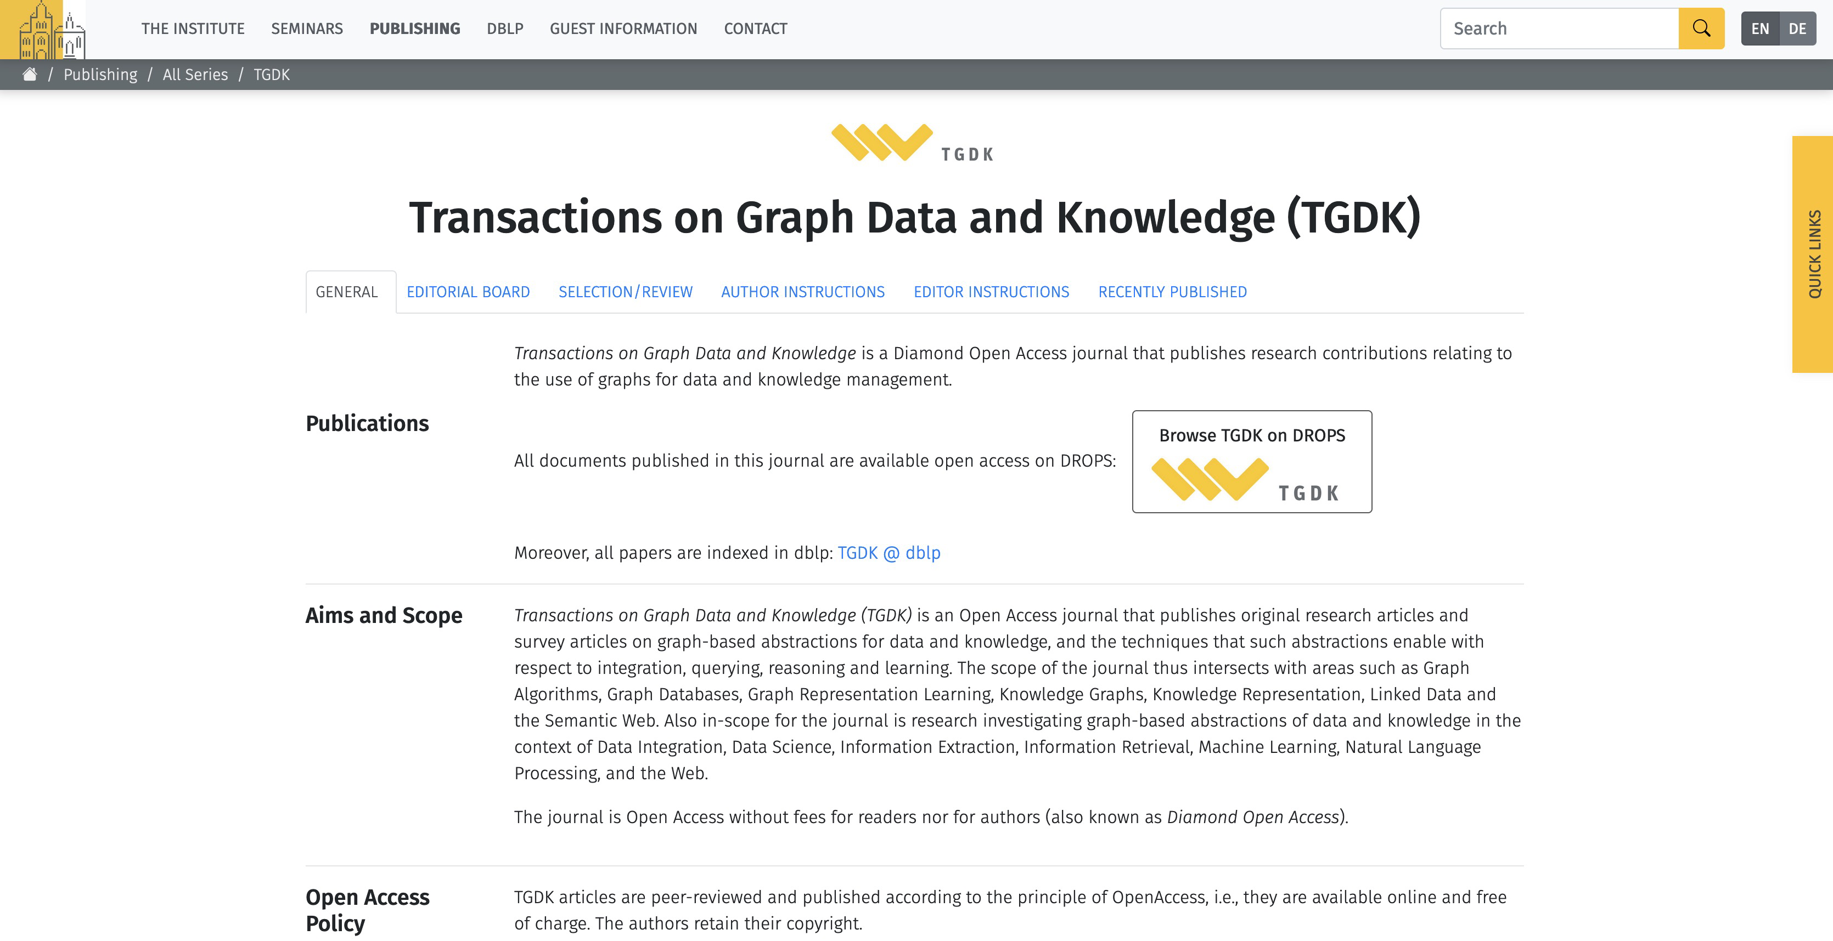
Thanks to my co-authors and to the new TGDK journal!

Slide 13
What did I want to talk about?
Open Knowledge Graphs?
Perspectives on evolution: dimensions of time and temporality
Observability of evolution
Metrics for evolution
How does evolution affect downstream tasks and resp. techniques?
Recent own work…

Slide 14
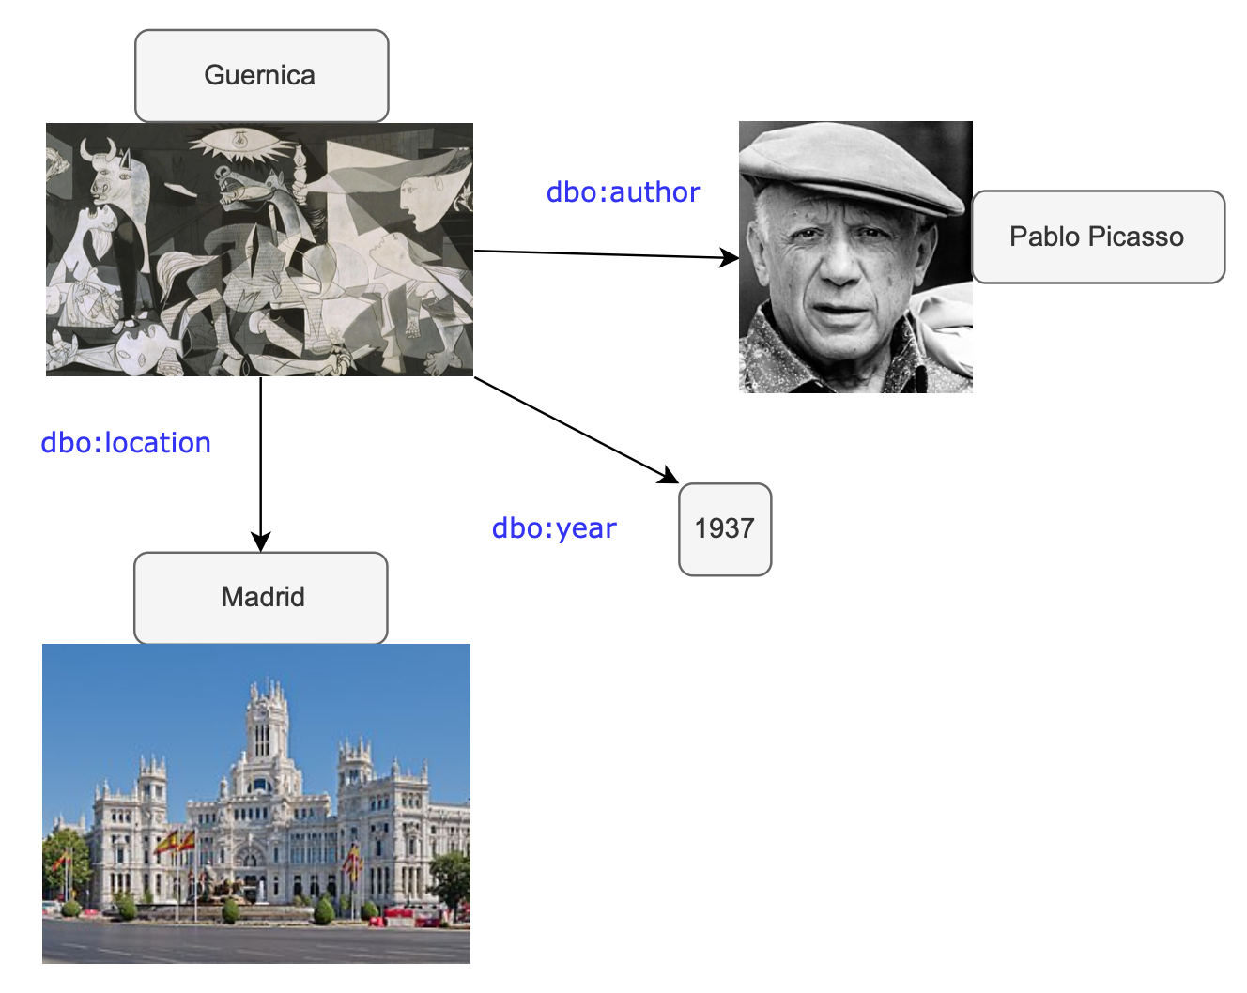
Open, collaborively edited KGs
  E.g.
    DBPedia
    Wikidata
  Maintain collaboratively edited, curated, reusable knowledge
  Serve as a backbone for various applications!

Slide 15
Main questions:
Which publicly accessible, open KGs are observable in a manner that would allow a longitudinal analysis of their evolution and how?
Do we have the right metrics to analyse KGs’ evolution?
Do we have the right techniques to process evolving KGs?
  → What dimensions does evolution have at all?

Slide 16
What dimensions does evolution have at all?
Temporal KGs: Time as Data (“valid time”)
  Dates/Timestamps

Slide 17
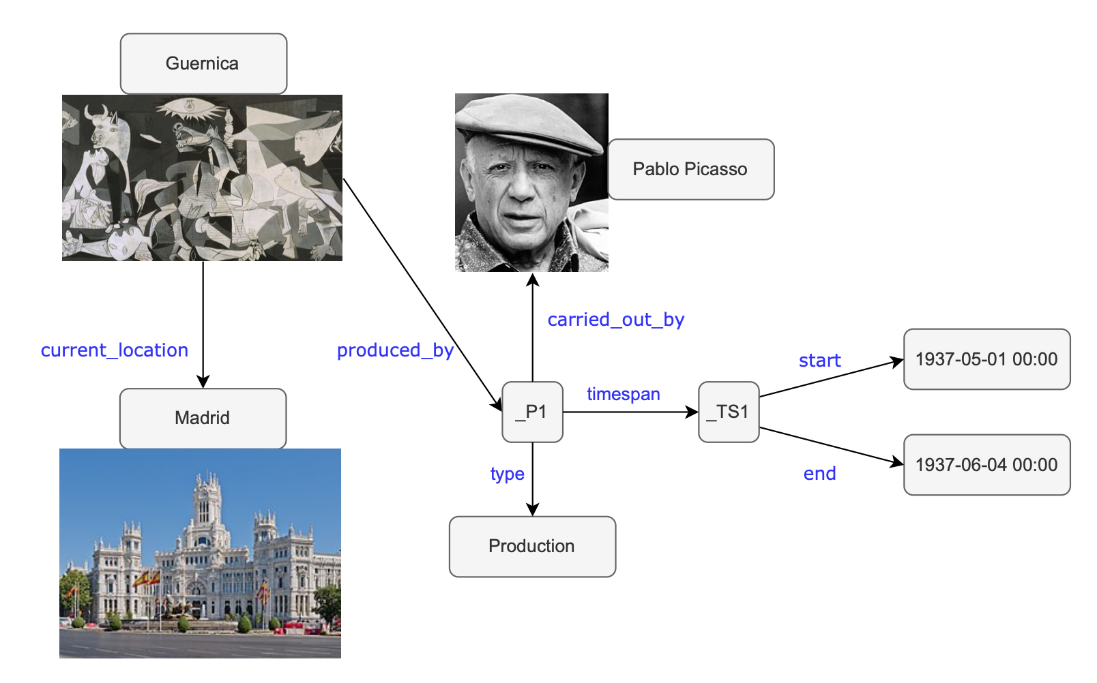
What dimensions does evolution have at all?
Temporal KGs: Time as Data (“valid time”)
  Dates/Timestamps
  Intervals
  (start/end events)
Challenge: Needs reification!
Notes:
Doesn’t fit the flat RDF model…

Slide 18
What dimensions does evolution have at all?
Time-varying KGs: Time as meta-data/log data (“transaction time”)
Edit events(Dates/Timestamps)
“Pablo Picasso” (Q5593) added on 1 November 2012
“Guernica” (Q175036) was created on 28 November 2012 in Wikidata
The statement that Picasso created Guernica was only created in Wikidata in March 2013
Notes:
Doesn’t fit the flat RDF model…

Slide 19
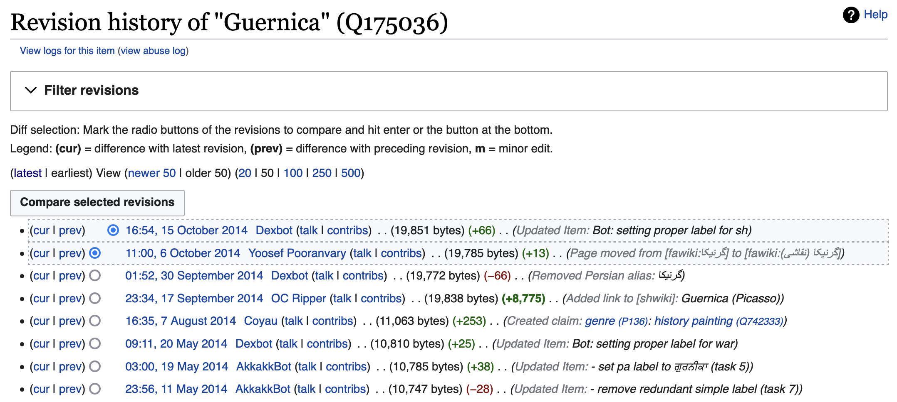
What dimensions does evolution have at all?
Time-varying KGs: Time as meta-data/log data (“transaction time”)
Edit events(Dates/Timestamps)
  Metadata also contains additional provenance information
  … yet, often not part of the RDF/Graph model itself!
Notes:
Doesn’t fit the flat RDF model…

Slide 20
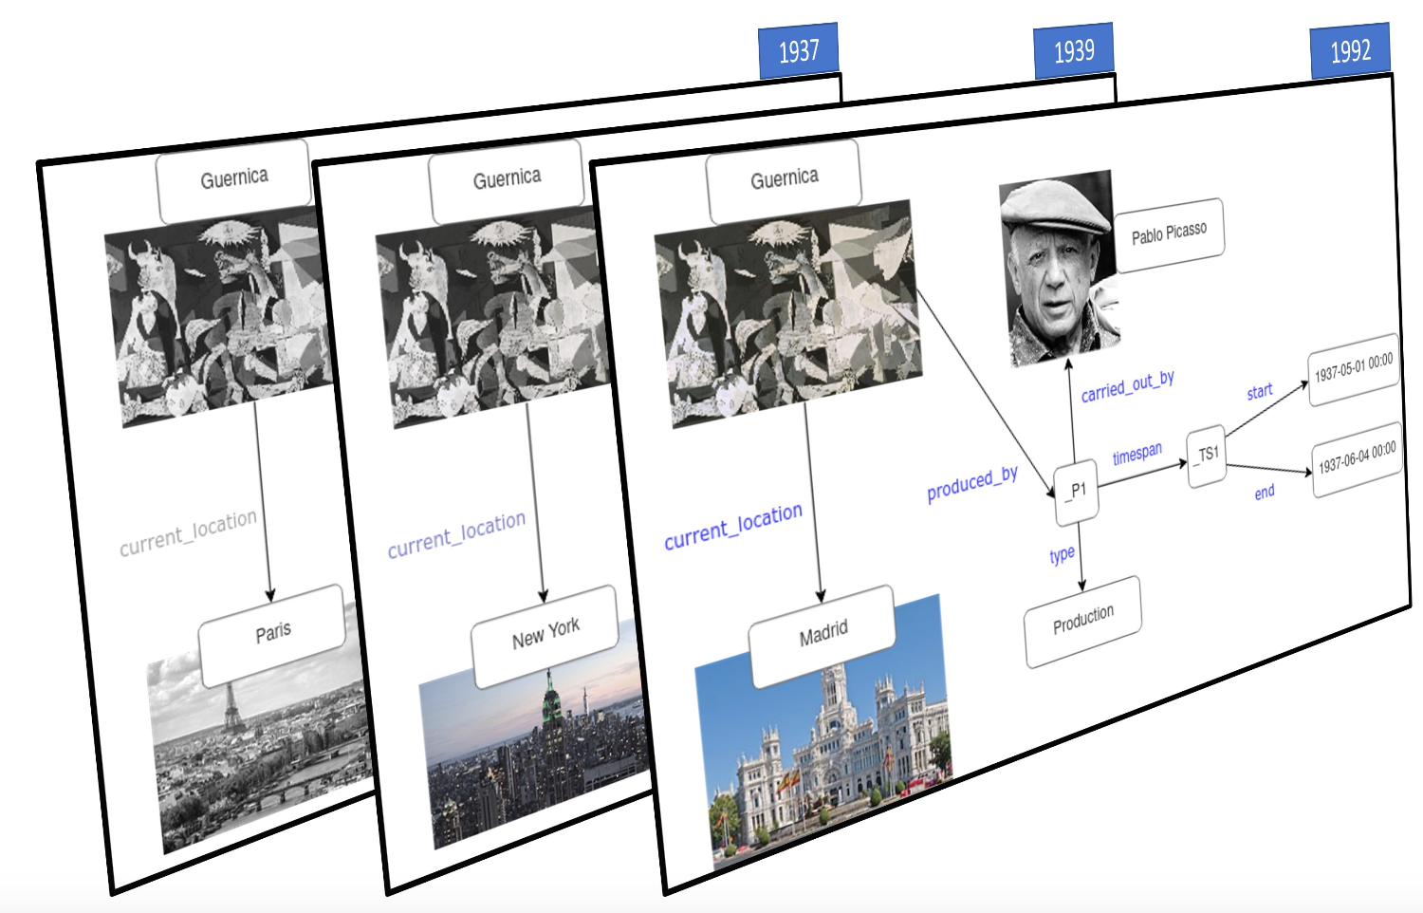
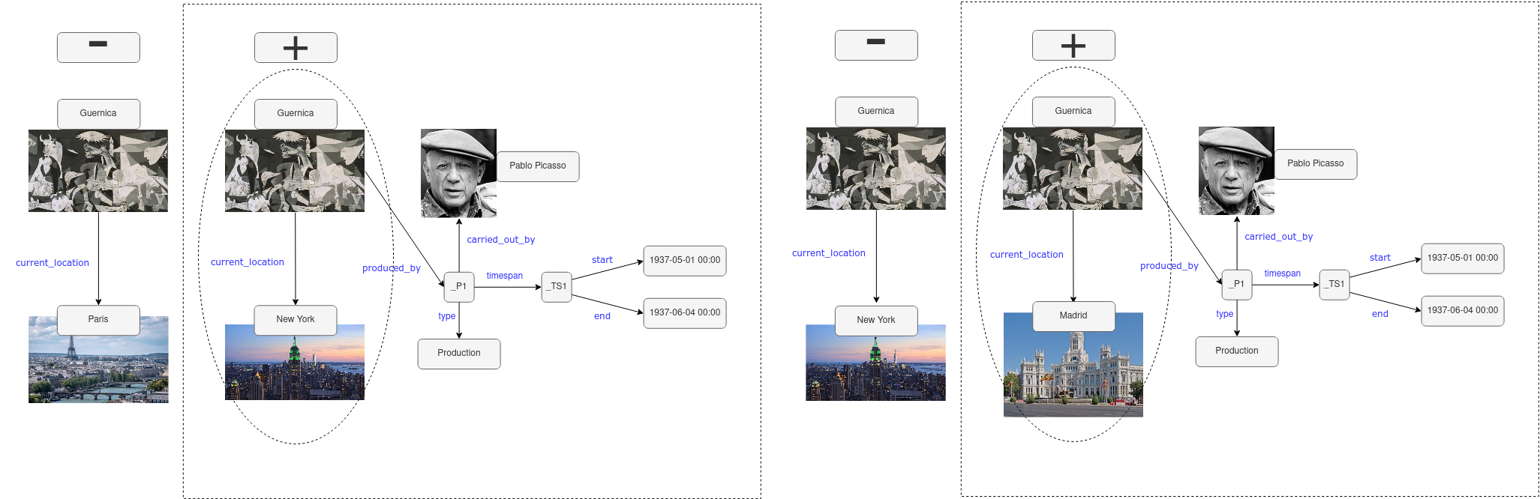
What dimensions does evolution have at all?
Time-varying KGs: Granularity of dynamicity (observability):
    “Versioned KG” vs. “Dynamic KG”
    (”snapshot”) of particular materialisations down to single Edit events
Notes:
Doesn’t fit the flat RDF model…

Slide 21
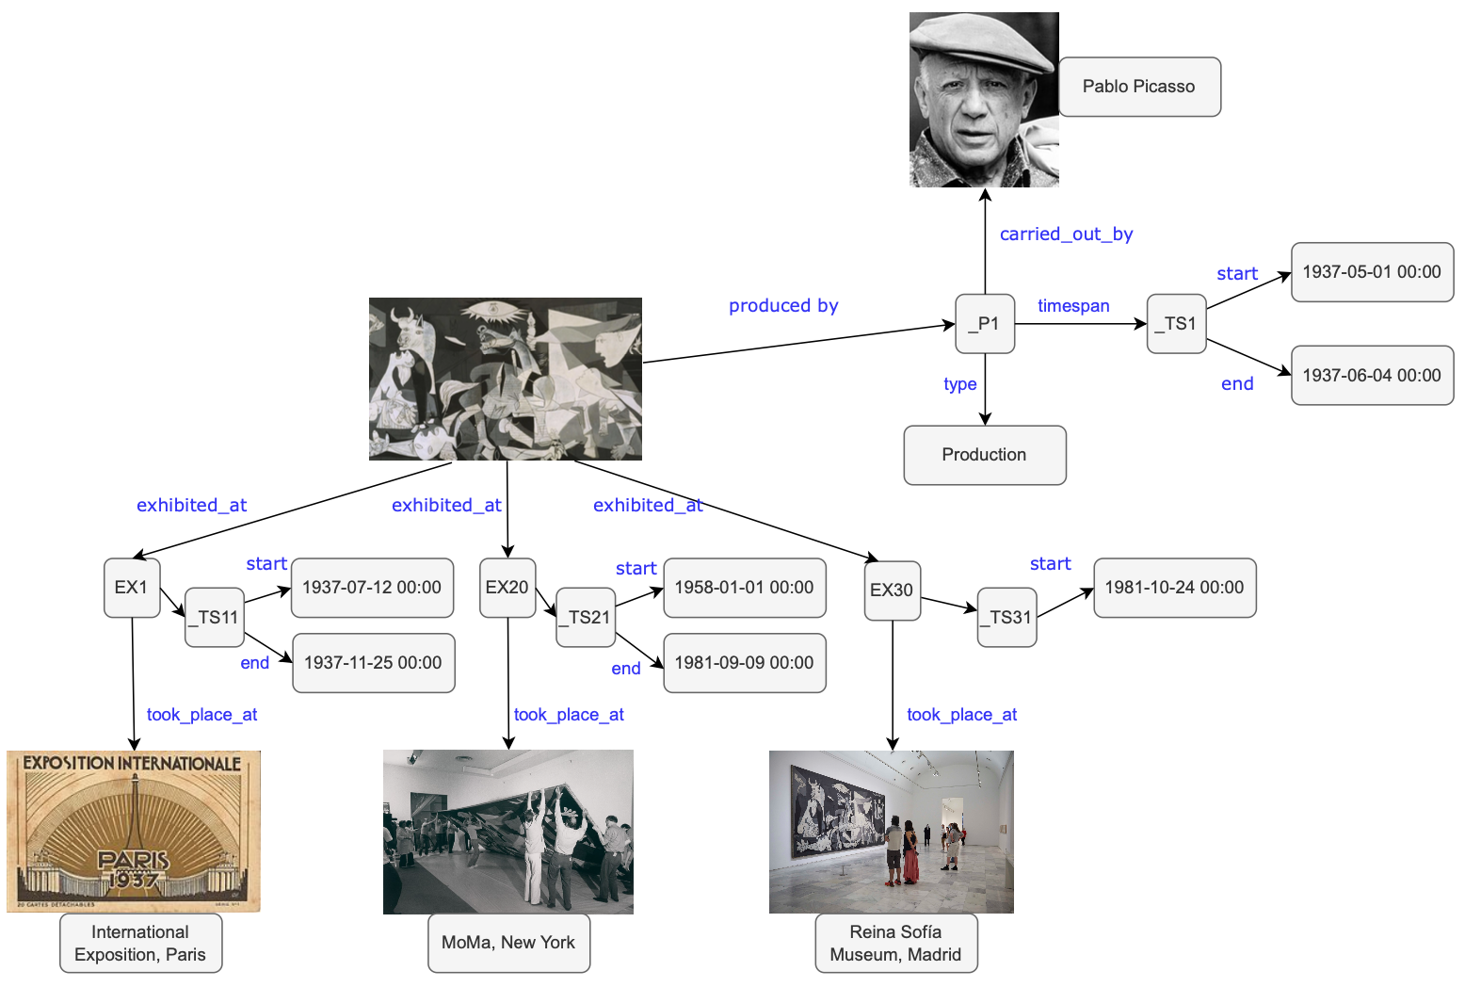
What dimensions does evolution have at all?
Lines are blurry…
location could also be modelled as data:
Notes:
Doesn’t fit the flat RDF model…

Slide 22
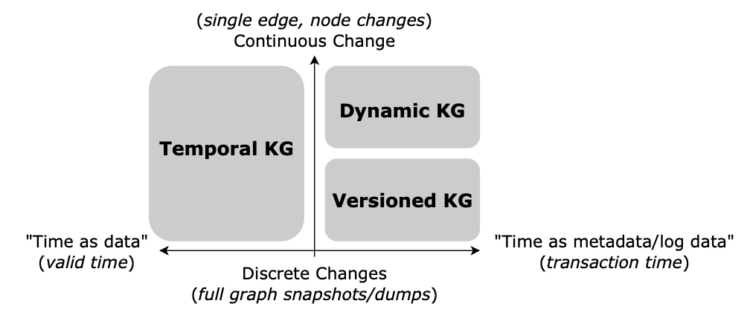
What dimensions does evolution have at all?
Instance evolution
Schema evolution
Collaboration models
Time-Varying KG

Slide 23
What dimensions does evolution have at all?
additional
Instance evolution
Schema evolution
Collaboration evolution
Structural evolution
Dynamics (change frequencies, etc.)
Timeliness (recency of temporal information, delays)
Monotonicity (“growth” vs. “deletions”)

Slide 24
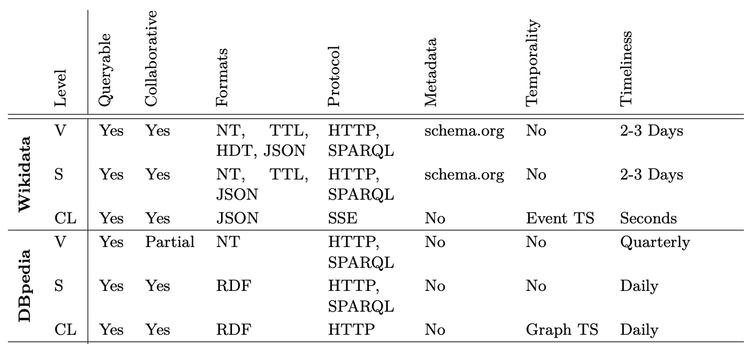
Availability of Dbpedia and Wikidata:
Availability of Open KG Versions (V), Schema (S), and Change logs (CL), find more in the paper!

Slide 25
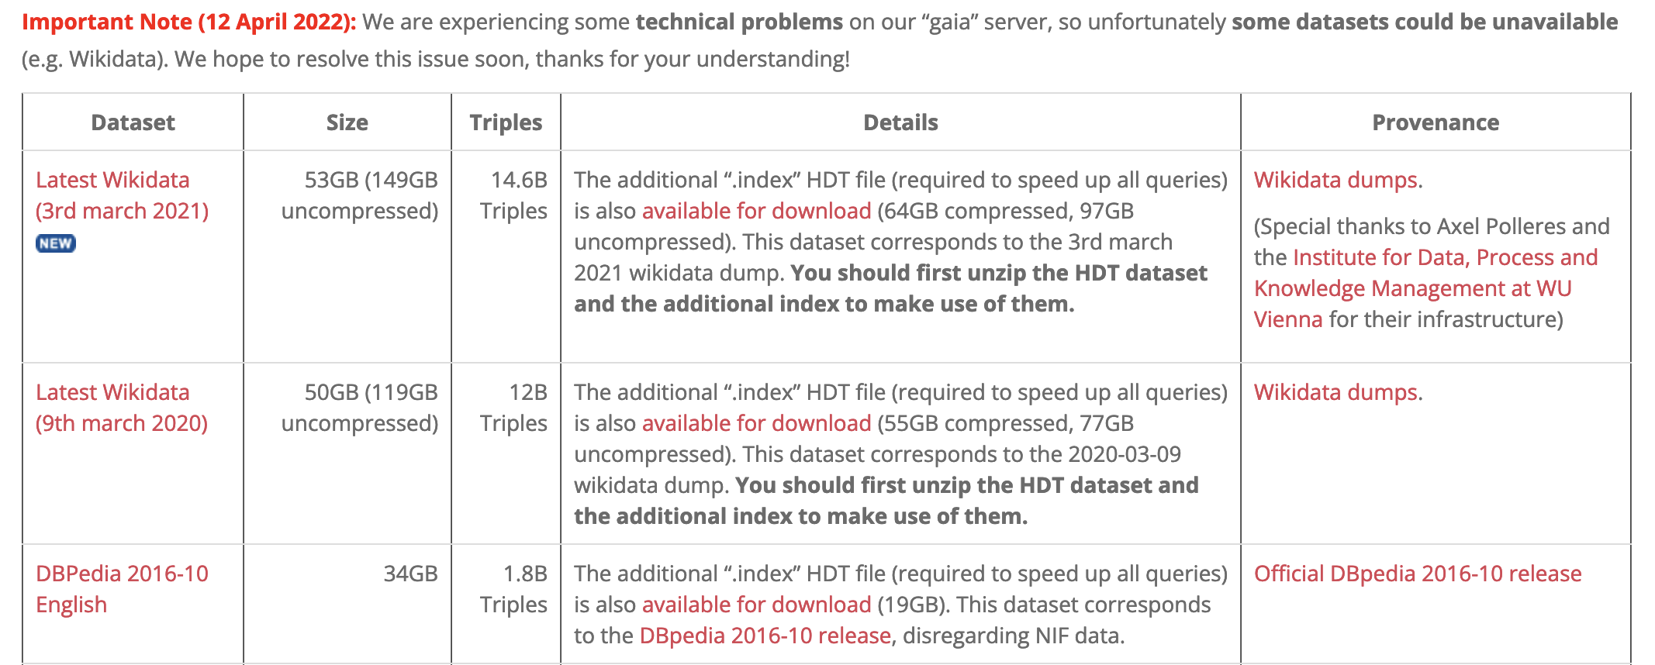
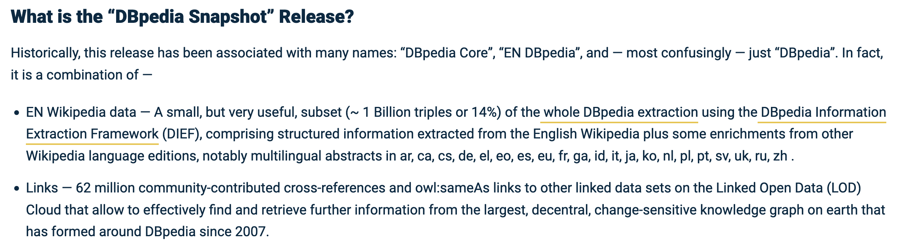
Note: additional Caveat:
Historic versions are hard to maintain and host:
  https://www.rdfhdt.org/datasets/
https://www.dbpedia.org/resources/snapshot-release/

Slide 26
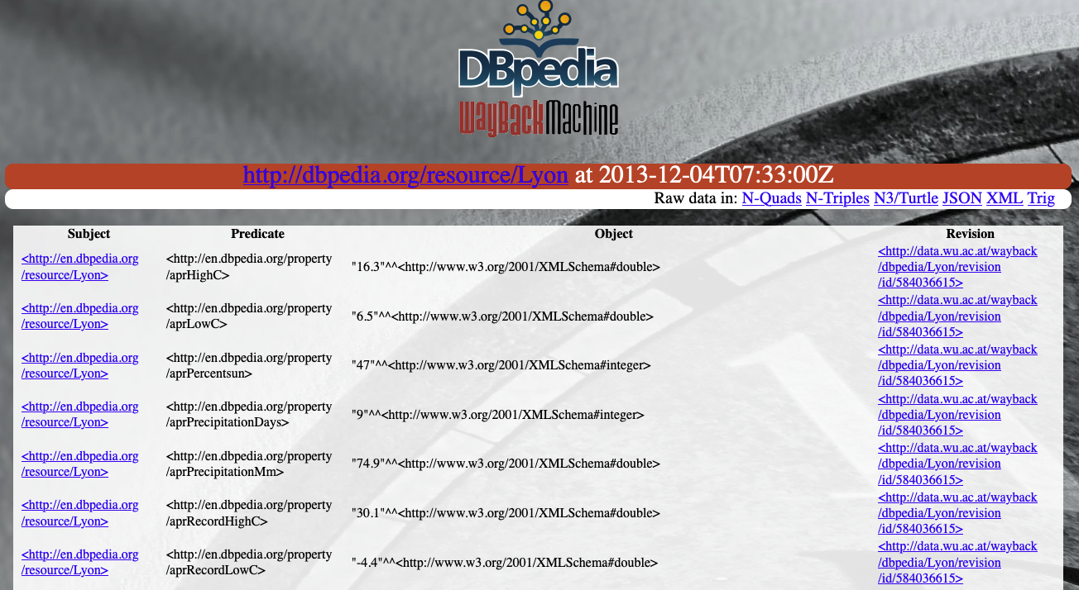

Another approach (for dbpedia):
Dbpedia “Wayback machine”
https://wayback.cluster.ai.wu.ac.at/
SEMANTiCS2015
Challenge: keep these services running…

Slide 27
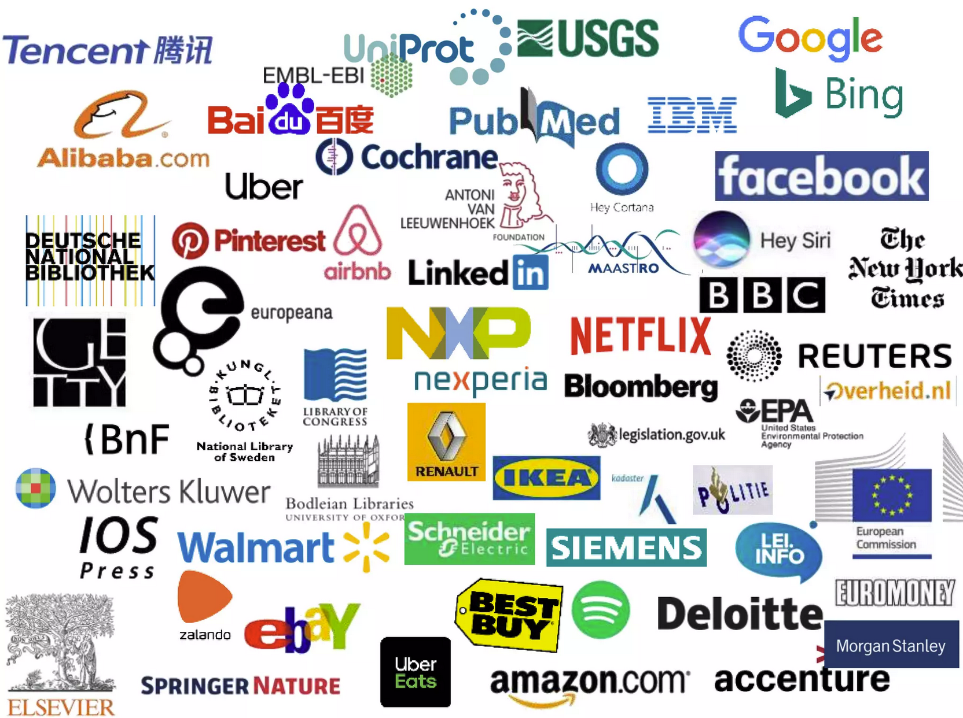
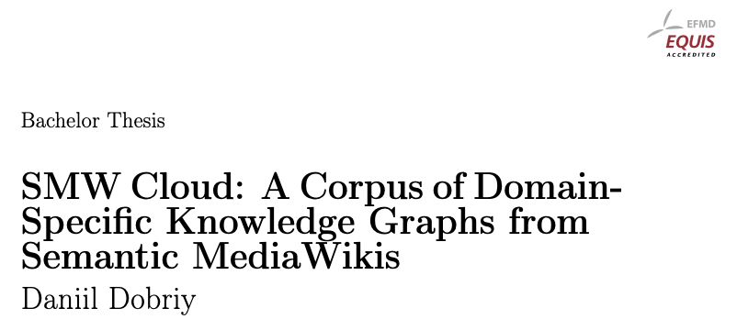

Another Open Question:
How representative are big Open Collaborative KGs like Dbpedia & Wikidata at all?
… What about Enterprise KGs?
Challenge: not accessible ☹
https://www.slideshare.net/Frank.van.Harmelen/adoption-of-knowledge-graphs-mid-2022-incomplete

Slide 28

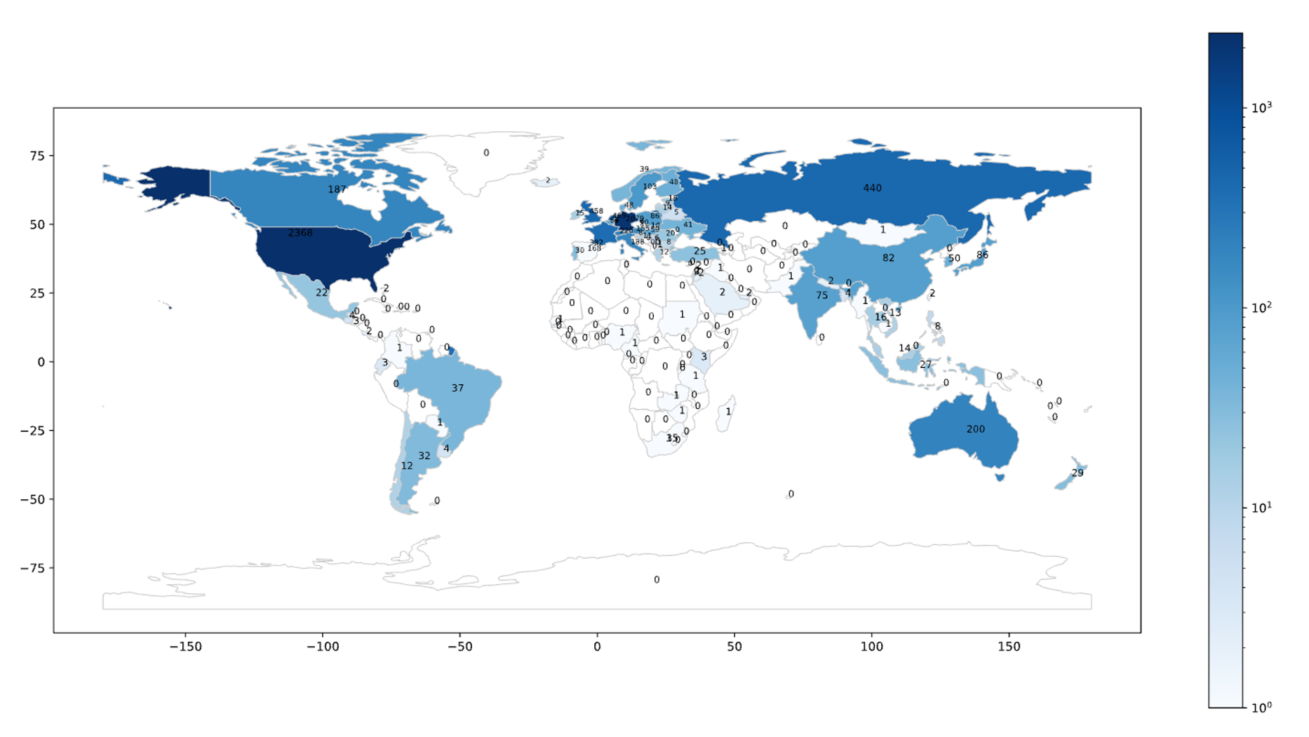
Wikis
Powered by MediaWiki software.
We know of 60527 currently active wikis.
(It’s a lot ☺)

Slide 29
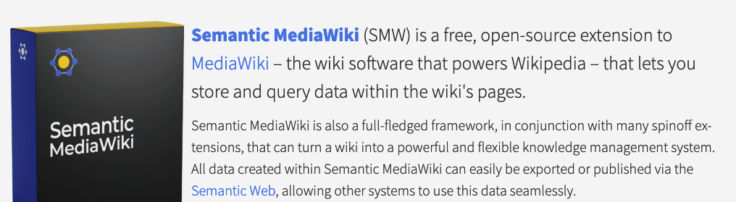
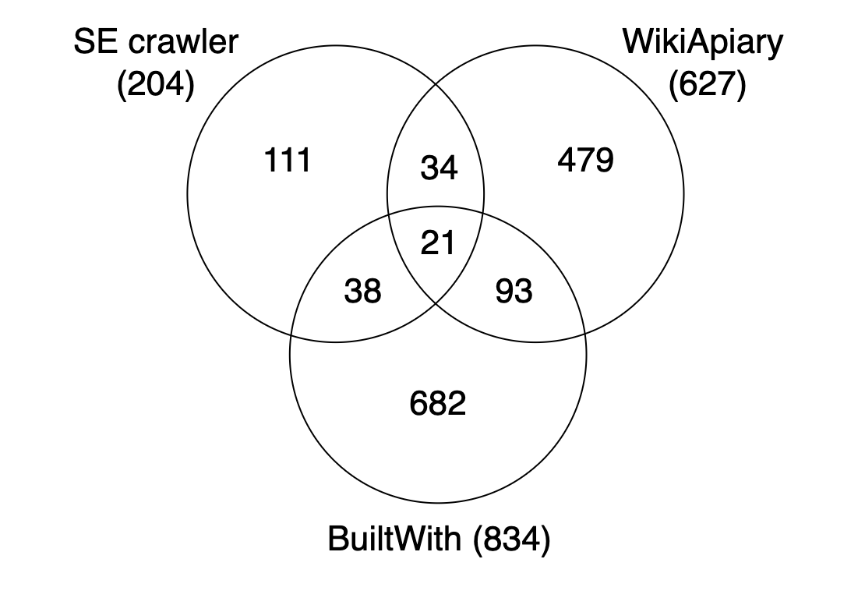
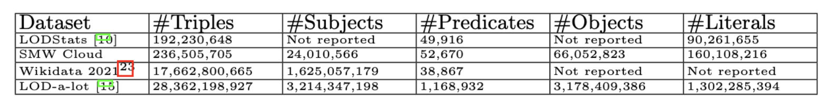
How many Semantic MediaWikis?
SMW Cloud (1458 wikis)
Crawled RDF data available at semantic-data.cluster.ai.wu.ac.at/smwcloud/
Currently ongoing work/next steps:
also crawl historic data (Semantic MediaWiki edit history)
also crawl Wikiba.se instances!

Slide 30
SMW Cloud:
Very different KGs than Dbpedia and Wikidata
Small, narrow scheme
…very likely, very different evolution!

Slide 31
What dimensions does evolution have at all?
additional
Instance evolution
Schema evolution
Collaboration evolution
Structural evolution
Dynamics (change frequencies, etc.)
Timeliness (recency of temporal information, delays)
Monotonicity (“growth” vs. “deletions”)

Slide 32
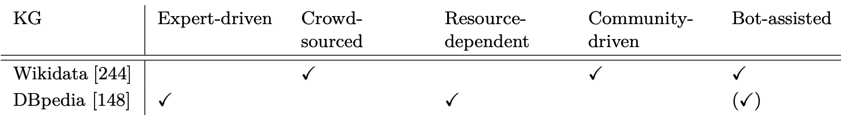
Underlying Collaborative KG-Creation Processes
Question: How can we observe and analyse KG collaboration models?
Following:
Piscopo and Simperl. Who Models the World? Collaborative Ontology Creation and User Roles in Wikidata.

Slide 33
Possible further directions to analyse collaboration in more detail:
Question: How does the schema evolve in relation to the data?
Question: How is the use of the schema related to specific user communities?

Slide 34
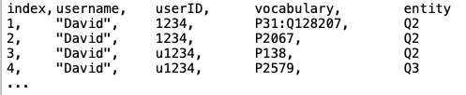
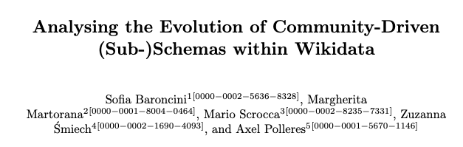

Possible further directions to analyse collaboration in more detail:
Extract aggregated log for analysis
Users, vocabulary (classes/properties), entities:
Position paper, Wikidata Workshop 2022
Starting points/hypotheses:
  Schema in Open KGs like Wikidata evolve in a modular fashion
Challenge:
  Again: User/collaboration data not “readily available”
http://polleres.net/supervised_theses/Nicola_Krenn_MSc_2023.pdf

Slide 35
Main questions:
Which publicly accessible, open KGs are observable in a manner that would allow a longitudinal analysis of their evolution and how?
Do we have the right metrics to analyse KGs’ evolution?
Do we have the right techniques to process evolving KGs?

Slide 36
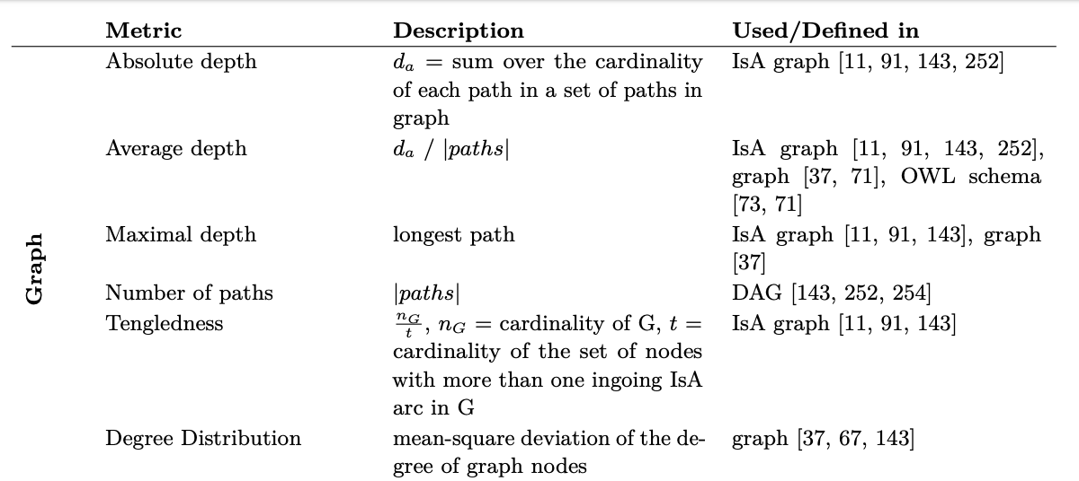
From static metrics to dynamic metrics
Basic (static) Graph metrics, e.g.

Slide 37
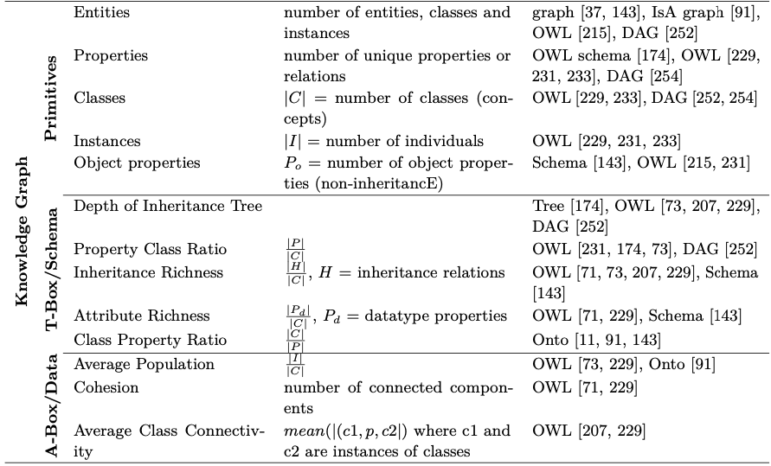
From static metrics to dynamic metrics
Basic (static) Knowledge Graph metrics, e.g.

Slide 38
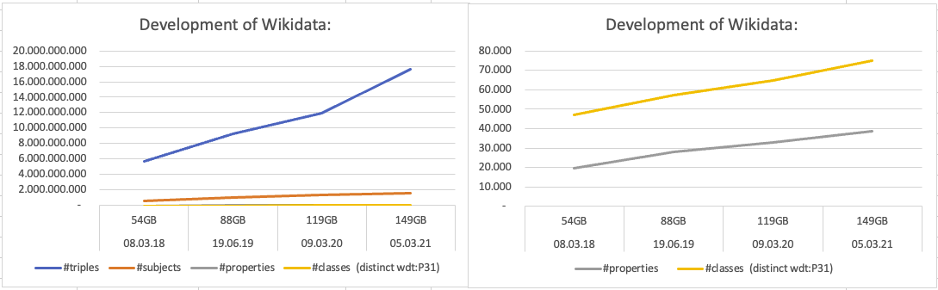
Challenge: What do these metrics tell us over time?
Bottomline/Challenges:
  These metrics are not sufficient to track patterns of evolution…
  We need to track changes on a finer granularity level
  We need new metrics (from other fields):
    Time series analyses (change frequencies, seasonality)
    Network science (dynamics of networks)
    etc.

Slide 39
More Open question(s)
How does consistency evolve over time (and why is this important)?
Challenge:
  Our “classical” tools (OWL, SHACL?) are not really useful here directly

Slide 40
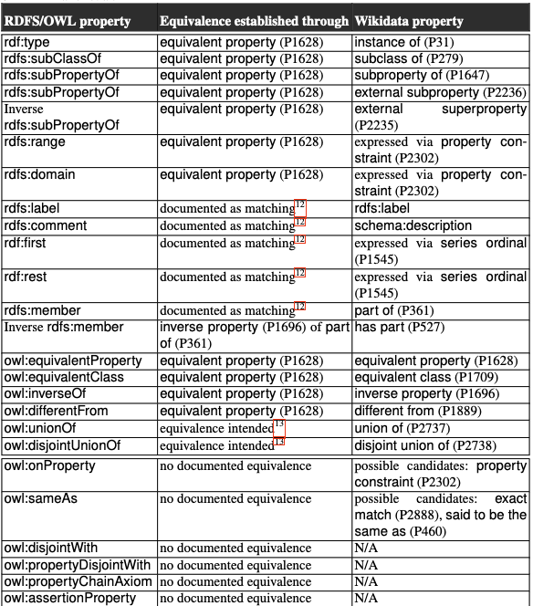
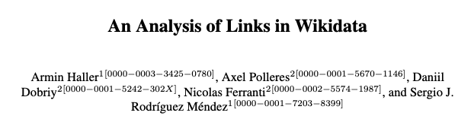
Reasoning+Constraints in Wikidata: OWL?
Challenges:
Wikidata does not use OWL!
Big Open KGs are all quite inconsistent!

Slide 41

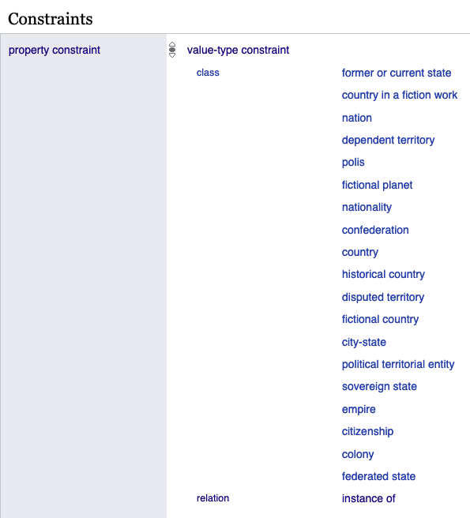
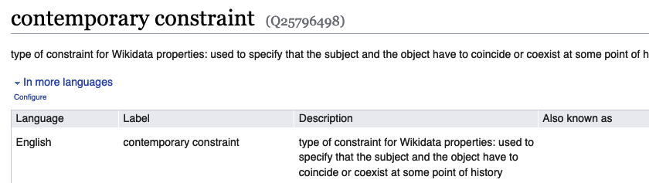
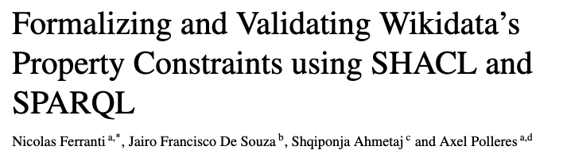
Reasoning+Constraints in Wikidata: SHACL?
Challenges:
Wikidata does not use SHACL either!
  Formalization
  Analysis of violations over time!
https://www.semantic-web-journal.net/content/formalizing-and-validating-wikidatas-property-constraints-using-shacl-and-sparql

Slide 42
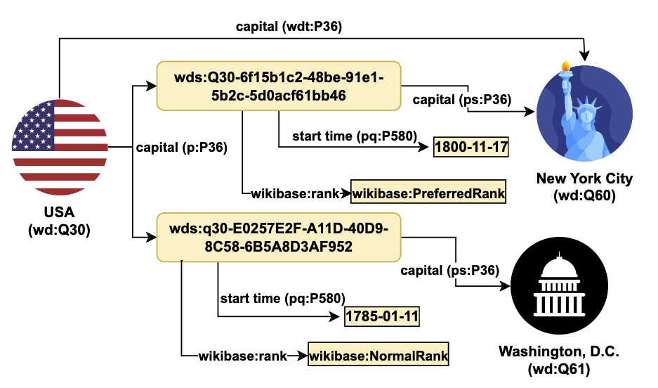
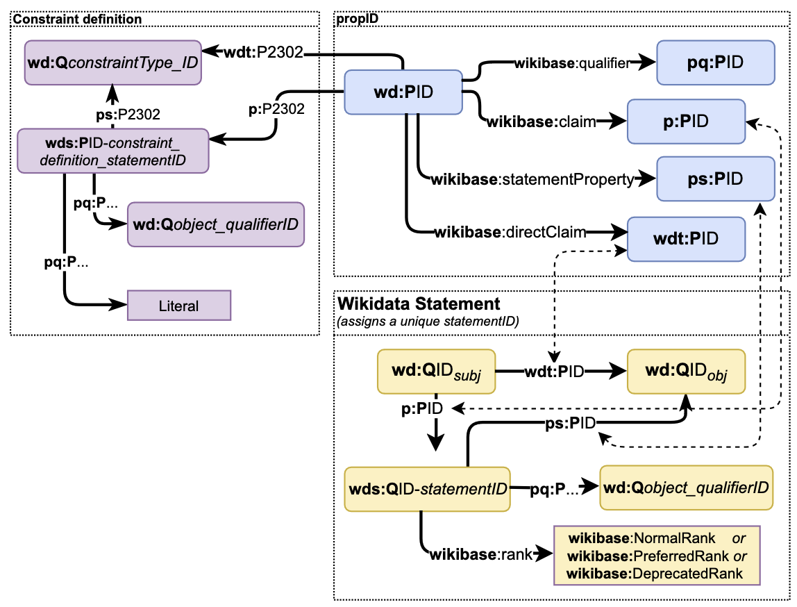
Reasoning+Constraints in Wikidata: SHACL?
Challenges:
Wikidata does not use SHACL either!
  Formalization - what makes it challenging? ---> Reification galore! ;-)

Slide 43
Main questions:
Which publicly accessible, open KGs are observable in a manner that would allow a longitudinal analysis of their evolution and how?
Do we have the right metrics to analyse KGs’ evolution?
Do we have the right techniques to process evolving KGs?

Slide 44
Do we have the right techniques to process evolving KGs?
What else will you find in our paper? Survey of …
  Storage techniques for evolving KGs
  Reasoning & Querying techniques for evolving KGs
  Learning & Embeddings for evolving KGs
Challenges:
  Again: How do we make these methods scale to large-scale, evolving, collaborative KGs?
  E.g. How to reason and query over evolving KGs?
    Need to extend our techniques to deal with reification?
    What’s the “right” reification?
      Labelled property Graphs?
      RDF-*?
      Wikidata’s proprietary reification mechanism?
    How to scale and modularize existing techniques over highly reified KGs?

Slide 45
Some take home messages:
There’s a lot to learn about the dynamics of (Open) KGs!
  Understanding the evolution of knowledge (graphs) is a hot topic!
Yet, there are some major challenges:
Data Availability:
  (fine-grained) data about their evolution it not available (Streams!)
  We need more long-tail data!
  It’s hard to to sustain efforts to sustain data about evolution!
Metrics:
  We need metrics and technniques to analyse KG dynamics and evolution:
    New metrics, look into other fields!
    Adaptions and extensions of existing metrics
Techniques: Storage/Querying/Learning
  How to scale and modularize existing techniques over highly reified KGs?
  Dynamic Embeddings/Model Dynamics?
P.S.: Submit to TGDK ☺
… would have loved to discuss these challenges with you in person ☹

